Slide 1
Chapter 30
Sources of the Magnetic Field

Slide 2
Biot-Savart Law – Introduction
Biot and Savart conducted experiments on the force exerted by an electric current on a nearby magnet
They arrived at a mathematical expression that gives the magnetic field at some point in space due to a current

Slide 3
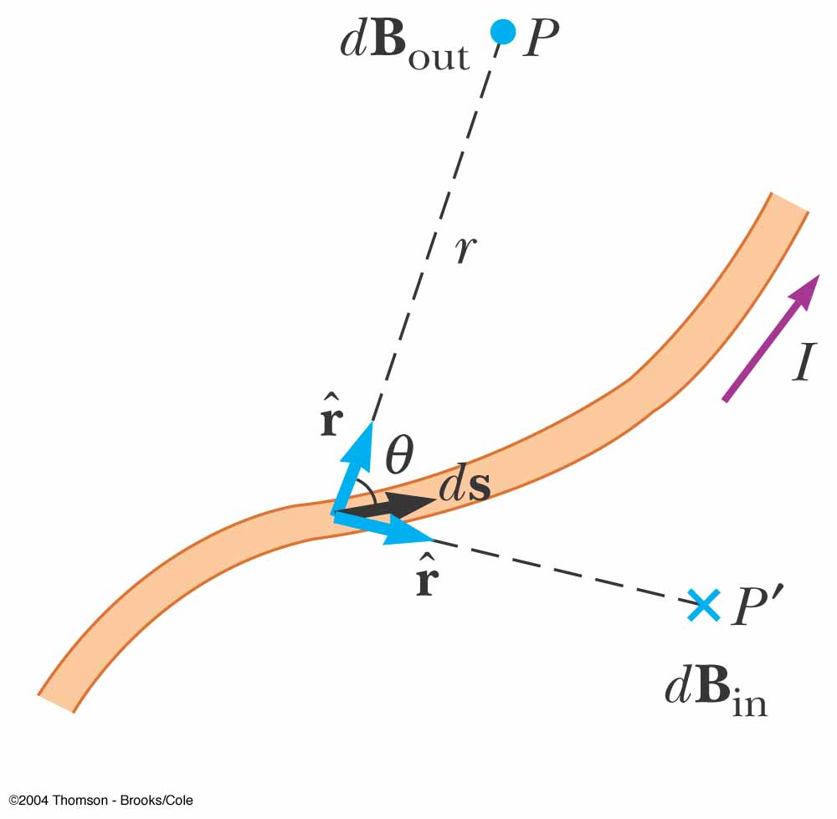
Biot-Savart Law – Set-Up
The magnetic field is at some point P
The length element is
The wire is carrying a steady current of I
Please replace with fig. 30.1

Slide 4
Biot-Savart Law – Observations
The vector is perpendicular to both and to the unit vector directed from toward P
The magnitude of is inversely proportional to r², where r is the distance from to P

Slide 5
Biot-Savart Law – Observations, cont
The magnitude of is proportional to the current and to the magnitude ds of the length element
The magnitude of is proportional to sin θ, where θ is the angle between the vectors and

Slide 6
Biot-Savart Law – Equation
The observations are summarized in the mathematical equation called the Biot-Savart law:
The magnetic field described by the law is the field due to the current-carrying conductor
  Don’t confuse this field with a field external to the conductor

Slide 7
Permeability of Free Space
The constant μ_{o} is called the permeability of free space
μ_{o} = 4π x 10⁻⁷ T. m / A

Slide 8
Total Magnetic Field
is the field created by the current in the length segment ds
To find the total field, sum up the contributions from all the current elements I
  The integral is over the entire current distribution

Slide 9
Biot-Savart Law – Final Notes
The law is also valid for a current consisting of charges flowing through space
represents the length of a small segment of space in which the charges flow
  For example, this could apply to the electron beam in a TV set

Slide 10
Compared to
Distance
  The magnitude of the magnetic field varies as the inverse square of the distance from the source
  The electric field due to a point charge also varies as the inverse square of the distance from the charge

Slide 11
Compared to , 2
Direction
  The electric field created by a point charge is radial in direction
  The magnetic field created by a current element is perpendicular to both the length element and the unit vector

Slide 12
Compared to , 3
Source
  An electric field is established by an isolated electric charge
  The current element that produces a magnetic field must be part of an extended current distribution
    Therefore you must integrate over the entire current distribution

Slide 13
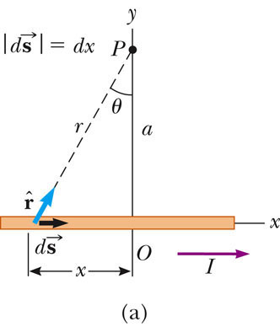
for a Long, Straight Conductor
The thin, straight wire is carrying a constant current
Integrating over all the current elements gives

Slide 14
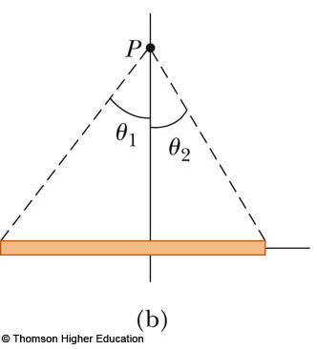
for a Long, Straight Conductor, Special Case
If the conductor is an infinitely long, straight wire, θ₁ = π/2 and
θ₂ = -π/2
The field becomes

Slide 15
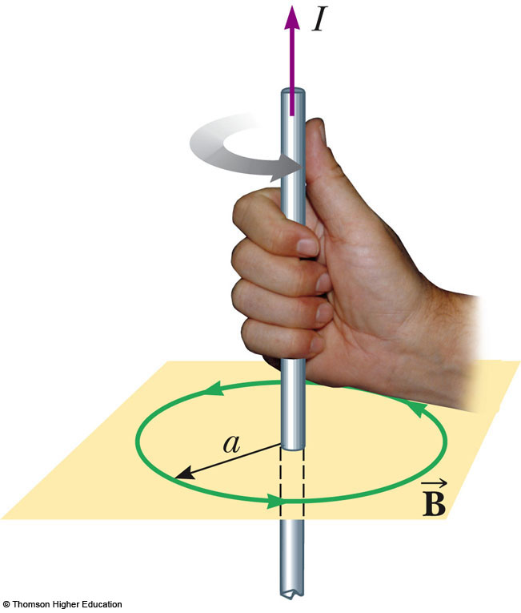
for a Long, Straight Conductor, Direction
The magnetic field lines are circles concentric with the wire
The field lines lie in planes perpendicular to to wire
The magnitude of the field is constant on any circle of radius a
The right-hand rule for determining the direction of the field is shown

Slide 16
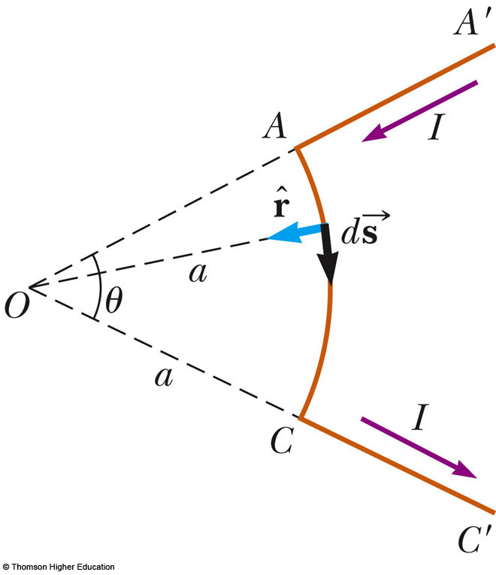
for a Curved Wire Segment
Find the field at point O due to the wire segment
I and R are constants
  θ will be in radians

Slide 17
for a Circular Loop of Wire
Consider the previous result, with a full circle
  θ = 2π
This is the field at the center of the loop

Slide 18
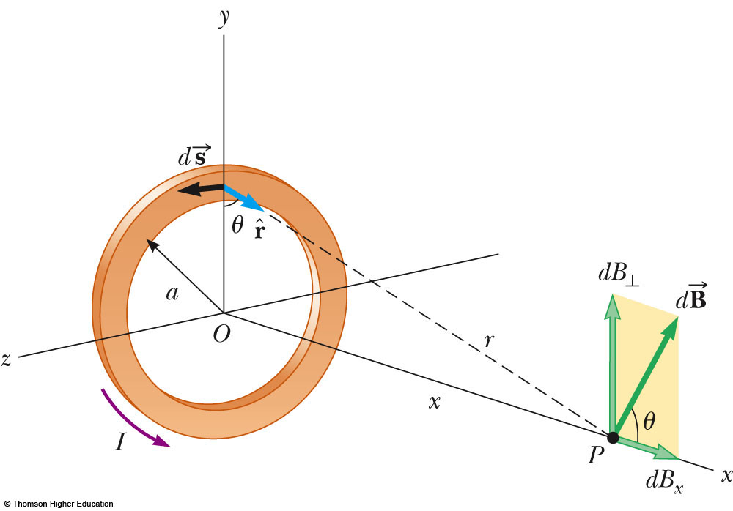
for a Circular Current Loop
The loop has a radius of R and carries a steady current of I
Find the field at point P

Slide 19
Comparison of Loops
Consider the field at the center of the current loop
At this special point, x = 0
Then,
  This is exactly the same result as from the curved wire

Slide 20
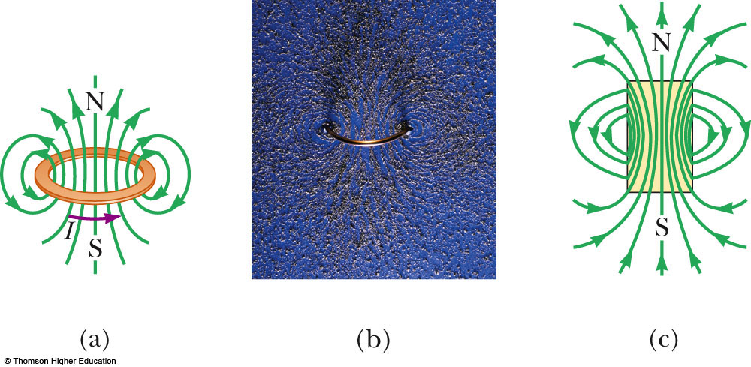
Magnetic Field Lines for a Loop
Figure (a) shows the magnetic field lines surrounding a current loop
Figure (b) shows the field lines in the iron filings
Figure (c) compares the field lines to that of a bar magnet

Slide 21
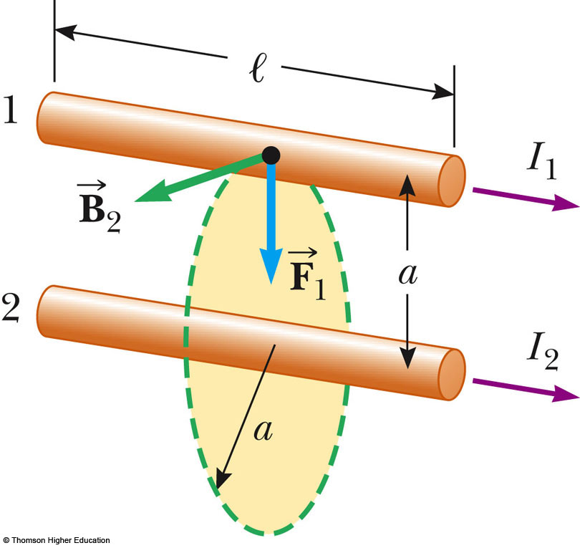
Magnetic Force Between Two Parallel Conductors
Two parallel wires each carry a steady current
The field due to the current in wire 2 exerts a force on wire 1 of F₁ = I₁ℓ B₂
PLAY
ACTIVE FIGURE

Slide 22
Magnetic Force Between Two Parallel Conductors, cont.
Substituting the equation for gives
  Parallel conductors carrying currents in the same direction attract each other
  Parallel conductors carrying current in opposite directions repel each other

Slide 23
Magnetic Force Between Two Parallel Conductors, final
The result is often expressed as the magnetic force between the two wires, F_{B}
This can also be given as the force per unit length:

Slide 24
Definition of the Ampere
The force between two parallel wires can be used to define the ampere
When the magnitude of the force per unit length between two long, parallel wires that carry identical currents and are separated by 1 m is 2 x 10⁻⁷ N/m, the current in each wire is defined to be 1 A

Slide 25
Definition of the Coulomb
The SI unit of charge, the coulomb, is defined in terms of the ampere
When a conductor carries a steady current of 1 A, the quantity of charge that flows through a cross section of the conductor in 1 s is 1 C

Slide 26
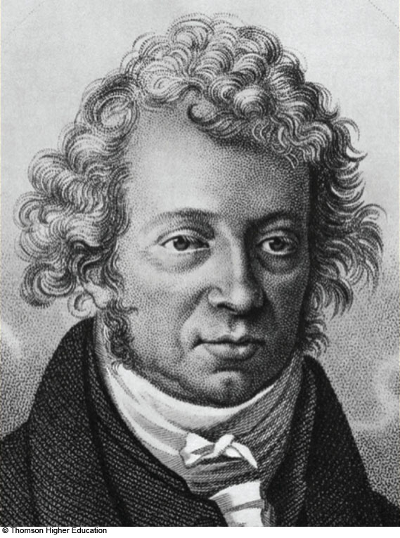
Andre-Marie Ampère
1775 – 1836
French physicist
Created with the discovery of electromagnetism
  The relationship between electric current and magnetic fields
Also worked in mathematics

Slide 27
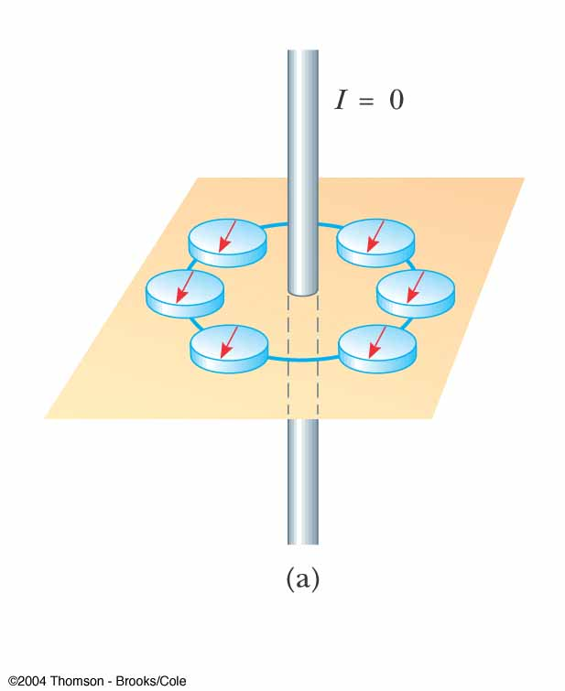
Magnetic Field of a Wire
A compass can be used to detect the magnetic field
When there is no current in the wire, there is no field due to the current
The compass needles all point toward the Earth’s north pole
  Due to the Earth’s magnetic field

Slide 28
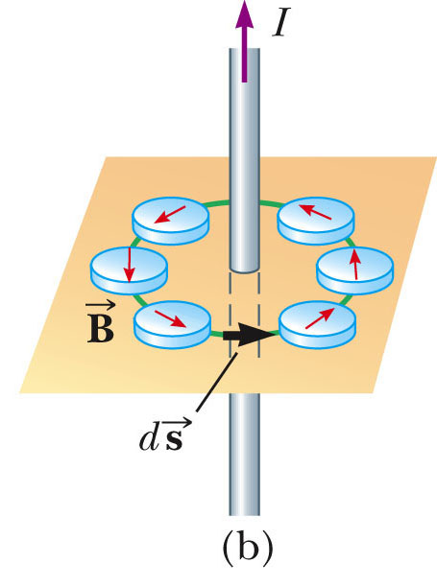
Magnetic Field of a Wire, 2
Here the wire carries a strong current
The compass needles deflect in a direction tangent to the circle
This shows the direction of the magnetic field produced by the wire
Use the active figure to vary the current
PLAY
ACTIVE FIGURE

Slide 29
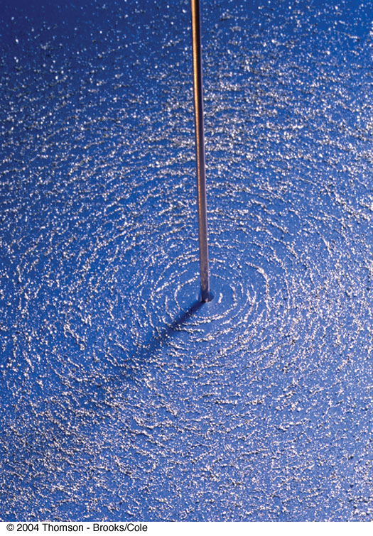
Magnetic Field of a Wire, 3
The circular magnetic field around the wire is shown by the iron filings

Slide 30
Ampere’s Law
The product of can be evaluated for small length elements on the circular path defined by the compass needles for the long straight wire
Ampere’s law states that the line integral of
around any closed path equals μ_{o}I where I is the total steady current passing through any surface bounded by the closed path:

Slide 31
Ampere’s Law, cont.
Ampere’s law describes the creation of magnetic fields by all continuous current configurations
  Most useful for this course if the current configuration has a high degree of symmetry
Put the thumb of your right hand in the direction of the current through the amperian loop and your fingers curl in the direction you should integrate around the loop

Slide 32
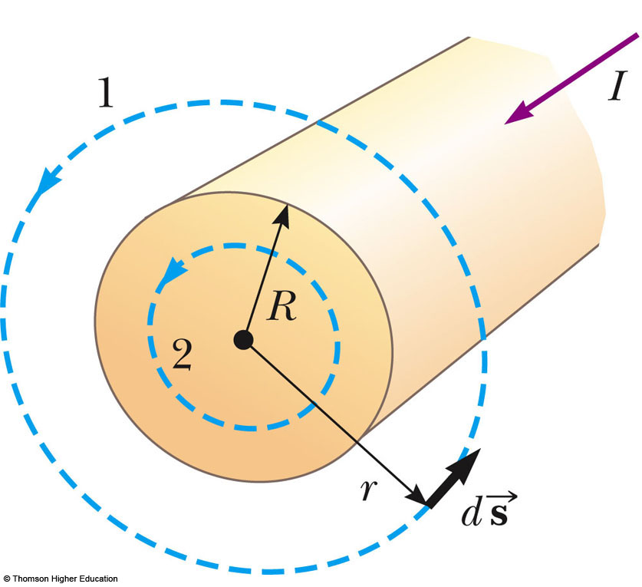
Field Due to a Long Straight Wire – From Ampere’s Law
Want to calculate the magnetic field at a distance r from the center of a wire carrying a steady current I
The current is uniformly distributed through the cross section of the wire

Slide 33
Field Due to a Long Straight Wire – Results From Ampere’s Law
Outside of the wire, r > R
Inside the wire, we need I’, the current inside the amperian circle

Slide 34
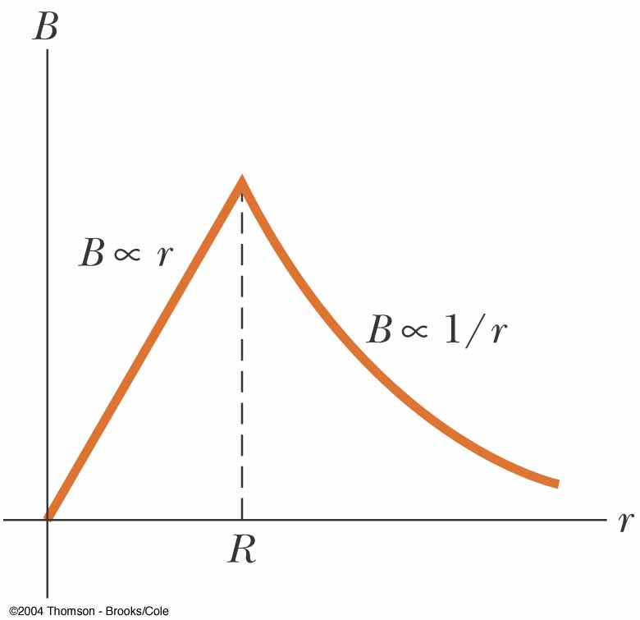
Field Due to a Long Straight Wire – Results Summary
The field is proportional to r inside the wire
The field varies as 1/r outside the wire
Both equations are equal at r = R

Slide 35
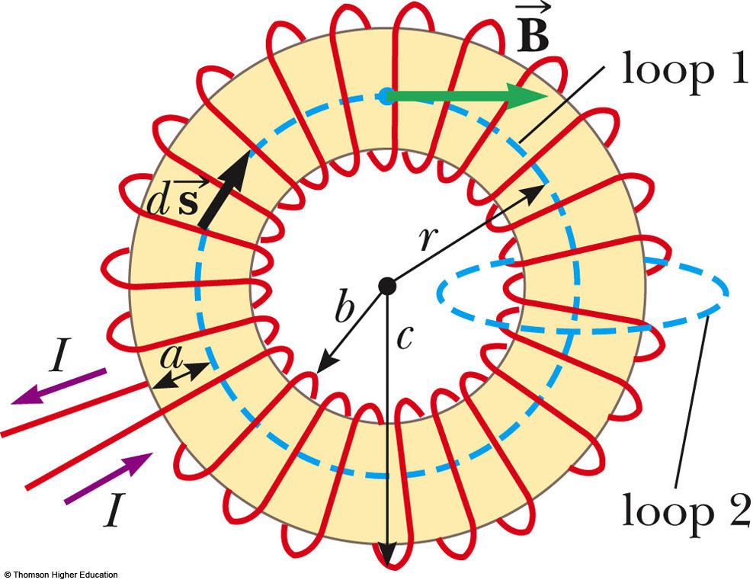
Magnetic Field of a Toroid
Find the field at a point at distance r from the center of the toroid
The toroid has N turns of wire

Slide 36
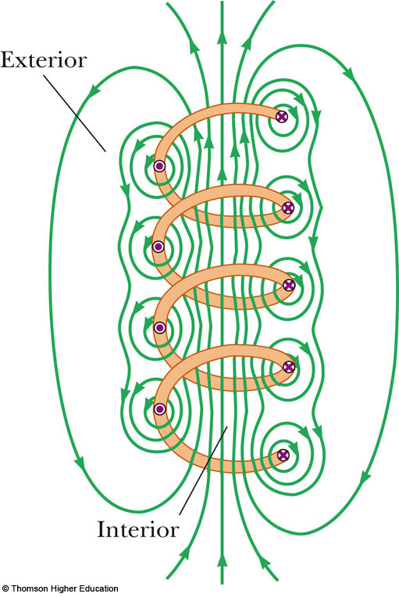
Magnetic Field of a Solenoid
A solenoid is a long wire wound in the form of a helix
A reasonably uniform magnetic field can be produced in the space surrounded by the turns of the wire
  The interior of the solenoid

Slide 37
Magnetic Field of a Solenoid, Description
The field lines in the interior are
  nearly parallel to each other
  uniformly distributed
  close together
This indicates the field is strong and almost uniform

Slide 38
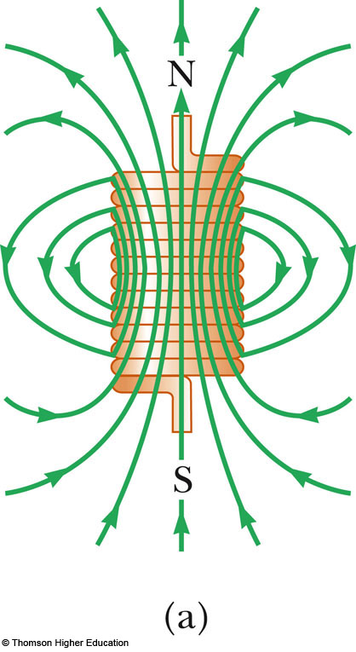
Magnetic Field of a Tightly Wound Solenoid
The field distribution is similar to that of a bar magnet
As the length of the solenoid increases
  the interior field becomes more uniform
  the exterior field becomes weaker

Slide 39
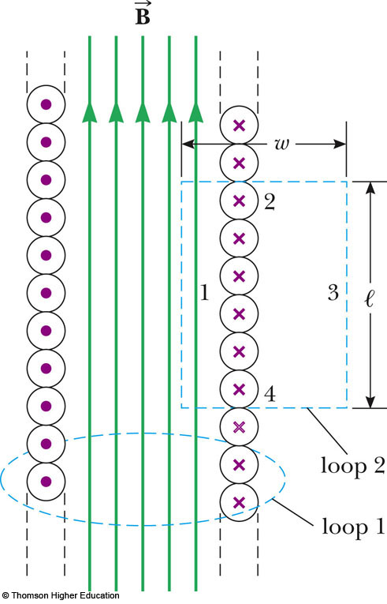
Ideal Solenoid – Characteristics
An ideal solenoid is approached when:
  the turns are closely spaced
  the length is much greater than the radius of the turns

Slide 40
Ampere’s Law Applied to a Solenoid
Ampere’s law can be used to find the interior magnetic field of the solenoid
Consider a rectangle with side ℓ parallel to the interior field and side w perpendicular to the field
  This is loop 2 in the diagram
The side of length ℓ inside the solenoid contributes to the field
  This is side 1 in the diagram

Slide 41
Ampere’s Law Applied to a Solenoid, cont.
Applying Ampere’s Law gives
The total current through the rectangular path equals the current through each turn multiplied by the number of turns

Slide 42
Magnetic Field of a Solenoid, final
Solving Ampere’s law for the magnetic field is
  n = N / ℓ is the number of turns per unit length
This is valid only at points near the center of a very long solenoid

Slide 43
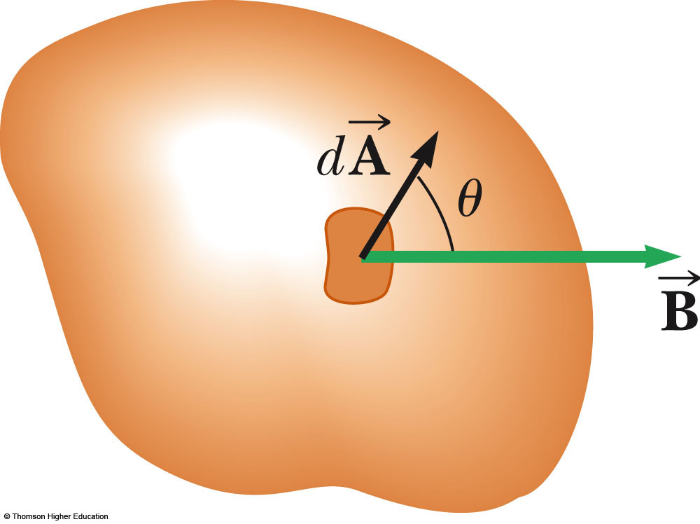
Magnetic Flux
The magnetic flux associated with a magnetic field is defined in a way similar to electric flux
Consider an area element dA on an arbitrarily shaped surface

Slide 44
Magnetic Flux, cont.
The magnetic field in this element is
is a vector that is perpendicular to the surface
has a magnitude equal to the area dA
The magnetic flux Φ_{B} is
The unit of magnetic flux is T.m² = Wb
  Wb is a weber

Slide 45
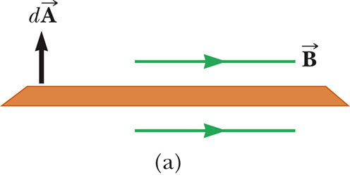
Magnetic Flux Through a Plane, 1
A special case is when a plane of area A makes an angle θ with
The magnetic flux is Φ_{B} = BA cos θ
In this case, the field is parallel to the plane and Φ = 0
PLAY
ACTIVE FIGURE

Slide 46
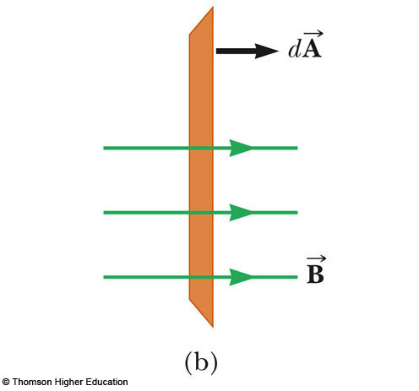
Magnetic Flux Through A Plane, 2
The magnetic flux is Φ_{B} = BA cos θ
In this case, the field is perpendicular to the plane and
Φ = BA
This will be the maximum value of the flux
Use the active figure to investigate different angles
PLAY
ACTIVE FIGURE

Slide 47
Gauss’ Law in Magnetism
Magnetic fields do not begin or end at any point
  The number of lines entering a surface equals the number of lines leaving the surface
Gauss’ law in magnetism says the magnetic flux through any closed surface is always zero:

Slide 48
Magnetic Moments
In general, any current loop has a magnetic field and thus has a magnetic dipole moment
This includes atomic-level current loops described in some models of the atom
This will help explain why some materials exhibit strong magnetic properties

Slide 49
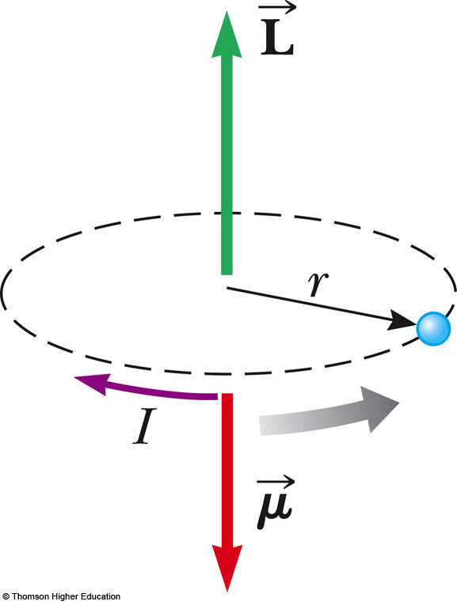
Magnetic Moments – Classical Atom
The electrons move in circular orbits
The orbiting electron constitutes a tiny current loop
The magnetic moment of the electron is associated with this orbital motion
is the angular momentum
is magnetic moment

Slide 50
Magnetic Moments – Classical Atom, 2
This model assumes the electron moves
  with constant speed v
  in a circular orbit of radius r
  travels a distance 2πr in a time interval T
The current associated with this orbiting electron is

Slide 51
Magnetic Moments – Classical Atom, 3
The magnetic moment is
The magnetic moment can also be expressed in terms of the angular momentum

Slide 52
Magnetic Moments – Classical Atom, final
The magnetic moment of the electron is proportional to its orbital angular momentum
  The vectors and point in opposite directions
  Because the electron is negatively charged
Quantum physics indicates that angular momentum is quantized

Slide 53
Magnetic Moments of Multiple Electrons
In most substances, the magnetic moment of one electron is canceled by that of another electron orbiting in the same direction
The net result is that the magnetic effect produced by the orbital motion of the electrons is either zero or very small

Slide 54
Electron Spin
Electrons (and other particles) have an intrinsic property called spin that also contributes to their magnetic moment
  The electron is not physically spinning
  It has an intrinsic angular momentum as if it were spinning
  Spin angular momentum is actually a relativistic effect

Slide 55
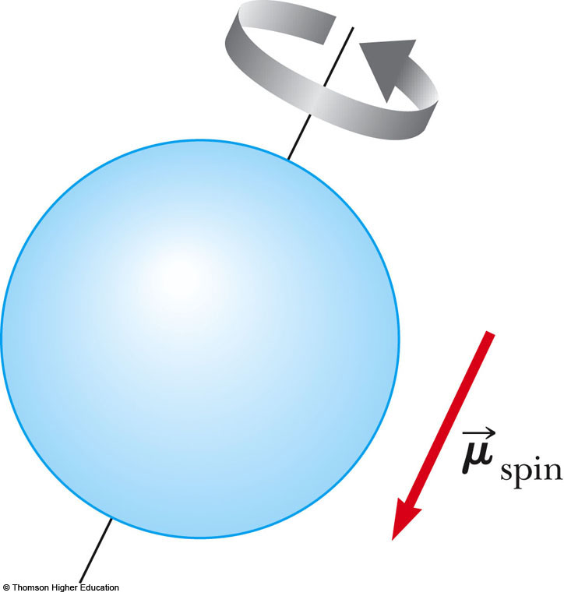
Electron Spin, cont.
The classical model of electron spin is the electron spinning on its axis
The magnitude of the spin angular momentum is
  is Planck’s constant

Slide 56
Electron Spin and Magnetic Moment
The magnetic moment characteristically associated with the spin of an electron has the value
This combination of constants is called the Bohr magneton μ_{B} = 9.27 x 10⁻²⁴ J/T

Slide 57
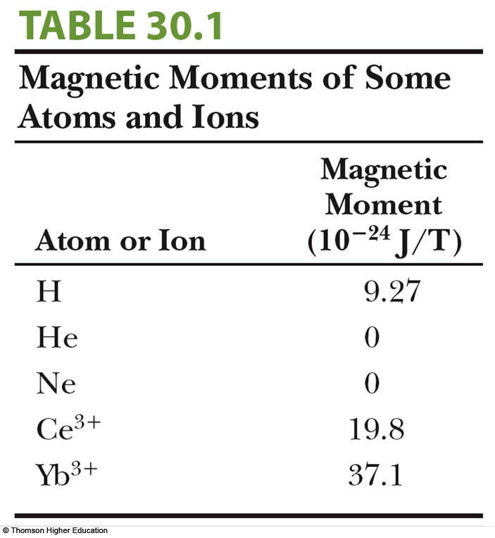
Electron Magnetic Moment, final
The total magnetic moment of an atom is the vector sum of the orbital and spin magnetic moments
Some examples are given in the table at right
The magnetic moment of a proton or neutron is much smaller than that of an electron and can usually be neglected

Slide 58
Ferromagnetism
Some substances exhibit strong magnetic effects called ferromagnetism
Some examples of ferromagnetic materials are:
  iron
  cobalt
  nickel
  gadolinium
  dysprosium
They contain permanent atomic magnetic moments that tend to align parallel to each other even in a weak external magnetic field

Slide 59
Domains
All ferromagnetic materials are made up of microscopic regions called domains
  The domain is an area within which all magnetic moments are aligned
The boundaries between various domains having different orientations are called domain walls

Slide 60
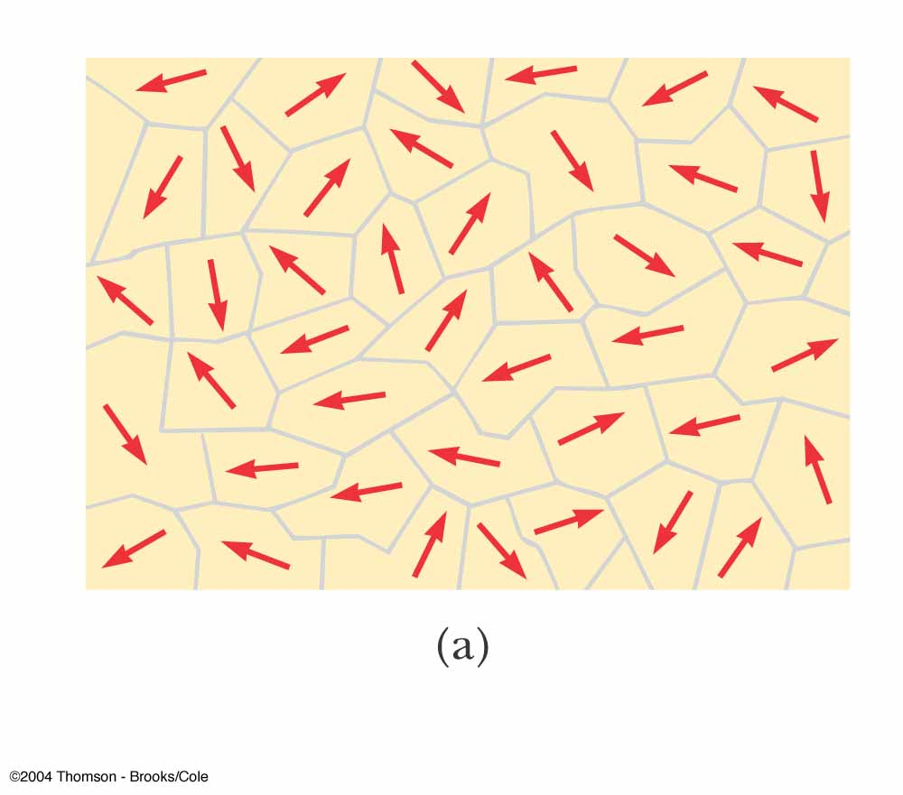
Domains, Unmagnetized Material
The magnetic moments in the domains are randomly aligned
The net magnetic moment is zero

Slide 61
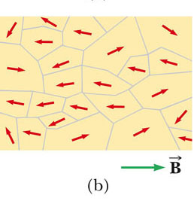
Domains, External Field Applied
A sample is placed in an external magnetic field
The size of the domains with magnetic moments aligned with the field grows
The sample is magnetized

Slide 62
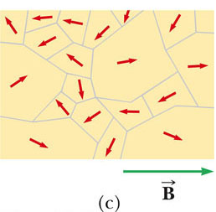
Domains, External Field Applied, cont.
The material is placed in a stronger field
The domains not aligned with the field become very small
When the external field is removed, the material may retain a net magnetization in the direction of the original field

Slide 63
Curie Temperature
The Curie temperature is the critical temperature above which a ferromagnetic material loses its residual magnetism
  The material will become paramagnetic
Above the Curie temperature, the thermal agitation is great enough to cause a random orientation of the moments

Slide 64
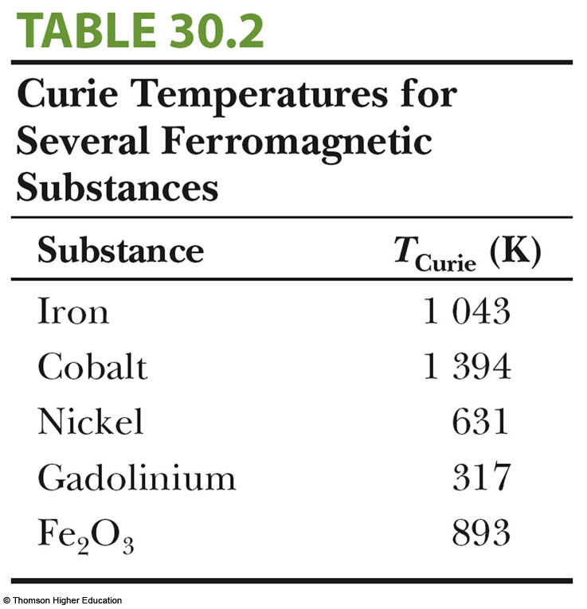
Table of Some Curie Temperatures

Slide 65
Paramagnetism
Paramagnetic substances have small but positive magnetism
It results from the presence of atoms that have permanent magnetic moments
  These moments interact weakly with each other
When placed in an external magnetic field, its atomic moments tend to line up with the field
  The alignment process competes with thermal motion which randomizes the moment orientations

Slide 66
Diamagnetism
When an external magnetic field is applied to a diamagnetic substance, a weak magnetic moment is induced in the direction opposite the applied field
Diamagnetic substances are weakly repelled by a magnet
  Weak, so only present when ferromagnetism or paramagnetism do not exist

Slide 67
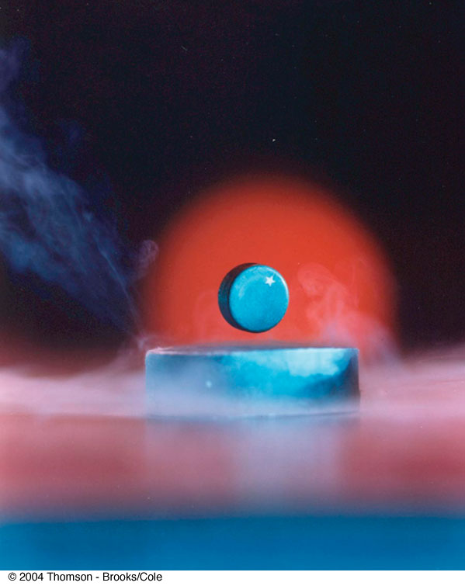
Meissner Effect
Certain types of superconductors also exhibit perfect diamagnetism in the superconducting state
  This is called the Meissner effect
If a permanent magnet is brought near a superconductor, the two objects repel each other

Slide 68
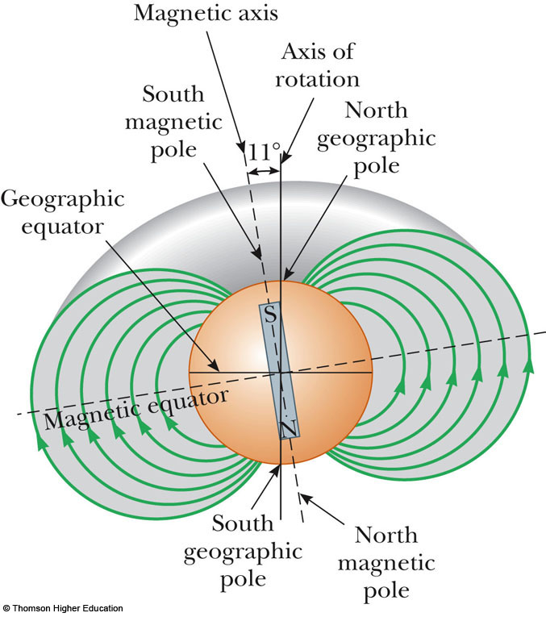
Earth’s Magnetic Field
The Earth’s magnetic field resembles that achieved by burying a huge bar magnet deep in the Earth’s interior
The Earth’s south magnetic pole is located near the north geographic pole
The Earth’s north magnetic pole is located near the south geographic pole

Slide 69
Vertical Movement of a Compass
If a compass is free to rotate vertically as well as horizontally, it points to the Earth’s surface
The farther north the device is moved, the farther from horizontal the compass needle would be
  The compass needle would be horizontal at the equator
  The compass needle would point straight down at the magnetic pole

Slide 70
More About the Earth’s Magnetic Poles
The compass needle with point straight downward found at a point just north of Hudson Bay in Canada
  This is considered to be the location of the south magnetic pole
  The exact location varies slowly with time
The magnetic and geographic poles are not in the same exact location
  The difference between true north, at the geographic north pole, and magnetic north is called the magnetic declination
    The amount of declination varies by location on the Earth’s surface

Slide 71
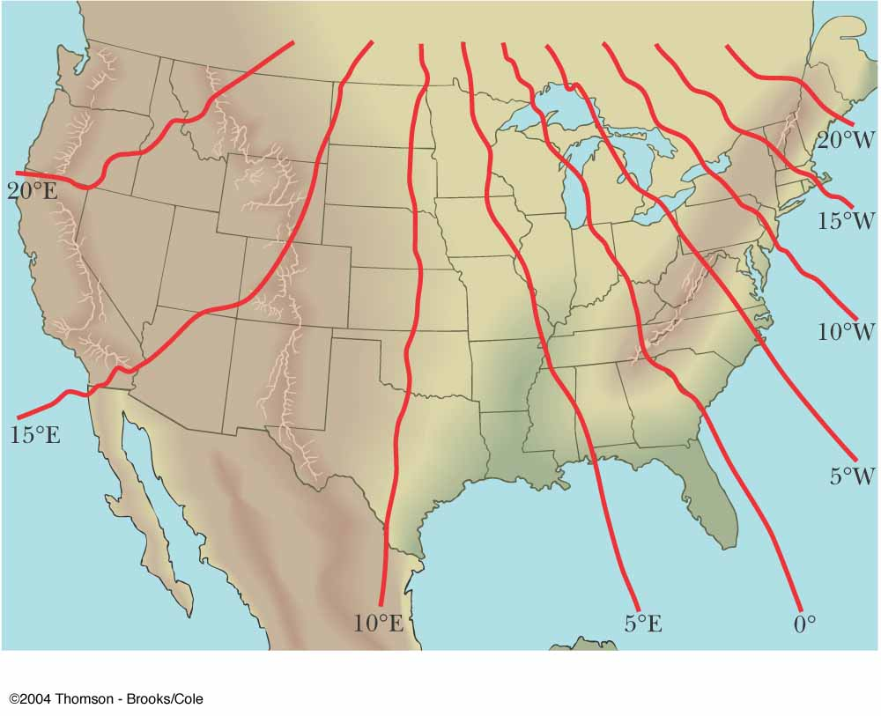
Earth’s Magnetic Declination

Slide 72
Source of the Earth’s Magnetic Field
There cannot be large masses of permanently magnetized materials since the high temperatures of the core prevent materials from retaining permanent magnetization
The most likely source of the Earth’s magnetic field is believed to be convection currents in the liquid part of the core
There is also evidence that the planet’s magnetic field is related to its rate of rotation

Slide 73
Reversals of the Earth’s Magnetic Field
The direction of the Earth’s magnetic field reverses every few million years
  Evidence of these reversals are found in basalts resulting from volcanic activity
  The rocks provide a timeline for the periodic reversals of the field
    The rocks are dated by other means to determine the timeline

