Slide 1
Chapter 33
Alternating Current Circuits

Slide 2
AC Circuits
An AC circuit consists of a combination of circuit elements and a power source
The power source provides an alternative voltage, Δv
Notation Note
  Lower case symbols will indicate instantaneous values
  Capital letters will indicate fixed values

Slide 3
AC Voltage
The output of an AC power source is sinusoidal and varies with time according to the following equation:
  Δv = ΔV_{max} sin ωt
    Δv is the instantaneous voltage
    ΔV_{max} is the maximum output voltage of the source
      Also called the voltage amplitude
    ω is the angular frequency of the AC voltage

Slide 4
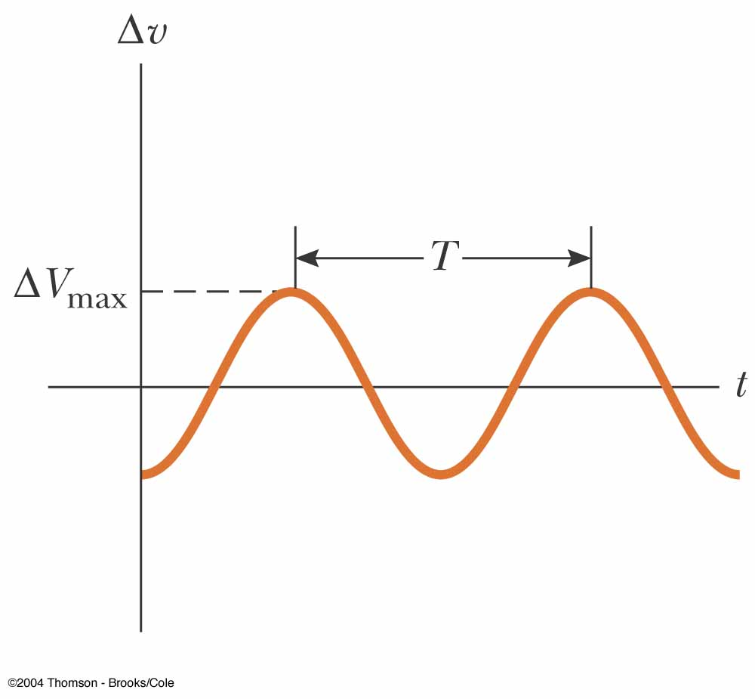
AC Voltage, cont.
The angular frequency is
  ƒ is the frequency of the source
  T is the period of the source
The voltage is positive during one half of the cycle and negative during the other half

Slide 5
AC Voltage, final
The current in any circuit driven by an AC source is an alternating current that varies sinusoidally with time
Commercial electric power plants in the US use a frequency of 60 Hz
  This corresponds with an angular frequency of 377 rad/s

Slide 6
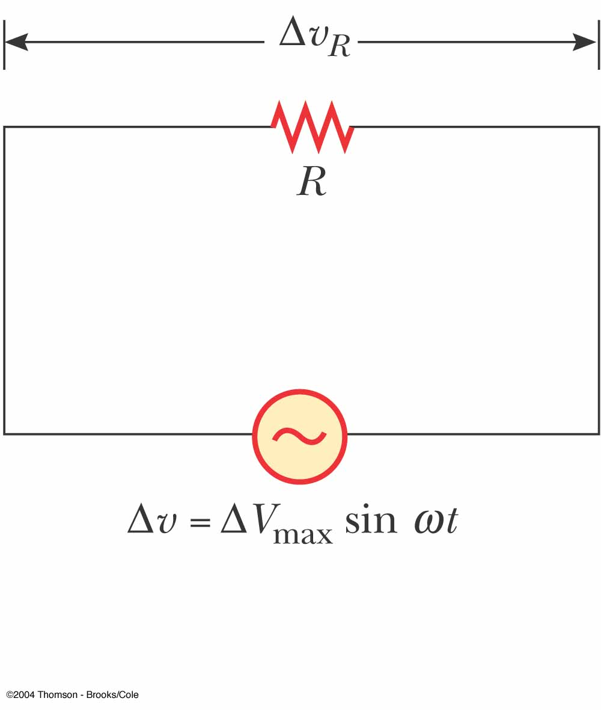

Resistors in an AC Circuit
Consider a circuit consisting of an AC source and a resistor
The AC source is symbolized by
Δv_{R} = ΔV_{max}= V_{max} sin ωt
Δv_{R} is the instantaneous voltage across the resistor

Slide 7
Resistors in an AC Circuit, 2
The instantaneous current in the resistor is
The instantaneous voltage across the resistor is also given as
Δv_{R} = I_{max} R sin ωt

Slide 8
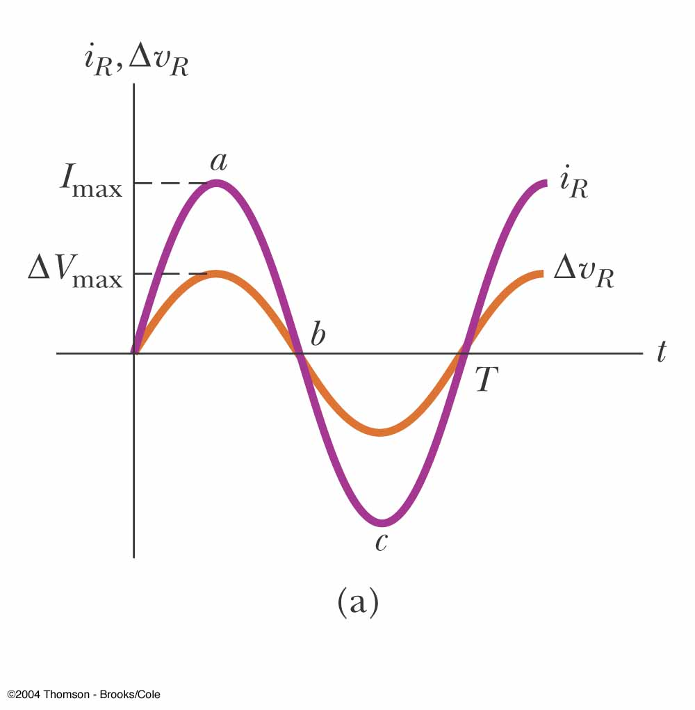
Resistors in an AC Circuit, 3
The graph shows the current through and the voltage across the resistor
The current and the voltage reach their maximum values at the same time
The current and the voltage are said to be in phase

Slide 9
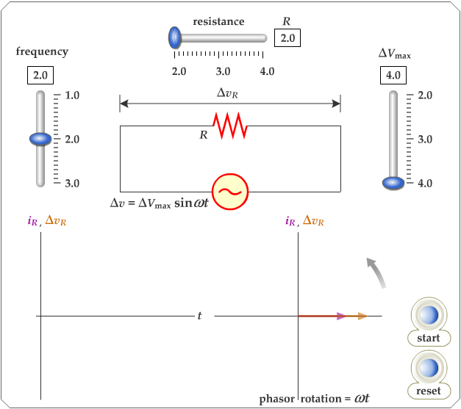
Active Figure 33.2
Adjust the resistance, frequency and V_{max}
Observe the results with the graph and the phasor diagram
PLAY
ACTIVE FIGURE

Slide 10
Resistors in an AC Circuit, 4
For a sinusoidal applied voltage, the current in a resistor is always in phase with the voltage across the resistor
The direction of the current has no effect on the behavior of the resistor
Resistors behave essentially the same way in both DC and AC circuits

Slide 11
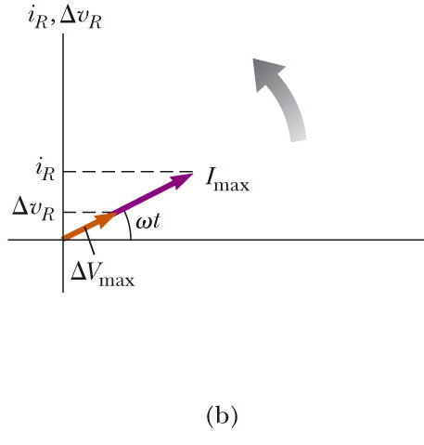
Phasor Diagram
To simplify the analysis of AC circuits, a graphical constructor called a phasor diagram can be used
A phasor is a vector whose length is proportional to the maximum value of the variable it represents

Slide 12
Phasors, cont.
The vector rotates counterclockwise at an angular speed equal to the angular frequency associated with the variable
The projection of the phasor onto the vertical axis represents the instantaneous value of the quantity it represents

Slide 13
rms Current and Voltage
The average current in one cycle is zero
The rms current is the average of importance in an AC circuit
    rms stands for root mean square
Alternating voltages can also be discussed in terms of rms values

Slide 14
Power
The rate at which electrical energy is dissipated in the circuit is given by
  P = i ² R
    i is the instantaneous current
    The heating effect produced by an AC current with a maximum value of I_{max} is not the same as that of a DC current of the same value
    The maximum current occurs for a small amount of time

Slide 15
Power, cont.
The average power delivered to a resistor that carries an alternating current is

Slide 16
Notes About rms Values
rms values are used when discussing alternating currents and voltages because
  AC ammeters and voltmeters are designed to read rms values
  Many of the equations that will be used have the same form as their DC counterparts

Slide 17
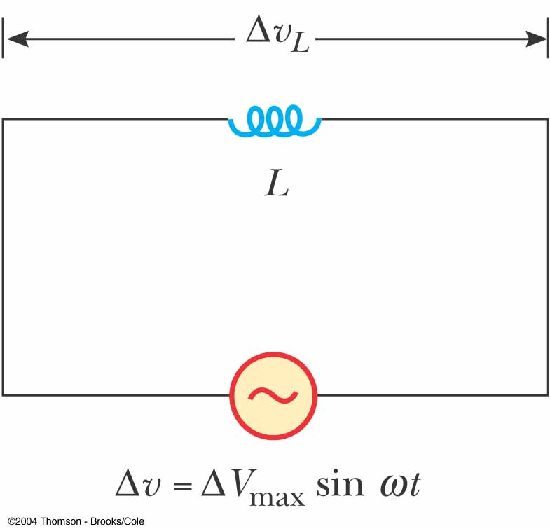
Inductors in an AC Circuit
Kirchhoff’s loop rule can be applied and gives:

Slide 18
Current in an Inductor
The equation obtained from Kirchhoff's loop rule can be solved for the current
This shows that the instantaneous current i_{L} in the inductor and the instantaneous voltage Δv_{L} across the inductor are out of phase by (π/2) rad = 90º

Slide 19
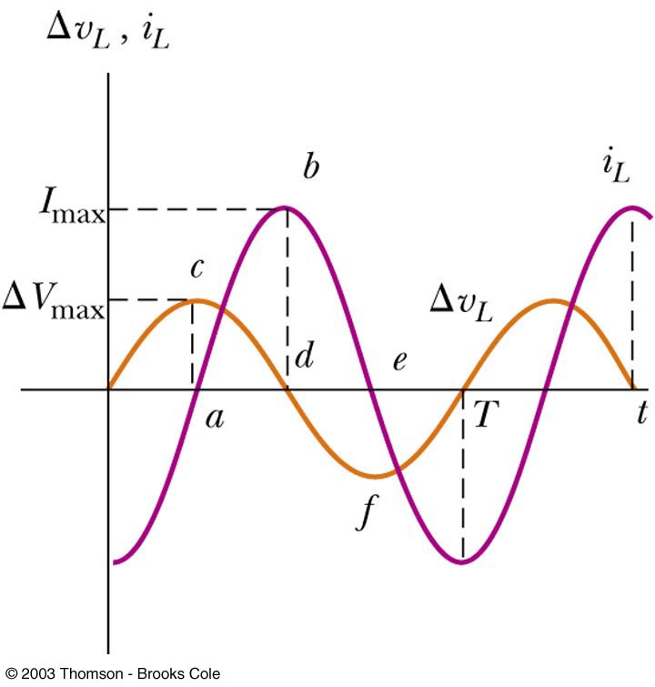
Phase Relationship of Inductors in an AC Circuit
The current is a maximum when the voltage across the inductor is zero
  The current is momentarily not changing
For a sinusoidal applied voltage, the current in an inductor always lags behind the voltage across the inductor by 90° (π/2)

Slide 20
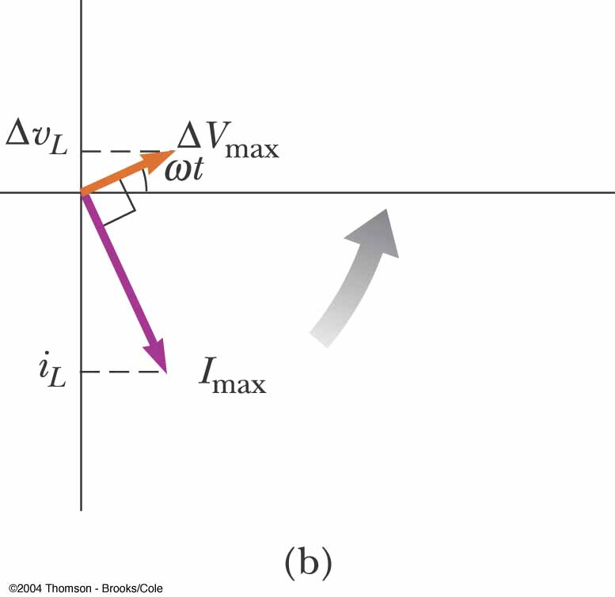
Phasor Diagram for an Inductor
The phasors are at 90º with respect to each other
This represents the phase difference between the current and voltage
Specifically, the current lags behind the voltage by 90º

Slide 21
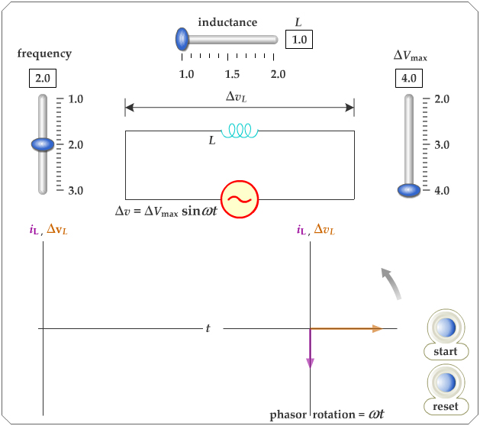
Active Figure 33.6
Use the active figure to adjust the inductance, frequency and voltage
Observe the results on the graph and phasor diagrams
PLAY
ACTIVE FIGURE

Slide 22
Inductive Reactance
The factor ωL has the same units as resistance and is related to current and voltage in the same way as resistance
Because ωL depends on the frequency, it reacts differently, in terms of offering resistance to current, for different frequencies
The factor is the inductive reactance and is given by:
  X_{L} = ωL

Slide 23
Inductive Reactance, cont.
Current can be expressed in terms of the inductive reactance
As the frequency increases, the inductive reactance increases
  This is consistent with Faraday’s Law:
    The larger the rate of change of the current in the inductor, the larger the back emf, giving an increase in the reactance and a decrease in the current

Slide 24
Voltage Across the Inductor
The instantaneous voltage across the inductor is

Slide 25
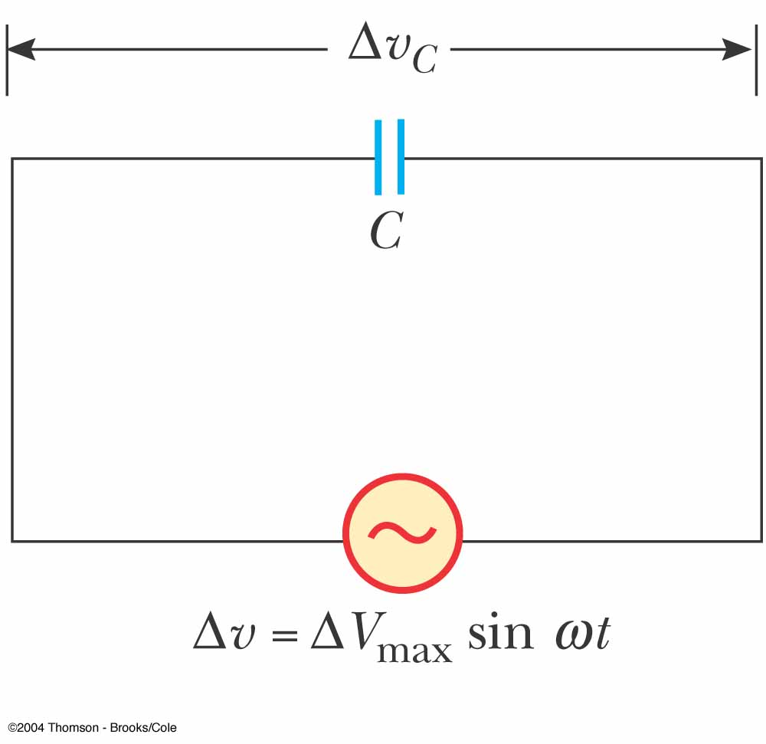
Capacitors in an AC Circuit
The circuit contains a capacitor and an AC source
Kirchhoff’s loop rule gives:
Δv + Δv_{c} = 0 and so
Δv = Δv_{C} = ΔV_{max} sin ωt
  Δv_{c} is the instantaneous voltage across the capacitor

Slide 26
Capacitors in an AC Circuit, cont.
The charge is q = CΔV_{max} sin ωt
The instantaneous current is given by
The current is π/2 rad = 90º out of phase with the voltage

Slide 27
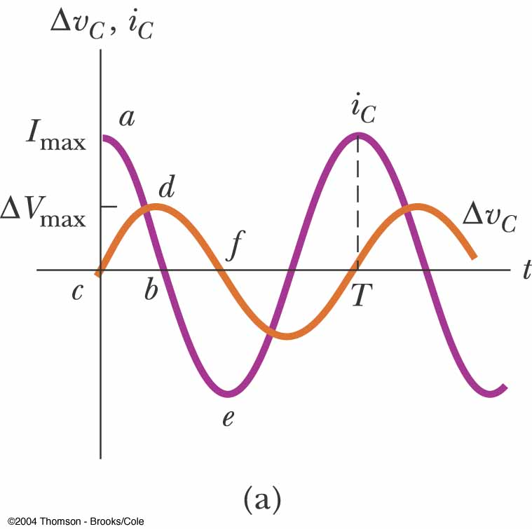
More About Capacitors in an AC Circuit
The current reaches its maximum value one quarter of a cycle sooner than the voltage reaches its maximum value
The current leads the voltage by 90º

Slide 28
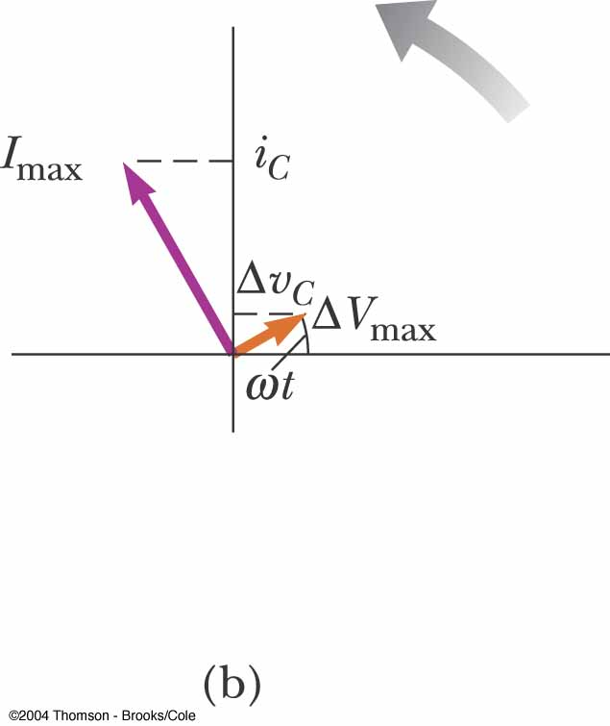
Phasor Diagram for Capacitor
The phasor diagram shows that for a sinusoidally applied voltage, the current always leads the voltage across a capacitor by 90º

Slide 29
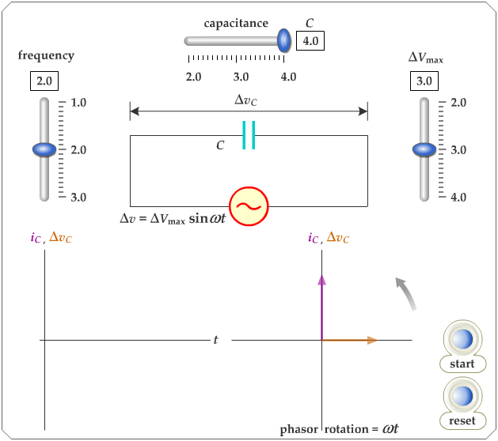
Active Figure 33.9
Use the active figure to adjust capacitance, frequency and voltage
Observe the effect on the graph and the phasor diagram
PLAY
ACTIVE FIGURE

Slide 30
Capacitive Reactance
The maximum current in the circuit occurs at cos ωt = 1 which gives
The impeding effect of a capacitor on the current in an AC circuit is called the capacitive reactance and is given by

Slide 31
Voltage Across a Capacitor
The instantaneous voltage across the capacitor can be written as Δv_{C} = ΔV_{max} sin ωt = I_{max} X_{C} sin ωt
As the frequency of the voltage source increases, the capacitive reactance decreases and the maximum current increases
As the frequency approaches zero, X_{C} approaches infinity and the current approaches zero
  This would act like a DC voltage and the capacitor would act as an open circuit

Slide 32
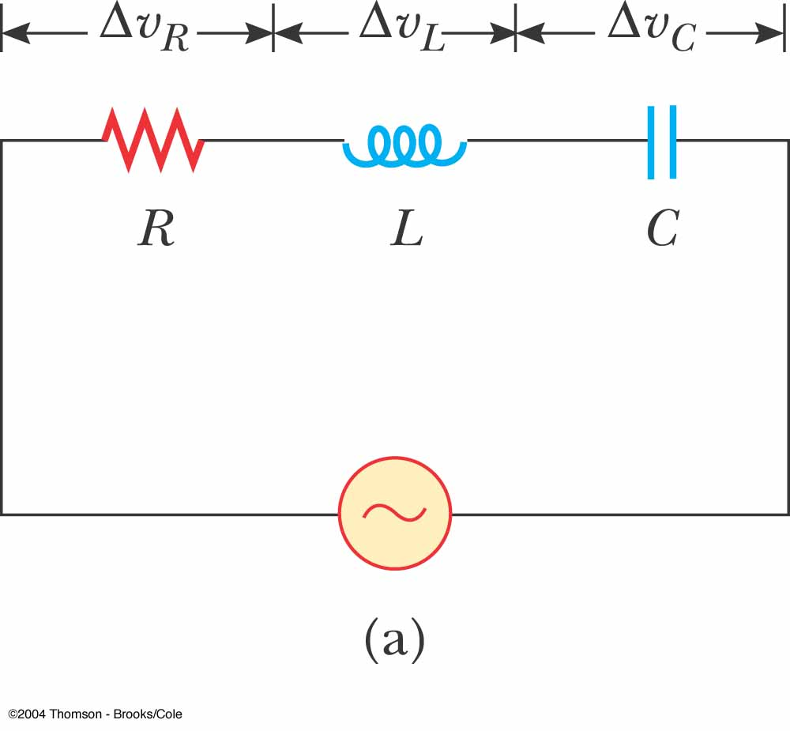
The RLC Series Circuit
The resistor, inductor, and capacitor can be combined in a circuit
The current and the voltage in the circuit vary sinusoidally with time

Slide 33
The RLC Series Circuit, cont.
The instantaneous voltage would be given by Δv = ΔV_{max} sin ωt
The instantaneous current would be given by i = I_{max} sin (ωt - φ)
  φ is the phase angle between the current and the applied voltage
Since the elements are in series, the current at all points in the circuit has the same amplitude and phase

Slide 34
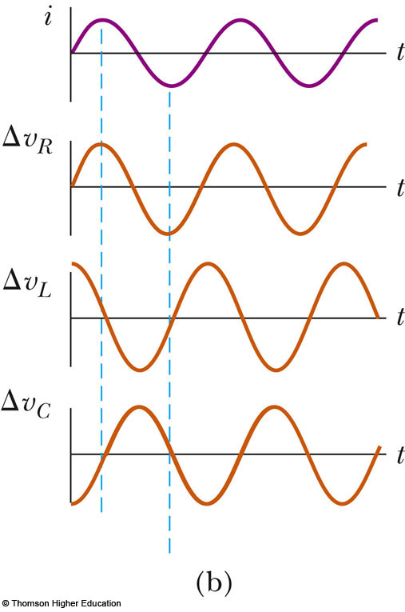
i and v Phase Relationships – Graphical View
The instantaneous voltage across the resistor is in phase with the current
The instantaneous voltage across the inductor leads the current by 90°
The instantaneous voltage across the capacitor lags the current by 90°
PLAY
ACTIVE FIGURE

Slide 35
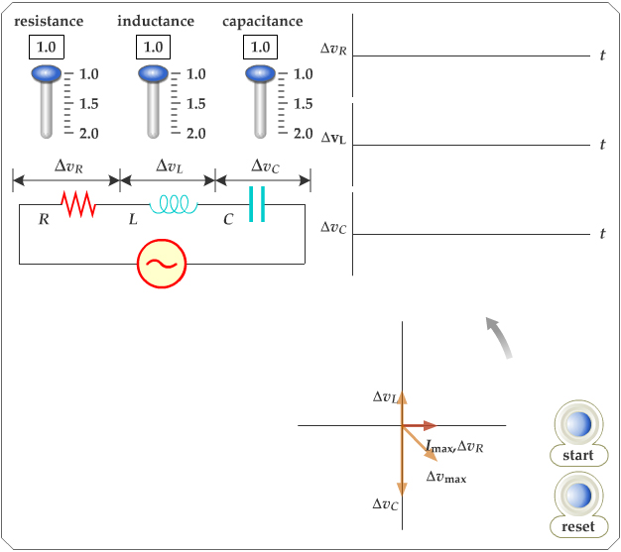
Active Figure 33.13
Use the active figure to adjust the resistance, capacitance and inductance
Observe the results on the graph and the phasor diagram
PLAY
ACTIVE FIGURE

Slide 36
i and v Phase Relationships – Equations
The instantaneous voltage across each of the three circuit elements can be expressed as

Slide 37
More About Voltage in RLC Circuits
ΔV_{R} is the maximum voltage across the resistor and ΔV_{R} = I_{max}R
ΔV_{L} is the maximum voltage across the inductor and ΔV_{L} = I_{max}X_{L}
ΔV_{C} is the maximum voltage across the capacitor and ΔV_{C} = I_{max}X_{C}
The sum of these voltages must equal the voltage from the AC source
Because of the different phase relationships with the current, they cannot be added directly

Slide 38
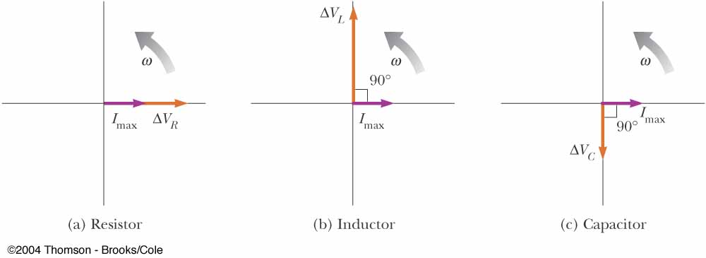
Phasor Diagrams
To account for the different phases of the voltage drops, vector techniques are used
Remember the phasors are rotating vectors
The phasors for the individual elements are shown

Slide 39
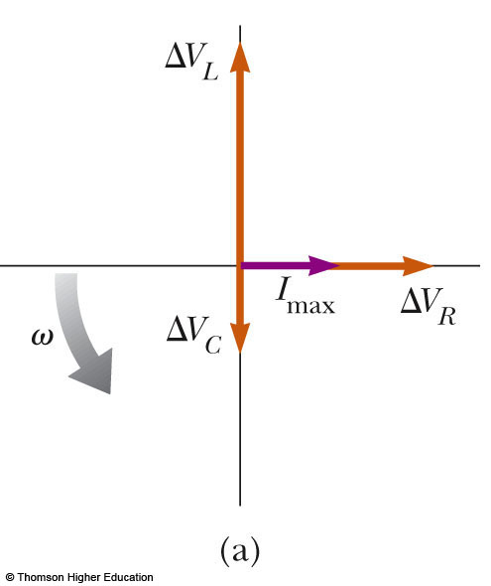
Resulting Phasor Diagram
The individual phasor diagrams can be combined
Here a single phasor I_{max} is used to represent the current in each element
  In series, the current is the same in each element
PLAY
ACTIVE FIGURE

Slide 40
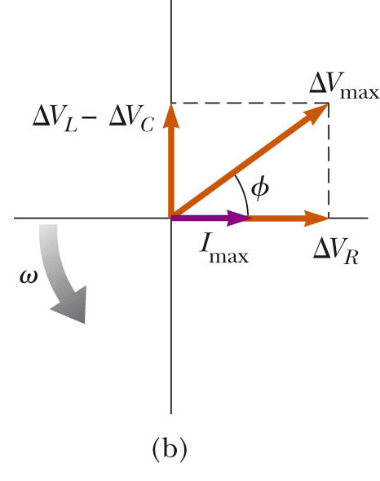
Vector Addition of the Phasor Diagram
Vector addition is used to combine the voltage phasors
ΔV_{L} and ΔV_{C} are in opposite directions, so they can be combined
Their resultant is perpendicular to ΔV_{R}
PLAY
ACTIVE FIGURE

Slide 41
Total Voltage in RLC Circuits
From the vector diagram, ΔV_{max} can be calculated

Slide 42
Impedance
The current in an RLC circuit is
Z is called the impedance of the circuit and it plays the role of resistance in the circuit, where
  Impedance has units of ohms

Slide 43
Phase Angle
The right triangle in the phasor diagram can be used to find the phase angle, φ
The phase angle can be positive or negative and determines the nature of the circuit

Slide 44
Determining the Nature of the Circuit
If φ is positive
  X_{L}> X_{C} (which occurs at high frequencies)
  The current lags the applied voltage
  The circuit is more inductive than capacitive
If φ is negative
  X_{L}< X_{C} (which occurs at low frequencies)
  The current leads the applied voltage
  The circuit is more capacitive than inductive
If φ is zero
  X_{L}= X_{C}
  The circuit is purely resistive

Slide 45
Power in an AC Circuit
The average power delivered by the AC source is converted to internal energy in the resistor
  ℘_{av} = ½ I_{max} ΔV_{max} cos φ = I_{rms}ΔV_{rms} cos φ
  cos φ is called the power factor of the circuit
We can also find the average power in terms of R
  ℘_{av} = I²_{rms}R

Slide 46
Power in an AC Circuit, cont.
The average power delivered by the source is converted to internal energy in the resistor
No power losses are associated with pure capacitors and pure inductors in an AC circuit
  In a capacitor, during one-half of a cycle, energy is stored and during the other half the energy is returned to the circuit and no power losses occur in the capacitor
  In an inductor, the source does work against the back emf of the inductor and energy is stored in the inductor, but when the current begins to decrease in the circuit, the energy is returned to the circuit

Slide 47
Power and Phase
The power delivered by an AC circuit depends on the phase
Some applications include using capacitors to shift the phase to heavy motors or other inductive loads so that excessively high voltages are not needed

Slide 48
Resonance in an AC Circuit
Resonance occurs at the frequency ω_{o} where the current has its maximum value
  To achieve maximum current, the impedance must have a minimum value
  This occurs when X_{L} = X_{C}
  Solving for the frequency gives
The resonance frequency also corresponds to the natural frequency of oscillation of an LC circuit

Slide 49
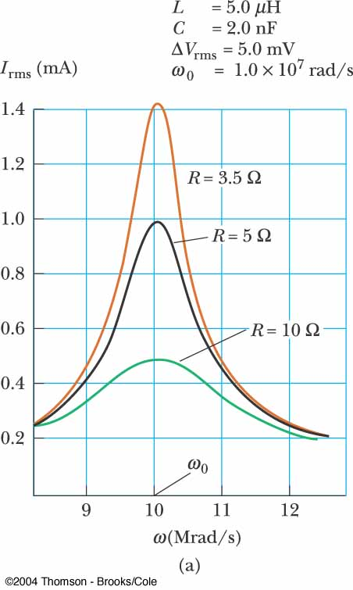
Resonance, cont.
Resonance occurs at the same frequency regardless of the value of R
As R decreases, the curve becomes narrower and taller
Theoretically, if R = 0 the current would be infinite at resonance
  Real circuits always have some resistance

Slide 50
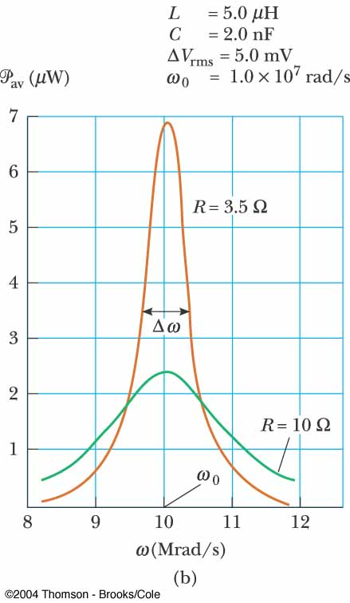
Power as a Function of Frequency
Power can be expressed as a function of frequency in an RLC circuit
This shows that at resonance, the average power is a maximum

Slide 51
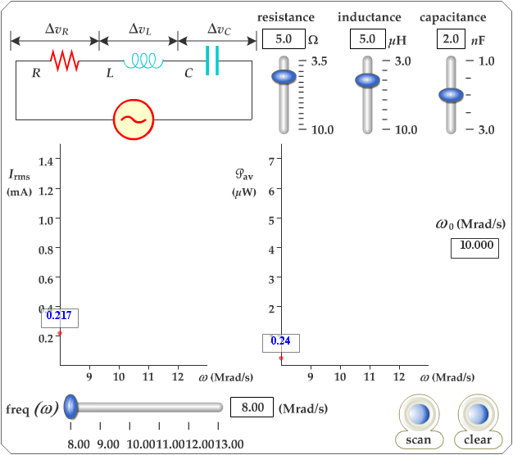
Active Figure 33.17
Use the active figure to adjust R, L and C in the circuit
Determine the current and the power
PLAY
ACTIVE FIGURE

Slide 52
Quality Factor
The sharpness of the resonance curve is usually described by a dimensionless parameter known as the quality factor, Q
Q = ω_{o} / Δω = (ω_{o}L) / R
  Δω is the width of the curve, measured between the two values of ω for which ℘_{avg} has half its maximum value
    These points are called the half-power points

Slide 53
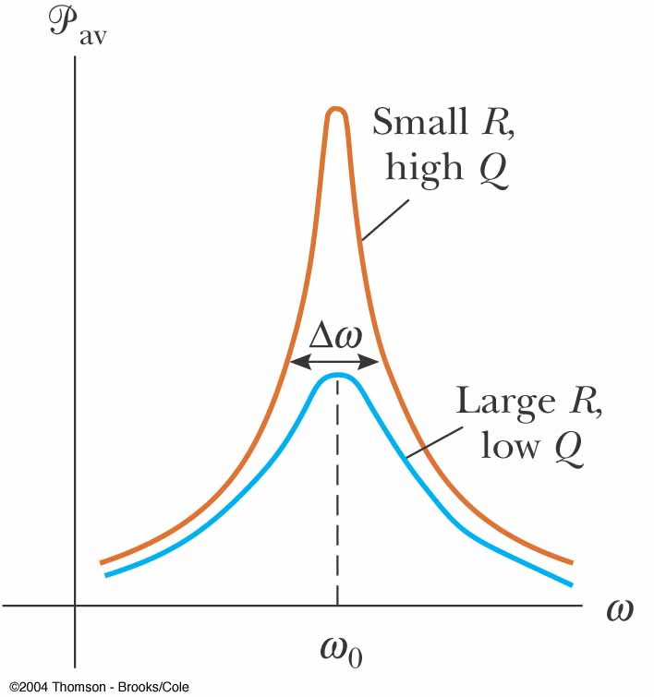
Quality Factor, cont.
A high-Q circuit responds only to a narrow range of frequencies
  Narrow peak
A low-Q circuit can detect a much broader range of frequencies

Slide 54
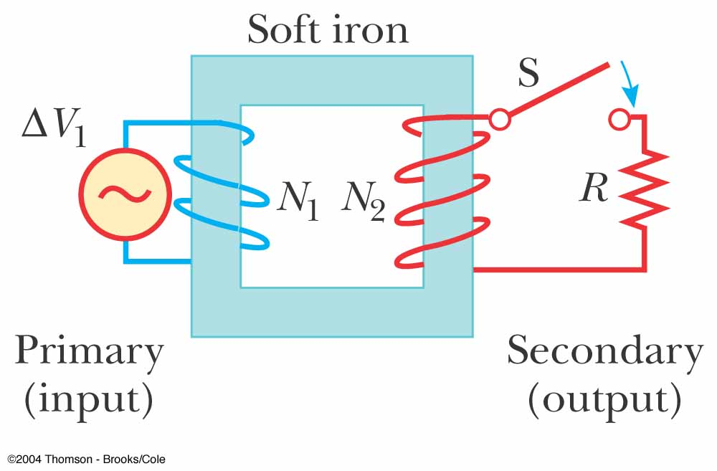
Transformers
An AC transformer consists of two coils of wire wound around a core of iron
The side connected to the input AC voltage source is called the primary and has N₁ turns

Slide 55
Transformers, 2
The other side, called the secondary, is connected to a resistor and has N₂ turns
The core is used to increase the magnetic flux and to provide a medium for the flux to pass from one coil to the other
  Eddy-current losses are minimized by using a laminated core

Slide 56
Transformers, 3
Assume an ideal transformer
  One in which the energy losses in the windings and the core are zero
    Typical transformers have power efficiencies of 90% to 99%
In the primary,
The rate of change of the flux is the same for both coils

Slide 57
Transformers, 4
The voltage across the secondary is
The voltages are related by
When N₂ > N₁, the transformer is referred to as a step-up transformer
When N₂ < N₁, the transformer is referred to as a step-down transformer

Slide 58
Transformers, 5
The power input into the primary equals the power output at the secondary
  I₁ΔV₁ = I₂ΔV₂
The equivalent resistance of the load resistance when viewed from the primary is

Slide 59
Transformers, final
A transformer may be used to match resistances between the primary circuit and the load
This way, maximum power transfer can be achieved between a given power source and the load resistance
  In stereo terminology, this technique is called impedance matching

Slide 60
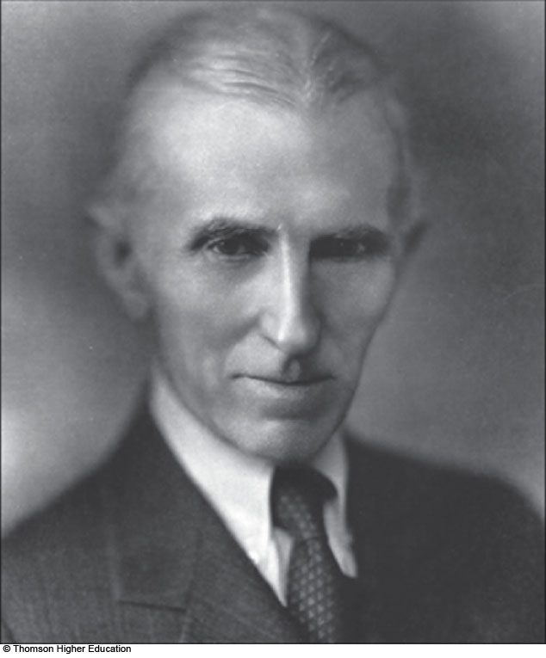
Nikola Tesla
1856 – 1943
American physicist
Key figure in development of
  Alternating-current electricity
  High-voltage transformers
  Transport of electric power using AC transmission lines

Slide 61
Rectifier
The process of converting alternating current to direct current is called rectification
A rectifier is the converting device
The most important element in a rectifier circuit is the diode
  A diode is a circuit element that conducts current in one direction but not the other

Slide 62
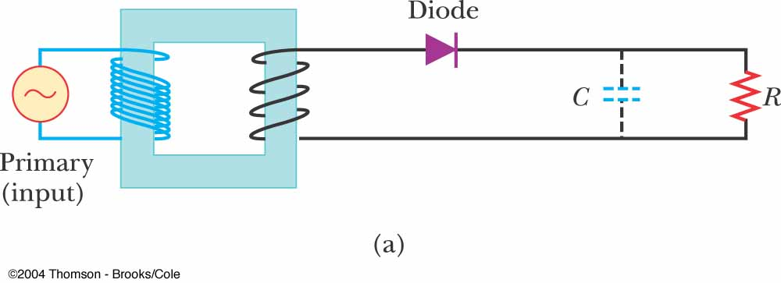

Rectifier Circuit
The arrow on the diode ( ) indicates the direction of the current in the diode
  The diode has low resistance to current flow in this direction
Because of the diode, the alternating current in the load resistor is reduced to the positive portion of the cycle

Slide 63
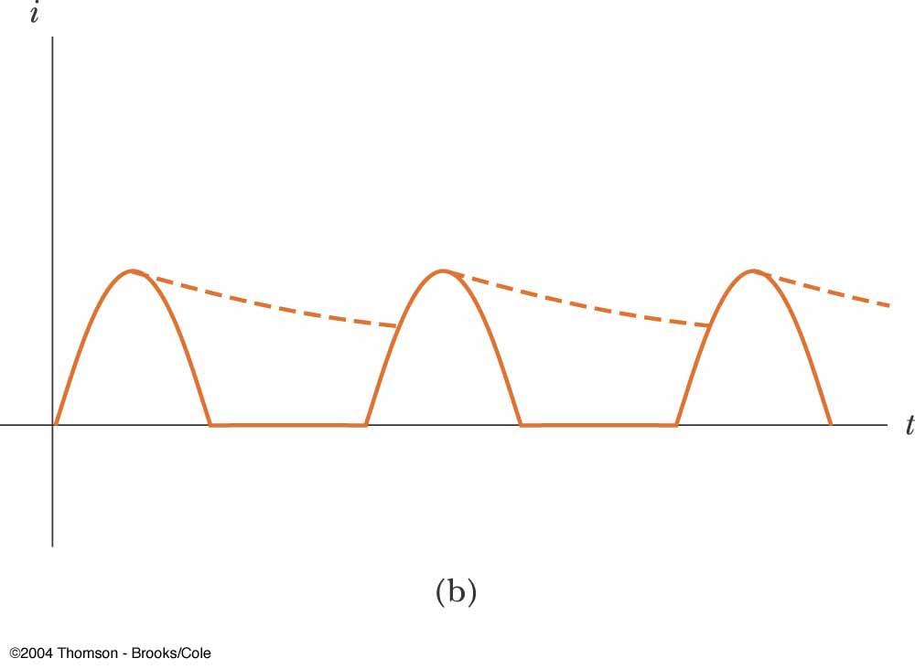
Half-Wave Rectifier
The solid line in the graph is the result through the resistor
It is called a half-wave rectifier because current is present in the circuit during only half of each cycle

Slide 64
Half-Wave Rectifier, Modification
A capacitor can be added to the circuit
The circuit is now a simple DC power supply
The time variation in the circuit is close to zero
  It is determined by the RC time constant of the circuit
  This is represented by the dotted lines in the previous graph

Slide 65
Filter Circuit, Example
A filter circuit is one used to smooth out or eliminate a time-varying signal
After rectification, a signal may still contain a small AC component
  This component is often called a ripple
By filtering, the ripple can be reduced
Filters can also be built to respond differently to different frequencies

Slide 66
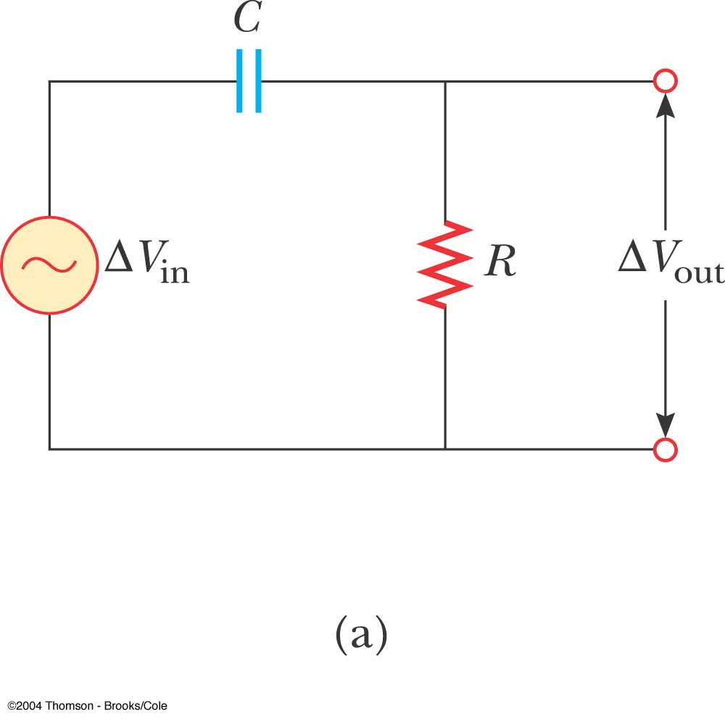
High-Pass Filter
The circuit shown is one example of a high-pass filter
A high-pass filter is designed to preferentially pass signals of higher frequency and block lower frequency signals

Slide 67
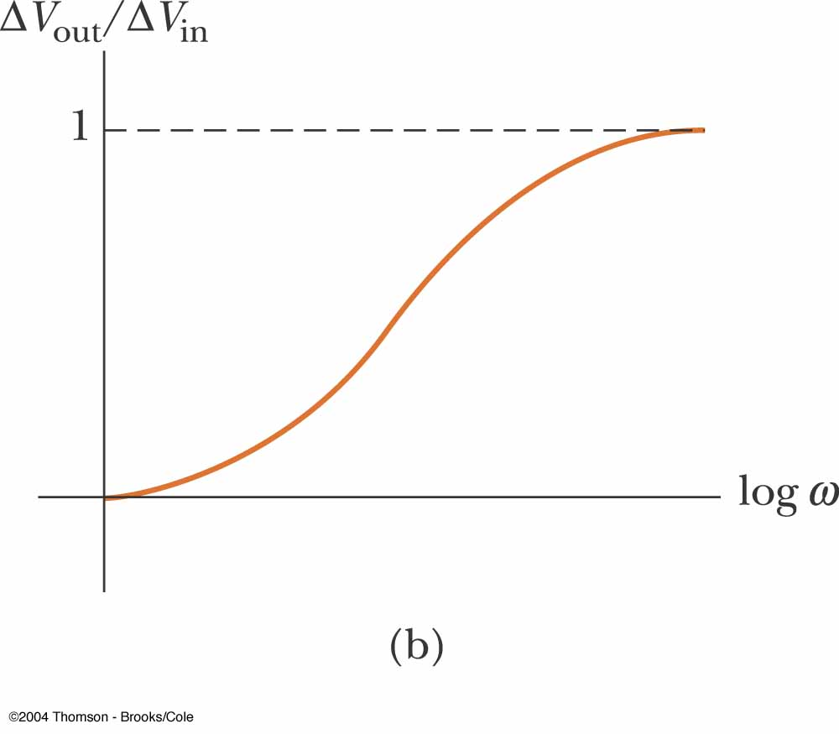
High-Pass Filter, cont
At low frequencies, ΔV_{out} is much smaller than ΔV_{in}
  At low frequencies, the capacitor has high reactance and much of the applied voltage appears across the capacitor
At high frequencies, the two voltages are equal
  At high frequencies, the capacitive reactance is small and the voltage appears across the resistor

Slide 68
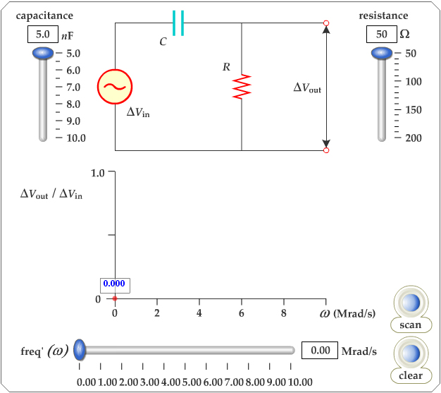
Active Figure 33.25
Use the active figure to adjust C and R
Determine the output voltage for a given frequency
Sweep through the frequencies and observe the results
PLAY
ACTIVE FIGURE

Slide 69
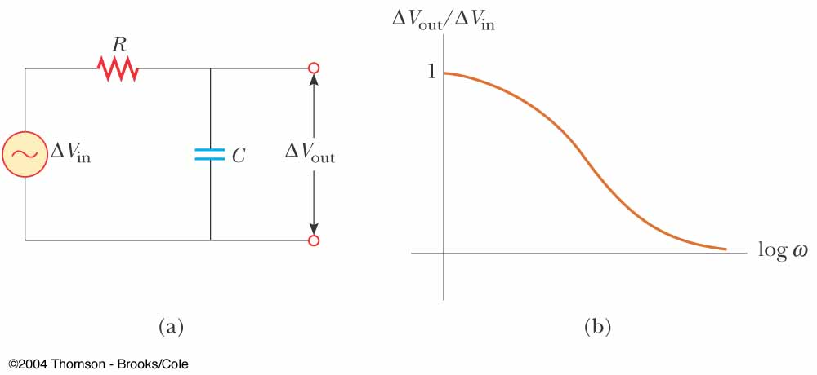
Low-Pass Filter
At low frequencies, the reactance and voltage across the capacitor are high
As the frequency increases, the reactance and voltage decrease
This is an example of a low-pass filter

Slide 70
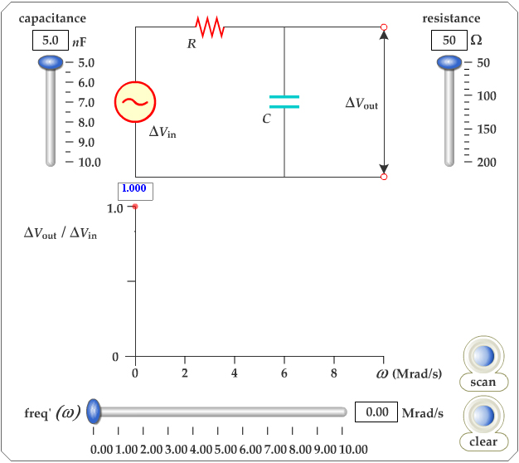
Active Figure 33.23
Use the active figure to adjust R and C
Determine the output voltage for a given frequency
Sweep through the frequencies and observe the results
PLAY
ACTIVE FIGURE

