Slide 1
Chapter 34
Electromagnetic Waves

Slide 2
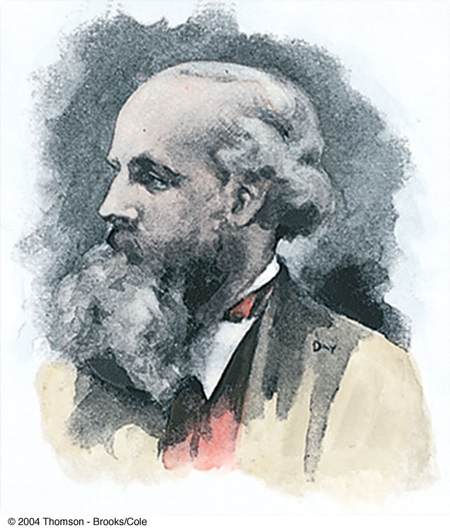
James Clerk Maxwell
1831 – 1879
Scottish physicist
Provided a mathematical theory that showed a close relationship between all electric and magnetic phenomena
His equations predict the existence of electromagnetic waves that propagate through space
Also developed and explained
  Kinetic theory of gases
  Nature of Saturn’s rings
  Color vision

Slide 3
Modifications to Ampère’s Law
Ampère’s Law is used to analyze magnetic fields created by currents:
But this form is valid only if any electric fields present are constant in time
Maxwell modified the equation to include time-varying electric fields
Maxwell’s modification was to add a term

Slide 4
Modifications to Ampère’s Law, cont
The additional term included a factor called the displacement current, I_{d}
This term was then added to Ampère’s Law
  Now sometimes called Ampère-Maxwell Law
This showed that magnetic fields are produced both by conduction currents and by time-varying electric fields

Slide 5
Maxwell’s Equations
In his unified theory of electromagnetism, Maxwell showed that electromagnetic waves are a natural consequence of the fundamental laws expressed in these four equations:

Slide 6
Maxwell’s Equation 1 – Gauss’ Law
The total electric flux through any closed surface equals the net charge inside that surface divided by ε_{o}
This relates an electric field to the charge distribution that creates it

Slide 7
Maxwell’s Equation 2 – Gauss’ Law in Magnetism
The net magnetic flux through a closed surface is zero
The number of magnetic field lines that enter a closed volume must equal the number that leave that volume
If this wasn’t true, there would be magnetic monopoles found in nature
  There haven’t been any found

Slide 8
Maxwell’s Equation 3 – Faraday’s Law of Induction
Describes the creation of an electric field by a time-varying magnetic field
The emf, which is the line integral of the electric field around any closed path, equals the rate of change of the magnetic flux through any surface bounded by that path
One consequence is the current induced in a conducting loop placed in a time-varying magnetic field

Slide 9
Maxwell’s Equation 4 – Ampère-Maxwell Law
Describes the creation of a magnetic field by a changing electric field and by electric current
The line integral of the magnetic field around any closed path is the sum of μ_{o} times the net current through that path and ε_{ο}μ_{o} times the rate of change of electric flux through any surface bounded by that path

Slide 10
Lorentz Force Law
Once the electric and magnetic fields are known at some point in space, the force acting on a particle of charge q can be found
Maxwell’s equations with the Lorentz Force Law completely describe all classical electromagnetic interactions

Slide 11
Speed of Electromagnetic Waves
In empty space, q = 0 and I = 0
The last two equations can be solved to show that the speed at which electromagnetic waves travel is the speed of light
This result led Maxwell to predict that light waves were a form of electromagnetic radiation

Slide 12
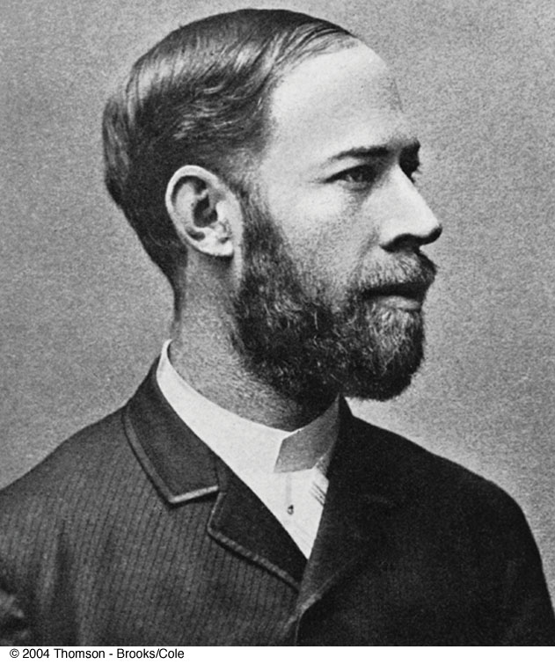
Heinrich Rudolf Hertz
1857 – 1894
German physicist
First to generate and detect electromagnetic waves in a laboratory setting
The most important discoveries were in 1887
He also showed other wave aspects of light

Slide 13
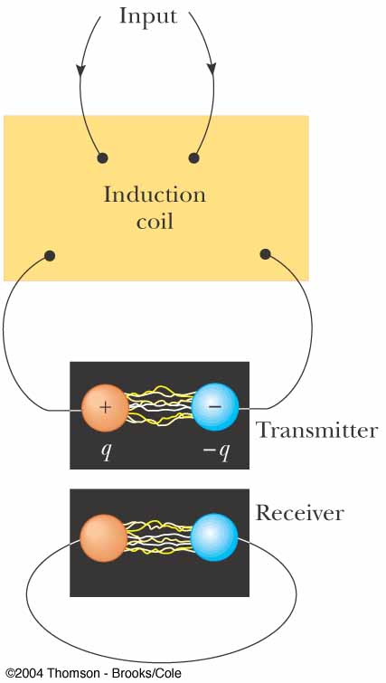
Hertz’s Experiment
An induction coil is connected to a transmitter
The transmitter consists of two spherical electrodes separated by a narrow gap

Slide 14
Hertz’s Experiment, cont.
The coil provides short voltage surges to the electrodes
As the air in the gap is ionized, it becomes a better conductor
The discharge between the electrodes exhibits an oscillatory behavior at a very high frequency
From a circuit viewpoint, this is equivalent to an LC circuit

Slide 15
Hertz’s Experiment, final
Sparks were induced across the gap of the receiving electrodes when the frequency of the receiver was adjusted to match that of the transmitter
In a series of other experiments, Hertz also showed that the radiation generated by this equipment exhibited wave properties
  Interference, diffraction, reflection, refraction and polarization
He also measured the speed of the radiation

Slide 16
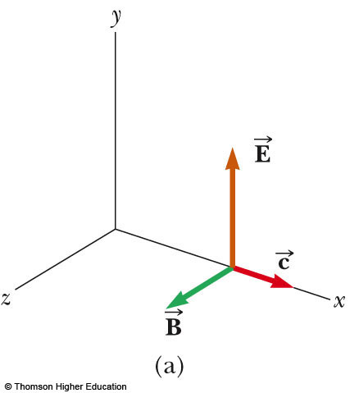
Plane em Waves
We will assume that the vectors for the electric and magnetic fields in an em wave have a specific space-time behavior that is consistent with Maxwell’s equations
Assume an em wave that travels in the x direction with
as shown
PLAY
ACTIVE FIGURE

Slide 17
Plane em Waves, cont.
The x-direction is the direction of propagation
The electric field is assumed to be in the y direction and the magnetic field in the z direction
Waves in which the electric and magnetic fields are restricted to being parallel to a pair of perpendicular axes are said to be linearly polarized waves
We also assume that at any point in space, the magnitudes E and B of the fields depend upon x and t only

Slide 18
Rays
A ray is a line along which the wave travels
All the rays for the type of linearly polarized waves that have been discussed are parallel
The collection of waves is called a plane wave
A surface connecting points of equal phase on all waves, called the wave front, is a geometric plane

Slide 19
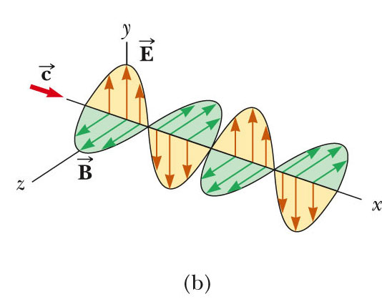
Wave Propagation, Example
The figure represents a sinusoidal em wave moving in the x direction with a speed c
Use the active figure to observe the motion
Take a “snapshot” of the wave and investigate the fields
PLAY
ACTIVE FIGURE

Slide 20
Waves – A Terminology Note
The word wave represents both
  The emission from a single point
  The collection of waves from all points on the source
The meaning should be clear from the context

Slide 21
Properties of em Waves
The solutions of Maxwell’s third and fourth equations are wave-like, with both E and B satisfying a wave equation
Electromagnetic waves travel at the speed of light:
  This comes from the solution of Maxwell’s equations

Slide 22
Properties of em Waves, 2
The components of the electric and magnetic fields of plane electromagnetic waves are perpendicular to each other and perpendicular to the direction of propagation
  This can be summarized by saying that electromagnetic waves are transverse waves

Slide 23
Properties of em Waves, 3
The magnitudes of the electric and magnetic fields in empty space are related by the expression
  This comes from the solution of the partial differentials obtained from Maxwell’s equations
Electromagnetic waves obey the superposition principle

Slide 24
Derivation of Speed –
Some Details
From Maxwell’s equations applied to empty space, the following partial derivatives can be found:
These are in the form of a general wave equation, with
Substituting the values for μ_{o} and ε_{o} gives c = 2.99792 x 10⁸ m/s

Slide 25
E to B Ratio – Some Details
The simplest solution to the partial differential equations is a sinusoidal wave:
  E = E_{max} cos (kx – ωt)
  B = B_{max} cos (kx – ωt)
The angular wave number is k = 2π/λ
  λ is the wavelength
The angular frequency is ω = 2πƒ
  ƒ is the wave frequency

Slide 26
E to B Ratio – Details, cont.
The speed of the electromagnetic wave is
Taking partial derivations also gives

Slide 27
Poynting Vector
Electromagnetic waves carry energy
As they propagate through space, they can transfer that energy to objects in their path
The rate of flow of energy in an em wave is described by a vector, , called the Poynting vector

Slide 28
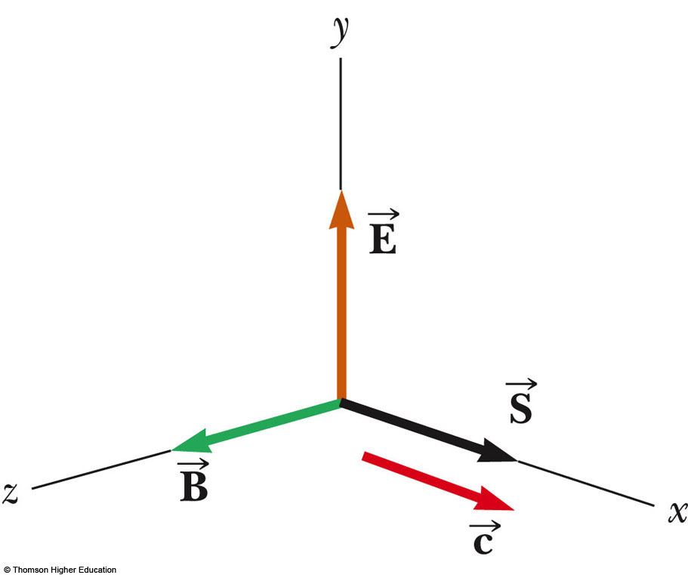
Poynting Vector, cont.
The Poynting vector is defined as
Its direction is the direction of propagation
This is time dependent
  Its magnitude varies in time
  Its magnitude reaches a maximum at the same instant as

Slide 29
Poynting Vector, final
The magnitude of represents the rate at which energy flows through a unit surface area perpendicular to the direction of the wave propagation
  This is the power per unit area
The SI units of the Poynting vector are J/(s.m²) = W/m²

Slide 30
Intensity
The wave intensity, I, is the time average of S (the Poynting vector) over one or more cycles
When the average is taken, the time average of cos²(kx - ωt) = ½ is involved

Slide 31
Energy Density
The energy density, u, is the energy per unit volume
For the electric field, u_{E}= ½ ε_{o}E²
For the magnetic field, u_{B} = ½ μ_{o}B²
Since B = E/c and

Slide 32
Energy Density, cont.
The instantaneous energy density associated with the magnetic field of an em wave equals the instantaneous energy density associated with the electric field
  In a given volume, the energy is shared equally by the two fields

Slide 33
Energy Density, final
The total instantaneous energy density is the sum of the energy densities associated with each field
  u =u_{E} + u_{B} = ε_{o}E² = B² / μ_{o}
When this is averaged over one or more cycles, the total average becomes
  u_{avg} = ε_{o}(E²)_{avg} = ½ ε_{o}E²_{max} = B²_{max} / 2μ_{o}
In terms of I, I = S_{avg} = cu_{avg}
  The intensity of an em wave equals the average energy density multiplied by the speed of light

Slide 34
Momentum
Electromagnetic waves transport momentum as well as energy
As this momentum is absorbed by some surface, pressure is exerted on the surface
Assuming the wave transports a total energy T_{ER} to the surface in a time interval Δt, the total momentum is p = T_{ER} / c for complete absorption

Slide 35
Pressure and Momentum
Pressure, P, is defined as the force per unit area
But the magnitude of the Poynting vector is (dT_{ER}/dt)/A and so P = S / c
  For a perfectly absorbing surface

Slide 36
Pressure and Momentum, cont.
For a perfectly reflecting surface,
p = 2T_{ER} /c and P = 2S/c
For a surface with a reflectivity somewhere between a perfect reflector and a perfect absorber, the pressure delivered to the surface will be somewhere in between S/c and 2S/c
For direct sunlight, the radiation pressure is about 5 x 10⁻⁶ N/m²

Slide 37
Production of em Waves by an Antenna
Neither stationary charges nor steady currents can produce electromagnetic waves
The fundamental mechanism responsible for this radiation is the acceleration of a charged particle
Whenever a charged particle accelerates, it radiates energy

Slide 38
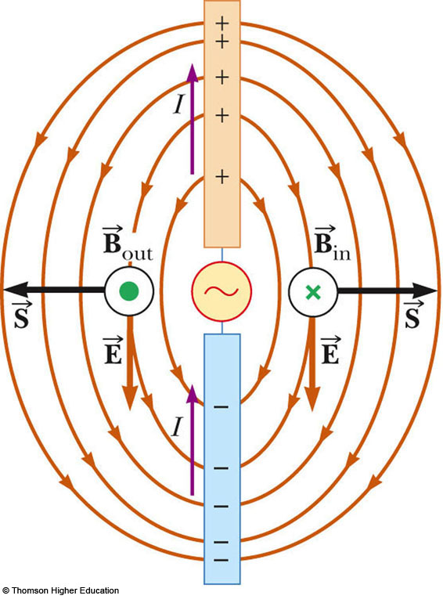
Production of em Waves by an Antenna, 2
This is a half-wave antenna
Two conducting rods are connected to a source of alternating voltage
The length of each rod is one-quarter of the wavelength of the radiation to be emitted

Slide 39
Production of em Waves by an Antenna, 3
The oscillator forces the charges to accelerate between the two rods
The antenna can be approximated by an oscillating electric dipole
The magnetic field lines form concentric circles around the antenna and are perpendicular to the electric field lines at all points
The electric and magnetic fields are 90º out of phase at all times
This dipole energy dies out quickly as you move away from the antenna

Slide 40
Production of em Waves by an Antenna, final
The source of the radiation found far from the antenna is the continuous induction of an electric field by the time-varying magnetic field and the induction of a magnetic field by a time-varying electric field
The electric and magnetic field produced in this manner are in phase with each other and vary as 1/r
The result is the outward flow of energy at all times

Slide 41
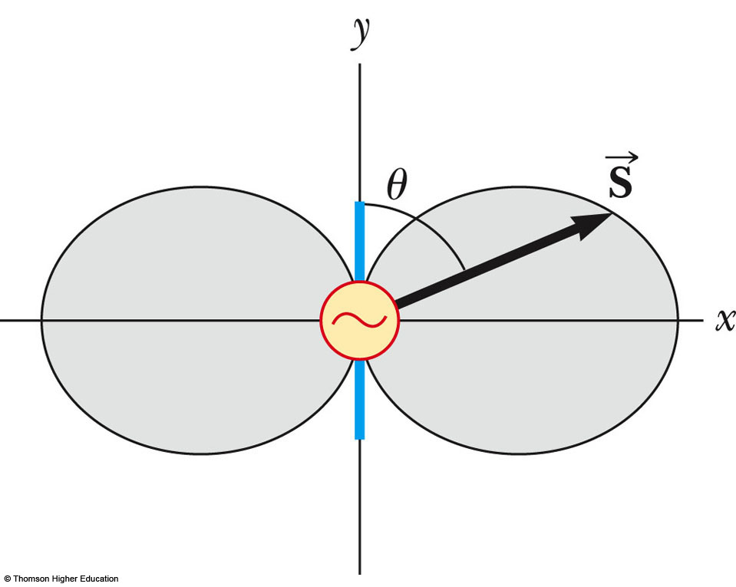
Angular Dependence of Intensity
This shows the angular dependence of the radiation intensity produced by a dipole antenna
The intensity and power radiated are a maximum in a plane that is perpendicular to the antenna and passing through its midpoint
The intensity varies as
(sin² θ) / r²

Slide 42
The Spectrum of EM Waves
Various types of electromagnetic waves make up the em spectrum
There is no sharp division between one kind of em wave and the next
All forms of the various types of radiation are produced by the same phenomenon – accelerating charges

Slide 43
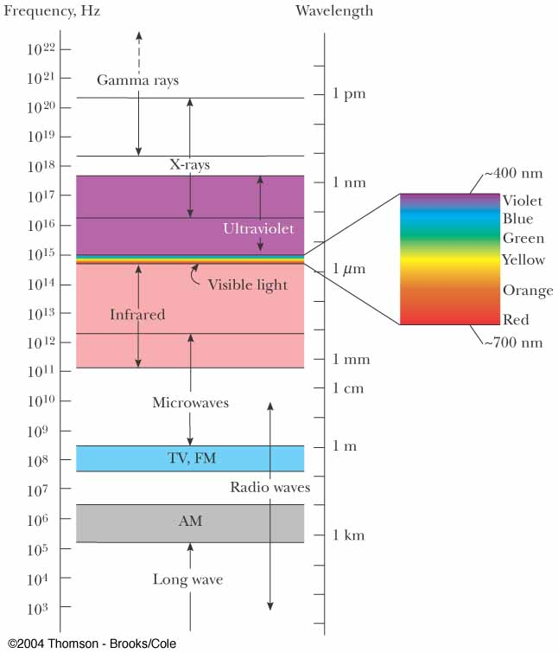
The EM Spectrum
Note the overlap between types of waves
Visible light is a small portion of the spectrum
Types are distinguished by frequency or wavelength

Slide 44
Notes on the EM Spectrum
Radio Waves
  Wavelengths of more than 10⁴ m to about 0.1 m
  Used in radio and television communication systems
Microwaves
  Wavelengths from about 0.3 m to 10⁻⁴ m
  Well suited for radar systems
  Microwave ovens are an application

Slide 45
Notes on the EM Spectrum, 2
Infrared waves
  Wavelengths of about 10⁻³ m to 7 x 10⁻⁷ m
  Incorrectly called “heat waves”
  Produced by hot objects and molecules
  Readily absorbed by most materials
Visible light
  Part of the spectrum detected by the human eye
  Most sensitive at about 5.5 x 10⁻⁷ m (yellow-green)

Slide 46
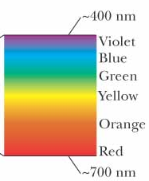
More About Visible Light
Different wavelengths correspond to different colors
The range is from red (λ ~ 7 x 10⁻⁷ m) to violet (λ ~4 x 10⁻⁷ m)

Slide 47
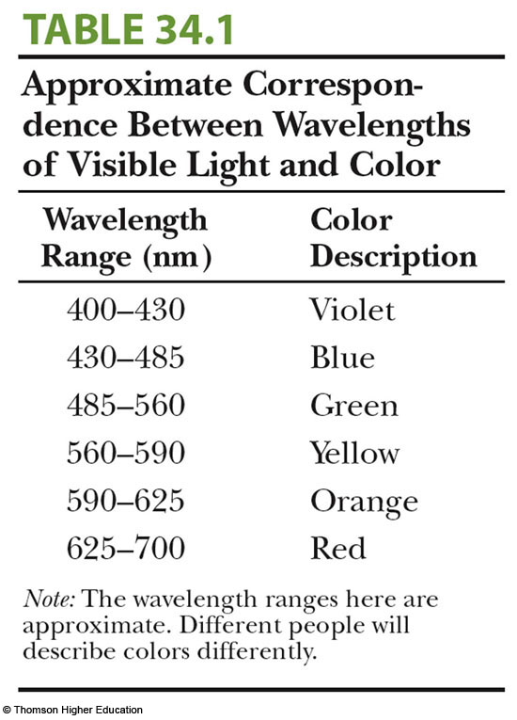
Visible Light, cont

Slide 48
Notes on the EM Spectrum, 3
Ultraviolet light
  Covers about 4 x 10⁻⁷ m to 6 x 10⁻¹⁰ m
  Sun is an important source of uv light
  Most uv light from the sun is absorbed in the stratosphere by ozone
X-rays
  Wavelengths of about 10⁻⁸ m to 10⁻¹² m
  Most common source is acceleration of high-energy electrons striking a metal target
  Used as a diagnostic tool in medicine

Slide 49
Notes on the EM Spectrum, final
Gamma rays
  Wavelengths of about 10⁻¹⁰ m to 10⁻¹⁴ m
  Emitted by radioactive nuclei
  Highly penetrating and cause serious damage when absorbed by living tissue
Looking at objects in different portions of the spectrum can produce different information

Slide 50
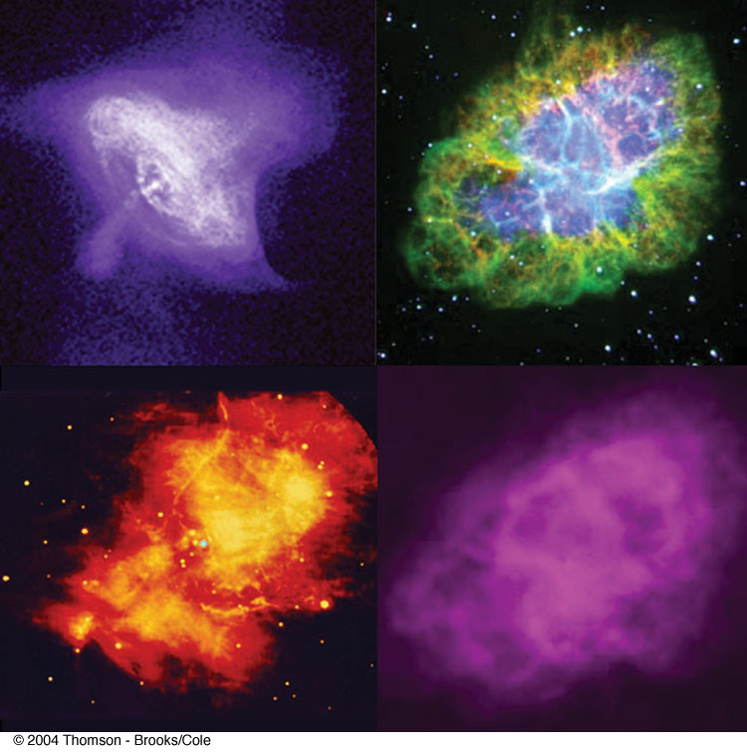
Wavelengths and Information
These are images of the Crab Nebula
They are (clockwise from upper left) taken with
  x-rays
  visible light
  radio waves
  infrared waves

