Slide 1
Chapter 35
The Nature of Light and the
Laws of Geometric Optics

Slide 2
The Nature of Light
Before the beginning of the nineteenth century, light was considered to be a stream of particles
The particles were either emitted by the object being viewed or emanated from the eyes of the viewer
Newton was the chief architect of the particle theory of light
  He believed the particles left the object and stimulated the sense of sight upon entering the eyes

Slide 3
Nature of Light –
Alternative View
Christian Huygens argued that light might be some sort of a wave motion
Thomas Young (in 1801) provided the first clear demonstration of the wave nature of light
  He showed that light rays interfere with each other
  Such behavior could not be explained by particles

Slide 4
More Confirmation of Wave Nature
During the nineteenth century, other developments led to the general acceptance of the wave theory of light
Maxwell asserted that light was a form of high-frequency electromagnetic wave
Hertz confirmed Maxwell’s predictions

Slide 5
Particle Nature
Some experiments could not be explained by the wave nature of light
The photoelectric effect was a major phenomenon not explained by waves
  When light strikes a metal surface, electrons are sometimes ejected from the surface
  The kinetic energy of the ejected electron is independent of the frequency of the light

Slide 6
Particle Nature, cont.
Einstein (in 1905) proposed an explanation of the photoelectric effect that used the idea of quantization
  The quantization model assumes that the energy of a light wave is present in particles called photons
  E = hƒ
    h is Planck’s Constant and = 6.63 x 10⁻³⁴ J.s

Slide 7
Dual Nature of Light
In view of these developments, light must be regarded as having a dual nature
Light exhibits the characteristics of a wave in some situations and the characteristics of a particle in other situations

Slide 8
Measurements of the
Speed of Light
Since light travels at a very high speed, early attempts to measure its speed were unsuccessful
  Remember c = 3.00 x 10⁸ m/s
Galileo tried by using two observers separated by about 10 km
  The reaction time of the observers was more than the transit time of the light

Slide 9
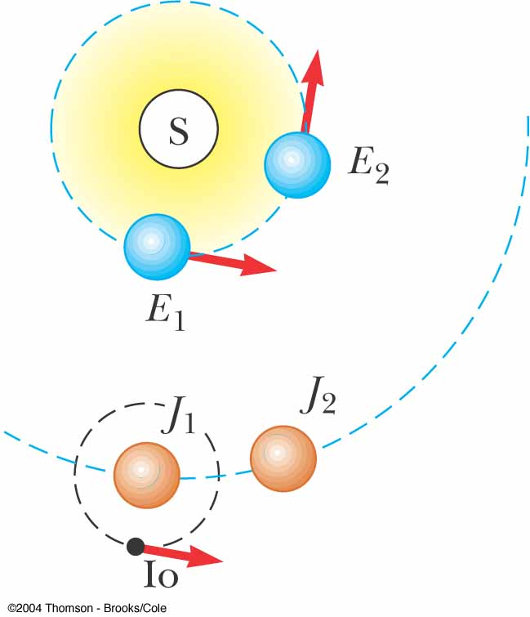
Measurement of the Speed of Light – Roemer’s Method
Ole Roemer (1675) used astronomical observations to estimate the speed of light
He used the period of revolution of Io, a moon of Jupiter, as Jupiter revolved around the sun

Slide 10
Roemer’s Method, cont.
The periods of revolution were longer when the Earth was receding from Jupiter
  Shorter when the Earth was approaching
Using Roemer’s data, Huygens estimated the lower limit of the speed of light to be 2.3 x 10⁸ m/s
  This was important because it demonstrated that light has a finite speed as well as giving an estimate of that speed

Slide 11
Measurements of the Speed of Light – Fizeau’s Method
This was the first successful method for measuring the speed of light by means of a purely terrestrial technique
It was developed in 1849 by Armand Fizeau
He used a rotating toothed wheel
The distance between the wheel (considered to be the source) and a mirror was known

Slide 12
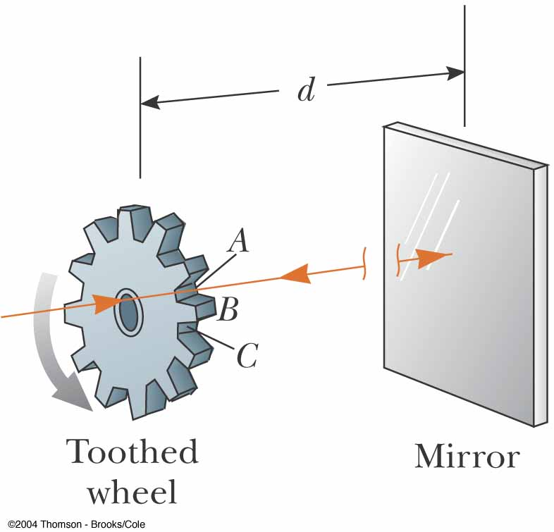
Fizeau’s Method, cont.
d is the distance between the wheel and the mirror
Δt is the time for one round trip
Then c = 2d / Δt
Fizeau found a value of
c = 3.1 x 10⁸ m/s

Slide 13
The Ray Approximation in Geometric Optics
Geometric optics involves the study of the propagation of light
It uses the assumption that light travels in a straight-line path in a uniform medium and changes its direction when it meets the surface of a different medium or if the optical properties of the medium are nonuniform
The ray approximation is used to represent beams of light

Slide 14
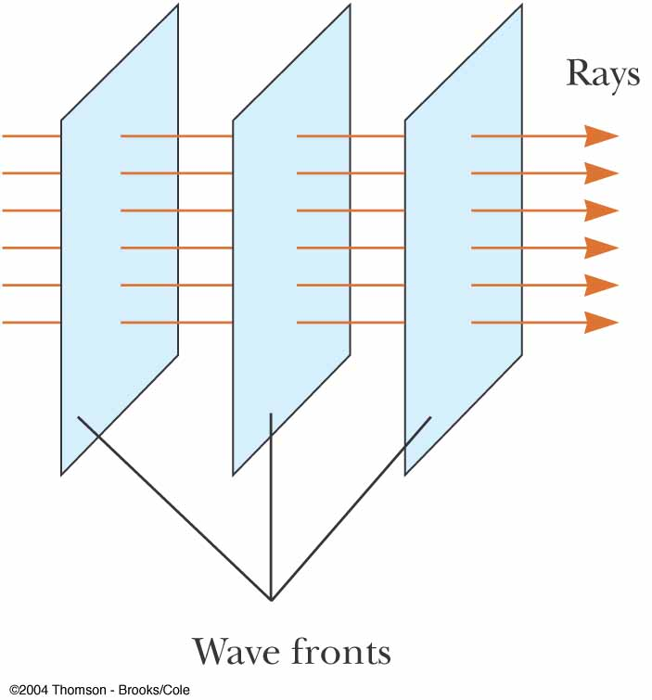
Ray Approximation
The rays are straight lines perpendicular to the wave fronts
With the ray approximation, we assume that a wave moving through a medium travels in a straight line in the direction of its rays

Slide 15
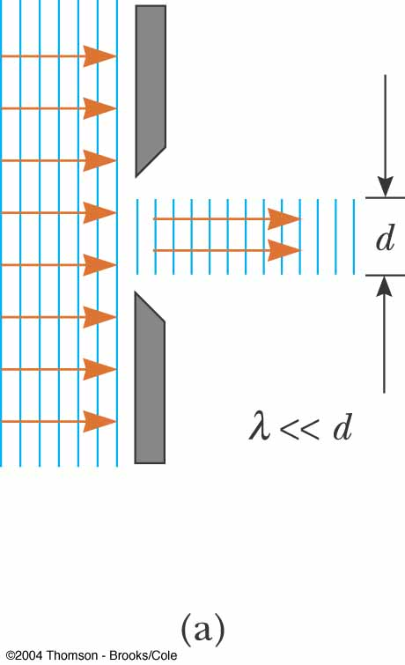
Ray Approximation, cont.
If a wave meets a barrier, we will assume that λ<<d
  d is the diameter of the opening
This approximation is good for the study of mirrors, lenses, prisms, etc.
Other effects occur for openings of other sizes

Slide 16
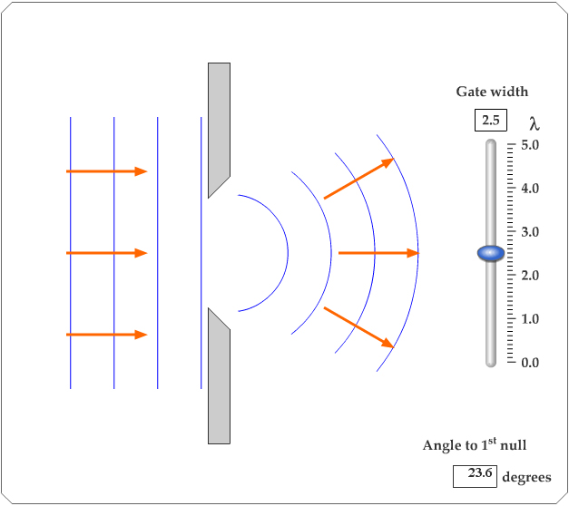
Active Figure 35.4
Adjust the size of the opening
Observe the effects on the waves passing through
PLAY
ACTIVE FIGURE

Slide 17
Reflection of Light
A ray of light, the incident ray, travels in a medium
When it encounters a boundary with a second medium, part of the incident ray is reflected back into the first medium
  This means it is directed backward into the first medium

Slide 18
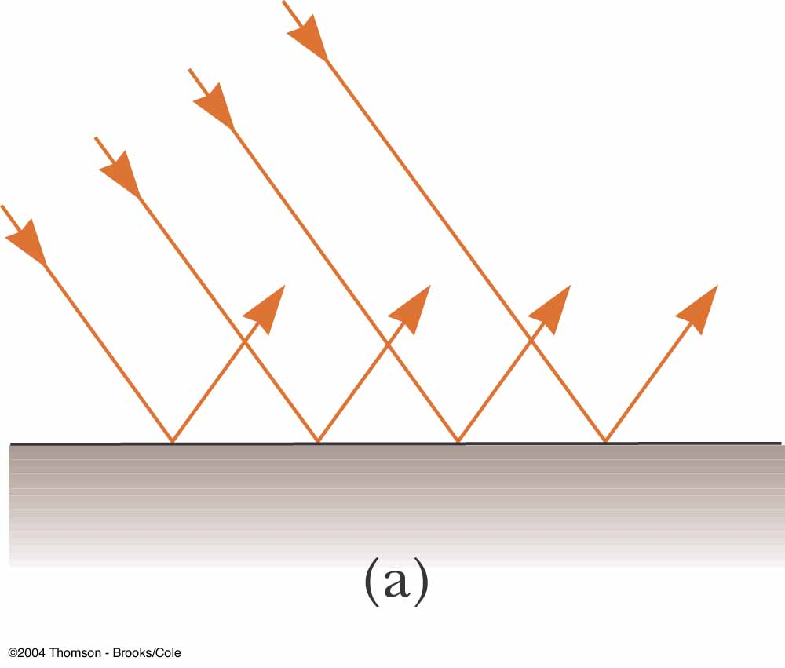
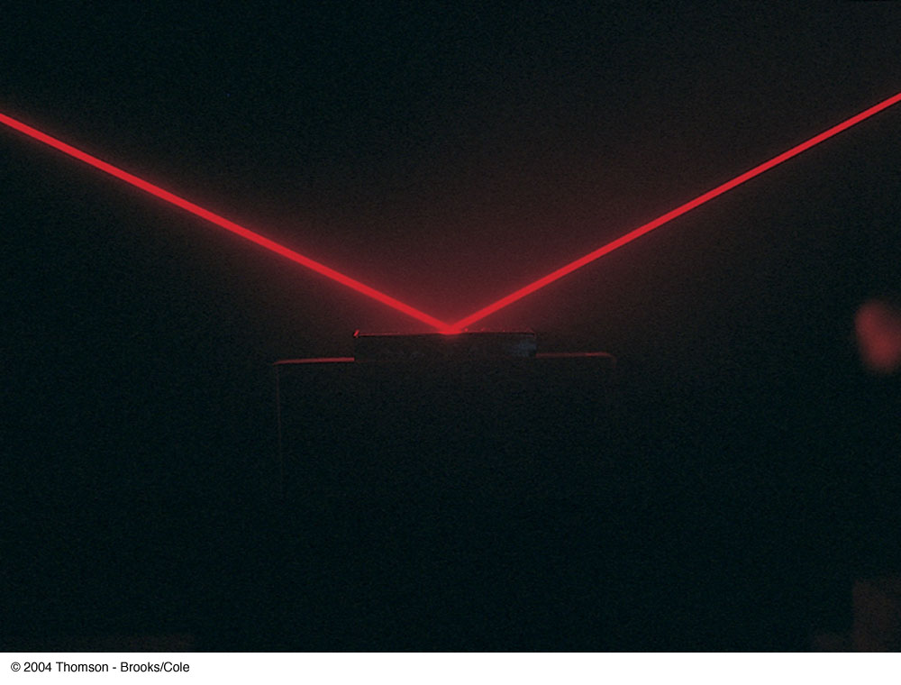
Specular
Reflection
Specular reflection is reflection from a smooth surface
The reflected rays are parallel to each other
All reflection in this text is assumed to be specular

Slide 19
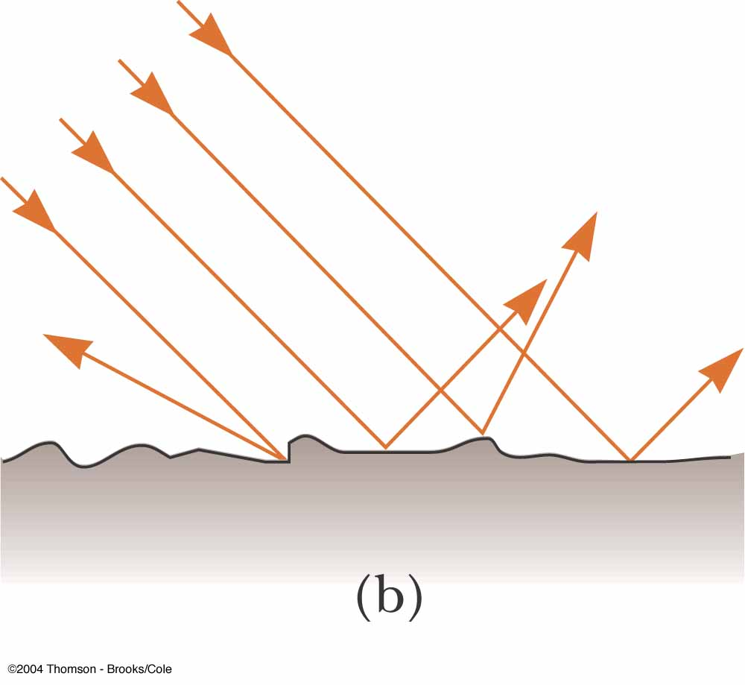
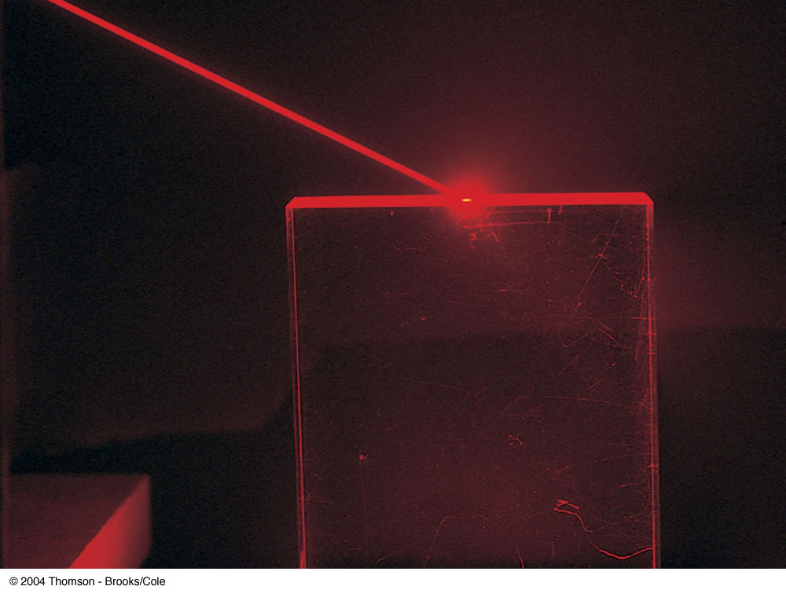
Diffuse
Reflection
Diffuse reflection is reflection from a rough surface
The reflected rays travel in a variety of directions
A surface behaves as a smooth surface as long as the surface variations are much smaller than the wavelength of the light

Slide 20
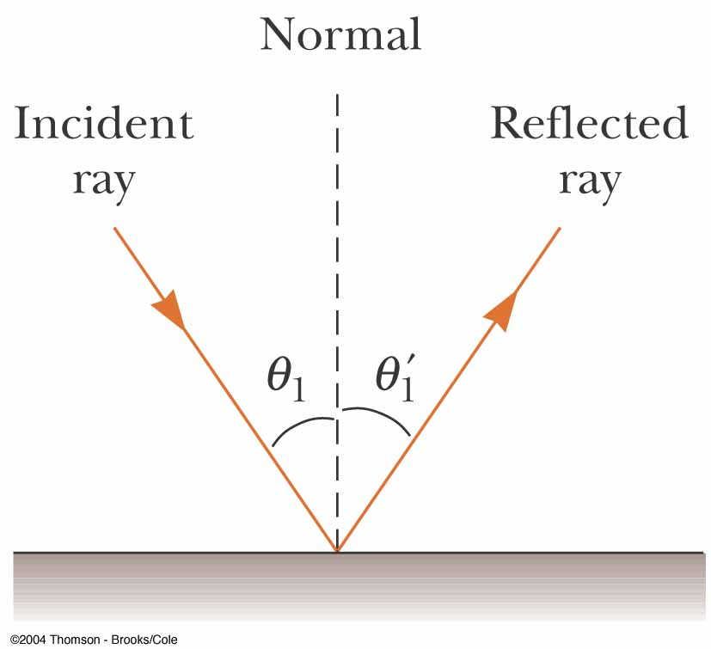
Law of Reflection
The normal is a line perpendicular to the surface
  It is at the point where the incident ray strikes the surface
The incident ray makes an angle of θ₁ with the normal
The reflected ray makes an angle of θ₁’ with the normal

Slide 21
Law of Reflection, cont.
The angle of reflection is equal to the angle of incidence
θ₁’= θ₁
  This relationship is called the Law of Reflection
The incident ray, the reflected ray and the normal are all in the same plane
Because this situation happens often, an analysis model, wave under reflection, is identified

Slide 22
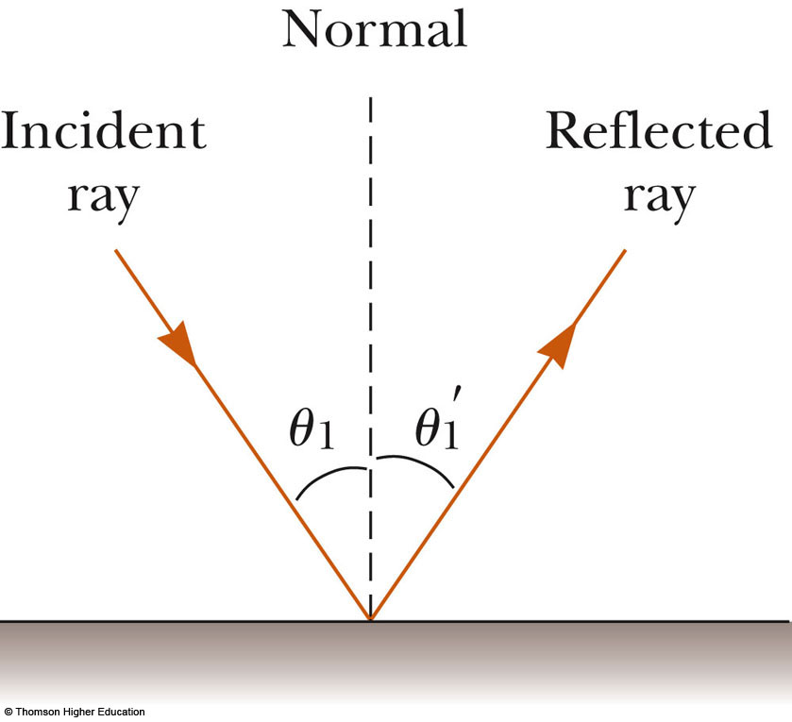
Active Figure 35.6
Use the active figure to vary the angle of incidence
Observe the effect on the angle of reflection
PLAY
ACTIVE FIGURE

Slide 23
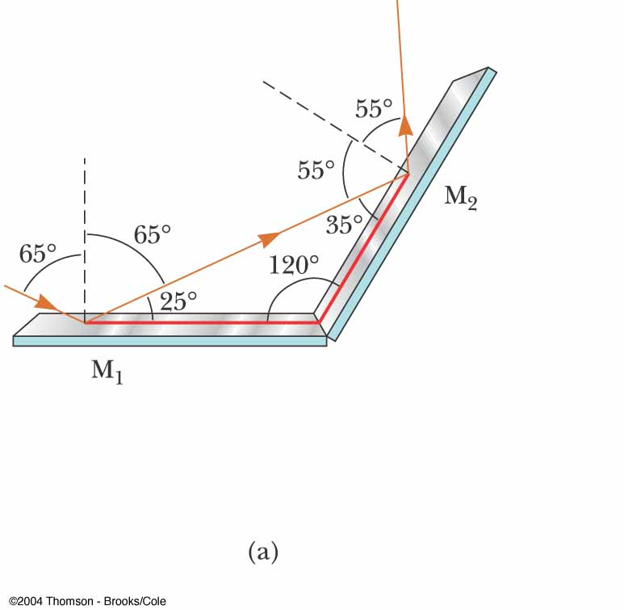
Multiple Reflections
The incident ray strikes the first mirror
The reflected ray is directed toward the second mirror
There is a second reflection from the second mirror
Apply the Law of Reflection and some geometry to determine information about the rays

Slide 24
Retroreflection
Assume the angle between two mirrors is 90º
The reflected beam returns to the source parallel to its original path
This phenomenon is called retroreflection
Applications include
  Measuring the distance to the Moon
  Automobile taillights
  Traffic signs

Slide 25
Refraction of Light
When a ray of light traveling through a transparent medium encounters a boundary leading into another transparent medium, part of the energy is reflected and part enters the second medium
The ray that enters the second medium is bent at the boundary
  This bending of the ray is called refraction

Slide 26
Refraction, 2
The incident ray, the reflected ray, the refracted ray, and the normal all lie on the same plane
The angle of refraction depends upon the material and the angle of incidence
  v₁ is the speed of the light in the first medium and v₂ is its speed in the second

Slide 27
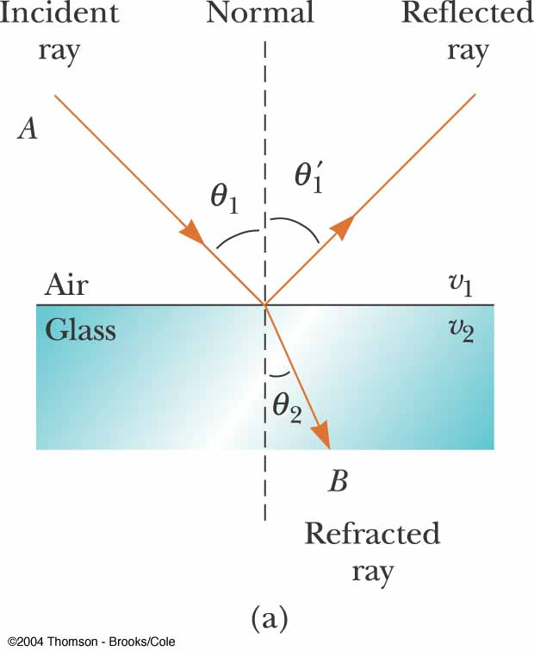
Refraction of Light, 3
The path of the light through the refracting surface is reversible
  For example, a ray that travels from A to B
  If the ray originated at B, it would follow the line AB to reach point A

Slide 28
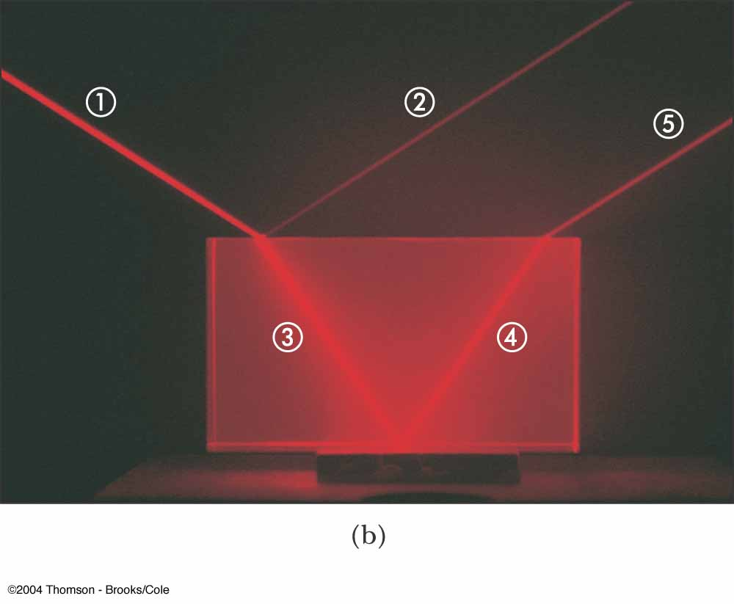
Following the Reflected and Refracted Rays
Ray  is the incident ray
Ray  is the reflected ray
Ray  is refracted into the lucite
Ray  is internally reflected in the lucite
Ray  is refracted as it enters the air from the lucite

Slide 29
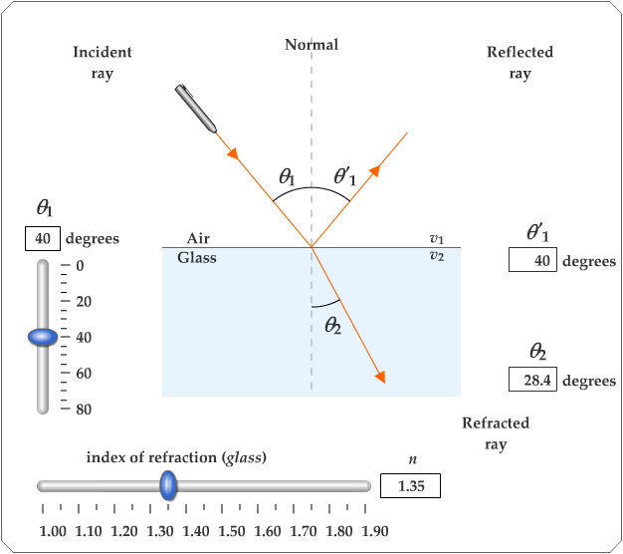
Active Figure 35.10
Use the active figure to vary the incident angle
Observe the effect on the reflected and refracted rays
PLAY
ACTIVE FIGURE

Slide 30
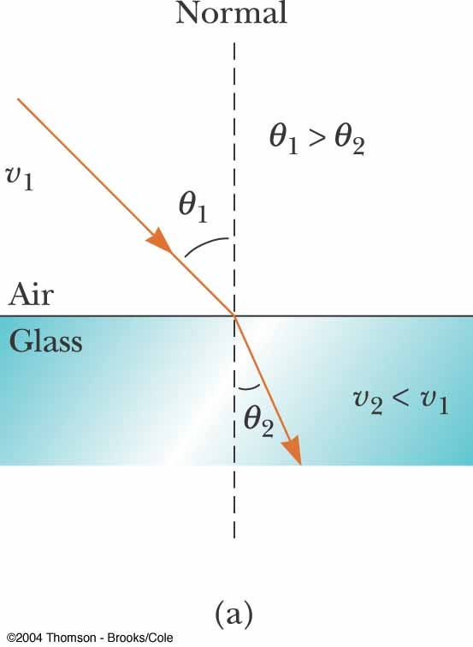
Refraction Details, 1
Light may refract into a material where its speed is lower
The angle of refraction is less than the angle of incidence
  The ray bends toward the normal

Slide 31
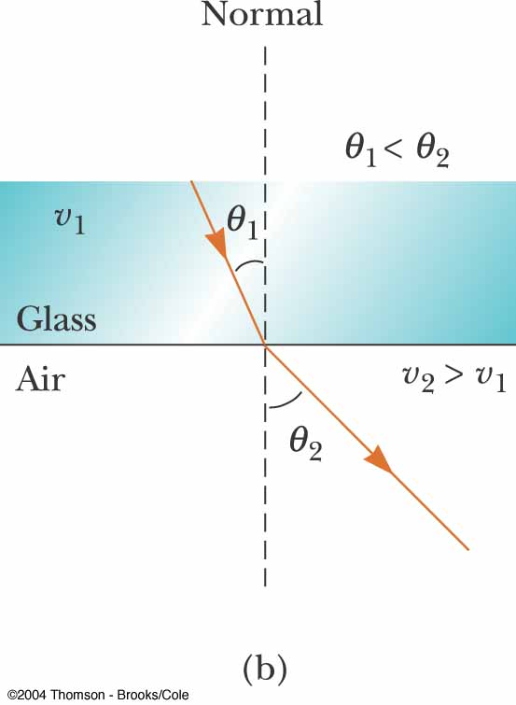
Refraction Details, 2
Light may refract into a material where its speed is higher
The angle of refraction is greater than the angle of incidence
  The ray bends away from the normal

Slide 32
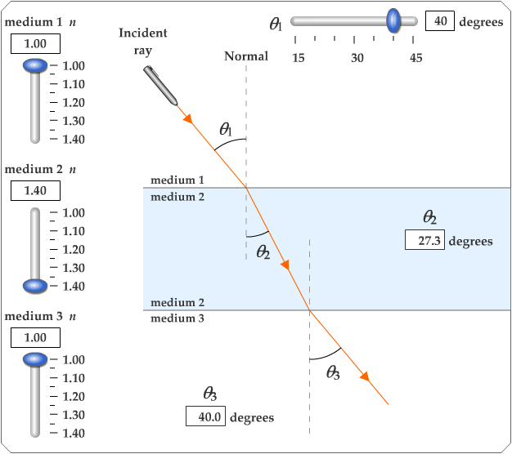
Active Figure 35.11
Use the active figure to observe the light passing through three layers of material
Vary the incident angle and the materials
Observe the effect on the refracted ray
PLAY
ACTIVE FIGURE

Slide 33
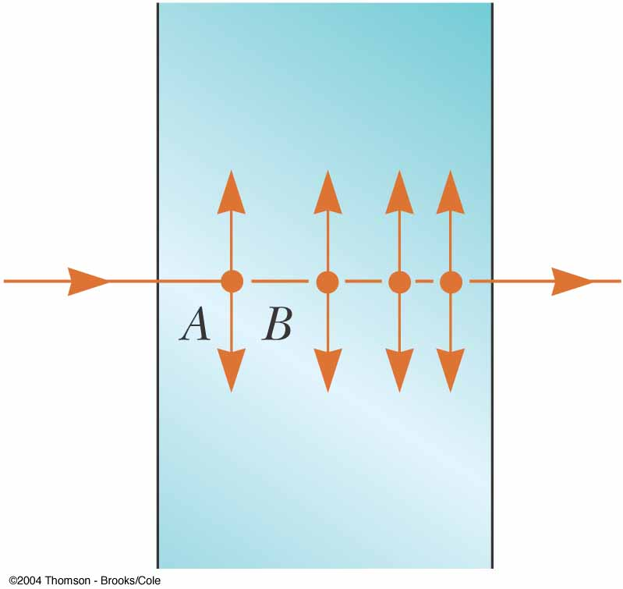
Light in a Medium
The light enters from the left
The light may encounter an electron
The electron may absorb the light, oscillate, and reradiate the light
The absorption and radiation cause the average speed of the light moving through the material to decrease

Slide 34
The Index of Refraction
The speed of light in any material is less than its speed in vacuum
The index of refraction, n, of a medium can be defined as

Slide 35
Index of Refraction, cont.
For a vacuum, n = 1
  We assume n = 1 for air also
For other media, n > 1
n is a dimensionless number greater than unity
  n is not necessarily an integer

Slide 36
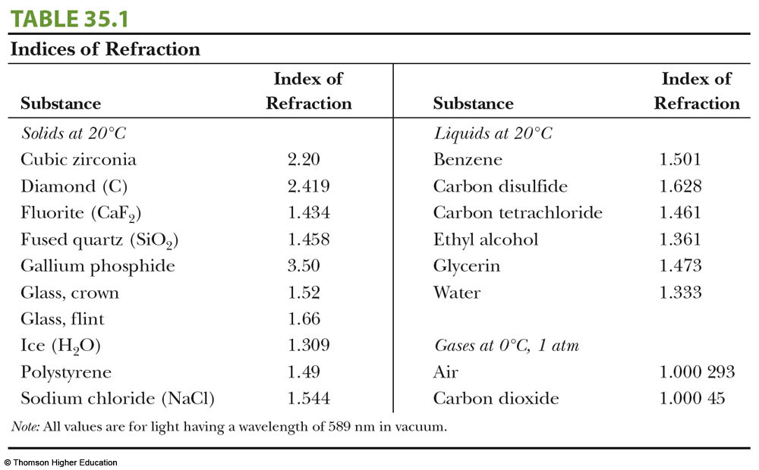
Some Indices of Refraction

Slide 37
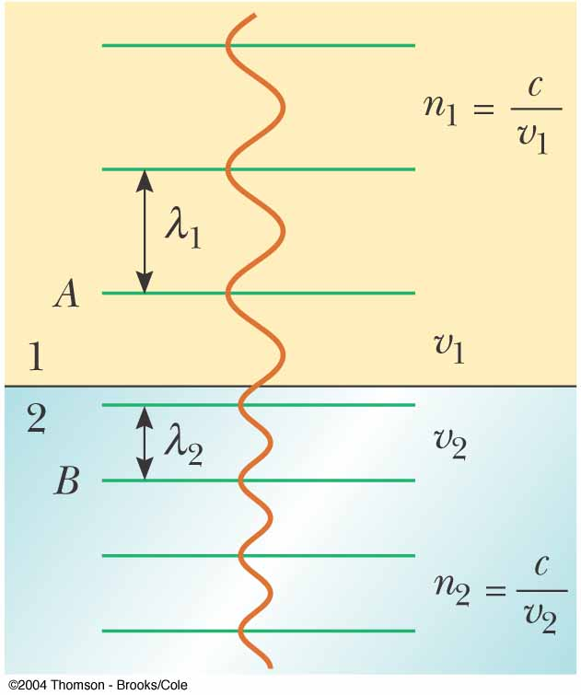
Frequency Between Media
As light travels from one medium to another, its frequency does not change
  Both the wave speed and the wavelength do change
  The wavefronts do not pile up, nor are created or destroyed at the boundary, so ƒ must stay the same

Slide 38
Index of Refraction Extended
The frequency stays the same as the wave travels from one medium to the other
v = ƒλ
  ƒ₁ = ƒ₂ but v₁ ≠ v₂ so λ₁ ≠ λ₂
The ratio of the indices of refraction of the two media can be expressed as various ratios

Slide 39
More About Index of Refraction
The previous relationship can be simplified to compare wavelengths and indices: λ₁n₁ = λ₂n₂
In air, n₁ = 1 and the index of refraction of the material can be defined in terms of the wavelengths

Slide 40
Snell’s Law of Refraction
n₁ sin θ₁ = n₂ sin θ₂
  θ₁ is the angle of incidence
  θ₂ is the angle of refraction
The experimental discovery of this relationship is usually credited to Willebrord Snell and is therefore known as Snell’s law of refraction
Refraction is a commonplace occurrence, so identify an analysis model as a wave under refraction

Slide 41
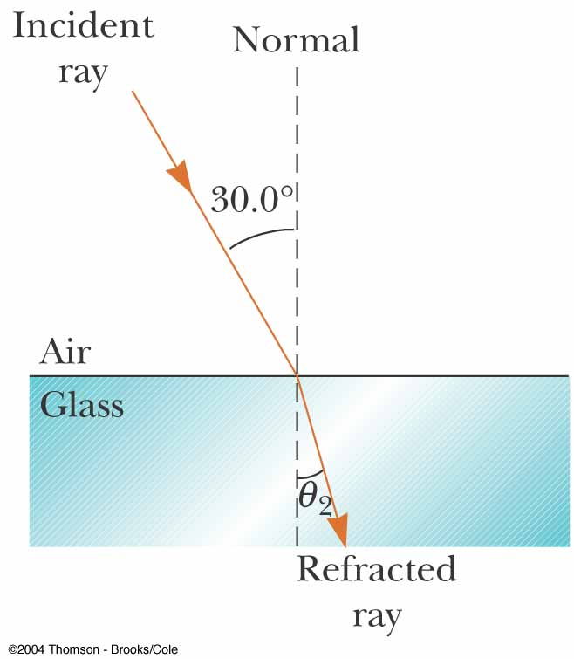
Snell’s Law – Example
Light is refracted into a crown glass slab
θ₁ = 30.0º, θ₂ = ?
n₁ = 1.00 and n₂ = 1.52
  From Table 35.1
θ₂ = sin⁻¹(n₁ / n₂) sin θ₁ = 19.2º
The ray bends toward the normal, as expected

Slide 42
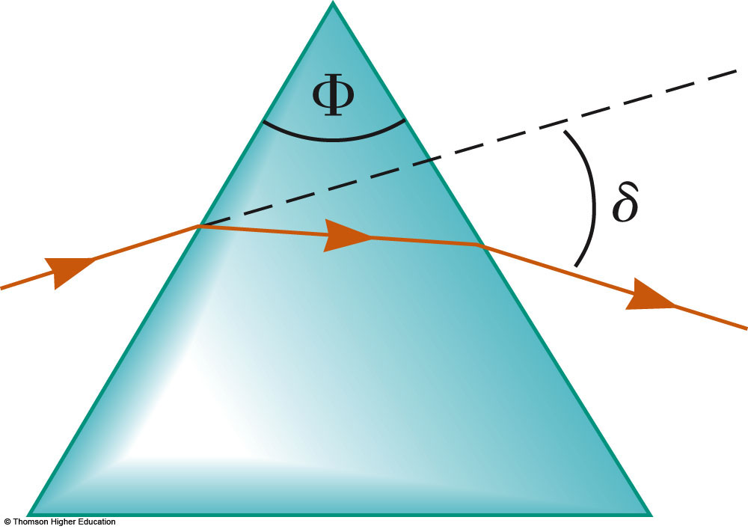
Prism
A ray of single-wavelength light incident on the prism will emerge at angle δ from its original direction of travel
  δ is called the angle of deviation
  Φ is the apex angle

Slide 43
Huygens’s Principle
Huygens assumed that light is a form of wave motion rather than a stream of particles
Huygens’s Principle is a geometric construction for determining the position of a new wave at some point based on the knowledge of the wave front that preceded it

Slide 44
Huygens’s Principle, cont.
All points on a given wave front are taken as point sources for the production of spherical secondary waves, called wavelets, which propagate outward through a medium with speeds characteristic of waves in that medium
After some time has passed, the new position of the wave front is the surface tangent to the wavelets

Slide 45
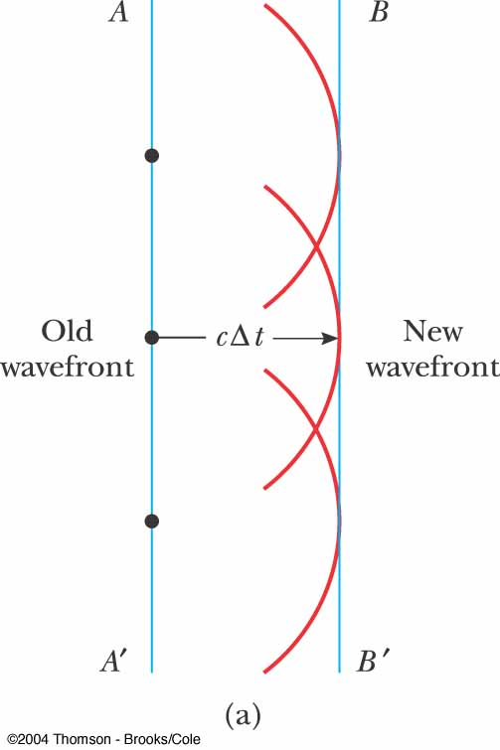
Huygens’s Construction for a Plane Wave
At t = 0, the wave front is indicated by the plane AA’
The points are representative sources for the wavelets
After the wavelets have moved a distance cΔt, a new plane BB’ can be drawn tangent to the wavefronts

Slide 46
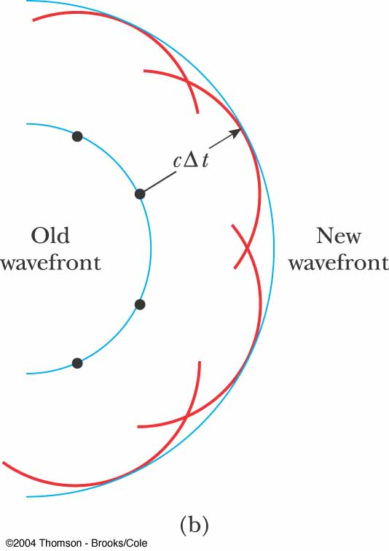
Huygens’s Construction for a Spherical Wave
The inner arc represents part of the spherical wave
The points are representative points where wavelets are propagated
The new wavefront is tangent at each point to the wavelet

Slide 47
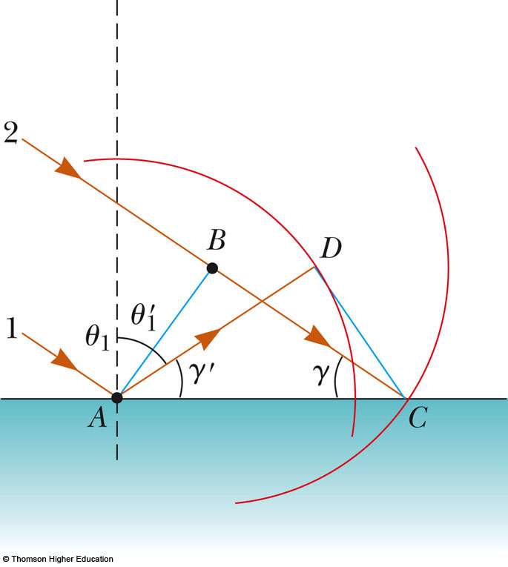
Huygens’s Principle and the Law of Reflection
The law of reflection can be derived from Huygens’s principle
AB is a plane wave front of incident light
  The wave at A sends out a wavelet centered on A toward D
  The wave at B sends out a wavelet centered on B toward C
AD = BC = cΔt

Slide 48
Huygens’s Principle and the Law of Reflection, cont.
Triangle ABC is congruent to triangle ADC
cos γ = BC / AC
cos γ’ = AD / AC
Therefore, cos γ = cos γ’ and γ = γ’
This gives θ₁ = θ₁’
This is the law of reflection

Slide 49
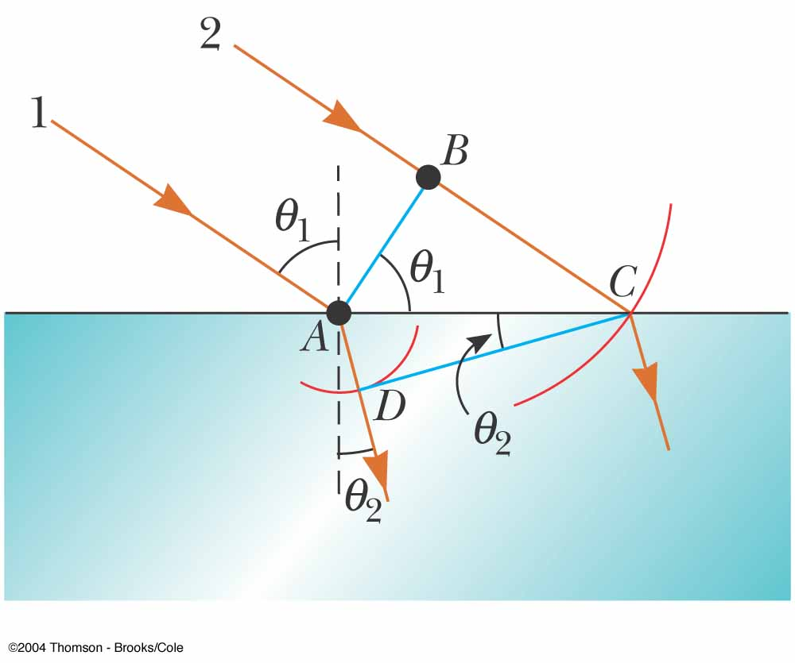
Huygens’s Principle and the Law of Refraction
Ray 1 strikes the surface and at a time interval Δt later, ray 2 strikes the surface
During this time interval, the wave at A sends out a wavelet, centered at A, toward D

Slide 50
Huygens’s Principle and the Law of Refraction, cont.
The wave at B sends out a wavelet, centered at B, toward C
The two wavelets travel in different media, therefore their radii are different
From triangles ABC and ADC, we find

Slide 51
Huygens’s Principle and the Law of Refraction, final
The preceding equation can be simplified to
This is Snell’s law of refraction

Slide 52
Dispersion
For a given material, the index of refraction varies with the wavelength of the light passing through the material
This dependence of n on λ is called dispersion
Snell’s law indicates light of different wavelengths is bent at different angles when incident on a refracting material

Slide 53
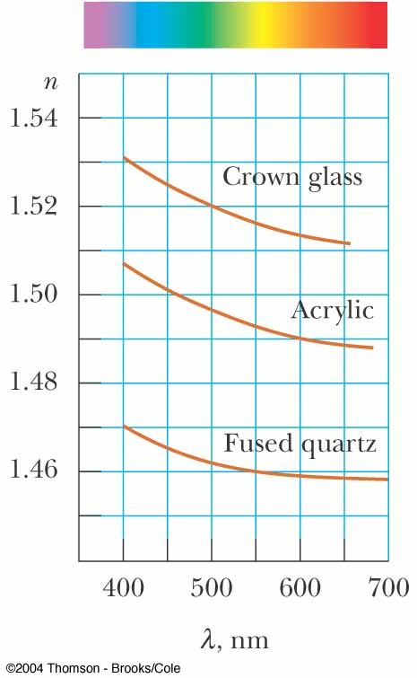
Variation of Index of Refraction with Wavelength
The index of refraction for a material generally decreases with increasing wavelength
Violet light bends more than red light when passing into a refracting material

Slide 54
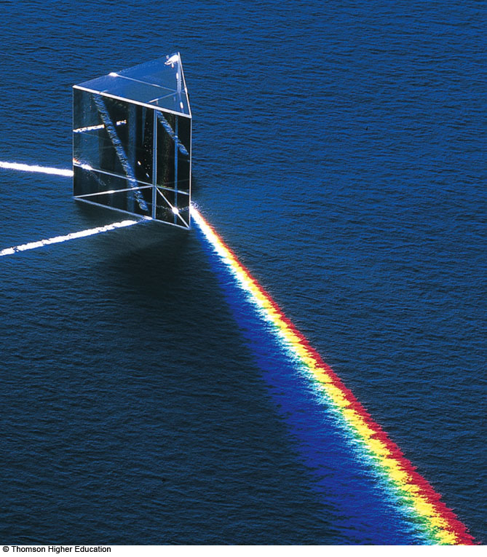
Refraction in a Prism
Since all the colors have different angles of deviation, white light will spread out into a spectrum
  Violet deviates the most
  Red deviates the least
  The remaining colors are in between

Slide 55
The Rainbow
A ray of light strikes a drop of water in the atmosphere
It undergoes both reflection and refraction
  First refraction at the front of the drop
    Violet light will deviate the most
    Red light will deviate the least

Slide 56
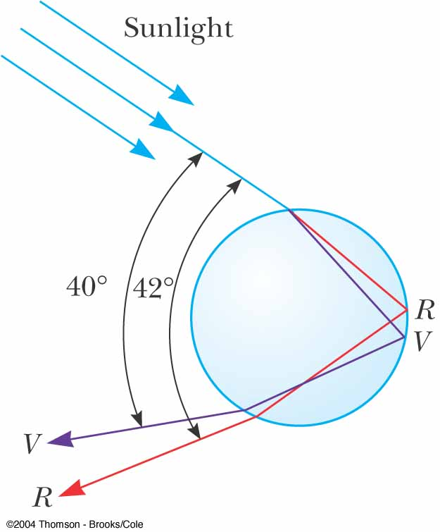
The Rainbow, 2
At the back surface the light is reflected
It is refracted again as it returns to the front surface and moves into the air
The rays leave the drop at various angles
  The angle between the white light and the most intense violet ray is 40°
  The angle between the white light and the most intense red ray is 42°

Slide 57
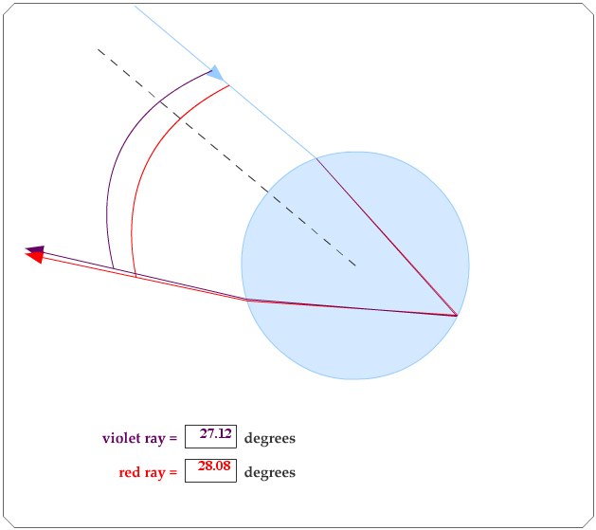
Active Figure 35.23
Use the active figure to vary the point at which the sunlight enters the raindrop
Observe the angles and verify the maximum angles
PLAY
ACTIVE FIGURE

Slide 58
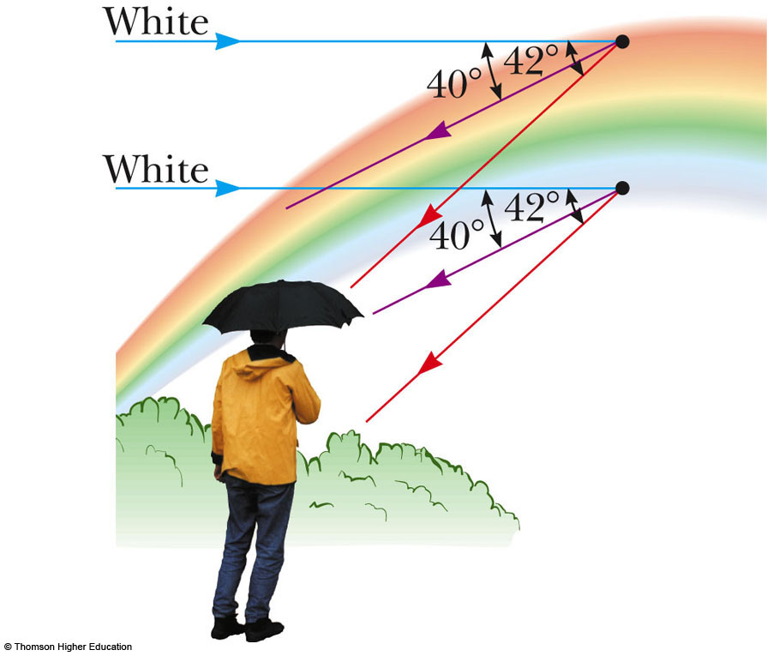
Observing the Rainbow
If a raindrop high in the sky is observed, the red ray is seen
A drop lower in the sky would direct violet light to the observer
The other colors of the spectra lie in between the red and the violet

Slide 59
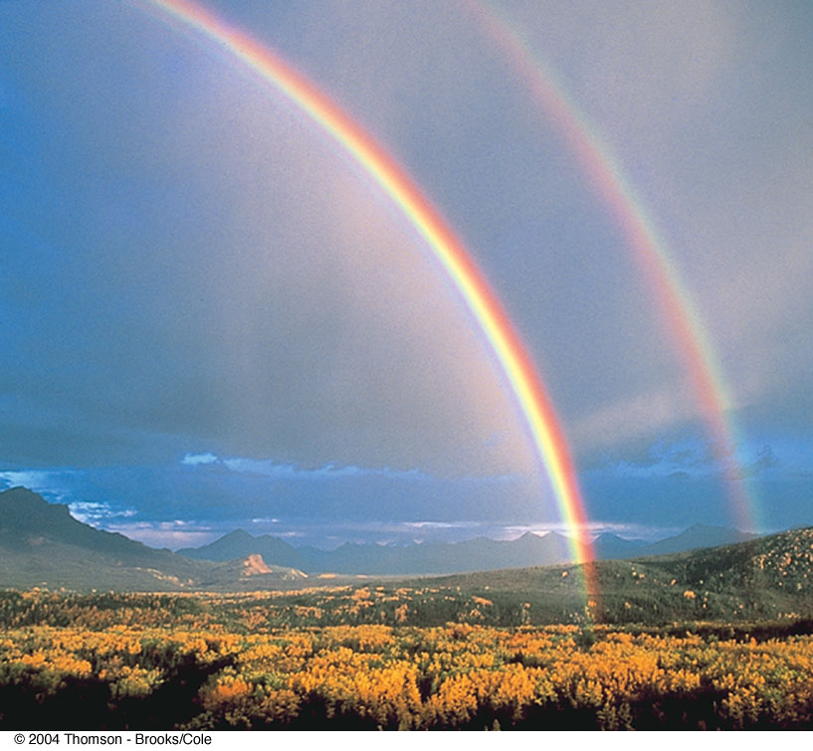
Double Rainbow
The secondary rainbow is fainter than the primary
The colors are reversed
The secondary rainbow arises from light that makes two reflections from the interior surface before exiting the raindrop
Higher-order rainbows are possible, but their intensity is low

Slide 60
Total Internal Reflection
A phenomenon called total internal reflection can occur when light is directed from a medium having a given index of refraction toward one having a lower index of refraction

Slide 61
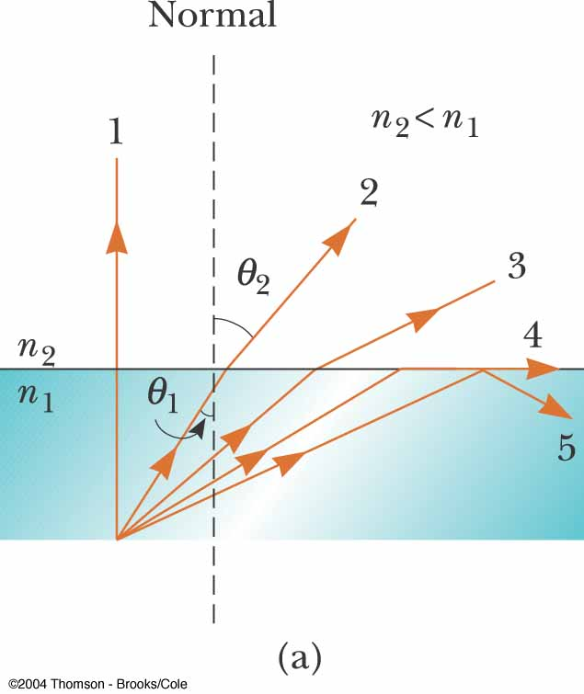
Possible Beam Directions
Possible directions of the beam are indicated by rays numbered 1 through 5
The refracted rays are bent away from the normal since n₁ > n₂

Slide 62
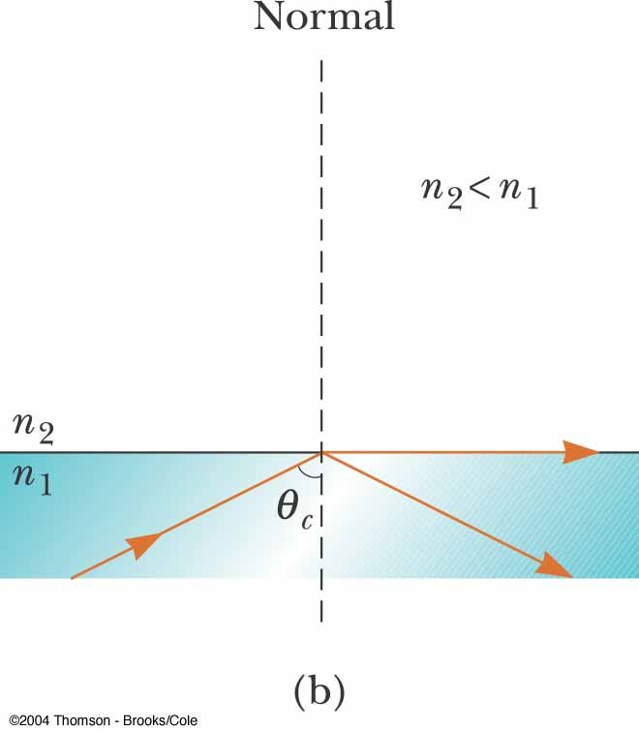
Critical Angle
There is a particular angle of incidence that will result in an angle of refraction of 90°
  This angle of incidence is called the critical angle, θ_{C}

Slide 63
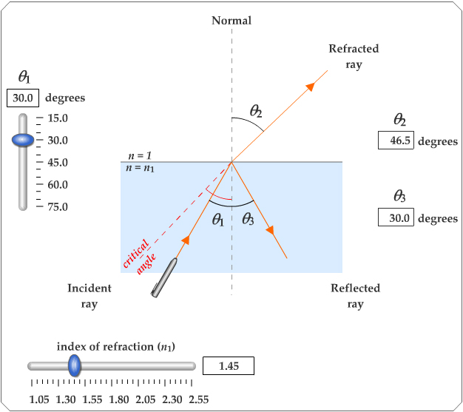
Active Figure 35.25
Use the active figure to vary the incident angle
Observe the effect on the refracted ray
PLAY
ACTIVE FIGURE

Slide 64
Critical Angle, cont.
For angles of incidence greater than the critical angle, the beam is entirely reflected at the boundary
  This ray obeys the law of reflection at the boundary
Total internal reflection occurs only when light is directed from a medium of a given index of refraction toward a medium of lower index of refraction

Slide 65
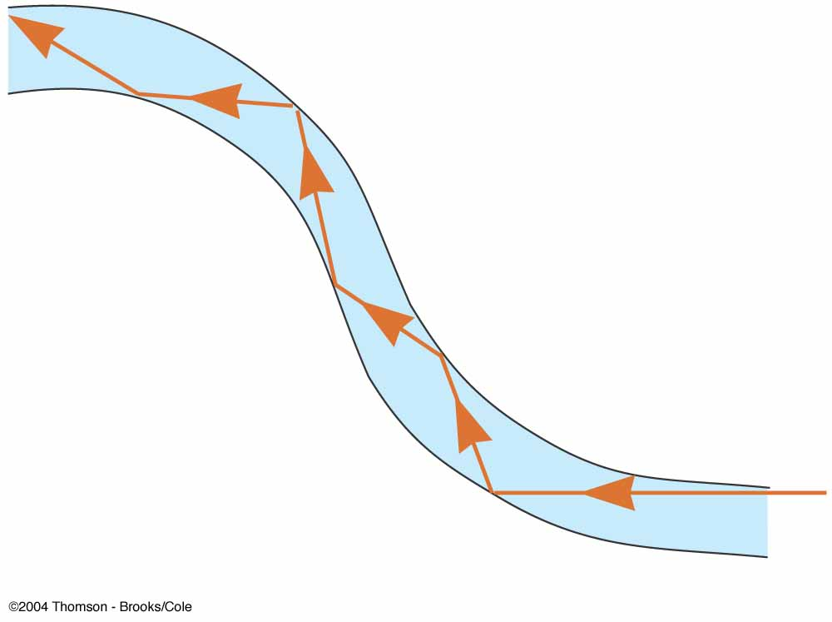
Fiber Optics
An application of internal reflection
Plastic or glass rods are used to “pipe” light from one place to another
Applications include
  Medical examination of internal organs
  Telecommunications

Slide 66
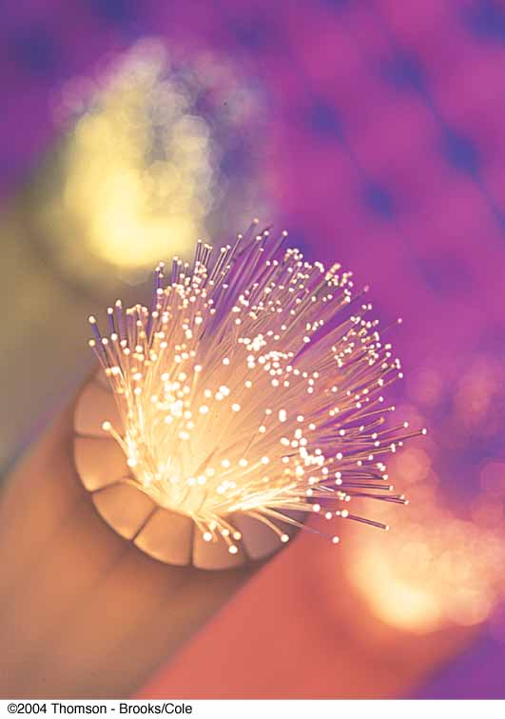
Fiber Optics, cont.
A flexible light pipe is called an optical fiber
A bundle of parallel fibers (shown) can be used to construct an optical transmission line

Slide 67
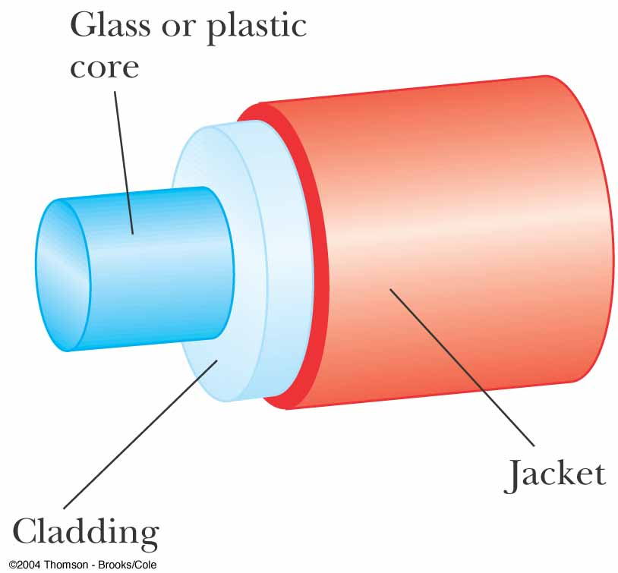
Construction of an Optical Fiber
The transparent core is surrounded by cladding
  The cladding has a lower n than the core
  This allows the light in the core to experience total internal reflection
The combination is surrounded by the jacket

