Slide 1
Chapter 37
Interference of Light Waves

Slide 2
Wave Optics
Wave optics is a study concerned with phenomena that cannot be adequately explained by geometric (ray) optics
These phenomena include:
  Interference
  Diffraction
  Polarization

Slide 3
Interference
In constructive interference the amplitude of the resultant wave is greater than that of either individual wave
In destructive interference the amplitude of the resultant wave is less than that of either individual wave
All interference associated with light waves arises when the electromagnetic fields that constitute the individual waves combine

Slide 4
Conditions for Interference
To observe interference in light waves, the following two conditions must be met:
  1) The sources must be coherent
    They must maintain a constant phase with respect to each other
  2) The sources should be monochromatic
    Monochromatic means they have a single wavelength

Slide 5
Producing Coherent Sources
Light from a monochromatic source is used to illuminate a barrier
The barrier contains two narrow slits
  The slits are small openings
The light emerging from the two slits is coherent since a single source produces the original light beam
This is a commonly used method

Slide 6
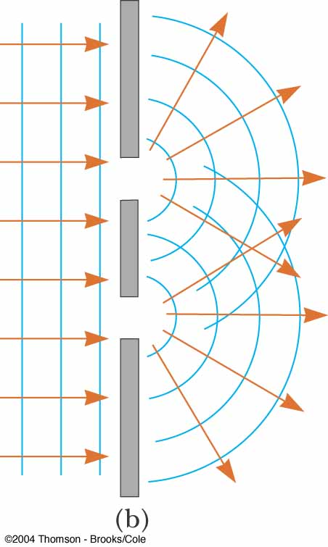
Diffraction
From Huygens’s principle we know the waves spread out from the slits
This divergence of light from its initial line of travel is called diffraction

Slide 7
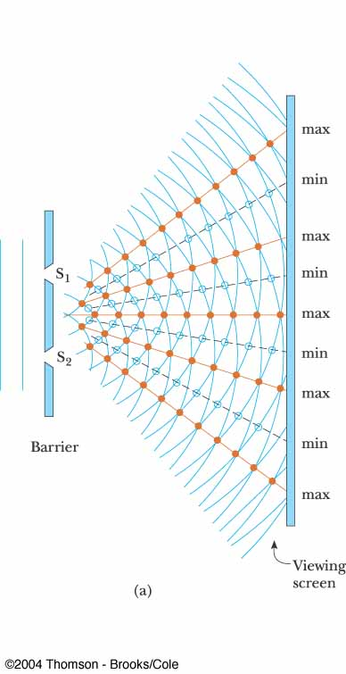
Young’s Double-Slit Experiment: Schematic
Thomas Young first demonstrated interference in light waves from two sources in 1801
The narrow slits S₁ and S₂ act as sources of waves
The waves emerging from the slits originate from the same wave front and therefore are always in phase

Slide 8
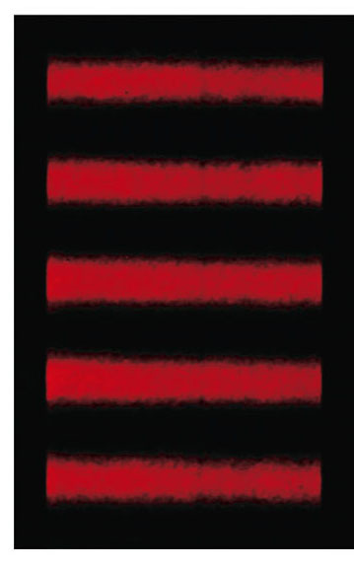
Resulting Interference Pattern
The light from the two slits forms a visible pattern on a screen
The pattern consists of a series of bright and dark parallel bands called fringes
Constructive interference occurs where a bright fringe occurs
Destructive interference results in a dark fringe
PLAY
ACTIVE FIGURE

Slide 9
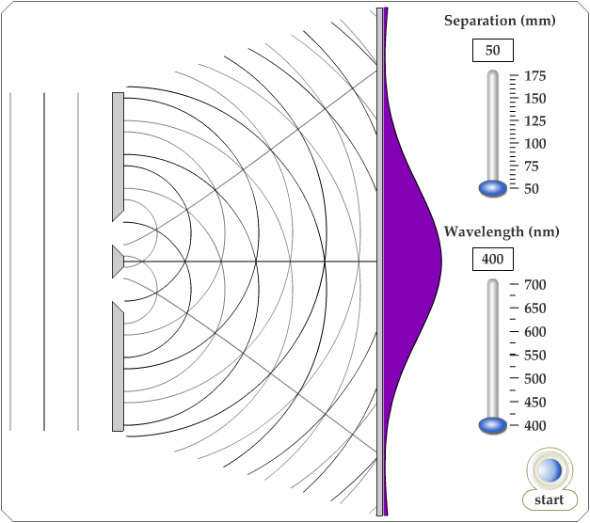
Active Figure 37.2
Use the active figure to vary slit separation and the wavelength
Observe the effect on the interference pattern
PLAY
ACTIVE FIGURE

Slide 10
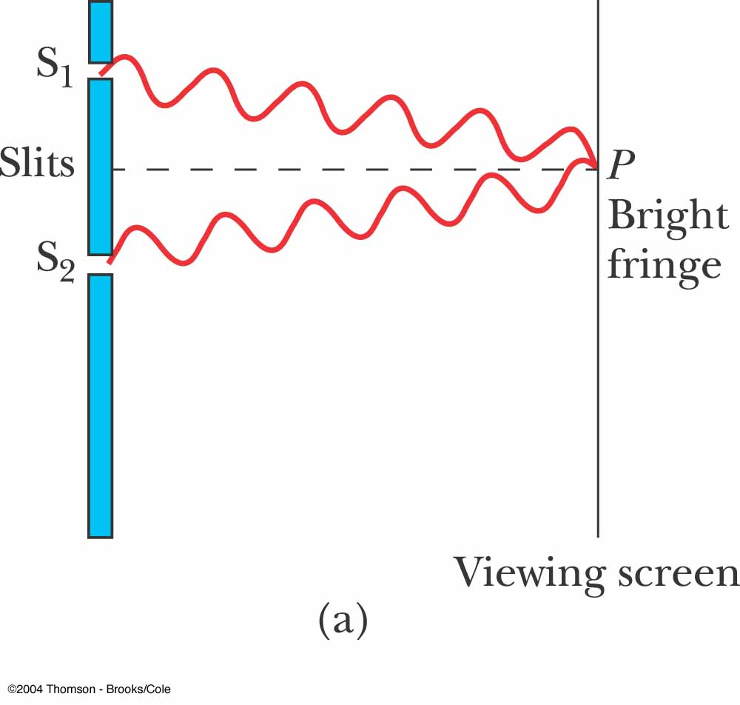
Interference Patterns
Constructive interference occurs at point P
The two waves travel the same distance
  Therefore, they arrive in phase
As a result, constructive interference occurs at this point and a bright fringe is observed

Slide 11
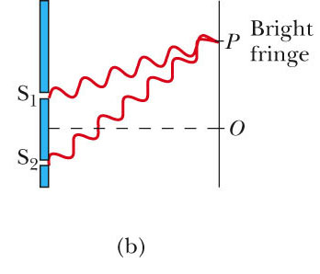
Interference Patterns, 2
The lower wave has to travel farther than the upper wave to reach point P
The lower wave travels one wavelength farther
  Therefore, the waves arrive in phase
A second bright fringe occurs at this position

Slide 12
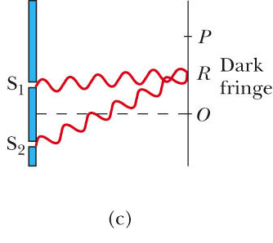
Interference Patterns, 3
The upper wave travels one-half of a wavelength farther than the lower wave to reach point R
The trough of the upper wave overlaps the crest of the lower wave
This is destructive interference
  A dark fringe occurs

Slide 13
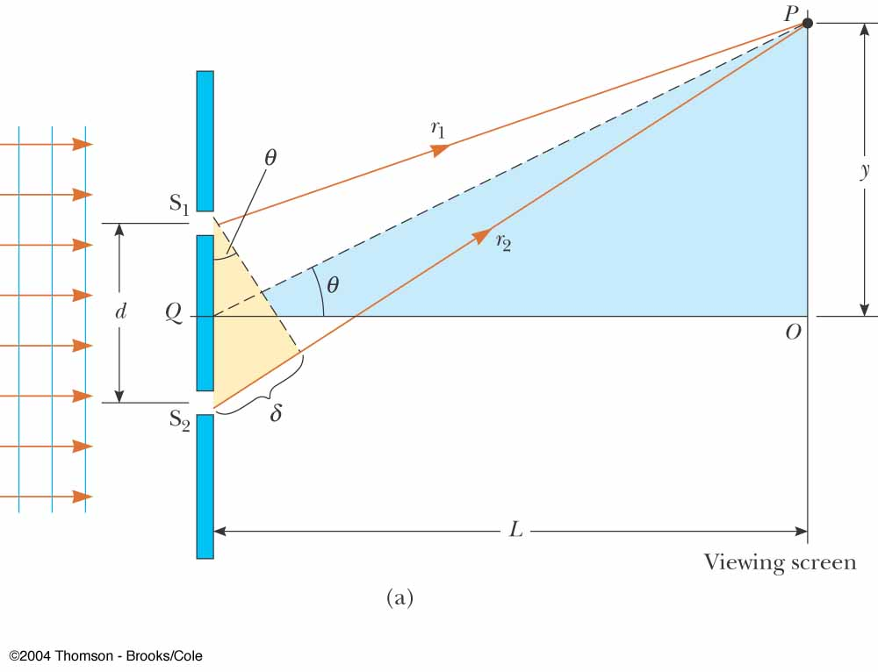
Young’s Double-Slit Experiment: Geometry
The path difference, δ, is found from the tan triangle
δ = r₂ – r₁ = d sin θ
  This assumes the paths are parallel
  Not exactly true, but a very good approximation if L is much greater than d

Slide 14
Interference Equations
For a bright fringe produced by constructive interference, the path difference must be either zero or some integral multiple of the wavelength
δ = d sin θ_{bright} = mλ
  m = 0, ±1, ±2, …
  m is called the order number
    When m = 0, it is the zeroth-order maximum
    When m = ±1, it is called the first-order maximum

Slide 15
Interference Equations, 2
When destructive interference occurs, a dark fringe is observed
This needs a path difference of an odd half wavelength
δ = d sin θ_{dark} = (m + ½)λ
  m = 0, ±1, ±2, …

Slide 16
Interference Equations, 4
The positions of the fringes can be measured vertically from the zeroth-order maximum
Using the blue triangle
  y_{bright} = L tan θ_{bright}
  y_{dark} = L tan θ_{dark}

Slide 17
Interference Equations, final
Assumptions in a Young’s Double Slit Experiment
  L >> d
  d >> λ
Approximation:
  θ is small and therefore the small angle approximation tan θ ~ sin θ can be used
y = L tan θ ≈ L sin θ
For bright fringes

Slide 18
Uses for Young’s Double-Slit Experiment
Young’s double-slit experiment provides a method for measuring wavelength of the light
This experiment gave the wave model of light a great deal of credibility
  It was inconceivable that particles of light could cancel each other in a way that would explain the dark fringes

Slide 19
Intensity Distribution: Double-Slit Interference Pattern
The bright fringes in the interference pattern do not have sharp edges
  The equations developed give the location of only the centers of the bright and dark fringes
We can calculate the distribution of light intensity associated with the double-slit interference pattern

Slide 20
Intensity Distribution, Assumptions
Assumptions:
  The two slits represent coherent sources of sinusoidal waves
  The waves from the slits have the same angular frequency, ω
  The waves have a constant phase difference, φ
The total magnitude of the electric field at any point on the screen is the superposition of the two waves

Slide 21
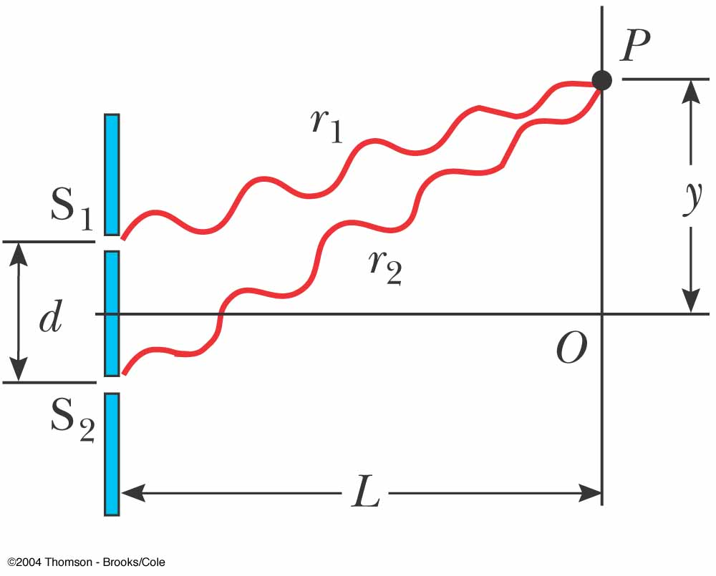
Intensity Distribution,
Electric Fields
The magnitude of each wave at point P can be found
  E₁ = E_{o} sin ωt
  E₂ = E_{o} sin (ωt + φ)
  Both waves have the same amplitude, E_{o}

Slide 22
Intensity Distribution,
Phase Relationships
The phase difference between the two waves at P depends on their path difference
  δ = r₂ – r₁ = d sin θ
A path difference of λ (for constructive interference) corresponds to a phase difference of 2π rad
A path difference of δ is the same fraction of λ as the phase difference φ is of 2π
This gives

Slide 23
Intensity Distribution, Resultant Field
The magnitude of the resultant electric field comes from the superposition principle
  E_{P} = E₁+ E₂ = E_{o}[sin ωt + sin (ωt + φ)]
This can also be expressed as
  E_{P} has the same frequency as the light at the slits
  The magnitude of the field is multiplied by the factor 2 cos (φ / 2)

Slide 24
Intensity Distribution, Equation
The expression for the intensity comes from the fact that the intensity of a wave is proportional to the square of the resultant electric field magnitude at that point
The intensity therefore is

Slide 25
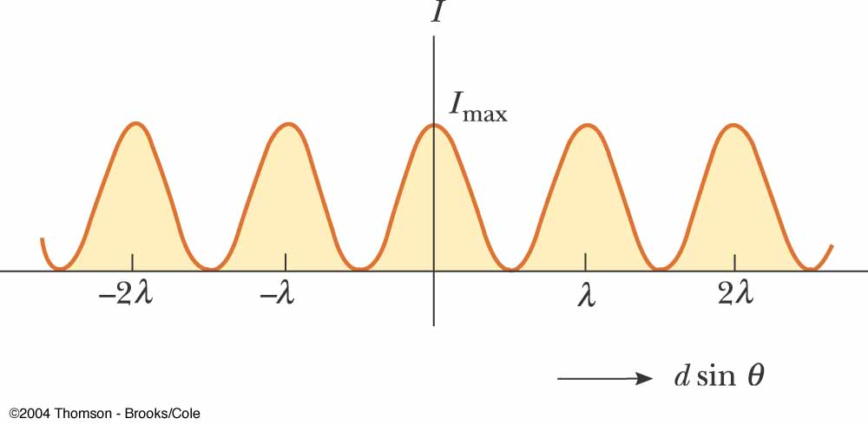
Light Intensity, Graph
The interference pattern consists of equally spaced fringes of equal intensity
This result is valid only if L >> d and for small values of θ

Slide 26
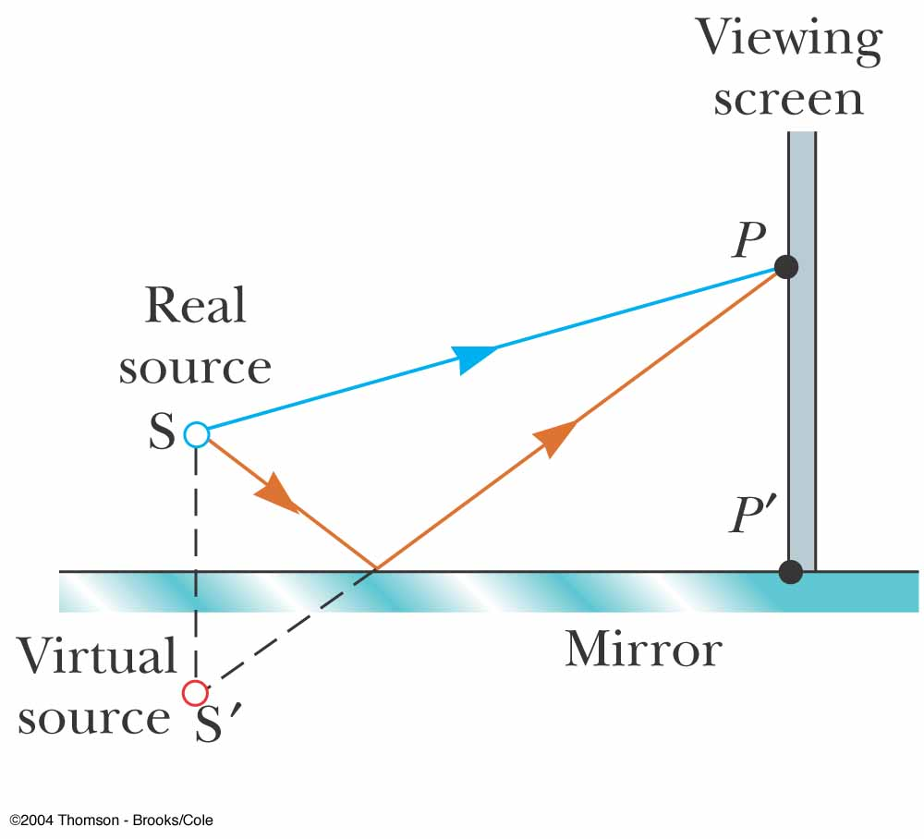
Lloyd’s Mirror
An arrangement for producing an interference pattern with a single light source
Waves reach point P either by a direct path or by reflection
The reflected ray can be treated as a ray from the source S’ behind the mirror

Slide 27
Interference Pattern from a Lloyd’s Mirror
This arrangement can be thought of as a double-slit source with the distance between points S and S’ comparable to length d
An interference pattern is formed
The positions of the dark and bright fringes are reversed relative to the pattern of two real sources
This is because there is a 180° phase change produced by the reflection

Slide 28
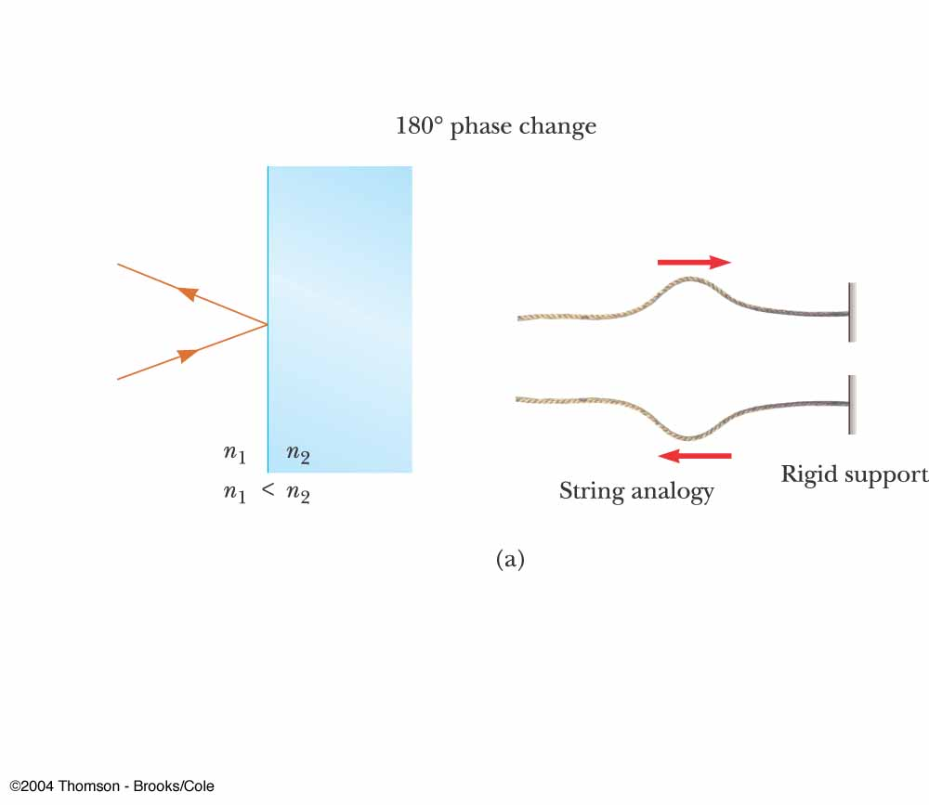
Phase Changes Due To Reflection
An electromagnetic wave undergoes a phase change of 180° upon reflection from a medium of higher index of refraction than the one in which it was traveling
  Analogous to a pulse on a string reflected from a rigid support

Slide 29
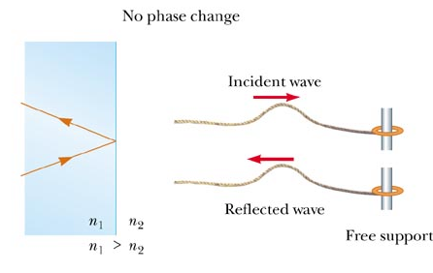
Phase Changes Due To Reflection, cont.
There is no phase change when the wave is reflected from a boundary leading to a medium of lower index of refraction
  Analogous to a pulse on a string reflecting from a free support

Slide 30
Interference in Thin Films
Interference effects are commonly observed in thin films
  Examples include soap bubbles and oil on water
The various colors observed when white light is incident on such films result from the interference of waves reflected from the two surfaces of the film

Slide 31
Interference in Thin Films, 2
Facts to remember
  An electromagnetic wave traveling from a medium of index of refraction n₁ toward a medium of index of refraction n₂ undergoes a 180° phase change on reflection when n₂ > n₁
    There is no phase change in the reflected wave if n₂ < n₁
  The wavelength of light λ_{n} in a medium with index of refraction n is λ_{n} = λ/n where λ is the wavelength of light in vacuum

Slide 32
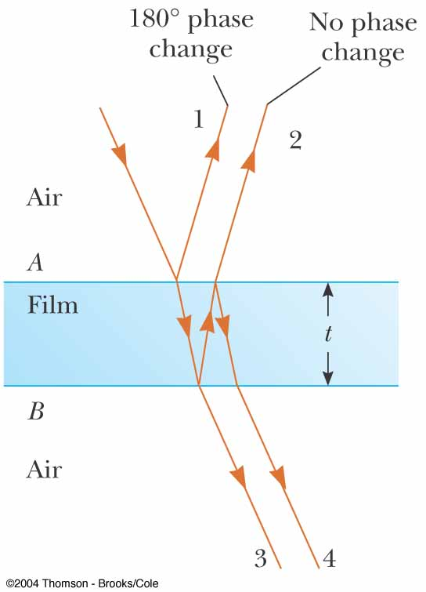
Interference in Thin Films, 3
Assume the light rays are traveling in air nearly normal to the two surfaces of the film
Ray 1 undergoes a phase change of 180° with respect to the incident ray
Ray 2, which is reflected from the lower surface, undergoes no phase change with respect to the incident wave

Slide 33
Interference in Thin Films, 4
Ray 2 also travels an additional distance of 2t before the waves recombine
For constructive interference
  2nt = (m + ½)λ (m = 0, 1, 2 …)
    This takes into account both the difference in optical path length for the two rays and the 180° phase change
For destructive interference
  2nt = mλ (m = 0, 1, 2 …)

Slide 34
Interference in Thin Films, 5
Two factors influence interference
  Possible phase reversals on reflection
  Differences in travel distance
The conditions are valid if the medium above the top surface is the same as the medium below the bottom surface
  If there are different media, these conditions are valid as long as the index of refraction for both is less than n

Slide 35
Interference in Thin Films, 6
If the thin film is between two different media, one of lower index than the film and one of higher index, the conditions for constructive and destructive interference are reversed
With different materials on either side of the film, you may have a situation in which there is a 180º phase change at both surfaces or at neither surface
  Be sure to check both the path length and the phase change

Slide 36
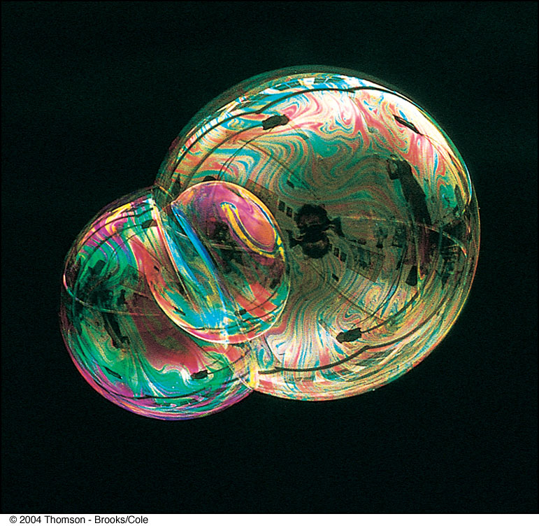
Interference in Thin Film, Soap Bubble Example

Slide 37
Newton’s Rings
Another method for viewing interference is to place a plano-convex lens on top of a flat glass surface
The air film between the glass surfaces varies in thickness from zero at the point of contact to some thickness t
A pattern of light and dark rings is observed
  These rings are called Newton’s rings
  The particle model of light could not explain the origin of the rings
Newton’s rings can be used to test optical lenses

Slide 38
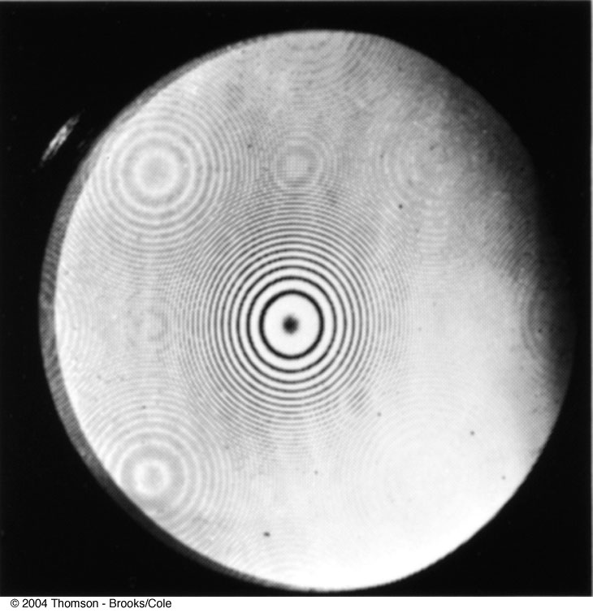
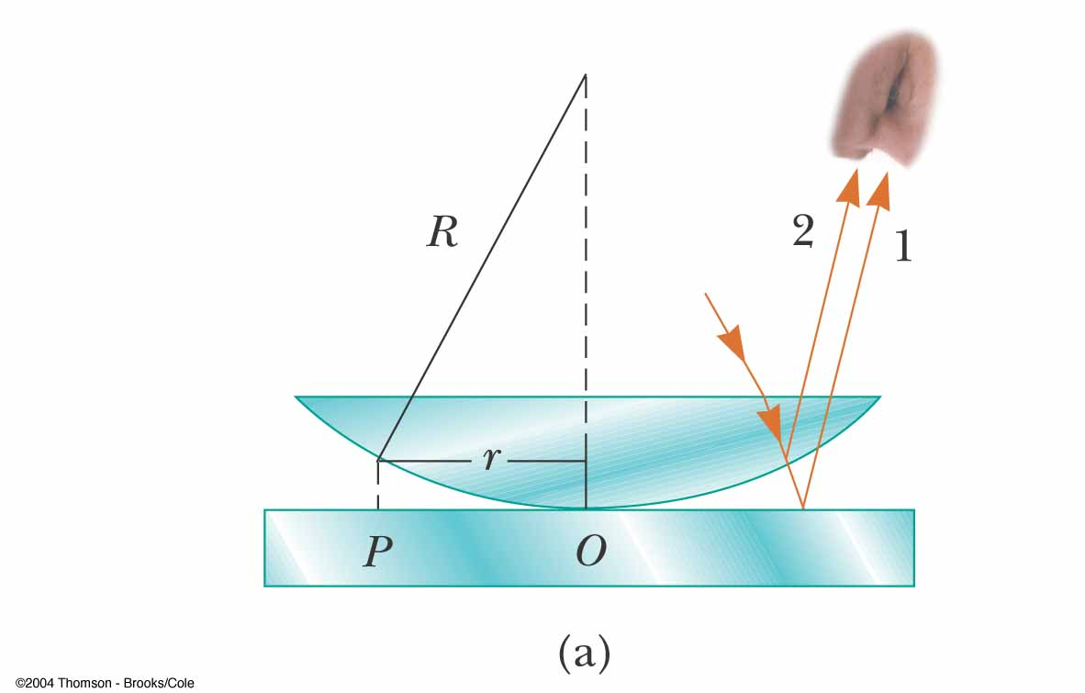
Newton’s Rings,
Set-Up and Pattern

Slide 39
Problem Solving Strategy with Thin Films, 1
Conceptualize
  Identify the light source
  Identify the location of the observer
Categorize
  Be sure the techniques for thin-film interference are appropriate
  Identify the thin film causing the interference

Slide 40
Problem Solving with Thin Films, 2
Analyze
  The type of interference – constructive or destructive – that occurs is determined by the phase relationship between the upper and lower surfaces
  Phase differences have two causes
    differences in the distances traveled
    phase changes occurring on reflection
  Both causes must be considered when determining constructive or destructive interference
  Use the indices of refraction of the materials to determine the correct equations
Finalize
  Be sure your results make sense physically
  Be sure they are of an appropriate size

Slide 41
Michelson Interferometer
The interferometer was invented by an American physicist, A. A. Michelson
The interferometer splits light into two parts and then recombines the parts to form an interference pattern
The device can be used to measure wavelengths or other lengths with great precision

Slide 42
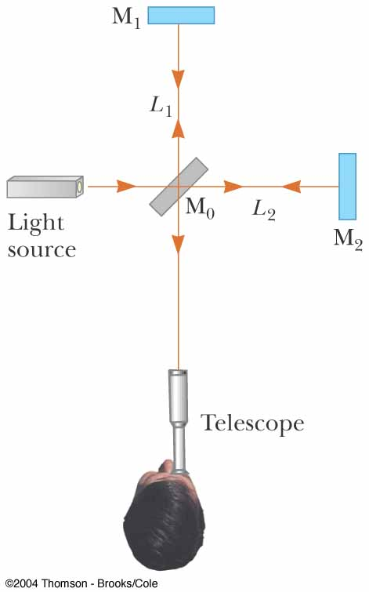
Michelson Interferometer, Schematic
A ray of light is split into two rays by the mirror M_{o}
  The mirror is at 45º to the incident beam
  The mirror is called a beam splitter
It transmits half the light and reflects the rest

Slide 43
Michelson Interferometer, Schematic Explanation, cont.
The reflected ray goes toward mirror M₁
The transmitted ray goes toward mirror M₂
The two rays travel separate paths L₁ and L₂
After reflecting from M₁ and M₂, the rays eventually recombine at M_{o} and form an interference pattern

Slide 44
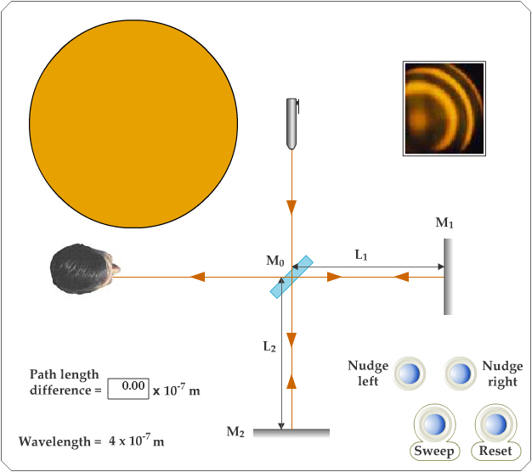
Active Figure 37.14
Use the active figure to move the mirror
Observe the effect on the interference pattern
Use the interferometer to measure the wavelength of the light
PLAY
ACTIVE FIGURE

Slide 45
Michelson Interferometer – Operation
The interference condition for the two rays is determined by their path length difference
M₁ is moveable
As it moves, the fringe pattern collapses or expands, depending on the direction M₁ is moved

Slide 46
Michelson Interferometer – Operation, cont.
The fringe pattern shifts by one-half fringe each time M₁ is moved a distance λ/4
The wavelength of the light is then measured by counting the number of fringe shifts for a given displacement of M₁

Slide 47
Michelson Interferometer – Applications
The Michelson interferometer was used to disprove the idea that the Earth moves through an ether
Modern applications include
  Fourier Transform Infrared Spectroscopy (FTIR)
  Laser Interferometer Gravitational-Wave Observatory (LIGO)

Slide 48
Fourier Transform Infrared Spectroscopy
This is used to create a high-resolution spectrum in a very short time interval
The result is a complex set of data relating light intensity as a function of mirror position
  This is called an interferogram
The interferogram can be analyzed by a computer to provide all of the wavelength components
  This process is called a Fourier transform

Slide 49
Laser Interferometer Gravitational-Wave Observatory
General relativity predicts the existence of gravitational waves
In Einstein’s theory, gravity is equivalent to a distortion of space
  These distortions can then propagate through space
The LIGO apparatus is designed to detect the distortion produced by a disturbance that passes near the Earth

Slide 50
LIGO, cont.
The interferometer uses laser beams with an effective path length of several kilometers
At the end of an arm of the interferometer, a mirror is mounted on a massive pendulum
When a gravitational wave passes, the pendulum moves, and the interference pattern due to the laser beams from the two arms changes

Slide 51
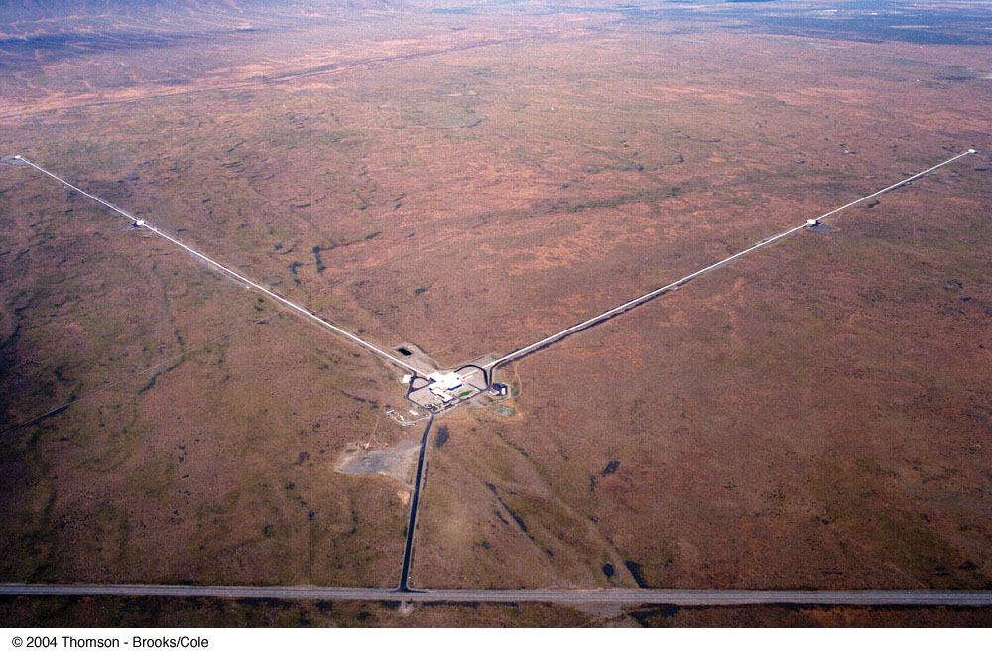
LIGO in Richland, Washington

