Slide 1
Chapter 31
Faraday’s Law

Slide 2
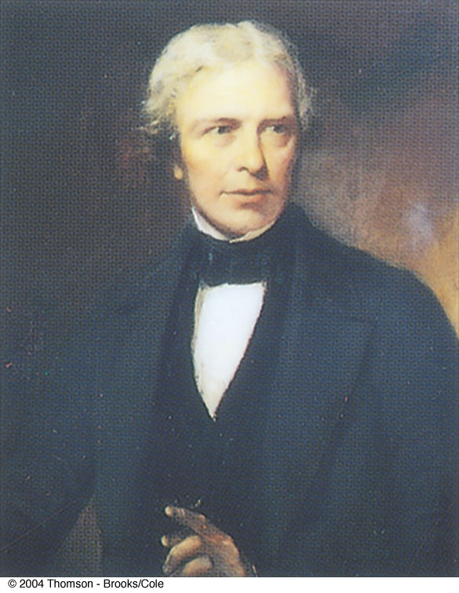
Michael Faraday
1791 – 1867
British physicist and chemist
Great experimental scientist
Contributions to early electricity include:
  Invention of motor, generator, and transformer
  Electromagnetic induction
  Laws of electrolysis

Slide 3
Induction
An induced current is produced by a changing magnetic field
There is an induced emf associated with the induced current
A current can be produced without a battery present in the circuit
Faraday’s law of induction describes the induced emf

Slide 4
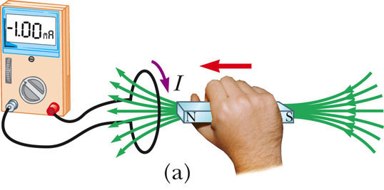
EMF Produced by a Changing Magnetic Field, 1
A loop of wire is connected to a sensitive ammeter
When a magnet is moved toward the loop, the ammeter deflects
  The direction was arbitrarily chosen to be negative
PLAY
ACTIVE FIGURE

Slide 5
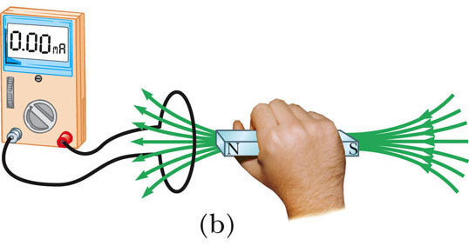
EMF Produced by a Changing Magnetic Field, 2
When the magnet is held stationary, there is no deflection of the ammeter
Therefore, there is no induced current
  Even though the magnet is in the loop
PLAY
ACTIVE FIGURE

Slide 6
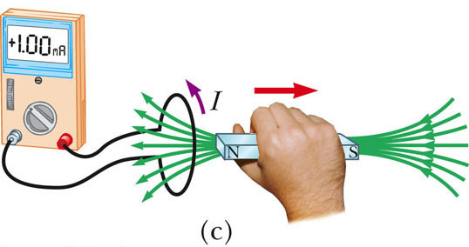
EMF Produced by a Changing Magnetic Field, 3
The magnet is moved away from the loop
The ammeter deflects in the opposite direction
Use the active figure to move the wires and observe the deflection on the meter
PLAY
ACTIVE FIGURE

Slide 7
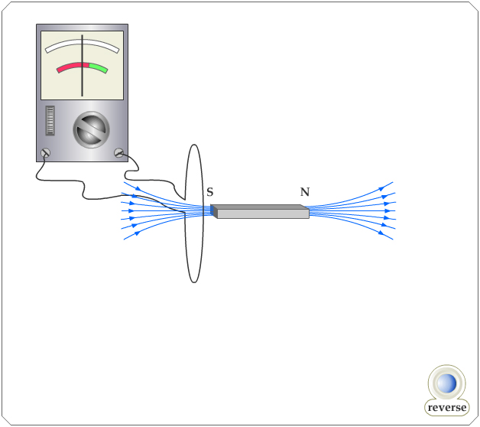
Active Figure 31.1
PLAY
ACTIVE FIGURE

Slide 8
EMF Produced by a Changing Magnetic Field, Summary
The ammeter deflects when the magnet is moving toward or away from the loop
The ammeter also deflects when the loop is moved toward or away from the magnet
Therefore, the loop detects that the magnet is moving relative to it
  We relate this detection to a change in the magnetic field
  This is the induced current that is produced by an induced emf

Slide 9
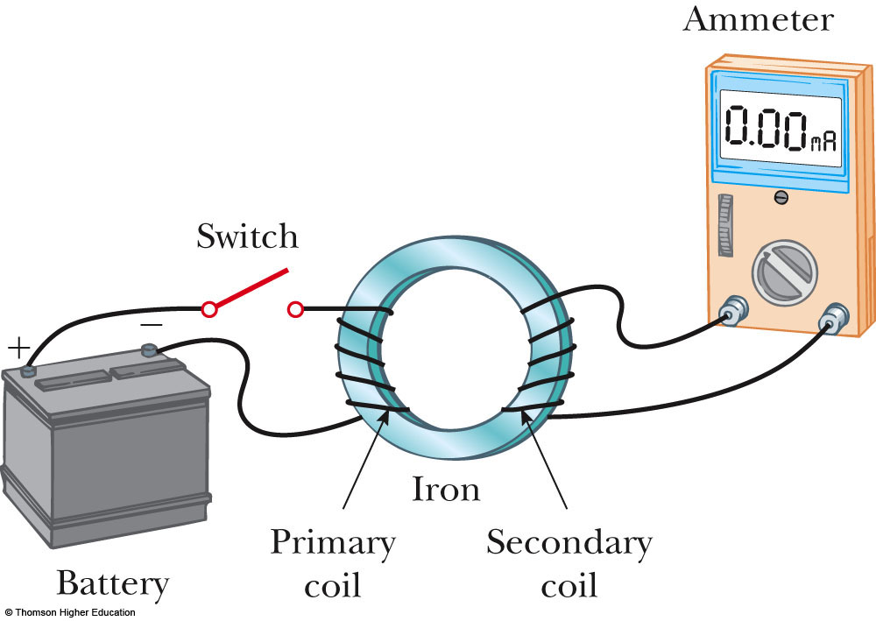
Faraday’s Experiment –
Set Up
A primary coil is connected to a switch and a battery
The wire is wrapped around an iron ring
A secondary coil is also wrapped around the iron ring
There is no battery present in the secondary coil
The secondary coil is not directly connected to the primary coil
PLAY
ACTIVE FIGURE

Slide 10
Active Figure 31.2
Close the switch and observe the current readings given by the ammeter
PLAY
ACTIVE FIGURE

Slide 11
Faraday’s Experiment – Findings
At the instant the switch is closed, the ammeter changes from zero in one direction and then returns to zero
When the switch is opened, the ammeter changes in the opposite direction and then returns to zero
The ammeter reads zero when there is a steady current or when there is no current in the primary circuit

Slide 12
Faraday’s Experiment – Conclusions
An electric current can be induced in a loop by a changing magnetic field
  This would be the current in the secondary circuit of this experimental set-up
The induced current exists only while the magnetic field through the loop is changing
This is generally expressed as: an induced emf is produced in the loop by the changing magnetic field
  The actual existence of the magnetic flux is not sufficient to produce the induced emf, the flux must be changing

Slide 13
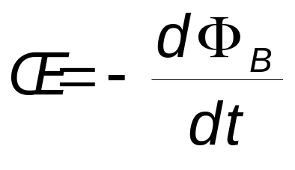
Faraday’s Law – Statements
Faraday’s law of induction states that “the emf induced in a circuit is directly proportional to the time rate of change of the magnetic flux through the circuit”
Mathematically,

Slide 14
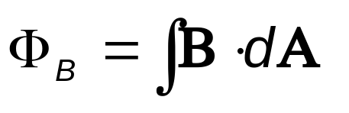
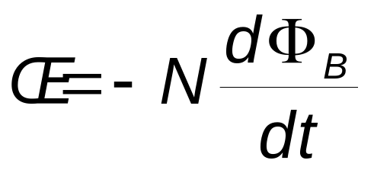
Faraday’s Law – Statements, cont
Remember Φ_{B} is the magnetic flux through the circuit and is found by
If the circuit consists of N loops, all of the same area, and if Φ_{B} is the flux through one loop, an emf is induced in every loop and Faraday’s law becomes

Slide 15
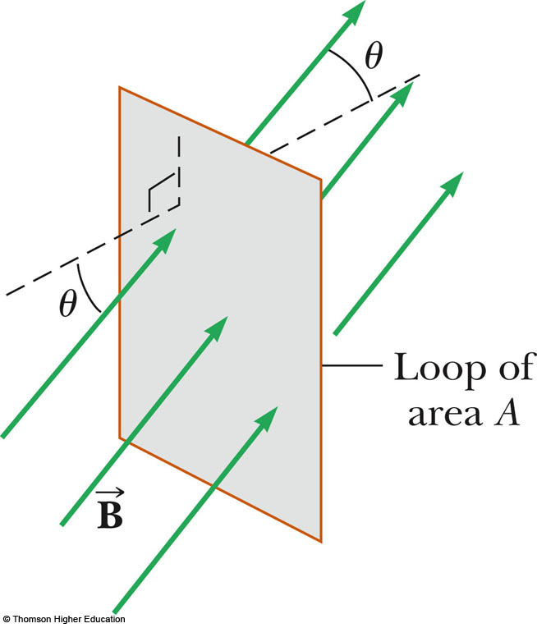

Faraday’s Law – Example
Assume a loop enclosing an area A lies in a uniform magnetic field
The magnetic flux through the loop is Φ_{B} = BA cos θ
The induced emf is
ε = - d/dt (BA cos θ)‏

Slide 16
Ways of Inducing an emf
The magnitude of can change with time
The area enclosed by the loop can change with time
The angle θ between and the normal to the loop can change with time
Any combination of the above can occur

Slide 17
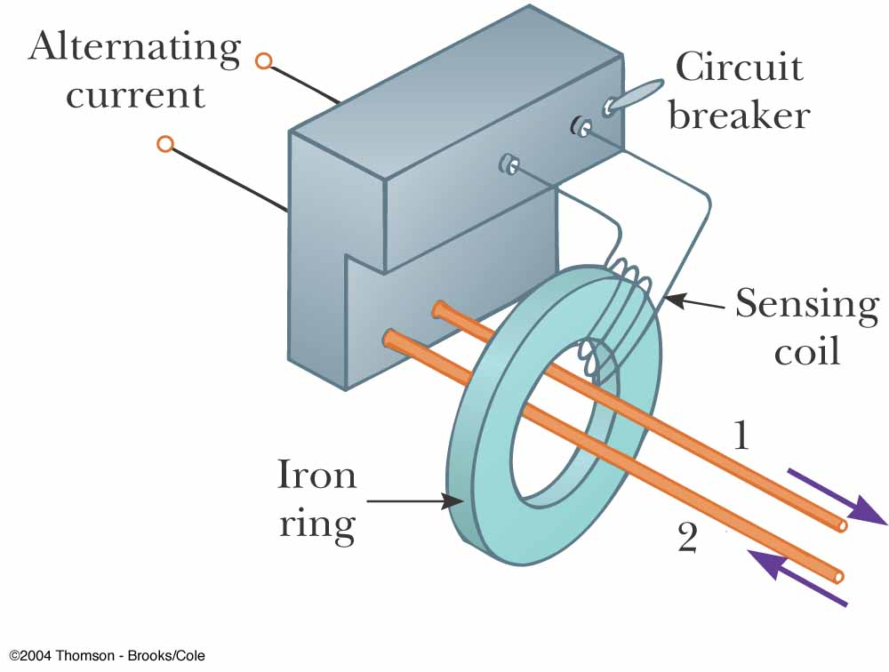
Applications of Faraday’s Law – GFI
A GFI (ground fault indicator) protects users of electrical appliances against electric shock
When the currents in the wires are in opposite directions, the flux is zero
When the return current in wire 2 changes, the flux is no longer zero
The resulting induced emf can be used to trigger a circuit breaker

Slide 18
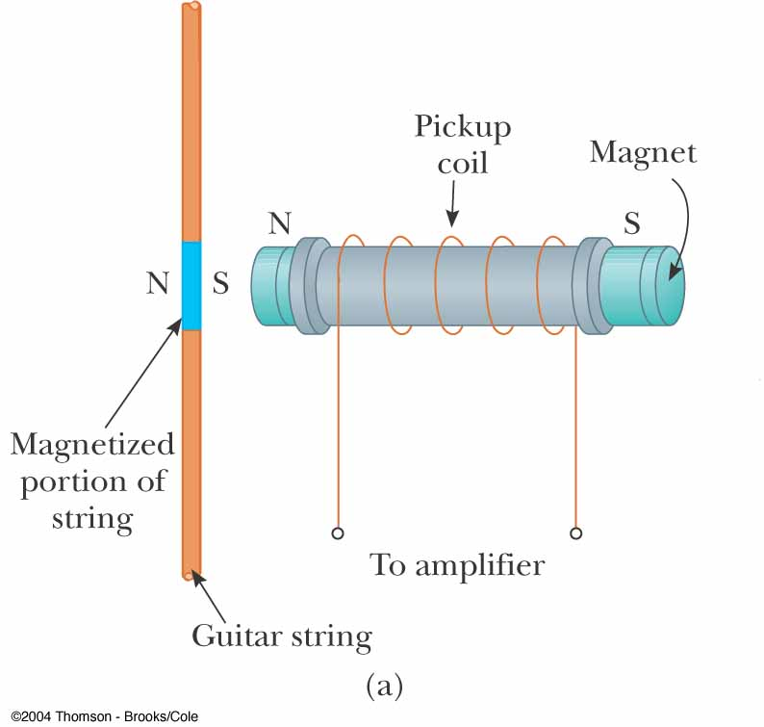
Applications of Faraday’s Law – Pickup Coil
The pickup coil of an electric guitar uses Faraday’s law
The coil is placed near the vibrating string and causes a portion of the string to become magnetized
When the string vibrates at some frequency, the magnetized segment produces a changing flux through the coil
The induced emf is fed to an amplifier

Slide 19
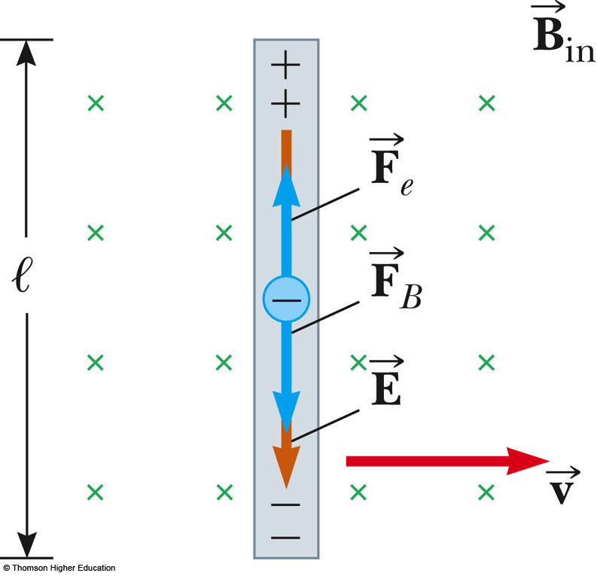
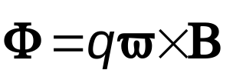
Motional emf
A motional emf is the emf induced in a conductor moving through a constant magnetic field
The electrons in the conductor experience a force, that is directed along ℓ

Slide 20
Motional emf, cont.
Under the influence of the force, the electrons move to the lower end of the conductor and accumulate there
As a result of the charge separation, an electric field is produced inside the conductor
The charges accumulate at both ends of the conductor until they are in equilibrium with regard to the electric and magnetic forces

Slide 21
Motional emf, final
For equilibrium, qE = qvB or E = vB
The electric field is related to the potential difference across the ends of the conductor: DV = E ℓ =B ℓ v
A potential difference is maintained between the ends of the conductor as long as the conductor continues to move through the uniform magnetic field
If the direction of the motion is reversed, the polarity of the potential difference is also reversed

Slide 22
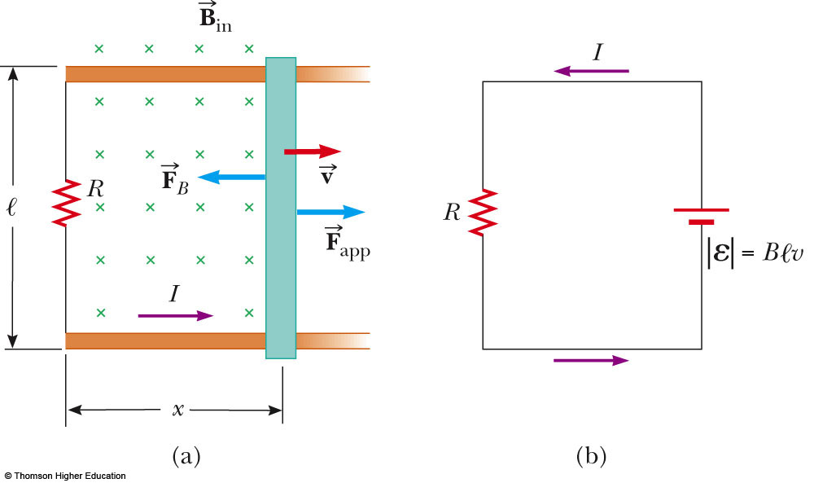
Sliding Conducting Bar
A bar moving through a uniform field and the equivalent circuit diagram
Assume the bar has zero resistance
The stationary part of the circuit has a resistance R
PLAY
ACTIVE FIGURE

Slide 23
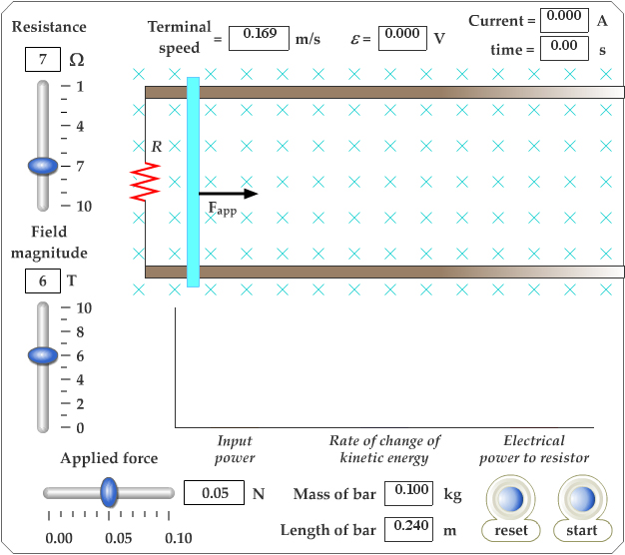
Active Figure 31.8
Use the active figure to adjust the applied force, the electric field and the resistance
Observe the effects on the motion of the bar
PLAY
ACTIVE FIGURE

Slide 24
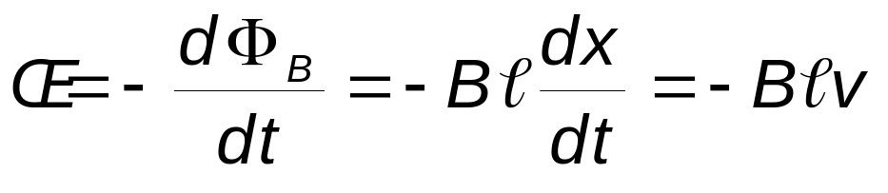
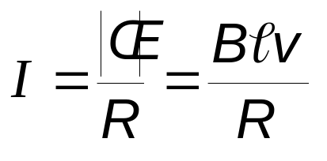
Sliding Conducting Bar, cont.
The induced emf is
Since the resistance in the circuit is R, the current is

Slide 25
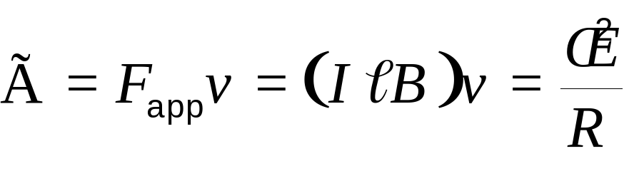
Sliding Conducting Bar, Energy Considerations
The applied force does work on the conducting bar
This moves the charges through a magnetic field and establishes a current
The change in energy of the system during some time interval must be equal to the transfer of energy into the system by work
The power input is equal to the rate at which energy is delivered to the resistor

Slide 26
Lenz’s Law
Faraday’s law indicates that the induced emf and the change in flux have opposite algebraic signs
This has a physical interpretation that has come to be known as Lenz’s law
Developed by German physicist Heinrich Lenz

Slide 27
Lenz’s Law, cont.
Lenz’s law: the induced current in a loop is in the direction that creates a magnetic field that opposes the change in magnetic flux through the area enclosed by the loop
The induced current tends to keep the original magnetic flux through the circuit from changing

Slide 28
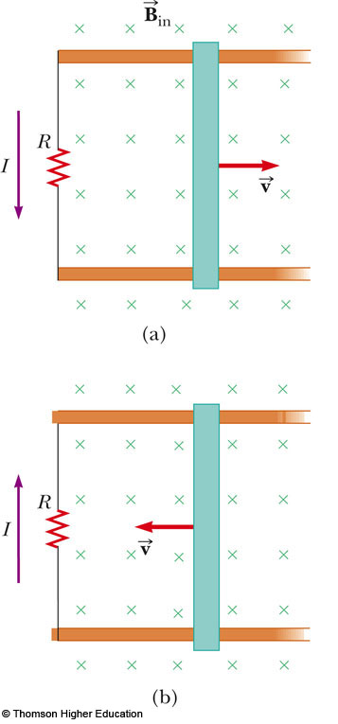
Lenz’ Law, Example
The conducting bar slides on the two fixed conducting rails
The magnetic flux due to the external magnetic field through the enclosed area increases with time
The induced current must produce a magnetic field out of the page
  The induced current must be counterclockwise
If the bar moves in the opposite direction, the direction of the induced current will also be reversed

Slide 29
Induced emf and Electric Fields
An electric field is created in the conductor as a result of the changing magnetic flux
Even in the absence of a conducting loop, a changing magnetic field will generate an electric field in empty space
This induced electric field is nonconservative
  Unlike the electric field produced by stationary charges

Slide 30
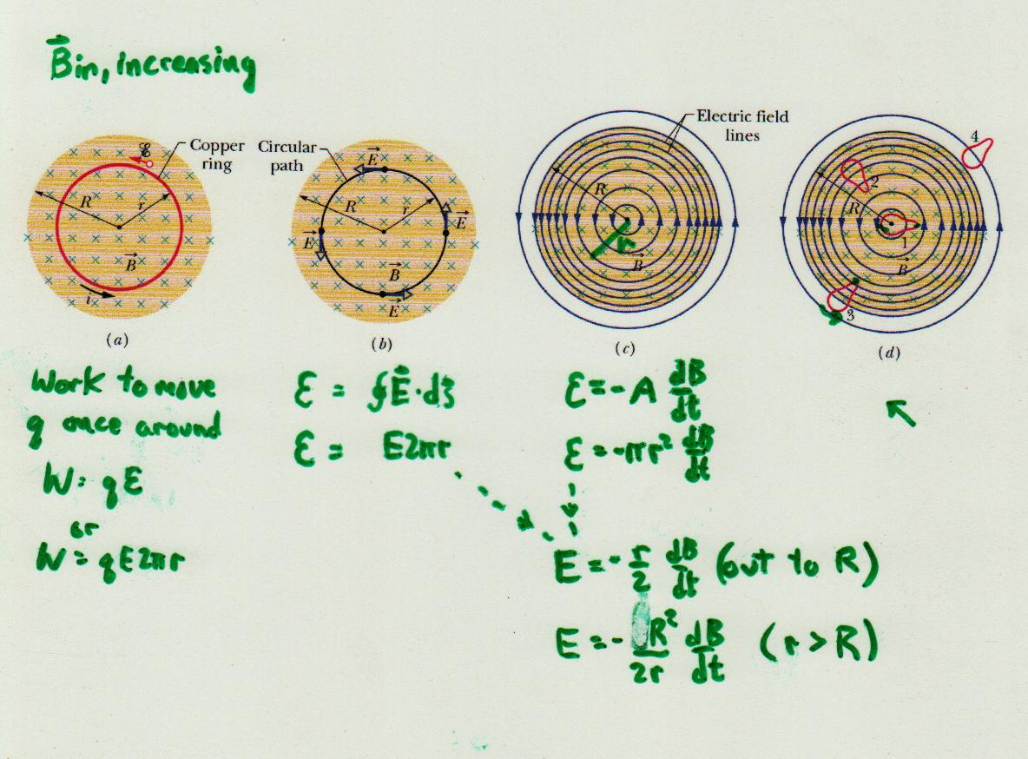
Induced emf and Electric Fields

Slide 31

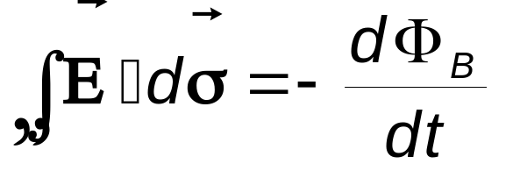
Induced emf and Electric Fields, cont.
The emf for any closed path can be expressed as the line integral of over the path
Faraday’s law can be written in a general form:

Slide 32
Induced emf and Electric Fields, final
The induced electric field is a nonconservative field that is generated by a changing magnetic field
The field cannot be an electrostatic field because if the field were electrostatic, and hence conservative, the line integral of would be zero and it isn’t

Slide 33
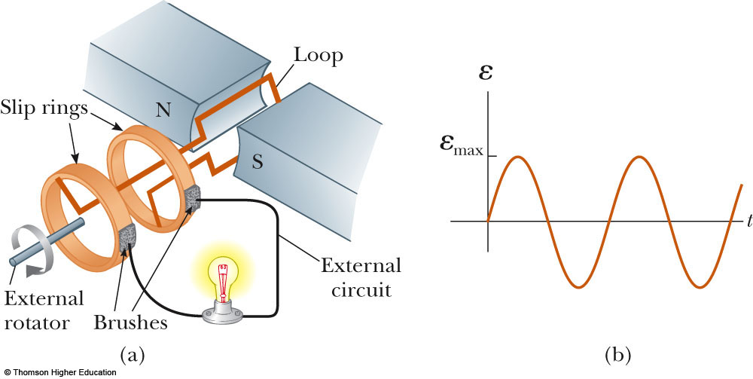
Generators
Electric generators take in energy by work and transfer it out by electrical transmission
The AC generator consists of a loop of wire rotated by some external means in a magnetic field

Slide 34
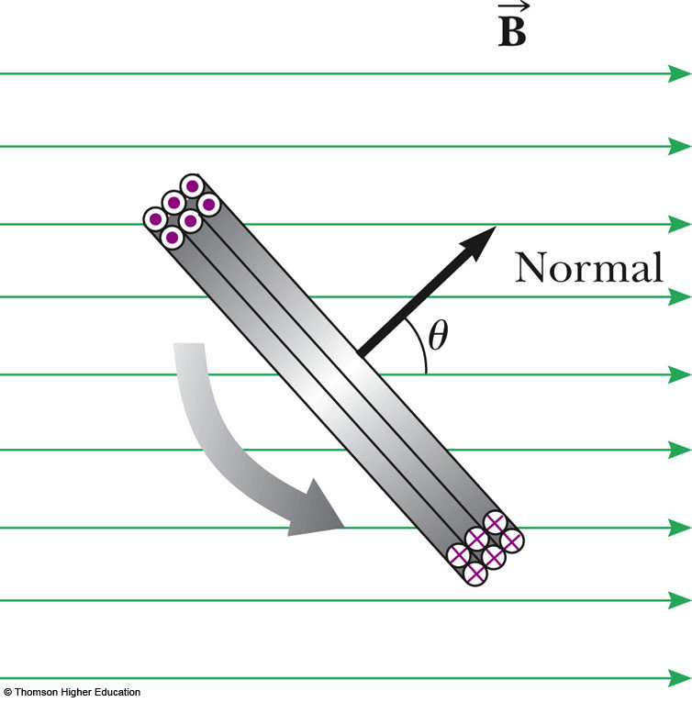
Rotating Loop
Assume a loop with N turns, all of the same area rotating in a magnetic field
The flux through the loop at any time t is Φ_{B} = BA cos θ =
BA cos ωt

Slide 35
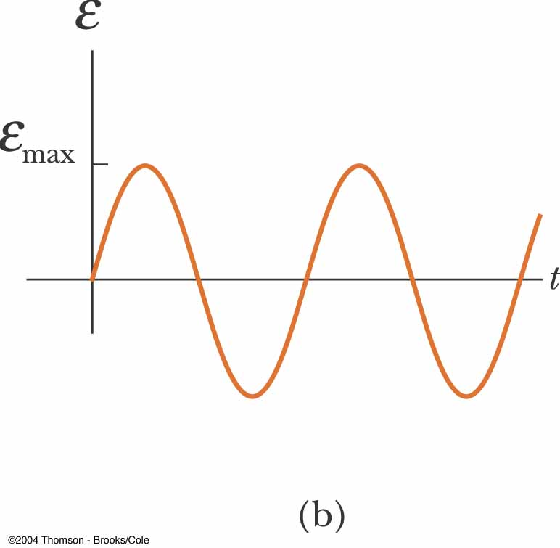
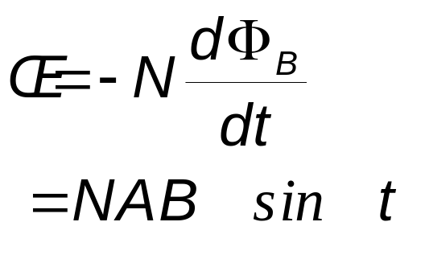
Induced emf in a Rotating Loop
The induced emf in the loop is
This is sinusoidal, with ε_{max} = NABω

Slide 36
Induced emf in a Rotating Loop, cont.
ε_{max} occurs when ωt = 90º or 270º
  This occurs when the magnetic field is in the plane of the coil and the time rate of change of flux is a maximum
ε = 0 when ωt = 0º or 180º
  This occurs when the magnetic field is perpendicular to the plane of the coil and the time rate of change of flux is zero

Slide 37
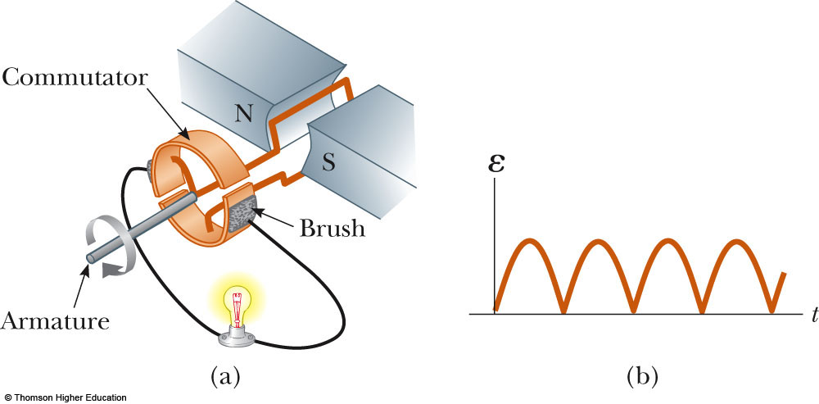
DC Generators
The DC (direct current) generator has essentially the same components as the AC generator
The main difference is that the contacts to the rotating loop are made using a split ring called a commutator

Slide 38
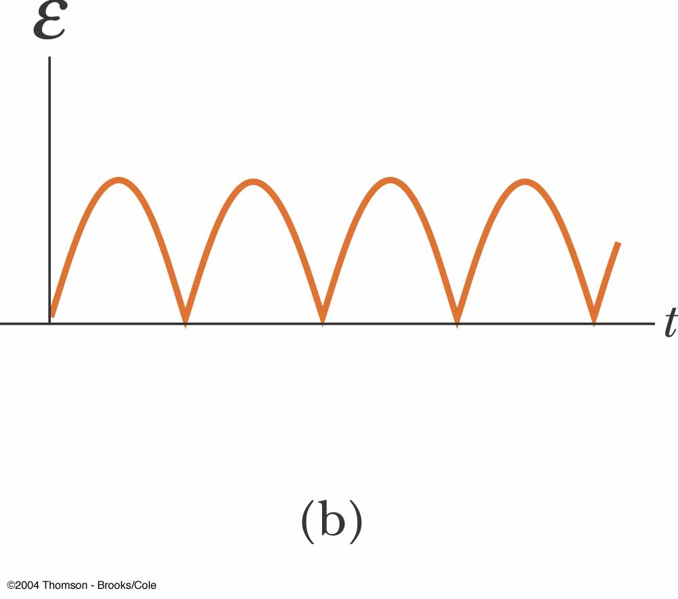
DC Generators, cont.
In this configuration, the output voltage always has the same polarity
It also pulsates with time
To obtain a steady DC current, commercial generators use many coils and commutators distributed so the pulses are out of phase

Slide 39
Motors
Motors are devices into which energy is transferred by electrical transmission while energy is transferred out by work
A motor is a generator operating in reverse
A current is supplied to the coil by a battery and the torque acting on the current-carrying coil causes it to rotate

Slide 40
Motors, cont.
Useful mechanical work can be done by attaching the rotating coil to some external device
However, as the coil rotates in a magnetic field, an emf is induced
  This induced emf always acts to reduce the current in the coil
  The back emf increases in magnitude as the rotational speed of the coil increases

Slide 41
Motors, final
The current in the rotating coil is limited by the back emf
  The term back emf is commonly used to indicate an emf that tends to reduce the supplied current
The induced emf explains why the power requirements for starting a motor and for running it are greater for heavy loads than for light ones

Slide 42
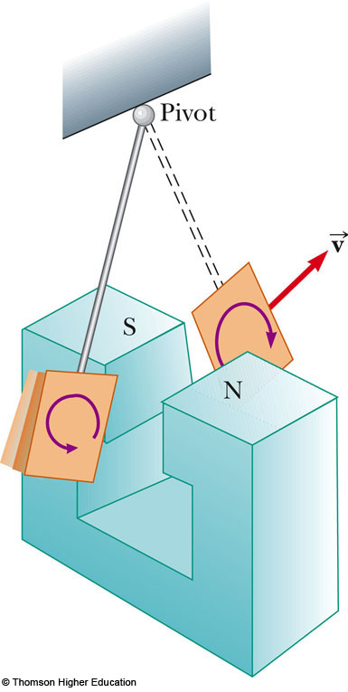
Eddy Currents
Circulating currents called eddy currents are induced in bulk pieces of metal moving through a magnetic field
The eddy currents are in opposite directions as the plate enters or leaves the field
Eddy currents are often undesirable because they represent a transformation of mechanical energy into internal energy

Slide 43
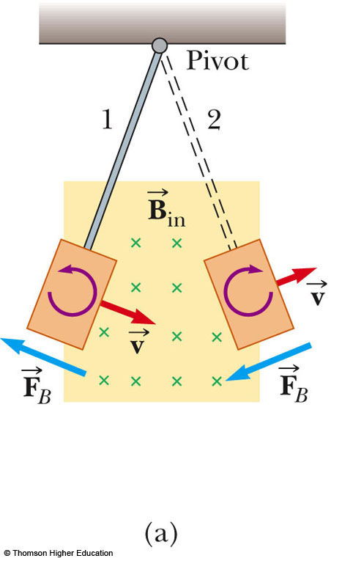
Eddy Currents, Example
The magnetic field is directed into the page
The induced eddy current is counterclockwise as the plate enters the field
It is opposite when the plate leaves the field
The induced eddy currents produce a magnetic retarding force and the swinging plate eventually comes to rest
PLAY
ACTIVE FIGURE

Slide 44
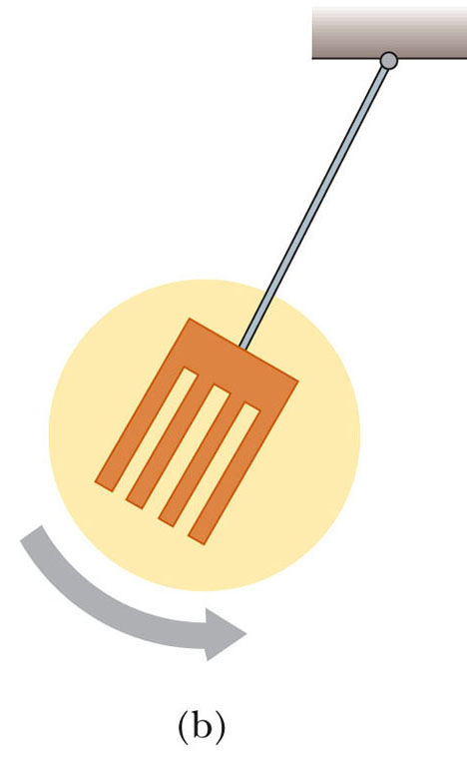
Eddy Currents, Final
To reduce energy loses by the eddy currents, the conducting parts can
  Be built up in thin layers separated by a nonconducting material
  Have slots cut in the conducting plate
Both prevent large current loops and increase the efficiency of the device
PLAY
ACTIVE FIGURE

