Slide 1
OUTLINE P233 Week3 -- Gauss' Law
I. Review Electric Fields
a. Point charges
b. Rules for field lines
c. Field lines near extended charge distributions
II. Gauss' Law – allows new way to find E-fields
a. Defined: electric flux is proportional to charge enclosed
b. Applied to point charges
c. Applies best to extended charge distributions.

Slide 2
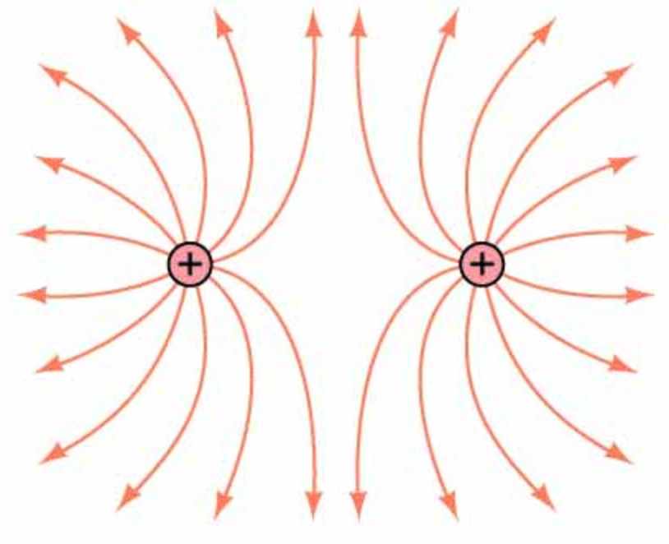
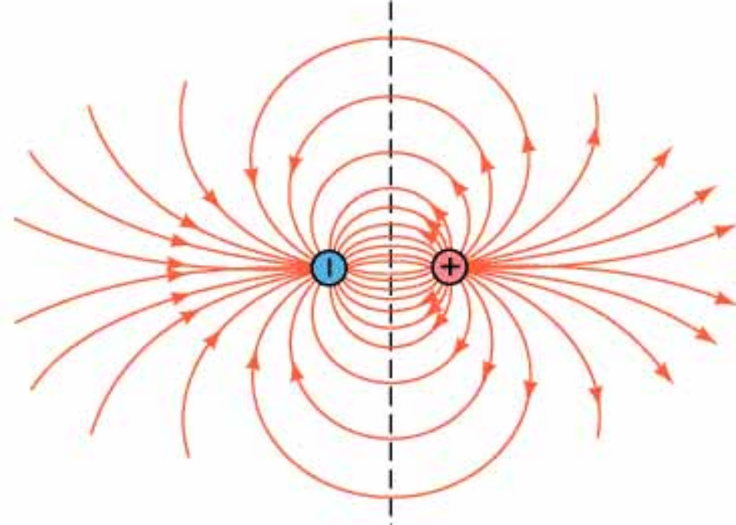
Like Point Charged
Unlike Point Charged
(THE dipole field)

Slide 3
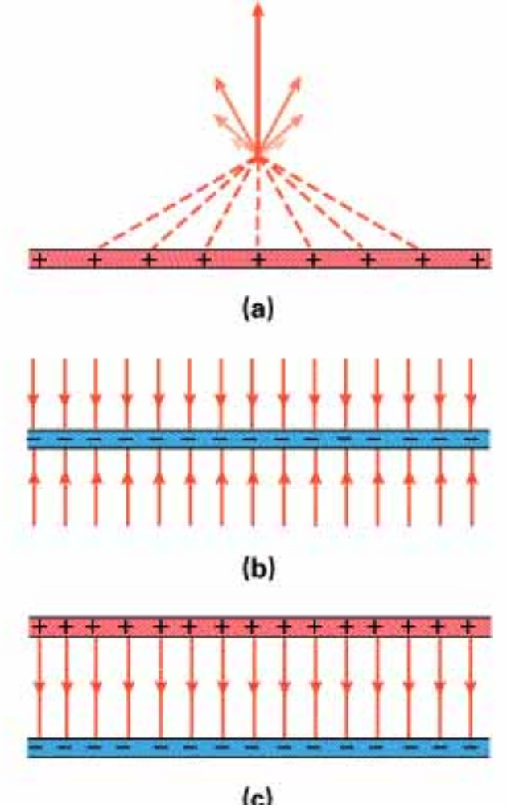
Near Large Plates of Charge
x-components cancel
y-components add
Positively Charged Plate
(E field away from the plate)
Negatively Charged Plate
(E field towards the plate)
Superposition or vector addition – fields add like vectors – only a field in the middle

Slide 4
Electrostatics: E fields and conductors
In electrostatics, E fields always point away (perpendicular) from the conductor and E = 0 inside of a conductor.
  If they did not, electrical currents would exist, F = q E, and charges would move to an equilibrium configuration.
Net charge resides on the surface of conductors
Charge accumulates at sharp points

Slide 5
Examples
Note that the top and bottom lines on the parallel plates example is misleading – breaks the rule we just discussed.

Slide 6
Is this safe?
Henry is inside of a conductor. The tires are insulators.
E=0 inside and the electrical current passes along the surface of the car.

Slide 7
Gauss’s Law
The net number of E field lines, Φ, passing through an imaginary closed surface is proportional to the amount of net charge enclosed within that surface, q_{enclosed}.
Surface is imaginary and arbitrary, but convenient
Analogy with water

Slide 8
More E lines enter than leave with a net negative charge
The larger the net charge, the more lines

Slide 9
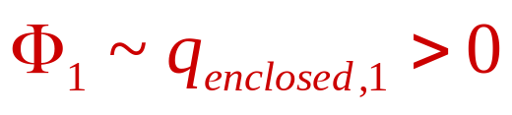
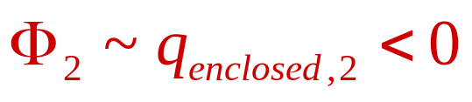


Dipole example
Surface 1
  net positive charge
Surface 2
  net negative charge
Surface 3
  zero net charge
Surface 4
  zero net charge

Slide 10
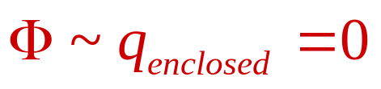
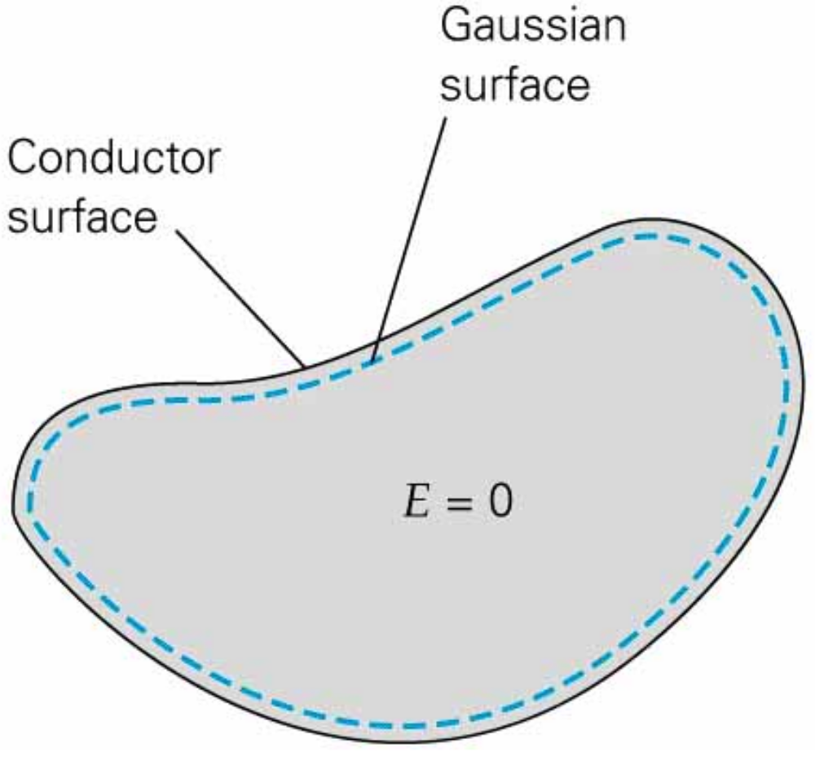
Gauss's Law, Conductors, and Electrostatics
Very useful in these cases
Inside conductors, E = 0, so q_{enclosed} = 0

Slide 11
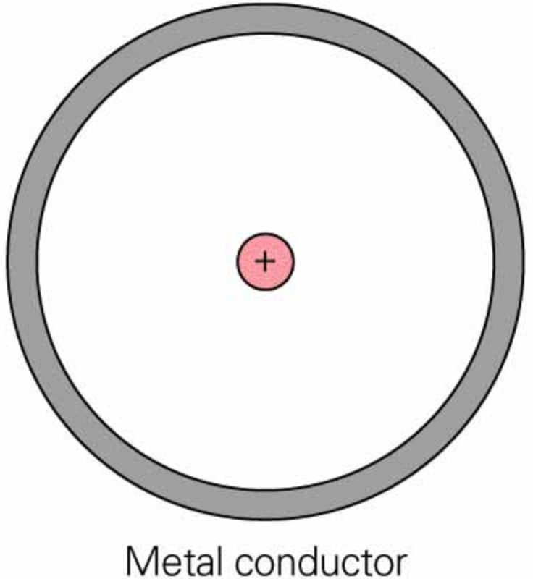
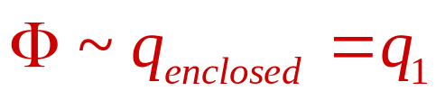
Example – Hollow Conducting Sphere
Metal has zero net charge, q_{inside surface} + q_{outside surface} = 0
E field of a point charge in the hollow region
E = 0 inside the metal
q_{inside surface} = – q₁
q_{outside surface} = +q₁
+q₁
E field outside the conductor
looks like a point charge!
q₁ is a point charge

