Slide 1
Rotation curve kinematics
Complications
1. inclination correction
2. can't be sure that stars/gas are in circular orbits
- asymmetric drift
Implications
1. Total mass of Milky Way ~ 4x10¹¹ Msun
2. Dark matter exists in galaxies – especially halos
3. SMBH reside in bulges of galaxies
4. Distance estimator: Tully-Fisher relation

Slide 2
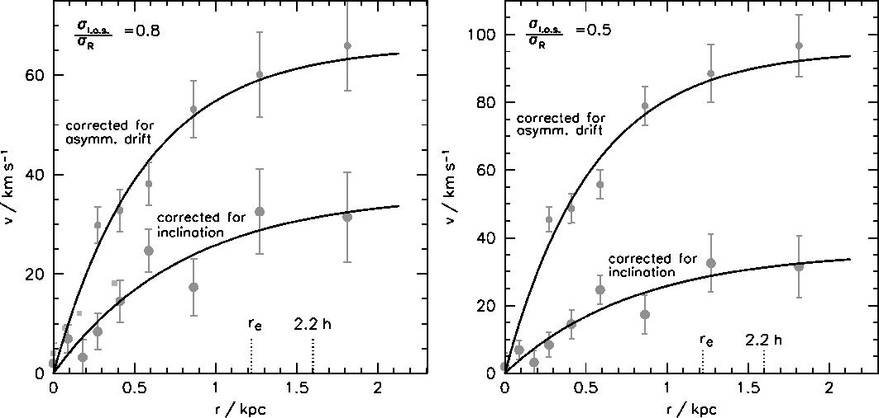
Rotation curve kinematics
Complications
1. inclination correction
2. can't be sure that stars/gas are in circular orbits
- asymmetric drift
Early-type dwarf galaxy with disk (Lisker and Fuchs 2009)‏

Slide 3
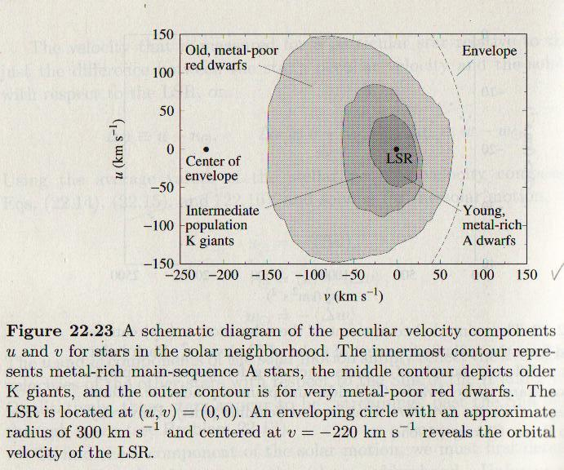
Rotation curve kinematics
Complications
1. inclination correction
2. can't be sure that stars/gas are in circular orbits
- asymmetric drift
From Carroll and Ostlie (1st Ed.)

Slide 4
Rotation curve kinematics
Complications
1. inclination correction
2. can't be sure that stars/gas are in circular orbits
- asymmetric drift
Implications
1. Total mass of Milky Way ~ 4x10¹¹ Msun
2. Dark matter exists in galaxies – especially halos
3. SMBH reside in bulges of galaxies

Slide 5
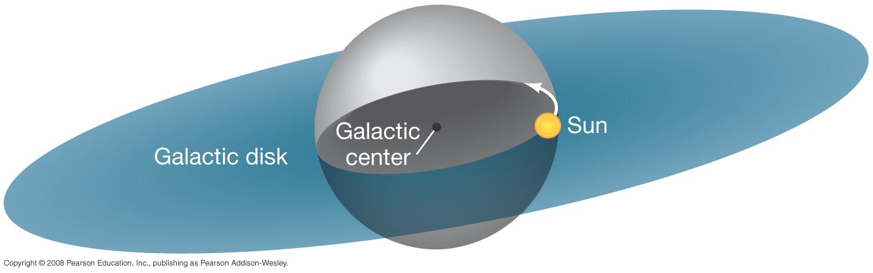
Rotation curve kinematics
The orbital speed of an object depends only on the amount of mass between it and the galactic center:

Slide 6
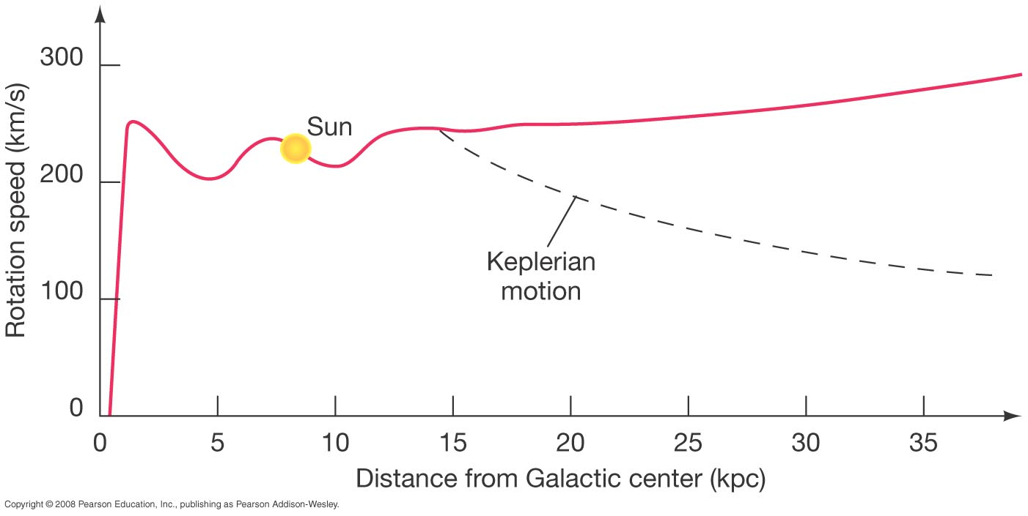
Rotation curve kinematics
Milky Way rotation
More than twice the mass of the galaxy would have to be outside the visible part to reproduce the observed curve.
Notes:
Figure 23-21. Galaxy Rotation Curve The rotation curve for the Milky Way Galaxy plots rotation speed against distance from the Galactic center. We can use this curve to compute the mass of the Galaxy that lies within any given radius. The dashed curve is the rotation curve expected if the Galaxy “ended” abruptly at a radius of 15 kpc, the limit of most of the known spiral structure and the globular cluster distribution. The fact that the red curve does not follow this dashed line, but instead stays well above it, indicates that additional unseen matter must be beyond that radius.

Slide 7
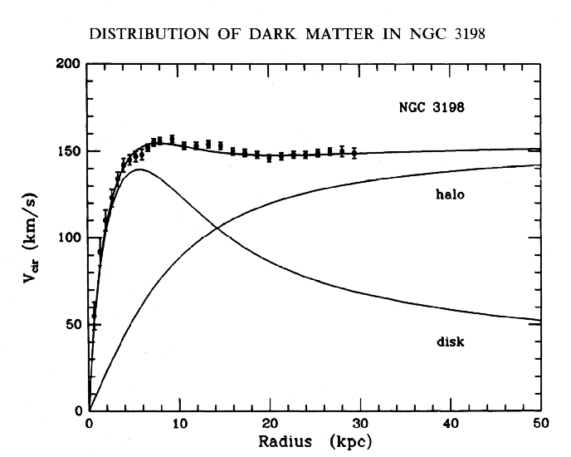
Rotation curve kinematics
From 21 cm
radio (cool
HI gas)‏
See how Carroll & Ostlie's Fig. 22.30 decomposes the rotation curve into
disk, spheroid (bulge), corona (halo) and total.
Notes:
Figure 23-21. Galaxy Rotation Curve The rotation curve for the Milky Way Galaxy plots rotation speed against distance from the Galactic center. We can use this curve to compute the mass of the Galaxy that lies within any given radius. The dashed curve is the rotation curve expected if the Galaxy “ended” abruptly at a radius of 15 kpc, the limit of most of the known spiral structure and the globular cluster distribution. The fact that the red curve does not follow this dashed line, but instead stays well above it, indicates that additional unseen matter must be beyond that radius.

Slide 8
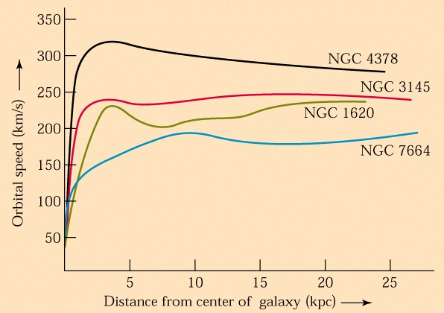
Rotation curve kinematics
Other galaxy rotation curves.
Notes:
Figure 23-21. Galaxy Rotation Curve The rotation curve for the Milky Way Galaxy plots rotation speed against distance from the Galactic center. We can use this curve to compute the mass of the Galaxy that lies within any given radius. The dashed curve is the rotation curve expected if the Galaxy “ended” abruptly at a radius of 15 kpc, the limit of most of the known spiral structure and the globular cluster distribution. The fact that the red curve does not follow this dashed line, but instead stays well above it, indicates that additional unseen matter must be beyond that radius.

Slide 9
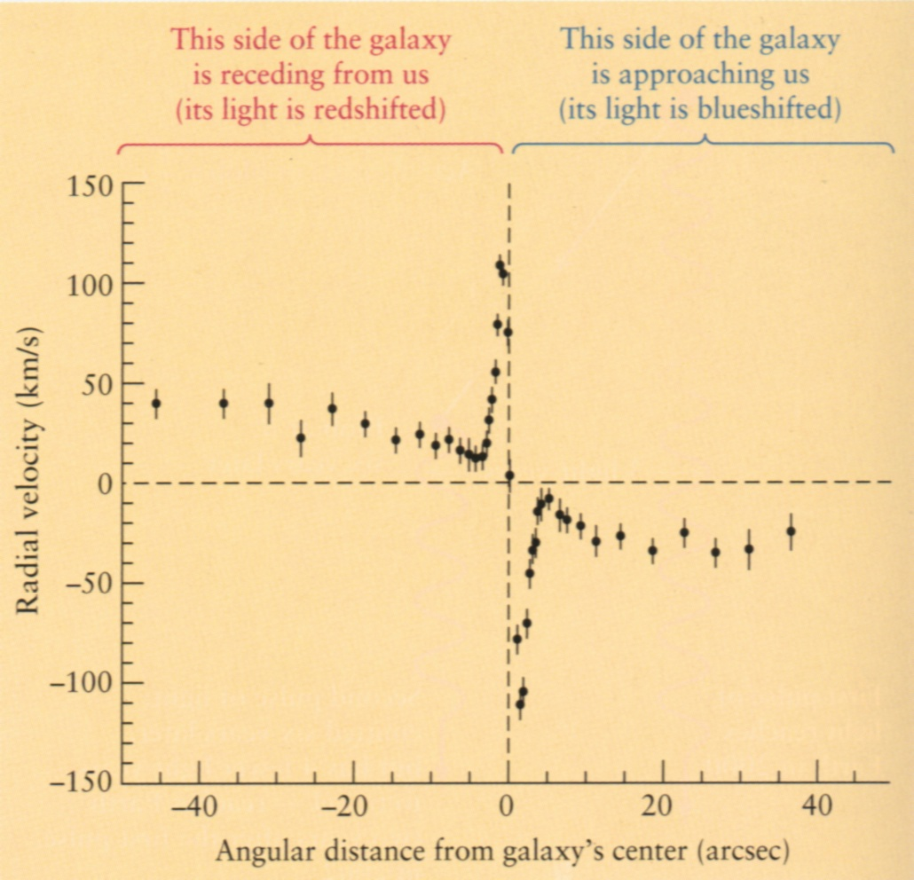
Rotation curve kinematics
SMBH reside in the bulges of galaxies
M31 inner
rotation curve
Notes:
Figure 23-21. Galaxy Rotation Curve The rotation curve for the Milky Way Galaxy plots rotation speed against distance from the Galactic center. We can use this curve to compute the mass of the Galaxy that lies within any given radius. The dashed curve is the rotation curve expected if the Galaxy “ended” abruptly at a radius of 15 kpc, the limit of most of the known spiral structure and the globular cluster distribution. The fact that the red curve does not follow this dashed line, but instead stays well above it, indicates that additional unseen matter must be beyond that radius.

Slide 10

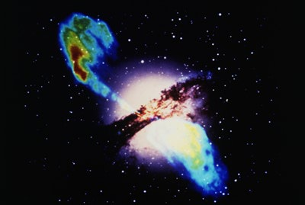
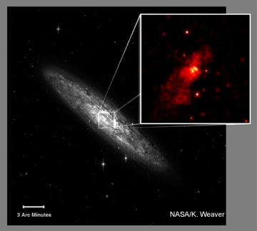
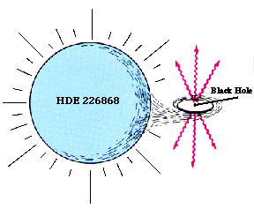
Types of Black Holes
Observationally ...
stellar
(3-30 M⊙)‏
intermediate
(100 - 10⁴ M⊙)‏
Supermassive
(10⁵ - 10¹⁰M⊙)‏

Slide 11
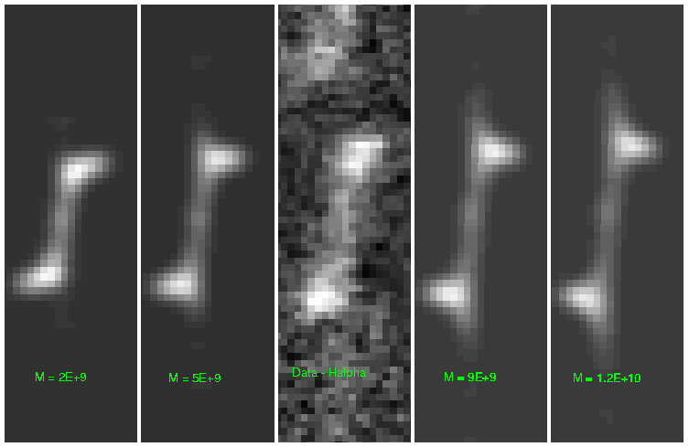
Rotation curve kinematics
SMBH reside in the bulges of galaxies
Notes:
Figure 23-21. Galaxy Rotation Curve The rotation curve for the Milky Way Galaxy plots rotation speed against distance from the Galactic center. We can use this curve to compute the mass of the Galaxy that lies within any given radius. The dashed curve is the rotation curve expected if the Galaxy “ended” abruptly at a radius of 15 kpc, the limit of most of the known spiral structure and the globular cluster distribution. The fact that the red curve does not follow this dashed line, but instead stays well above it, indicates that additional unseen matter must be beyond that radius.

Slide 12
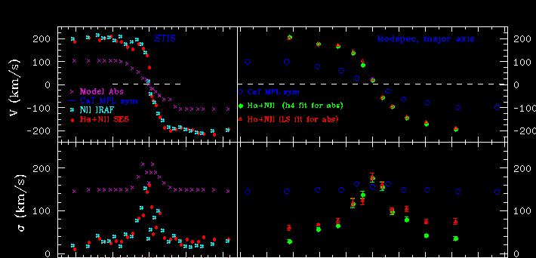
Rotation curve kinematics
SMBH reside in the bulges of galaxies
NGC 4697 kinematics
Notes:
Figure 23-21. Galaxy Rotation Curve The rotation curve for the Milky Way Galaxy plots rotation speed against distance from the Galactic center. We can use this curve to compute the mass of the Galaxy that lies within any given radius. The dashed curve is the rotation curve expected if the Galaxy “ended” abruptly at a radius of 15 kpc, the limit of most of the known spiral structure and the globular cluster distribution. The fact that the red curve does not follow this dashed line, but instead stays well above it, indicates that additional unseen matter must be beyond that radius.

Slide 13
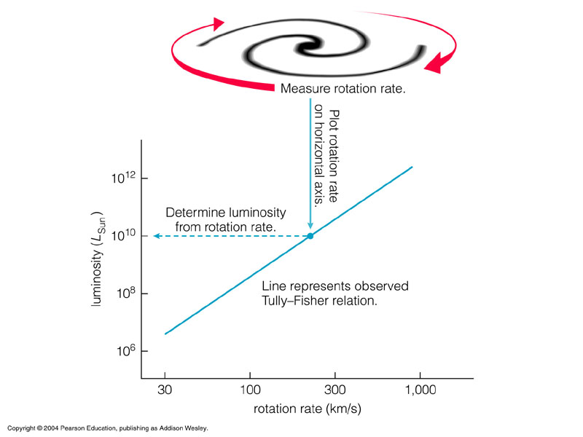
Rotation curve kinematics
Tully-Fisher relation – distance indicator
Notes:
Figure 23-21. Galaxy Rotation Curve The rotation curve for the Milky Way Galaxy plots rotation speed against distance from the Galactic center. We can use this curve to compute the mass of the Galaxy that lies within any given radius. The dashed curve is the rotation curve expected if the Galaxy “ended” abruptly at a radius of 15 kpc, the limit of most of the known spiral structure and the globular cluster distribution. The fact that the red curve does not follow this dashed line, but instead stays well above it, indicates that additional unseen matter must be beyond that radius.

Slide 14
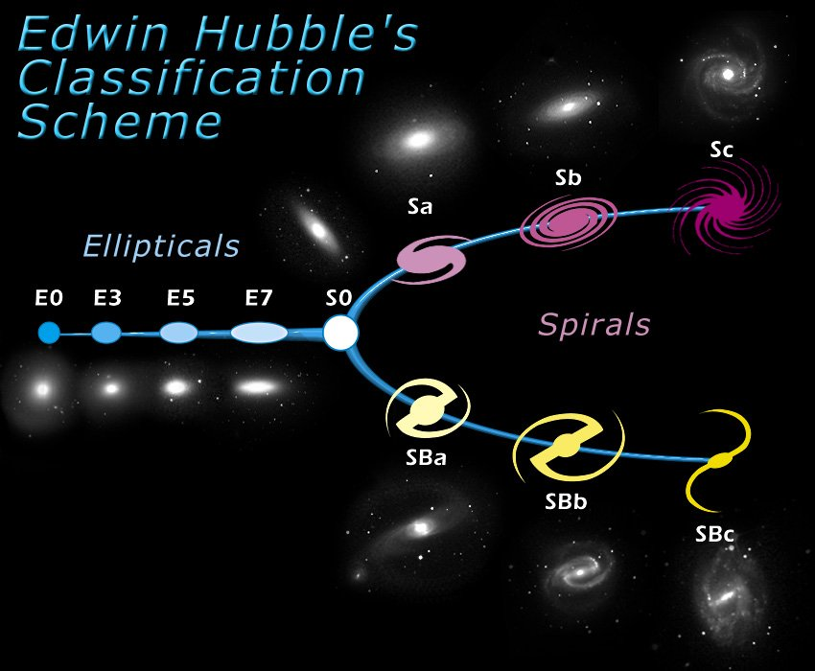
Galaxy Classification
See handout of “Hubble Types”
See “Galaxies Across the Hubble Sequence” web page.
Notes:
Figure 23-21. Galaxy Rotation Curve The rotation curve for the Milky Way Galaxy plots rotation speed against distance from the Galactic center. We can use this curve to compute the mass of the Galaxy that lies within any given radius. The dashed curve is the rotation curve expected if the Galaxy “ended” abruptly at a radius of 15 kpc, the limit of most of the known spiral structure and the globular cluster distribution. The fact that the red curve does not follow this dashed line, but instead stays well above it, indicates that additional unseen matter must be beyond that radius.

Slide 15
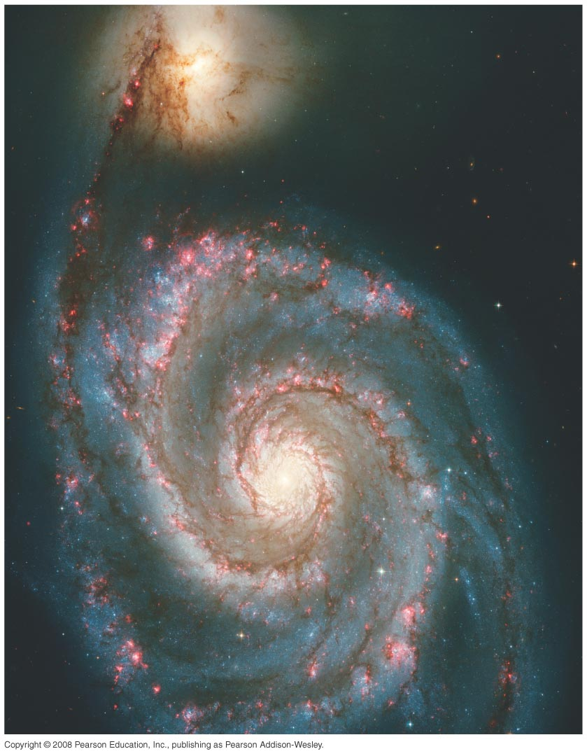
The Distance Ladder I.
Distances within the Milky Way
Notes:
Chapter 23 opener. Stars cluster into gargantuan assemblages called galaxies, of which our Milky Way Galaxy is just one among more than a hundred billion others. Our Sun sits in the suburbs of the Milky Way, nearly 30,000 light-years from its central regions, which appear to be a good deal more violent than the part of the Galaxy in which we live. Here, the graceful, winding arms of the majestic spiral galaxy, M51, also known as the Whirlpool Galaxy, resemble a curving staircase sweeping through space. Its size, shape and mass (minus the blob at top) resemble those of our own Galaxy. (STSCI)‏

Slide 16
Distance Scale
1. Distances within the Milky Way
a) Stellar and spectroscopic parallax
b) “Standard Candles” or “Beasts of a kind” concept
c) Herschel's star counts
d) “Intrinsic” Variable Stars
e) Other Distance Indicators

Slide 17
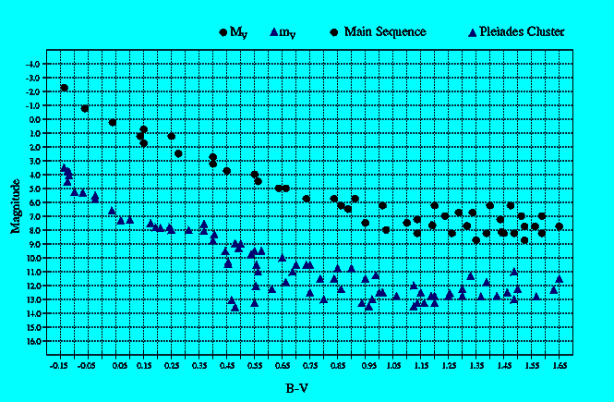
Stellar and Spectroscopic Parallax
Stellar Parallax: works out to 300pc (ground), 1000 pc (Hipparcos)‏
Spectroscopic Parallax: works for stars for which a good spectrum
can be observed (about 8 kpc).
Single stars – not precise
Clusters of stars – better! (“main-sequence fitting”)‏
m-M=5log(d/10)‏

Slide 18

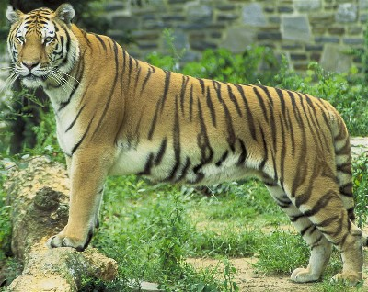
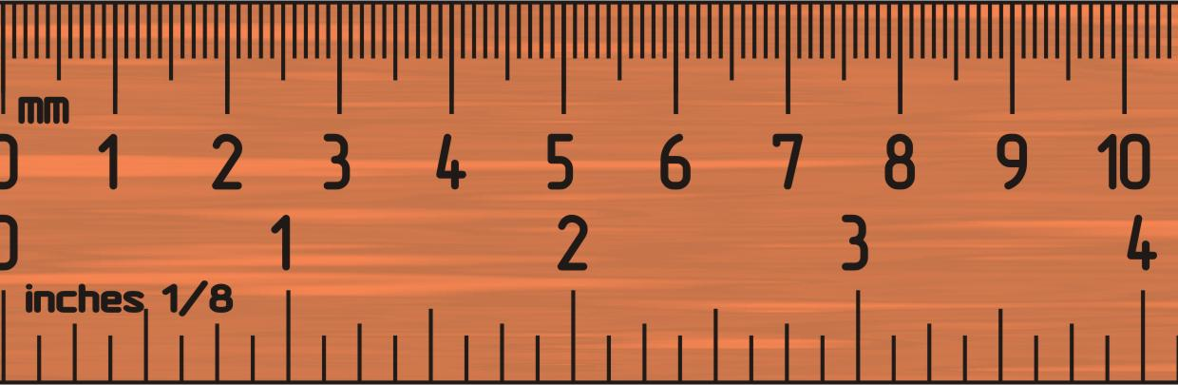
Standard Candles / Beasts of a kind
Nearby
Far away
Flux, I ~ 1/d²
Nearby
Far away
Angle, θ ~ 1/d

Slide 19
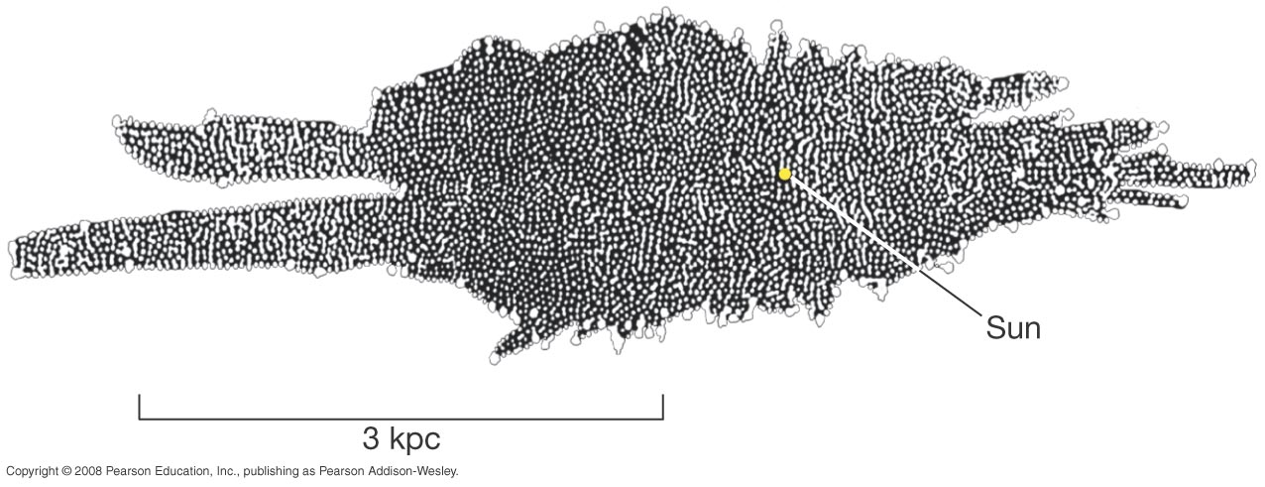
23.2 Measuring the Milky Way
One of the first attempts to measure the Milky Way was done by W. Herschel using visible stars.
Problems:
1. patchy dust blocked view! (extinction)‏
2. all stars do not have the same luminosity!!
Notes:
Figure 23-4. Herschel’s Galaxy Model Eighteenth-century astronomer William Herschel constructed this “map” of the Galaxy by counting the numbers of stars he saw in different directions of the sky. Our Sun (marked by the large yellow dot) appears to lie near the center of the distribution. The long axis of the diagram lies in the plane of the Galactic disk.

Slide 20
23.2 Variable stars & distances
Extrinsic variables: eclipsing binaries, rotating stars.
Cataclysmic variables: novae, supernovae.
Long period variables, semi-regular
``Intrinsic variables” - pulsating regularly: RR Lyrae stars and Cepheids.

Slide 21
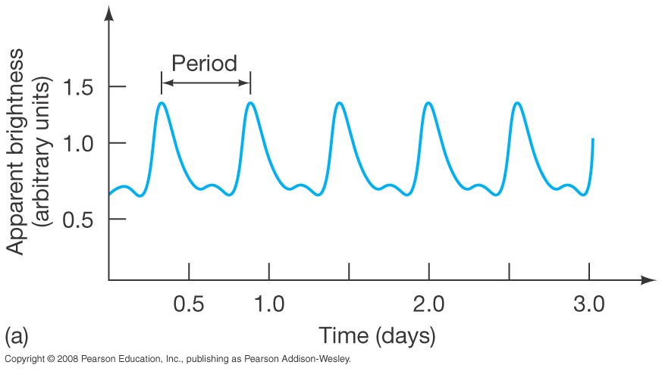
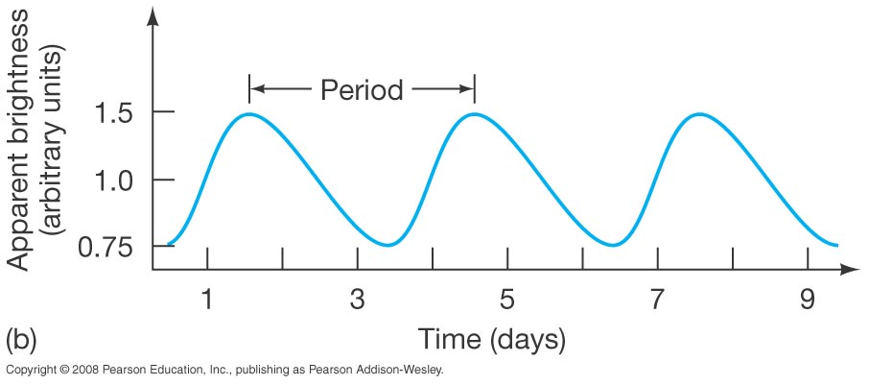
23.2 Variable stars & distances
The upper plot is an RR Lyrae star. All such stars have essentially the same luminosity curve with periods from 0.5 to 1 day.
The lower plot is a Cepheid variable; Cepheid periods range from about 1 to 100 days.
Notes:
Figure 23-5. Variable Stars (a) Light curve of the pulsating variable star RR Lyrae. All RR Lyrae-type variables have essentially similar light curves, with periods of less than a day. (b) The light curve of a Cepheid variable star called WW Cygni, having a period of several days.

Slide 22
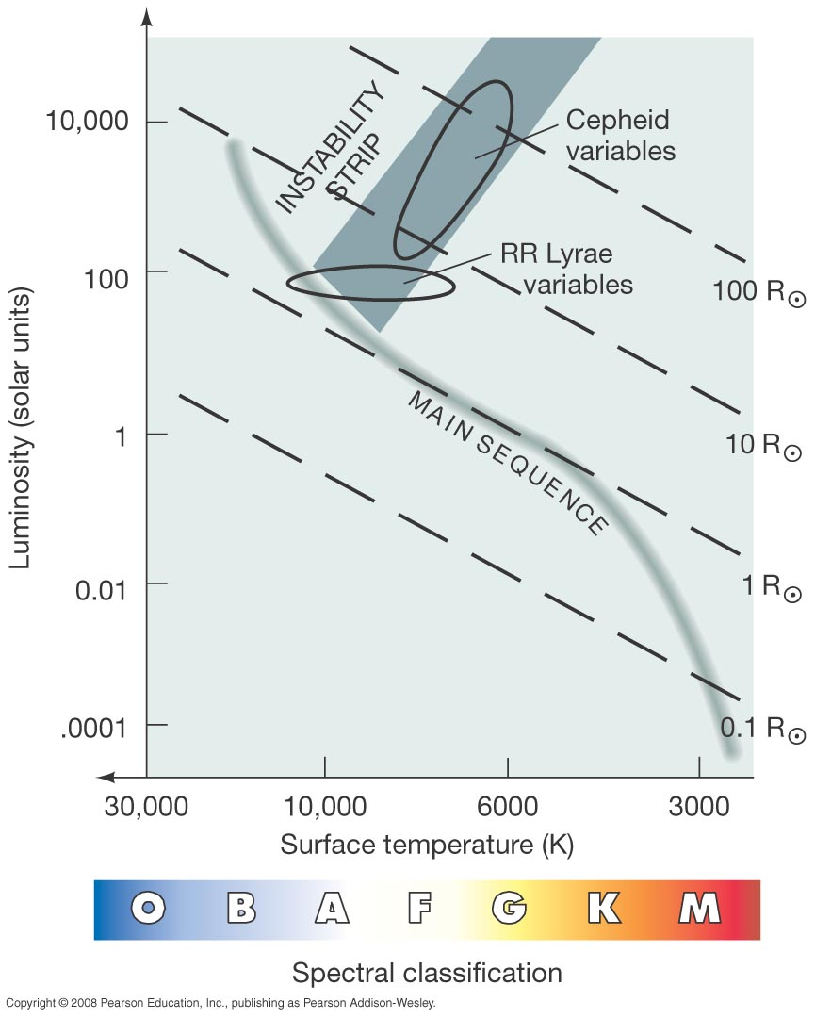
23.2 Variable stars & distances
The variability of these stars comes from a dynamic balance between gravity and pressure—they have large oscillations around stability.
Notes:
Figure 23-6. Variable Stars on the H–R Diagram Pulsating variable stars are found in the instability strip of the H–R diagram. As a high-mass star evolves through the strip, it becomes a Cepheid variable. Low-mass horizontal-branch stars in the instability strip are RR Lyrae variables.

Slide 23
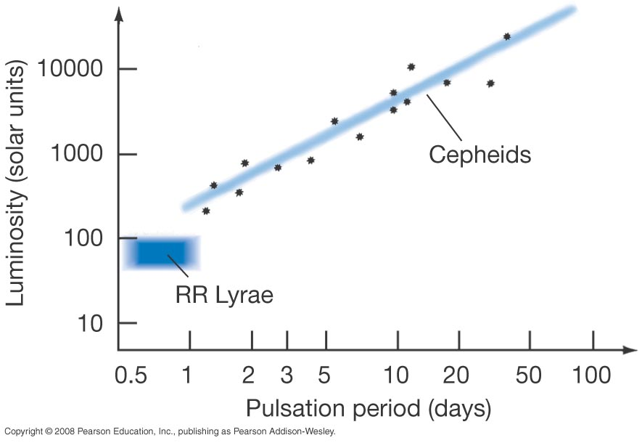
23.2 Variable stars & distances
The usefulness of these stars comes from their period–luminosity relation:
Notes:
Figure 23-7. Period–Luminosity Plot A plot of pulsation period versus average absolute brightness (that is, luminosity) for a group of Cepheid variable stars. The two properties are quite tightly correlated. The pulsation periods of some RR Lyrae variables are also shown.

Slide 24
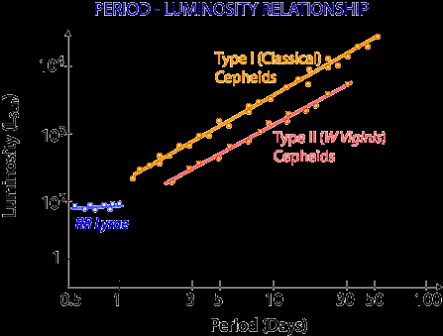
23.2 Variable stars & distances
Notes:
Figure 23-5. Variable Stars (a) Light curve of the pulsating variable star RR Lyrae. All RR Lyrae-type variables have essentially similar light curves, with periods of less than a day. (b) The light curve of a Cepheid variable star called WW Cygni, having a period of several days.

Slide 25
23.2 Variable stars & distances
This allows us to measure the distances to these stars:
RR Lyrae stars all have about the same luminosity; knowing their apparent magnitude allows us to calculate the distance.
Cepheids have a luminosity that is strongly correlated with the period of their oscillations; once the period is measured, the luminosity is known and we can proceed as above.

Slide 26
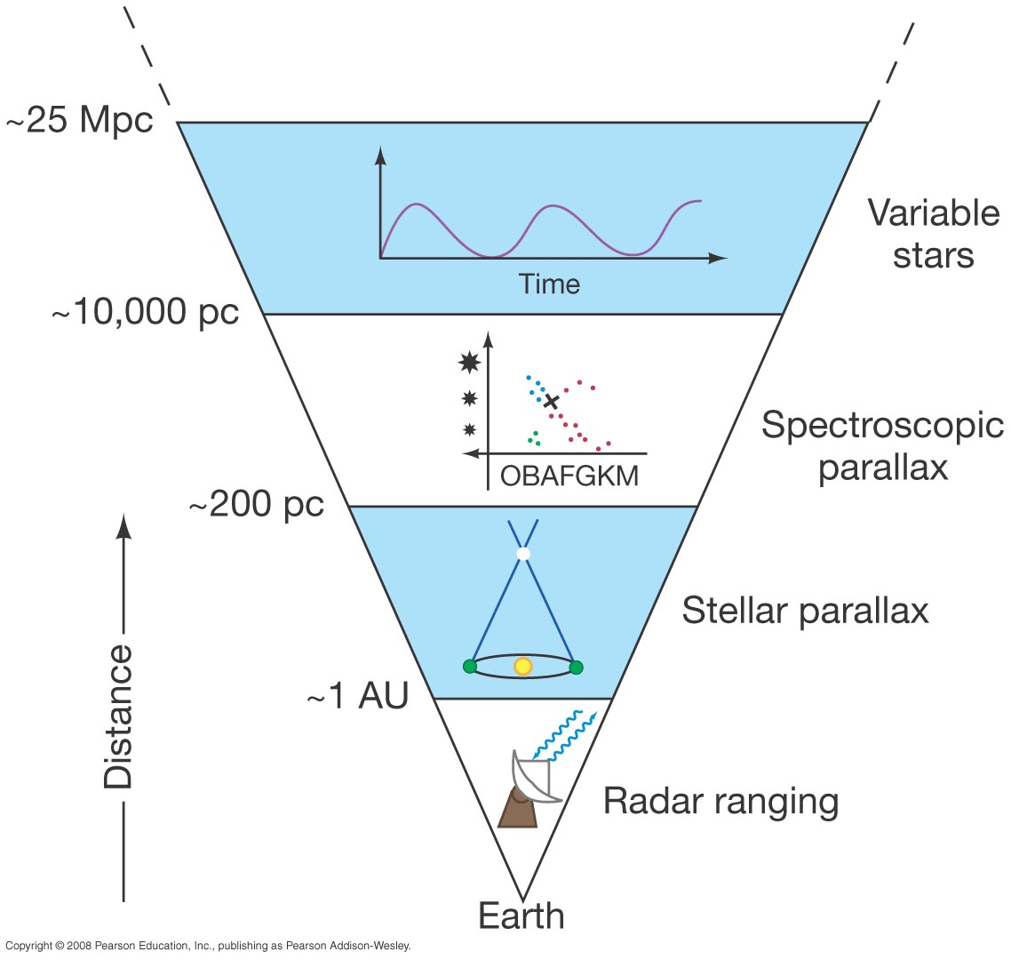
23.2 Measuring the Milky Way
We have now expanded our cosmic distance ladder one more step:
Notes:
Figure 23-8. Variable Stars on Distance Ladder Application of the period–luminosity relationship of Cepheid variable stars allows us to determine distances out to about 25 Mpc with reasonable accuracy.

Slide 27
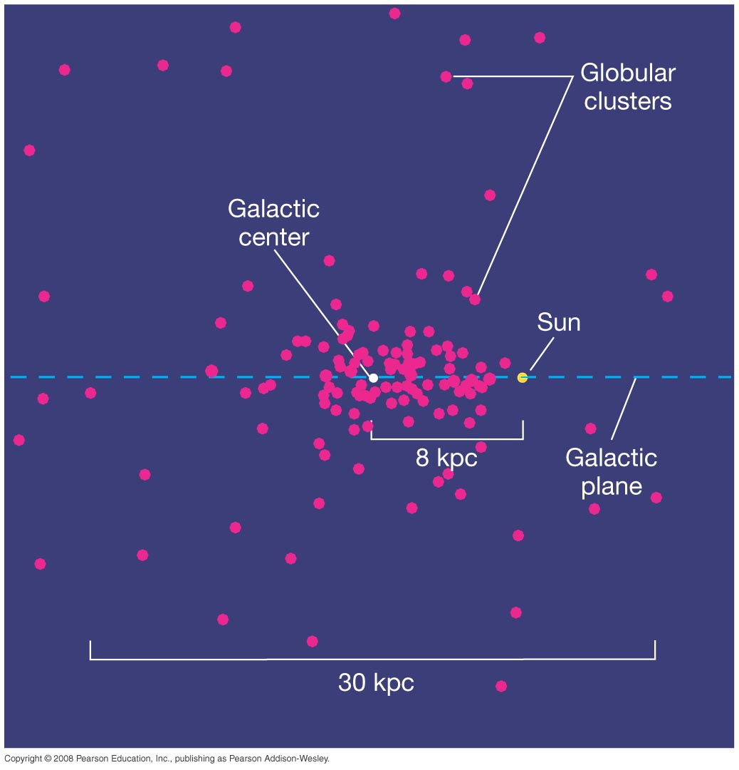
23.2 Measuring the Milky Way
Many RR Lyrae stars are found in globular clusters. Harlow Shapley used these to estimate the size of the M.W.
This yields a much more accurate picture of the extent of our galaxy and our place within it.
Notes:
Figure 23-9. Globular Cluster Distribution Our Sun does not coincide with the center of the very large collection of globular clusters (indicated by the pink dots). Instead, more globular clusters are found in one direction than in any other. The Sun resides closer to the edge of the collection, which measures roughly 30 kpc across. The globular clusters outline the true distribution of stars in the Galactic halo.

Slide 28
23.2 Other stellar distance indicators
Brightest blue stars
Brightest red stars
Tip of the red giant branch (TRGB)‏
Planetary nebula luminosity function (PNLF)‏
globular cluster luminosity function (GCLF)‏
Novae (see slide 41 of Stel.Evol.)‏
Supernovae
Notes:
Figure 23-9. Globular Cluster Distribution Our Sun does not coincide with the center of the very large collection of globular clusters (indicated by the pink dots). Instead, more globular clusters are found in one direction than in any other. The Sun resides closer to the edge of the collection, which measures roughly 30 kpc across. The globular clusters outline the true distribution of stars in the Galactic halo.

