Slide 1
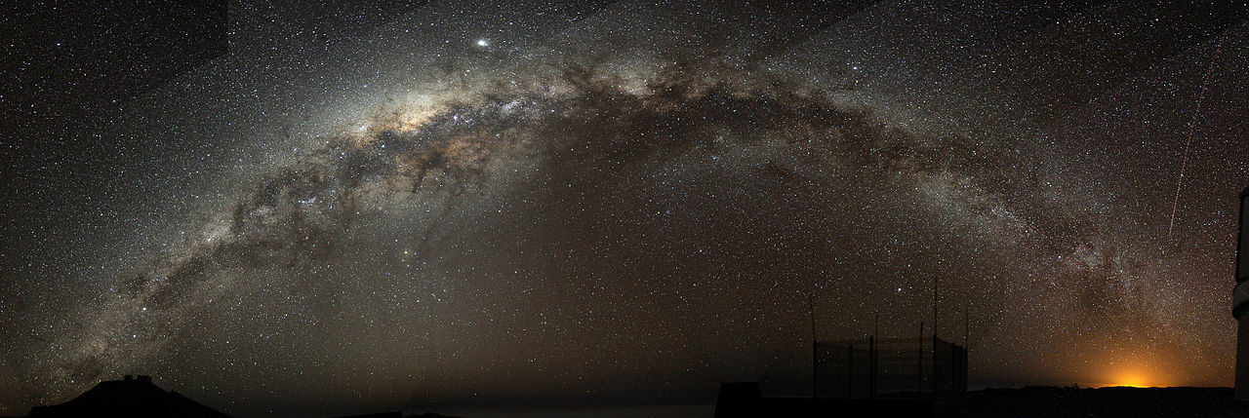
The Milky Way Galaxy
(Ch. 24)‏
Notes:
Chapter 23 opener. Stars cluster into gargantuan assemblages called galaxies, of which our Milky Way Galaxy is just one among more than a hundred billion others. Our Sun sits in the suburbs of the Milky Way, nearly 30,000 light-years from its central regions, which appear to be a good deal more violent than the part of the Galaxy in which we live. Here, the graceful, winding arms of the majestic spiral galaxy, M51, also known as the Whirlpool Galaxy, resemble a curving staircase sweeping through space. Its size, shape and mass (minus the blob at top) resemble those of our own Galaxy. (STSCI)‏

Slide 2
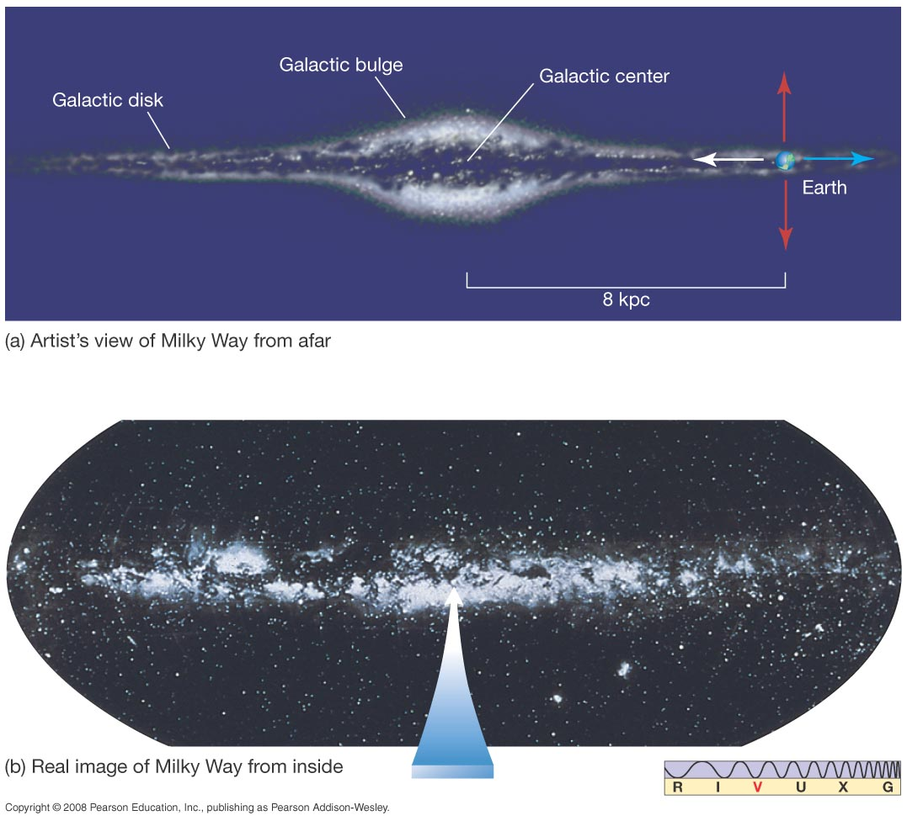
Our Parent Galaxy
Milky Way is what our galaxy appears as in the night sky.
Notes:
Figure 23-1. Galactic Plane (a) Gazing from Earth toward the Galactic center (white arrow) in this artist’s conception, we see myriad stars stacked up within the thin band of light known as the Milky Way. Looking in the opposite direction (blue arrow), we still see the Milky Way band, but now it is fainter because our Sun lies far from the Galactic center, so we see more stars when looking toward the center than when looking in the opposite direction. Looking perpendicular to the disk (red arrows), we see far fewer stars. (b) This is a real optical view of the sky all around us. The white band is the disk of our Milky Way Galaxy—dimly seen with the naked eye from very dark locations on Earth. This is what one sees looking toward the Galactic center—in the direction of the white arrow in part (a). (Lund Observatory)‏

Slide 3
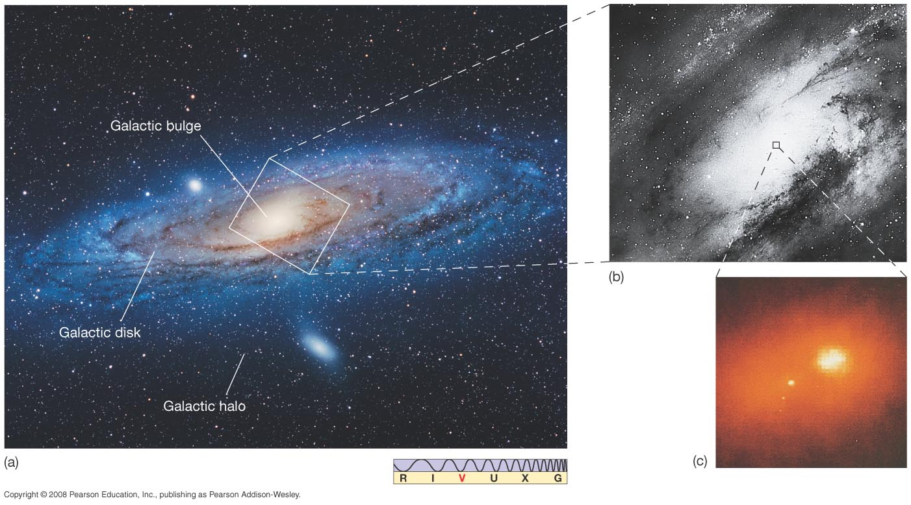
Our Parent Galaxy
Our galaxy is a spiral galaxy. The Andromeda Galaxy, our closest spiral neighbor, probably resembles the Milky Way fairly closely.
Notes:
Figure 23-2. Andromeda Structure (a) The Andromeda Galaxy probably resembles fairly closely the overall layout of our own Milky Way Galaxy. The disk and bulge are clearly visible in this image, which is about 30,000 pc across. The faint stars of the halo, completely surrounding the disk and bulge, cannot be seen here. The white stars sprinkled all across this image are not part of Andromeda’s halo; they are foreground stars in our own Galaxy, lying in the same region of the sky as Andromeda, but about a thousand times closer. (b) More detail within the inner parts of the galaxy. (c) The galaxy’s peculiar—and still unexplained—double core; this inset covers a region only 15 pc across. (R. Gendler; Palomar/Caltech; NASA)‏

Slide 4
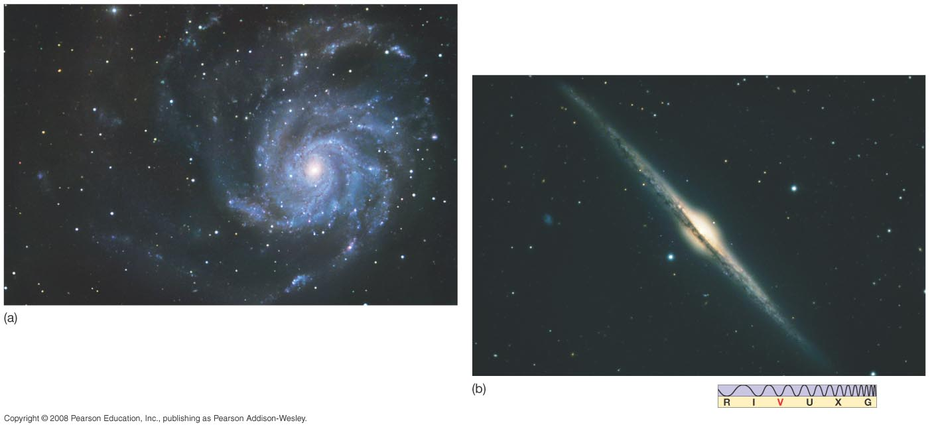
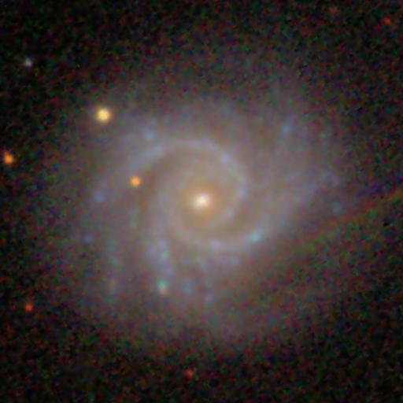
Our Parent Galaxy
Here are two other spiral galaxies, one viewed from the top and the other from the side:
“Face on” “Edge on”
Notes:
Figure 23-3. Spiral Galaxies (a) This galaxy, catalogued as M101 and seen nearly face-on, is somewhat similar in its overall structure to our own Milky Way Galaxy and Andromeda. (b) The galaxy NGC 4565 happens to be oriented in such a way that we see it edge-on, allowing us to make out its disk and central bulge. (R. Gendler)‏

Slide 5
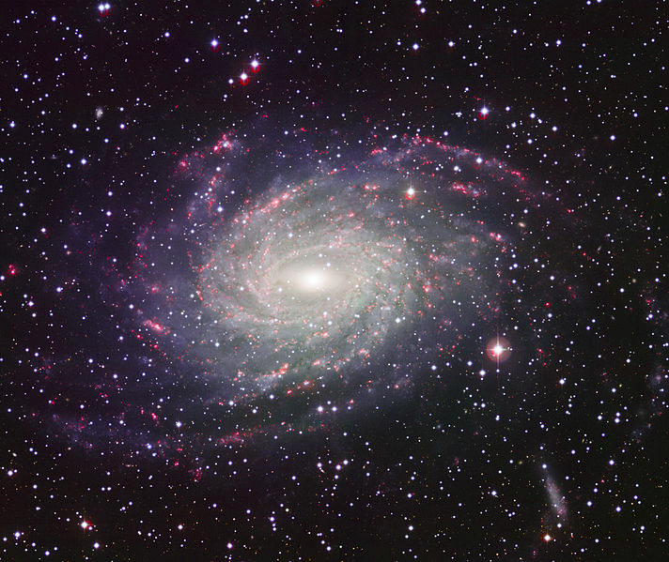
Our Parent Galaxy
Here is a better twin to the MW, NGC 6744.
Barred, medium-sized bulge, flocculant spiral.
Notes:
Figure 23-3. Spiral Galaxies (a) This galaxy, catalogued as M101 and seen nearly face-on, is somewhat similar in its overall structure to our own Milky Way Galaxy and Andromeda. (b) The galaxy NGC 4565 happens to be oriented in such a way that we see it edge-on, allowing us to make out its disk and central bulge. (R. Gendler)‏

Slide 6
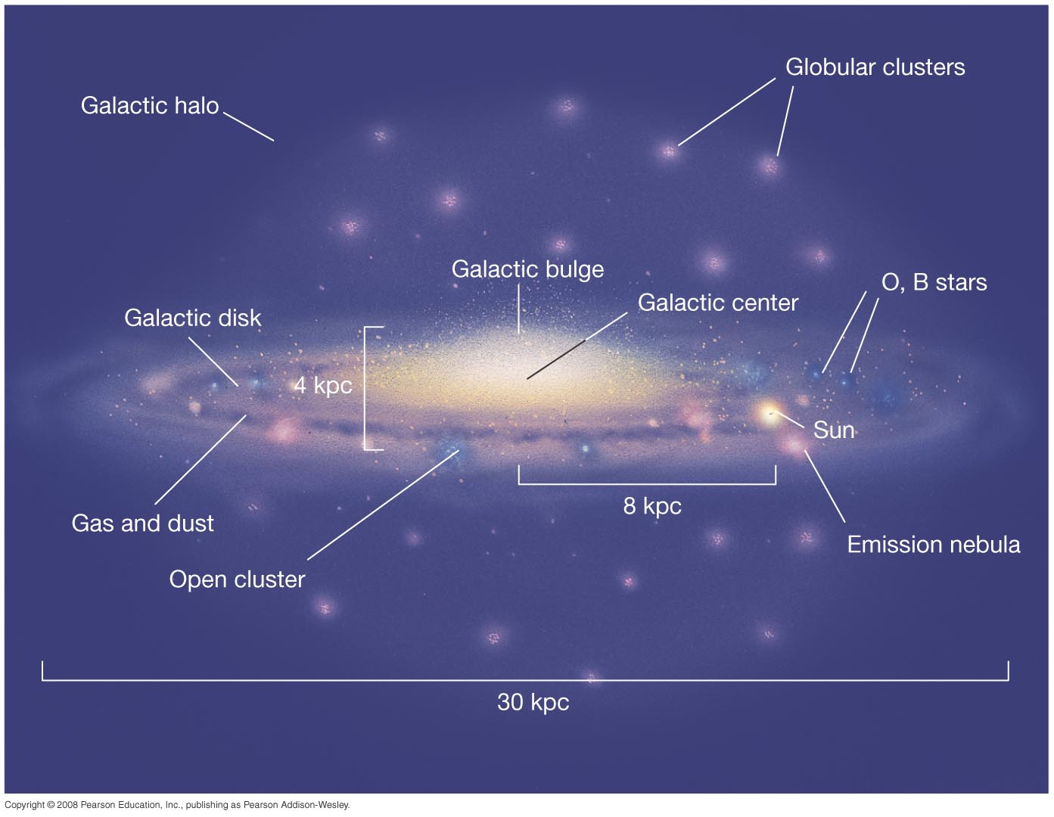
Galactic Structure
The various parts of our galaxy:
Notes:
Figure 23-10. Stellar Populations in Our Galaxy Artist’s conception of a (nearly) edge-on view of the Milky Way Galaxy, showing schematically the distributions of young blue stars, open clusters, old red stars, and globular clusters. (The brightness and size of our Sun are greatly exaggerated for clarity.)‏

Slide 7
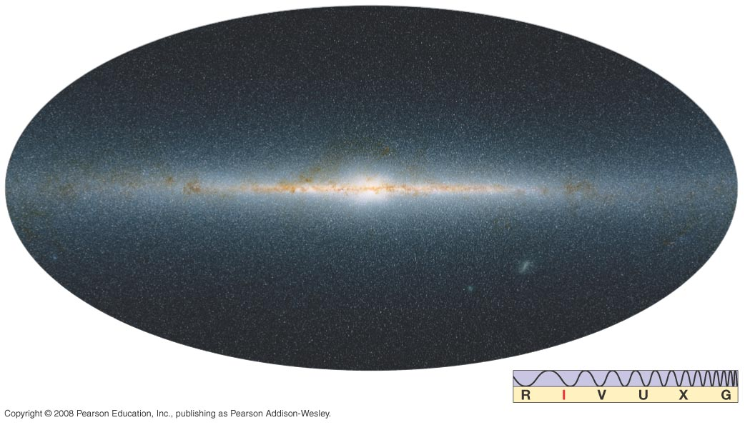
Galactic Structure
This infrared view of our galaxy shows much more detail of the galactic center than the visible-light view does, as infrared is not absorbed as much by gas and dust.
Notes:
Figure 23-11. Infrared View of the Milky Way A wide-angle infrared image of the disk and bulge of the Milky Way Galaxy, as observed by the Two Micron All Sky Survey. Compare Figure 23.3(b). (UMass/Caltech)‏

Slide 8
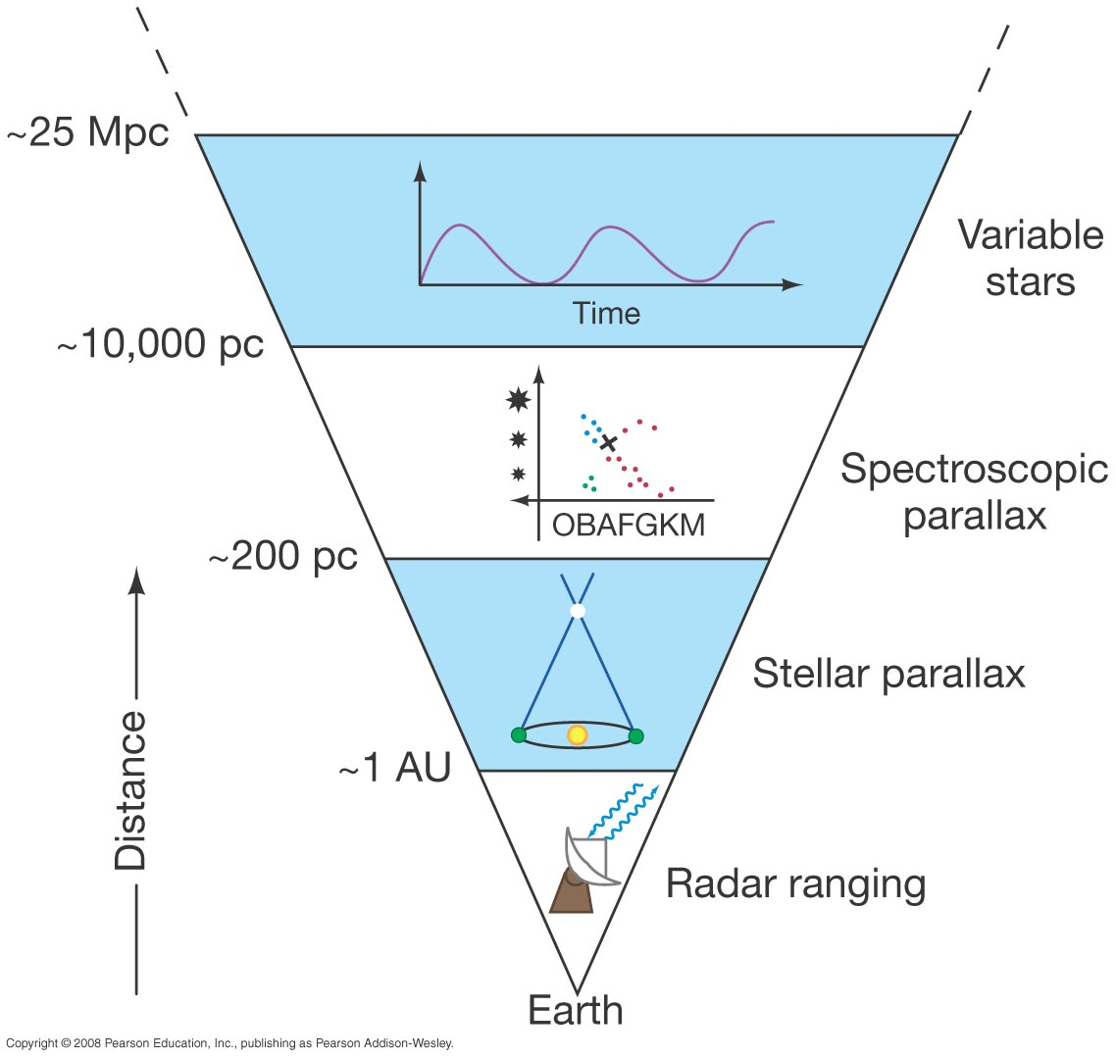
Measuring the Milky Way
We can measure distances to (bright) parts of the MW with many techniques: spec parallax, Cepheid and RR Lyrae variables, cluster sizes, expanding photospheres, moving cluster method, stat parallax, novae, etc, etc.
Finding Cepheids out to 25 Mpc was the original “Key” project for the Hubble Space Telescope.
Notes:
Figure 23-8. Variable Stars on Distance Ladder Application of the period–luminosity relationship of Cepheid variable stars allows us to determine distances out to about 25 Mpc with reasonable accuracy.

Slide 9
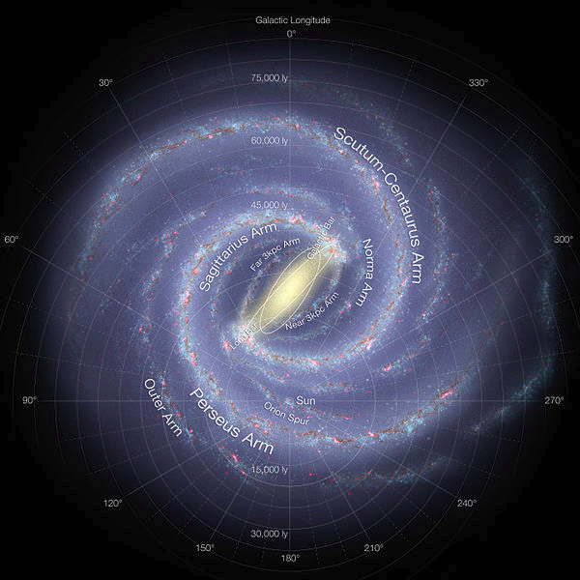
Measuring the Milky Way
Modern mapping of the M.W. Has relied on a variety of observations,
especially 20 cm radio observations of the HI gas.
Notes:
Figure 23-9. Globular Cluster Distribution Our Sun does not coincide with the center of the very large collection of globular clusters (indicated by the pink dots). Instead, more globular clusters are found in one direction than in any other. The Sun resides closer to the edge of the collection, which measures roughly 30 kpc across. The globular clusters outline the true distribution of stars in the Galactic halo.

Slide 10
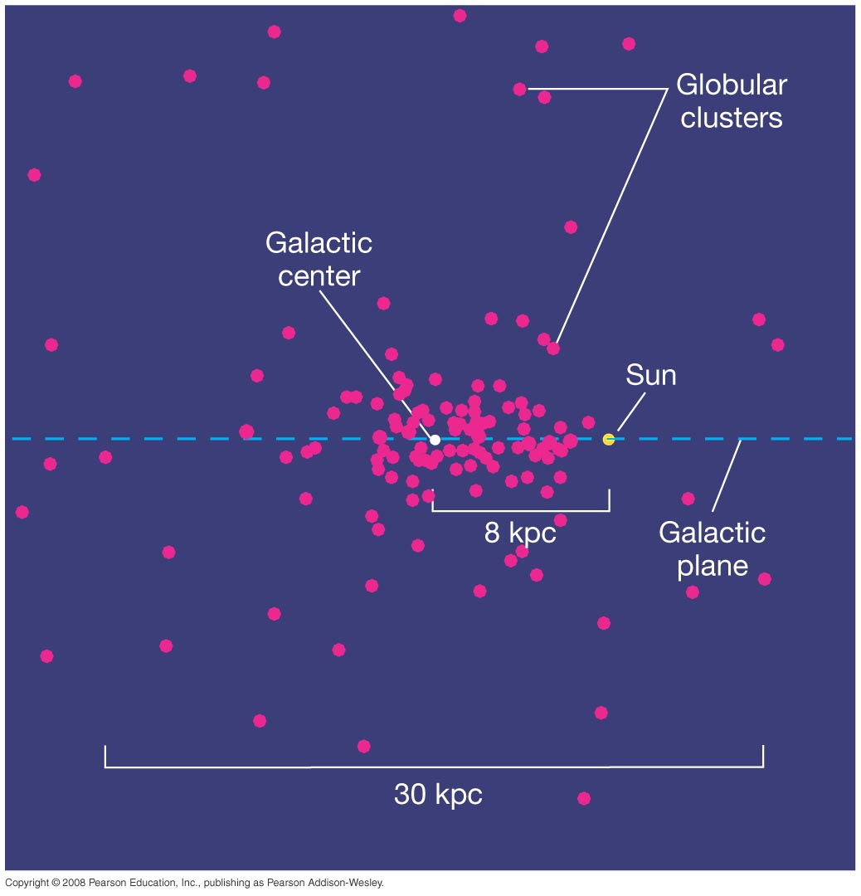
23.2 Measuring the Milky Way
Many RR Lyrae stars are found in globular clusters. Harlow Shapley used these to estimate the size of the M.W.
He correctly determined that we were far from the center. But he overestimated the size.
Notes:
Figure 23-9. Globular Cluster Distribution Our Sun does not coincide with the center of the very large collection of globular clusters (indicated by the pink dots). Instead, more globular clusters are found in one direction than in any other. The Sun resides closer to the edge of the collection, which measures roughly 30 kpc across. The globular clusters outline the true distribution of stars in the Galactic halo.

Slide 11
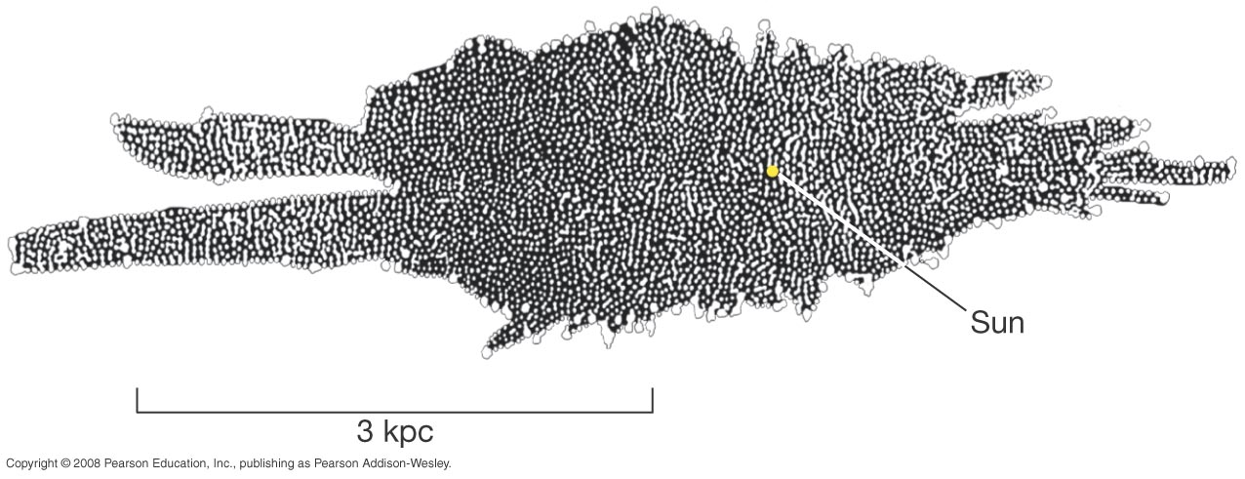
Measuring the Milky Way
One of the first attempts to measure the Milky Way was done by W. Herschel (1738-1822) using visible stars.
Problems:
1. patchy dust blocked view! (extinction)‏
2. all stars do not have the same luminosity!!
Notes:
Figure 23-4. Herschel’s Galaxy Model Eighteenth-century astronomer William Herschel constructed this “map” of the Galaxy by counting the numbers of stars he saw in different directions of the sky. Our Sun (marked by the large yellow dot) appears to lie near the center of the distribution. The long axis of the diagram lies in the plane of the Galactic disk.

Slide 12
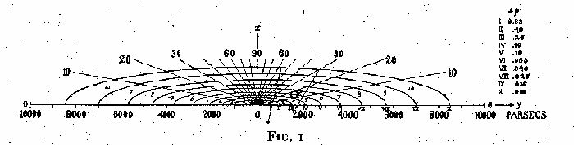
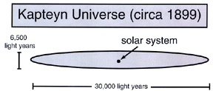
Measuring the Milky Way
A model based on star brightnesses, types, & motions was done by Jacobus Kapteyn (1850-1922).
Still lacked corrections for
extinction.
Sun 2000 LY from center.
1920
Notes:
Figure 23-4. Herschel’s Galaxy Model Eighteenth-century astronomer William Herschel constructed this “map” of the Galaxy by counting the numbers of stars he saw in different directions of the sky. Our Sun (marked by the large yellow dot) appears to lie near the center of the distribution. The long axis of the diagram lies in the plane of the Galactic disk.

Slide 13
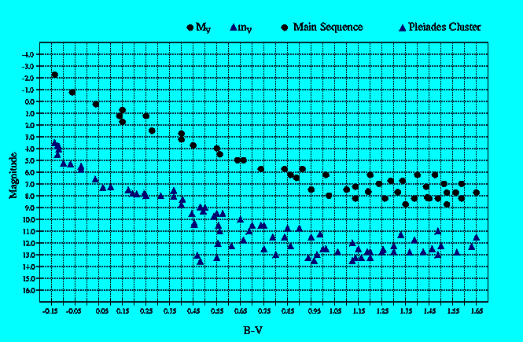
Stellar and Spectroscopic Parallax
Stellar Parallax works out to 200pc (ground), 1000 pc (Hipparcos)‏
Spectroscopic Parallax works for stars for which a good spectrum
can be observed (about 8 kpc), but ...
Not precise for individual stars, especially giants
Entire clusters of stars works better! (“main-sequence fitting”)‏
m-M=5log(d/10)‏
Spec Parallax assumes, for example, that all A0V stars have the same M.
That makes A0V stars “standard candles”.

Slide 14

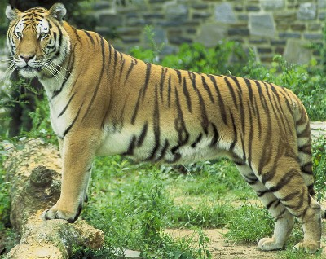
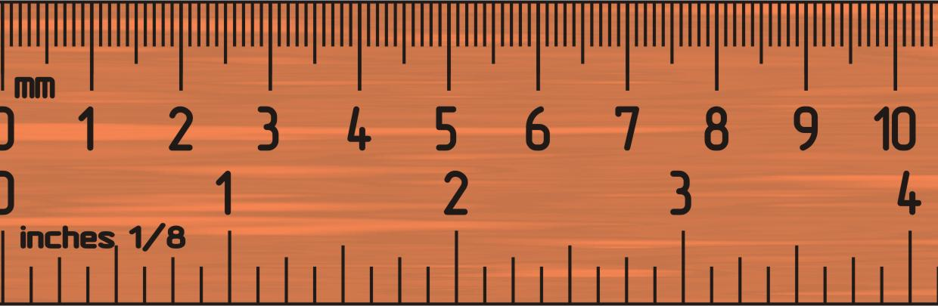
Beasts of a kind: standard candles/yardsticks
Nearby
Far away
Flux, I ~ 1/d²
Nearby
Far away
Angle, θ ~ 1/d

Slide 15
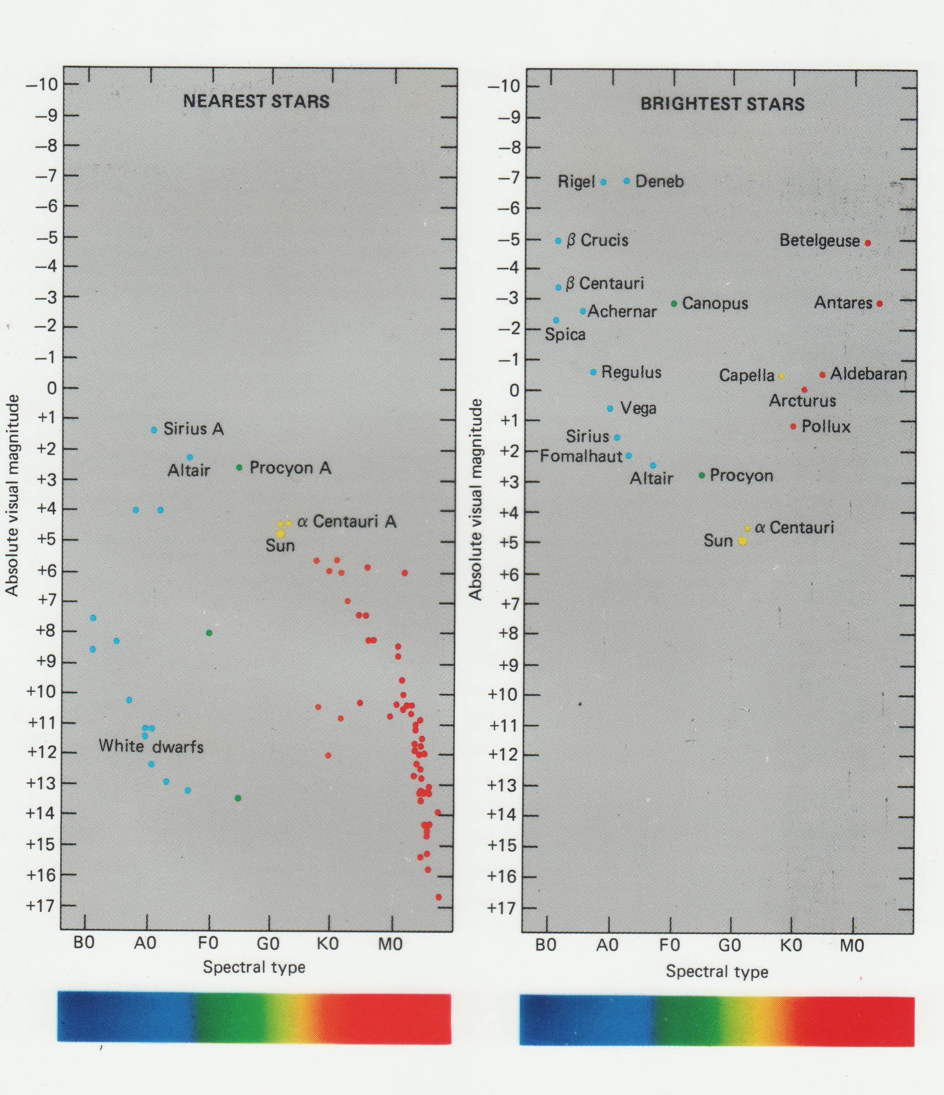
Measuring the Milky Way
If we want to use stars to probe the geometry of the MW, we need to know about their demography.
Near stars: faint.
Brightest: luminous.
Notes:
Figure 23-4. Herschel’s Galaxy Model Eighteenth-century astronomer William Herschel constructed this “map” of the Galaxy by counting the numbers of stars he saw in different directions of the sky. Our Sun (marked by the large yellow dot) appears to lie near the center of the distribution. The long axis of the diagram lies in the plane of the Galactic disk.

Slide 16
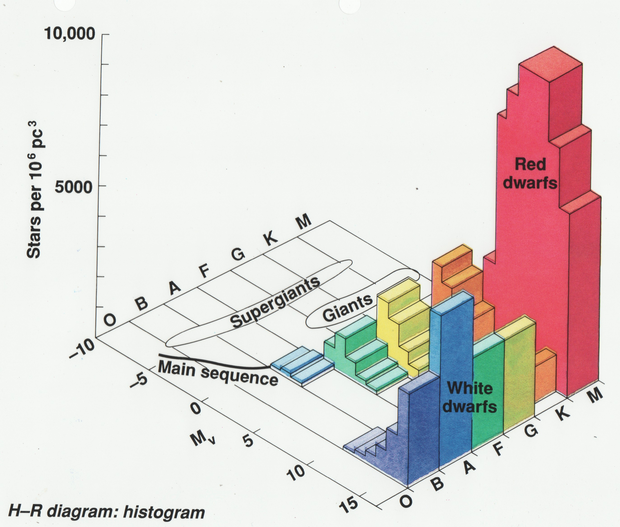
Measuring the Milky Way
Studies of volume-limited samples reveal the rarity of luminous stars.
Notes:
Figure 23-4. Herschel’s Galaxy Model Eighteenth-century astronomer William Herschel constructed this “map” of the Galaxy by counting the numbers of stars he saw in different directions of the sky. Our Sun (marked by the large yellow dot) appears to lie near the center of the distribution. The long axis of the diagram lies in the plane of the Galactic disk.

Slide 17
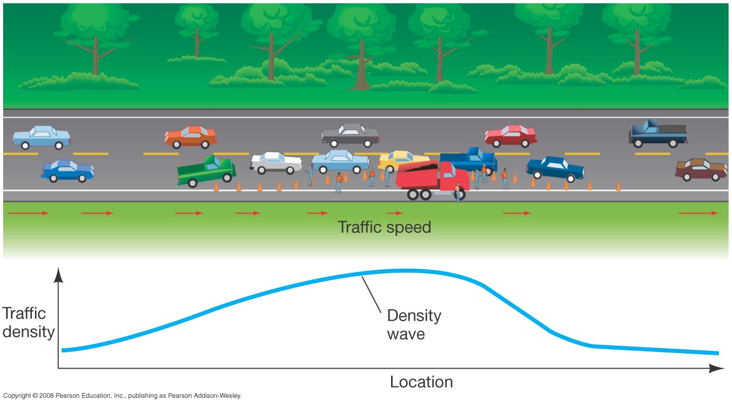
Discovery 23-2: Density Waves
Spiral arms as density waves, rather than as structures made up of particular stars, may be understood using a traffic jam analogy. The jam persists even though particular cars move in and out of it, and it can persist long after the event that triggered it is over.

Slide 18
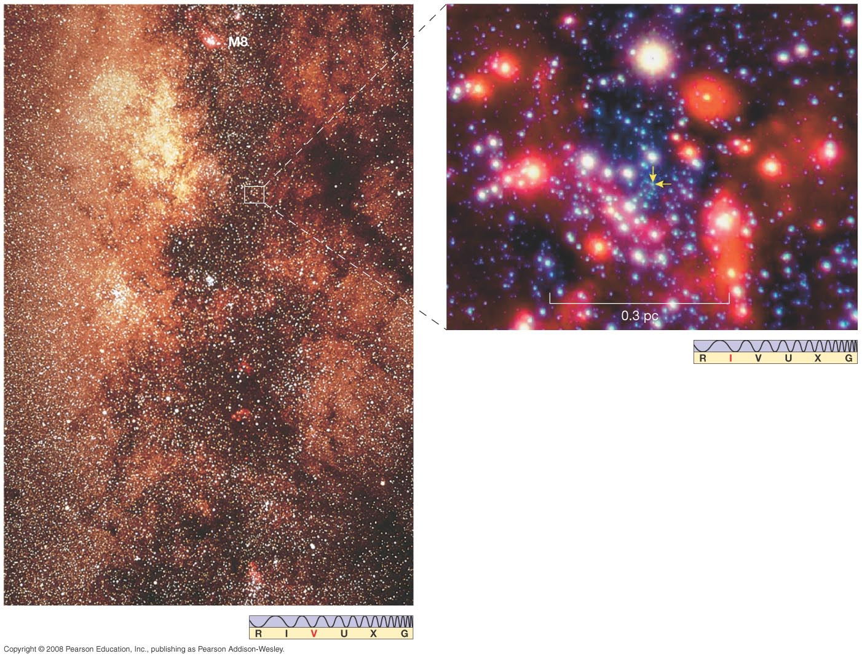
23.7 The Galactic Center
Two views toward the galactic center.
Notes:
Figure 23-24. Galactic Center Photograph of stellar and interstellar matter in the direction of the Galactic center. Because of heavy obscuration, even the largest optical telescopes can see no farther than one-tenth the distance to the center. To connect with previous Figures, the M8 nebula can be seen at extreme top center. (Sec. 18.2) The field is roughly 20° vertically across and is a continuation of the bottom part of Figure 18.6. The overlaid box outlines the location of the center of our Galaxy. The inset shows an adaptive-optics infrared view of the dense stellar cluster surrounding the Galactic center, whose very core is indicated by the twin arrows. (AURA; ESO)‏

Slide 19
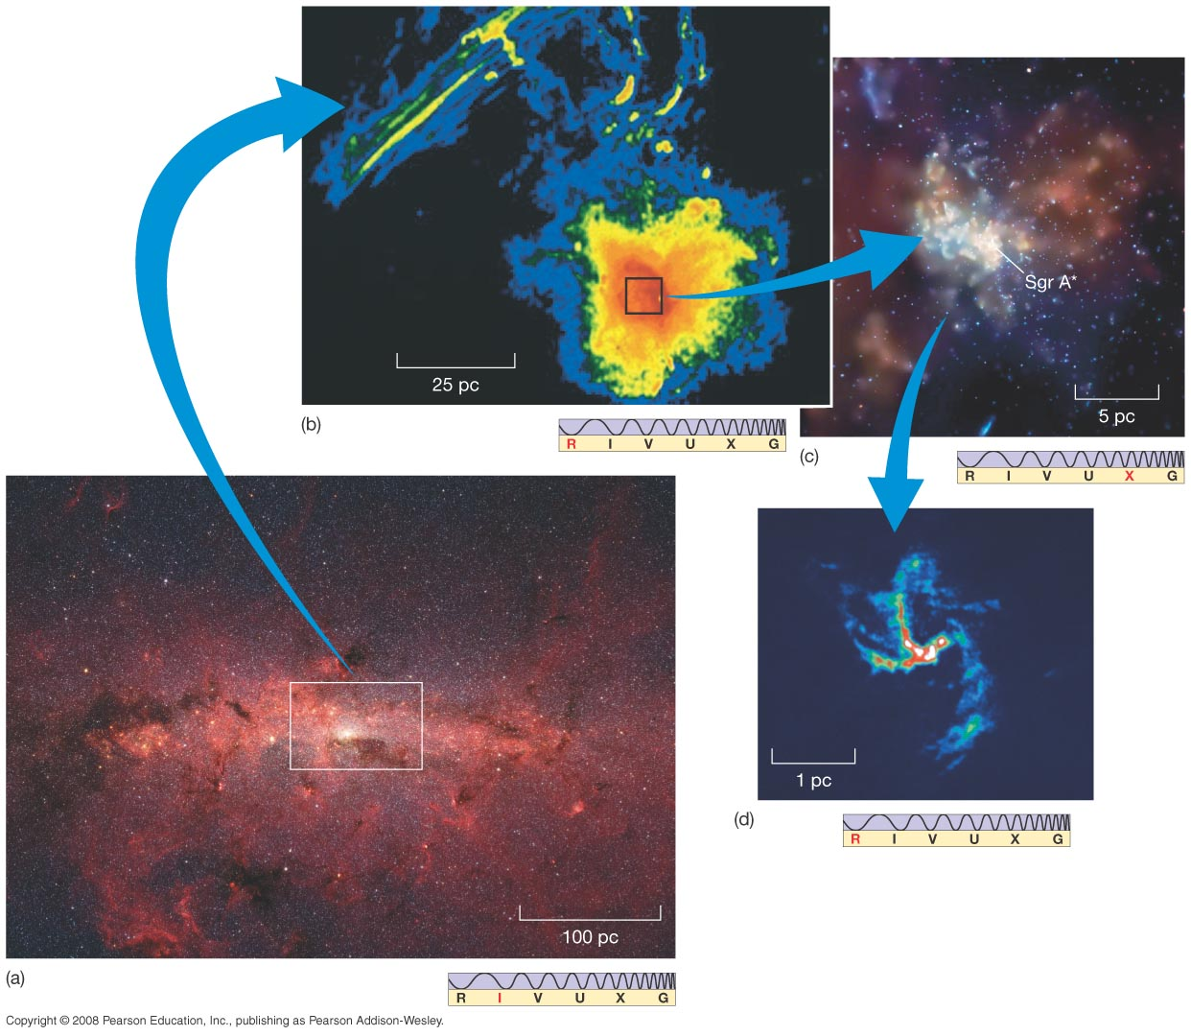
23.7 The Galactic Center
These images—in infrared, radio, and X-ray—offer a different view of the galactic center:
Notes:
Figure 23-25. Galactic Center Close-Up (a) An infrared image of part of the Galactic plane shows many bright stars packed into a relatively small volume surrounding the Galactic center (white box). The average density of matter in this boxed region is estimated to be about a million times that in the solar neighborhood. (b) The central portion of our Galaxy, as observed in the radio part of the spectrum. This image shows a region about 100 pc across surrounding the Galactic center (which lies within the bright blob at the bottom right). The long-wavelength radio emission cuts through the Galaxy’s dust, providing a view of matter in the immediate vicinity of the Galaxy’s center. (c) A recent Chandra image showing the relation of a hot supernova remnant (red) and Sgr A*, the suspected black hole at the very center of our Galaxy. (d) The spiral pattern of radio emission arising from Sagittarius A itself suggests a rotating ring of matter only a few parsecs across. All images are false-color, since they lie outside the visible spectrum. (SST; NRAO; NASA)‏

Slide 20
23.7 The Galactic Center
The galactic center appears to have:
A stellar density a million times higher than near Earth – a nuclear star cluster.
A ring of molecular gas 400 pc across
Strong magnetic fields
A rotating ring or disk of matter a few parsecs across
A strong X-ray source at the center, thought to be a …
Supermassive Black Hole (4x10⁶ Msun)

Slide 21
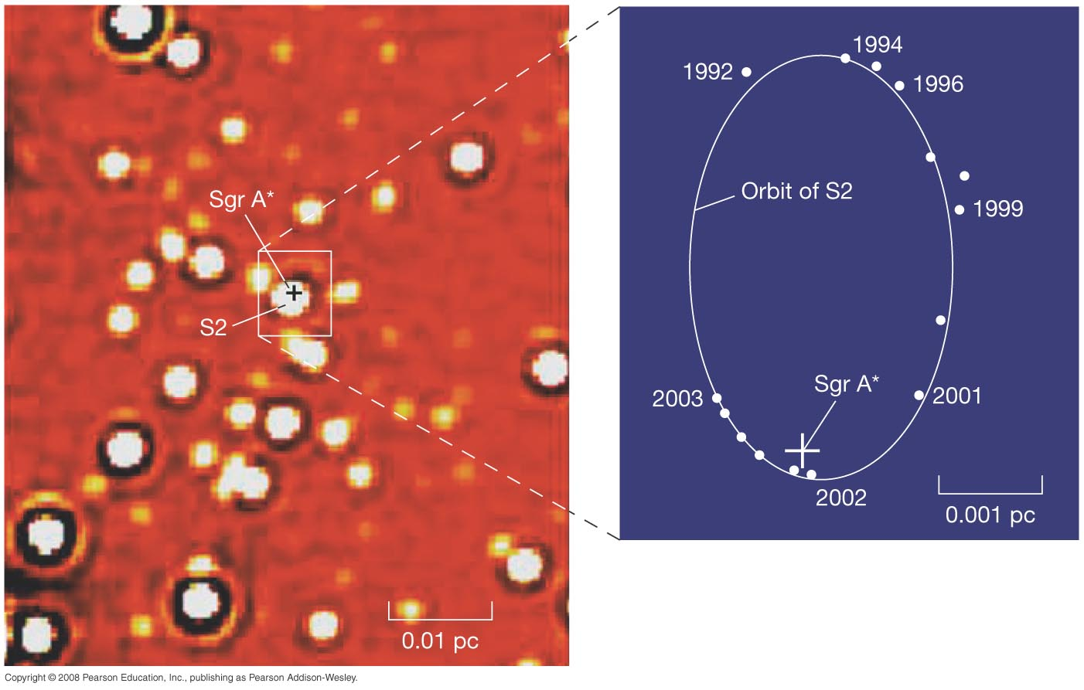
23.7 The Galactic Center
These objects are very close to the galactic center. The orbit on the right is the best fit; it's consistent with a central black hole of 3.7* million solar masses.
*Recent estimates are 4.0 million
Notes:
Figure 23-26. Orbits Near the Galactic Center This extremely close-up map of the Galactic center (left) was obtained by infrared adaptive optics, resulting in an ultra-high-resolution image of the innermost 0.1 pc of the Milky Way. The resolution is high enough that the orbits of individual stars can be tracked with confidence around a still-unseen Sgr A* (marked with a cross). The inset shows the orbit of the innermost star in the frame, labeled S2, between 1992 and 2003. The solid line shows the best-fitting orbit for S2 around a black hole of 3.7 million solar masses, located at Sgr A*. (ESO)‏

Slide 22
Units of Chapter 23
1. Our Milky Way Galaxy
a) Dimensions and structure
b) Spiral Arms
c) Mass and Dark Matter
d) Nucleus
2. Distances within the Milky Way
a) Stellar and spectroscopic parallax
b) “Standard Candle” or “Beasts of a kind” concept
c) Herschel's (& Kaptyn's) star counts
d) “Intrinsic” Variable Stars
e) Other Distance Indicators

Slide 23
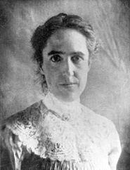
23.2 Variable stars & distances
Extrinsic variables: eclipsing binaries
Cataclysmic variables: novae, supernovae.
``Intrinsic variables” - pulsating regularly: RR Lyrae stars and Cepheids. - very good for distances!
Long period, semi-regular variables (like Mira) – not good for distances
Henrietta Leavitt: measured Cepheids in
the Magellanic Clouds. Finds P-L relation!

Slide 24
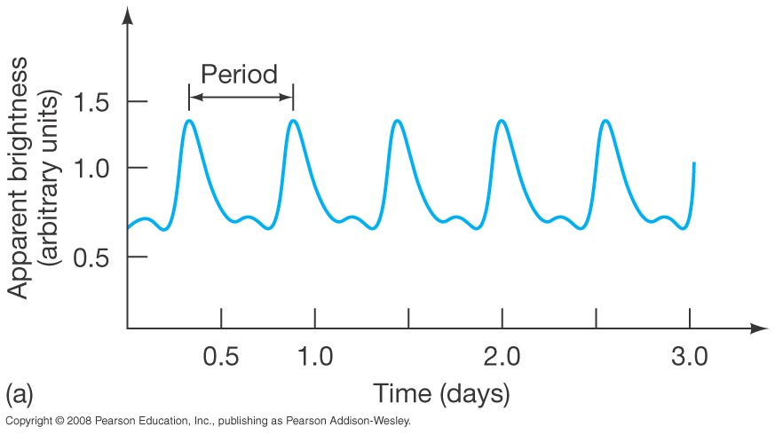
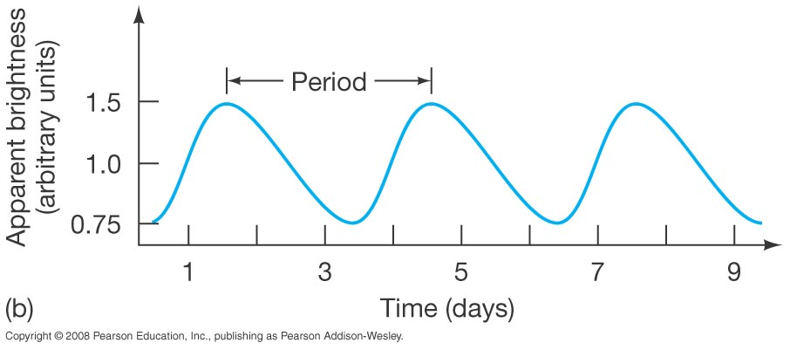
23.2 Variable stars & distances
The upper plot is an RR Lyrae star. All such stars have essentially the same luminosity curve with periods from 0.5 to 1 day.
The lower plot is a Cepheid variable; Cepheid periods range from about 1 to 100 days.
Notes:
Figure 23-5. Variable Stars (a) Light curve of the pulsating variable star RR Lyrae. All RR Lyrae-type variables have essentially similar light curves, with periods of less than a day. (b) The light curve of a Cepheid variable star called WW Cygni, having a period of several days.

Slide 25
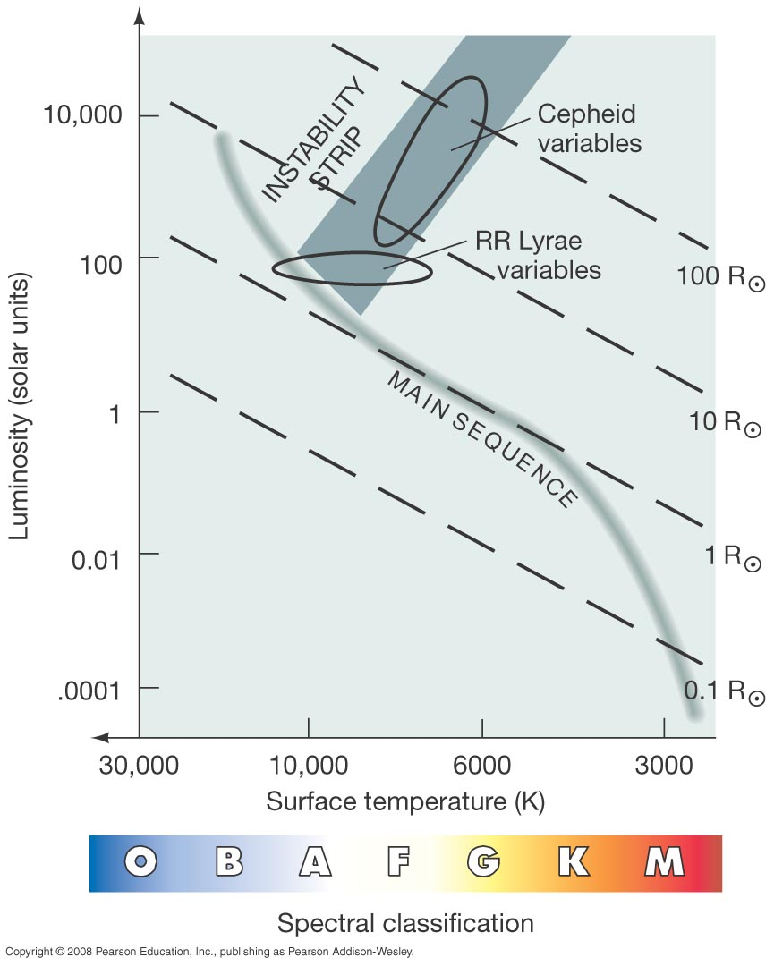
23.2 Variable stars & distances
The variability of these stars comes from a dynamic balance between gravity and pressure—they have large oscillations around stability.
- HeIII opacity-
Notes:
Figure 23-6. Variable Stars on the H–R Diagram Pulsating variable stars are found in the instability strip of the H–R diagram. As a high-mass star evolves through the strip, it becomes a Cepheid variable. Low-mass horizontal-branch stars in the instability strip are RR Lyrae variables.

Slide 26
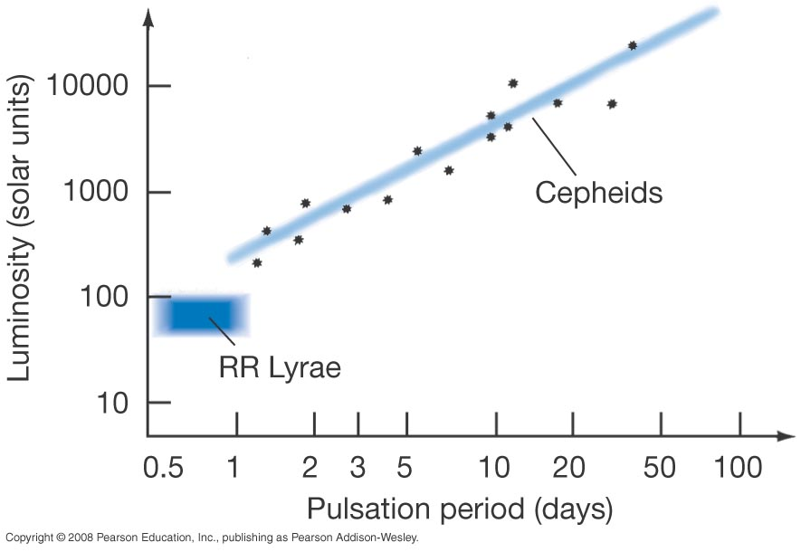
23.2 Variable stars & distances
The usefulness of these stars comes from their period–luminosity relation:
These are just “Classical” Cepheids, like those observed by Leavitte in the SMC.
Notes:
Figure 23-7. Period–Luminosity Plot A plot of pulsation period versus average absolute brightness (that is, luminosity) for a group of Cepheid variable stars. The two properties are quite tightly correlated. The pulsation periods of some RR Lyrae variables are also shown.

Slide 27
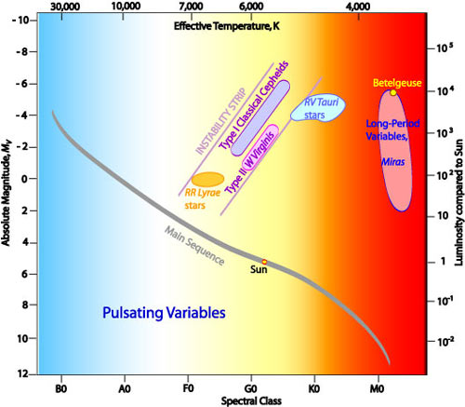
23.2 Variable stars & distances
It was later realized that there was a fainter,
population II version of the Cepheid.
Notes:
Figure 23-7. Period–Luminosity Plot A plot of pulsation period versus average absolute brightness (that is, luminosity) for a group of Cepheid variable stars. The two properties are quite tightly correlated. The pulsation periods of some RR Lyrae variables are also shown.

Slide 28
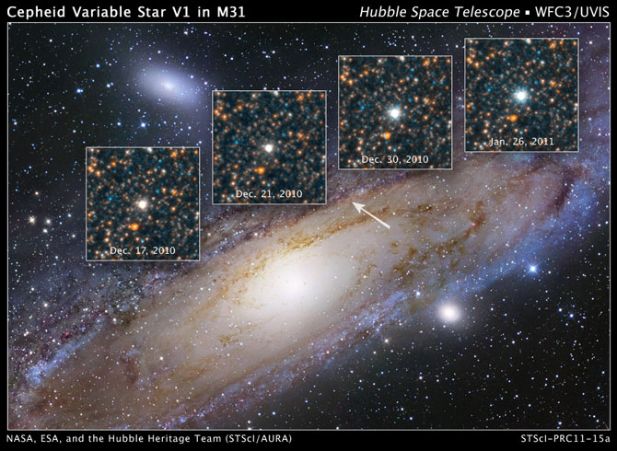
23.2 Measuring the Milky Way - and beyond!
Notes:
Figure 23-8. Variable Stars on Distance Ladder Application of the period–luminosity relationship of Cepheid variable stars allows us to determine distances out to about 25 Mpc with reasonable accuracy.

Slide 29
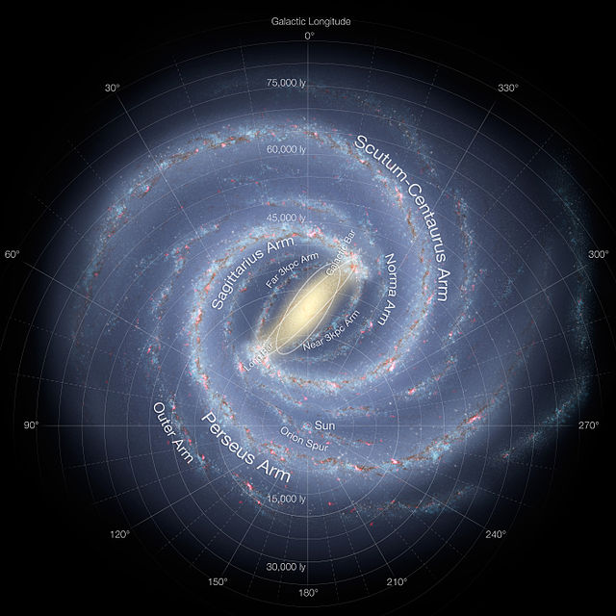
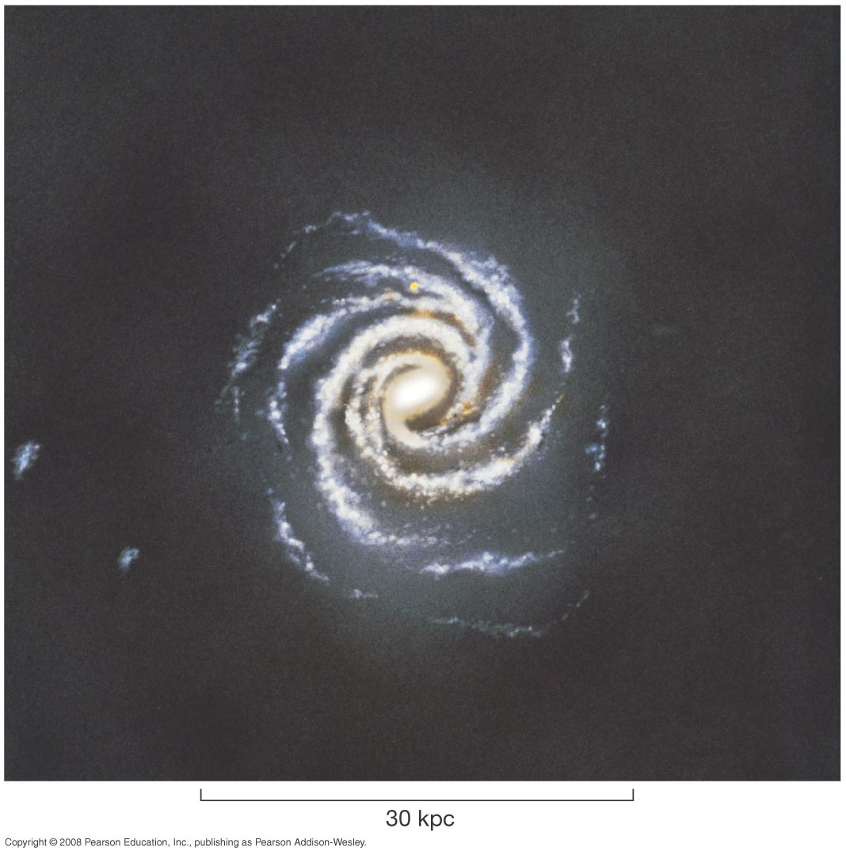
Galactic Structure
Measurement of the position and motion of gas clouds shows that the Milky Way has a spiral form:
See Wikipedia “Milky Way” for better diagrams.
Notes:
Figure 23-16. Milky Way Spiral Structure An artist’s conception of our Milky Way Galaxy seen face-on. This illustration is based on data accumulated by legions of astronomers during the past few decades, including radio and infrared maps of gas and dust in the Galactic disk. Painted from the perspective of an observer 100 kpc above the Galactic plane, the spiral arms are at their best-determined positions, apparently emanating from a bar whose length is twice its width. All the features are drawn to scale (except for the oversized yellow dot near the top, which represents our Sun). The two small blotches to the left are irregular dwarf galaxies, called the Magellanic Clouds. We will study them in Chapter 24. (L. Chaisson)‏

Slide 30
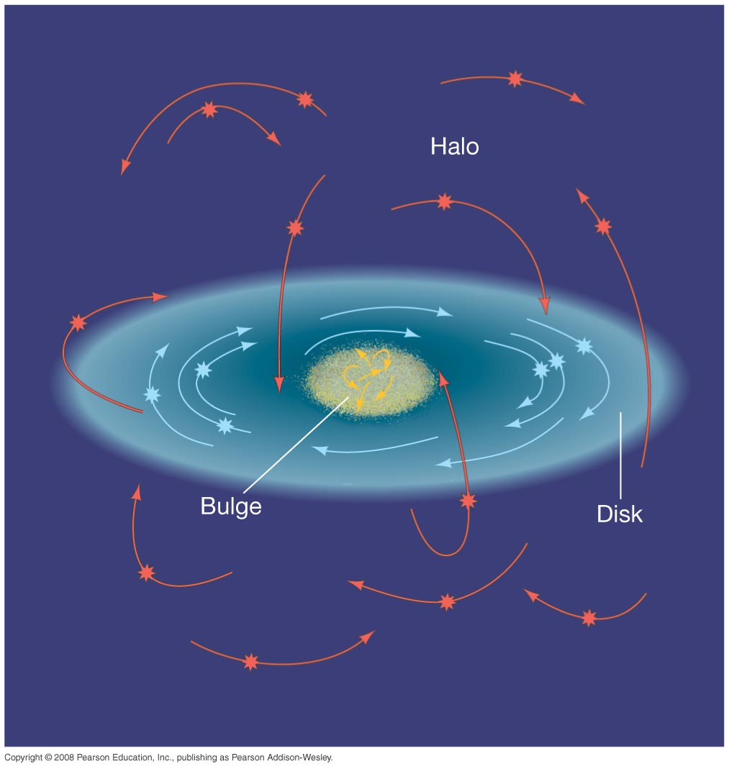
23.3 Galactic Structure - kinematics
Stellar orbits in the disk move in a common plane (co-planar) and in the same direction.
The orbits in the halo and bulge are much more random (isotropic).
Notes:
Figure 23-13. Stellar Orbits in Our Galaxy Stars in the Galactic disk (blue curves) move in orderly, circular orbits about the Galactic center. In contrast, halo stars (orange curves) have orbits with largely random orientations and eccentricities. The orbit of a typical halo star takes it high above the Galactic disk, then down through the disk plane, and then out the other side and far below the disk. The orbital properties of bulge stars are intermediate between those of disk stars and those of halo stars.

Slide 31
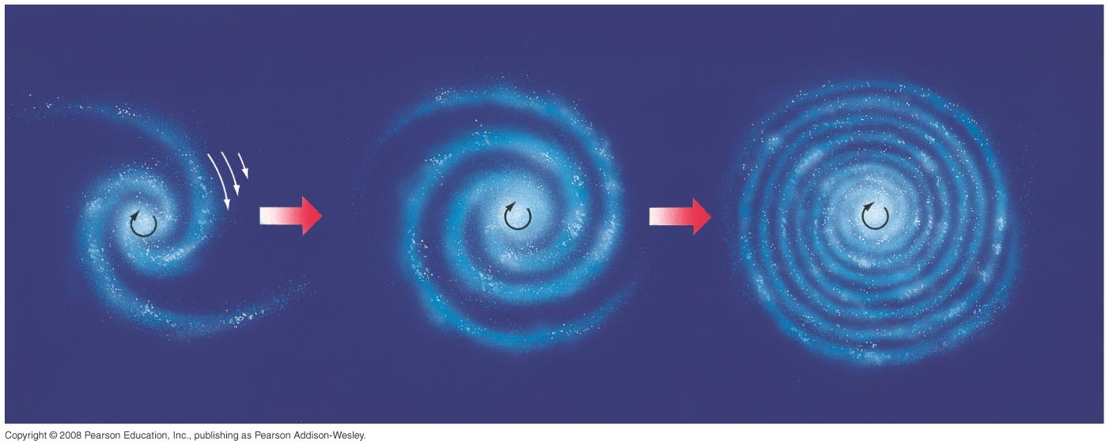
23.5 Galactic Spiral Arms
The spiral arms cannot rotate exactly as the stars do; they would “wind up”.
(The “winding problem”.)
The speed of the stars is almost constant with radius, so inner stars make it around in less time than outer stars. The period is ~240 Myrs. MW formed ~50 rotations ago.
ago.
Notes:
Figure 23-17. Differential Galactic Rotation The disk of our Galaxy rotates differentially—stars close to the Galactic center take less time to orbit the center than those farther out. (The white arrows represent angular speed of the disk; the big red arrows denote time evolution from left to right.) If spiral arms were somehow tied to the material of the Galactic disk, this differential rotation would cause the spiral pattern to wind up and disappear in a few hundred million years. Spiral arms would be too short-lived to be consistent with the numbers of spiral galaxies we observe today.

Slide 32
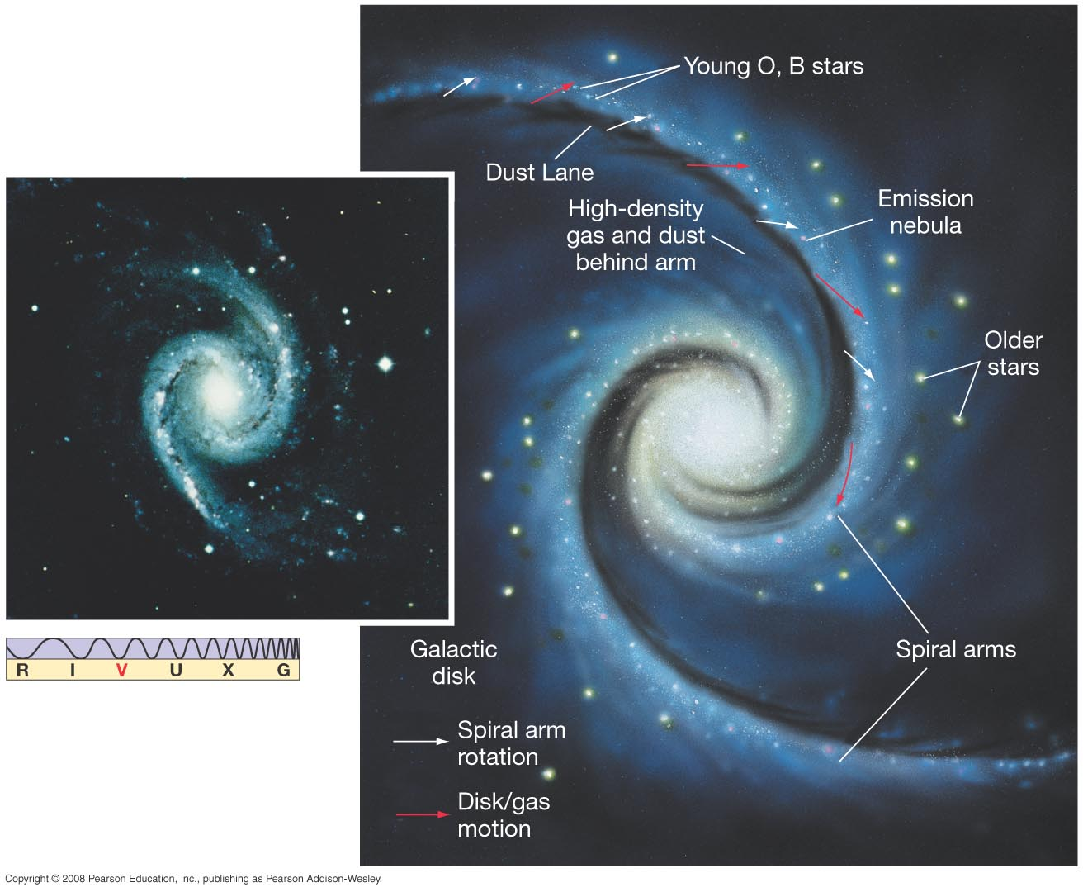
Galactic Spiral Arms
Rather, they appear to be density waves, with stars moving in and out of them such as cars move in and out of a traffic jam:
Notes:
Figure 23-18. Spiral Density Waves Density-wave theory holds that the spiral arms seen in our own and many other galaxies are waves of gas compression and star formation moving through the material of the galactic disk. In the painting at right, gas motion is indicated by red arrows and arm motion by white arrows. Gas enters an arm from behind, is compressed, and forms stars. The spiral pattern is delineated by dust lanes, regions of high gas density, and newly formed O- and B-type stars. The inset at left shows the spiral galaxy NGC 1566, which displays many of the features just described. (AURA)‏

Slide 33
Measuring the Milky Way
Modern mapping of the M.W. Has relied on a variety of observations,
especially 20 cm radio observations of the HI gas.
Notes:
Figure 23-9. Globular Cluster Distribution Our Sun does not coincide with the center of the very large collection of globular clusters (indicated by the pink dots). Instead, more globular clusters are found in one direction than in any other. The Sun resides closer to the edge of the collection, which measures roughly 30 kpc across. The globular clusters outline the true distribution of stars in the Galactic halo.

Slide 34
The Shapley – Curtis debate (1920)
Main issue: are spiral nebulae part of our Galaxy or are they other
“island universes”?
1) Size of the Milky way
Shapley used globulars and RR Lyrae – got 300,000 LY
Curtis underestimated
2) Distribution of Nebulae in sky
Zone of avoidance explained by Curtis
3) Novae in spiral nebulae
Shapley mistook supernovae for novae. This made spiral neb-
ulae look closer than proposed by Curtis.
4) Brightness and spectra of nebulae
Colors looked redder than our galaxy (it was reddening)
Spectra – the nebulae were made of many stars (not one)
5) Rotation of the nebulae
Erroneous measurements of rotation made it impossible for
The spiral nebulae to be far away.
Result: Curtis was right – they are island universes. The story of Edwin Hubble ...

Slide 35
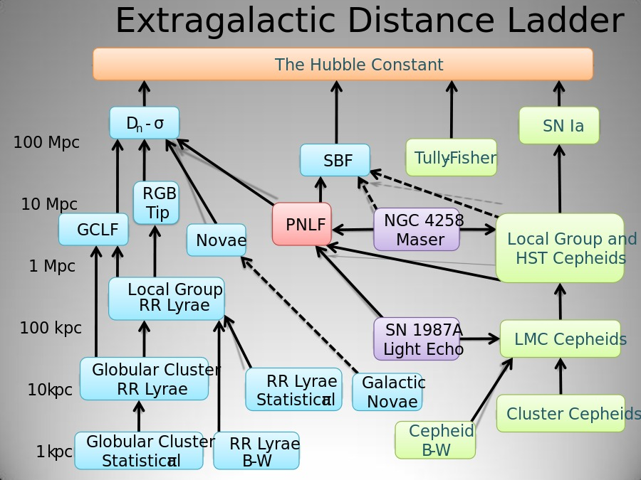
23.2 Distance indicators
Notes:
Figure 23-9. Globular Cluster Distribution Our Sun does not coincide with the center of the very large collection of globular clusters (indicated by the pink dots). Instead, more globular clusters are found in one direction than in any other. The Sun resides closer to the edge of the collection, which measures roughly 30 kpc across. The globular clusters outline the true distribution of stars in the Galactic halo.

Slide 36
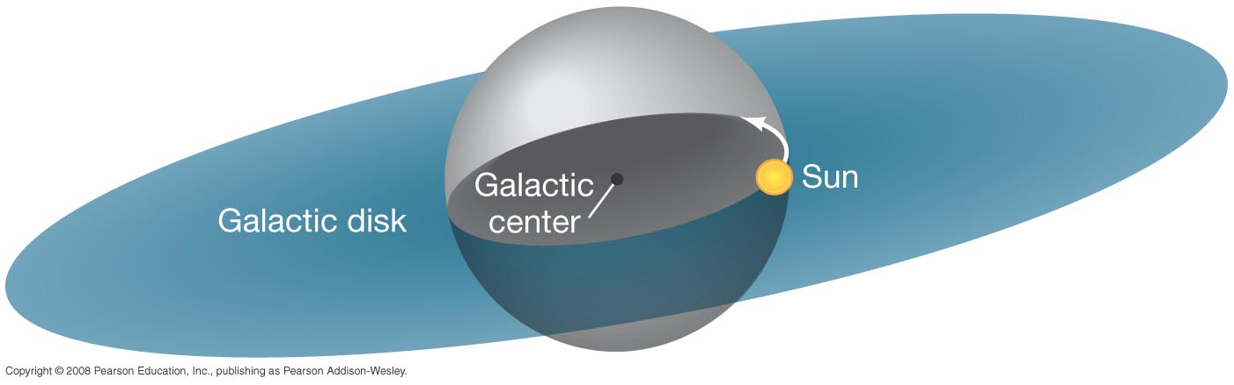
23.6 The Mass of the Milky Way Galaxy
The orbital speed of an object depends only on the amount of mass between it and the galactic center:
Notes:
Figure 23-20. Weighing the Galaxy The orbital speed of a star or gas cloud moving around the Galactic center is determined only by the mass of the Galaxy lying inside the orbit (within the gray-shaded sphere). Thus, to measure the Galaxy’s total mass, we must look for objects orbiting at large distances from the center.

Slide 37
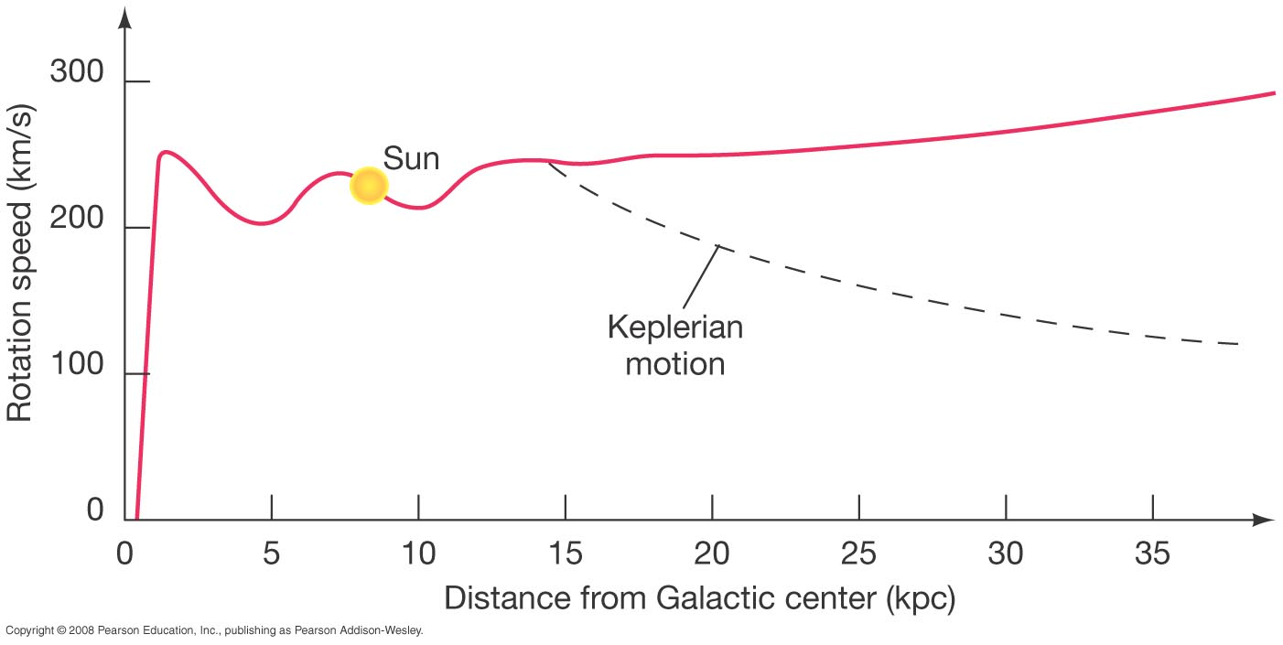
23.6 The Mass of the Milky Way Galaxy
Beyond the limits of the visible galaxy, the velocity should diminish with distance, as the dashed curve shows.
It doesn’t; more than twice the mass of the galaxy would have to be outside the visible part to reproduce the observed curve.
Notes:
Figure 23-21. Galaxy Rotation Curve The rotation curve for the Milky Way Galaxy plots rotation speed against distance from the Galactic center. We can use this curve to compute the mass of the Galaxy that lies within any given radius. The dashed curve is the rotation curve expected if the Galaxy “ended” abruptly at a radius of 15 kpc, the limit of most of the known spiral structure and the globular cluster distribution. The fact that the red curve does not follow this dashed line, but instead stays well above it, indicates that additional unseen matter must be beyond that radius.

Slide 38
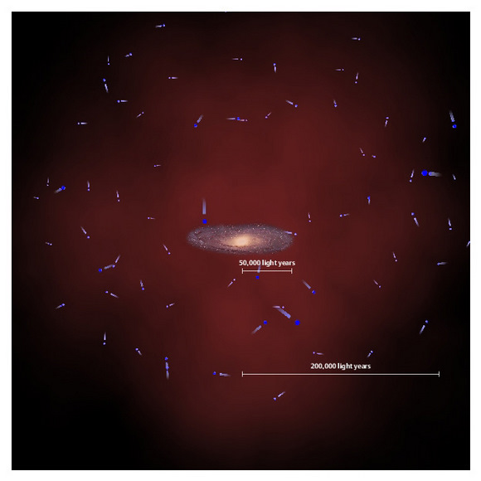
23.6 The Mass of the Milky Way Galaxy
The MW has a dark matter halo.
Candidates:
MACHOS:
Brown dwarfs
Red dwarfs
Stellar black holes
Neutron stars
WIMPS:
Axions, neutrinos,
unknown
Notes:
Figure 23-21. Galaxy Rotation Curve The rotation curve for the Milky Way Galaxy plots rotation speed against distance from the Galactic center. We can use this curve to compute the mass of the Galaxy that lies within any given radius. The dashed curve is the rotation curve expected if the Galaxy “ended” abruptly at a radius of 15 kpc, the limit of most of the known spiral structure and the globular cluster distribution. The fact that the red curve does not follow this dashed line, but instead stays well above it, indicates that additional unseen matter must be beyond that radius.

