Slide 1
The Interaction of Light and Matter

Slide 2
Outline
(1) Motivation: Why spectral lines?
  the Birth of Spectroscopy
  Kirchoff's Laws
(2) Photons – the particle nature of light
  Blackbody radiation (Planck introduces quantum of light)‏
  Photoelectric Effect
  Compton Scattering
(3) The Bohr Model of the Atom
  a theory to describe spectral lines,
(4) Quantum Mechanics and the Wave-Particle Duality
  De Broglie wavelength
  Schrodinger's probability waves.

Slide 3

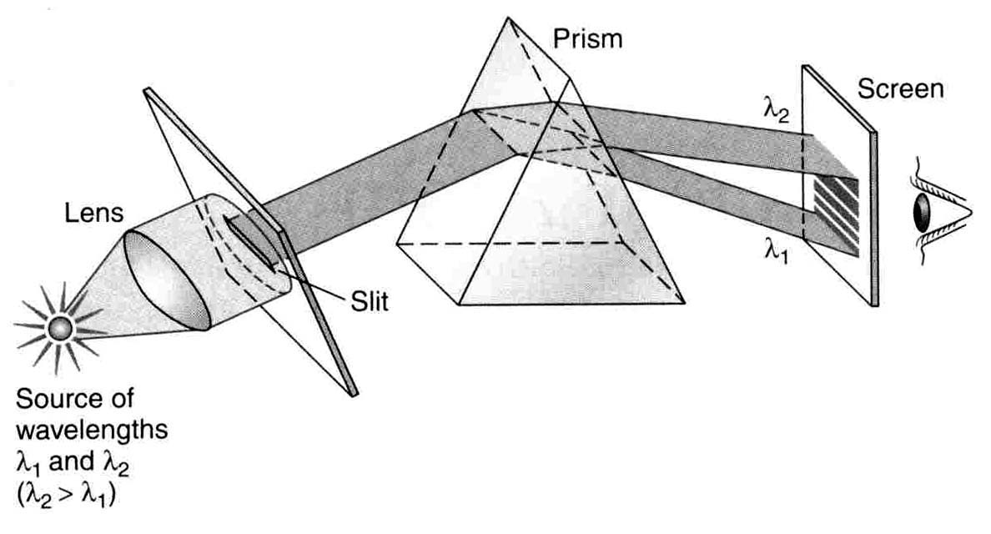
Spectroscopy - history
Trogg (50 million BC) – rainbow
Newton (1642-1727) – decomposes light into
spectrum and back again
W. Herschel (1800) – discovers infrared
J. W. Ritter (1801) – discovers ultraviolet
W. Wollaston (1802) – discovers absorption lines in solar spectrum
Prism separates wavelengths
Q: Where is Red vs. Blue?

Slide 4
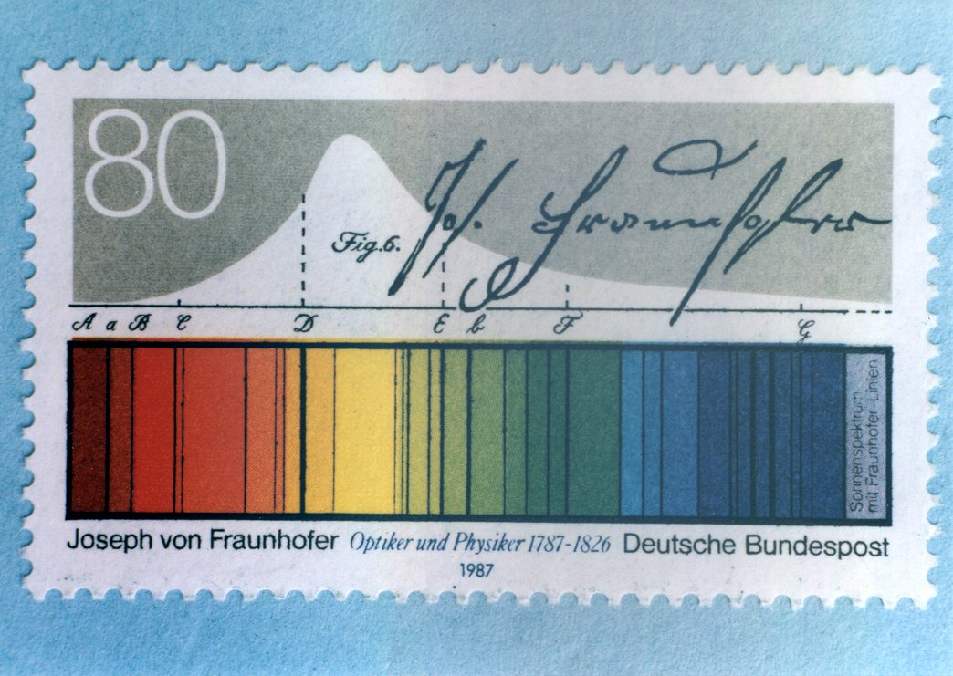
Spectroscopy - history
J. Herschel, Wheatstone, Alter, Talbot and Angstrom studied spectra of terrestrial things (flames, arcs and sparks) ~1810
Joseph Fraunhofer
    Cataloged ~475 dark lines of the solar spectrum by 1814
    Identifies sodium in the Sun from flame spectra in the lab!
    Looks at other stars (connects telescope to spectroscope)‏
Foucault (1848) – sees absorption lines in sodium flame with bright arc behind it.
      There is the need for a new physics!

Slide 5
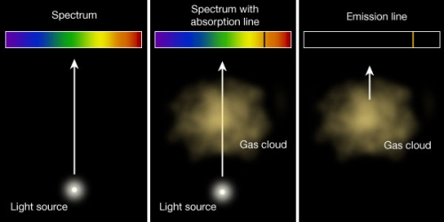
Kirchhoff’s laws (1859):
Worked with Bunsen on flame spectra
Developed a prism spectroscope
Hot solid or dense gas, → blackbody radiation
Cool diffuse gas in front of a blackbody → absorption lines
Hot diffuse gas → emission lines

Slide 6
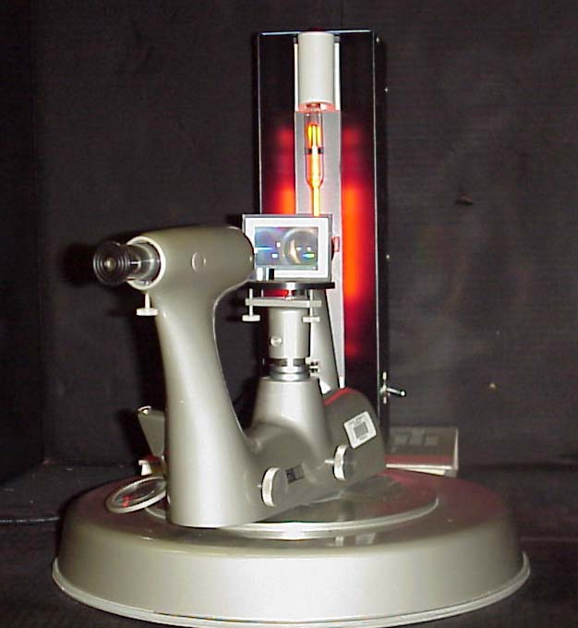
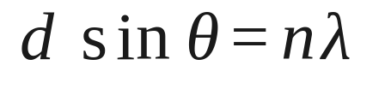
Atomic Spectra Lab
High Voltage
Supply
Neon Tube
Diffraction
Grating
Eyepiece

Slide 7
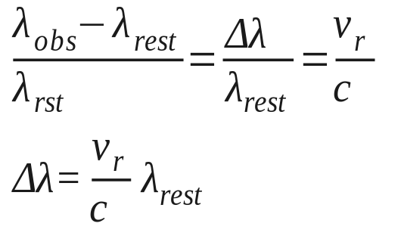
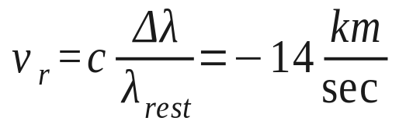
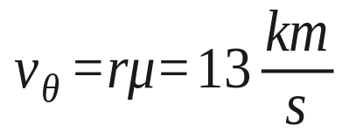
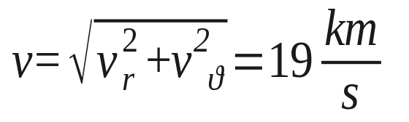
Doppler shift
Spectral lines allow for the measurement of radial velocities
At low velocities, v_{r} << c
  Classical Doppler effect
    Radial velocity, v_{r}
    Heliocentric correction for Earth’s motion, up
    to 29.8 km/s, depending on direction.
Example: H_{α} is 6562.80 Å
  Vega is measured to be 6562.50 Å
  Coupled with the proper motion
    Can determine total velocity

Slide 8
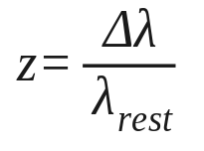
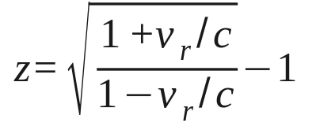
Doppler shift
Since most galaxies are moving away, astronomers call the Doppler shift a redshift, z.
At high velocities, v_{r} <~ c
  Relativistic redshift parameter (Ch. 4):
  Example: Prob. 4.8.
  (should get: v_{r} = 0.9337c)

Slide 9
What is Modern Physics?
Modern physics only came of age in the 1900’s.
  Physicists discovered that Newtonian mechanics does not apply when objects move very fast or are very small!
If things move very fast (close to the speed of light), then RELATIVISTIC mechanics is necessary.
  Cosmic particles, atomic clocks (GPS), synchrotrons.
If things are confined to very small dimensions (nanometer-scale), then QUANTUM mechanics is necessary.
  Atomic orbitals, quantum heterostructures.
Need a lot of these ideas to describe the universe

Slide 10
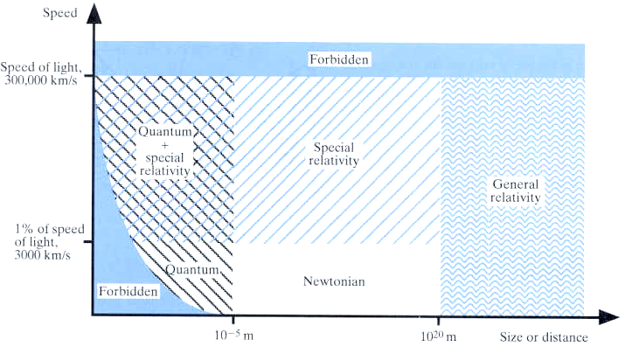
Beyond Newton
Gravity passed every test until ~1890s
Newton’s gravity and motion is incorrect when …
One way
One way
One way
One way
One way

Slide 11
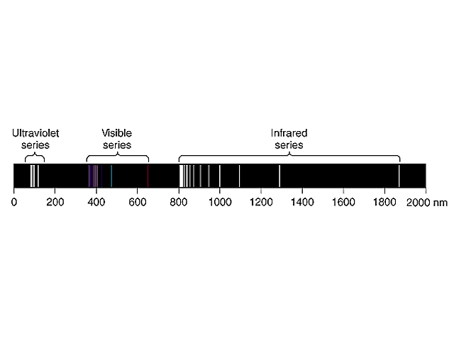
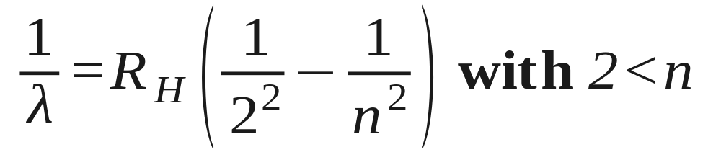
Atomic Spectra
1885 - Balmer observed Hydrogen Spectrum
  Found empirical formula for discrete wavelengths
  Later generalized by Rydberg for simple ionized atoms

Slide 12
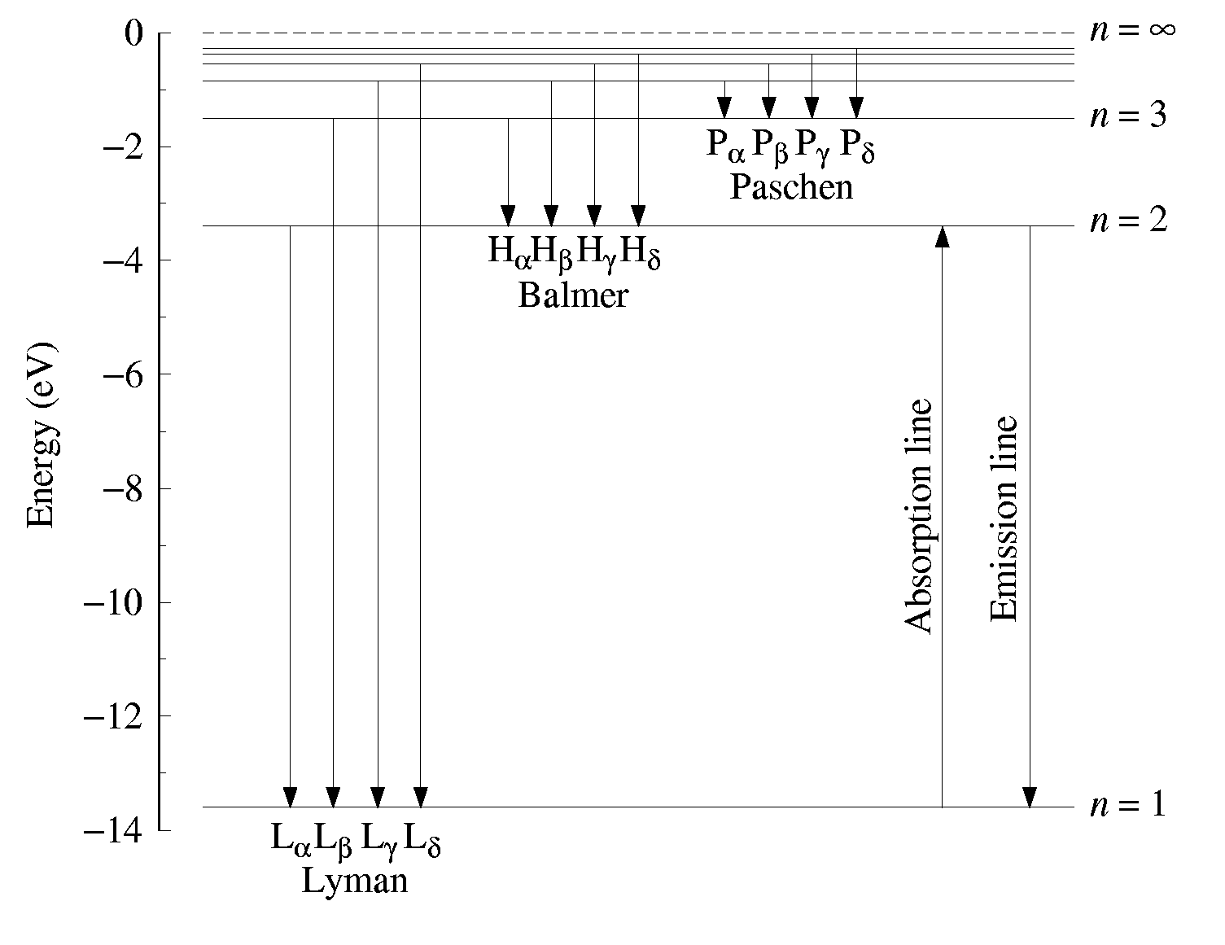
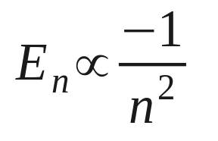
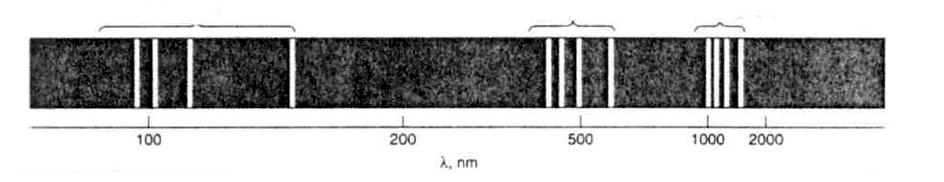
Atomic Spectra: Hydrogen Energy Levels
E∝ = 0 eV
Energy
E₁ = -13.6 eV

Slide 13
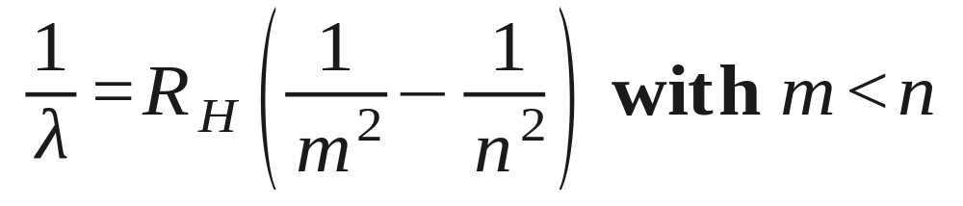
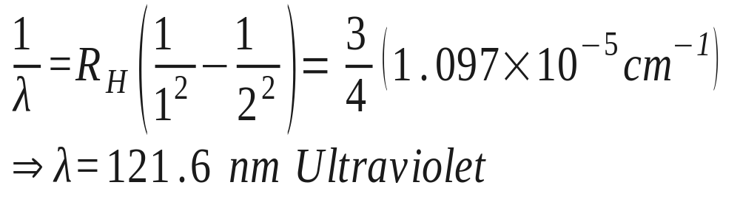
Atomic Spectra: Rydberg Formula
Gives λ for any lower level m and upper level n of Hydrogren.
Rydberg constant R_{H} ~ 1.097 x 10⁵ cm⁻¹
m = 1 (Lyman), 2 (Balmer), 3 (Paschen)‏
Example for n = 2 to m = 1 transition:

Slide 14
Particle/Wave Duality - Part 1
PART 1
Electrons as discrete Particles
  Measurement of e/m (CRT) and e (oil-drop expt.)‏
Photons as discrete Particles
  Blackbody Radiation: Temp. Relations & Spectral Distribution
  Photoelectric Effect: Photon “kicks out” Electron
  Compton Effect: Photon “scatters” off Electron
PART 2
Wave Behavior: Diffraction and Interference
Photons as Waves: λ = hc / E
  X-ray Diffraction (Bragg’s Law)‏
Electrons as Waves: λ = h / p
  Low-Energy Electron Diffraction (LEED)‏

Slide 15
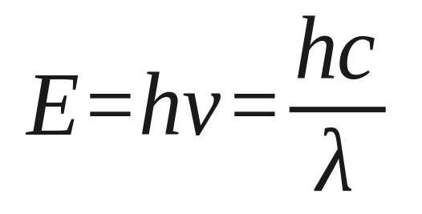
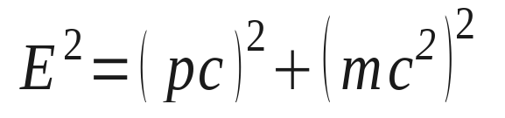
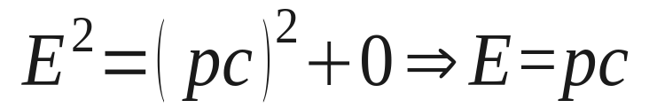
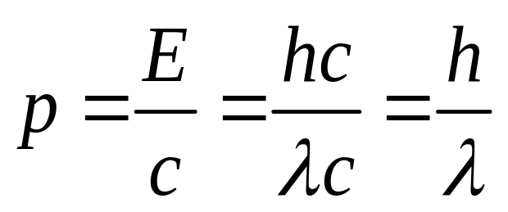
Photons: Quantized Energy Particle
Light comes in discrete energy “packets” called photons
Energy of
Single Photon
From Relativity:
Rest mass
For a Photon (m = 0):
Momentum of
Single Photon

Slide 16
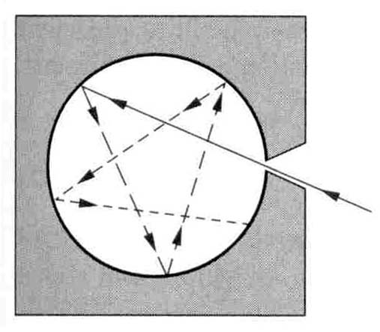
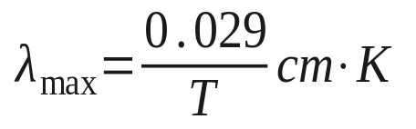

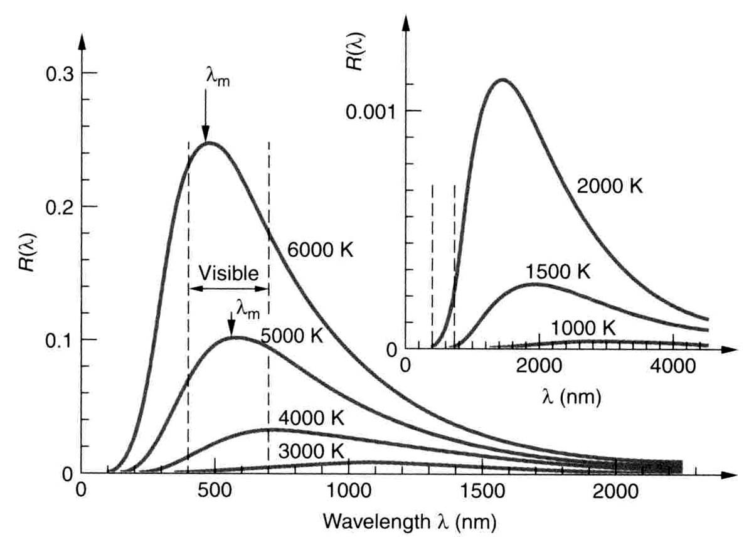
Blackbody Radiation: First clues to quantization
Recall Wien's Law:
and the Stefan-Boltzmann Law:
Sunlight
Spectral Distribution depends only on Temperature

Slide 17
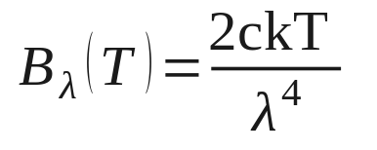
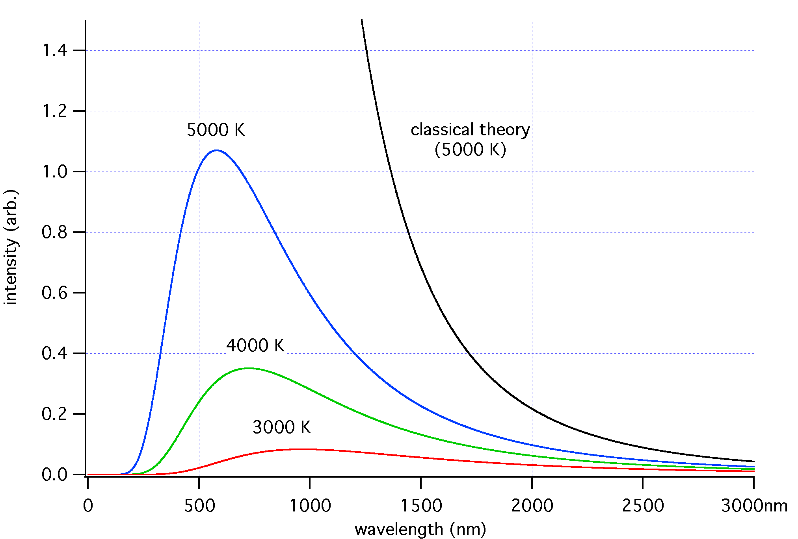
Blackbody Radiation: Rayleigh-Jeans Equation
Classical physics led to a prediction for the spectrum of cavity (blackbody) radiation whereby .
This was derived by assuming each mode of oscillation in the cavity would have an energy E_{avg} = kT (k = 1.38 x 10⁻²³ J/K is Boltzmann’s constant)‏
The number of modes per
wavelength interval increased
as lambda decreased leading
to excess energy at small λ s.‏
Rayleigh-Jeans
Equation
UV Catastrophe!
(B explodes for small λ)‏

Slide 18
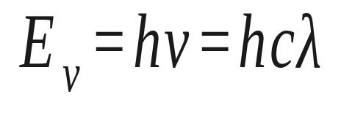
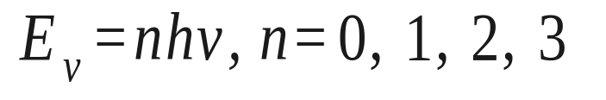
Spectral Blackbody: Planck’s Law
Planck’s Law was found empirically (trial and error!)‏
‏Quantize the E&M radiation so that the‏ minimum
energy for light at a given wavelength is:
where h = Planck’s Constant = 6.266 x 10⁻²⁷ erg·s.
  Then
can be used in replacing the classical kT expression for the average energy in a mode.
Now the entire hot object may not have enough energy to emit one photon of light at very small wavelengths, so n=0, and the UV catastrophe can be avoided.

Slide 19
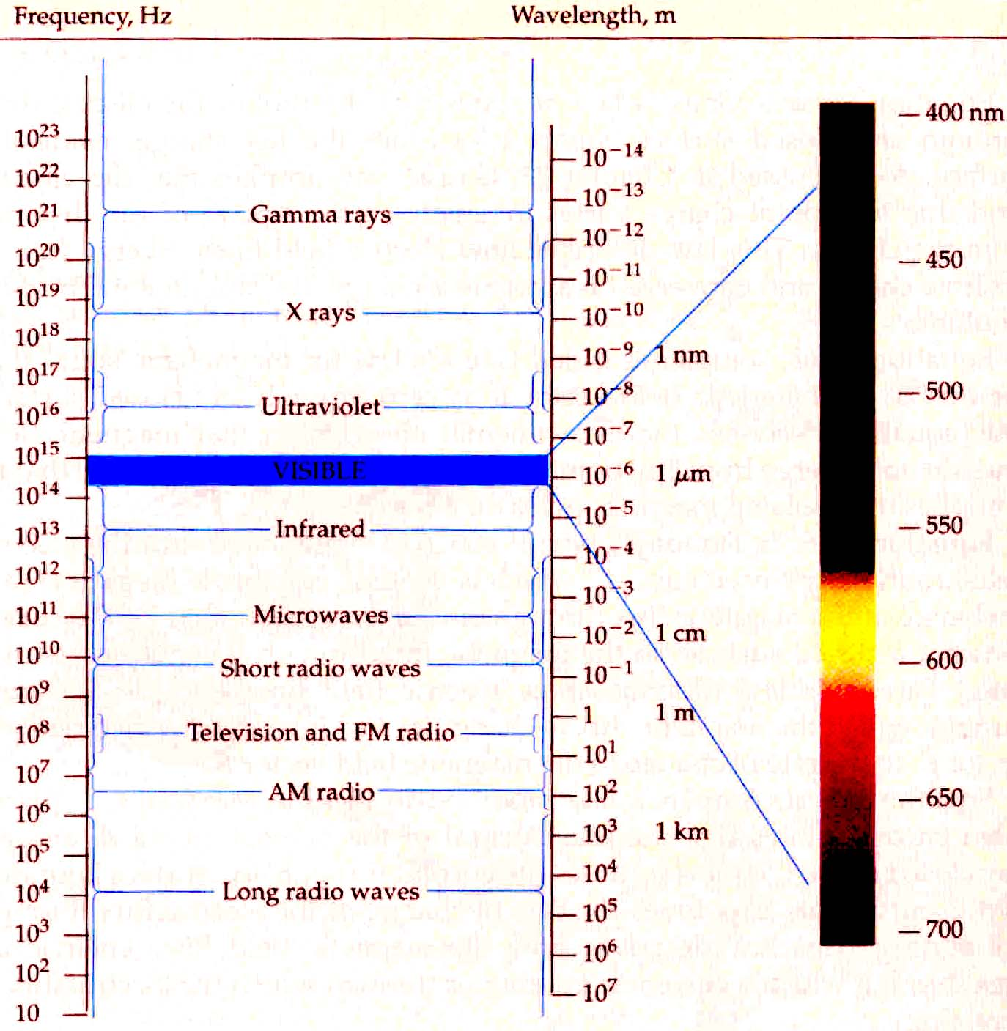
Photons: Electromagnetic Spectrum

Slide 20
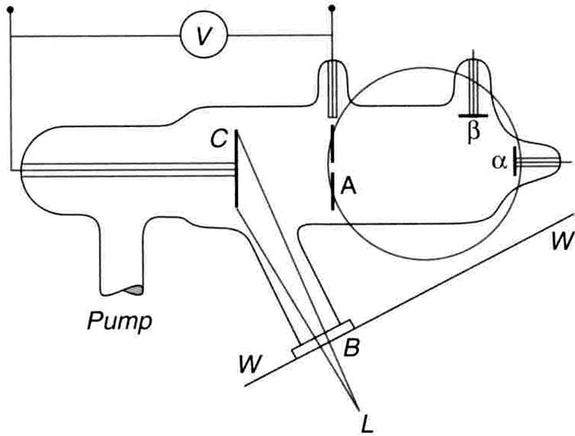
Photoelectric Effect: “Particle Behavior” of Photon
Shows quantum nature of light (Theory by Einstein & Expt. by Millikan).
Photons hit metal cathode and instantaneously eject electrons
(requires minimum energy = work function).
Electrons travel from cathode to anode against retarding voltage V_{R}
Electrons collected as “photoelectric” current at anode.
Photocurrent becomes zero when retarding voltage V_{R} equals the stopping voltage V_{stop}, i.e. eV_{stop} = K_{e}
Cathode
Anode
Light

Slide 21
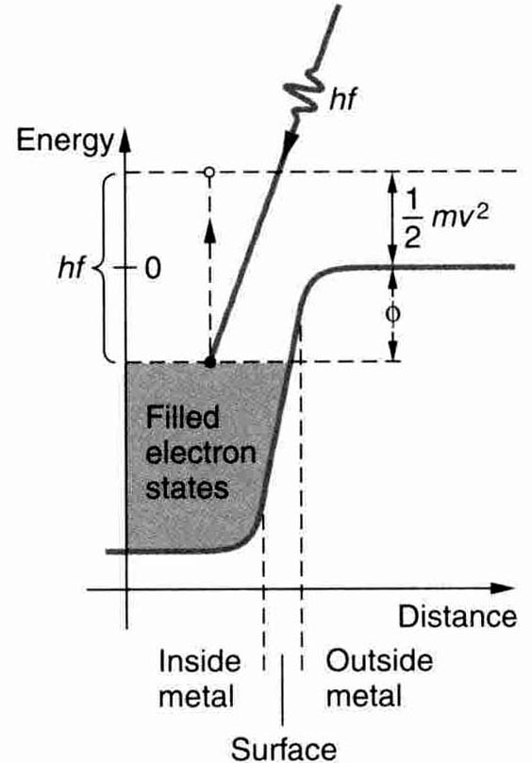
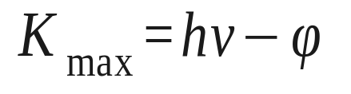
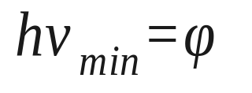
Photoelectric Effect - equation
PHOTON IN ⇒ ELECTRON OUT
  e– kinetic energy = Total photon energy – e– ejection energy
  where hv = photon energy, φ = work function, and K_{max} = kinetic energy
  K_{max} = eV_{stop} = stopping energy
Special Case: No kinetic energy (V_{o} = 0)‏
  Minimum frequency v to eject electron
f=v

Slide 22
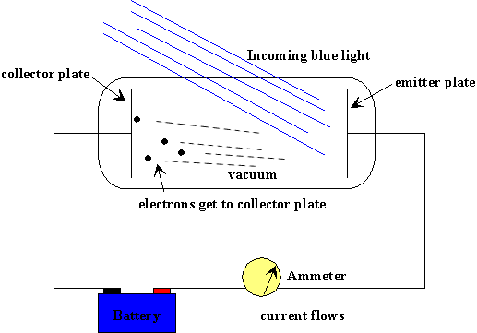
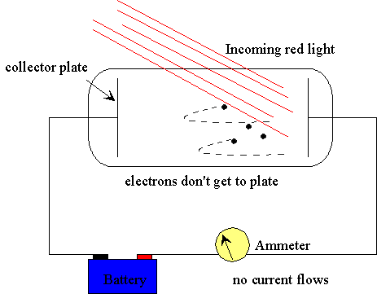
Photoelectric Effect
In order to make electrons reach the collector plate, the light has to be blue enough; the intensity doesn't matter if light is red!

Slide 23
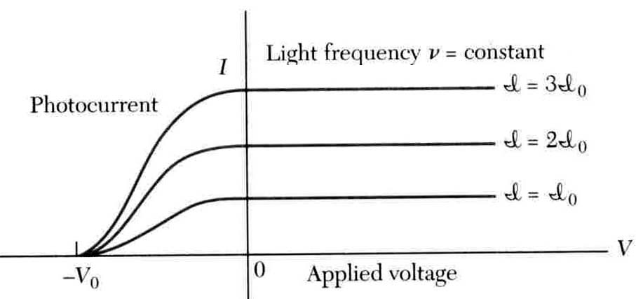
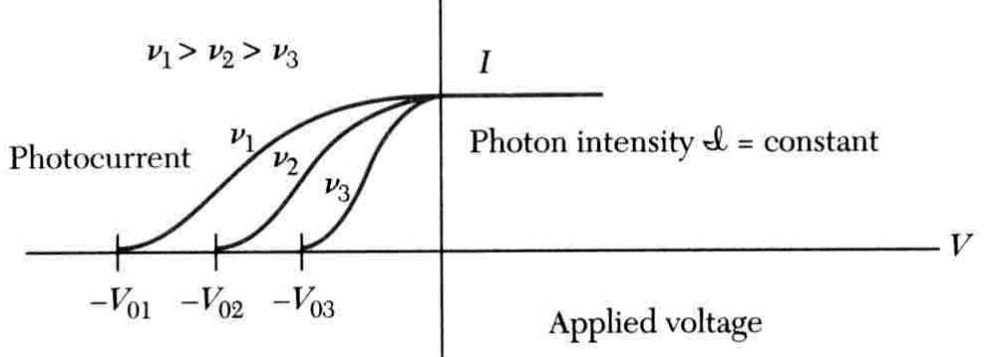
Photoelectric Effect: IV Curve Dependence
Intensity dependence
V_{stop}= fixed for fixed frequency
Frequency dependence
V_{stop}∝ ν

Slide 24
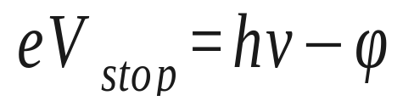
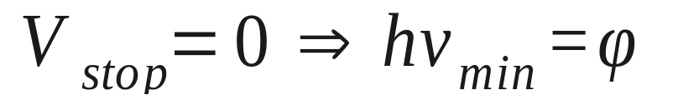
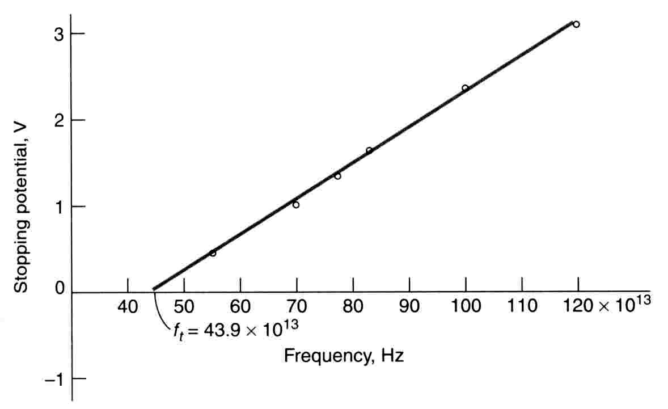
Photoelectric Effect: V_{stop} vs. Frequency
hv_{min}
Slope = h = Planck’s constant

Slide 25
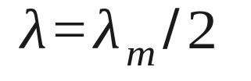
Photoelectric Effect Problem
If the work function of a metal is 2.0 eV,
a) find the maximum wavelength _{m} capable of causing the photo-
electric effect, and,
b) find the stopping potential if

Slide 26
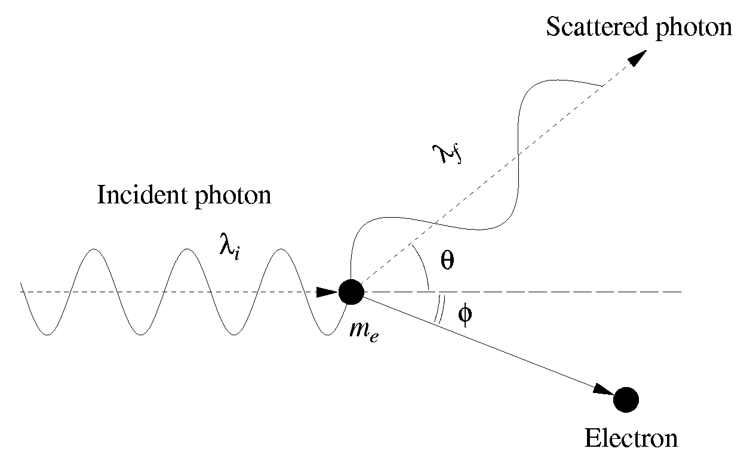
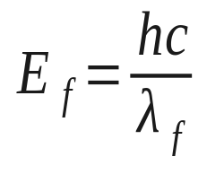
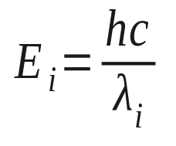
Compton Scattering: “Particle-like” Behavior of Photon
Concept: Photon scatters off electron losing energy and momentum to the electron. The _{f} of scattered photon depends on 
Conservation of relativistic momentum and Energy!
No mass for the photon but it has momentum!!!

Slide 27
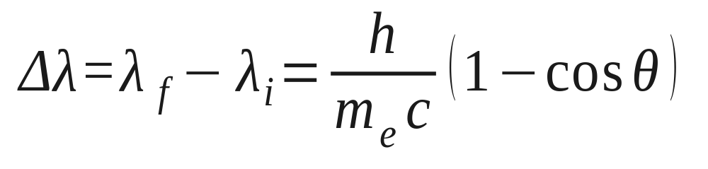
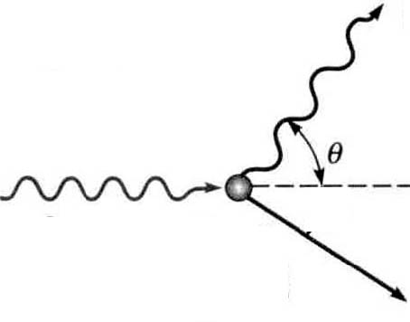
Compton Scattering: Equation
Photon OUT
Scattering Angle
Photon IN
Critical λ_{c}= 0.0024 nm for e⁻
Limiting Values
  No scattering: θ = 0º → cos0º = 1 → Δλ = 0
  “Bounce Back”: θ = 180º → cos180º = –1 → Δλ = 2λ_{c}
Difficult to observe unless λ is small (i.e. Δλ/λ > 0.01)‏

Slide 28
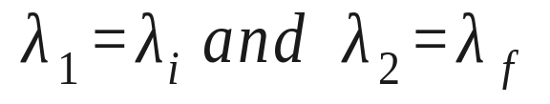
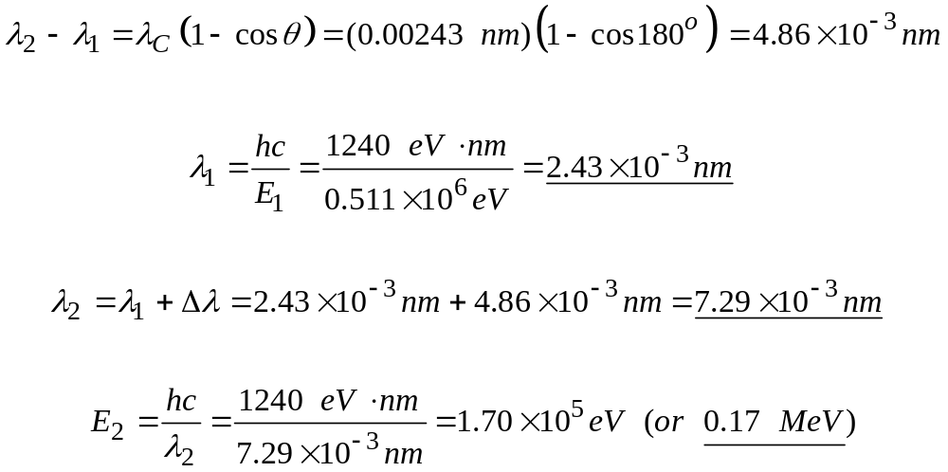
Compton Scattering Problem
notaiton

Slide 29

Bohr Model
1913 – Bohr proposed quantized model of the H atom to predict the observed spectrum.
Problem: Classical model of the electron “orbiting” nucleus is unstable. Why unstable?
  Electron experiences (centripetal) acceleration.
  Accelerated electron emits radiation.
  Radiation leads to energy loss.
  Electron eventually “crashes” into nucleus.

Slide 30



Bohr Model: Quantization
Solution: Bohr proposed two “quantum” postulates
  Electrons exist in stationary orbits (no radiation) with quantized angular momentum.
  Atom radiates with quantized frequency v (or energy E) only when the electron makes a transition between two stationary states.

Slide 31




Planetary Mechanics Applied to the Atom
Consider the attractive electrostatic force and circular motion
Note: in cgs, e = 4.803x10⁻¹⁰ esu
m_{p}=1836 m_{e}
Kinetic energy
Potential energy

Slide 32




Planetary Mechanics Applied to the Atom
(wrong)‏
Introduce Bohr’s quantized angular momentum
Solving for r
Get the Total Energy in terms of n
Principle quantum number, n = 1, 2, 3, …
a₀ is the Bohr radius

Slide 33


Bohr Model: Transitions
Transitions predicted by Bohr yield general Rydberg formula
  Applies to ionized atoms with only one electron and of nuclear charge Z.

Slide 34

Bohr Model Problem: Unknown Transition
If the wavelength of a transition in the Balmer series for a He⁺ atom is 121 nm, then find the corresponding transition, i.e. initial and final n values.

Slide 35

Bohr Model Problem: Ionization Energy
Suppose that a He atom (Z=2) in its ground state (n = 1) absorbs a photon whose wavelength is λ = 41.3 nm. Will the atom be ionized?
Find the energy of the incoming photon and compare it to the ground state ionization energy of helium, or E₀ from n=1 to ∞.
The photon energy (30 eV) is less than the ionization energy (54 eV), so the electron will NOT be ionized.

Slide 36

Bohr Model Problem: Series Limit (book)‏
Find the shortest wavelength that can be emitted by the Li ⁺ ⁺ ion.
The shortest λ (or highest energy) transition occurs for the highest initial state (n_{i} = ∞) to the lowest final state (n_{f} = 1).

Slide 38
Particle/Wave Duality - Part 2
PART 1
Electrons as discrete Particles
  Measurement of e/m (CRT) and e (oil-drop expt.)‏
Photons as discrete Particles
  Blackbody Radiation: Temp. Relations & Spectral Distribution
  Photoelectric Effect: Photon “kicks out” Electron
  Compton Effect: Photon “scatters” off Electron
PART 2
Wave Behavior: Diffraction and Interference
Photons as Waves: λ = hc / E
  X-ray Diffraction (Bragg’s Law)‏
Electrons as Waves: λ = h / p
  Low-Energy Electron Diffraction (LEED)‏

Slide 39




Wave Property: Single-Slit Diffraction
Intensity
a = slit width
(Sin(x) / x)² maxima
Diffraction Pattern of Electron Waves
28 e⁻
10⁴ e⁻

Slide 40



Electrons: Wave-like Behavior
Every particle has a wavelength given by:
Question: Why don’t we observe effects of particle waves (i.e., diffraction and interference) in day-to-day life?
Answer: Wavelengths of most macroscopic objects are too small to interact with slits, BUT atomic-sized objects DO behave like waves!
Macroscopic – ping pong ball
Microscopic – “slow electron” (1% speed of light)‏

Slide 41



Electron Diffraction: Wave-like Behavior
1927 – Davisson and Germer studied the diffraction of an electron beam from a nickel crystal surface and observed discrete spots (maxima).
Modern day technique now: Low Energy Electron Diffraction (LEED).

Slide 42



Electron Diffraction: LEED Equation
Concept: Use Bragg’s Law for X-ray scattering and then substitute appropriate angles, where λ is now the electron wavelength.
Electron Diffraction
X-ray Diffraction
Angle φ
D spacing
Dsinα
cosα
½sin2α by trig

Slide 43

Wave/Particle Duality
The particle wavefunction,ψ, predicts the probability of where we might find the particle.
Probability =
Can have destructive and constructive interference

Slide 44



Probability “clouds”
  kind of the opposite to the “Plum Pudding” model

Slide 45

Quantum Tunneling

Slide 46




Wave Packets in Real vs. Momentum Space: Pictures
Real Space
Momentum Space
Gaussian
Square Pulse

Slide 47


Heisenberg Uncertainty Principle
(Fourier transforms)‏
Momentum(k) ↔ real(x)‏
frequency(ω = 2πν) ↔ time(t)‏
→ Particle only highly localized in space if its momentum is undefined.
→ Particle’s energy only well-known if measurement taken for a long time.

Slide 48


Wave Packets

Slide 49


Zeeman Effect
Measure magnetic field strengths
Solving the Schrodinger equation yields two more quantum numbers
Spectral line becomes split

