Slide 1
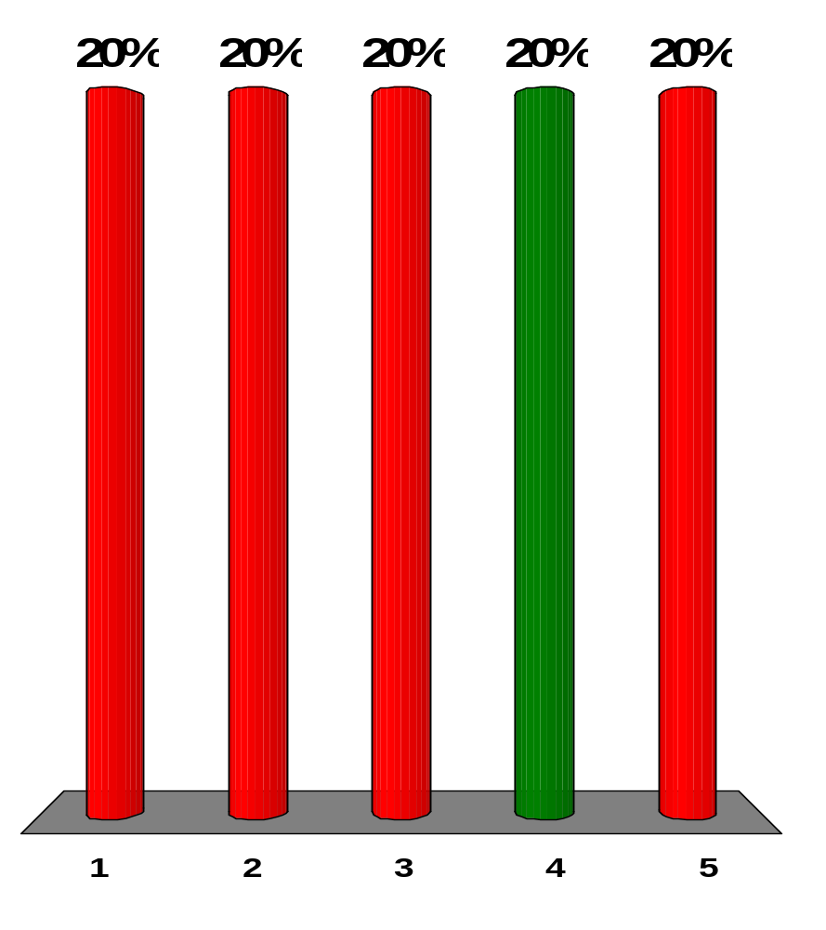
An electromagnetic wave with a peak magnetic field magnitude of 1.50 × 10⁻⁷ T has an associated peak electric field of what magnitude?
0.500 × 10⁻¹⁵ N/C
2.00 × 10⁻⁵ N/C
2.20 × 10⁴ N/C
45.0 N/C
22.0 N/C
Notes:
Remarks for instructors: Answer (4). The peak values of the electric and magnetic field components of an electromagnetic wave are related by E_{max}/B_{max} = c, where c is the speed of light in vacuum. Thus,
E_{max} = cB_{max} = (3.00×10⁸ m/s)(1.50×10⁻⁷ T) = 45.0 N/C

Slide 2
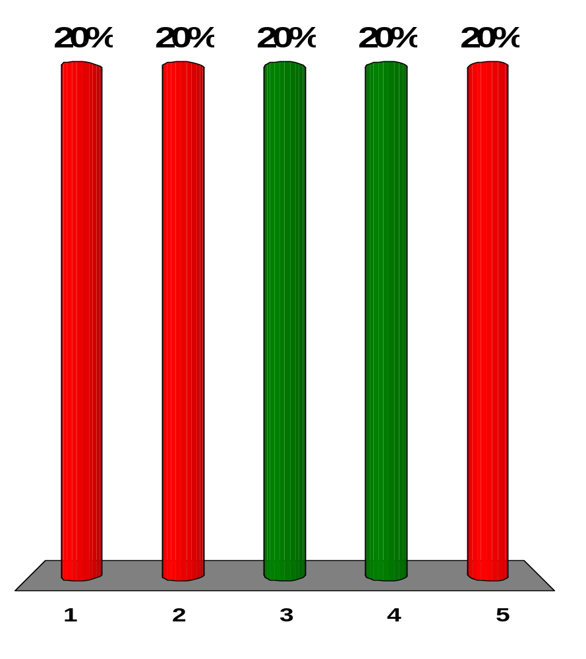
Which of the following statements are true regarding electromagnetic waves traveling through a vacuum? More than one statement may be correct.
All waves have the same wavelength.
All waves have the same frequency.
All waves travel at 3.00 × 10⁸ m/s.
The electric and magnetic fields associated with the waves are perpendicular to each other and to the direction of wave propagation.
The speed of the waves depends on their frequency.
Notes:
Remarks for instructors: Answers (3) and (4). The relationship between frequency, wavelength, and the speed of a wave is flλ= v. In a vacuum, all electromagnetic waves travel at the same speed: v = c. Electromagnetic waves, consisting of oscillating electric and magnetic fields, are transverse waves.

Slide 3
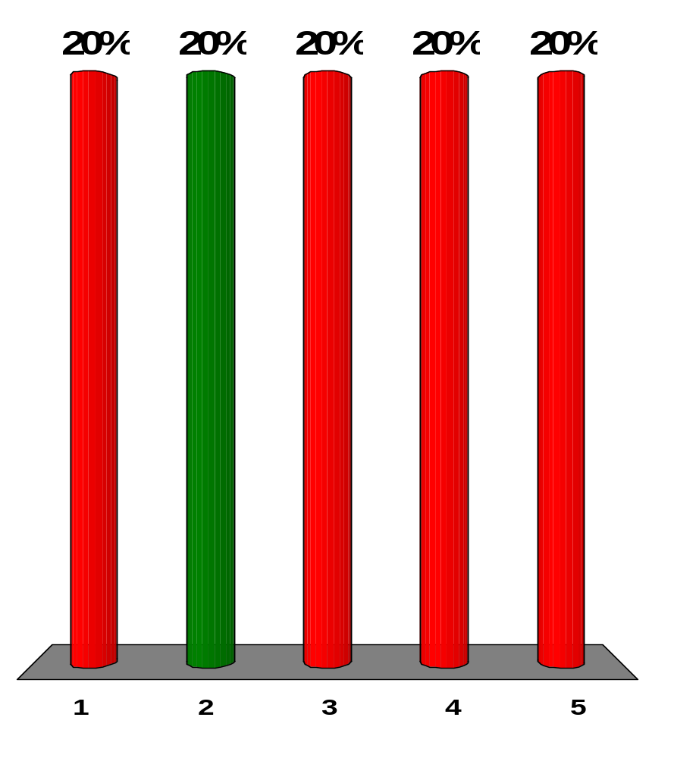
A typical microwave oven operates at a frequency of 2.45 GHz. What is the wavelength associated with the electromagnetic waves in the oven?
8.20 m
12.2 cm
1.20 × 10⁸ m
8.20 × 10⁻⁹ m
none of those answers
Notes:
Remarks for instructors: Answer (2). Frequency, wavelength, and the speed of light are related:
fλ = c → λ = c/f =(3.00×10⁸ m/s)/(2.45×10⁹ Hz) = 0.122 m = 12.2 cm

Slide 4
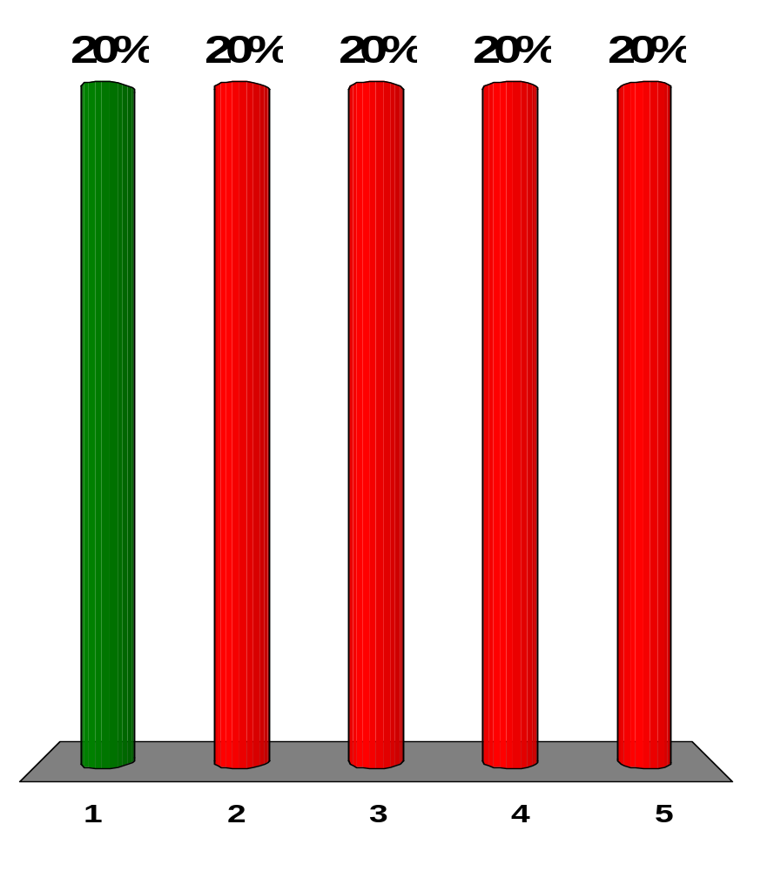
A student working with a transmitting apparatus like Heinrich Hertz’s wishes to adjust the electrodes to generate electromagnetic waves with a frequency half as large as before. How large should she make the effective capacitance of the pair of electrodes?
four times larger than before
two times larger than before
one-half as large as before
one-fourth as large as before
none of those answers
Notes:
Remarks for instructors: Answer (1). According to f = (2π)⁻¹(LC)^{−1/2}, to make f half as large, the capacitance should be made four times larger.

Slide 5
A student working with a transmitting apparatus like Heinrich Hertz’s wishes to adjust the electrodes to generate electromagnetic waves with a frequency half as large as before. After she makes the required adjustment, what will the wavelength of the transmitted wave be?
four times larger than before
two times larger than before
one-half as large as before
one-fourth as large as before
none of those answers
Notes:
Remarks for instructors: Answer (2). According to fλ = c, if frequency is halved, wavelength is doubled.

Slide 6
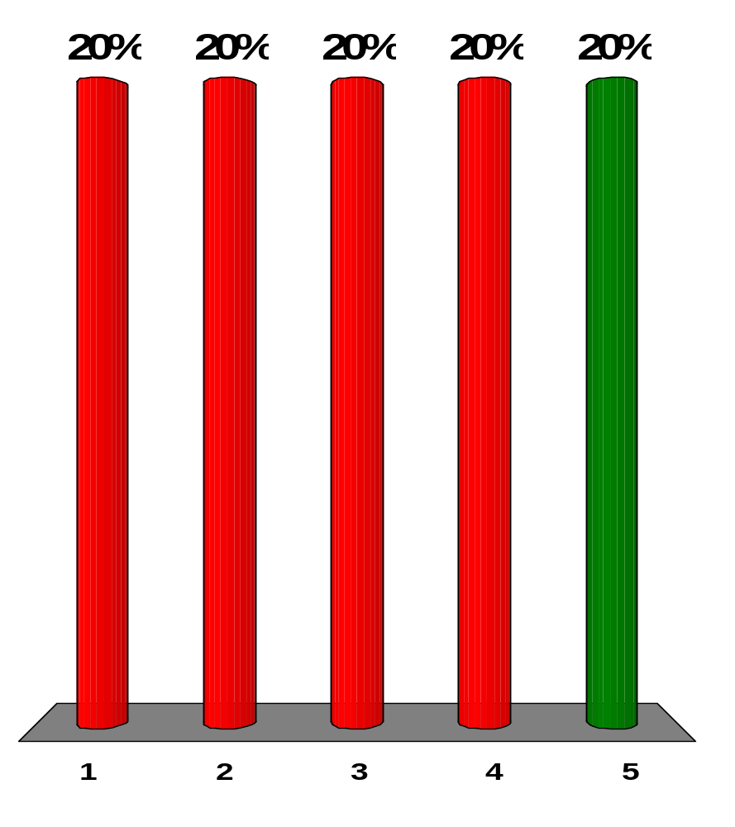
Assume you charge a comb by running it through your hair and then hold the comb next to a bar magnet. Do the electric and magnetic fields produced constitute an electromagnetic wave?
Yes they do, necessarily.
Yes they do, because charged particles are moving inside the bar magnet.
They can, but only if the electric field of the comb and the magnetic field of the magnet are perpendicular.
They can, but only if both the comb and the magnet are moving.
They can, if either the comb or the magnet or both are accelerating.
Notes:
Remarks for instructors: Answer (5). Accelerating charge, changing electric field, or changing magnetic field can be the source of a radiated electromagnetic wave.

Slide 7
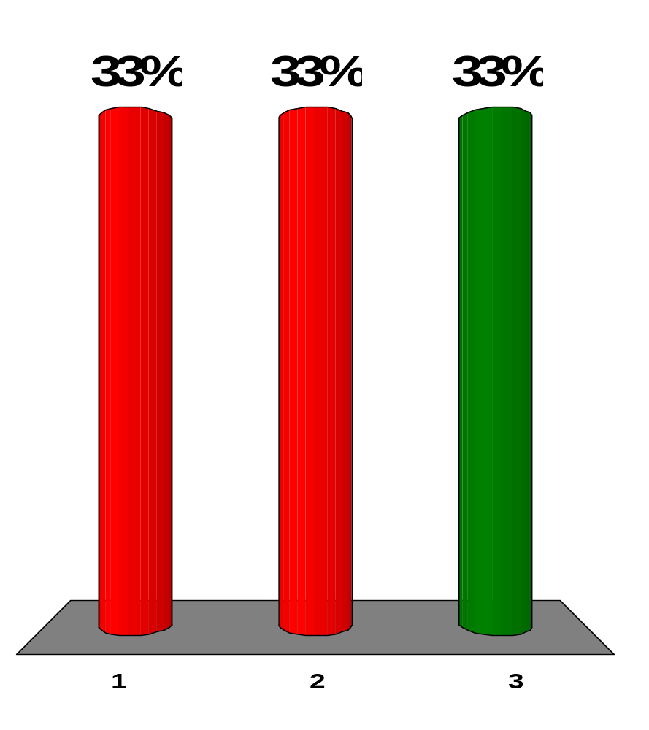
A small source radiates an electromagnetic wave with a single frequency into vacuum, equally in all directions. As the wave moves, its frequency:
increases.
decreases.
stays constant.
Notes:
Remarks for instructors: Answer (3). The same amount of energy passes through concentric spheres of increasing area as the wave travels outward from its source, so the amplitude and the intensity, which is proportional to the square of the amplitude, decrease.

Slide 8
A small source radiates an electromagnetic wave with a single frequency into vacuum, equally in all directions. As the wave moves, its wavelength:
increases.
decreases.
stays constant.
Notes:
Remarks for instructors: Answer (3). The same amount of energy passes through concentric spheres of increasing area as the wave travels outward from its source, so the amplitude and the intensity, which is proportional to the square of the amplitude, decrease.

Slide 9
A small source radiates an electromagnetic wave with a single frequency into vacuum, equally in all directions. As the wave moves, its speed:
increases.
decreases.
stays constant.
Notes:
Remarks for instructors: Answer (3). The same amount of energy passes through concentric spheres of increasing area as the wave travels outward from its source, so the amplitude and the intensity, which is proportional to the square of the amplitude, decrease.

Slide 10
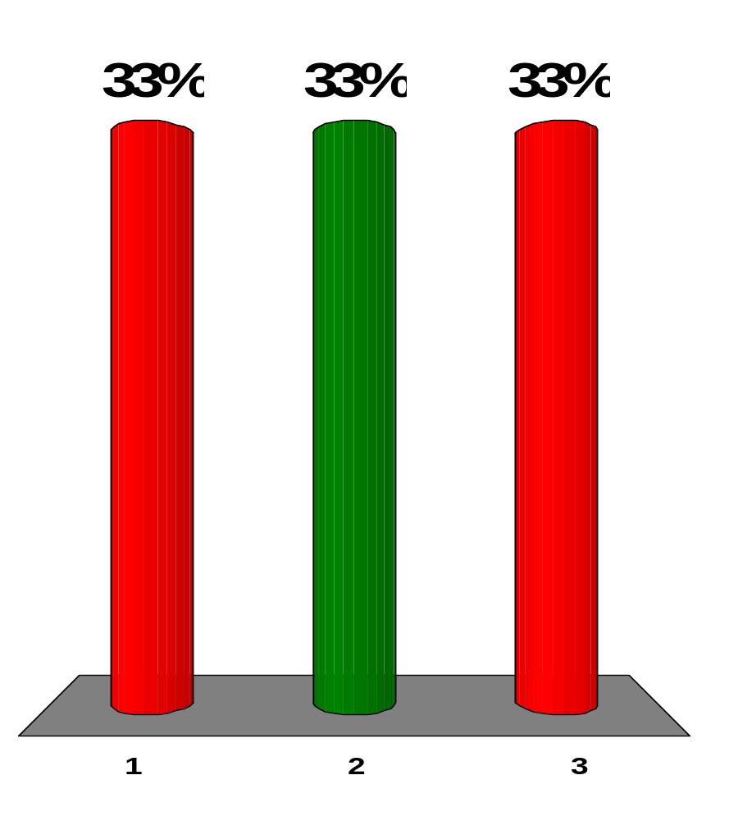
A small source radiates an electromagnetic wave with a single frequency into vacuum, equally in all directions. As the wave moves, its intensity:
increases.
decreases.
stays constant.
Notes:
Remarks for instructors: Answer (2). The same amount of energy passes through concentric spheres of increasing area as the wave travels outward from its source, so the amplitude and the intensity, which is proportional to the square of the amplitude, decrease.

Slide 11
A small source radiates an electromagnetic wave with a single frequency into vacuum, equally in all directions. As the wave moves, the amplitude of its electric field:
increases.
decreases.
stays constant.
Notes:
Remarks for instructors: Answer (2). The same amount of energy passes through concentric spheres of increasing area as the wave travels outward from its source, so the amplitude and the intensity, which is proportional to the square of the amplitude, decrease.

Slide 12
A plane electromagnetic wave with a single frequency moves in vacuum in the positive x direction. Its amplitude is uniform over the yz plane. As the wave moves, its frequency:
increases.
decreases.
stays constant.
Notes:
Remarks for instructors: Answer (3). The same amount of energy passes through equal areas parallel to the yz plane as the wave travels in the +x direction, so the amplitude and the intensity, which is proportional to the square of the amplitude, do not change.

Slide 13
A plane electromagnetic wave with a single frequency moves in vacuum in the positive x direction. Its amplitude is uniform over the yz plane. As the wave moves, its wavelength:
increases.
decreases.
stays constant.
Notes:
Remarks for instructors: Answer (3). The same amount of energy passes through equal areas parallel to the yz plane as the wave travels in the +x direction, so the amplitude and the intensity, which is proportional to the square of the amplitude, do not change.

Slide 14
A plane electromagnetic wave with a single frequency moves in vacuum in the positive x direction. Its amplitude is uniform over the yz plane. As the wave moves, its speed:
increases.
decreases.
stays constant.
Notes:
Remarks for instructors: Answer (3). The same amount of energy passes through equal areas parallel to the yz plane as the wave travels in the +x direction, so the amplitude and the intensity, which is proportional to the square of the amplitude, do not change.

Slide 15
A plane electromagnetic wave with a single frequency moves in vacuum in the positive x direction. Its amplitude is uniform over the yz plane. As the wave moves, its intensity:
increases.
decreases.
stays constant.
Notes:
Remarks for instructors: Answer (3). The same amount of energy passes through equal areas parallel to the yz plane as the wave travels in the +x direction, so the amplitude and the intensity, which is proportional to the square of the amplitude, do not change.

Slide 16
A plane electromagnetic wave with a single frequency moves in vacuum in the positive x direction. Its amplitude is uniform over the yz plane. (i) As the wave moves, the amplitude of its magnetic field:
increases.
decreases.
stays constant.
Notes:
Remarks for instructors: Answer (3). The same amount of energy passes through equal areas parallel to the yz plane as the wave travels in the +x direction, so the amplitude and the intensity, which is proportional to the square of the amplitude, do not change.

Slide 17
Assume the amplitude of the electric field in a plane electromagnetic wave is E₁ and the amplitude of the magnetic field is B₁. The source of the wave is then adjusted so that the amplitude of the electric field doubles to become 2E₁. What happens to the amplitude of the magnetic field in this process?
It becomes four times larger.
It becomes two times larger.
It can stay constant.
It becomes one-half as large.
It becomes one-fourth as large.
Notes:
Remarks for instructors: Answer (2). Electric and magnetic fields must both carry the same energy, so their amplitudes are proportional to each other.

Slide 18
Assume the amplitude of the electric field in a plane electromagnetic wave is E₁ and the amplitude of the magnetic field is B₁. The source of the wave is then adjusted so that the amplitude of the electric field doubles to become 2E₁. What happens to the intensity of the wave?
It becomes four times larger.
It becomes two times larger.
It can stay constant.
It becomes one-half as large.
It becomes one-fourth as large.
Notes:
Remarks for instructors: Answer (1). The intensity is proportional to the square of the amplitude.

Slide 19
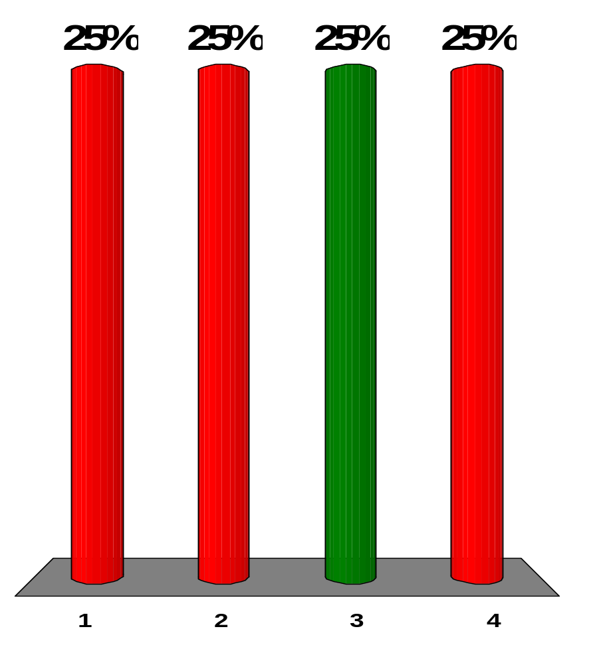
A spherical interplanetary grain of dust of radius 0.2 mm is at a distance r₁ from the Sun. The gravitational force exerted by the Sun on the grain just balances the force due to radiation pressure from the Sun’s light. Assume the grain is moved to a distance 2r₁ from the Sun and released. At this location, what is the net force exerted on the grain?
toward the Sun
away from the Sun
zero
impossible to determine without knowing the mass of the grain
Notes:
Remarks for instructors: Answer (3). Both the light intensity and the gravitational force follow inverse-square laws.

Slide 20
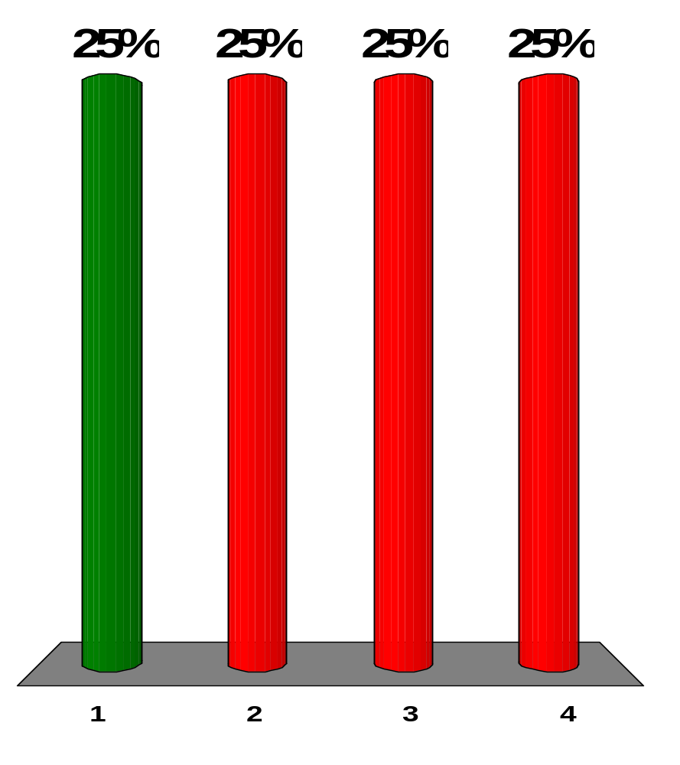
A spherical interplanetary grain of dust of radius 0.2 mm is at a distance r₁ from the Sun. The gravitational force exerted by the Sun on the grain just balances the force due to radiation pressure from the Sun’s light. Suppose the grain is compressed so that it crystallizes into a sphere with significantly higher density, still at a distance r₁. What is the net force exerted on the grain?
toward the Sun
away from the Sun
zero
impossible to determine without knowing the mass of the grain
Notes:
Remarks for instructors: Answer (1). The smaller grain presents less face area and feels a smaller force due to light pressure.

Slide 21
Rank the following kinds of waves according to their wavelength ranges from those with the largest typical or average wavelength to the smallest, noting any cases of equality:
(a) gamma rays
(b) microwaves
(c) radio waves
(d) visible light
(e) x-rays
c > b > d > e > a
b > c > e > b > a
a > e > d > b > c
e = a = c = d = b
Notes:
Remarks for instructors: Answer (1). Gamma rays have the shortest wavelength.

Slide 22
Rank the following kinds of waves according to their frequencies from highest to lowest:
(a) gamma rays
(b) microwaves
(c) radio waves
(d) visible light
(e) x-rays
c > b > d > e > a
b > c > e > b > a
a > e > d > b > c
e = a = c = d = b
Notes:
Remarks for instructors: Answer (3). According to fλ = c, as wavelength decreases, frequency increases.

Slide 23
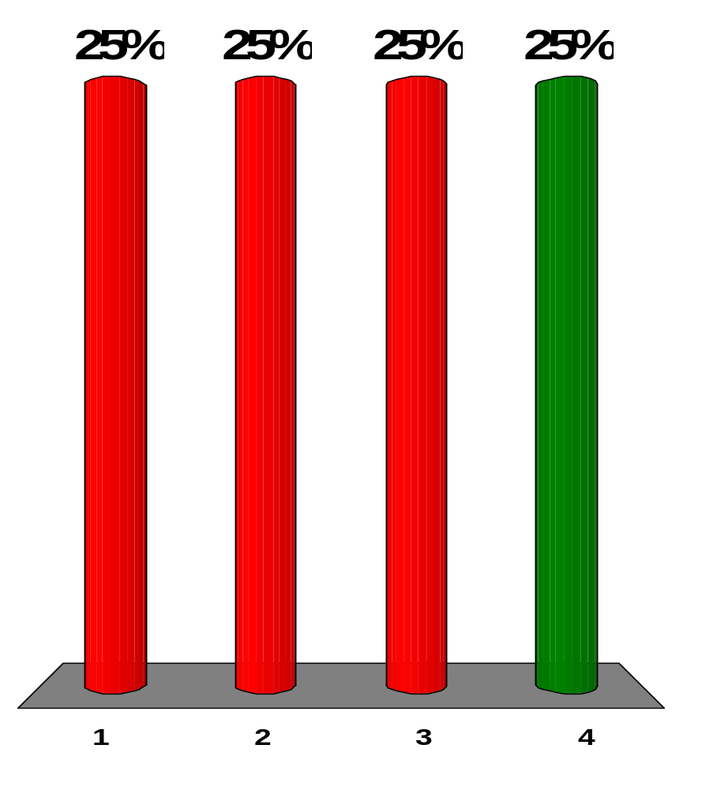
Rank the following kinds of waves according to their speeds from fastest to slowest:
(a) gamma rays
(b) microwaves
(c) radio waves
(d) visible light
(e) x-rays
c > b > d > e > a
b > c > e > b > a
a > e > d > b > c
e = a = c = d = b
Notes:
Remarks for instructors: Answer (4). All electromagnetic waves travel at the speed of light c in vacuum, which is assumed here.

Slide 24
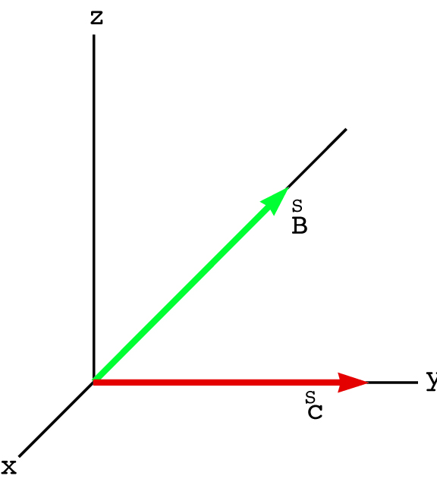
Consider an electromagnetic wave traveling in the positive y direction. The magnetic field associated with the wave at some location at some instant points in the negative x direction as shown in Figure OQ34.11. What is the direction of the electric field at this position and at this instant?
y
[Figure OQ34.11]
the positive x direction
the positive y direction
the positive z direction
the negative z direction
the negative y direction
Notes:
Remarks for instructors: Answer: (4). An electromagnetic wave travels in the direction of the Poynting vector: S = E×B/µ_{o}

