Slide 1
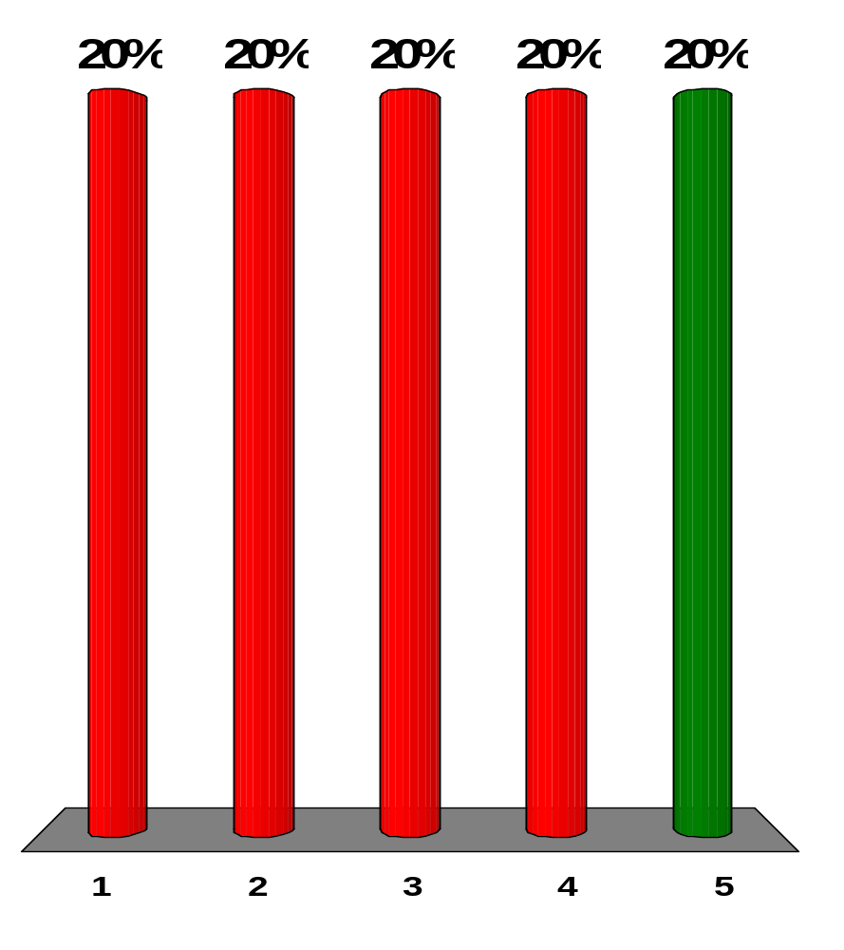
What happens to a light wave when it travels from air into glass?
Its speed remains the same.
Its speed increases.
Its wavelength increases.
Its wavelength remains the same.
Its frequency remains the same.
Notes:
Remarks for instructors: Answer (5). The index of refraction of glass is greater than that of air, which means the speed of light in glass is slower than in air (n = c/v). The frequency does not change, but because the speed decreases, the wavelength also decreases.

Slide 2
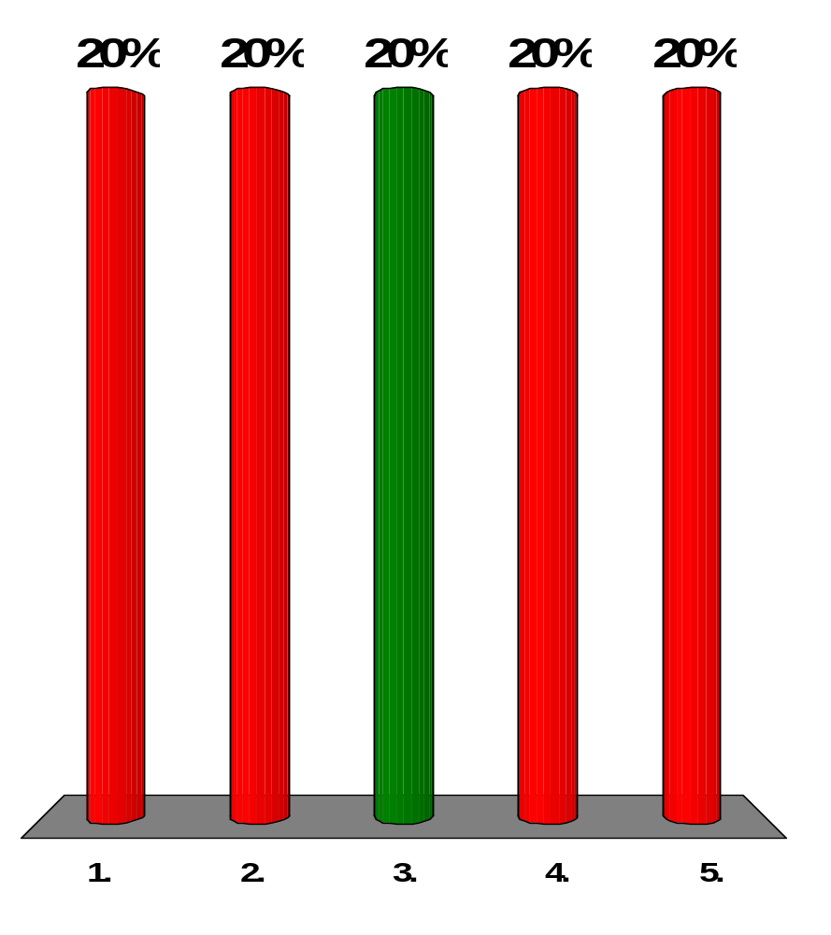
A source emits monochromatic light of wavelength 495 nm in air. When the light passes through a liquid, its wavelength reduces to 434 nm. What is the liquid’s index of refraction?
1.26
1.49
1.14
1.33
2.03
Notes:
Remarks for instructors: Answer (3). As light travels from one medium to another, both the wavelength of the light and the index of refraction of the medium will change, but the product λn is constant: λ₂n₂ = λ_{air}n_{air}. In going from air into a second medium of index n, according to Equation 35.7, n = λ/ λ_{n} =495 nm/434 nm = 1.14.

Slide 3
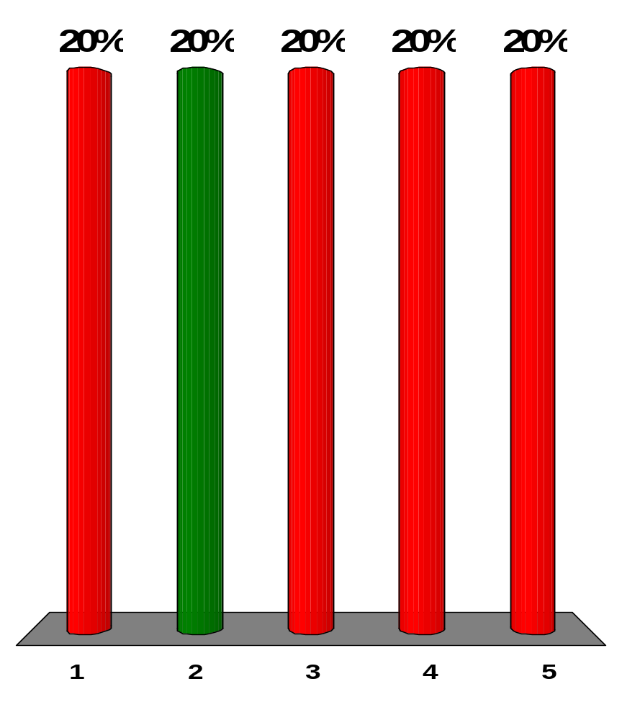
Carbon disulfide (n = 1.63) is poured into a container made of crown glass (n = 1.52). What is the critical angle for total internal reflection of a light ray in the liquid when it is incident on the liquid-to-glass surface?
89.2°
68.8°
21.2°
1.07°
43.0°
Notes:
Remarks for instructors: Answer (2). In going from carbon disulfide (n₁ = 1.63) to crown glass (n₂ = 1.52), the critical angle for total internal reflection is θ_{c} = sin⁻¹(n₂/n₁) = sin⁻¹(1.52/1.63) = 68.8°

Slide 4
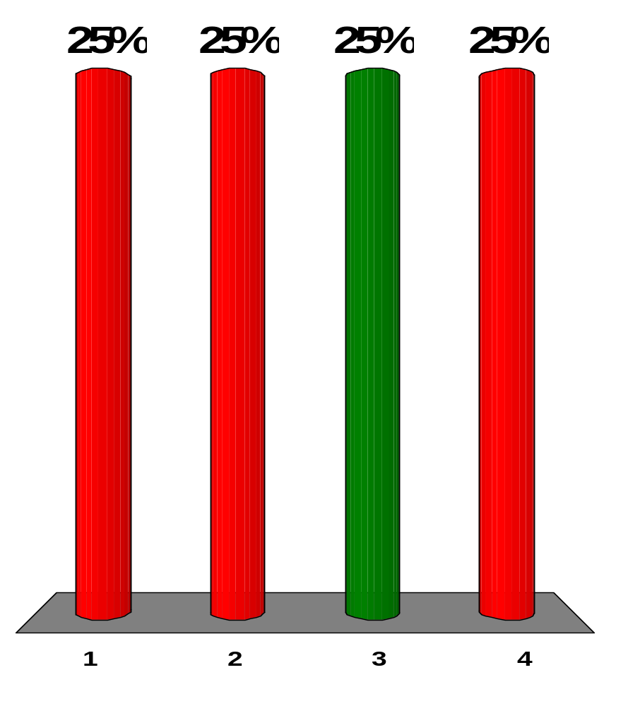
What is the order of magnitude of the time interval required for light to travel 10 km as in Galileo’s attempt to measure the speed of light?
several seconds
several milliseconds
several microseconds
several nanoseconds
Notes:
Remarks for instructors: Answer (3). The time interval is 10⁴ m/(3×10⁸ m /s) = 33 µs.

Slide 5
In each of the following situations, a wave passes through an opening in an absorbing wall. Rank the situations in order from the one in which the wave is best described by the ray approximation to the one in which the wave coming through the opening spreads out most nearly equally in all directions in the hemisphere beyond the wall.
(a) The sound of a low whistle at 1 kHz passes through a doorway 1 m wide.
(b) Red light passes through the pupil of your eye.
(c) Blue light passes through the pupil of your eye.
(d) The wave broadcast by an AM radio station passes through a doorway
1 m wide.
(e) An x-ray passes through the space between bones in your elbow joint.
e, b, d, c, a
b, c, a, d, e
c, e, b, d, a
d, c, a, e, b
e, c, b, a, d
Notes:
Remarks for instructors: Answer (5). We consider the quantity λ/d. The smaller it is, the better the ray approximation works.
In (a), (0.34 m)/(1 m) ≈ 0.3.
In (b), (0.7 μm)/(2 mm) ≈ 0.000 3.
In (c), (0.4 μm)/(2 mm) ≈ 0.000 2.
In (d), (300 m)/(1 m) ≈ 300.
In (e), (1 nm)/(1 mm) ≈ 0.000 001.

Slide 6
The index of refraction for water is about 4/3. What happens as a beam of light travels from air into water?
Its speed increases to 4/3 c, and its frequency decreases.
Its speed decreases to 3/4 c, and its wavelength decreases by a factor of 3/4.
Its speed decreases to 3/4 c, and its wavelength increases by a factor of 4/3.
Its speed and frequency remain the same.
Its speed decreases to 3/4 c, and its frequency increases.
Notes:
Remarks for instructors: Answer (2). When light is in water, the relationships between the values of its speed and wave­length to the values of the same quantities in air are
n_{water} = c/v_{water} → v_{water} = c/n_{water} = 3c/4,
and n_{water}λ_{water} = n_{air}λ_{air} = (n_{air}/n_{water})λ_{air} = 3λ_{air}/4

Slide 7
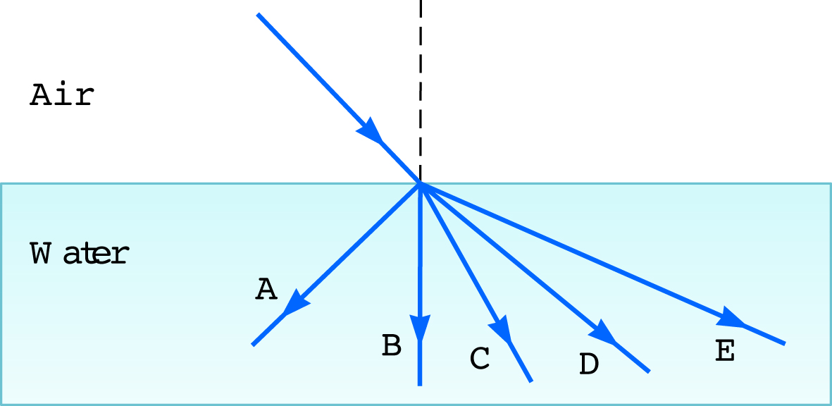

Light can travel from air into water. Some possible paths for the light ray in the water are shown in Figure OQ35.7. Which path will the light most likely follow?
[Figure OQ35.7]
A
B
C
D
E
Notes:
Remarks for instructors: Answer (3). Water has a greater index of refraction than air. In passing from one of these media into the other, light will be refracted (deviated in direction) unless the angle of inci­dence is zero (in which case, the angle of refraction is also zero). Thus, rays B and D cannot be correct. In refraction, the incident ray and the refracted ray are never on the same side of the line normal to the surface at the point of contact, so ray A cannot be correct. Also in refraction, n₂sinθ₂ = n₁sinθ₁; thus, if n₂ > n₁, then θ₂ < θ₁: the refracted ray makes a smaller angle with the normal in the medium having the higher index of refraction. Therefore, ray E cannot be correct, leaving only ray C as a likely path.

Slide 8
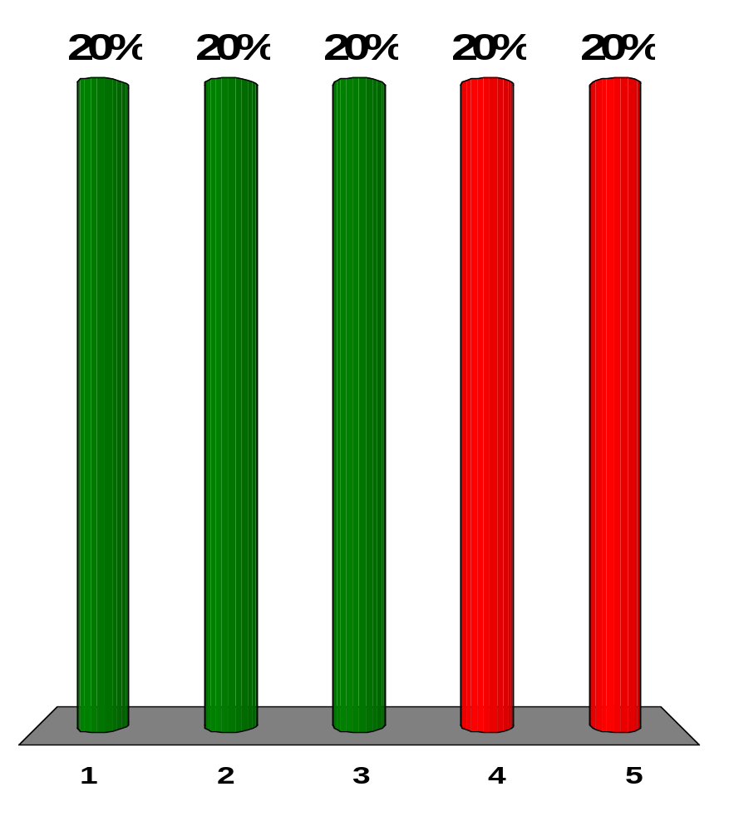
A light wave moves between medium 1 and medium 2. Which of the following are correct statements relating its speed, frequency, and wavelength in the two media, the indices of refraction of the media, and the angles of incidence and refraction? More than one statement may be correct.
v₁/sin θ₁ = v₂/sin θ₂
csc θ₁/n₁ = csc θ₂/n₂
λ₁/sin θ₁ = λ₂/sin θ₂
f₁/sin θ₁ = f₂/sin θ₂
n₁/cos θ₁ = n₂/cos θ₂
Notes:
Remarks for instructors: Answers (1), (2), and (3). The frequency of a wave does not change when it travels from one medium to another: f₁ = f₂ → λ₁n₁ = λ₂n₂; also, Snell’s law of refraction states n₁sinθ₁= n₂sinθ₂. By their definitions, n = c/v = c/fλ and sin θ = 1/csc θ. Thus, Snell’s law can take these alternate forms:
sinθ₁/v₁ = sinθ₂/v₂ → v₁/sinθ₁ = v₂/sinθ₂ → cscθ₁/n₁ = cscθ₂/n₂ → λ₁/sinθ₁ = λ₂/sinθ₂
Snell originally stated his law in terms of cosecants.

Slide 9
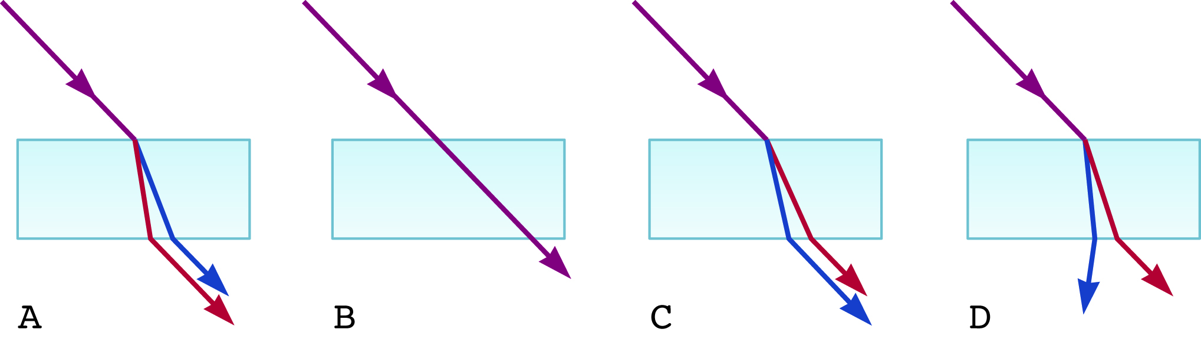
A light ray containing both blue and red wavelengths is incident at an angle on a slab of glass. Which of the sketches in Figure OQ35.9 represents the most likely outcome?
[Figure OQ35.9]
A
B
C
D
none of them
Notes:
Remarks for instructors: Answer (3). For any medium, other than vacuum, the index of refraction for red light is slightly lower (closer to 1) than that for blue light. This means that when light goes from vacuum (or air) into glass, the red light deviates from its original direction less than does the blue light. Also, as the light reemerges from the glass into vacuum (or air), the red light again deviates less than the blue light. If the two surfaces of the glass are parallel to each other, the red and blue rays will emerge traveling parallel to each other, but displaced laterally from one another. The sketch that best illustrates this process is C.

Slide 10
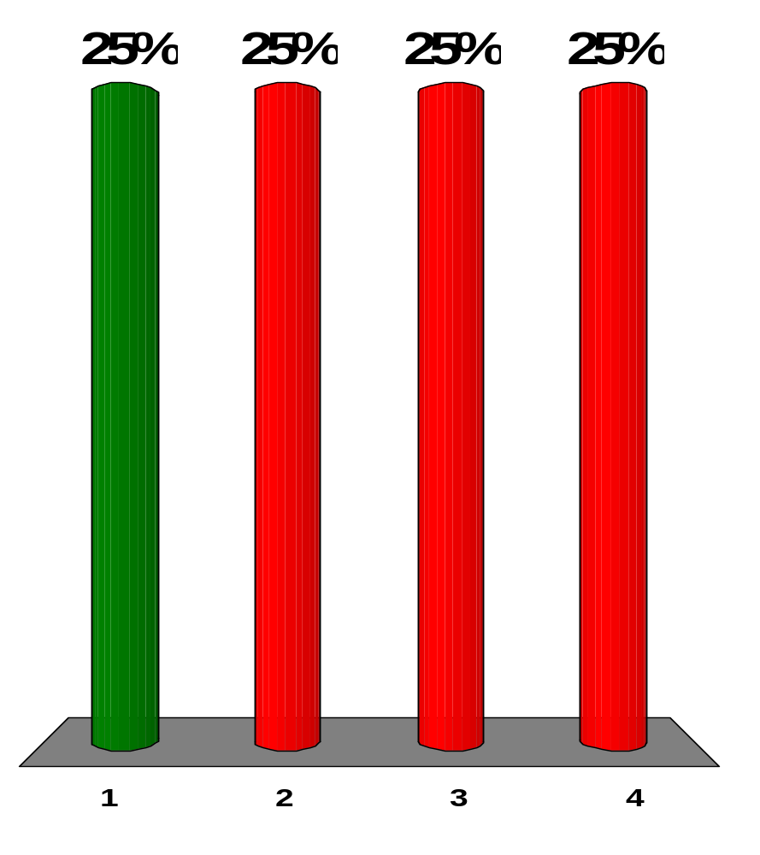
Can light undergo total internal reflection at a smooth interface between air and water? If so, in which medium must it be traveling originally?
yes; water
yes; air
yes; it doesn't matter
no
Notes:
Remarks for instructors: Answer (1). For a wave to experience total internal reflection, it must be traveling in the medium in which it moves slower, in which it has a greater index of refraction. Water has a greater index of refraction than air.

Slide 11
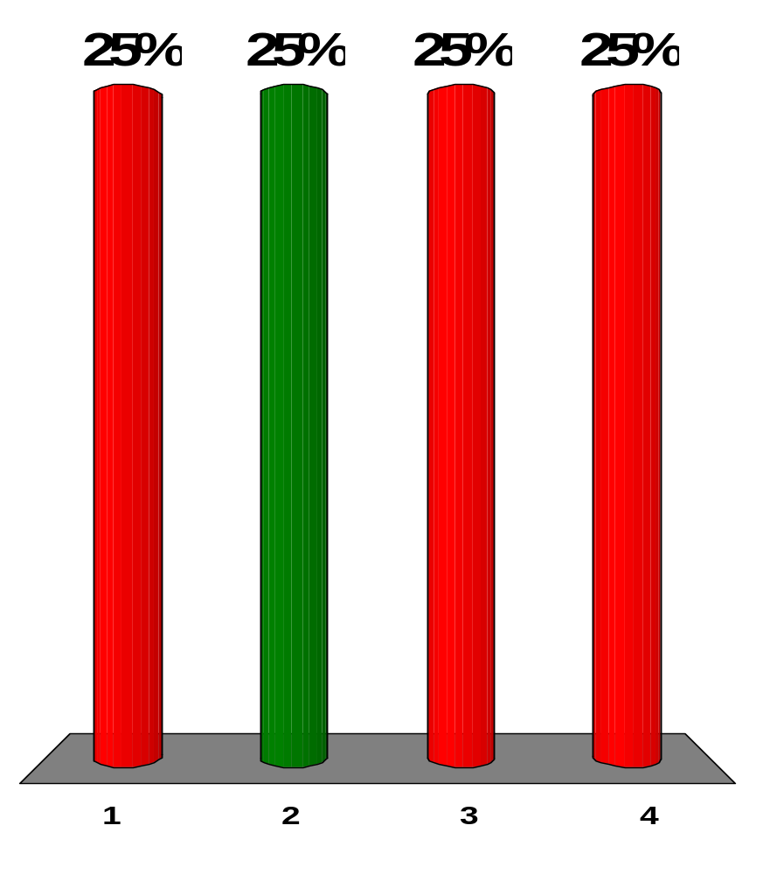
Can sound undergo total internal reflection at a smooth interface between air and water? If so, in which medium must it be traveling originally?
yes; water
yes; air
yes; it doesn't matter
no
Notes:
Remarks for instructors: Answer (2). For a wave to experience total internal reflection, it must be traveling in the medium in which it moves slower, in which it has a greater index of refraction. The sound travels slower in air than in water.

Slide 12
Light traveling in a medium of index of refraction n₁ is incident on another medium having an index of refraction n₂. Under which of the following conditions can total internal reflection occur at the interface of the two media?
The indices of refraction have the relation n₂ > n₁.
The indices of refraction have the relation n₁ > n₂.
Light travels slower in the second medium than in the first.
The angle of incidence is less than the critical angle.
The angle of incidence must equal the angle of refraction.
Notes:
Remarks for instructors: Answer (2). For a wave to experience total internal reflection, it must be traveling in the medium in which it moves slower, in which it has a greater index of refraction. A light ray, in attempting to go from a medium with index of refraction n₁ into a second medium with index of refraction n₂, will undergo total internal reflection if n₂ < n₁ and if the ray strikes the surface at an angle of incidence greater than or equal to the critical angle.

Slide 13
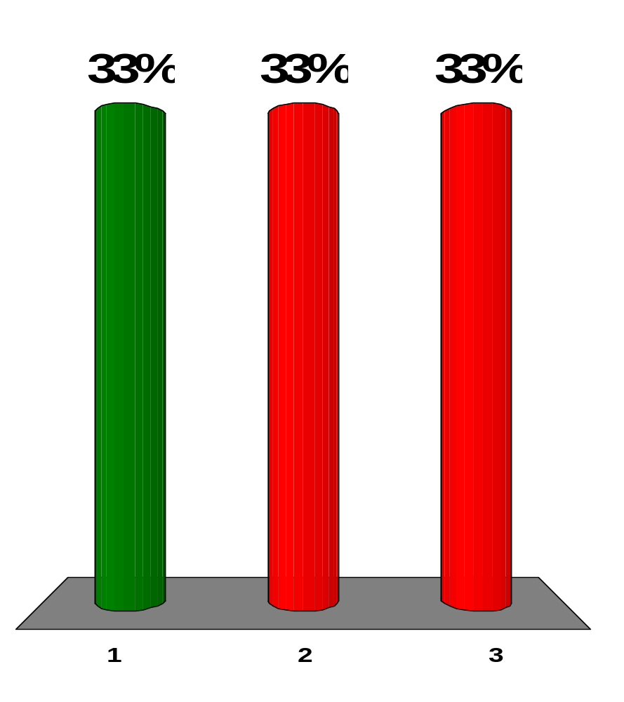
Suppose you find experimentally that two colors of light, A and B, originally traveling in the same direction in air, are sent through a glass prism, and A changes direction more than B. Which travels more slowly in the prism, A or B?
A
B
There is insufficient information to determine which moves more slowly.
Notes:
Remarks for instructors: Answer (1). Color A travels slower in the glass of the prism. Light with the greater change in speed will have the greater deviation in direction.

Slide 14
The core of an optical fiber transmits light with minimal loss if it is surrounded by what?
water
diamond
air
glass
fused quartz
Notes:
Remarks for instructors: Answer (3). We want a big difference between indices of refraction to have total internal reflection under the widest range of conditions.

Slide 15
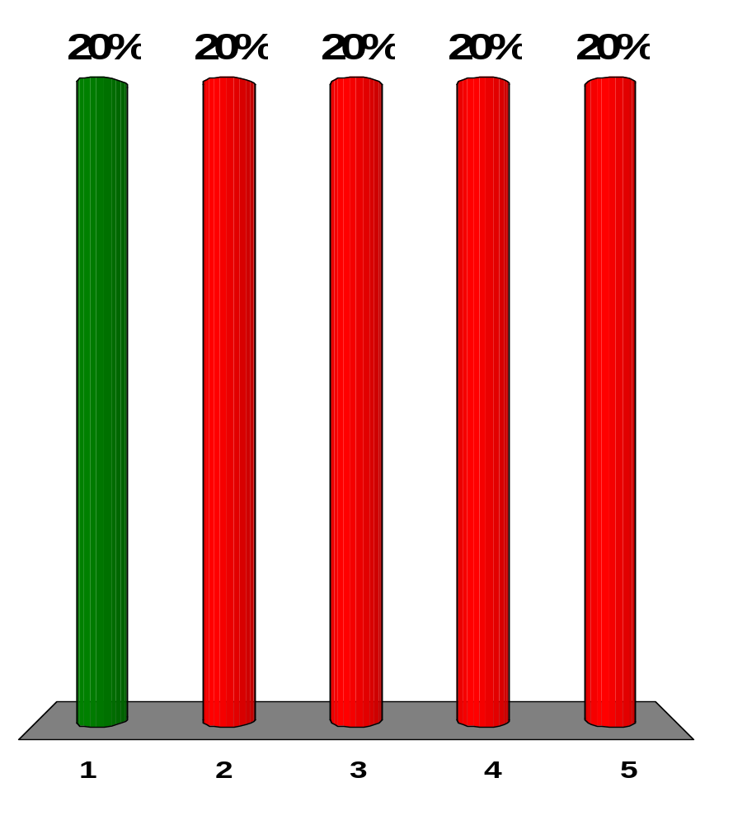
Which color light refracts the most when entering crown glass from air at some incident angle θ with respect to the normal?
violet
blue
green
yellow
red
Notes:
Remarks for instructors: Answer (1). In a dispersive medium, the index of refraction is largest for the shortest wave­length. Thus, the violet light will be refracted (or bent) the most as it passes through a surface of the crown glass.

Slide 16
A light ray travels from vacuum into a slab of material with index of refraction n₁ at incident angle θ with respect to the surface. It subsequently passes into a second slab of material with index of refraction n₂ before passing back into vacuum again. The surfaces of the different materials are all parallel to one another. As the light exits the second slab, what can be said of the final angle Φ that the outgoing light makes with the normal?
Φ > θ
Φ < θ
Φ = θ
The angle depends on the magnitudes of n₁ and n₂.
The angle depends on the wavelength of the light.
Notes:
Remarks for instructors: Answer (3). Apply Snell’s law to the refraction at each of the three surfaces. Because the surfaces are parallel, the resulting equations are
(1.00)sinθ = n₁sinα (top surface)
n₁sinα = n₂sinβ (middle surface)
n₂sinβ = (1.00)sinΦ (bottom surface)
These equations allow us to equate the left side of the first equation with the right side of the last equation:
(1.00)sinθ = (1.00)sinΦ → Φ = θ

