Slide 1
Chapter 16
Wave Motion

Slide 2
Types of Waves
There are two main types of waves
  Mechanical waves
    Some physical medium is being disturbed
    The wave is the propagation of a disturbance through a medium
  Electromagnetic waves
    No medium required
    Examples are light, radio waves, x-rays

Slide 3
General Features of Waves
In wave motion, energy is transferred over a distance
Matter is not transferred over a distance
All waves carry energy
  The amount of energy and the mechanism responsible for the transport of the energy differ

Slide 4
Mechanical Wave Requirements
Some source of disturbance
A medium that can be disturbed
Some physical mechanism through which elements of the medium can influence each other

Slide 5
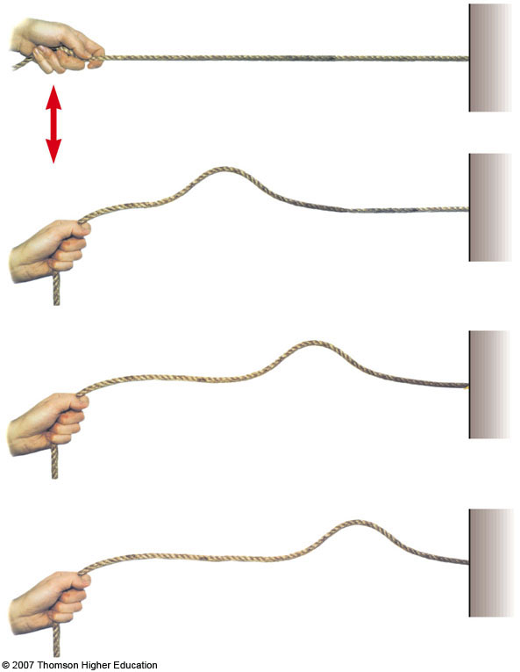
Pulse on a String
The wave is generated by a flick on one end of the string
The string is under tension
A single bump is formed and travels along the string
  The bump is called a pulse

Slide 6
Pulse on a String
The string is the medium through which the pulse travels
The pulse has a definite height
The pulse has a definite speed of propagation along the medium
The shape of the pulse changes very little as it travels along the string
A continuous flicking of the string would produce a periodic disturbance which would form a wave

Slide 7
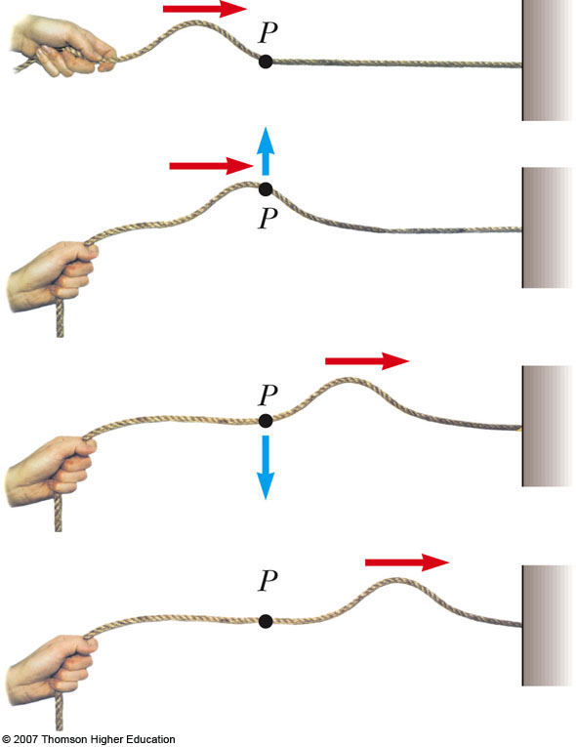
Transverse Wave
A traveling wave or pulse that causes the elements of the disturbed medium to move perpendicular to the direction of propagation is called a transverse wave
The particle motion is shown by the blue arrow
The direction of propagation is shown by the red arrow

Slide 8
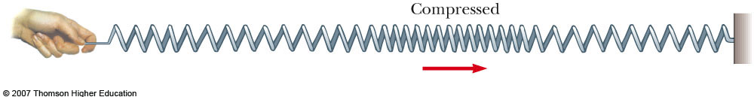
Longitudinal Wave
A traveling wave or pulse that causes the elements of the disturbed medium to move parallel to the direction of propagation is called a longitudinal wave
The displacement of the coils is parallel to the propagation

Slide 9
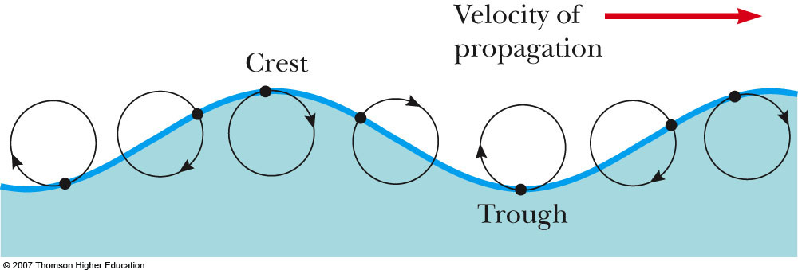
Complex Waves
Some waves exhibit a combination of transverse and longitudinal waves
Surface water waves are an example
Use the active figure to observe the displacements

Slide 10
Example: Earthquake Waves
P waves
  “P” stands for primary
  Fastest, at 7 – 8 km / s
  Longitudinal
S waves
  “S” stands for secondary
  Slower, at 4 – 5 km/s
  Transverse
A seismograph records the waves and allows determination of information about the earthquake’s place of origin

Slide 11
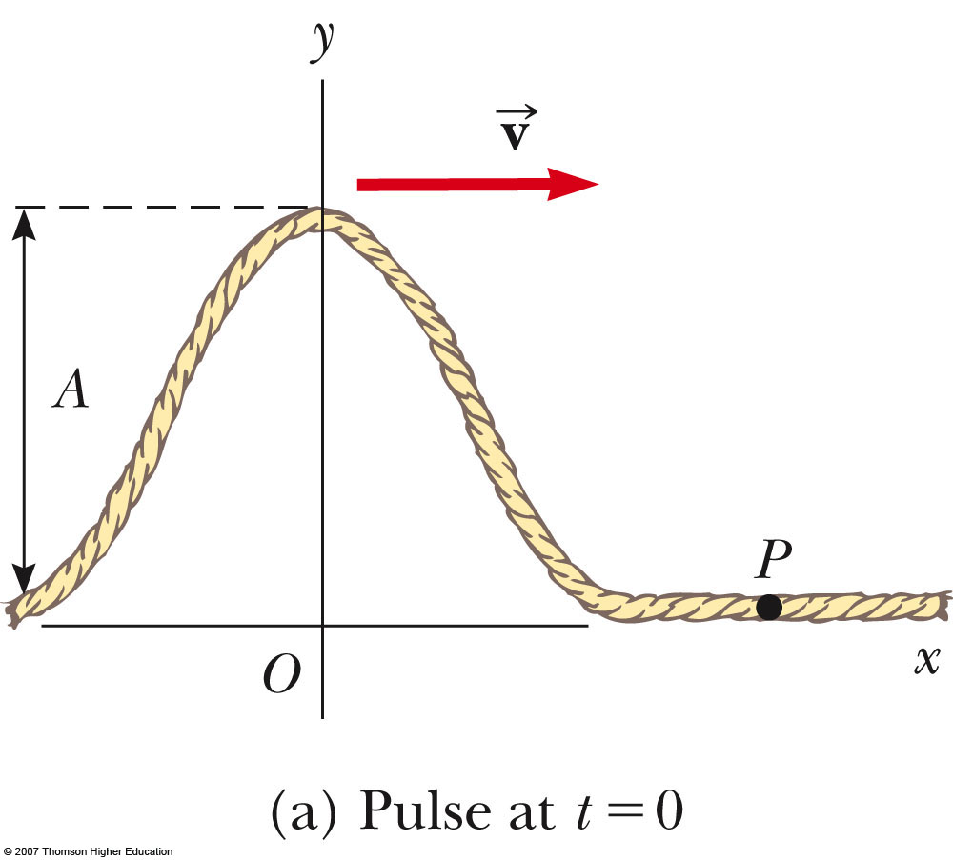
Traveling Pulse
The shape of the pulse at t = 0 is shown
The shape can be represented by
y (x,0) = f (x)
  This describes the transverse position y of the element of the string located at each value of x at t = 0

Slide 12
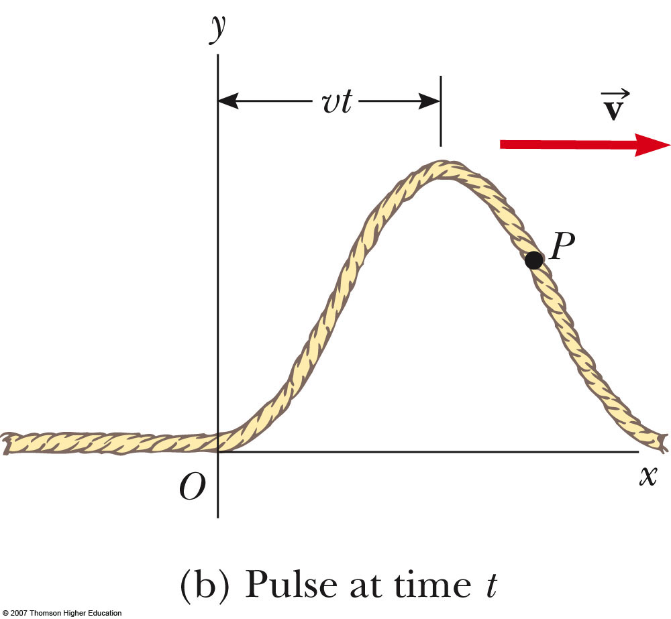
Traveling Pulse, 2
The speed of the pulse is v
At some time, t, the pulse has traveled a distance vt
The shape of the pulse does not change
Its position is now
y = f (x – vt)

Slide 13
Traveling Pulse, 3
For a pulse traveling to the right
  y (x, t) = f (x – vt)
For a pulse traveling to the left
  y (x, t) = f (x + vt)
The function y is also called the wave function:
y (x, t)
The wave function represents the y coordinate of any element located at position x at any time t
  The y coordinate is the transverse position

Slide 14
Traveling Pulse, final
If t is fixed then the wave function is called the waveform
  It defines a curve representing the actual geometric shape of the pulse at that time

Slide 15
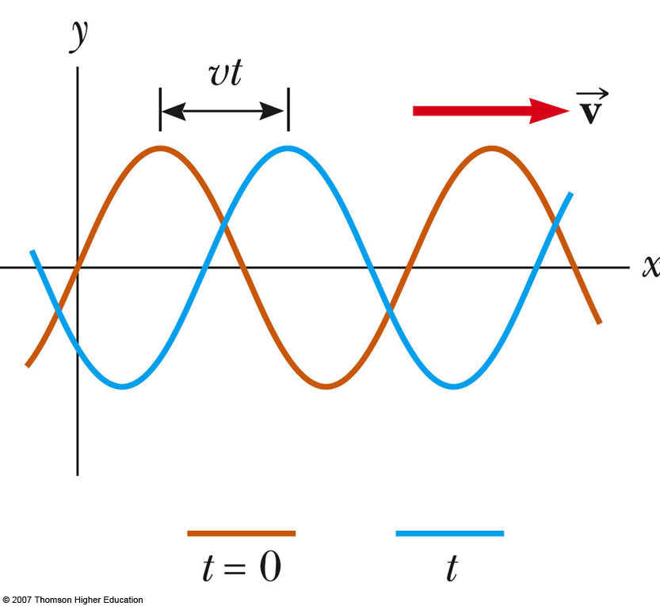
Sinusoidal Waves
The wave represented by the curve shown is a sinusoidal wave
It is the same curve as sin θ plotted against θ
This is the simplest example of a periodic continuous wave
  It can be used to build more complex waves

Slide 16
Sinusoidal Waves, cont
The wave moves toward the right
  In the previous example, the brown wave represents the initial position
  As the wave moves toward the right, it will eventually be at the position of the blue curve
Each element moves up and down in simple harmonic motion
It is important to distinguish between the motion of the wave and the motion of the particles of the medium

Slide 17
Wave Model
The wave model is a new simplification model
  Allows to explore more analysis models for solving problems
  An ideal wave has a single frequency
  An ideal wave is infinitely long
  Ideal waves can be combined

Slide 18
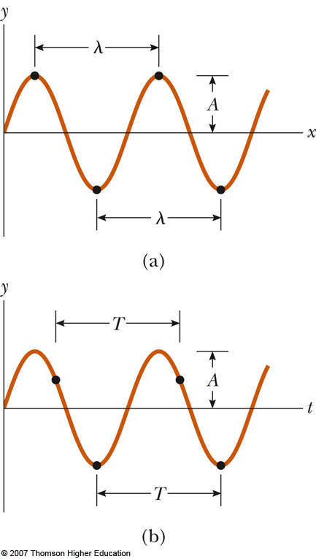
Terminology: Amplitude and Wavelength
The crest of the wave is the location of the maximum displacement of the element from its normal position
  This distance is called the amplitude, A
The wavelength, λ, is the distance from one crest to the next

Slide 19
Terminology: Wavelength and Period
More generally, the wavelength is the minimum distance between any two identical points on adjacent waves
The period, T , is the time interval required for two identical points of adjacent waves to pass by a point
  The period of the wave is the same as the period of the simple harmonic oscillation of one element of the medium

Slide 20
Terminology: Frequency
The frequency, ƒ, is the number of crests (or any point on the wave) that pass a given point in a unit time interval
  The time interval is most commonly the second
  The frequency of the wave is the same as the frequency of the simple harmonic motion of one element of the medium

Slide 21
Terminology: Frequency, cont
The frequency and the period are related
When the time interval is the second, the units of frequency are s⁻¹ = Hz
  Hz is a hertz

Slide 22
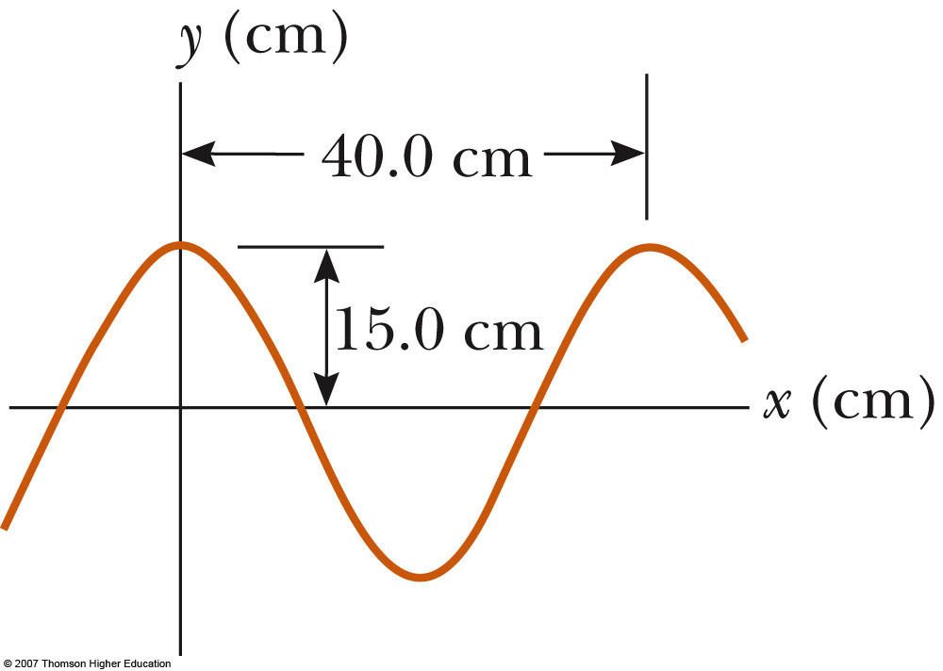
Terminology, Example
The wavelength, λ, is 40.0 cm
The amplitude, A, is 15.0 cm
The wave function can be written in the form y = A cos(kx – ωt)

Slide 23
Speed of Waves
Waves travel with a specific speed
  The speed depends on the properties of the medium being disturbed
The wave function is given by
  This is for a wave moving to the right
  For a wave moving to the left, replace x – vt
  with x + vt

Slide 24
Wave Function, Another Form
Since speed is distance divided by time,
v = λ / T
The wave function can then be expressed as
This form shows the periodic nature of y
  y can be used as shorthand notation for y(x, t)

Slide 25
Wave Equations
We can also define the angular wave number (or just wave number), k
The angular frequency can also be defined

Slide 26
Wave Equations, cont
The wave function can be expressed as
y = A sin (k x – ωt)
The speed of the wave becomes v = λ ƒ
If x ≠ 0 at t = 0, the wave function can be generalized to
y = A sin (k x – ωt + φ)
where φ is called the phase constant

Slide 27
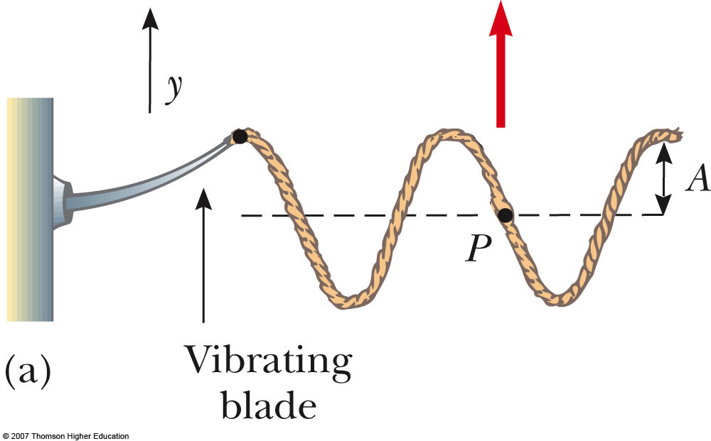
Sinusoidal Wave on a String
To create a series of pulses, the string can be attached to an oscillating blade
The wave consists of a series of identical waveforms
The relationships between speed, velocity, and period hold

Slide 28
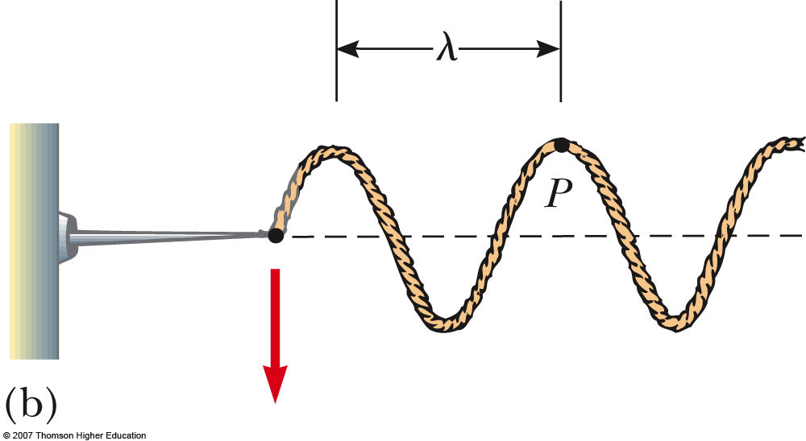
Sinusoidal Wave on a String, 2
Each element of the string oscillates vertically with simple harmonic motion
  For example, point P
Every element of the string can be treated as a simple harmonic oscillator vibrating with a frequency equal to the frequency of the oscillation of the blade

Slide 29
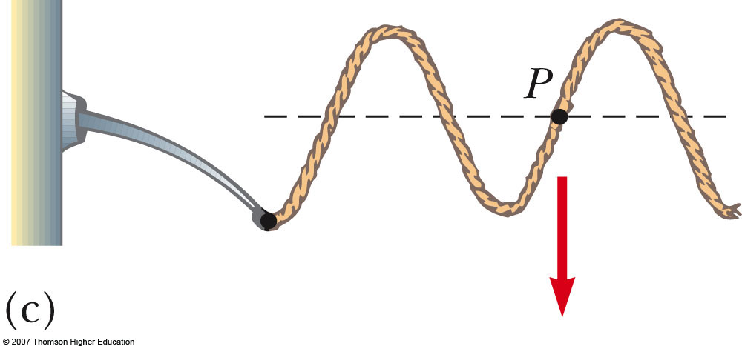
Sinusoidal Wave on a String, 3
The transverse speed of the element is
or v_{y} = -ωA cos(kx – ωt)
This is different than the speed of the wave itself

Slide 30
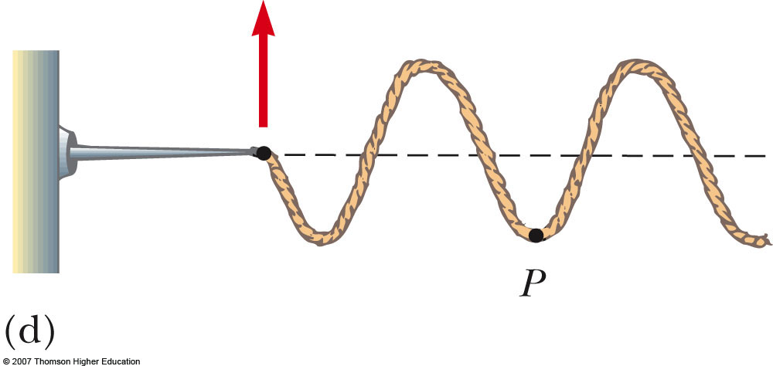
Sinusoidal Wave on a String, 4
The transverse acceleration of the element is
or a_{y} = -ω²A sin(kx – ωt)

Slide 31
Sinusoidal Wave on a String, 5
The maximum values of the transverse speed and transverse acceleration are
  v_{y}, _{max} = ωA
  a_{y}, _{max} = ω²A
The transverse speed and acceleration do not reach their maximum values simultaneously
  v is a maximum at y = 0
  a is a maximum at y = ±A

Slide 32
Speed of a Wave on a String
The speed of the wave depends on the physical characteristics of the string and the tension to which the string is subjected
This assumes that the tension is not affected by the pulse
This does not assume any particular shape for the pulse

Slide 33
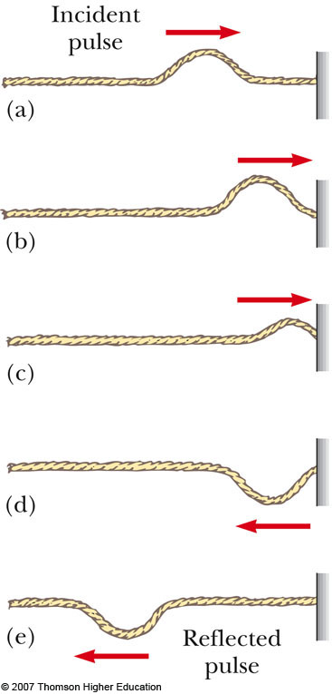
Reflection of a Wave, Fixed End
When the pulse reaches the support, the pulse moves back along the string in the opposite direction
This is the reflection of the pulse
The pulse is inverted

Slide 34
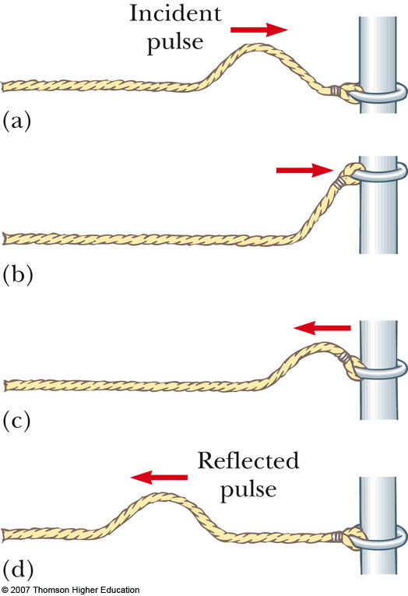
Reflection of a Wave, Free End
With a free end, the string is free to move vertically
The pulse is reflected
The pulse is not inverted
The reflected pulse has the same amplitude as the initial pulse

Slide 35
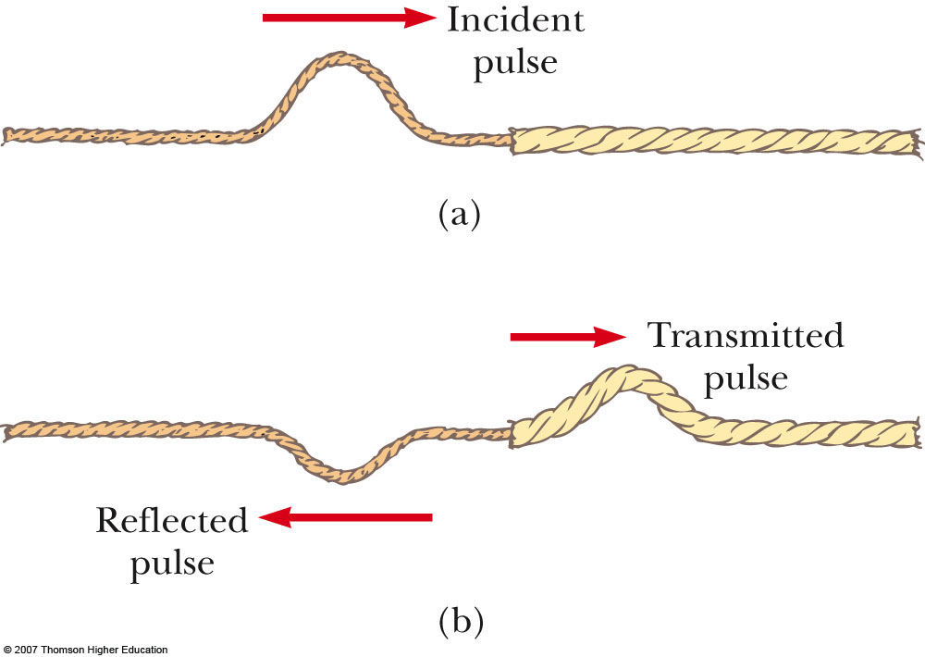
Transmission of a Wave
When the boundary is intermediate between the last two extremes
  Part of the energy in the incident pulse is reflected and part undergoes transmission
    Some energy passes through the boundary

Slide 36
Transmission of a Wave, 2
Assume a light string is attached to a heavier string
The pulse travels through the light string and reaches the boundary
The part of the pulse that is reflected is inverted
The reflected pulse has a smaller amplitude

Slide 37
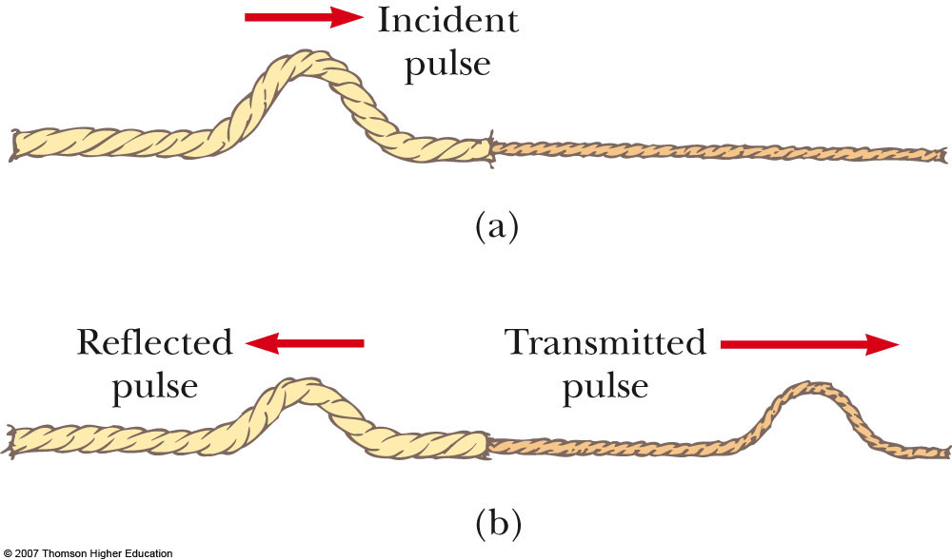
Transmission of a Wave, 3
Assume a heavier string is attached to a light string
Part of the pulse is reflected and part is transmitted
The reflected part is not inverted

Slide 38
Transmission of a Wave, 4
Conservation of energy governs the pulse
  When a pulse is broken up into reflected and transmitted parts at a boundary, the sum of the energies of the two pulses must equal the energy of the original pulse
When a wave or pulse travels from medium A to medium B and v_{A} > v_{B}, it is inverted upon reflection
  B is denser than A
When a wave or pulse travels from medium A to medium B and v_{A} < v_{B}, it is not inverted upon reflection
  A is denser than B

Slide 39
Energy in Waves in a String
Waves transport energy when they propagate through a medium
We can model each element of a string as a simple harmonic oscillator
  The oscillation will be in the y-direction
Every element has the same total energy

Slide 40
Energy, cont.
Each element can be considered to have a mass of dm
Its kinetic energy is dK = ½ (dm) v_{y}²
The mass dm is also equal to μdx
The kinetic energy of an element of the string is dK = ½ (μ dx) v_{y}²

Slide 41
Energy, final
Integrating over all the elements, the total kinetic energy in one wavelength is K_{λ} = ¼μω²A ²λ
The total potential energy in one wavelength is U_{λ} = ¼μω²A ²λ
This gives a total energy of
  E_{λ} = K_{λ} + U_{λ} = ½μω²A ²λ

Slide 42
Power Associated with a Wave
The power is the rate at which the energy is being transferred:
The power transfer by a sinusoidal wave on a string is proportional to the
  Frequency squared
  Square of the amplitude
  Wave speed

Slide 43
The Linear Wave Equation
The wave functions y (x, t) represent solutions of an equation called the linear wave equation
This equation gives a complete description of the wave motion
From it you can determine the wave speed
The linear wave equation is basic to many forms of wave motion

Slide 44
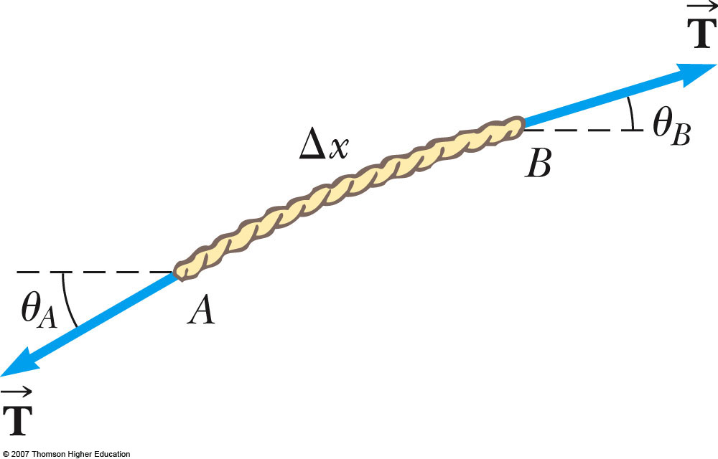
Linear Wave Equation Applied to a Wave on a String
The string is under tension T
Consider one small string element of length Δx
The net force acting in the y direction is
  This uses the small-angle approximation

Slide 45
Linear Wave Equation Applied to Wave on a String
Applying Newton’s Second Law gives
In the limit as Δx→0, this becomes
This is the linear wave equation as it applies to waves on a string

Slide 46
Linear Wave Equation, General
The equation can be written as
This applies in general to various types of traveling waves
  y represents various positions
    For a string, it is the vertical displacement of the elements of the string
    For a sound wave, it is the longitudinal position of the elements from the equilibrium position
    For em waves, it is the electric or magnetic field components

Slide 47
Linear Wave Equation, General cont
The linear wave equation is satisfied by any wave function having the form
y = f (x ± vt)
The linear wave equation is also a direct consequence of Newton’s Second Law applied to any element of a string carrying a traveling wave

