Slide 1
Chapter 23
Electric Fields

Slide 2
Electricity and Magnetism, Some History
Many applications
  Macroscopic and microscopic
Chinese
  Documents suggest that magnetism was observed as early as 2000 BC
Greeks
  Electrical and magnetic phenomena as early as 700 BC
  Experiments with amber and magnetite

Slide 3
Electricity and Magnetism, Some History, 2
1600
  William Gilbert showed electrification effects were not confined to just amber
  The electrification effects were a general phenomena
1785
  Charles Coulomb confirmed inverse square law form for electric forces

Slide 4
Electricity and Magnetism, Some History, 3
1819
  Hans Oersted found a compass needle deflected when near a wire carrying an electric current
1831
  Michael Faraday and Joseph Henry showed that when a wire is moved near a magnet, an electric current is produced in the wire

Slide 5
Electricity and Magnetism, Some History, 4
1873
  James Clerk Maxwell used observations and other experimental facts as a basis for formulating the laws of electromagnetism
    Unified electricity and magnetism
1888
  Heinrich Hertz verified Maxwell’s predictions
  He produced electromagnetic waves

Slide 6
Electric Charges
There are two kinds of electric charges
  Called positive and negative
    Negative charges are the type possessed by electrons
    Positive charges are the type possessed by protons
Charges of the same sign repel one another and charges with opposite signs attract one another

Slide 7
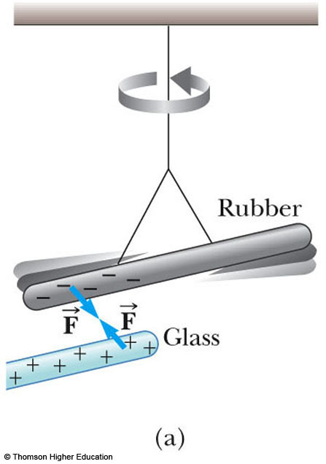
Electric Charges, 2
The rubber rod is negatively charged
The glass rod is positively charged
The two rods will attract

Slide 8
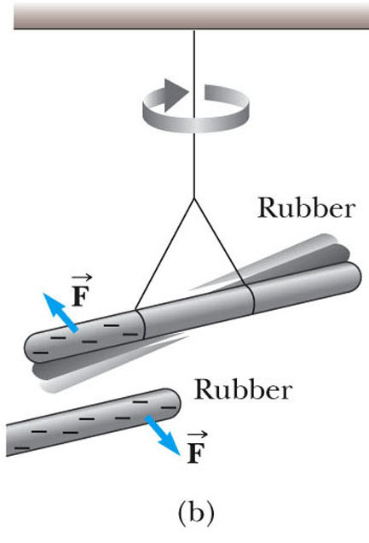
Electric Charges, 3
The rubber rod is negatively charged
The second rubber rod is also negatively charged
The two rods will repel

Slide 9
More About Electric Charges
Electric charge is always conserved in an isolated system
  For example, charge is not created in the process of rubbing two objects together
  The electrification is due to a transfer of charge from one object to another

Slide 10
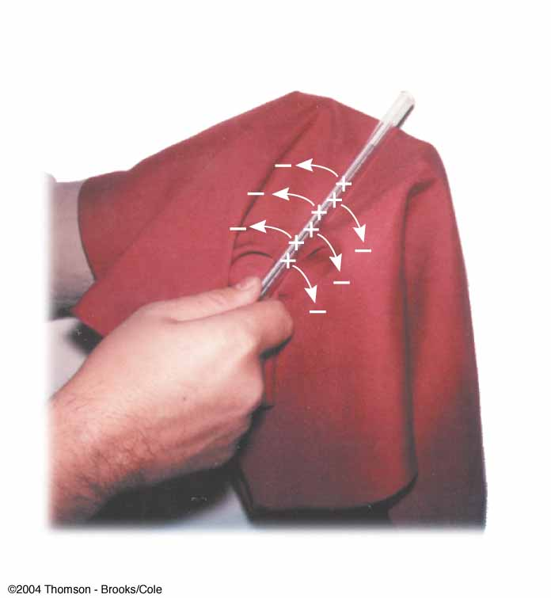
Conservation of Electric Charges
A glass rod is rubbed with silk
Electrons are transferred from the glass to the silk
Each electron adds a negative charge to the silk
An equal positive charge is left on the rod

Slide 11
Quantization of Electric Charges
The electric charge, q, is said to be quantized
  q is the standard symbol used for charge as a variable
  Electric charge exists as discrete packets
  q = ±Ne
    N is an integer
    e is the fundamental unit of charge
    |e| = 1.6 x 10⁻¹⁹ C
    Electron: q = -e
    Proton: q = +e

Slide 12
Conductors
Electrical conductors are materials in which some of the electrons are free electrons
  Free electrons are not bound to the atoms
  These electrons can move relatively freely through the material
  Examples of good conductors include copper, aluminum and silver
  When a good conductor is charged in a small region, the charge readily distributes itself over the entire surface of the material

Slide 13
Insulators
Electrical insulators are materials in which all of the electrons are bound to atoms
  These electrons can not move relatively freely through the material
  Examples of good insulators include glass, rubber and wood
  When a good insulator is charged in a small region, the charge is unable to move to other regions of the material

Slide 14
Semiconductors
The electrical properties of semiconductors are somewhere between those of insulators and conductors
Examples of semiconductor materials include silicon and germanium

Slide 15
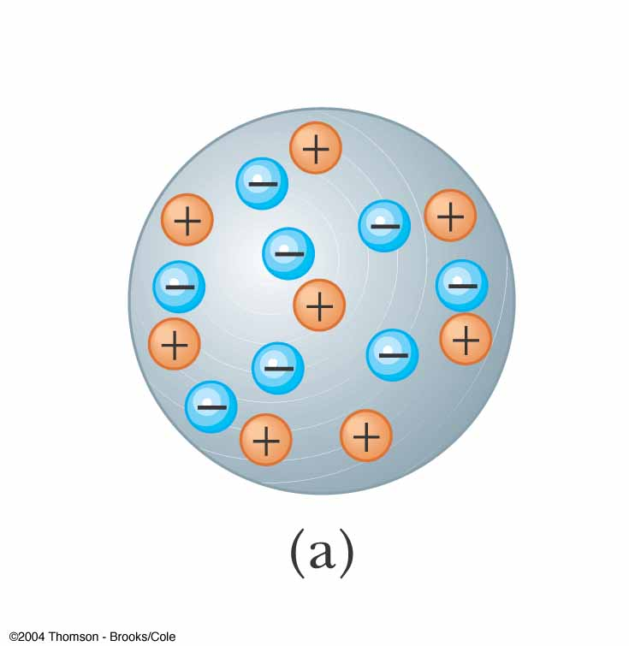
Charging by Induction
Charging by induction requires no contact with the object inducing the charge
Assume we start with a neutral metallic sphere
  The sphere has the same number of positive and negative charges

Slide 16
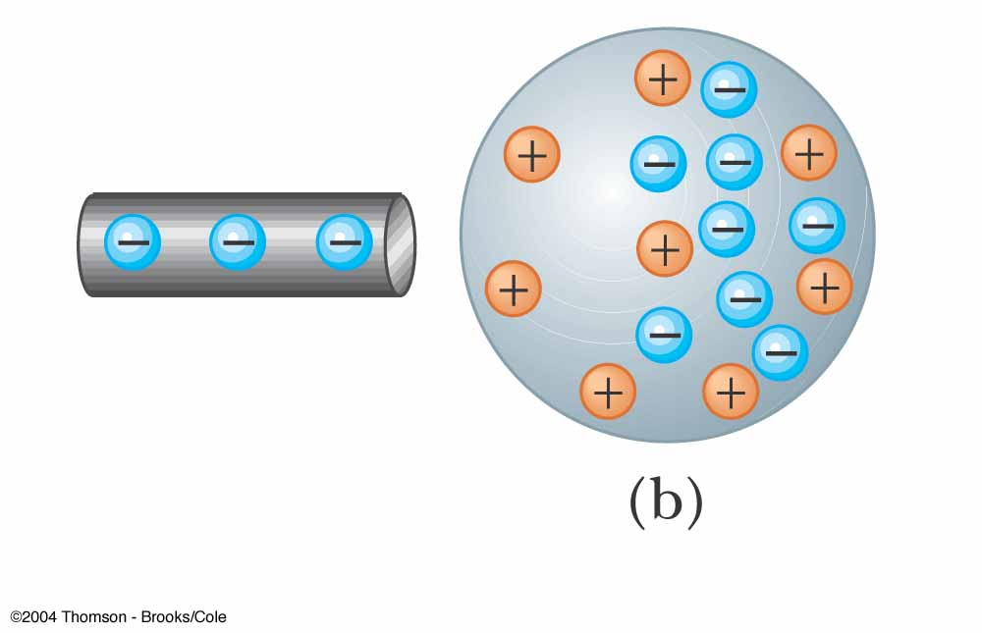
Charging by Induction, 2
A charged rubber rod is placed near the sphere
  It does not touch the sphere
The electrons in the neutral sphere are redistributed

Slide 17
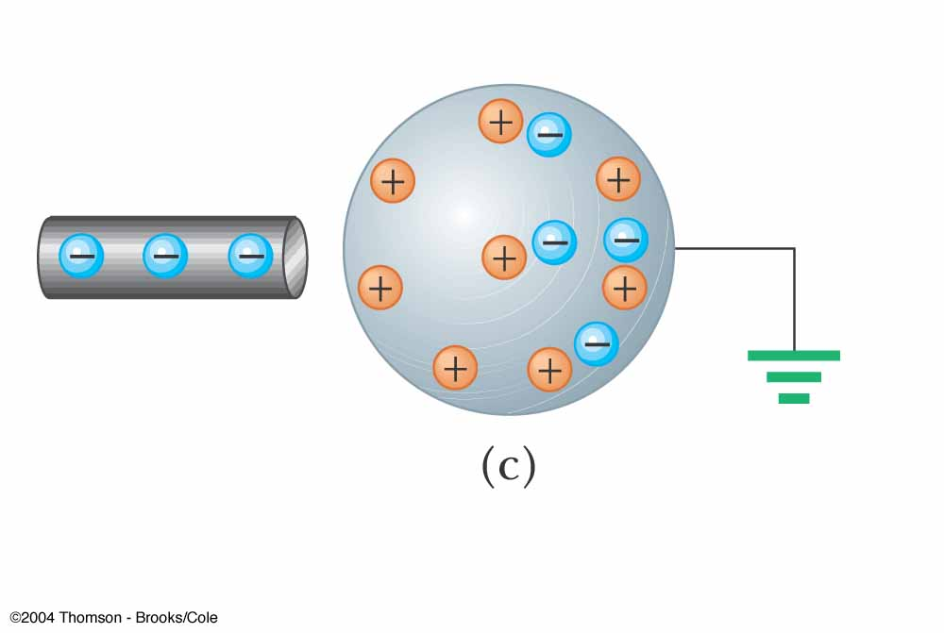
Charging by Induction, 3
The sphere is grounded
Some electrons can leave the sphere through the ground wire

Slide 18
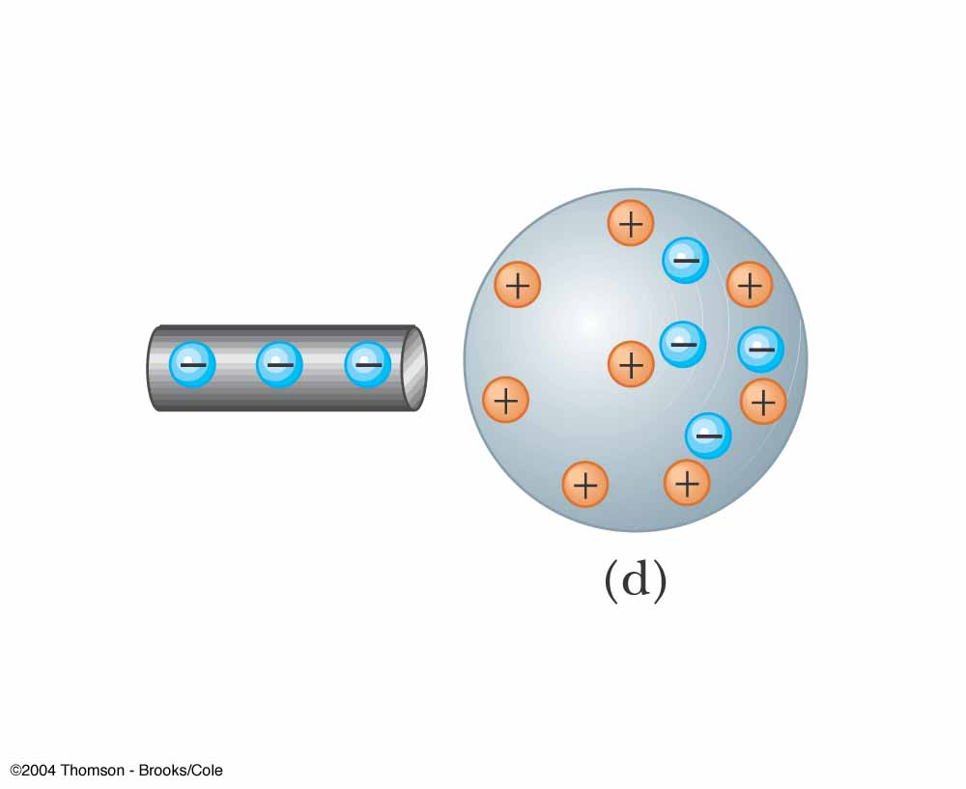
Charging by Induction, 4
The ground wire is removed
There will now be more positive charges
The charges are not uniformly distributed
The positive charge has been induced in the sphere

Slide 19
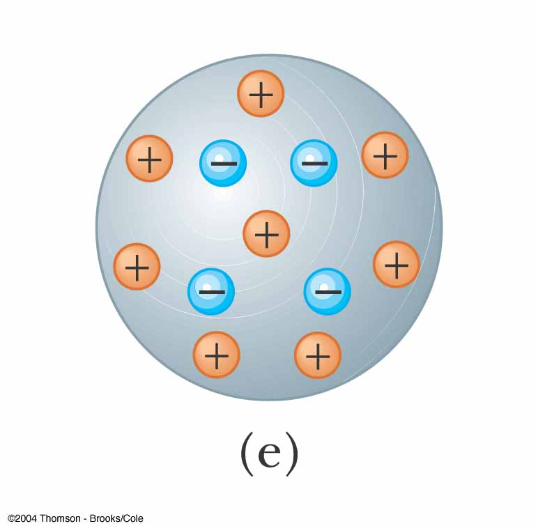
Charging by Induction, 5
The rod is removed
The electrons remaining on the sphere redistribute themselves
There is still a net positive charge on the sphere
The charge is now uniformly distributed

Slide 20
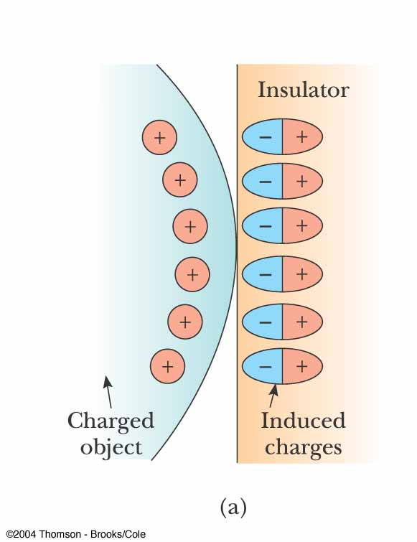
Charge Rearrangement in Insulators
A process similar to induction can take place in insulators
The charges within the molecules of the material are rearranged

Slide 21
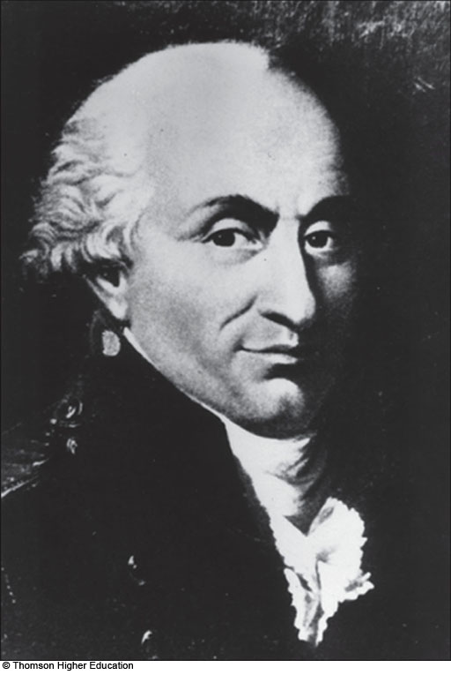
Charles Coulomb
1736 – 1806
French physicist
Major contributions were in areas of electrostatics and magnetism
Also investigated in areas of
  Strengths of materials
  Structural mechanics
  Ergonomics

Slide 22
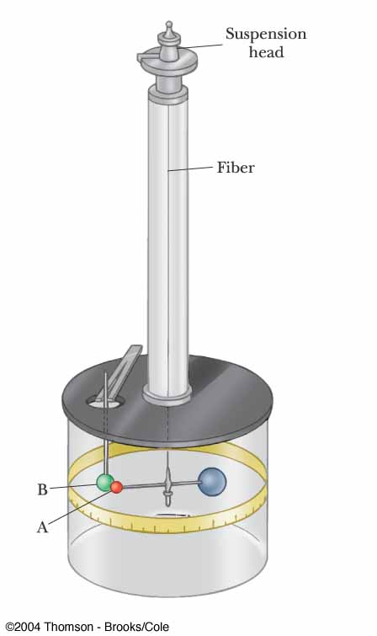
Coulomb’s Law
Charles Coulomb measured the magnitudes of electric forces between two small charged spheres
He found the force depended on the charges and the distance between them

Slide 23
Point Charge
The term point charge refers to a particle of zero size that carries an electric charge
  The electrical behavior of electrons and protons is well described by modeling them as point charges

Slide 24
Coulomb’s Law, 2
The electrical force between two stationary point charges is given by Coulomb’s Law
The force is inversely proportional to the square of the separation r between the charges and directed along the line joining them
The force is proportional to the product of the charges, q₁ and q₂, on the two particles

Slide 25
Coulomb’s Law, 3
The force is attractive if the charges are of opposite sign
The force is repulsive if the charges are of like sign
The force is a conservative force

Slide 26
Coulomb’s Law, Equation
Mathematically,
The SI unit of charge is the coulomb (C)
k_{e} is called the Coulomb constant
  k_{e} = 8.9876 x 10⁹ N.m²/C² = 1/(4πe_{o})
  e_{o} is the permittivity of free space
  e_{o} = 8.8542 x 10⁻¹² C² / N.m²

Slide 27
Coulomb's Law, Notes
Remember the charges need to be in coulombs
  e is the smallest unit of charge
    except quarks
  e = 1.6 x 10⁻¹⁹ C
  So 1 C needs 6.24 x 10¹⁸ electrons or protons
Typical charges can be in the µC range
Remember that force is a vector quantity

Slide 28
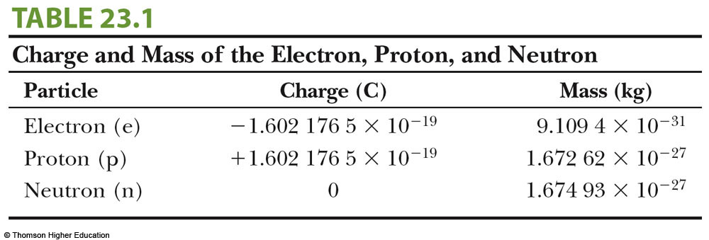
Particle Summary

Slide 29
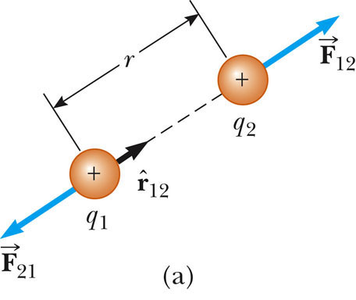
Vector Nature of Electric Forces
In vector form,
is a unit vector directed from q₁ to q₂
The like charges produce a repulsive force between them
Use the active figure to move the charges and observe the force
PLAY
ACTIVE FIGURE

Slide 30
Vector Nature of Electrical Forces, 2
Electrical forces obey Newton’s Third Law
The force on q₁ is equal in magnitude and opposite in direction to the force on q₂
With like signs for the charges, the product q₁q₂ is positive and the force is repulsive

Slide 31
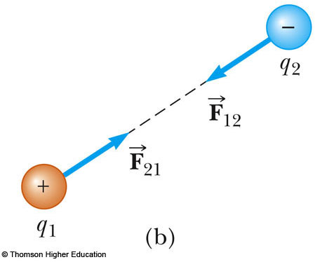
Vector Nature of Electrical Forces, 3
Two point charges are separated by a distance r
The unlike charges produce an attractive force between them
With unlike signs for the charges, the product q₁q₂ is negative and the force is attractive
  Use the active figure to investigate the force for different positions
PLAY
ACTIVE FIGURE

Slide 32
A Final Note about Directions
The sign of the product of q₁q₂ gives the relative direction of the force between q₁ and q₂
The absolute direction is determined by the actual location of the charges

Slide 33
The Superposition Principle
The resultant force on any one charge equals the vector sum of the forces exerted by the other individual charges that are present
  Remember to add the forces as vectors
The resultant force on q₁ is the vector sum of all the forces exerted on it by other charges:

Slide 34
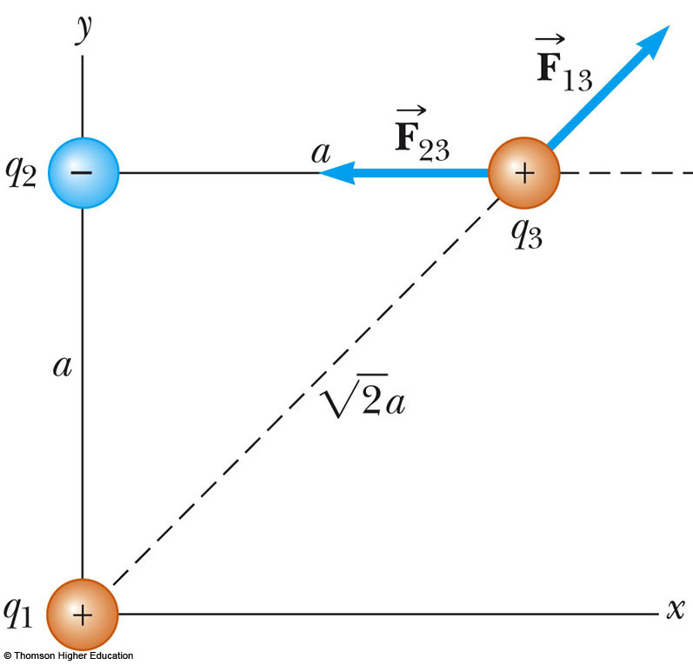
Superposition Principle, Example
The force exerted by q₁ on q₃ is
The force exerted by q₂ on q₃ is
The resultant force exerted on q₃ is the vector sum of and

Slide 35
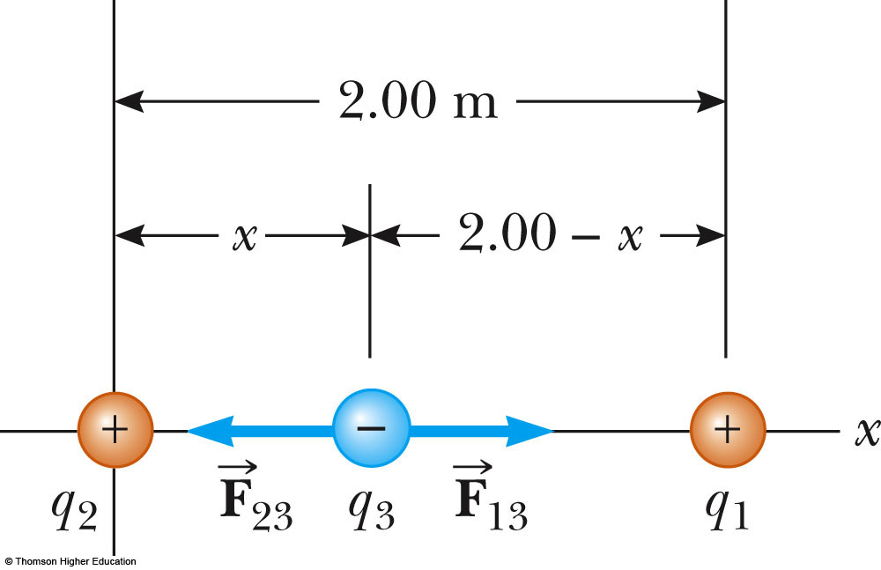
Zero Resultant Force, Example
Where is the resultant force equal to zero?
  The magnitudes of the individual forces will be equal
  Directions will be opposite
Will result in a quadratic
Choose the root that gives the forces in opposite directions

Slide 36
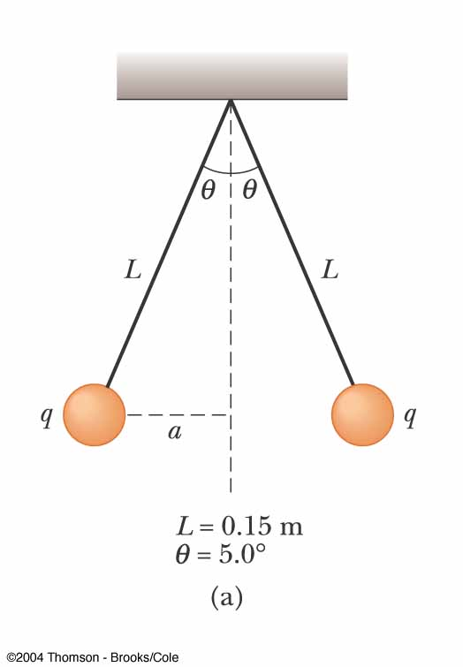
Electrical Force with Other Forces, Example
The spheres are in equilibrium
Since they are separated, they exert a repulsive force on each other
  Charges are like charges
Proceed as usual with equilibrium problems, noting one force is an electrical force

Slide 37
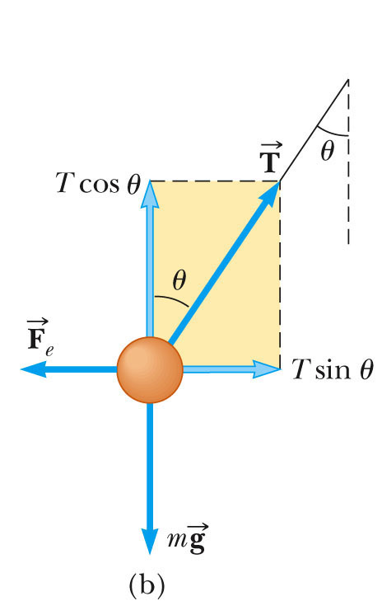
Electrical Force with Other Forces, Example cont.
The free body diagram includes the components of the tension, the electrical force, and the weight
Solve for |q|
You cannot determine the sign of q, only that they both have same sign

Slide 38
Electric Field – Introduction
The electric force is a field force
Field forces can act through space
  The effect is produced even with no physical contact between objects
Faraday developed the concept of a field in terms of electric fields

Slide 39
Electric Field – Definition
An electric field is said to exist in the region of space around a charged object
  This charged object is the source charge
When another charged object, the test charge, enters this electric field, an electric force acts on it

Slide 40
Electric Field – Definition, cont
The electric field is defined as the electric force on the test charge per unit charge
The electric field vector, , at a point in space is defined as the electric force acting on a positive test charge, q_{o} placed at that point divided by the test charge:

Slide 41
Electric Field, Notes
is the field produced by some charge or charge distribution, separate from the test charge
The existence of an electric field is a property of the source charge
  The presence of the test charge is not necessary for the field to exist
The test charge serves as a detector of the field

Slide 42
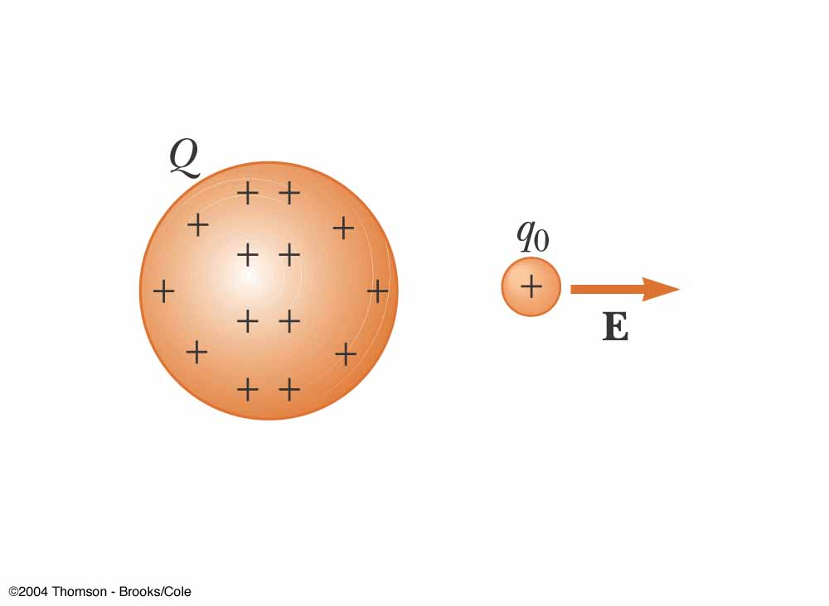
Electric Field Notes, Final
The direction of is that of the force on a positive test charge
The SI units of are N/C
We can also say that an electric field exists at a point if a test charge at that point experiences an electric force

Slide 43
Relationship Between F and E
  This is valid for a point charge only
  One of zero size
  For larger objects, the field may vary over the size of the object
If q is positive, the force and the field are in the same direction
If q is negative, the force and the field are in opposite directions

Slide 44
Electric Field, Vector Form
Remember Coulomb’s law, between the source and test charges, can be expressed as
Then, the electric field will be

Slide 45
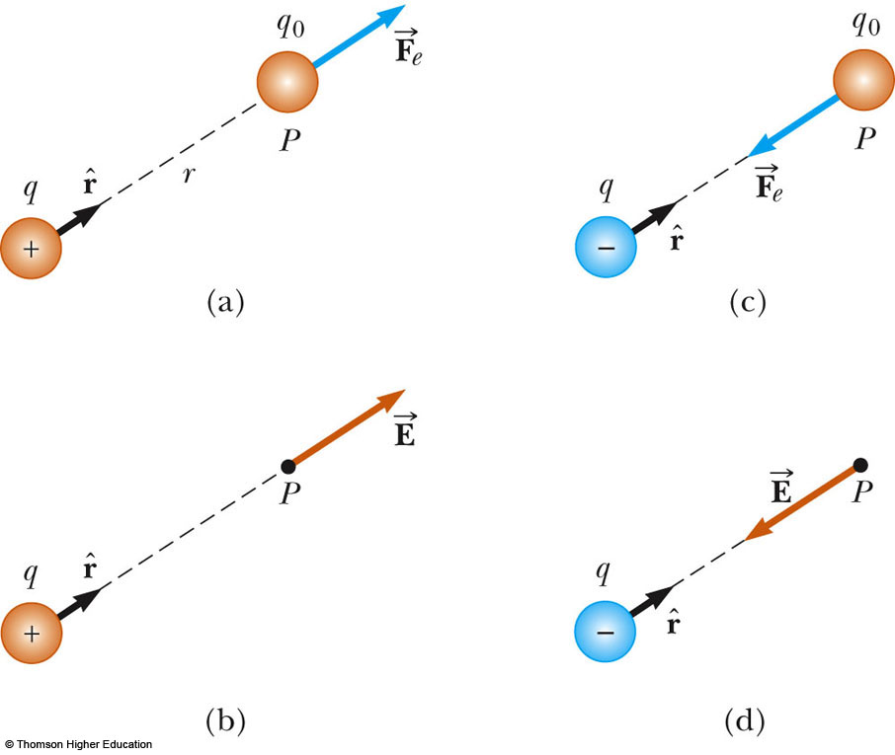
More About Electric
Field Direction
a) q is positive, the force is directed away from q
b) The direction of the field is also away from the positive source charge
c) q is negative, the force is directed toward q
d) The field is also toward the negative source charge
Use the active figure to change the position of point P and observe the electric field
PLAY
ACTIVE FIGURE

Slide 46
Superposition with Electric Fields
At any point P, the total electric field due to a group of source charges equals the vector sum of the electric fields of all the charges

Slide 47
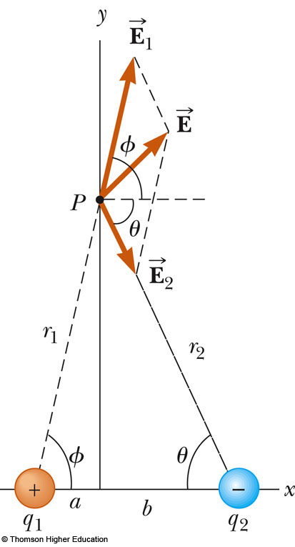
Superposition Example
Find the electric field due to q₁,
Find the electric field due to q₂,
  Remember, the fields add as vectors
  The direction of the individual fields is the direction of the force on a positive test charge

Slide 48
Electric Field – Continuous Charge Distribution
The distances between charges in a group of charges may be much smaller than the distance between the group and a point of interest
In this situation, the system of charges can be modeled as continuous
The system of closely spaced charges is equivalent to a total charge that is continuously distributed along some line, over some surface, or throughout some volume

Slide 49
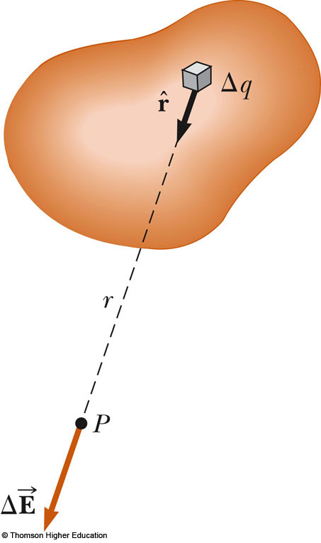
Electric Field – Continuous Charge Distribution, cont
Procedure:
  Divide the charge distribution into small elements, each of which contains Δq
  Calculate the electric field due to one of these elements at point P
  Evaluate the total field by summing the contributions of all the charge elements

Slide 50
Electric Field – Continuous Charge Distribution, equations
For the individual charge elements
Because the charge distribution is continuous

Slide 51
Charge Densities
Volume charge density: when a charge is distributed evenly throughout a volume
  ρ ≡ Q / V with units C/m³
Surface charge density: when a charge is distributed evenly over a surface area
  σ ≡ Q / A with units C/m²
Linear charge density: when a charge is distributed along a line
  λ ≡ Q / ℓ with units C/m

Slide 52
Amount of Charge in a Small Volume
If the charge is nonuniformly distributed over a volume, surface, or line, the amount of charge, dq, is given by
  For the volume: dq = ρ dV
  For the surface: dq = σ dA
  For the length element: dq = λ dℓ

Slide 53
Problem-Solving Strategy
Conceptualize
  Establish a mental representation of the problem
  Image the electric field produced by the charges or charge distribution
Categorize
  Individual charge?
  Group of individual charges?
  Continuous distribution of charges?

Slide 54
Problem-Solving Strategy, cont
Analyze
  Units: when using the Coulomb constant, k_{e}, the charges must be in C and the distances in m
  Analyzing a group of individual charges:
    Use the superposition principle, find the fields due to the individual charges at the point of interest and then add them as vectors to find the resultant field
    Be careful with the manipulation of vector quantities
  Analyzing a continuous charge distribution:
    The vector sums for evaluating the total electric field at some point must be replaced with vector integrals
    Divide the charge distribution into infinitesimal pieces, calculate the vector sum by integrating over the entire charge distribution

Slide 55
Problem Solving Hints, final
Analyze, cont.
  Symmetry:
    Take advantage of any symmetry to simplify calculations
Finalize
  Check to see if the electric field expression is consistent with your mental representation
  Check to see if the solution reflects any symmetry present
  Image varying parameters to see if the mathematical result changes in a reasonable way

Slide 56
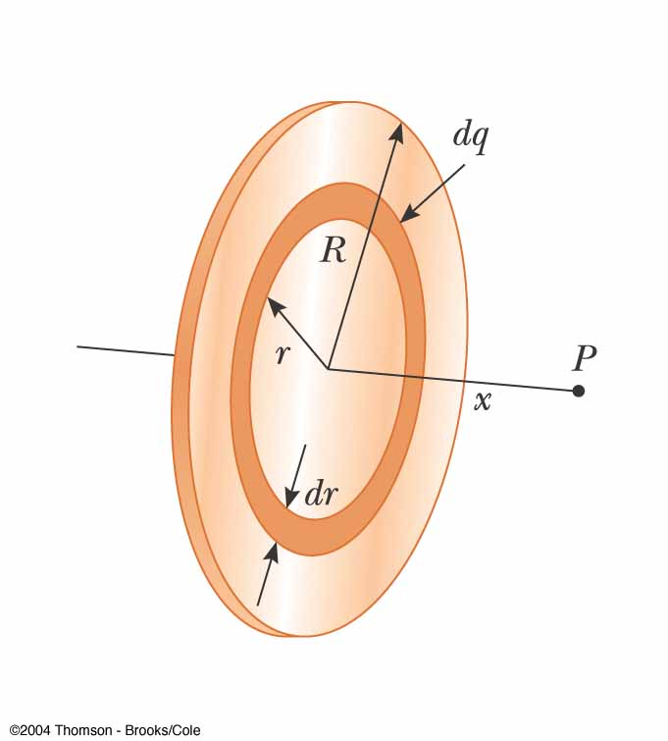
Example – Charged Disk
The ring has a radius R and a uniform charge density σ
Choose dq as a ring of radius r
The ring has a surface area 2πr dr

Slide 57
Electric Field Lines
Field lines give us a means of representing the electric field pictorially
The electric field vector is tangent to the electric field line at each point
  The line has a direction that is the same as that of the electric field vector
The number of lines per unit area through a surface perpendicular to the lines is proportional to the magnitude of the electric field in that region

Slide 58
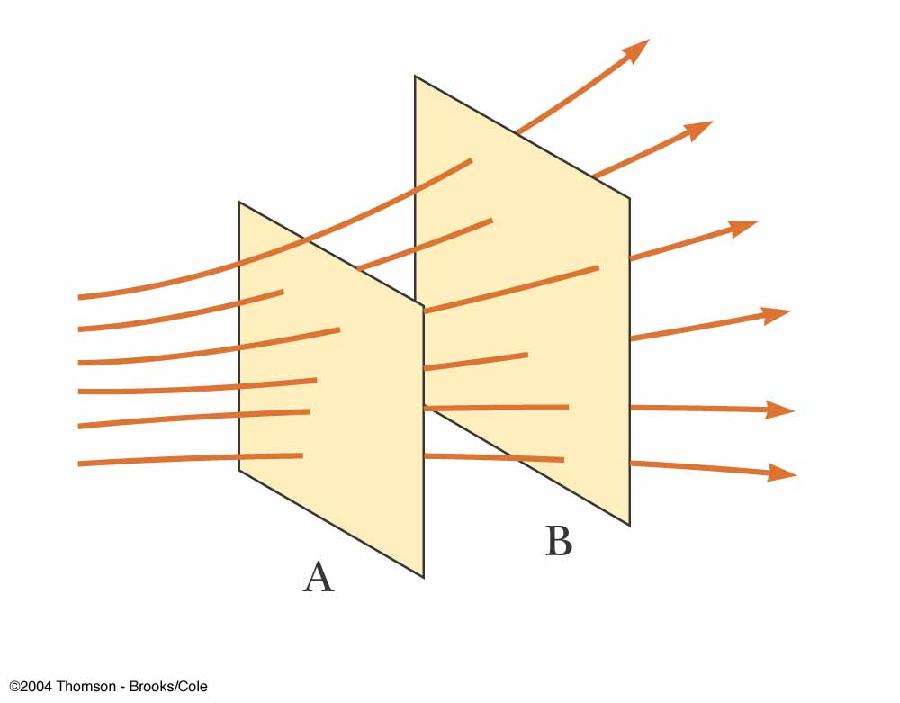
Electric Field Lines, General
The density of lines through surface A is greater than through surface B
The magnitude of the electric field is greater on surface A than B
The lines at different locations point in different directions
  This indicates the field is nonuniform

Slide 59
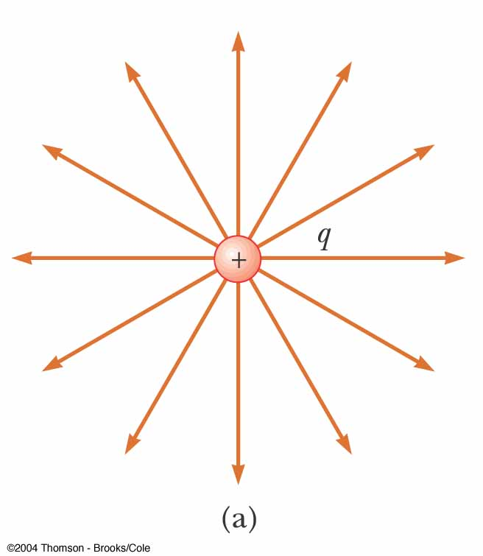
Electric Field Lines, Positive Point Charge
The field lines radiate outward in all directions
  In three dimensions, the distribution is spherical
The lines are directed away from the source charge
  A positive test charge would be repelled away from the positive source charge

Slide 60
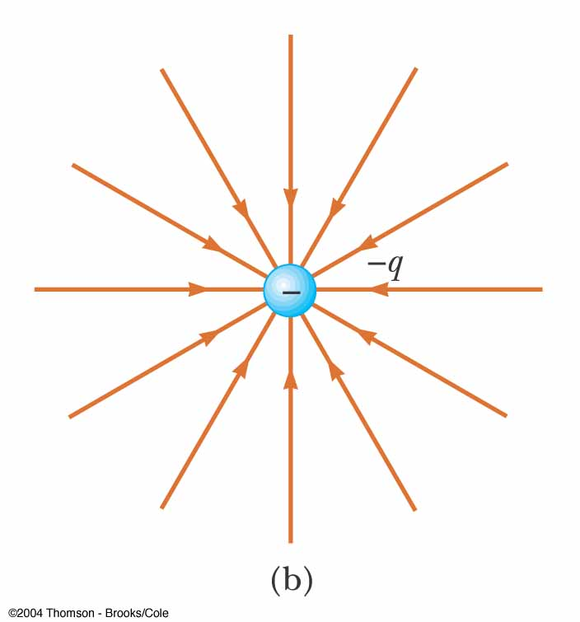
Electric Field Lines, Negative Point Charge
The field lines radiate inward in all directions
The lines are directed toward the source charge
  A positive test charge would be attracted toward the negative source charge

Slide 61
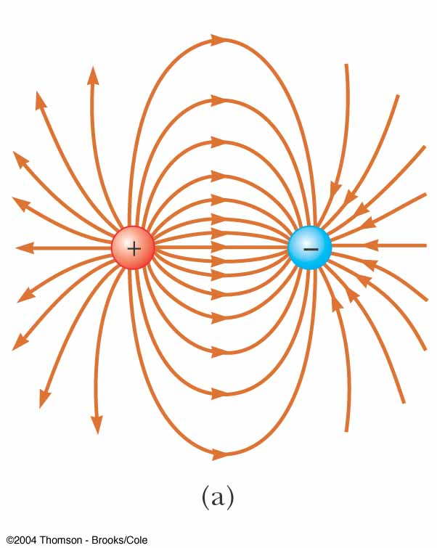
Electric Field Lines – Dipole
The charges are equal and opposite
The number of field lines leaving the positive charge equals the number of lines terminating on the negative charge

Slide 62
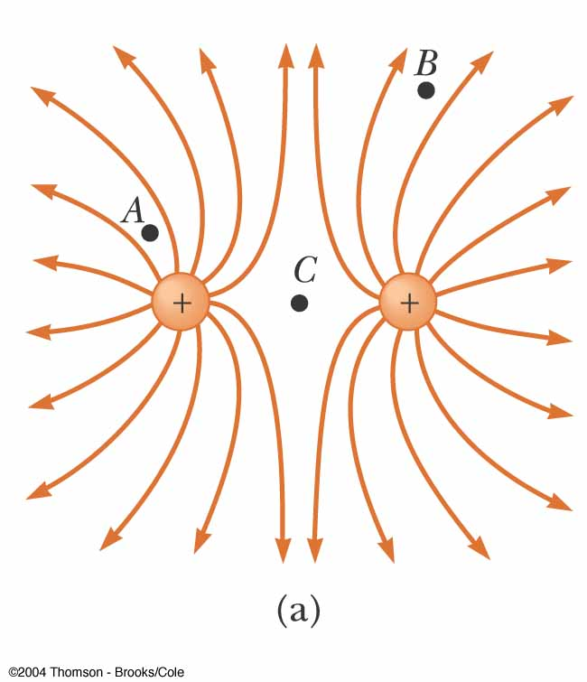
Electric Field Lines – Like Charges
The charges are equal and positive
The same number of lines leave each charge since they are equal in magnitude
At a great distance, the field is approximately equal to that of a single charge of 2q

Slide 63
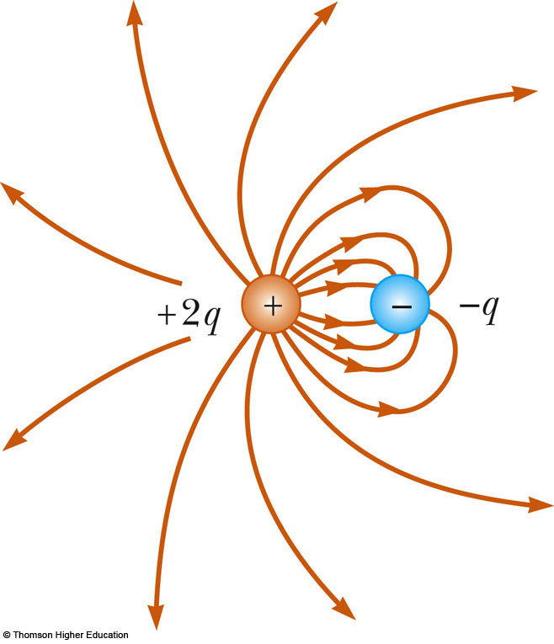
Electric Field Lines, Unequal Charges
The positive charge is twice the magnitude of the negative charge
Two lines leave the positive charge for each line that terminates on the negative charge
At a great distance, the field would be approximately the same as that due to a single charge of +q
Use the active figure to vary the charges and positions and observe the resulting electric field
PLAY
ACTIVE FIGURE

Slide 64
Electric Field Lines – Rules for Drawing
The lines must begin on a positive charge and terminate on a negative charge
  In the case of an excess of one type of charge, some lines will begin or end infinitely far away
The number of lines drawn leaving a positive charge or approaching a negative charge is proportional to the magnitude of the charge
No two field lines can cross
Remember field lines are not material objects, they are a pictorial representation used to qualitatively describe the electric field

Slide 65
Motion of Charged Particles
When a charged particle is placed in an electric field, it experiences an electrical force
If this is the only force on the particle, it must be the net force
The net force will cause the particle to accelerate according to Newton’s second law

Slide 66
Motion of Particles, cont
If is uniform, then the acceleration is constant
If the particle has a positive charge, its acceleration is in the direction of the field
If the particle has a negative charge, its acceleration is in the direction opposite the electric field
Since the acceleration is constant, the kinematic equations can be used

Slide 67
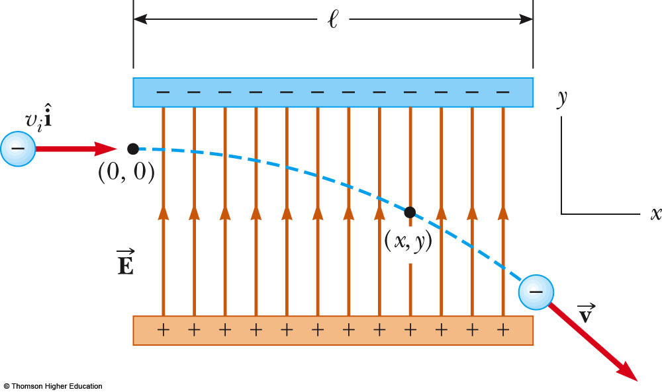
Electron in a Uniform Field, Example
The electron is projected horizontally into a uniform electric field
The electron undergoes a downward acceleration
  It is negative, so the acceleration is opposite the direction of the field
Its motion is parabolic while between the plates
Use the active figure to vary the field and the characteristics of the particle.
PLAY
ACTIVE FIGURE

