Slide 1
Chapter 25
Electric Potential

Slide 2
Electrical Potential Energy
When a test charge is placed in an electric field, it experiences a force
  The force is conservative
If the test charge is moved in the field by some external agent, the work done by the field is the negative of the work done by the external agent
is an infinitesimal displacement vector that is oriented tangent to a path through space

Slide 3
Electric Potential Energy, cont
The work done by the electric field is
As this work is done by the field, the potential energy of the charge-field system is changed by ΔU =
For a finite displacement of the charge from A to B,

Slide 4
Electric Potential Energy, final
Because the force is conservative, the line integral does not depend on the path taken by the charge
This is the change in potential energy of the system

Slide 5
Electric Potential
The potential energy per unit charge, U/q_{o}, is the electric potential
  The potential is characteristic of the field only
    The potential energy is characteristic of the charge-field system
  The potential is independent of the value of q_{o}
  The potential has a value at every point in an electric field
The electric potential is

Slide 6
Electric Potential, cont.
The potential is a scalar quantity
  Since energy is a scalar
As a charged particle moves in an electric field, it will experience a change in potential

Slide 7
Electric Potential, final
The difference in potential is the meaningful quantity
We often take the value of the potential to be zero at some convenient point in the field
Electric potential is a scalar characteristic of an electric field, independent of any charges that may be placed in the field

Slide 8
Work and Electric Potential
Assume a charge moves in an electric field without any change in its kinetic energy
The work performed on the charge is
  W = ΔU = q ΔV

Slide 9
Units
1 V = 1 J/C
  V is a volt
  It takes one joule of work to move a 1-coulomb charge through a potential difference of 1 volt
In addition, 1 N/C = 1 V/m
  This indicates we can interpret the electric field as a measure of the rate of change with position of the electric potential

Slide 10
Electron-Volts
Another unit of energy that is commonly used in atomic and nuclear physics is the electron-volt
One electron-volt is defined as the energy a charge-field system gains or loses when a charge of magnitude e (an electron or a proton) is moved through a potential difference of 1 volt
  1 eV = 1.60 x 10⁻¹⁹ J

Slide 11
Potential Difference in a Uniform Field
The equations for electric potential can be simplified if the electric field is uniform:
The negative sign indicates that the electric potential at point B is lower than at point A
  Electric field lines always point in the direction of decreasing electric potential

Slide 12
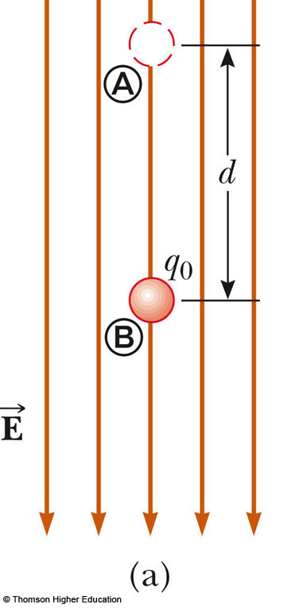
Energy and the Direction of Electric Field
When the electric field is directed downward, point B is at a lower potential than point A
When a positive test charge moves from A to B, the charge-field system loses potential energy
Use the active figure to compare the motion in the electric field to the motion in a gravitational field
PLAY
ACTIVE FIGURE

Slide 13
More About Directions
A system consisting of a positive charge and an electric field loses electric potential energy when the charge moves in the direction of the field
  An electric field does work on a positive charge when the charge moves in the direction of the electric field
The charged particle gains kinetic energy equal to the potential energy lost by the charge-field system
  Another example of Conservation of Energy

Slide 14
Directions, cont.
If q_{o} is negative, then ΔU is positive
A system consisting of a negative charge and an electric field gains potential energy when the charge moves in the direction of the field
  In order for a negative charge to move in the direction of the field, an external agent must do positive work on the charge

Slide 15
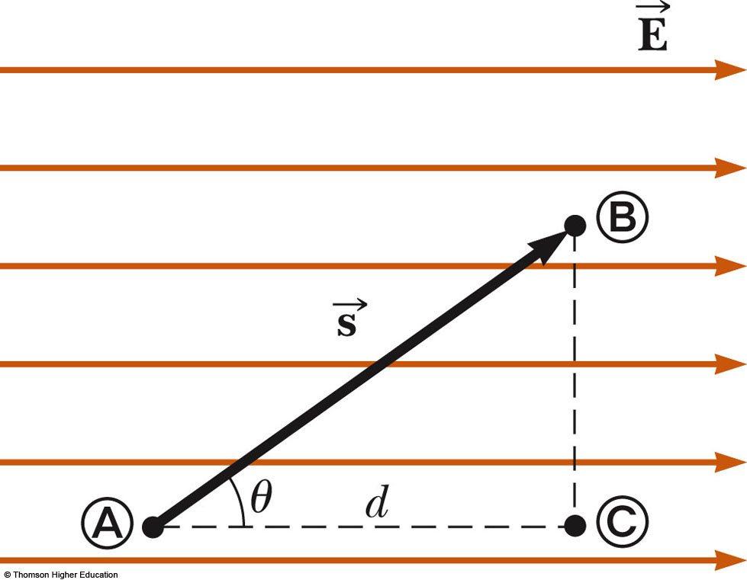
Equipotentials
Point B is at a lower potential than point A
Points A and C are at the same potential
  All points in a plane perpendicular to a uniform electric field are at the same electric potential
The name equipotential surface is given to any surface consisting of a continuous distribution of points having the same electric potential

Slide 16
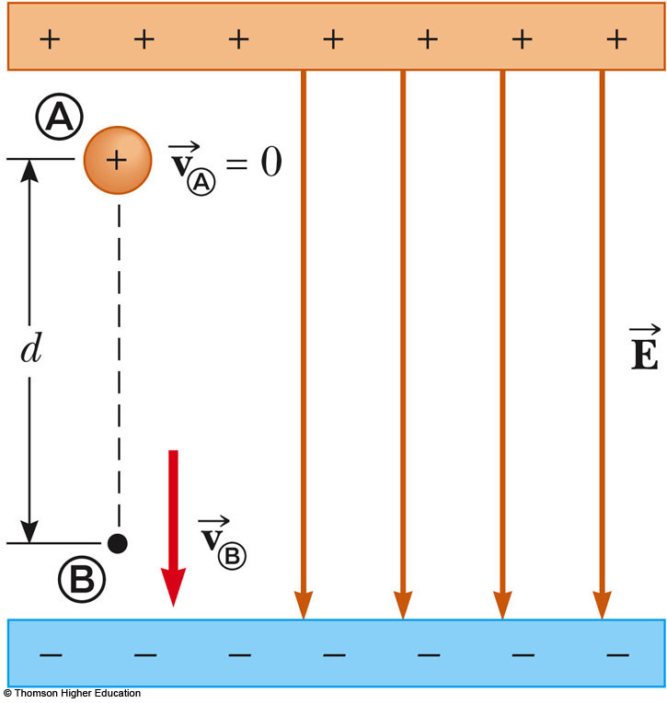
Charged Particle in a Uniform Field, Example
A positive charge is released from rest and moves in the direction of the electric field
The change in potential is negative
The change in potential energy is negative
The force and acceleration are in the direction of the field
Conservation of Energy can be used to find its speed

Slide 17
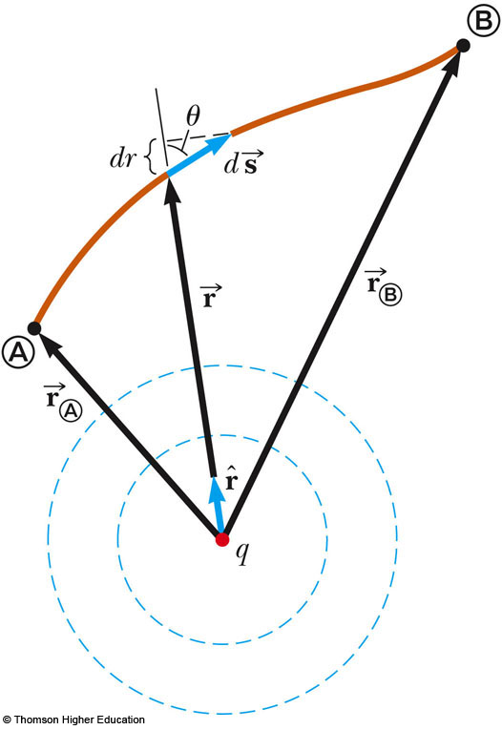
Potential and Point Charges
A positive point charge produces a field directed radially outward
The potential difference between points A and B will be

Slide 18
Potential and Point Charges, cont.
The electric potential is independent of the path between points A and B
It is customary to choose a reference potential of V = 0 at r_{A} = ∞
Then the potential at some point r is

Slide 19
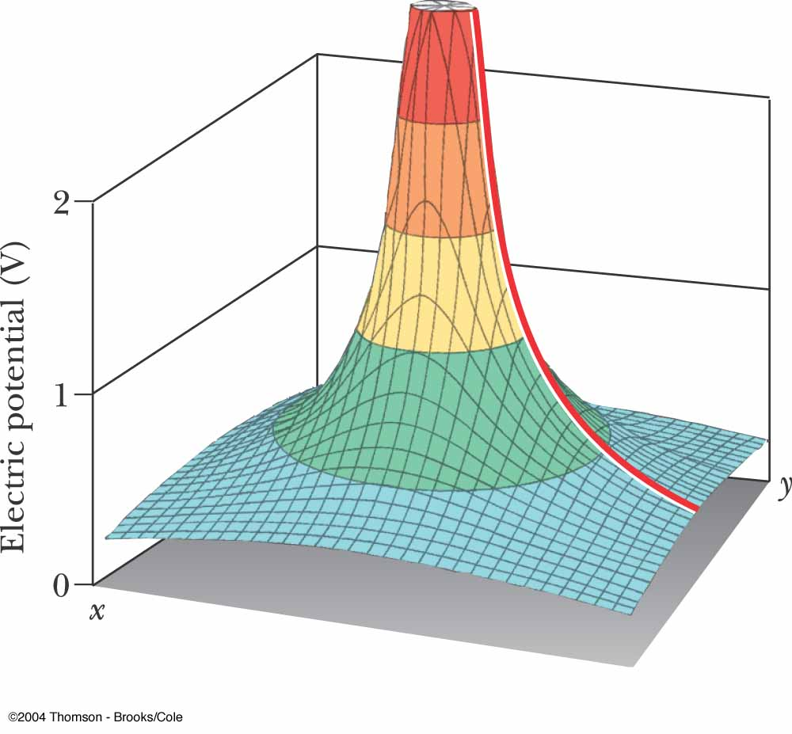
Electric Potential of a Point Charge
The electric potential in the plane around a single point charge is shown
The red line shows the 1/r nature of the potential

Slide 20
Electric Potential with Multiple Charges
The electric potential due to several point charges is the sum of the potentials due to each individual charge
  This is another example of the superposition principle
  The sum is the algebraic sum
    V = 0 at r = ∞

Slide 21
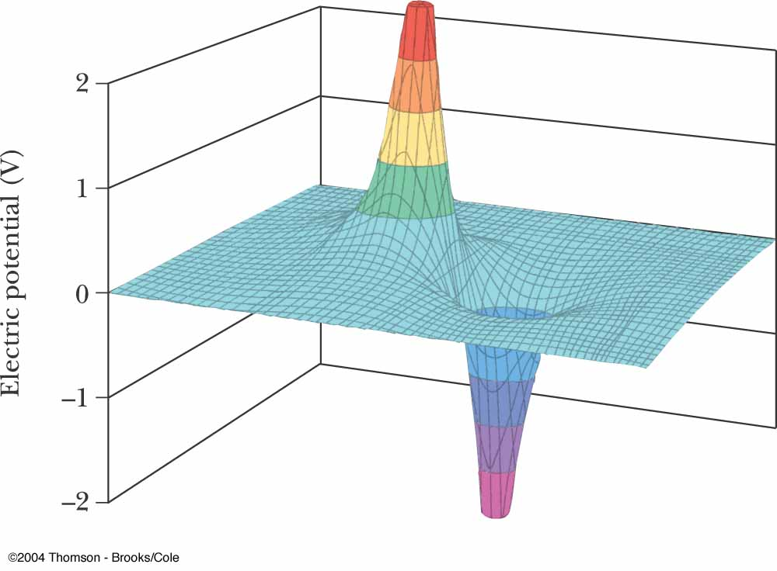
Electric Potential of a Dipole
The graph shows the potential (y-axis) of an electric dipole
The steep slope between the charges represents the strong electric field in this region

Slide 22
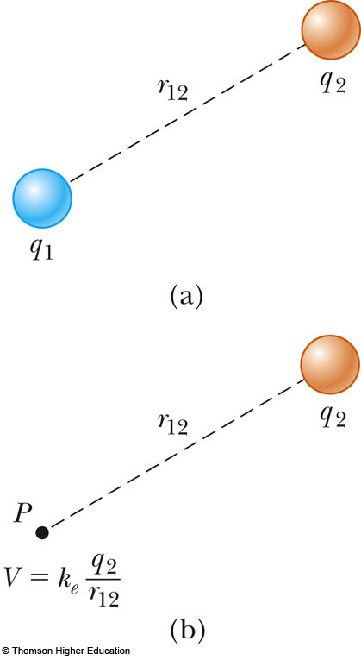
Potential Energy of Multiple Charges
Consider two charged particles
The potential energy of the system is
  Use the active figure to move the charge and see the effect on the potential energy of the system
PLAY
ACTIVE FIGURE

Slide 23
More About U of Multiple Charges
If the two charges are the same sign, U is positive and work must be done to bring the charges together
If the two charges have opposite signs, U is negative and work is done to keep the charges apart

Slide 24
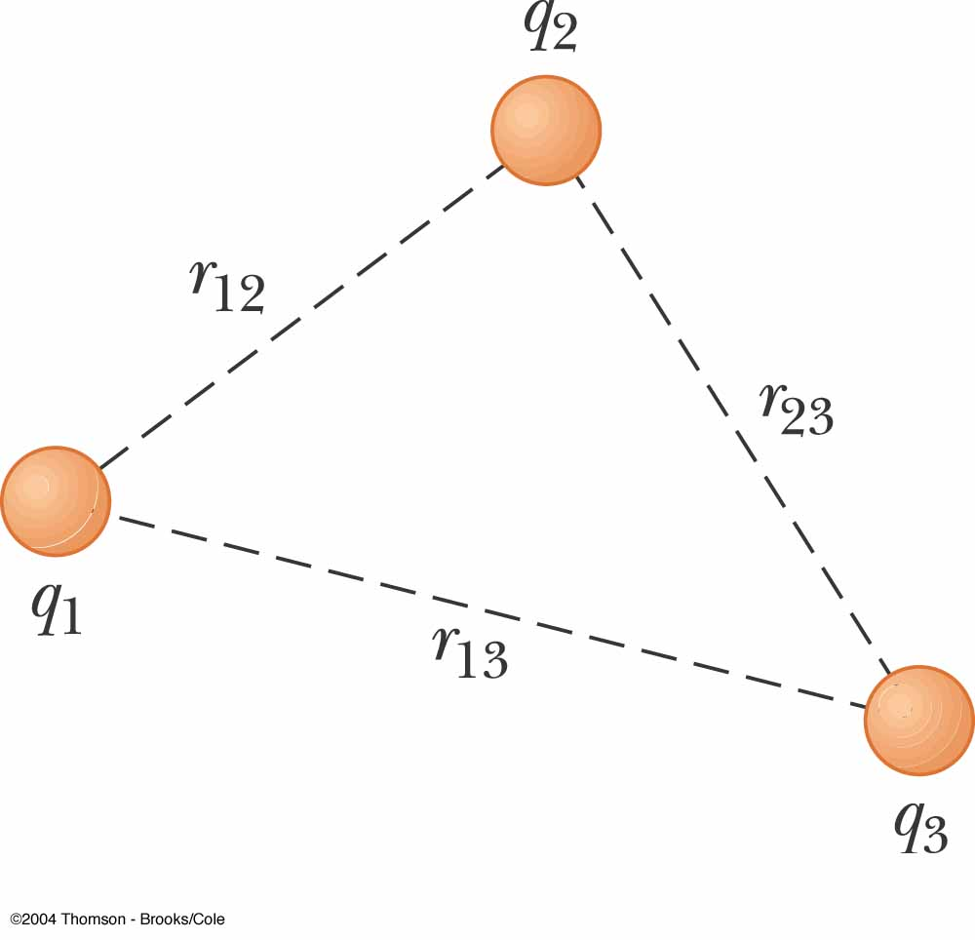
U with Multiple Charges, final
If there are more than two charges, then find U for each pair of charges and add them
For three charges:
  The result is independent of the order of the charges

Slide 25
Finding E From V
Assume, to start, that the field has only an x component
Similar statements would apply to the y and z components
Equipotential surfaces must always be perpendicular to the electric field lines passing through them

Slide 26
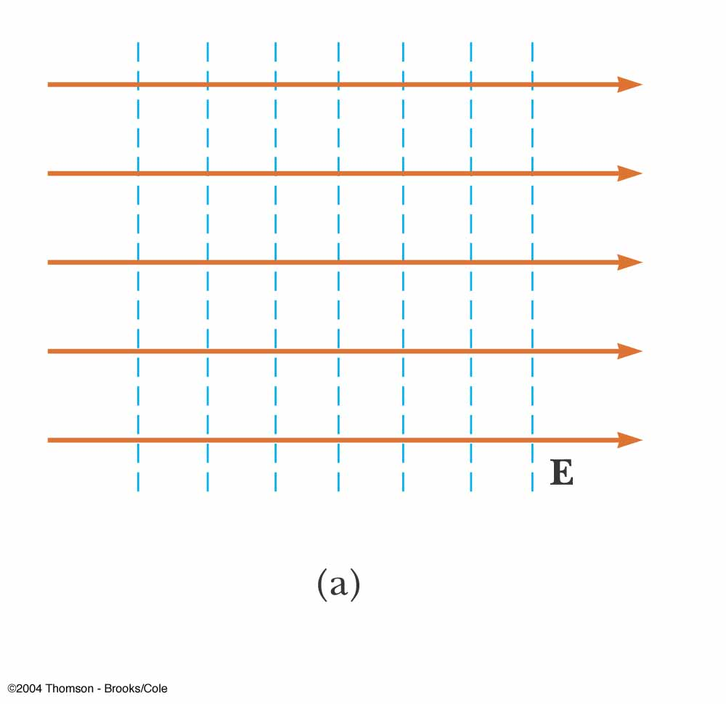
E and V for an Infinite Sheet of Charge
The equipotential lines are the dashed blue lines
The electric field lines are the brown lines
The equipotential lines are everywhere perpendicular to the field lines

Slide 27
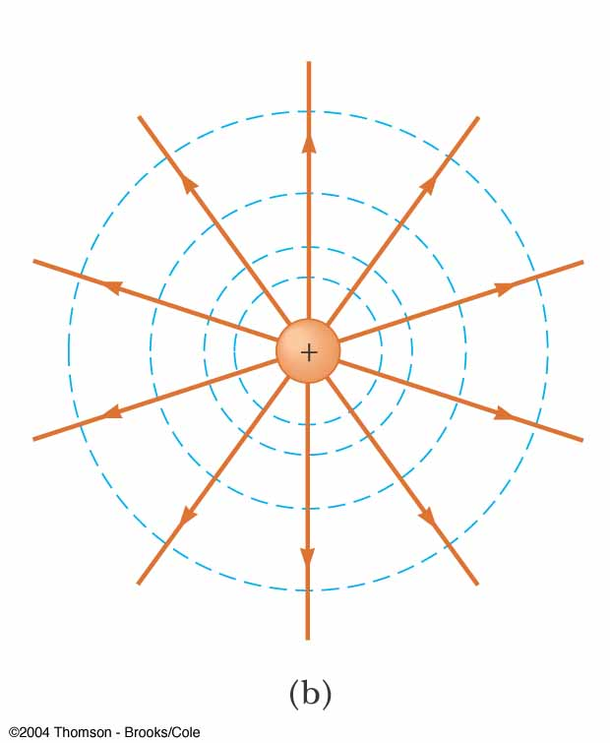
E and V for a Point Charge
The equipotential lines are the dashed blue lines
The electric field lines are the brown lines
The equipotential lines are everywhere perpendicular to the field lines

Slide 28
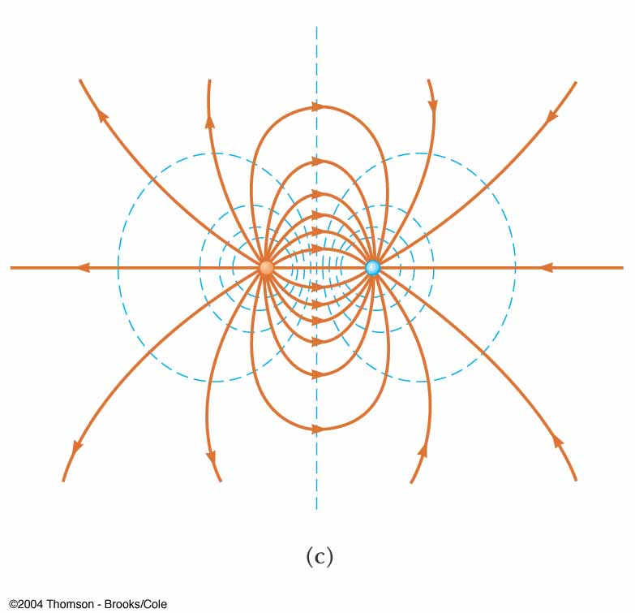
E and V for a Dipole
The equipotential lines are the dashed blue lines
The electric field lines are the brown lines
The equipotential lines are everywhere perpendicular to the field lines

Slide 29
Electric Field from Potential, General
In general, the electric potential is a function of all three dimensions
Given V (x, y, z) you can find E_{x}, E_{y} and E_{z} as partial derivatives

Slide 30
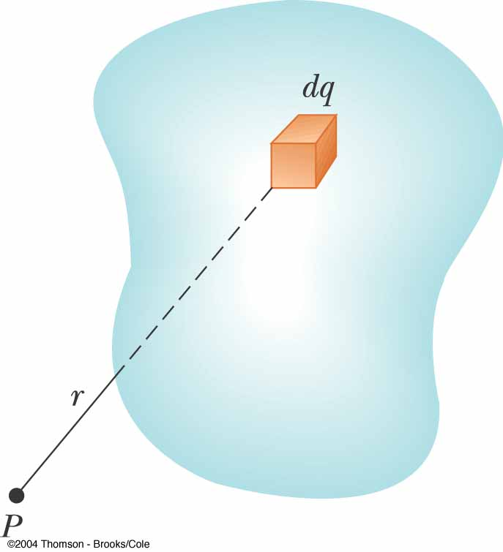
Electric Potential for a Continuous Charge Distribution
Consider a small charge element dq
  Treat it as a point charge
The potential at some point due to this charge element is

Slide 31
V for a Continuous Charge Distribution, cont.
To find the total potential, you need to integrate to include the contributions from all the elements
  This value for V uses the reference of V = 0 when P is infinitely far away from the charge distributions

Slide 32
V From a Known E
If the electric field is already known from other considerations, the potential can be calculated using the original approach
  If the charge distribution has sufficient symmetry, first find the field from Gauss’ Law and then find the potential difference between any two points
    Choose V = 0 at some convenient point

Slide 33
Problem-Solving Strategies
Conceptualize
  Think about the individual charges or the charge distribution
  Imagine the type of potential that would be created
  Appeal to any symmetry in the arrangement of the charges
Categorize
  Group of individual charges or a continuous distribution?

Slide 34
Problem-Solving Strategies, 2
Analyze
  General
    Scalar quantity, so no components
    Use algebraic sum in the superposition principle
    Only changes in electric potential are significant
    Define V = 0 at a point infinitely far away from the charges
      If the charge distribution extends to infinity, then choose some other arbitrary point as a reference point

Slide 35
Problem-Solving Strategies, 3
Analyze, cont
  If a group of individual charges is given
    Use the superposition principle and the algebraic sum
  If a continuous charge distribution is given
    Use integrals for evaluating the total potential at some point
    Each element of the charge distribution is treated as a point charge
  If the electric field is given
    Start with the definition of the electric potential
    Find the field from Gauss’ Law (or some other process) if needed

Slide 36
Problem-Solving Strategies, final
Finalize
  Check to see if the expression for the electric potential is consistent with your mental representation
  Does the final expression reflect any symmetry?
  Image varying parameters to see if the mathematical results change in a reasonable way

Slide 37
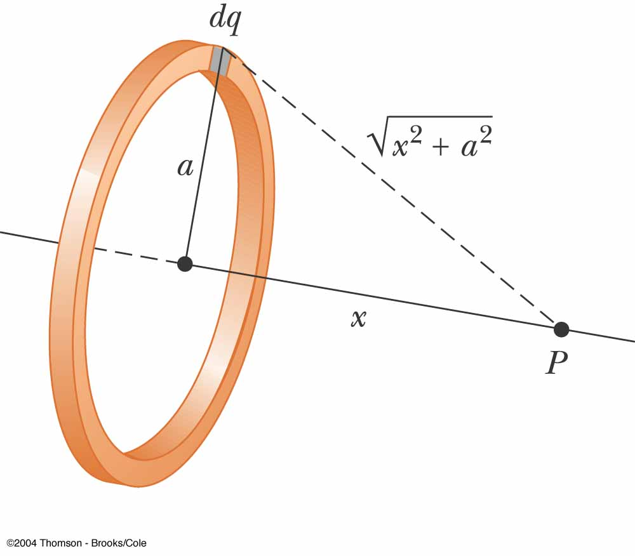
V for a Uniformly Charged Ring
P is located on the perpendicular central axis of the uniformly charged ring
  The ring has a radius a and a total charge Q

Slide 38
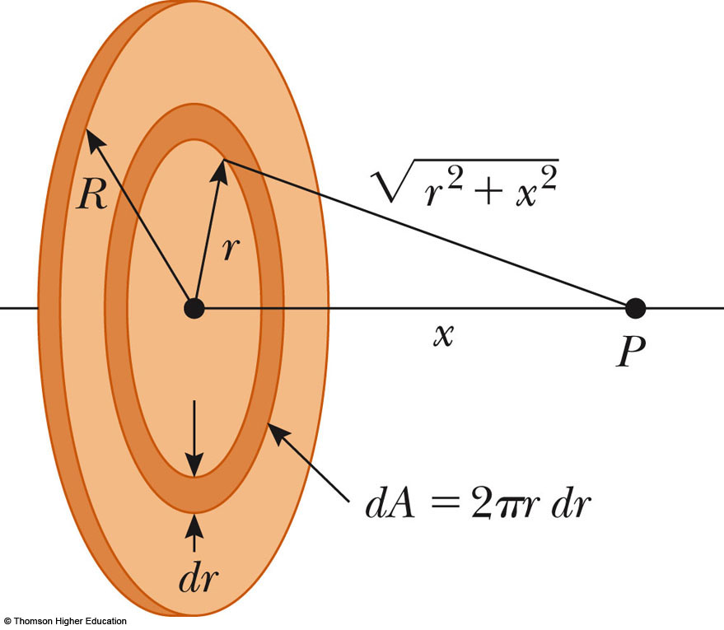
V for a Uniformly Charged Disk
The ring has a radius R and surface charge density of σ
P is along the perpendicular central axis of the disk

Slide 39
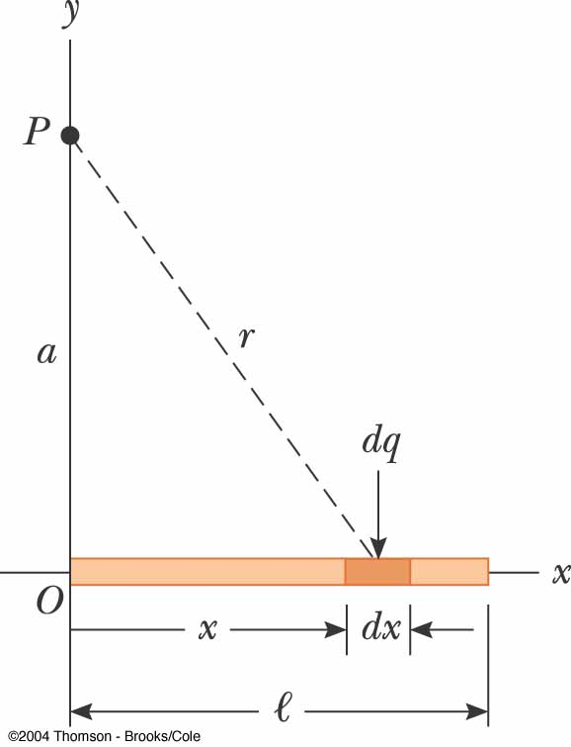
V for a Finite Line of Charge
A rod of line ℓ has a total charge of Q and a linear charge density of λ

Slide 40
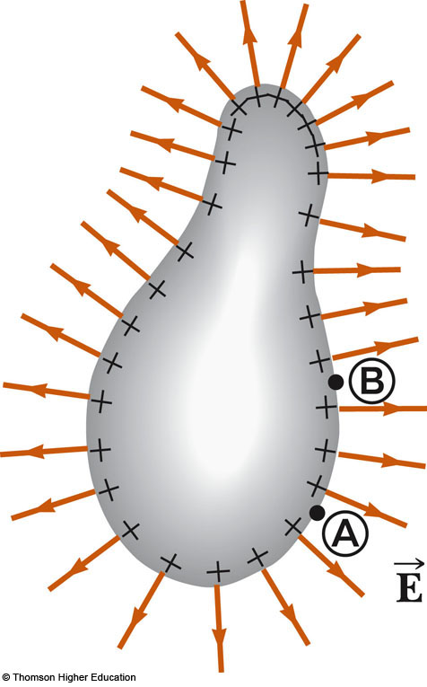
V Due to a Charged Conductor
Consider two points on the surface of the charged conductor as shown
is always perpendicular to the displacement
Therefore,
Therefore, the potential difference between A and B is also zero

Slide 41
V Due to a Charged Conductor, cont.
V is constant everywhere on the surface of a charged conductor in equilibrium
  ΔV = 0 between any two points on the surface
The surface of any charged conductor in electrostatic equilibrium is an equipotential surface
Because the electric field is zero inside the conductor, we conclude that the electric potential is constant everywhere inside the conductor and equal to the value at the surface

Slide 42
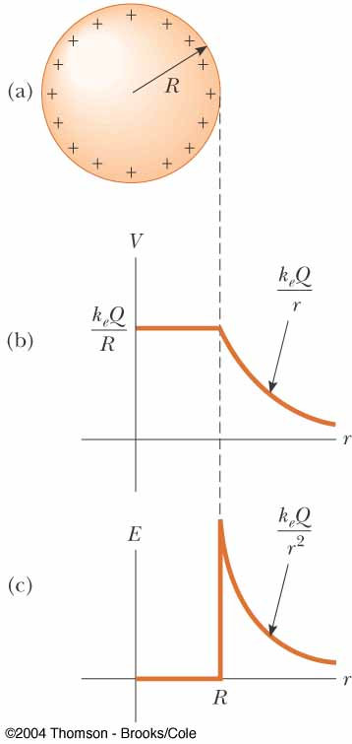
E Compared to V
The electric potential is a function of r
The electric field is a function of r²
The effect of a charge on the space surrounding it:
  The charge sets up a vector electric field which is related to the force
  The charge sets up a scalar potential which is related to the energy

Slide 43
Irregularly Shaped Objects
The charge density is high where the radius of curvature is small
  And low where the radius of curvature is large
The electric field is large near the convex points having small radii of curvature and reaches very high values at sharp points

Slide 44
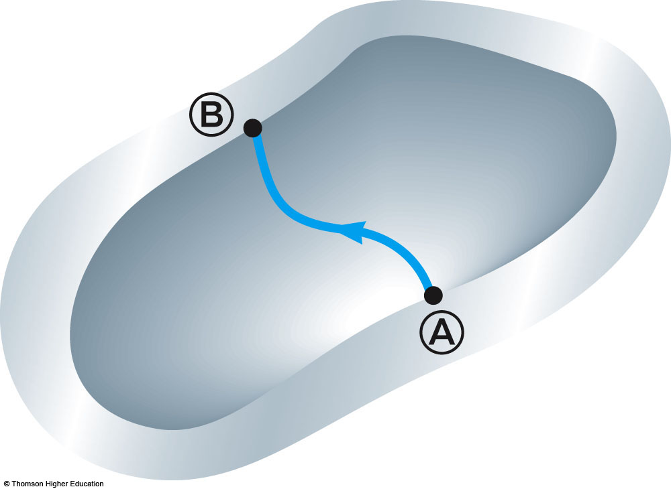
Cavity in a Conductor
Assume an irregularly shaped cavity is inside a conductor
Assume no charges are inside the cavity
The electric field inside the conductor must be zero

Slide 45
Cavity in a Conductor, cont
The electric field inside does not depend on the charge distribution on the outside surface of the conductor
For all paths between A and B,
A cavity surrounded by conducting walls is a field-free region as long as no charges are inside the cavity

Slide 46
Corona Discharge
If the electric field near a conductor is sufficiently strong, electrons resulting from random ionizations of air molecules near the conductor accelerate away from their parent molecules
These electrons can ionize additional molecules near the conductor

Slide 47
Corona Discharge, cont.
This creates more free electrons
The corona discharge is the glow that results from the recombination of these free electrons with the ionized air molecules
The ionization and corona discharge are most likely to occur near very sharp points

Slide 48
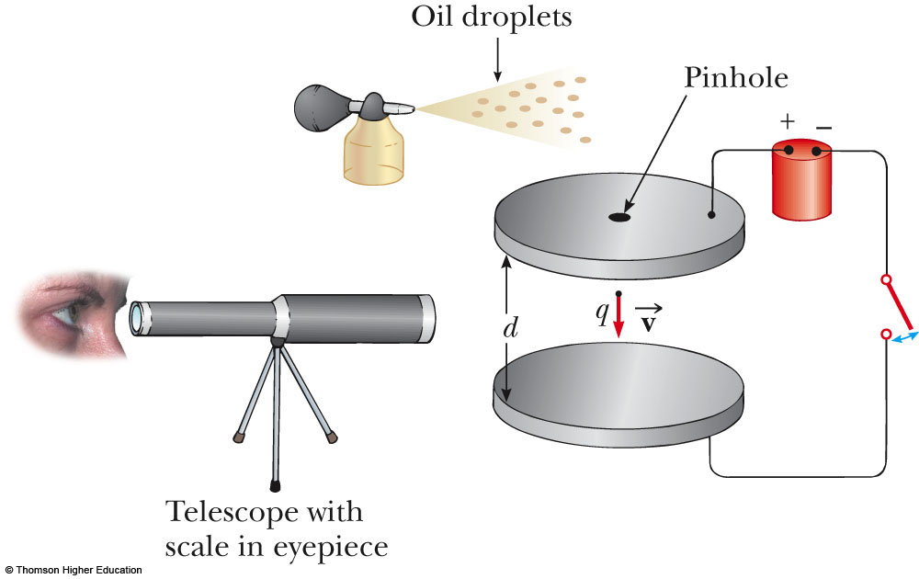
Millikan Oil-Drop Experiment – Experimental Set-Up
PLAY
ACTIVE FIGURE

Slide 49
Millikan Oil-Drop Experiment
Robert Millikan measured e, the magnitude of the elementary charge on the electron
He also demonstrated the quantized nature of this charge
Oil droplets pass through a small hole and are illuminated by a light

Slide 50
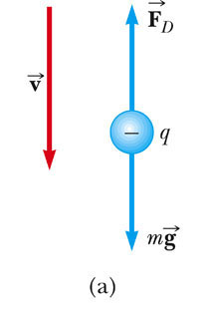
Oil-Drop Experiment, 2
With no electric field between the plates, the gravitational force and the drag force (viscous) act on the electron
The drop reaches terminal velocity with

Slide 51
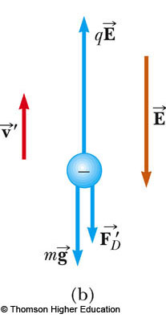
Oil-Drop Experiment, 3
When an electric field is set up between the plates
  The upper plate has a higher potential
The drop reaches a new terminal velocity when the electrical force equals the sum of the drag force and gravity

Slide 52
Oil-Drop Experiment, final
The drop can be raised and allowed to fall numerous times by turning the electric field on and off
After many experiments, Millikan determined:
  q = ne where n = 0, -1, -2, -3, …
  e = 1.60 x 10⁻¹⁹ C
This yields conclusive evidence that charge is quantized
Use the active figure to conduct a version of the experiment

Slide 53
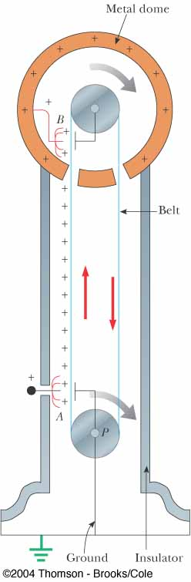
Van de Graaff
Generator
Charge is delivered continuously to a high-potential electrode by means of a moving belt of insulating material
The high-voltage electrode is a hollow metal dome mounted on an insulated column
Large potentials can be developed by repeated trips of the belt
Protons accelerated through such large potentials receive enough energy to initiate nuclear reactions

Slide 54
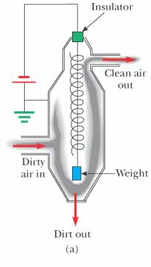
Electrostatic Precipitator
An application of electrical discharge in gases is the electrostatic precipitator
It removes particulate matter from combustible gases
The air to be cleaned enters the duct and moves near the wire
As the electrons and negative ions created by the discharge are accelerated toward the outer wall by the electric field, the dirt particles become charged
Most of the dirt particles are negatively charged and are drawn to the walls by the electric field

Slide 55
Application – Xerographic Copiers
The process of xerography is used for making photocopies
Uses photoconductive materials
  A photoconductive material is a poor conductor of electricity in the dark but becomes a good electric conductor when exposed to light

Slide 56
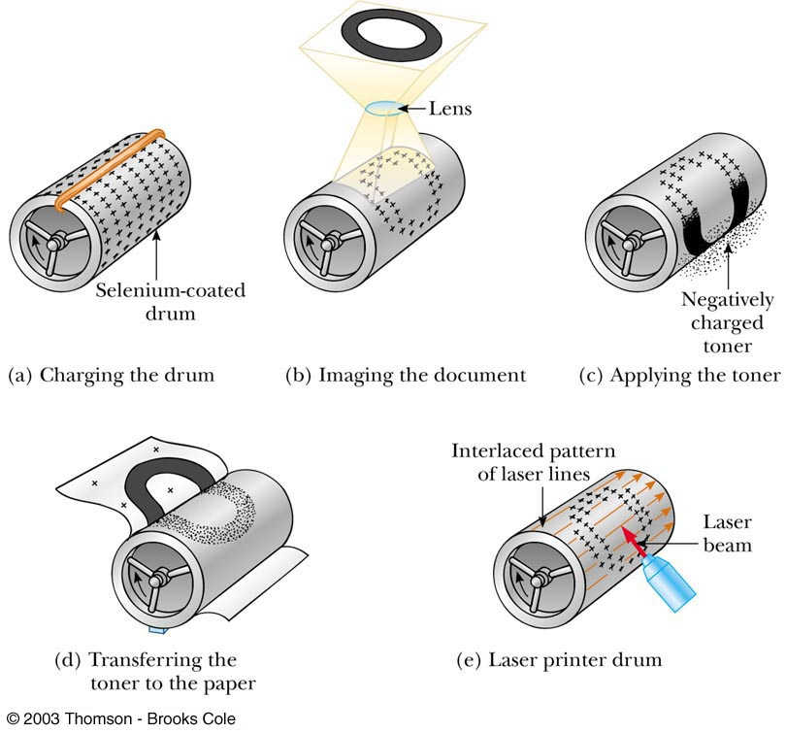
The Xerographic Process

Slide 57
Application – Laser Printer
The steps for producing a document on a laser printer is similar to the steps in the xerographic process
A computer-directed laser beam is used to illuminate the photoconductor instead of a lens

