Slide 1
Chapter 29
Magnetic Fields

Slide 2
A Brief History of Magnetism
13th century BC
  Chinese used a compass
    Uses a magnetic needle
    Probably an invention of Arabic or Indian origin
800 BC
  Greeks
    Discovered magnetite (Fe₃O₄) attracts pieces of iron

Slide 3
A Brief History of Magnetism, 2
1269
  Pierre de Maricourt found that the direction of a needle near a spherical natural magnet formed lines that encircled the sphere
  The lines also passed through two points diametrically opposed to each other
  He called the points poles

Slide 4
A Brief History of Magnetism, 3
1600
  William Gilbert
    Expanded experiments with magnetism to a variety of materials
    Suggested the Earth itself was a large permanent magnet

Slide 5
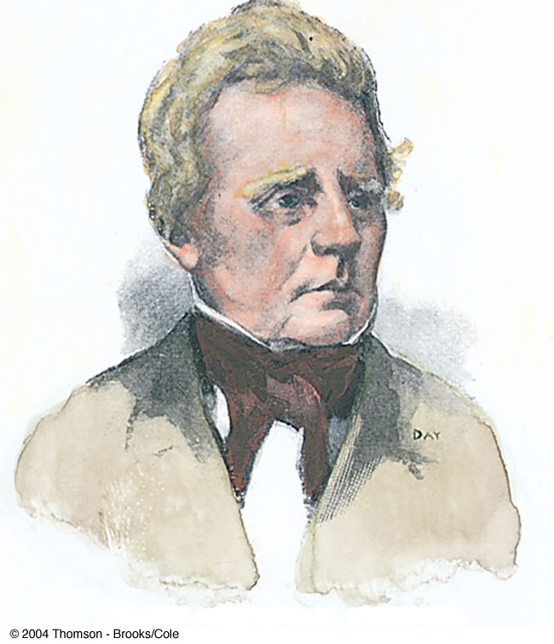
A Brief History of Magnetism, 4
1819
  Hans Christian Oersted
    Discovered the relationship between electricity and magnetism
    An electric current in a wire deflected a nearby compass needle

Slide 6
A Brief History of Magnetism, final
1820’s
  Faraday and Henry
    Further connections between electricity and magnetism
    A changing magnetic field creates an electric field
  Maxwell
    A changing electric field produces a magnetic field

Slide 7
Magnetic Poles
Every magnet, regardless of its shape, has two poles
  Called north and south poles
  Poles exert forces on one another
    Similar to the way electric charges exert forces on each other
    Like poles repel each other
      N-N or S-S
    Unlike poles attract each other
      N-S

Slide 8
Magnetic Poles, cont.
The poles received their names due to the way a magnet behaves in the Earth’s magnetic field
If a bar magnet is suspended so that it can move freely, it will rotate
  The magnetic north pole points toward the Earth’s north geographic pole
    This means the Earth’s north geographic pole is a magnetic south pole
    Similarly, the Earth’s south geographic pole is a magnetic north pole

Slide 9
Magnetic Poles, final
The force between two poles varies as the inverse square of the distance between them
A single magnetic pole has never been isolated
  In other words, magnetic poles are always found in pairs
  All attempts so far to detect an isolated magnetic pole has been unsuccessful
    No matter how many times a permanent magnetic is cut in two, each piece always has a north and south pole

Slide 10
Magnetic Fields
Reminder: an electric field surrounds any electric charge
The region of space surrounding any moving electric charge also contains a magnetic field
A magnetic field also surrounds a magnetic substance making up a permanent magnet

Slide 11
Magnetic Fields, cont.
A vector quantity
Symbolized by
Direction is given by the direction a north pole of a compass needle points in that location
Magnetic field lines can be used to show how the field lines, as traced out by a compass, would look

Slide 12
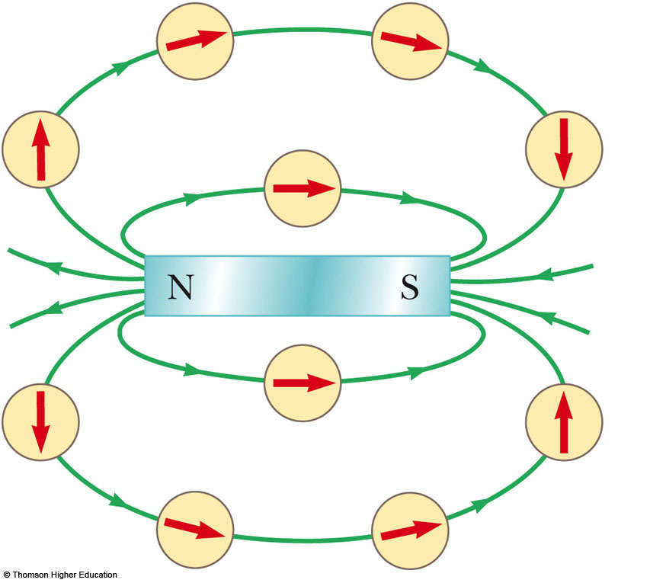
Magnetic Field Lines, Bar Magnet Example
The compass can be used to trace the field lines
The lines outside the magnet point from the North pole to the South pole
Use the active figure to trace the field lines
PLAY
ACTIVE FIGURE

Slide 13
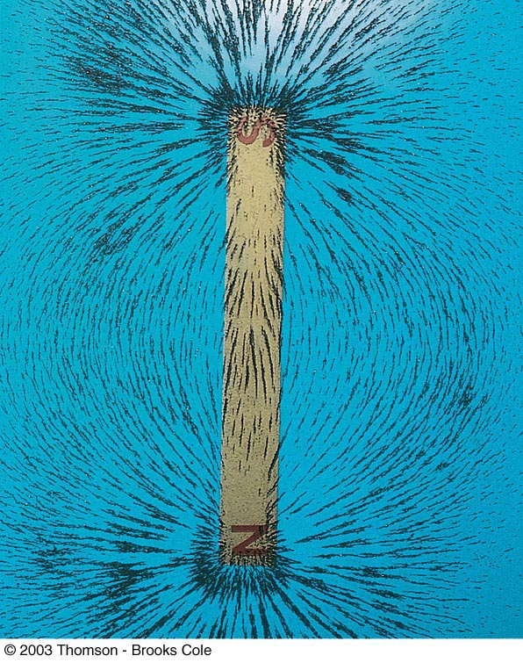
Magnetic Field Lines, Bar Magnet
Iron filings are used to show the pattern of the electric field lines
The direction of the field is the direction a north pole would point

Slide 14
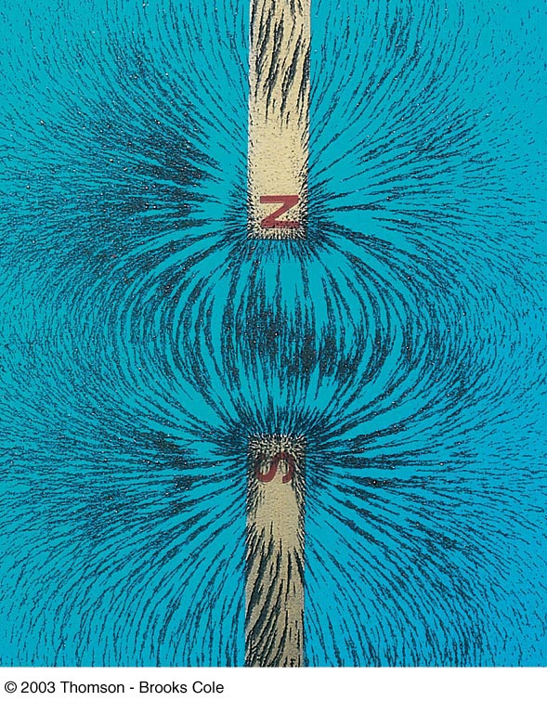
Magnetic Field Lines, Unlike Poles
Iron filings are used to show the pattern of the electric field lines
The direction of the field is the direction a north pole would point
  Compare to the electric field produced by an electric dipole

Slide 15
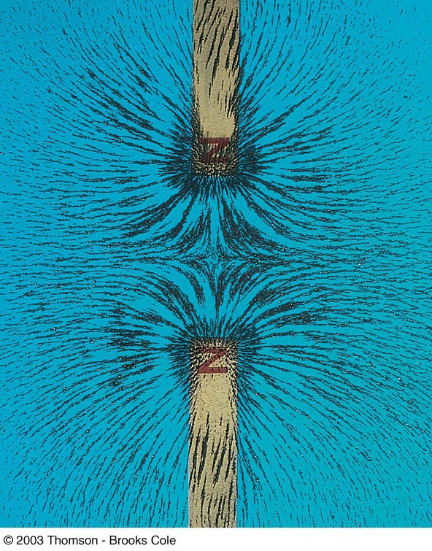
Magnetic Field Lines, Like Poles
Iron filings are used to show the pattern of the electric field lines
The direction of the field is the direction a north pole would point
  Compare to the electric field produced by like charges

Slide 16
Definition of Magnetic Field
The magnetic field at some point in space can be defined in terms of the magnetic force,
The magnetic force will be exerted on a charged particle moving with a velocity,
  Assume (for now) there are no gravitational or electric fields present

Slide 17
Force on a Charge Moving in a Magnetic Field
The magnitude F_{B} of the magnetic force exerted on the particle is proportional to the charge, q, and to the speed, v, of the particle
When a charged particle moves parallel to the magnetic field vector, the magnetic force acting on the particle is zero
When the particle’s velocity vector makes any angle θ ≠ 0 with the field, the force acts in a direction perpendicular to both the velocity and the field

Slide 18
F_{B} on a Charge Moving in a Magnetic Field, final
The magnetic force exerted on a positive charge is in the direction opposite the direction of the magnetic force exerted on a negative charge moving in the same direction
The magnitude of the magnetic force is proportional to sin θ, where θ is the angle the particle’s velocity makes with the direction of the magnetic field

Slide 19
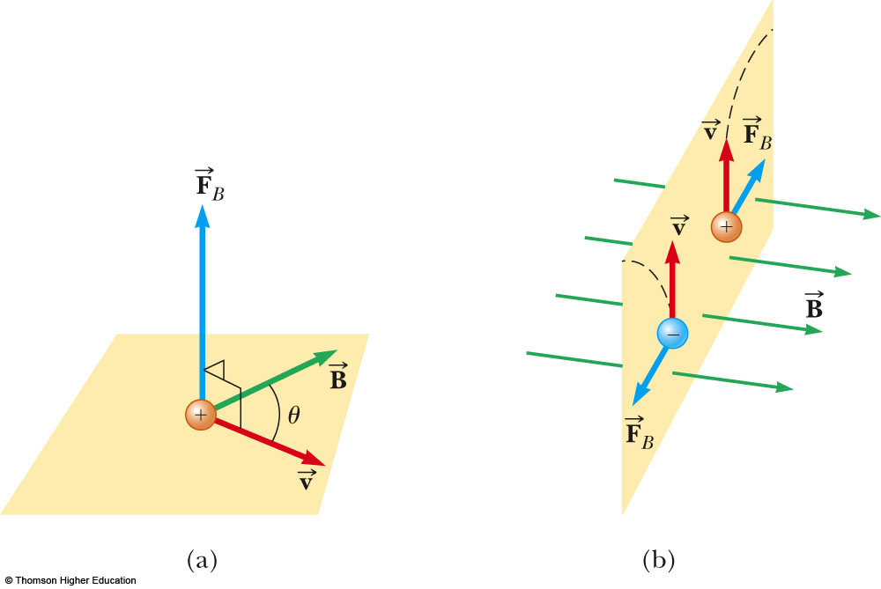
More About Direction
is perpendicular to the plane formed by and
Oppositely directed forces exerted on oppositely charged particles will cause the particles to move in opposite directions

Slide 20
Force on a Charge Moving in a Magnetic Field, Formula
The properties can be summarized in a vector equation:
  is the magnetic force
  q is the charge
  is the velocity of the moving charge
  is the magnetic field

Slide 21
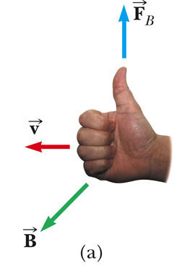
Direction: Right-Hand Rule #1
The fingers point in the direction of
comes out of your palm
  Curl your fingers in the direction of
The thumb points in the direction of which is the direction of

Slide 22
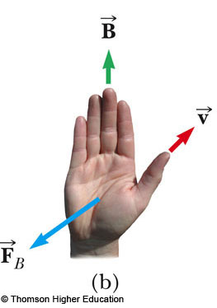
Direction: Right-Hand Rule #2
Alternative to Rule #1
Thumb is in the direction of
Fingers are in the direction of
Palm is in the direction of
  On a positive particle
  You can think of this as your hand pushing the particle

Slide 23
More About Magnitude of F
The magnitude of the magnetic force on a charged particle is F_{B} = |q| v B sin θ
  θ is the smaller angle between v and B
  F_{B} is zero when the field and velocity are parallel or antiparallel
    θ = 0 or 180º
  F_{B} is a maximum when the field and velocity are perpendicular
    θ = 90º

Slide 24
Differences Between Electric and Magnetic Fields
Direction of force
  The electric force acts along the direction of the electric field
  The magnetic force acts perpendicular to the magnetic field
Motion
  The electric force acts on a charged particle regardless of whether the particle is moving
  The magnetic force acts on a charged particle only when the particle is in motion

Slide 25
More Differences Between Electric and Magnetic Fields
Work
  The electric force does work in displacing a charged particle
  The magnetic force associated with a steady magnetic field does no work when a particle is displaced
    This is because the force is perpendicular to the displacement

Slide 26
Work in Fields, cont.
The kinetic energy of a charged particle moving through a magnetic field cannot be altered by the magnetic field alone
When a charged particle moves with a given velocity through a magnetic field, the field can alter the direction of the velocity, but not the speed or the kinetic energy

Slide 27
Units of Magnetic Field
The SI unit of magnetic field is the tesla (T)
  Wb is a weber
A non-SI commonly used unit is a gauss (G)
  1 T = 10⁴ G

Slide 28
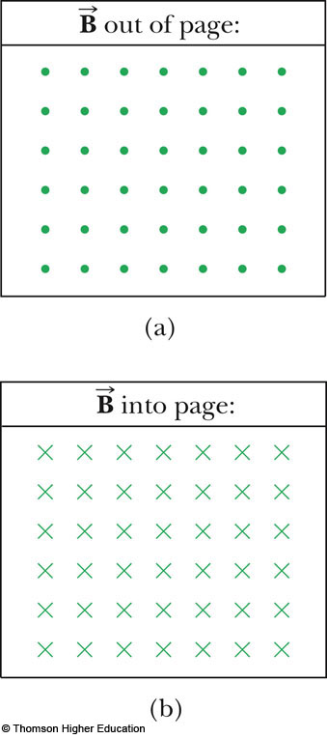
Notation Notes
When vectors are perpendicular to the page, dots and crosses are used
  The dots represent the arrows coming out of the page
  The crosses represent the arrows going into the page

Slide 29
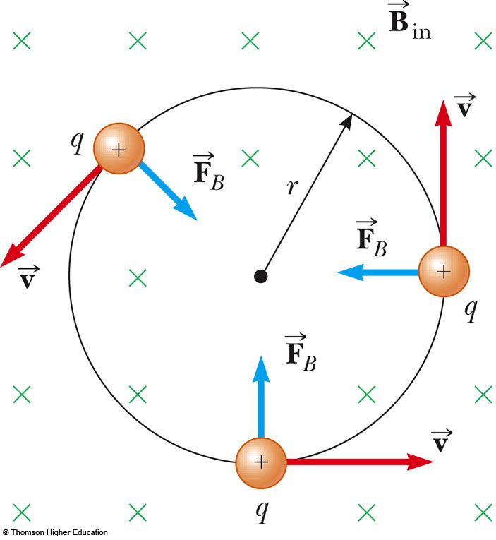
Charged Particle in a Magnetic Field
Consider a particle moving in an external magnetic field with its velocity perpendicular to the field
The force is always directed toward the center of the circular path
The magnetic force causes a centripetal acceleration, changing the direction of the velocity of the particle
Use the active figure to change the parameters of the particle and observe the motion
PLAY
ACTIVE FIGURE

Slide 30
Force on a Charged Particle
Equating the magnetic and centripetal forces:
Solving for r:
  r is proportional to the linear momentum of the particle and inversely proportional to the magnetic field

Slide 31
More About Motion of Charged Particle
The angular speed of the particle is
  The angular speed, ω, is also referred to as the cyclotron frequency
The period of the motion is

Slide 32
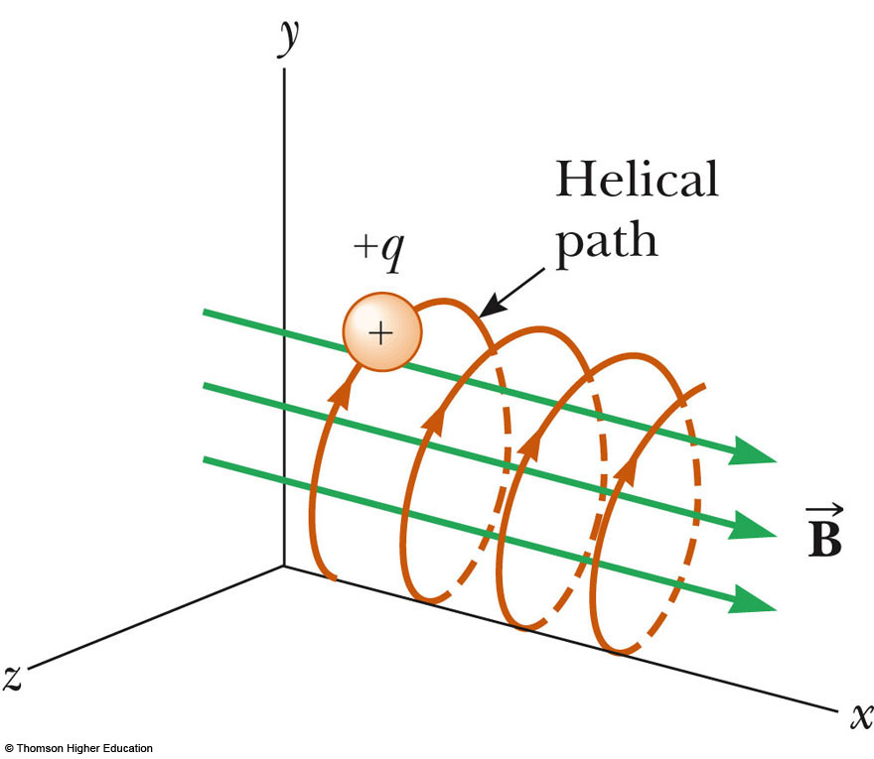
Motion of a Particle, General
If a charged particle moves in a magnetic field at some arbitrary angle with respect to the field, its path is a helix
Same equations apply, with
Use the active figure to vary the initial velocity and observe the resulting motion
PLAY
ACTIVE FIGURE

Slide 33
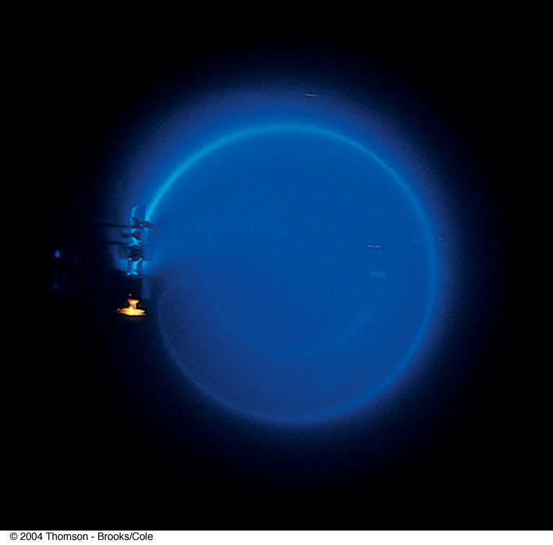
Bending of an Electron Beam
Electrons are accelerated from rest through a potential difference
The electrons travel in a curved path
Conservation of energy will give v
Other parameters can be found

Slide 34
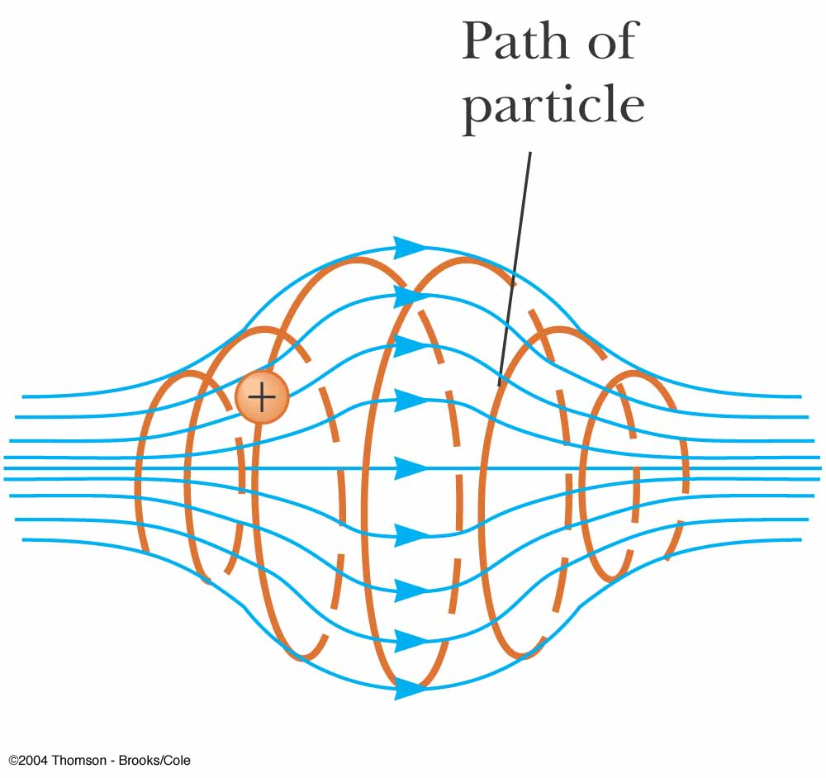
Particle in a Nonuniform Magnetic Field
The motion is complex
For example, the particles can oscillate back and forth between two positions
This configuration is known as a magnetic bottle

Slide 35
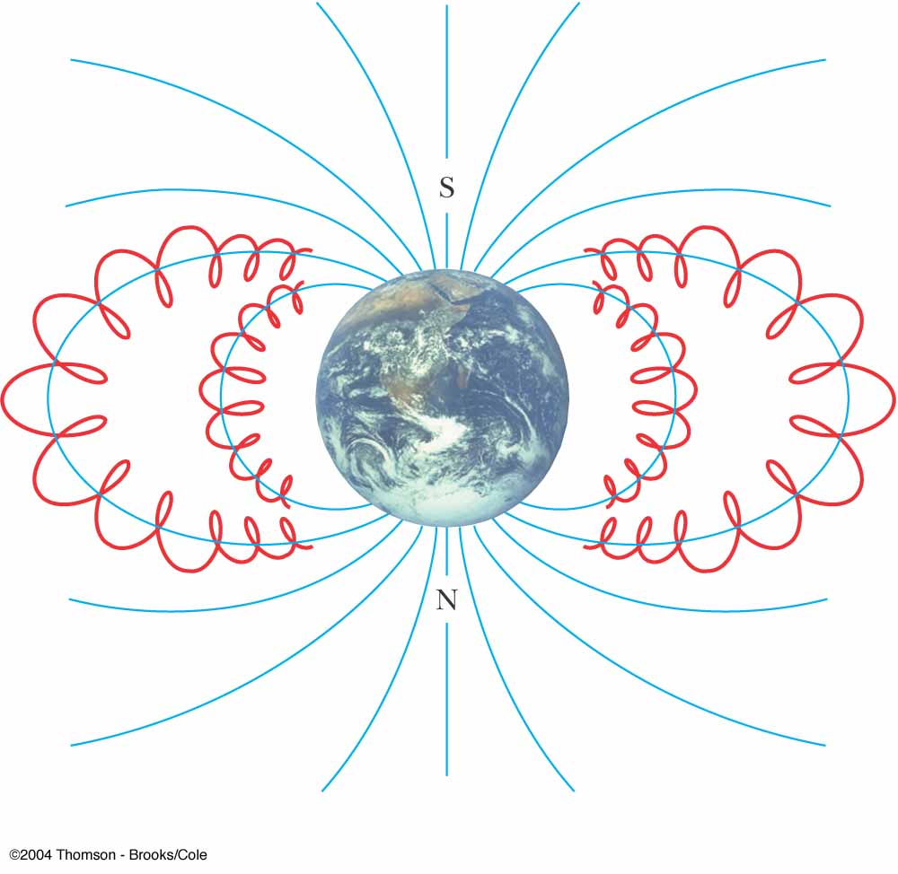
Van Allen Radiation Belts
The Van Allen radiation belts consist of charged particles surrounding the Earth in doughnut-shaped regions
The particles are trapped by the Earth’s magnetic field
The particles spiral from pole to pole
  May result in Auroras

Slide 36
Charged Particles Moving in Electric and Magnetic Fields
In many applications, charged particles will move in the presence of both magnetic and electric fields
In that case, the total force is the sum of the forces due to the individual fields
In general:

Slide 37
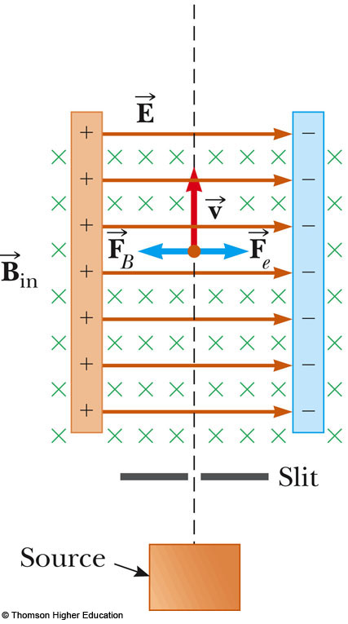
Velocity Selector
Used when all the particles need to move with the same velocity
A uniform electric field is perpendicular to a uniform magnetic field
Use the active figure to vary the fields to achieve the straight line motion
PLAY
ACTIVE FIGURE

Slide 38
Velocity Selector, cont.
When the force due to the electric field is equal but opposite to the force due to the magnetic field, the particle moves in a straight line
This occurs for velocities of value
v = E / B

Slide 39
Velocity Selector, final
Only those particles with the given speed will pass through the two fields undeflected
The magnetic force exerted on particles moving at speed greater than this is stronger than the electric field and the particles will be deflected to the left
Those moving more slowly will be deflected to the right

Slide 40
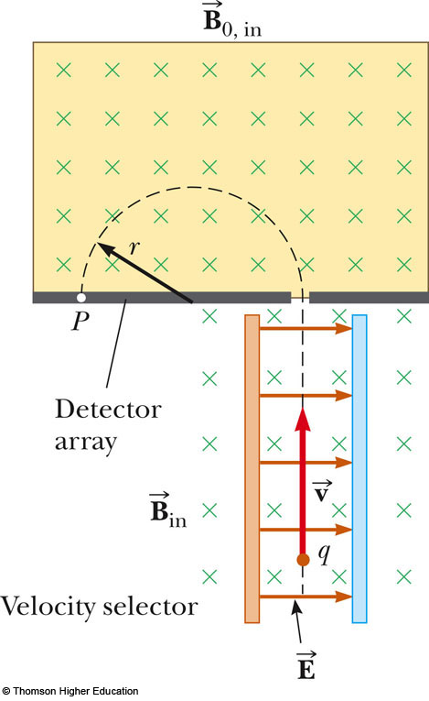
Mass Spectrometer
A mass spectrometer separates ions according to their mass-to-charge ratio
A beam of ions passes through a velocity selector and enters a second magnetic field
Use the active figure to see where the particles strike the detector array
PLAY
ACTIVE FIGURE

Slide 41
Mass Spectrometer, cont.
After entering the second magnetic field, the ions move in a semicircle of radius r before striking a detector at P
If the ions are positively charged, they deflect to the left
If the ions are negatively charged, they deflect to the right

Slide 42
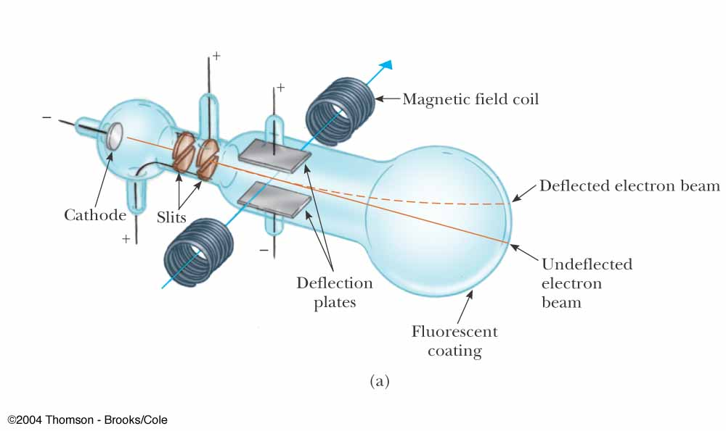
Thomson’s e/m Experiment
Electrons are accelerated from the cathode
They are deflected by electric and magnetic fields
The beam of electrons strikes a fluorescent screen
e/m was measured

Slide 43
Cyclotron
A cyclotron is a device that can accelerate charged particles to very high speeds
The energetic particles produced are used to bombard atomic nuclei and thereby produce reactions
These reactions can be analyzed by researchers

Slide 44
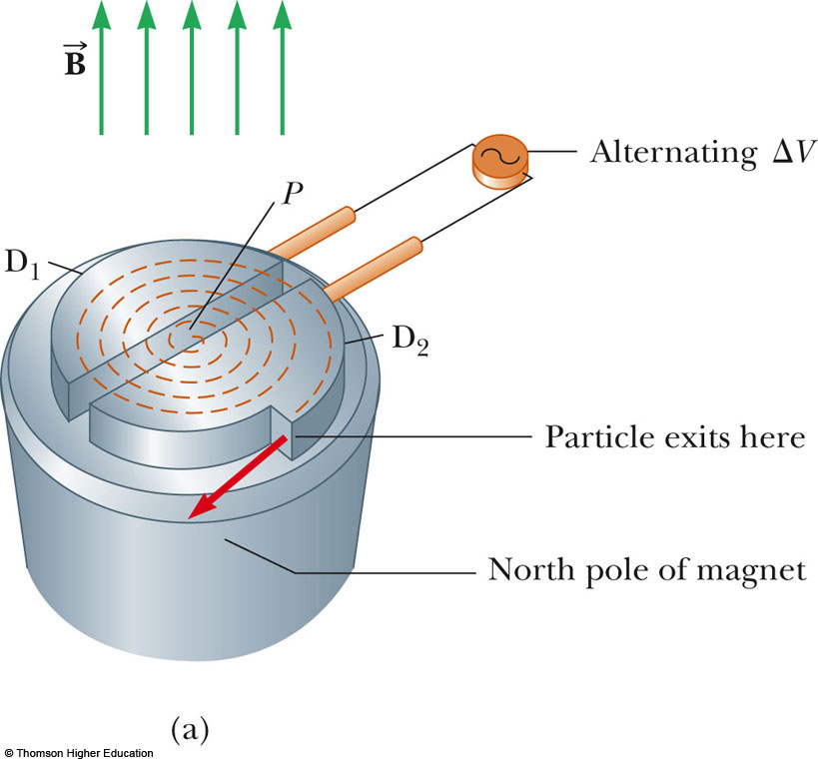

Cyclotron, 2
D₁ and D₂ are called dees because of their shape
A high frequency alternating potential is applied to the dees
A uniform magnetic field is perpendicular to them

Slide 45
Cyclotron, 3
A positive ion is released near the center and moves in a semicircular path
The potential difference is adjusted so that the polarity of the dees is reversed in the same time interval as the particle travels around one dee
This ensures the kinetic energy of the particle increases each trip

Slide 46
Cyclotron, final
The cyclotron’s operation is based on the fact that T is independent of the speed of the particles and of the radius of their path
When the energy of the ions in a cyclotron exceeds about 20 MeV, relativistic effects come into play

Slide 47
Magnetic Force on a Current Carrying Conductor
A force is exerted on a current-carrying wire placed in a magnetic field
  The current is a collection of many charged particles in motion
The direction of the force is given by the right-hand rule

Slide 48
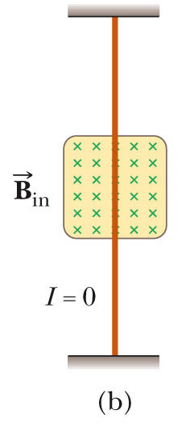
Force on a Wire
In this case, there is no current, so there is no force
Therefore, the wire remains vertical

Slide 49
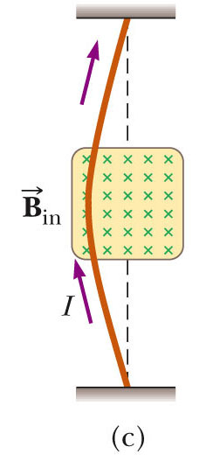
Force on a Wire (2)
The magnetic field is into the page
The current is up the page
The force is to the left

Slide 50
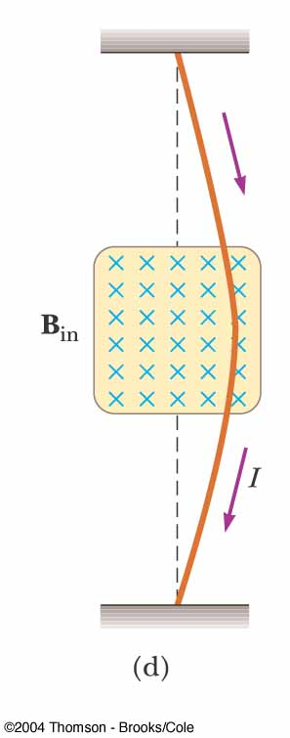
Force on a Wire, (3)
The magnetic field is into the page
The current is down the page
The force is to the right

Slide 51
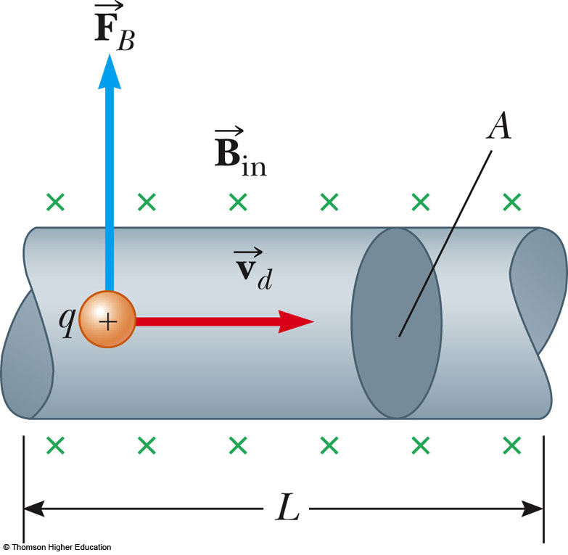
Force on a Wire, equation
The magnetic force is exerted on each moving charge in the wire
The total force is the product of the force on one charge and the number of charges

Slide 52
Force on a Wire, (4)
In terms of the current, this becomes
  I is the current
  is a vector that points in the direction of the current
    Its magnitude is the length L of the segment
  is the magnetic field

Slide 53
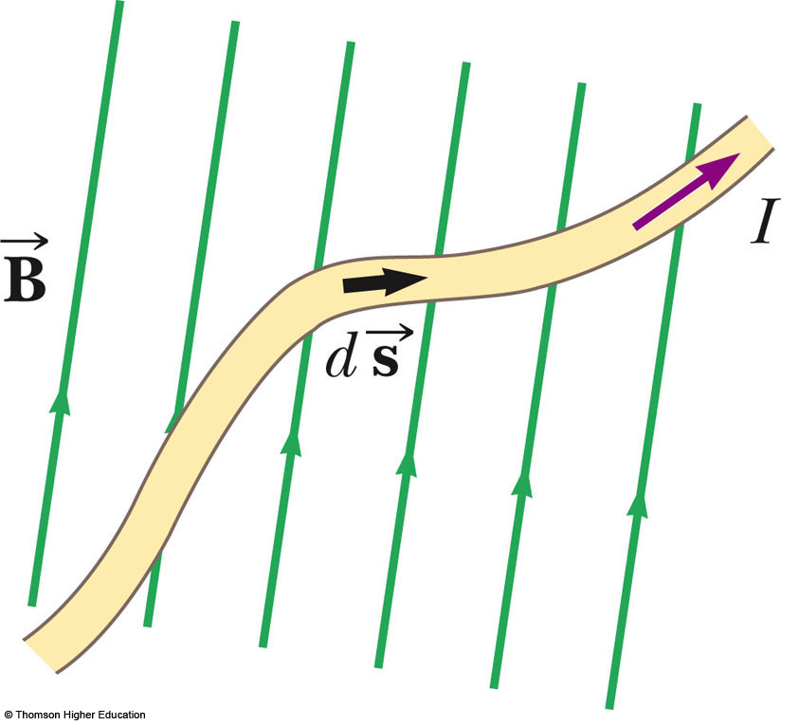
Force on a Wire, Arbitrary Shape
Consider a small segment of the wire,
The force exerted on this segment is
The total force is

Slide 54
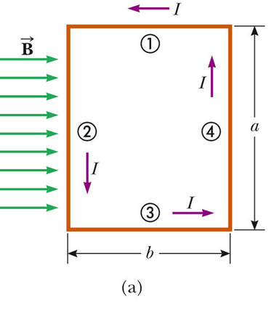
Torque on a Current Loop
The rectangular loop carries a current I in a uniform magnetic field
No magnetic force acts on sides 1 & 3
  The wires are parallel to the field and

Slide 55
Torque on a Current Loop, 2
There is a force on sides 2 & 4 since they are perpendicular to the field
The magnitude of the magnetic force on these sides will be:
  F₂ = F₄ = I a B
The direction of F₂ is out of the page
The direction of F₄ is into the page

Slide 56
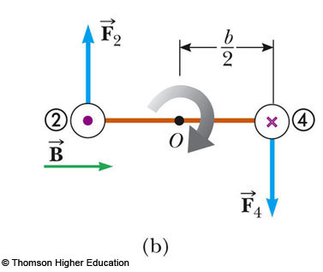
Torque on a Current Loop, 3
The forces are equal and in opposite directions, but not along the same line of action
The forces produce a torque around point O

Slide 57
Torque on a Current Loop, Equation
The maximum torque is found by:
The area enclosed by the loop is ab, so τ_{max} = IAB
  This maximum value occurs only when the field is parallel to the plane of the loop

Slide 58
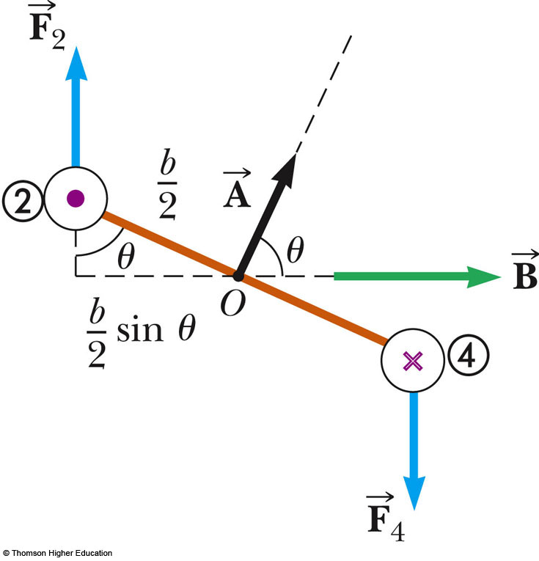
Torque on a Current Loop, General
Assume the magnetic field makes an angle of
θ < 90º with a line perpendicular to the plane of the loop
The net torque about point O will be τ = IAB sin θ
Use the active figure to vary the initial settings and observe the resulting motion
PLAY
ACTIVE FIGURE

Slide 59
Torque on a Current Loop, Summary
The torque has a maximum value when the field is perpendicular to the normal to the plane of the loop
The torque is zero when the field is parallel to the normal to the plane of the loop
where is perpendicular to the plane of the loop and has a magnitude equal to the area of the loop

Slide 60
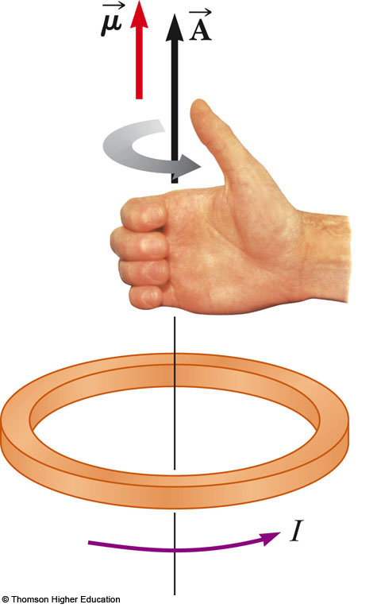
Direction
The right-hand rule can be used to determine the direction of
Curl your fingers in the direction of the current in the loop
Your thumb points in the direction of

Slide 61
Magnetic Dipole Moment
The product I is defined as the magnetic dipole moment, , of the loop
  Often called the magnetic moment
SI units: A · m²
Torque in terms of magnetic moment:
  Analogous to for electric dipole

Slide 62
Potential Energy
The potential energy of the system of a magnetic dipole in a magnetic field depends on the orientation of the dipole in the magnetic field:
  U_{min} = -μB and occurs when the dipole moment is in the same direction as the field
  U_{max} = +μB and occurs when the dipole moment is in the direction opposite the field

Slide 63
Hall Effect
When a current carrying conductor is placed in a magnetic field, a potential difference is generated in a direction perpendicular to both the current and the magnetic field
This phenomena is known as the Hall effect
It arises from the deflection of charge carriers to one side of the conductor as a result of the magnetic forces they experience

Slide 64
Hall Effect, cont.
The Hall effect gives information regarding the sign of the charge carriers and their density
It can also be used to measure magnetic fields

Slide 65
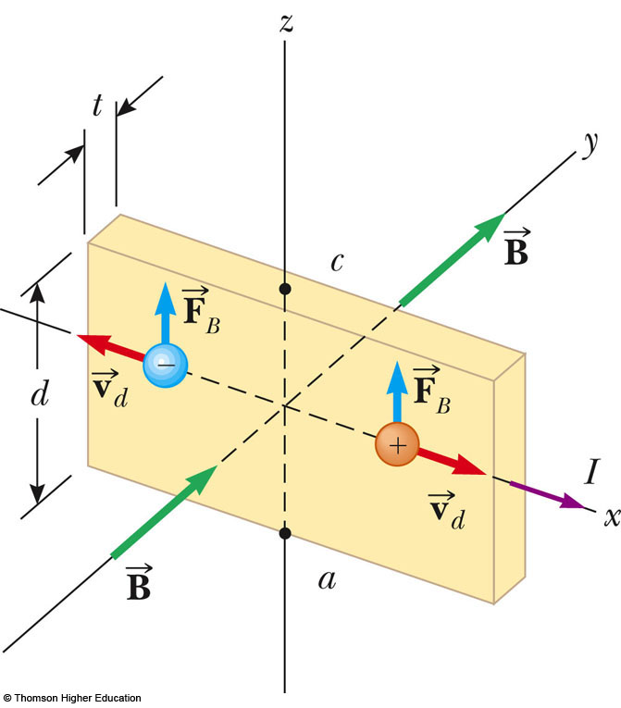
Hall Voltage
This shows an arrangement for observing the Hall effect
The Hall voltage is measured between points a and c

Slide 66
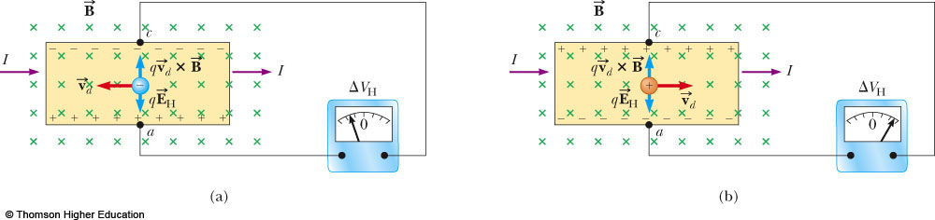
Hall Voltage, cont
When the charge carriers are negative, the upper edge of the conductor becomes negatively charged
  c is at a lower potential than a
When the charge carriers are positive, the upper edge becomes positively charged
  c is at a higher potential than a

Slide 67
Hall Voltage, final
ΔV_{H} = E_{H}d = v_{d} B d
  d is the width of the conductor
  v_{d} is the drift velocity
  If B and d are known, v_{d} can be found
  R_{H} = 1 / nq is called the Hall coefficient
  A properly calibrated conductor can be used to measure the magnitude of an unknown magnetic field

