Slide 1
Chapter 32
Inductance

Slide 2
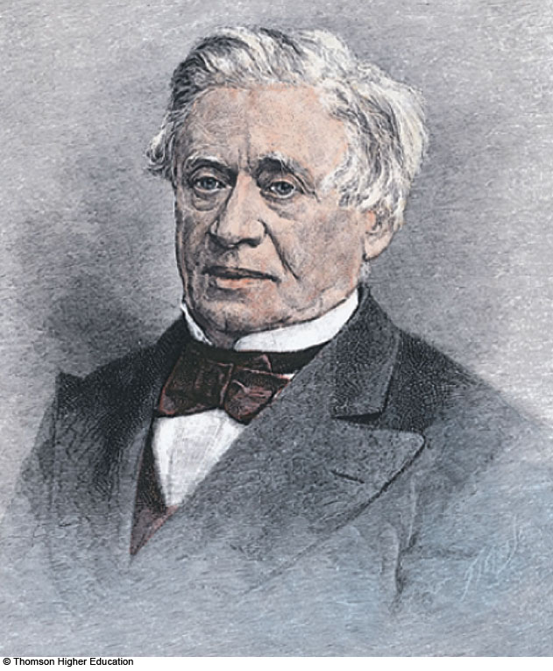
Joseph Henry
1797 – 1878
American physicist
First director of the Smithsonian
Improved design of electromagnet
Constructed one of the first motors
Discovered self-inductance
Unit of inductance is named in his honor

Slide 3
Some Terminology
Use emf and current when they are caused by batteries or other sources
Use induced emf and induced current when they are caused by changing magnetic fields
When dealing with problems in electromagnetism, it is important to distinguish between the two situations

Slide 4
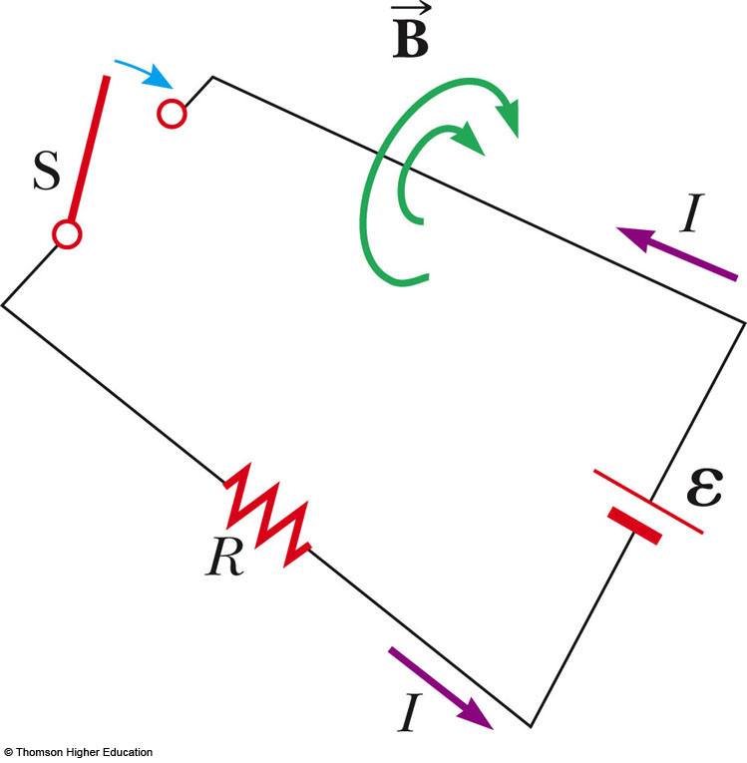
Self-Inductance
When the switch is closed, the current does not immediately reach its maximum value
Faraday’s law can be used to describe the effect

Slide 5
Self-Inductance, 2
As the current increases with time, the magnetic flux through the circuit loop due to this current also increases with time
This increasing flux creates an induced emf in the circuit

Slide 6
Self-Inductance, 3
The direction of the induced emf is such that it would cause an induced current in the loop which would establish a magnetic field opposing the change in the original magnetic field
The direction of the induced emf is opposite the direction of the emf of the battery
This results in a gradual increase in the current to its final equilibrium value

Slide 7
Self-Inductance, 4
This effect is called self-inductance
  Because the changing flux through the circuit and the resultant induced emf arise from the circuit itself
The emf ε_{L} is called a self-induced emf

Slide 8
Self-Inductance, Equations
An induced emf is always proportional to the time rate of change of the current
  The emf is proportional to the flux, which is proportional to the field and the field is proportional to the current
L is a constant of proportionality called the inductance of the coil and it depends on the geometry of the coil and other physical characteristics

Slide 9
Inductance of a Coil
A closely spaced coil of N turns carrying current I has an inductance of
The inductance is a measure of the opposition to a change in current

Slide 10
Inductance Units
The SI unit of inductance is the henry (H)
Named for Joseph Henry

Slide 11
Inductance of a Solenoid
Assume a uniformly wound solenoid having N turns and length ℓ
  Assume ℓ is much greater than the radius of the solenoid
The flux through each turn of area A is

Slide 12
Inductance of a Solenoid, cont
The inductance is
This shows that L depends on the geometry of the object

Slide 13

RL Circuit, Introduction
A circuit element that has a large self-inductance is called an inductor
The circuit symbol is
We assume the self-inductance of the rest of the circuit is negligible compared to the inductor
  However, even without a coil, a circuit will have some self-inductance

Slide 14
Effect of an Inductor in a Circuit
The inductance results in a back emf
Therefore, the inductor in a circuit opposes changes in current in that circuit
  The inductor attempts to keep the current the same way it was before the change occurred
  The inductor can cause the circuit to be “sluggish” as it reacts to changes in the voltage

Slide 15
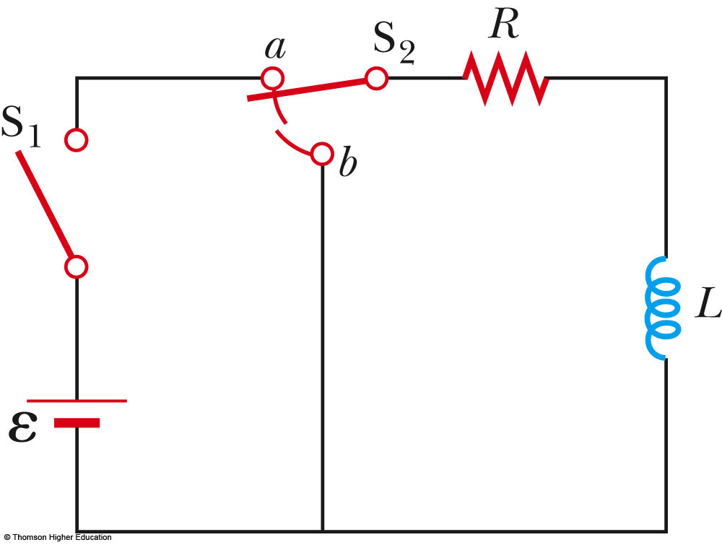
RL Circuit, Analysis
An RL circuit contains an inductor and a resistor
Assume S₂ is connected to a
When switch S₁ is closed (at time t = 0), the current begins to increase
At the same time, a back emf is induced in the inductor that opposes the original increasing current
PLAY
ACTIVE FIGURE

Slide 16
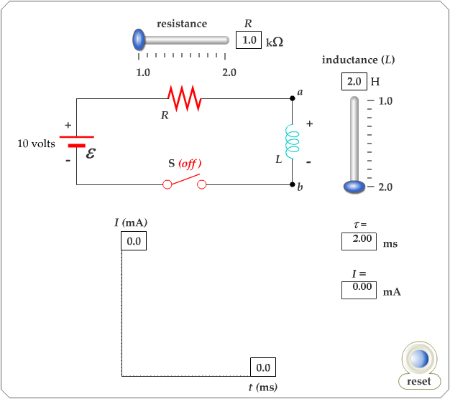
Active Figure 32.2 (a)
Use the active figure to set R and L and see the effect on the current
PLAY
ACTIVE FIGURE

Slide 17
RL Circuit, Analysis, cont.
Applying Kirchhoff’s loop rule to the previous circuit in the clockwise direction gives
Looking at the current, we find

Slide 18
RL Circuit, Analysis, Final
The inductor affects the current exponentially
The current does not instantly increase to its final equilibrium value
If there is no inductor, the exponential term goes to zero and the current would instantaneously reach its maximum value as expected

Slide 19
RL Circuit, Time Constant
The expression for the current can also be expressed in terms of the time constant, τ, of the circuit
  where τ = L / R
Physically, τ is the time required for the current to reach 63.2% of its maximum value

Slide 20
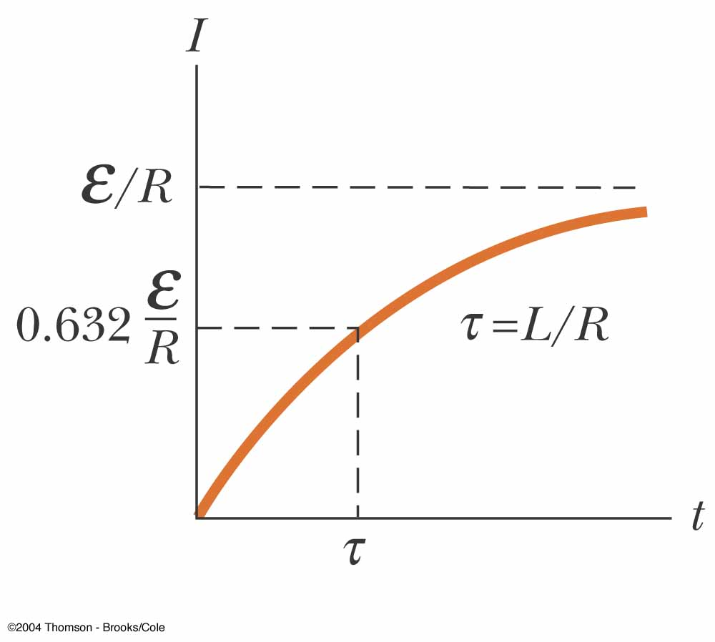
RL Circuit, Current-Time Graph, (1)
The equilibrium value of the current is ε /R and is reached as t approaches infinity
The current initially increases very rapidly
The current then gradually approaches the equilibrium value
Use the active figure to watch the graph
PLAY
ACTIVE FIGURE

Slide 21
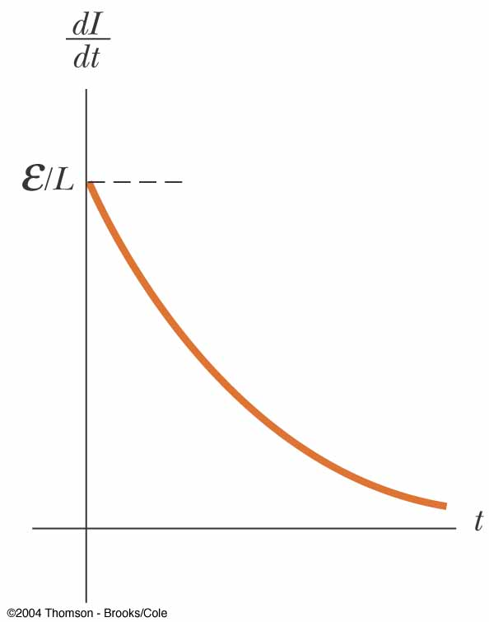
RL Circuit, Current-Time Graph, (2)
The time rate of change of the current is a maximum at t = 0
It falls off exponentially as t approaches infinity
In general,

Slide 22
RL Circuit Without A Battery
Now set S₂ to position b
The circuit now contains just the right hand loop
The battery has been eliminated
The expression for the current becomes
PLAY
ACTIVE FIGURE

Slide 23
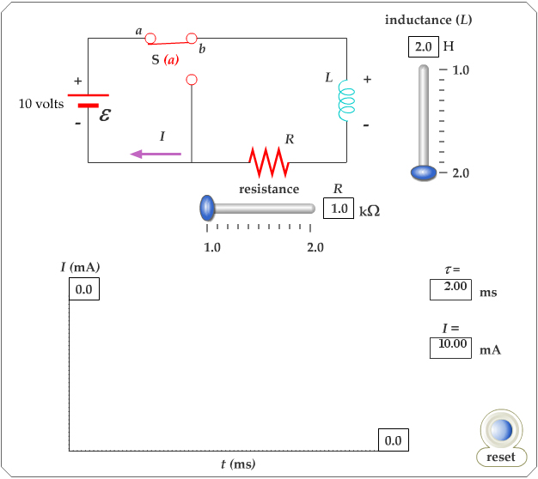
Active Figure 32.2 (b)
Use the active figure to change the values of R and L and watch the result on the graph
PLAY
ACTIVE FIGURE

Slide 24
Energy in a Magnetic Field
In a circuit with an inductor, the battery must supply more energy than in a circuit without an inductor
Part of the energy supplied by the battery appears as internal energy in the resistor
The remaining energy is stored in the magnetic field of the inductor

Slide 25
Energy in a Magnetic Field, cont.
Looking at this energy (in terms of rate)
  Iε is the rate at which energy is being supplied by the battery
  I²R is the rate at which the energy is being delivered to the resistor
  Therefore, LI (dI/dt) must be the rate at which the energy is being stored in the magnetic field

Slide 26
Energy in a Magnetic Field, final
Let U denote the energy stored in the inductor at any time
The rate at which the energy is stored is
To find the total energy, integrate and

Slide 27
Energy Density of a Magnetic Field
Given U = ½ L I² and assume (for simplicity) a solenoid with L = μ_{o} n² V
Since V is the volume of the solenoid, the magnetic energy density, u_{B} is
This applies to any region in which a magnetic field exists (not just the solenoid)

Slide 28
Energy Storage Summary
A resistor, inductor and capacitor all store energy through different mechanisms
  Charged capacitor
    Stores energy as electric potential energy
  Inductor
    When it carries a current, stores energy as magnetic potential energy
  Resistor
    Energy delivered is transformed into internal energy

Slide 29
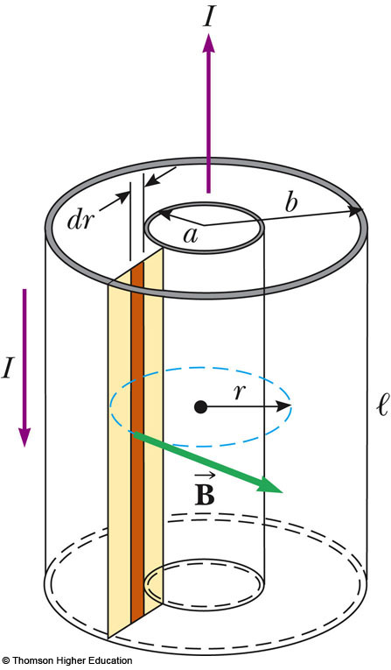
Example: The Coaxial Cable
Calculate L for the cable
The total flux is
Therefore, L is

Slide 30
Mutual Inductance
The magnetic flux through the area enclosed by a circuit often varies with time because of time-varying currents in nearby circuits
This process is known as mutual induction because it depends on the interaction of two circuits

Slide 31
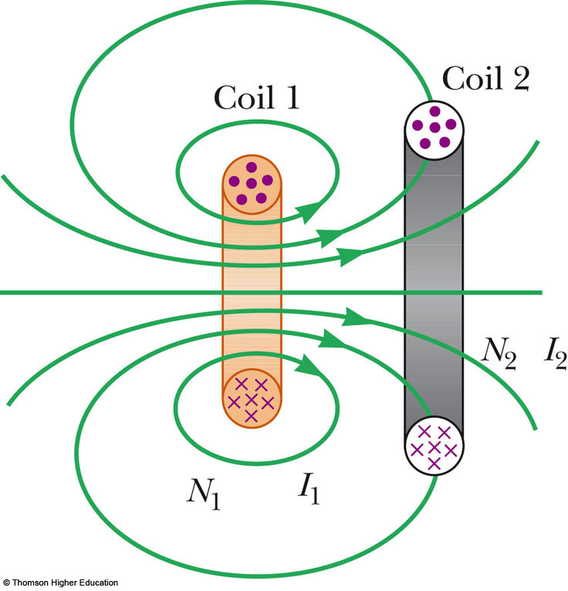
Mutual Inductance, 2
The current in coil 1 sets up a magnetic field
Some of the magnetic field lines pass through coil 2
Coil 1 has a current I₁ and N₁ turns
Coil 2 has N₂ turns

Slide 32
Mutual Inductance, 3
The mutual inductance M₁₂ of coil 2 with respect to coil 1 is
Mutual inductance depends on the geometry of both circuits and on their orientation with respect to each other

Slide 33
Induced emf in Mutual Inductance
If current I₁ varies with time, the emf induced by coil 1 in coil 2 is
If the current is in coil 2, there is a mutual inductance M₂₁
If current 2 varies with time, the emf induced by coil 2 in coil 1 is

Slide 34
Mutual Inductance, Final
In mutual induction, the emf induced in one coil is always proportional to the rate at which the current in the other coil is changing
The mutual inductance in one coil is equal to the mutual inductance in the other coil
  M₁₂ = M₂₁ = M
The induced emf’s can be expressed as

Slide 35
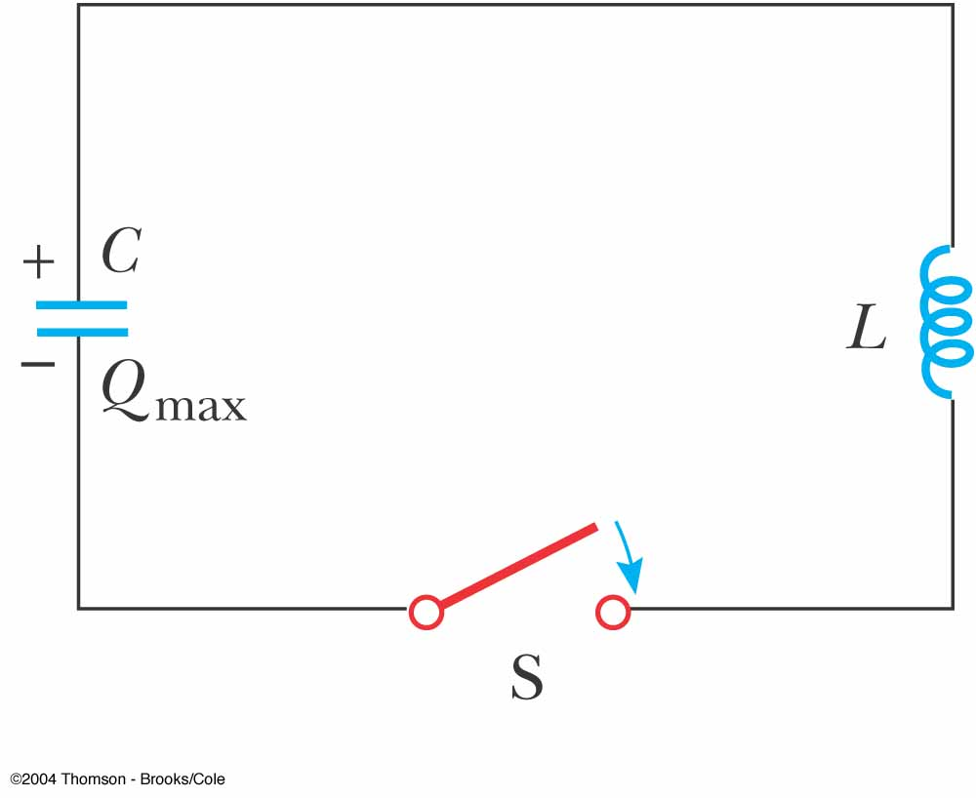
LC Circuits
A capacitor is connected to an inductor in an LC circuit
Assume the capacitor is initially charged and then the switch is closed
Assume no resistance and no energy losses to radiation

Slide 36
Oscillations in an LC Circuit
Under the previous conditions, the current in the circuit and the charge on the capacitor oscillate between maximum positive and negative values
With zero resistance, no energy is transformed into internal energy
Ideally, the oscillations in the circuit persist indefinitely
  The idealizations are no resistance and no radiation

Slide 37
Oscillations in an LC Circuit, 2
The capacitor is fully charged
  The energy U in the circuit is stored in the electric field of the capacitor
  The energy is equal to Q²_{max} / 2C
  The current in the circuit is zero
  No energy is stored in the inductor
The switch is closed

Slide 38
Oscillations in an LC Circuit, 3
The current is equal to the rate at which the charge changes on the capacitor
  As the capacitor discharges, the energy stored in the electric field decreases
  Since there is now a current, some energy is stored in the magnetic field of the inductor
  Energy is transferred from the electric field to the magnetic field

Slide 39
Oscillations in an LC Circuit, 4
Eventually, the capacitor becomes fully discharged
  It stores no energy
  All of the energy is stored in the magnetic field of the inductor
  The current reaches its maximum value
The current now decreases in magnitude, recharging the capacitor with its plates having opposite their initial polarity

Slide 40
Oscillations in an LC Circuit, final
The capacitor becomes fully charged and the cycle repeats
The energy continues to oscillate between the inductor and the capacitor
The total energy stored in the LC circuit remains constant in time and equals

Slide 41
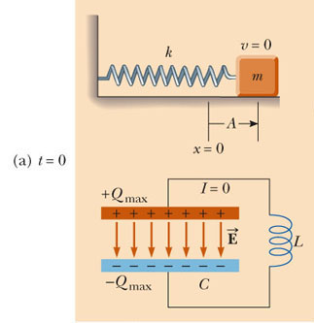
LC Circuit Analogy to Spring-Mass System, 1
The potential energy ½kx² stored in the spring is analogous to the electric potential energy (Q_{max})²/(2C) stored in the capacitor
All the energy is stored in the capacitor at t = 0
This is analogous to the spring stretched to its amplitude
PLAY
ACTIVE FIGURE

Slide 42
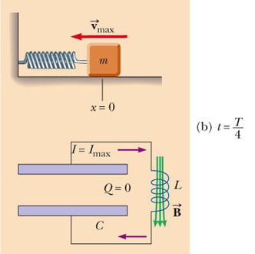
LC Circuit Analogy to Spring-Mass System, 2
The kinetic energy (½ mv²) of the spring is analogous to the magnetic energy (½ L I²) stored in the inductor
At t = ¼ T, all the energy is stored as magnetic energy in the inductor
The maximum current occurs in the circuit
This is analogous to the mass at equilibrium
PLAY
ACTIVE FIGURE

Slide 43
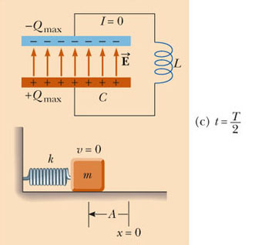
LC Circuit Analogy to Spring-Mass System, 3
At t = ½ T, the energy in the circuit is completely stored in the capacitor
The polarity of the capacitor is reversed
This is analogous to the spring stretched to -A
PLAY
ACTIVE FIGURE

Slide 44
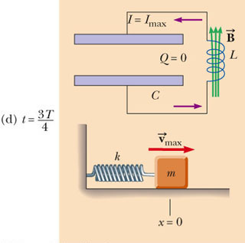
LC Circuit Analogy to Spring-Mass System, 4
At t = ¾ T, the energy is again stored in the magnetic field of the inductor
This is analogous to the mass again reaching the equilibrium position
PLAY
ACTIVE FIGURE

Slide 45
LC Circuit Analogy to Spring-Mass System, 5
At t = T, the cycle is completed
The conditions return to those identical to the initial conditions
At other points in the cycle, energy is shared between the electric and magnetic fields
PLAY
ACTIVE FIGURE

Slide 46
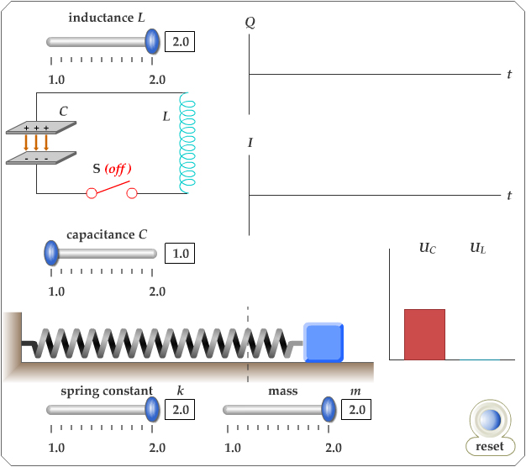
Active Figure 32.11
Use the active figure to adjust the values and L and C and see the effects on the current
PLAY
ACTIVE FIGURE

Slide 47
Time Functions of an LC Circuit
In an LC circuit, charge can be expressed as a function of time
  Q = Q_{max} cos (ωt + φ)
  This is for an ideal LC circuit
The angular frequency, ω, of the circuit depends on the inductance and the capacitance
  It is the natural frequency of oscillation of the circuit

Slide 48
Time Functions of an LC Circuit, 2
The current can be expressed as a function of time
The total energy can be expressed as a function of time

Slide 49
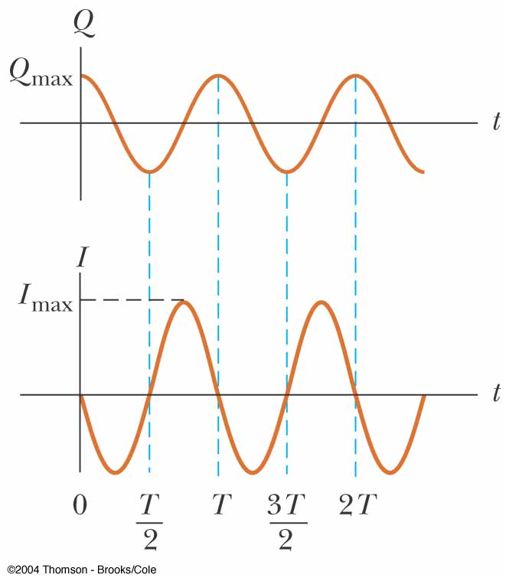
Charge and Current in an LC Circuit
The charge on the capacitor oscillates between Q_{max} and
-Q_{max}
The current in the inductor oscillates between I_{max} and -I_{max}
Q and I are 90º out of phase with each other
  So when Q is a maximum, I is zero, etc.

Slide 50
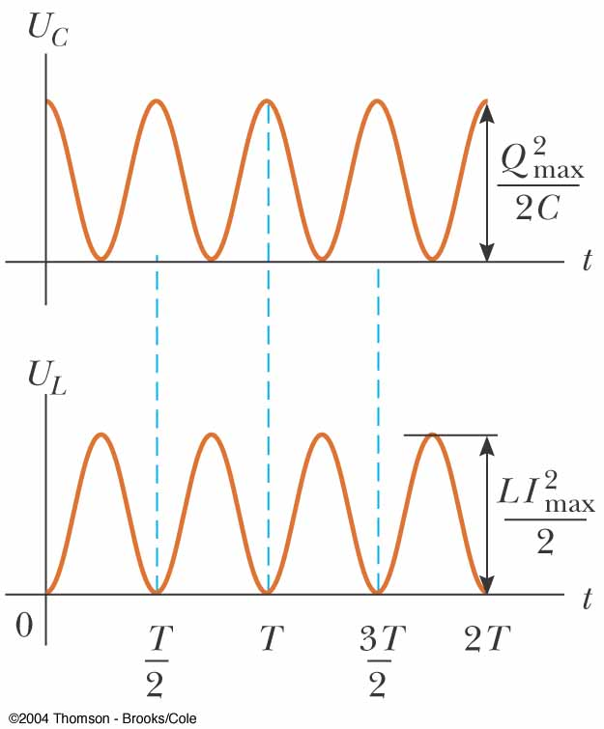
Energy in an LC Circuit – Graphs
The energy continually oscillates between the energy stored in the electric and magnetic fields
When the total energy is stored in one field, the energy stored in the other field is zero

Slide 51
Notes About Real LC Circuits
In actual circuits, there is always some resistance
Therefore, there is some energy transformed to internal energy
Radiation is also inevitable in this type of circuit
The total energy in the circuit continuously decreases as a result of these processes

Slide 52
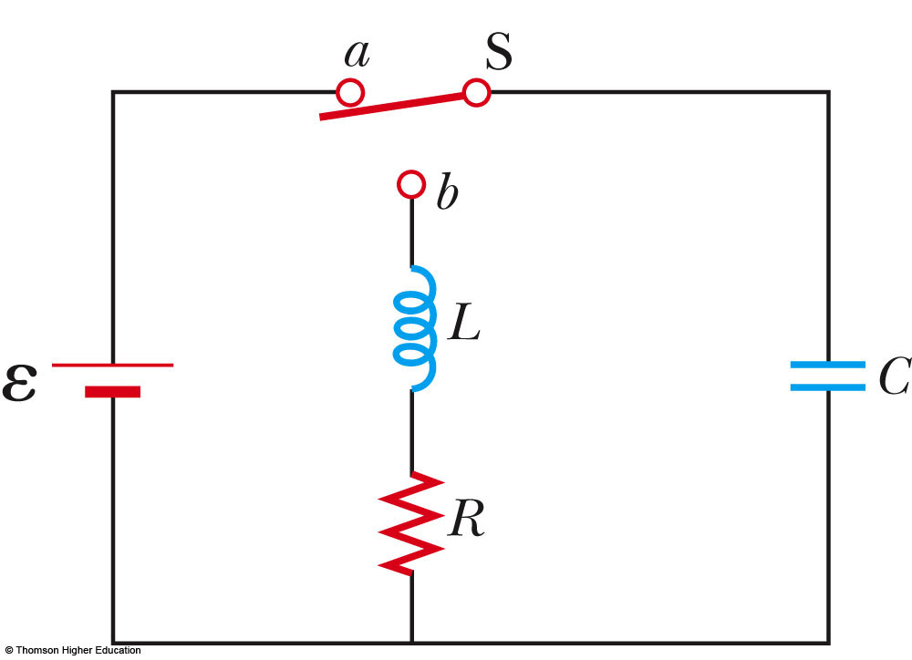
The RLC Circuit
A circuit containing a resistor, an inductor and a capacitor is called an RLC Circuit
Assume the resistor represents the total resistance of the circuit
PLAY
ACTIVE FIGURE

Slide 53
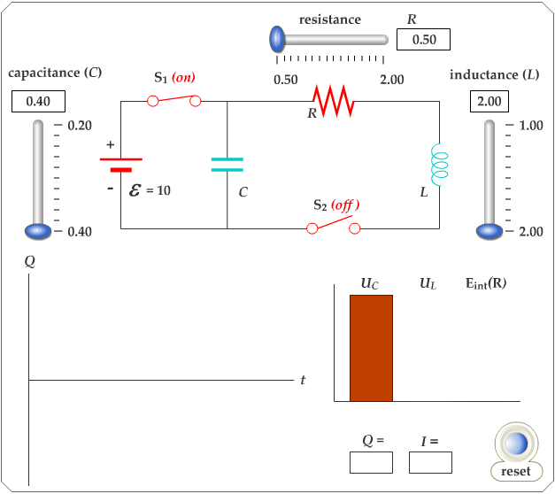
Active Figure 32.15
Use the active figure to adjust R, L, and C. Observe the effect on the charge
PLAY
ACTIVE FIGURE

Slide 54
RLC Circuit, Analysis
The total energy is not constant, since there is a transformation to internal energy in the resistor at the rate of dU/dt = -I²R
  Radiation losses are still ignored
The circuit’s operation can be expressed as

Slide 55
RLC Circuit Compared to Damped Oscillators
The RLC circuit is analogous to a damped harmonic oscillator
When R = 0
  The circuit reduces to an LC circuit and is equivalent to no damping in a mechanical oscillator

Slide 56
RLC Circuit Compared to Damped Oscillators, cont.
When R is small:
  The RLC circuit is analogous to light damping in a mechanical oscillator
  Q = Q_{max} e^{-Rt/2L} cos ω_{d}t
  ω_{d} is the angular frequency of oscillation for the circuit and

Slide 57
RLC Circuit Compared to Damped Oscillators, final
When R is very large, the oscillations damp out very rapidly
There is a critical value of R above which no oscillations occur
If R = R_{C}, the circuit is said to be critically damped
When R > R_{C}, the circuit is said to be overdamped

Slide 58
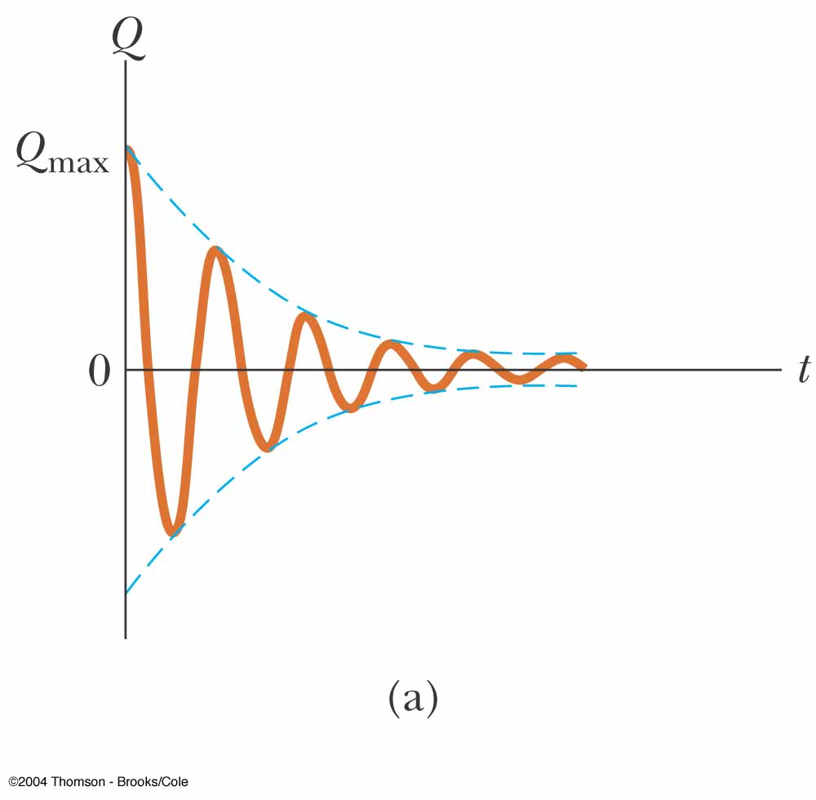
Damped RLC Circuit, Graph
The maximum value of Q decreases after each oscillation
  R < R_{C}
This is analogous to the amplitude of a damped spring-mass system

Slide 59
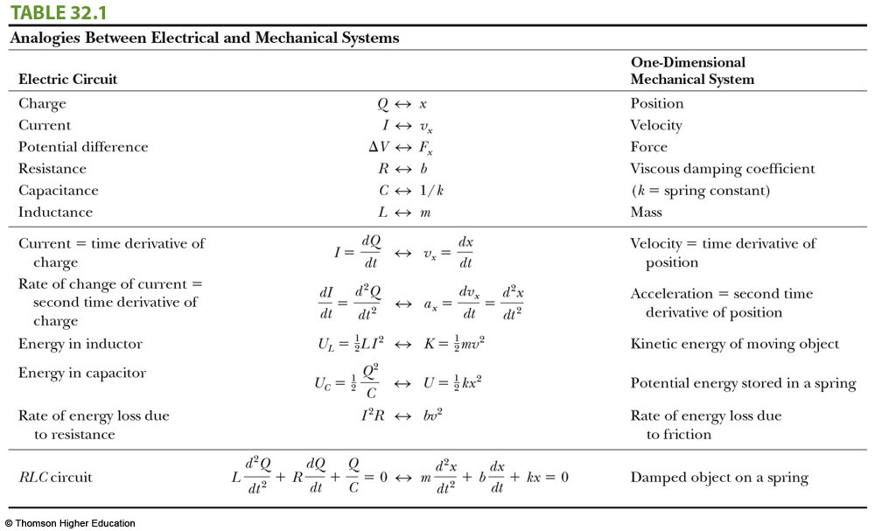
Summary: Analogies Between Electrical and Mechanic Systems

