Slide 1
Chapter 38
Diffraction Patterns
and
Polarization

Slide 2
Diffraction
Light of wavelength comparable to or larger than the width of a slit spreads out in all forward directions upon passing through the slit
This phenomena is called diffraction
  This indicates that light spreads beyond the narrow path defined by the slit into regions that would be in shadow if light traveled in straight lines

Slide 3
Diffraction Pattern
A single slit placed between a distant light source and a screen produces a diffraction pattern
  It will have a broad, intense central band
    Called the central maximum
  The central band will be flanked by a series of narrower, less intense secondary bands
    Called side maxima or secondary maxima
  The central band will also be flanked by a series of dark bands
    Called minima

Slide 4
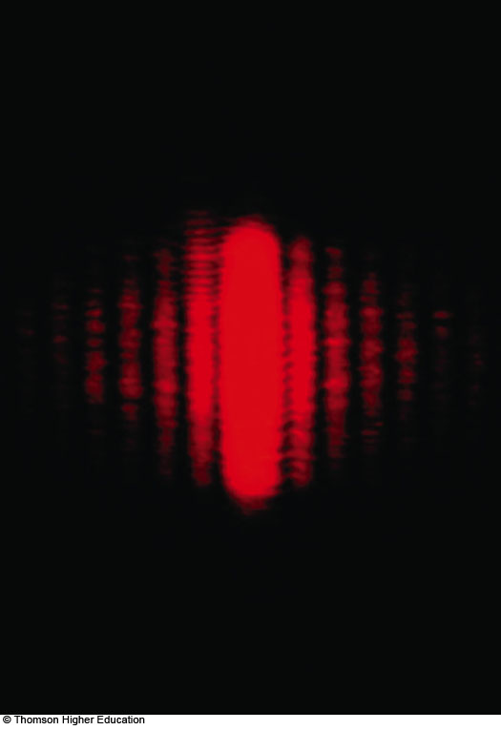
Diffraction Pattern, Single Slit
The diffraction pattern consists of the central maximum and a series of secondary maxima and minima
The pattern is similar to an interference pattern

Slide 5
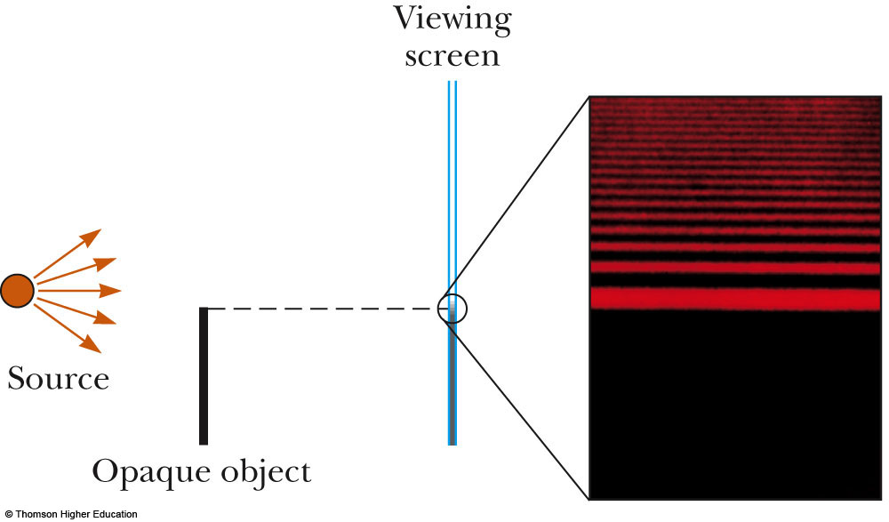
Diffraction Pattern, Object Edge
This shows the upper half of the diffraction pattern formed by light from a single source passing by the edge of an opaque object
The diffraction pattern is vertical with the central maximum at the bottom

Slide 6
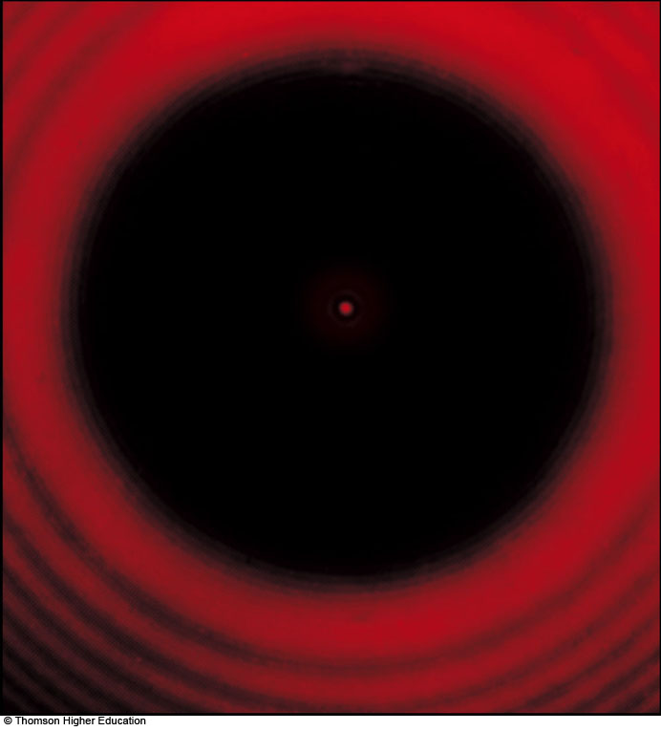
Confirming Wave Nature
Geometric optics would predict a dark spot in the center
Wave theory predicts the presence of the center spot
There is a bright spot at the center
  Confirms wave theory
The circular fringes extend outward from the shadow’s edge

Slide 7
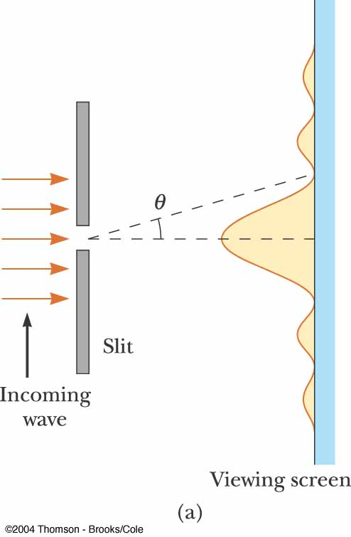
Fraunhofer Diffraction Pattern
A Fraunhofer diffraction pattern occurs when the rays leave the diffracting object in parallel directions
  Screen very far from the slit
  Could be accomplished by a converging lens

Slide 8
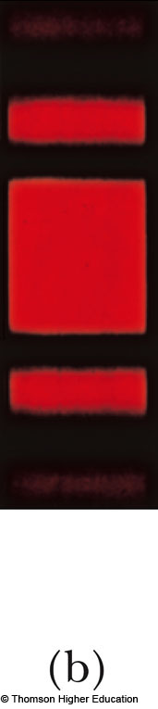
Fraunhofer Diffraction Pattern Photo
A bright fringe is seen along the axis (θ = 0)
Alternating bright and dark fringes are seen on each side

Slide 9
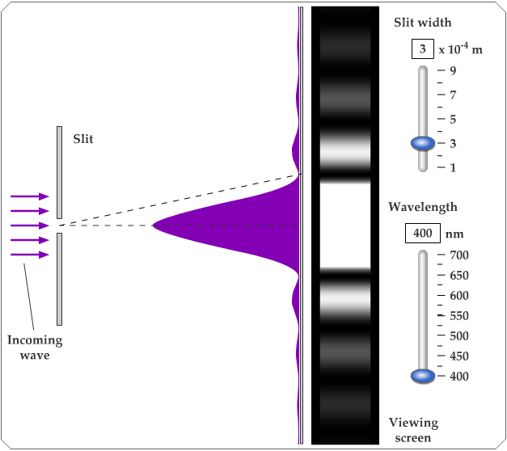
Active Figure 38.4
Use the active figure to adjust the slit width and the wavelength of the light
Observe the effect on the diffraction pattern
PLAY
ACTIVE FIGURE

Slide 10
Diffraction vs. Diffraction Pattern
Diffraction refers to the general behavior of waves spreading out as they pass through a slit
A diffraction pattern is actually a misnomer that is deeply entrenched
  The pattern seen on the screen is actually another interference pattern
  The interference is between parts of the incident light illuminating different regions of the slit

Slide 11
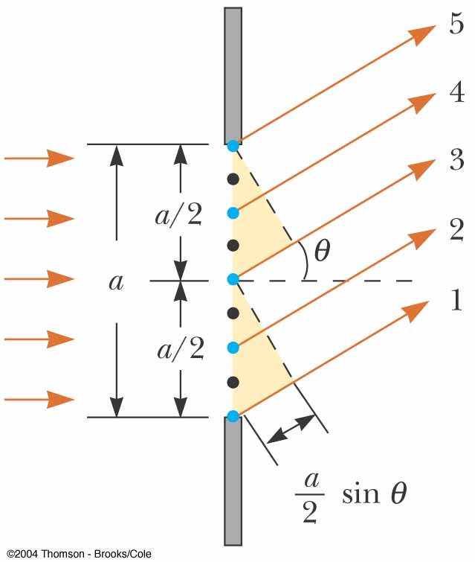
Single-Slit Diffraction
The finite width of slits is the basis for understanding Fraunhofer diffraction
According to Huygens’s principle, each portion of the slit acts as a source of light waves
Therefore, light from one portion of the slit can interfere with light from another portion

Slide 12
Single-Slit Diffraction, 2
The resultant light intensity on a viewing screen depends on the direction θ
The diffraction pattern is actually an interference pattern
  The different sources of light are different portions of the single slit

Slide 13
Single-Slit Diffraction, Analysis
All the waves are in phase as they leave the slit
Wave 1 travels farther than wave 3 by an amount equal to the path difference
  (a/2) sin θ
If this path difference is exactly half of a wavelength, the two waves cancel each other and destructive interference results
In general, destructive interference occurs for a single slit of width a when sin θ_{dark} = mλ / a
  m = ±1, ±2, ±3, …

Slide 14
Single-Slit Diffraction, Intensity
The general features of the intensity distribution are shown
A broad central bright fringe is flanked by much weaker bright fringes alternating with dark fringes
Each bright fringe peak lies approximately halfway between the dark fringes
The central bright maximum is twice as wide as the secondary maxima

Slide 15
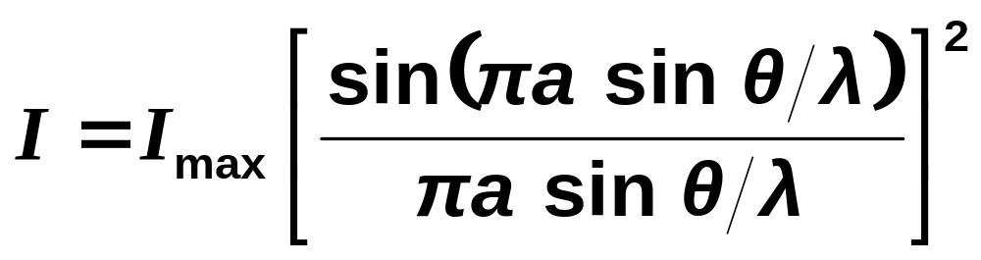
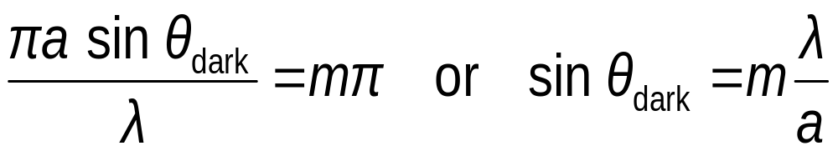
Intensity, equation
The intensity can be expressed as
Minima occur at

Slide 16
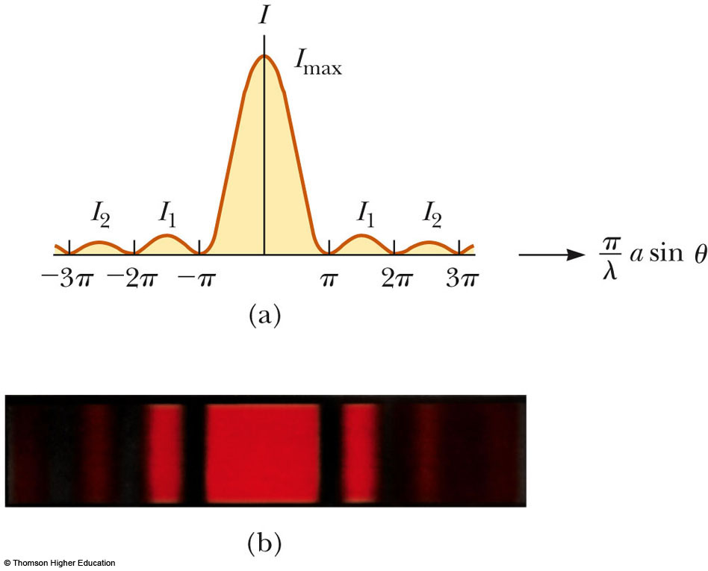
Intensity, final
Most of the light intensity is concentrated in the central maximum
The graph shows a plot of light intensity
vs. (π /λ) a sin θ

Slide 17
Intensity of Two-Slit
Diffraction Patterns
When more than one slit is present, consideration must be made of
  The diffraction patterns due to individual slits
  The interference due to the wave coming from different slits
The single-slit diffraction pattern will act as an “envelope” for a two-slit interference pattern

Slide 18
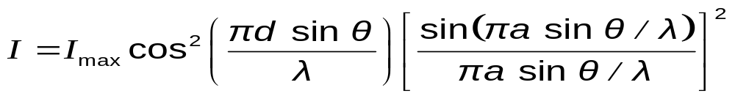
Intensity of Two-Slit Diffraction Patterns, Equation
To determine the maximum intensity:
  The factor in the square brackets represents the single-slit diffraction pattern
    This acts as the envelope
  The two-slit interference term is the cos² term

Slide 19
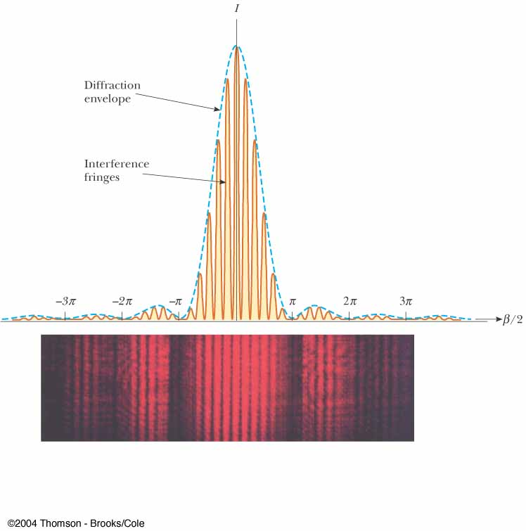
Intensity of Two-Slit Diffraction Patterns, Graph of Pattern
The broken blue line is the diffraction pattern
The brown curve shows the cos² term
  This term, by itself, would result in peaks with all the same heights
  The uneven heights result from the diffraction term (square brackets in the equation)

Slide 20
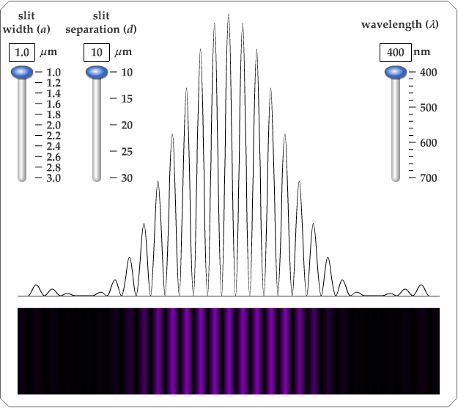
Active Figure 38.7
Use the active figure to adjust
  The slit width
  The slit separation
  The wavelength of the light
Observe the effect on the interference pattern
PLAY
ACTIVE FIGURE

Slide 21
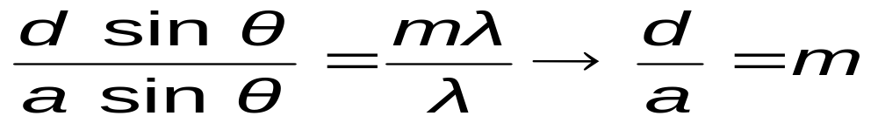
Two-Slit Diffraction Patterns, Maxima and Minima
To find which interference maximum coincides with the first diffraction minimum
  The conditions for the first interference maximum
    d sin θ = mλ
  The conditions for the first diffraction minimum
    a sin θ = λ

Slide 22
Resolution
The ability of optical systems to distinguish between closely spaced objects is limited because of the wave nature of light
If two sources are far enough apart to keep their central maxima from overlapping, their images can be distinguished
  The images are said to be resolved
If the two sources are close together, the two central maxima overlap and the images are not resolved

Slide 23
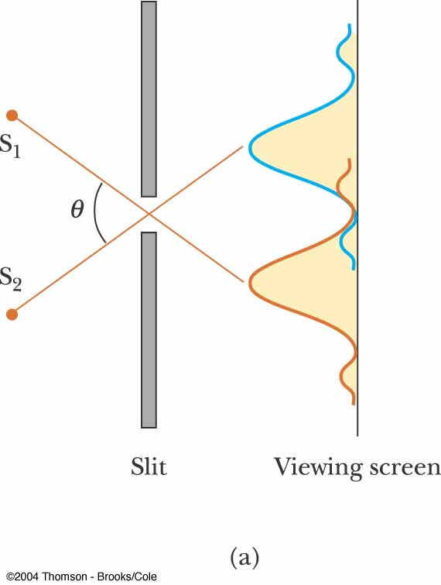
Resolved Images, Example
The images are far enough apart to keep their central maxima from overlapping
The angle subtended by the sources at the slit is large enough for the diffraction patterns to be distinguishable
The images are resolved

Slide 24
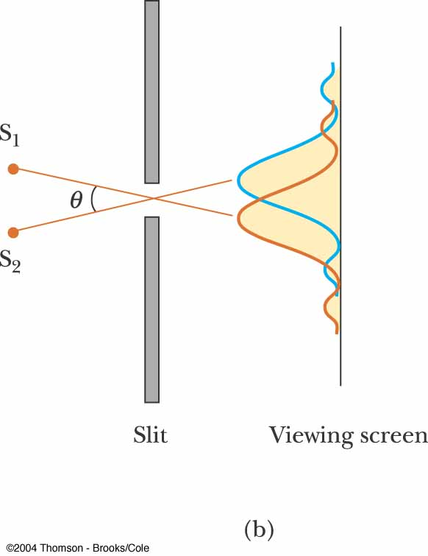
Images Not Resolved, Example
The sources are so close together that their central maxima do overlap
The angle subtended by the sources is so small that their diffraction patterns overlap
The images are not resolved

Slide 25
Resolution, Rayleigh’s Criterion
When the central maximum of one image falls on the first minimum of another image, the images are said to be just resolved
This limiting condition of resolution is called Rayleigh’s criterion

Slide 26

Resolution, Rayleigh’s Criterion, Equation
The angle of separation, θ_{min}, is the angle subtended by the sources for which the images are just resolved
Since λ << a in most situations, sin θ is very small and sin θ ≈ θ
Therefore, the limiting angle (in rad) of resolution for a slit of width a is
To be resolved, the angle subtended by the two sources must be greater than θ_{min}

Slide 27
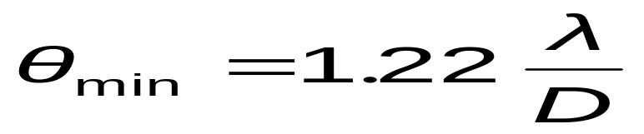
Circular Apertures
The diffraction pattern of a circular aperture consists of a central bright disk surrounded by progressively fainter bright and dark rings
The limiting angle of resolution of the circular aperture is
  D is the diameter of the aperture

Slide 28
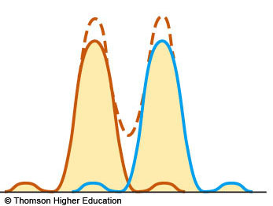
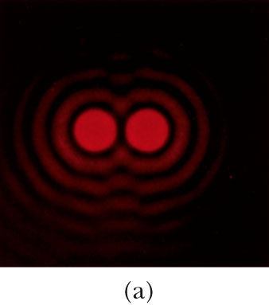
Circular Apertures, Well Resolved
The sources are far apart
The images are well resolved
The solid curves are the individual diffraction patterns
The dashed lines are the resultant pattern

Slide 29
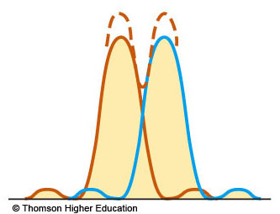
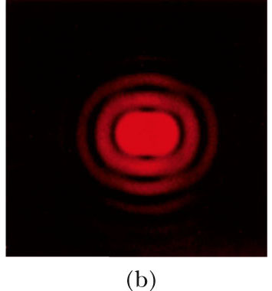
Circular Apertures, Just Resolved
The sources are separated by an angle that satisfies Rayleigh’s criterion
The images are just resolved
The solid curves are the individual diffraction patterns
The dashed lines are the resultant pattern

Slide 30
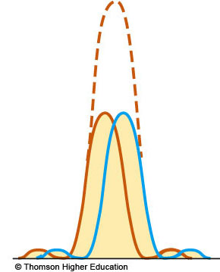
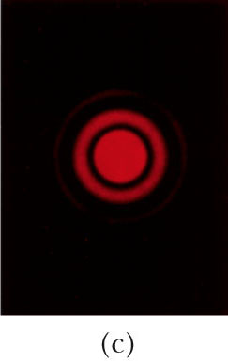
Circular Apertures, Not Resolved
The sources are close together
The images are unresolved
The solid curves are the individual diffraction patterns
The dashed lines are the resultant pattern

Slide 31
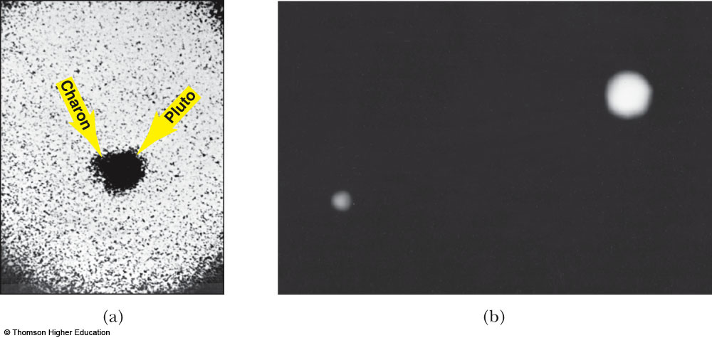
Resolution, Example
Pluto and its moon, Charon
Left: Earth-based telescope is blurred
Right: Hubble Space Telescope clearly resolves the two objects

Slide 32
Diffraction Grating
The diffracting grating consists of a large number of equally spaced parallel slits
  A typical grating contains several thousand lines per centimeter
The intensity of the pattern on the screen is the result of the combined effects of interference and diffraction
  Each slit produces diffraction, and the diffracted beams interfere with one another to form the final pattern

Slide 33
Diffraction Grating, Types
A transmission grating can be made by cutting parallel grooves on a glass plate
  The spaces between the grooves are transparent to the light and so act as separate slits
A reflection grating can be made by cutting parallel grooves on the surface of a reflective material
  The spaces between the grooves act as parallel sources of reflected light, like the slits in a transmission grating

Slide 34
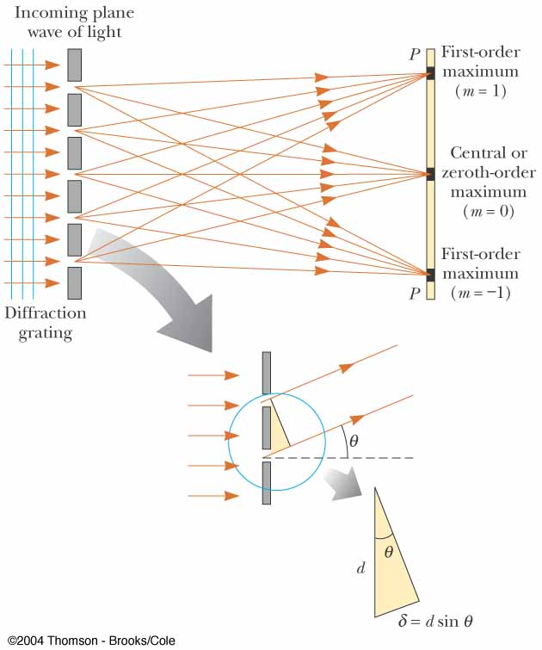
Diffraction Grating, cont.
The condition for maxima is
  d sin θ_{bright} = mλ
    m = 0, ±1, ±2, …
The integer m is the order number of the diffraction pattern
If the incident radiation contains several wavelengths, each wavelength deviates through a specific angle

Slide 35
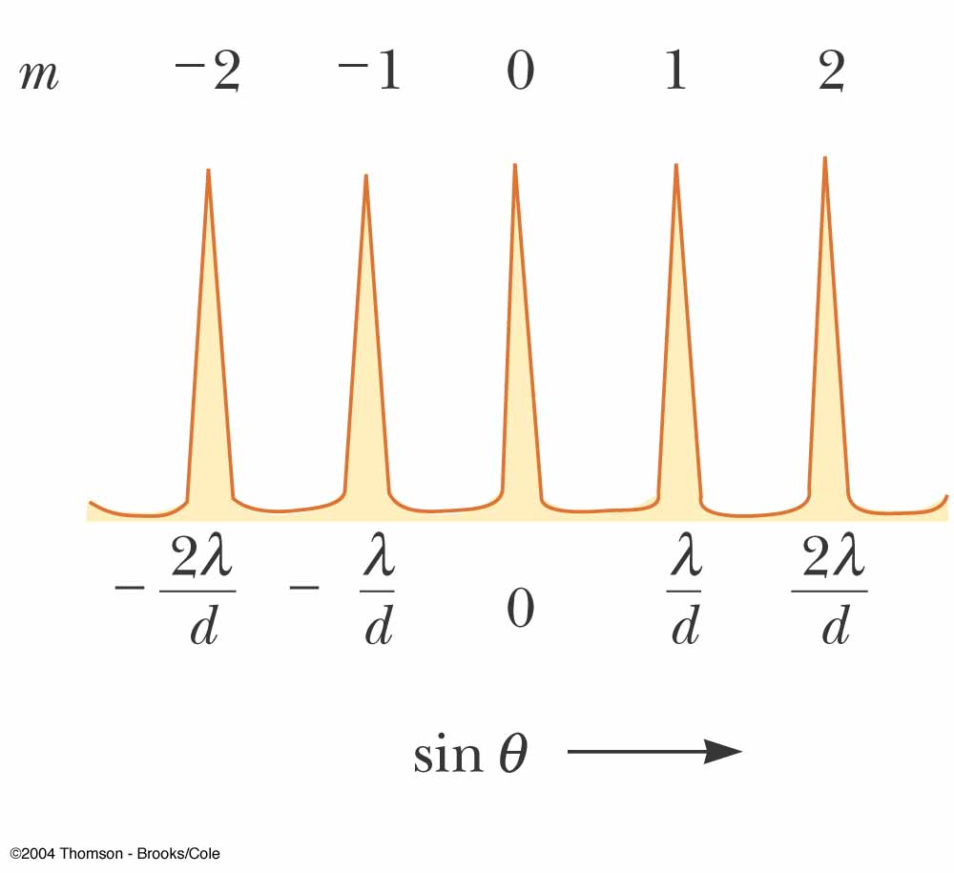
Diffraction Grating, Intensity
All the wavelengths are seen at m = 0
  This is called the zeroth-order maximum
The first-order maximum corresponds to m = 1
Note the sharpness of the principle maxima and the broad range of the dark areas

Slide 36
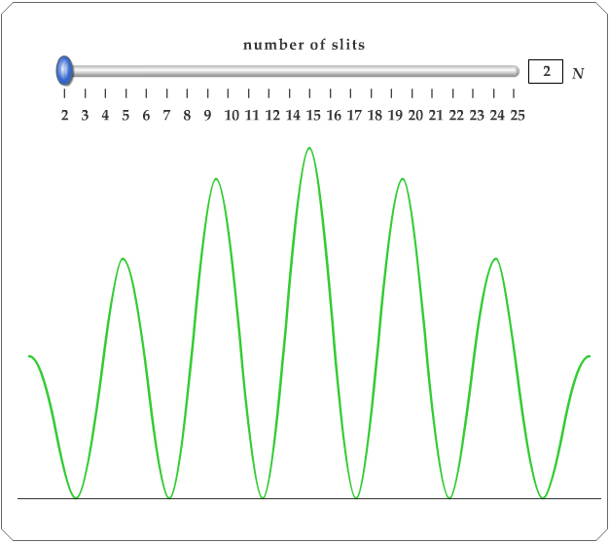
Active Figure 38.13
Use the active figure to choose the number of slits
See the effect on the interference pattern
PLAY
ACTIVE FIGURE

Slide 37
Diffraction Grating, Intensity, cont.
Characteristics of the intensity pattern
  The sharp peaks are in contrast to the broad, bright fringes characteristic of the two-slit interference pattern
  Because the principle maxima are so sharp, they are much brighter than two-slit interference patterns

Slide 38
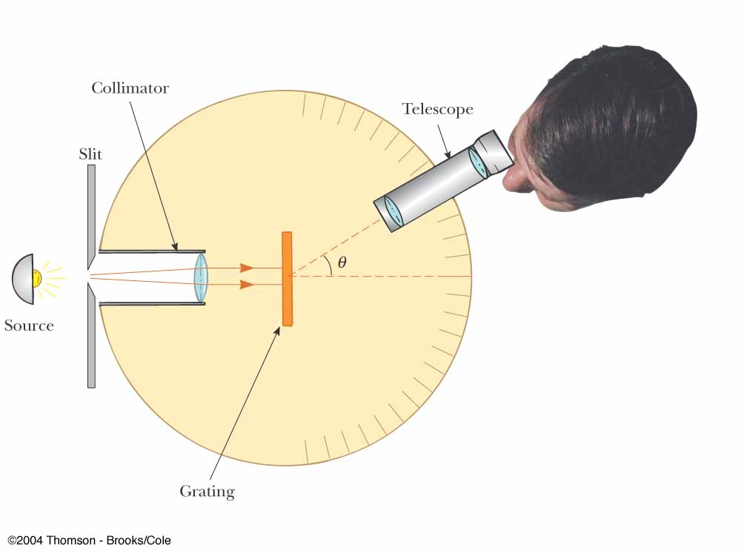
Diffraction Grating Spectrometer
The collimated beam is incident on the grating
The diffracted light leaves the gratings and the telescope is used to view the image
The wavelength can be determined by measuring the precise angles at which the images of the slit appear for the various orders

Slide 39
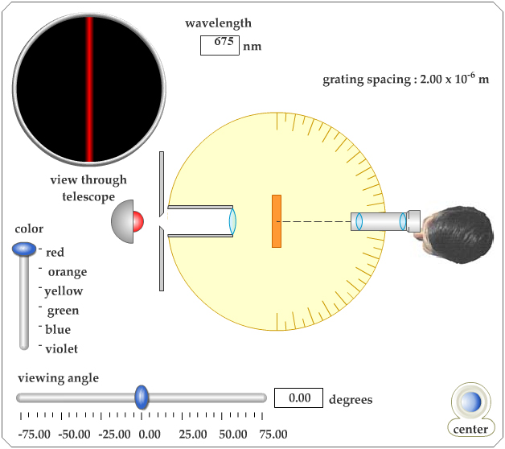
Active Figure 38.15
Use the active figure to operate the spectrometer
Observe constructive interference for various wavelengths
PLAY
ACTIVE FIGURE

Slide 40
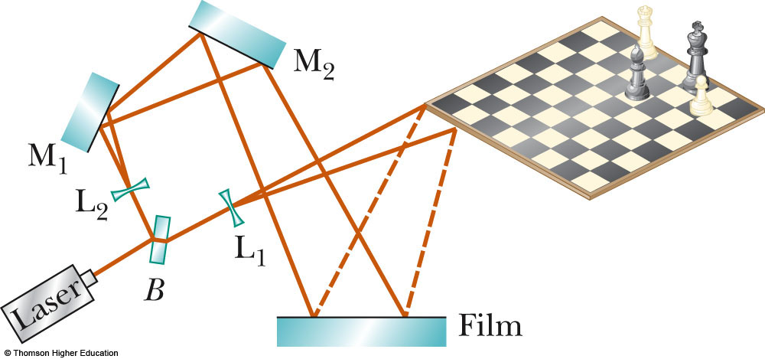
Holography
Holography is the production of three-dimensional images of objects
Light from a laser is split into two parts by a half-silvered mirror at B
One part of the light reflects off the object and strikes the film

Slide 41
Holography, cont
The other half of the beam is diverged by lens L₂
It then reflects to mirrors M₁ and M₂ and then strikes the film
The two beams overlap to form a complex interference pattern on the film
The holograph records the intensity of the light reflected by the object as well as the phase difference between the reference bean and the beam scattered from the object

Slide 42
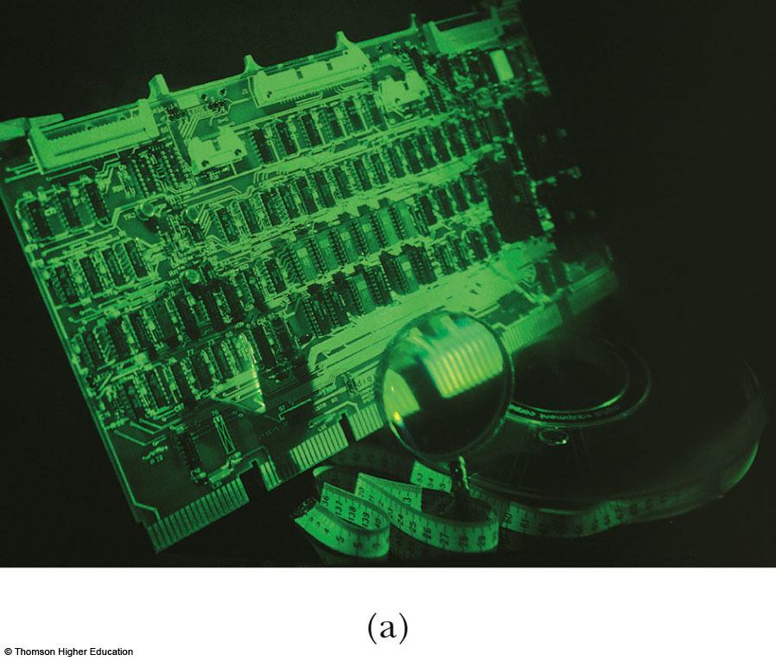
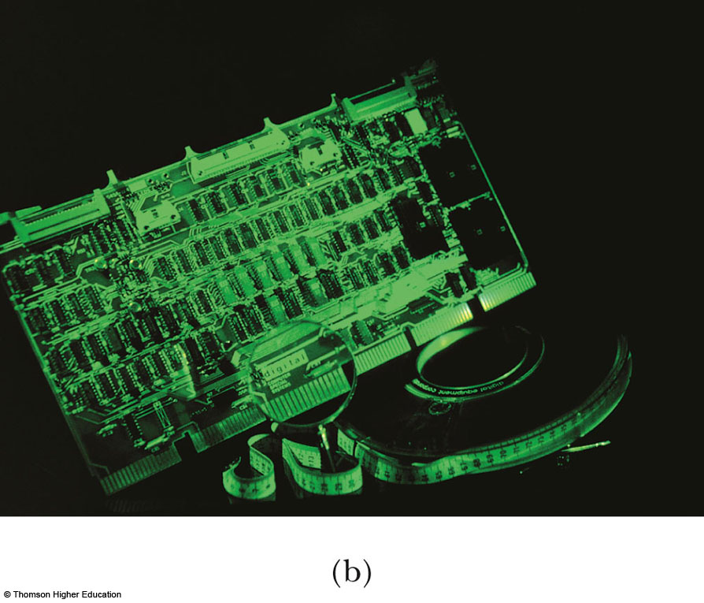
Holography, Example

Slide 43
Diffraction of X-Rays by Crystals
X-rays are electromagnetic waves of very short wavelength
Max von Laue suggested that the regular array of atoms in a crystal could act as a three-dimensional diffraction grating for x-rays

Slide 44
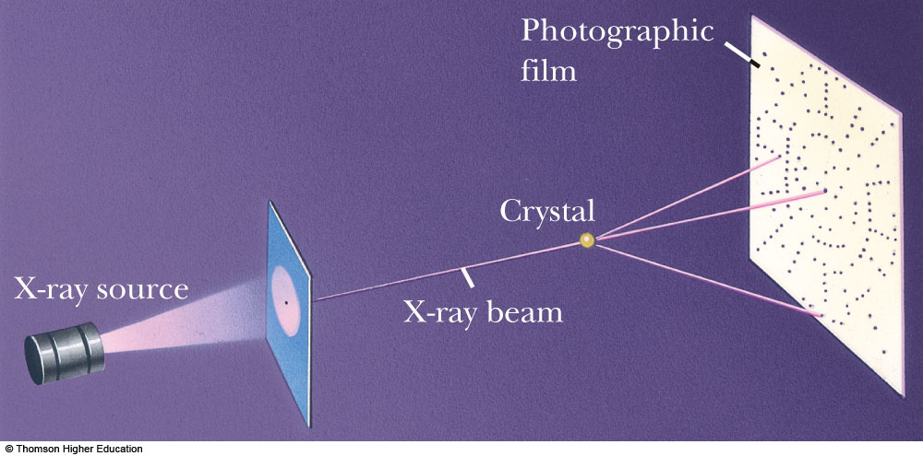
Diffraction of X-Rays by Crystals, Set-Up
A collimated beam of monochromatic x-rays is incident on a crystal
The diffracted beams are very intense in certain directions
  This corresponds to constructive interference from waves reflected from layers of atoms in the crystal
The diffracted beams form an array of spots known as a Laue pattern

Slide 45
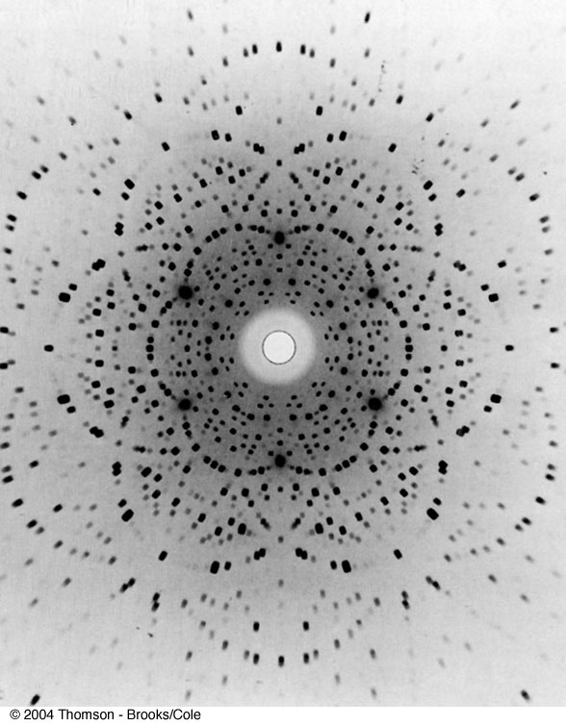
Laue Pattern for Beryl

Slide 46
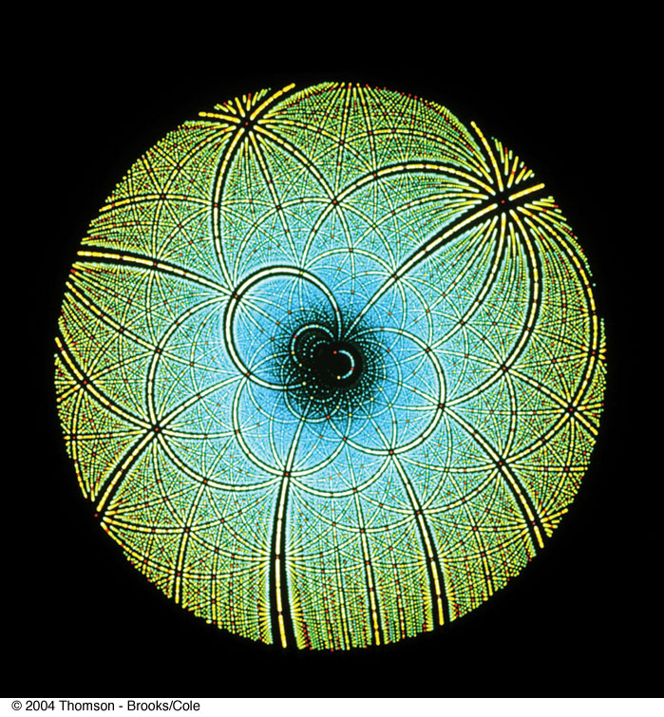
Laue Pattern for Rubisco

Slide 47
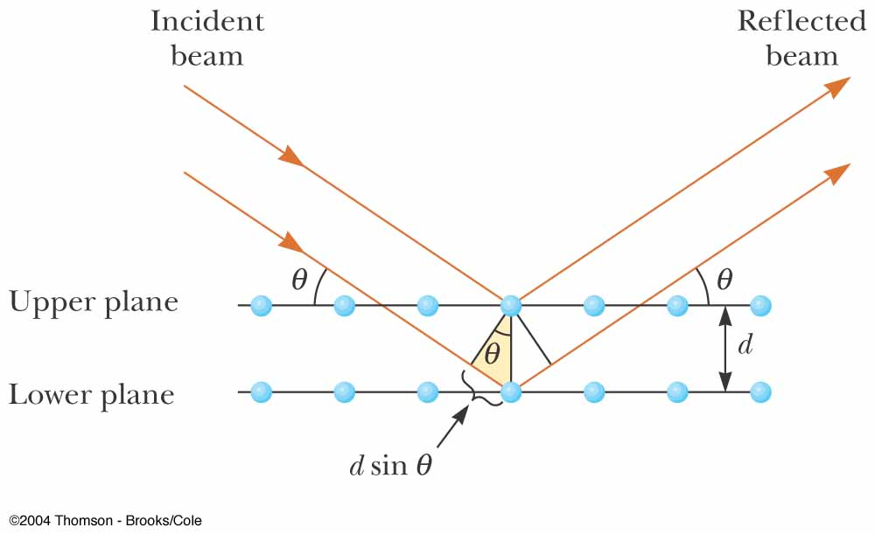
X-Ray Diffraction, Equations
This is a two-dimensional description of the reflection of the x-ray beams
The condition for constructive interference is
2d sin θ = mλ
where m = 1, 2, 3
This condition is known as Bragg’s law
This can also be used to calculate the spacing between atomic planes

Slide 48
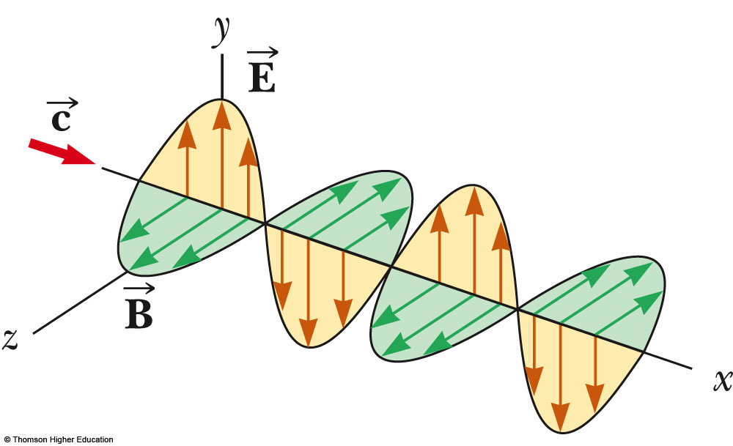
Polarization of Light Waves
The direction of polarization of each individual wave is defined to be the direction in which the electric field is vibrating
In this example, the direction of polarization is along the y-axis

Slide 49
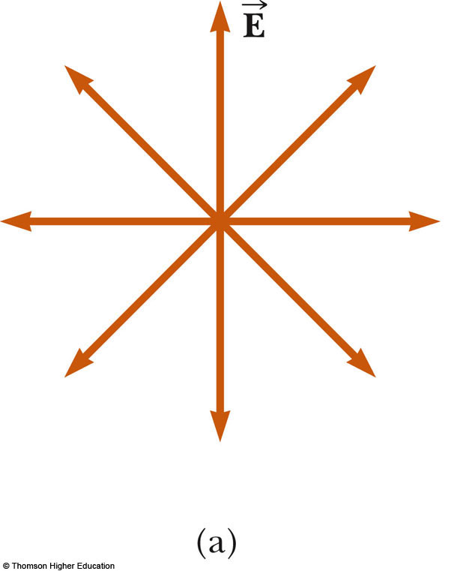
Unpolarized Light, Example
All directions of vibration from a wave source are possible
The resultant em wave is a superposition of waves vibrating in many different directions
This is an unpolarized wave
The arrows show a few possible directions of the waves in the beam

Slide 50
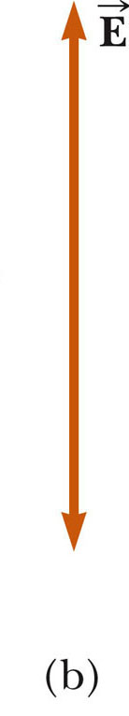
Polarization of Light, cont.
A wave is said to be linearly polarized if the resultant electric field vibrates in the same direction at all times at a particular point
The plane formed by E and the direction of propagation is called the plane of polarization of the wave

Slide 51
Methods of Polarization
It is possible to obtain a linearly polarized beam from an unpolarized beam by removing all waves from the beam except those whose electric field vectors oscillate in a single plane
Processes for accomplishing this include
  Selective absorption
  Reflection
  Double refraction
  Scattering

Slide 52
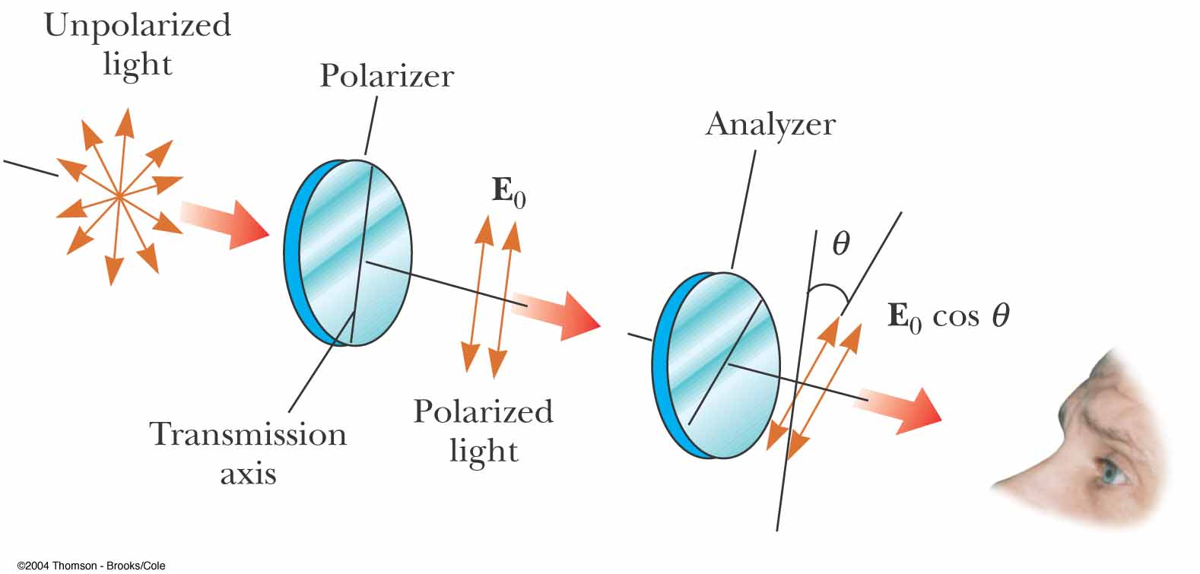
Polarization by Selective Absorption
The most common technique for polarizing light
Uses a material that transmits waves whose electric field vectors lie in the plane parallel to a certain direction and absorbs waves whose electric field vectors are in all other directions

Slide 53
Selective Absorption, cont.
E. H. Land discovered a material that polarizes light through selective absorption
  He called the material Polaroid
  The molecules readily absorb light whose electric field vector is parallel to their lengths and allow light through whose electric field vector is perpendicular to their lengths

Slide 54
Selective Absorption, final
It is common to refer to the direction perpendicular to the molecular chains as the transmission axis
In an ideal polarizer,
  All light with the electric field parallel to the transmission axis is transmitted
  All light with the electric field perpendicular to the transmission axis is absorbed

Slide 55
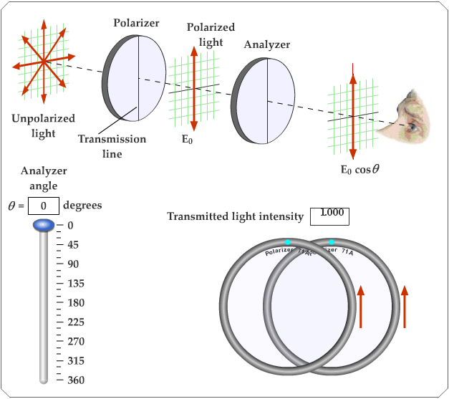
Active Figure 38.26
Use the active figure to rotate the analyzer
Observe the effect on the transmitted light
PLAY
ACTIVE FIGURE

Slide 56
Intensity of a Polarized Beam
The intensity of the polarized beam transmitted through the second polarizing sheet (the analyzer) varies as
  I = I_{max} cos² θ
    I_{max} is the intensity of the polarized wave incident on the analyzer
    This is known as Malus’ law and applies to any two polarizing materials whose transmission axes are at an angle of θ to each other

Slide 57
Intensity of a Polarized Beam, cont.
The intensity of the transmitted beam is a maximum when the transmission axes are parallel
  θ = 0 or 180º
The intensity is zero when the transmission axes are perpendicular to each other
  This would cause complete absorption

Slide 58
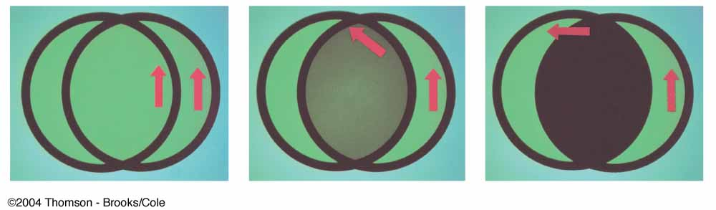
Intensity of Polarized Light, Examples
On the left, the transmission axes are aligned and maximum intensity occurs
In the middle, the axes are at 45º to each other and less intensity occurs
On the right, the transmission axes are perpendicular and the light intensity is a minimum

Slide 59
Polarization by Reflection
When an unpolarized light beam is reflected from a surface, the reflected light may be
  Completely polarized
  Partially polarized
  Unpolarized
It depends on the angle of incidence
  If the angle is 0°, the reflected beam is unpolarized
  For other angles, there is some degree of polarization
  For one particular angle, the beam is completely polarized

Slide 60
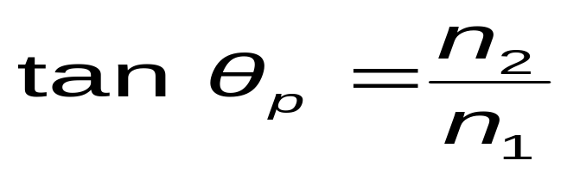
Polarization by Reflection, cont.
The angle of incidence for which the reflected beam is completely polarized is called the polarizing angle, θ_{p}
Brewster’s law relates the polarizing angle to the index of refraction for the material
θ_{p} may also be called Brewster’s angle

Slide 61
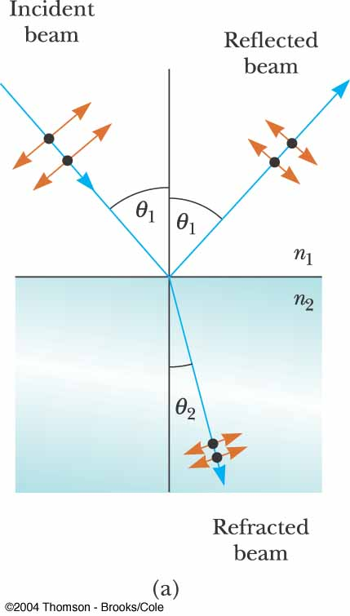
Polarization by Reflection, Partially Polarized Example
Unpolarized light is incident on a reflecting surface
The reflected beam is partially polarized
The refracted beam is partially polarized

Slide 62
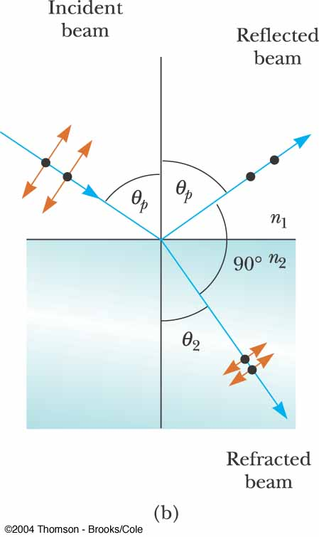
Polarization by Reflection, Completely Polarized Example
Unpolarized light is incident on a reflecting surface
The reflected beam is completely polarized
The refracted beam is perpendicular to the reflected beam
The angle of incidence is Brewster’s angle

Slide 63
Polarization by Double Refraction
In certain crystalline structures, the speed of light is not the same in all directions
Such materials are characterized by two indices of refraction
They are often called double-refracting or birefringent materials

Slide 64
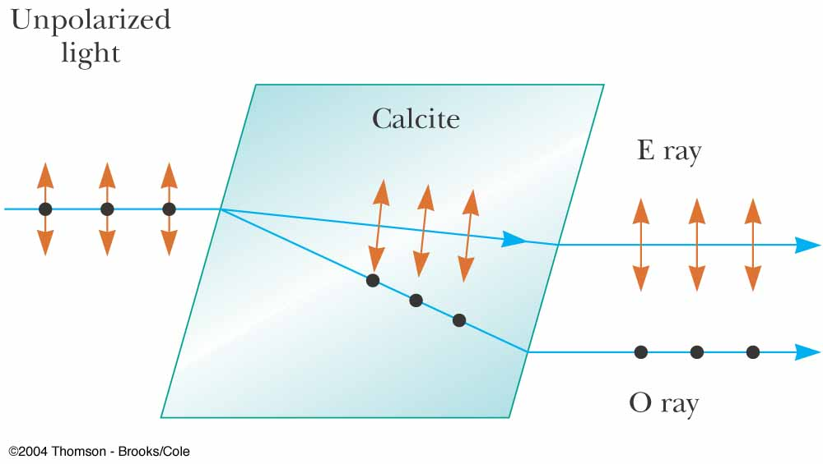
Polarization by Double Refraction, cont.
Unpolarized light splits into two plane-polarized rays
The two rays are in mutual perpendicular directions
  Indicated by the dots and arrows

Slide 65
Polarization by Double Refraction, Rays
The ordinary (O) ray is characterized by an index of refraction of n_{o}
  This is the same in all directions
The second ray is the extraordinary (E) ray which travels at different speeds in different directions
  Characterized by an index of refraction of n_{E} that varies with the direction of propagation

Slide 66
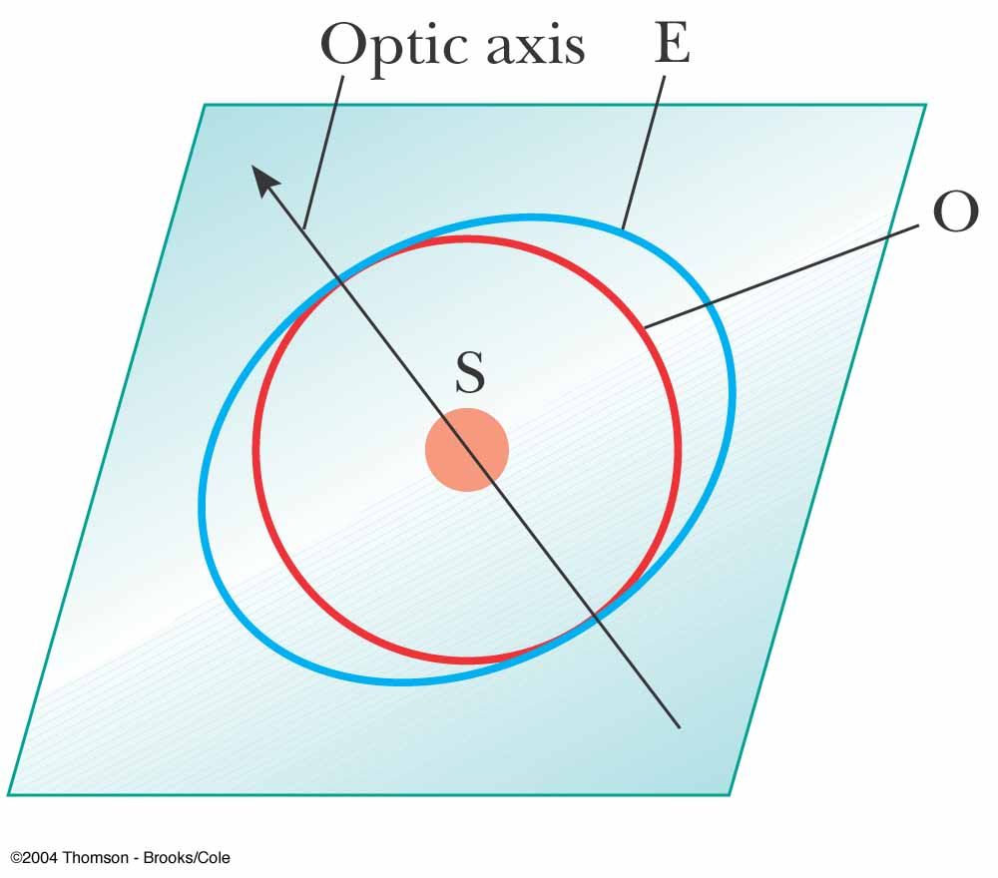
Polarization by Double Refraction, Optic Axis
There is one direction, called the optic axis, along which the ordinary and extraordinary rays have the same speed
  n_{O} = n_{E}
The difference in speeds for the two rays is a maximum in the direction perpendicular to the optic axis

Slide 67
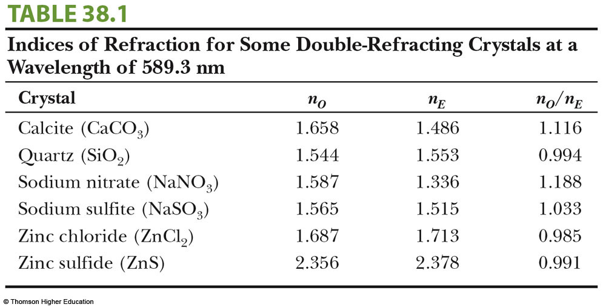
Some Indices of Refraction

Slide 68
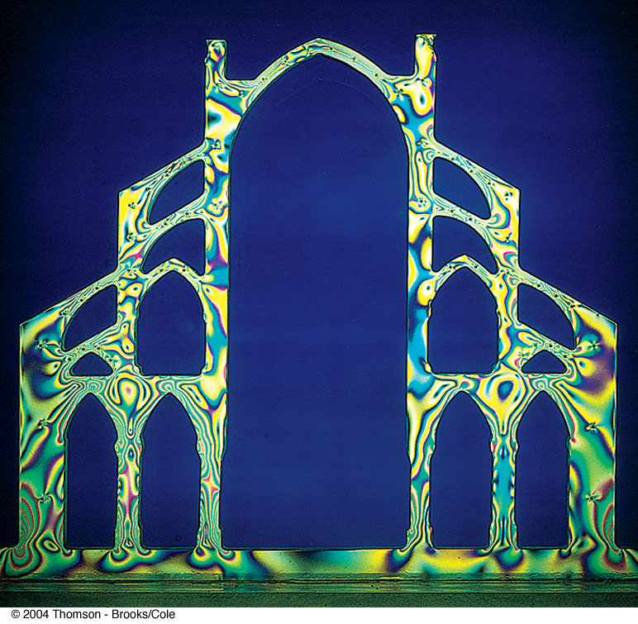
Optical Stress Analysis
Some materials become birefringent when stressed
When a material is stressed, a series of light and dark bands is observed
  The light bands correspond to areas of greatest stress
Optical stress analysis uses plastic models to test for regions of potential weaknesses

Slide 69
Polarization by Scattering
When light is incident on any material, the electrons in the material can absorb and reradiate part of the light
  This process is called scattering
An example of scattering is the sunlight reaching an observer on the Earth being partially polarized

Slide 70
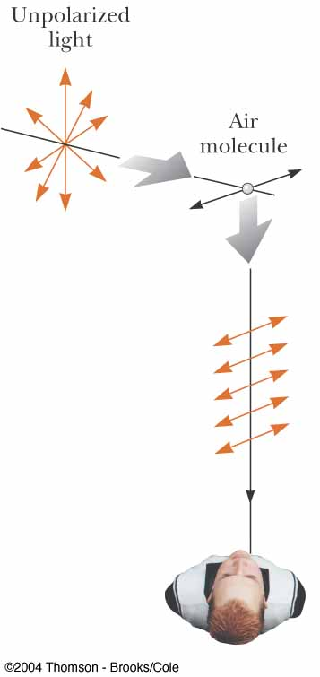
Polarization by Scattering, cont.
The horizontal part of the electric field vector in the incident wave causes the charges to vibrate horizontally
The vertical part of the vector simultaneously causes them to vibrate vertically
If the observer looks straight up, he sees light that is completely polarized in the horizontal direction

Slide 71
Scattering, cont.
Short wavelengths (violet) are scattered more efficiently than long wavelengths (red)
When sunlight is scattered by gas molecules in the air, the violet is scattered more intensely than the red
When you look up, you see blue
  Your eyes are more sensitive to blue, so you see blue instead of violet
At sunrise or sunset, much of the blue is scattered away, leaving the light at the red end of the spectrum

Slide 72
Optical Activity
Certain materials display the property of optical activity
  A material is said to be optically active if it rotates the plane of polarization of any light transmitted through it
  Molecular asymmetry determines whether a material is optically active

