Slide 1
PHYS 2321: Physics 2
Week 1 on Charge and Electric Fields
Day 1 outline
1) Safe seating – only touch towlets
2) Attendance – Ever been shocked, electrocuted, or otherwise
inconvenienced by electromagnetic phenomena?
3) Discuss syllabus
4) Begin Ch. 23 “Electric Fields”
a) charge
b) electrostatic forces
5) Homework for Friday:
a) read Ch. 23 Sec. 1-4
b) Ch. 23 Probs. 2-5,7,8,10,14
c) try practice quizzes and PhET simulation
This powerpoint will appear on class web page.

Slide 2
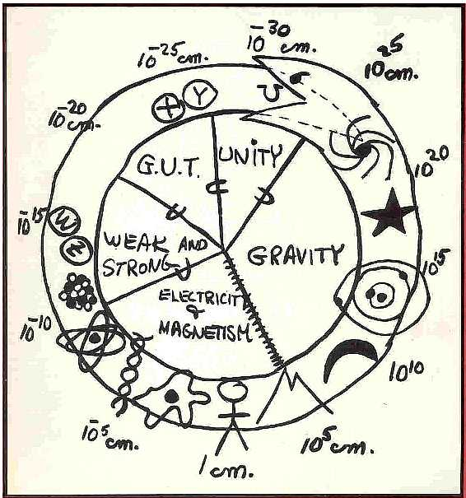
Fundamental Forces
Gravity
  force of gravity
Electromagnetic
Weak Nuclear
Strong Nuclear
all act at a distance
Contact forces
  Examples:
    objects in contact
      push/pull
    air resistance
    friction
  Electromagnetic
    electrons repelling

Slide 3
CHARGE !!!
What is charge?
A property of sub-atomic particles
That which flows in an electric current
An imbalance of the + and – particles in an object
That which causes “static cling”

Slide 4
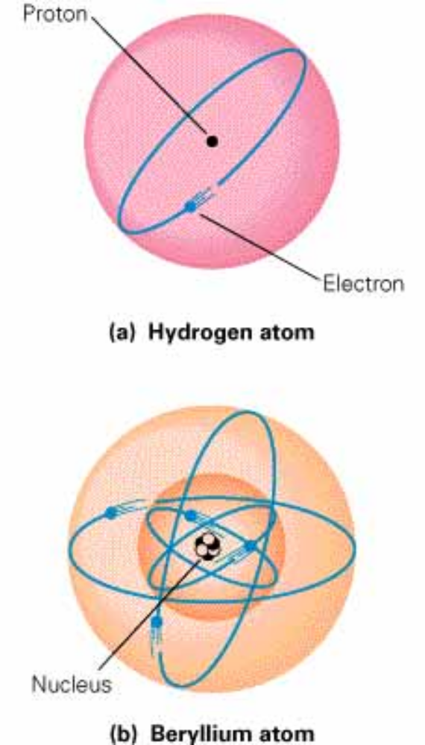
Simplified (Planetary) Model of the Atom
Planetary “Solar system” Model
  Neils Bohr (1885-1962)
  Not really correct, BUT its simple.
    All we need for now
Particles of matter
  Building blocks of atoms
    electrons, protons, neutrons
  properties
    Mass
      Gravitational forces
      O nly attractive
    electric charge
      Electromagnetic forces
      attractive or repulsive
        need two types of charge

Slide 5
1) A property of sub-atomic particles
Planetary (orbital) Model
  Neils Bohr (1885-1962)
  Not really correct, but simple
Atoms composed of:
  Protons m_{p}=1.673x10⁻²⁷ kg
  Neutrons m_{n}=1.675x10⁻²⁷ kg
  Electrons m_{e}=9.109x10⁻³¹ kg
Properties of sub-atomic particles:
  Mass
  Charge
  spin

Slide 6
1) A property of sub-atomic particles
Protons
  q_{p} = +1.602 × 10⁻¹⁹ C (C = Coulomb for SI units)
q_{p} = +e (e = 1.602 × 10⁻¹⁹ C, elementary charge )
Electrons
  q_{e} = -1.602 × 10⁻¹⁹ C
q_{e} = – e
Neutrons
q_{n} = 0 C neutral
Charge is Quantized
  Any object may have a net charge of q = ±ne
    or q = (n_{p} – n_{e})e
  Quarks can actually have charges of q=+2e/3 and -e/3)

Slide 7
CHARGE !!!
What is charge?
A property of sub-atomic particles
That which flows in an electric current
I = current = flow rate of charge carriers past a 2D boundary
[I] = coulombs/sec = C/s
1 C/s = 1 Ampere
* 1 Amp is a deadly amount of current (>0.1 A)
* 1 Coulomb is an even deadlier amount of charge
Ex) 2 objects with 1 C of excess charge separated by 1 m
Exerts 9x10⁹ N on each other !! (note: 4.45 N/lb)

Slide 8
CHARGE !!!
What is charge?
A property of sub-atomic particles
That which flows in an electric current
An imbalance of the + and – particles in an object
a) We say an object is “charged” when there are more + particles than – particles, or more – particles than + particles.
Ex) What is the charge on a sphere containing Np=10²⁰ protons
and Ne=1.1x10²⁰ electrons?
Ans: since Ne > Np, q = (Ne-Np) (-e)
q = (1.1-1.0)x10²⁰ X (-1.6x10⁻¹⁹ C)
q = -1.6 C
b) Large imbalances are rare because oppositely charged particles attract.
Ex) How many electrons are contained in 1 cm³ of neutral copper?
Ans: about a mole, ~ 10²³! (Each Cu atom has 29 e- )

Slide 9
Conservation of Charge
3) An imbalance of the + and – particles in an object
The net charge of an isolated system remains constant.
  Rubbing two objects together does not create new charge, it separates + from -
  Material with higher “electronegativity” obtains more e-
  Pair-production: when a high energy photon (gamma-ray) becomes two, oppositely charged particles.
    Ex) γ→ e⁻ + e+
  Annhilation: when a particle meets its antiparticle and they become a high-energy photon
    Ex) e⁻ + e+ → γ

Slide 10
CHARGE !!!
What is charge?
A property of sub-atomic particles
That which flows in an electric current
An imbalance of the + and – particles in an object
That which causes “static cling”
Static electric force is called the “Coulomb force” in physics.
Large scale objects (like pants) are normally neutral.
They become charged by:
a) rubbing against a different material
b) pealing apart two objects stuck together
c) disassociation of molecules
d) photoelectric effect (can make metals +)
e) bombardment by charged particles (α or β beams)

Slide 11
PHYS 2321: Physics 2
Week 1 on Charge and Electric Fields
Day 2 outline
1) Safe seating – only touch towlets
2) Attendance – Pictures
3) Homework for Friday:
a) read Ch. 23 Sec. 1-4
b) Ch. 23 Probs. 2-5,7,8,10,14 (due Fri 11:59pm, G.Drive)
c) try practice quizzes and PhET simulation
4) Today: Charge and Coulomb’s Law
a) demos showing charge separation and static electric forces
b) Coulomb’s Law
This powerpoint will appear on class web page.

Slide 12
CHARGE Demos
Recall that:
1. An object is “charged” when there is an imbalance of + and -
particles.
2. We can tell that something is charged by the electrostatic
force is exerts (“static cling”).
We can also tell that something was charged when a spark
is seen or heard.

Slide 13
CHARGE Demos
Balloons
1. Touch red and blue balloons against wall. What happens?
2. Bring red balloon close to blue balloon. Anything?
3. Rub two balloons together, then hold close to wall. Anything?
4. Rub red balloon against hair, then touch against wall.
What happens?
5. Bring blue balloon close to red balloon. Anything?
6. Touch blue balloon against red. Will blue now stick to wall?
No force.
No force.
No force.
Attraction! (To both hair and wall).
Weak attraction.
Not much force.

Slide 14
CHARGE Demos
Balloons (cont.)
7. Rub blue balloon against hair. Hold red close to blue. Anything?
Conclusions?
* Sticking to wall is not due to “stickiness” of balloons but because
they are getting charged by rubbing.
* Two balloons prepared in the same way (rubbed against hair) will
repel each other. → Like charges repel.
* The wall was never rubbed, but it was attracted to a charged balloon.
Repulsion!
This requires more thought ...

Slide 15
CHARGE Demos
Balloons + tape
8. A piece of Scotch tape pulled off of the back of another piece
of Scotch tape gets charged. What happens when tape is held
close to a (neutral) hand?
9. What happens when held close to a negative balloon?
10. What is likely the sign of the tape’s charge?
Conclusions:
* “Unsticking” two objects can lead to charging.
* Tape was attracted to negative balloon. –> opposites attract.
Attraction!
Attraction!
Positive. (there’s another possibility involving induction...)

Slide 16
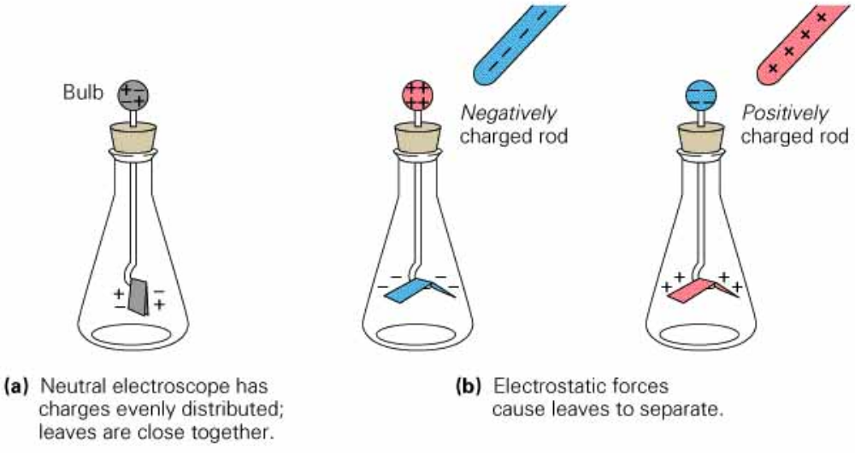
Electroscope – used to study electric charge
A neutral electroscope can determine if an object is charged
A charged object induces a charge separation – an INDUCED charge separation (zero net charge)
Metal ball, rod,
and leaves are
all electrically
connected and
charge is free to
move.
opposites
attract

Slide 17
CHARGE Demos
Balloon + electroscope.
11. Hold charged balloon close to electrode of electroscope. Anything?
12. Suppose we define the balloon’s charge to be negative, what is the charge on the petals?
Other objects + electroscope
13. Rub a plastic rod with wool/felt cloth. Is it charged?
14. Rub glass rod with silk. Charged?
15. Rub metal bar with cloth. (Need to hold bar with insulator!)
Petals rise.
Negative, because like charges repel.
Probably raises petals. Should be negative.
Should be positive.
Hard to observe charging. Can metal be charged?

Slide 18
CHARGE Demos
Balloon + aluminum bob.
16. Hold negative balloon next to untouched (neutral) bob. What happens?
17. Rub negative balloon against aluminum bob. What happens?
18. Bring a neutral object (finger?) close to the bob. What happens?
19. Hold the bob in bare hand. Any change?
Conclusions:
*Metal can be charged by direct contact.
*Metal can be easily discharged by contact with something that
is grounded.
Bob attracts towards balloon.
If enough charge transfers, the bob will now repel!
Attraction. Alum bob must be charged!
No attraction. Bob no longer charged.

Slide 19
CHARGE Demos
Balloon + electroscope.
20. Move charged balloon close and far from electroscope. Notice a change in the petals?
Conclusion:
*Electric forces/fields weaken with distance.
Now, back to the question of why a charged object attracts to a neutral one …
Usually, petals will rise as balloon nears.

Slide 20
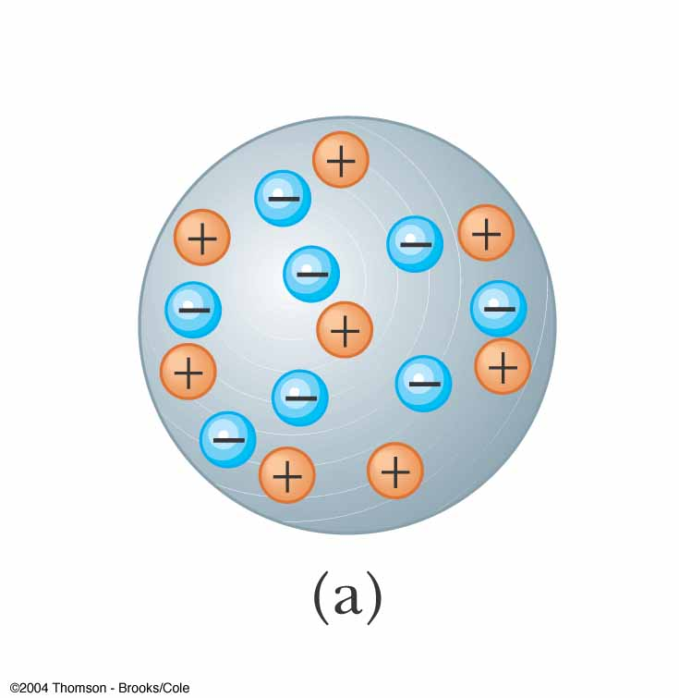
Charging by Induction
Charging by induction requires no contact with the object inducing the charge
Assume we start with a neutral metallic sphere
  The sphere has the same number of positive and negative charges

Slide 21
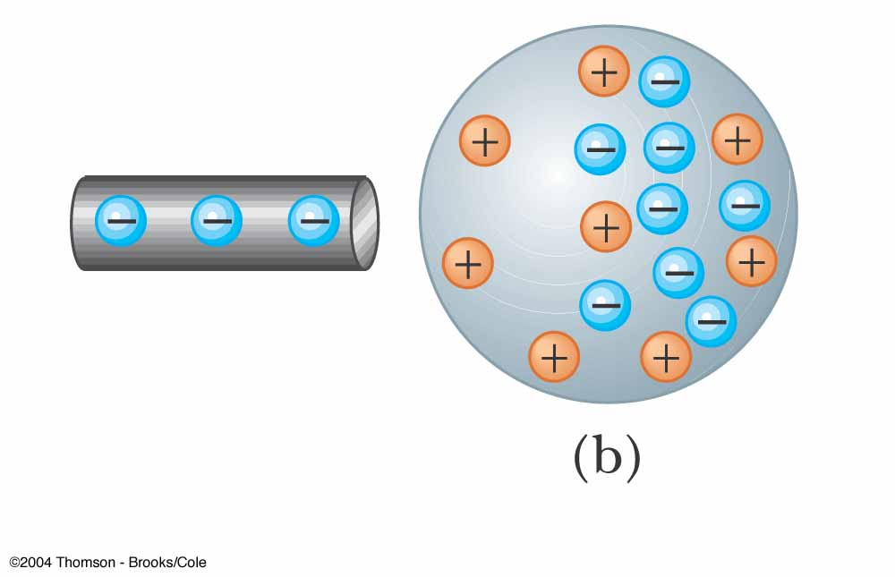
Charging by Induction, 2
A charged rubber rod is placed near the sphere
  It does not touch the sphere
The electrons in the neutral sphere are redistributed

Slide 22
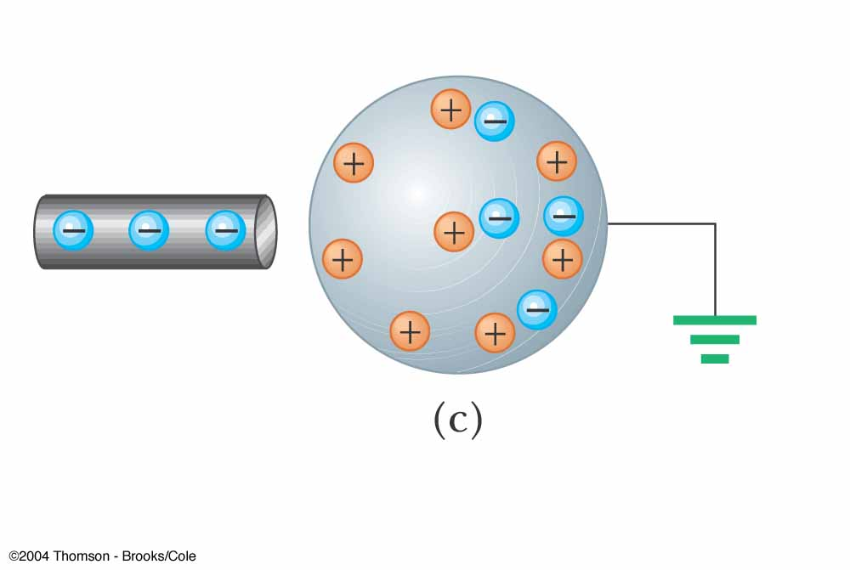
Charging by Induction, 3
The sphere is grounded
Some electrons can leave the sphere through the ground wire

Slide 23
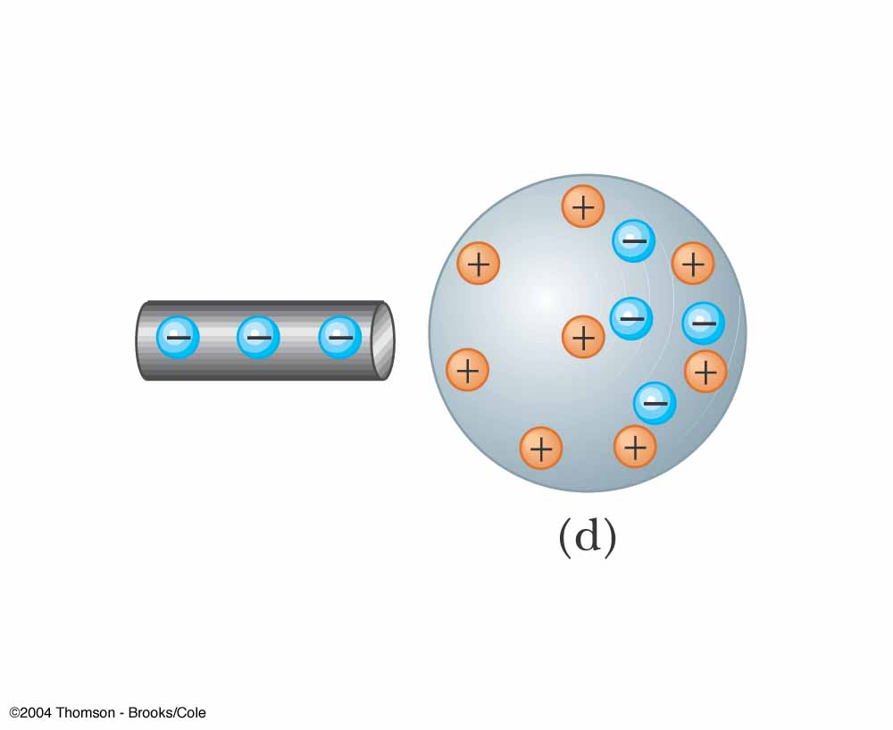
Charging by Induction, 4
The ground wire is removed
There will now be more positive charges
The charges are not uniformly distributed
The positive charge has been induced in the sphere
A charged insulator brought in contact with a conductor can stick to it and not loose its excess charge.
A charged conductor will not stick to another conductor for long because excess charge flows!

Slide 24
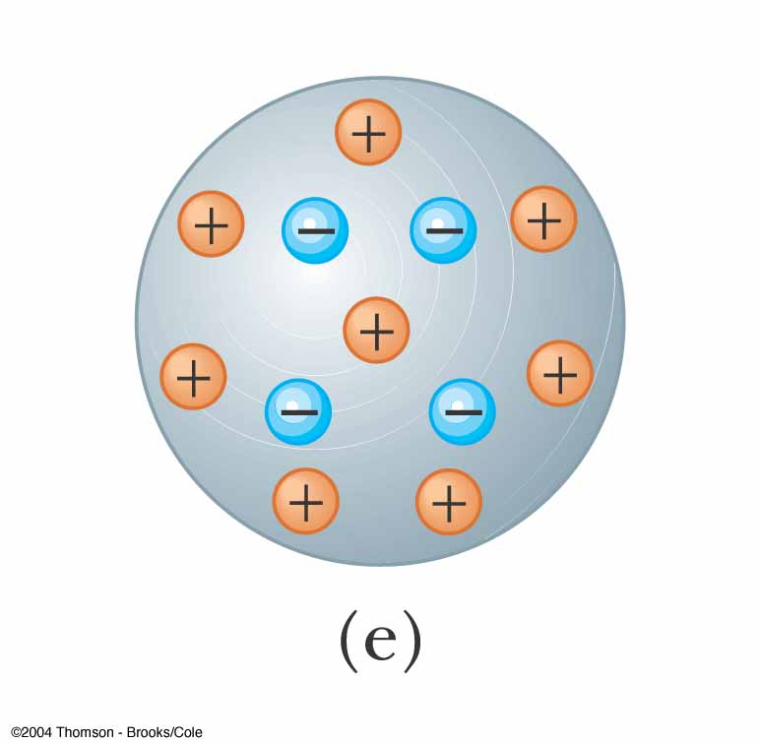
Charging by Induction, 5
The rod is removed
The electrons remaining on the sphere redistribute themselves
There is still a net positive charge on the sphere
The charge is now uniformly distributed

Slide 25
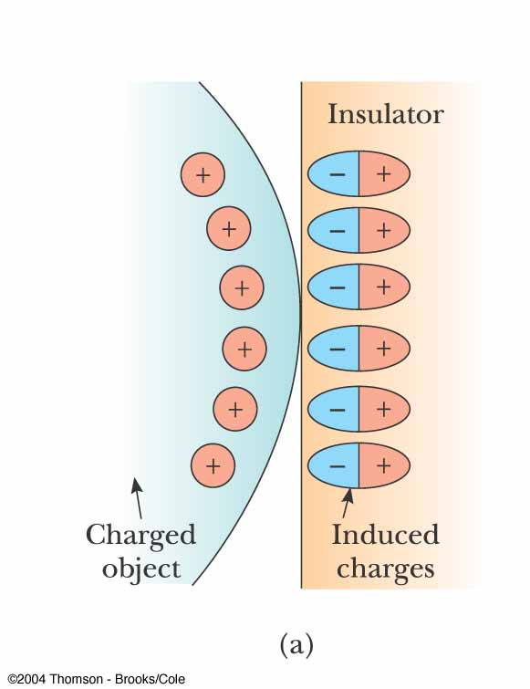
Charge Rearrangement in Insulators
A similar electrostatic induction can take place in insulators
The charges within the molecules of the material are rearranged
The molecules of the insulator become polarized

Slide 26
CHARGE Demos
Wimshurst machine – separates charge via induction.
21. If starting “cold”, operator should hold a charged object (plastic wand) opposite a “neutralizer bar”. Why?
22. What happens after prolonged cranking?
23. Connect one collection brush to the electroscope. What happens?
24. Connect a collection brush to the “spinner”.
25. Put the aluminum bob between the electrodes and crank.
This charges sectors on the opposite side via induction.
Sparks occur between electrodes. This indicates very strong electric fields that break down the insulative property of air and allow it to briefly conduct.
Petals rise until spark makes them drop→ spark transfers charge
It spins!
The bob alternates the sign of its charge on each contact.
How wimshurst machine works: https://www.youtube.com/watch?v=nA4aCd5qFWs

Slide 27
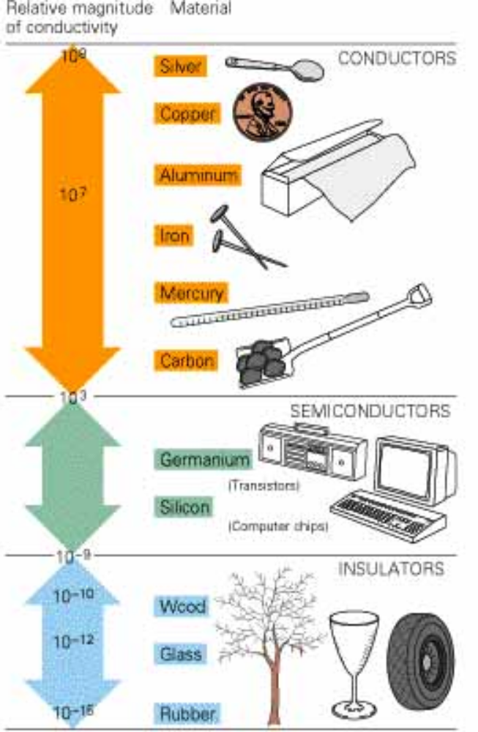
Electrical Conduction
Electrical conductivity is a property of a material
  Ability to transmit electrical charge
  Depends on bond strength of outer electrons
    loosely or tightly bound
Conductors
  Metals (electrons very mobile)
    valance electrons easily move
  Water conducts b/c of impurities (ions)
Semi-conductors
Insulators (poor conductors)
  Plastics, pure water, rubber

Slide 28
Ground
Something you stand on…
A very large conductor where like charges (that repel) can separate over large distances and be happy
  large conductor – you do not give it a significant amount of charge
  Earth is considered GROUND
  When a charged object is grounded, it becomes neutral “instantly”
    Ex: electric discharge on a door knob
      The door knob is “ground”
Humidity
  Causes objects to discharge gradually, without a spark.
  Makes it hard to separate charge by rubbing.

Slide 29
Charging
Something you do with your credit card
Methods to build up charge
FRICTION
  Mechanical Energy is converted into thermal energy (aka heat)
  This increases the temperature and motion of the atoms, making the electrons loosely bound
  Different materials have different electronegativities, so an electron temporarily goes to the material with a higher electronegativity.
  Electronegativity is related to electron conductivity
    Higher electronegativity –> poorer conductor
  Charges temporarily stay separated and can build up

Slide 30
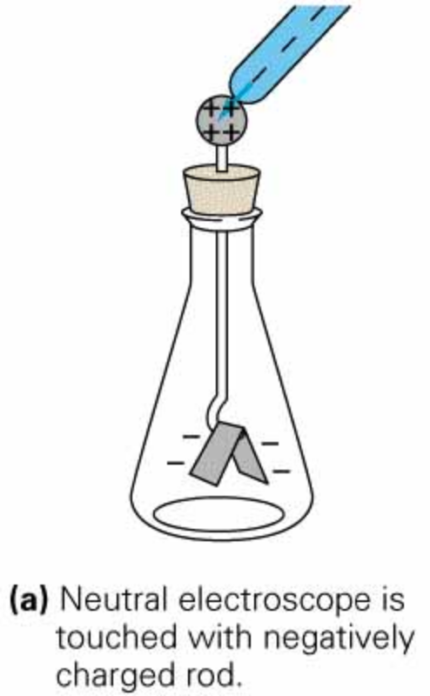
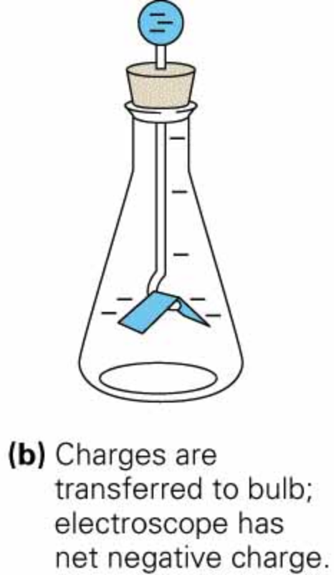
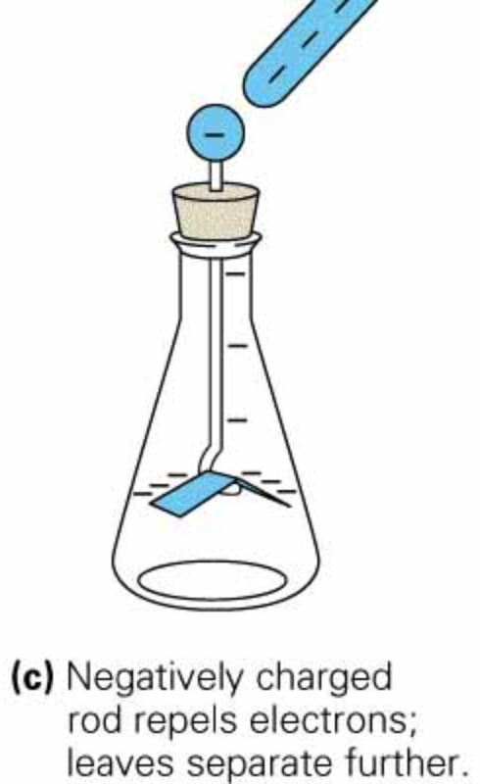
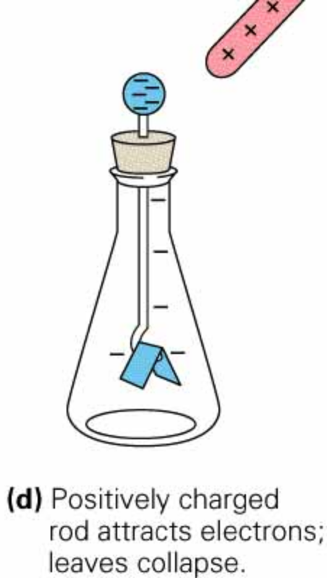
Charging …
CONTACT OR CONDUCTION
  + and – charges cancel, leaving behind a net charge
  Note that (c) and (d) can distinguish between the two types of charge

Slide 31
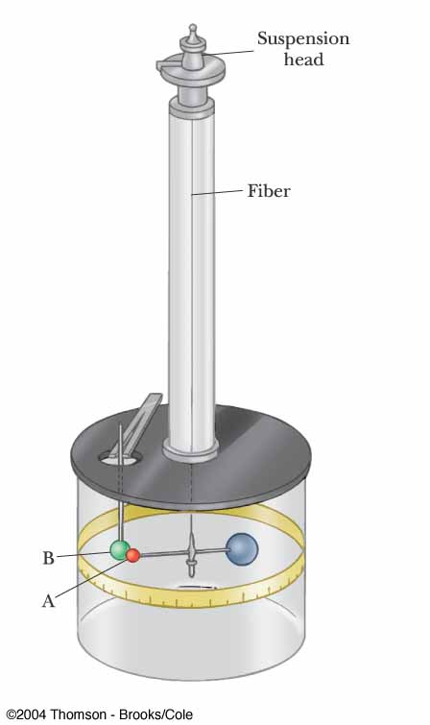
Coulomb’s Law
Charles Coulomb measured the magnitudes of electric forces between two small charged spheres
He found the force depended on the charges and the distance between them
F ∝1/r²

Slide 32
Point Charge
The term point charge refers to a particle of zero size that carries an electric charge
  The electrical behavior of electrons and protons is well described by modeling them as point charges

Slide 33
Coulomb’s Law, 2
The electrical force between two stationary point charges is given by Coulomb’s Law
The force is inversely proportional to the square of the separation r between the charges and directed along the line joining them
The force is proportional to the product of the charges, q₁ and q₂, on the two particles

Slide 34
Coulomb’s Law, 3
The force is attractive if the charges are of opposite sign
The force is repulsive if the charges are of like sign
The force is a conservative force

Slide 35
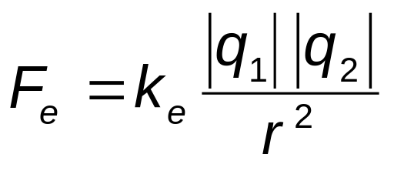
Coulomb’s Law, Equation
The magnitude of the Coulomb force is:
The SI unit of charge is the coulomb (C)
k_{e} is called the Coulomb constant
  k_{e} = 8.9876 x 10⁹ N.m²/C² = 1/(4πe_{o})
  e_{o} is the permittivity of free space
  e_{o} = 8.8542 x 10⁻¹² C² / N.m²

Slide 36
Coulomb's Law, Notes
Remember the charges need to be in coulombs
  e is the smallest unit of charge
    except quarks
  e = 1.6 x 10⁻¹⁹ C
  So 1 C needs 6.24 x 10¹⁸ electrons or protons
Typical charges can be in the µC range
Remember that force is a vector quantity

Slide 37
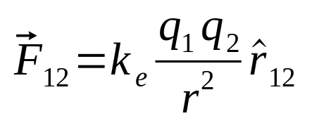
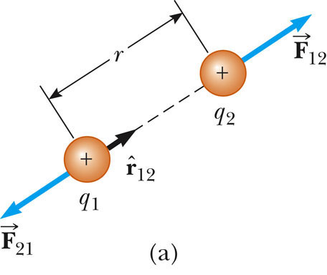

Vector Nature of Electric Forces
In vector form,
is a unit vector directed from q₁ to q₂
The like charges produce a repulsive force between them
Use the active figure to move the charges and observe the force
PLAY
ACTIVE FIGURE

Slide 38
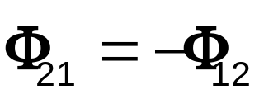
Vector Nature of Electrical Forces, 2
Electrical forces obey Newton’s Third Law
The force on q₁ is equal in magnitude and opposite in direction to the force on q₂
With like signs for the charges, the product q₁q₂ is positive and the force is repulsive

Slide 39
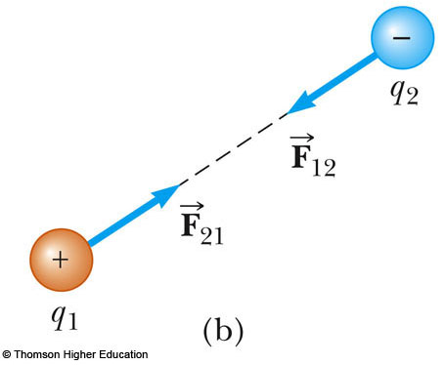
Vector Nature of Electrical Forces, 3
Two point charges are separated by a distance r
The unlike charges produce an attractive force between them
With unlike signs for the charges, the product q₁q₂ is negative and the force is attractive
  Use the active figure to investigate the force for different positions
PLAY
ACTIVE FIGURE

Slide 40
A Final Note about Directions
The sign of the product of q₁q₂ gives the relative direction of the force between q₁ and q₂
The absolute direction is determined by the actual location of the charges

Slide 41
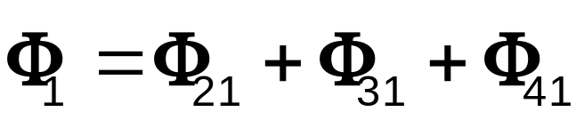
The Superposition Principle
The resultant force on any one charge equals the vector sum of the forces exerted by the other individual charges that are present
  Remember to add the forces as vectors
The resultant force on q₁ is the vector sum of all the forces exerted on it by other charges:

Slide 42
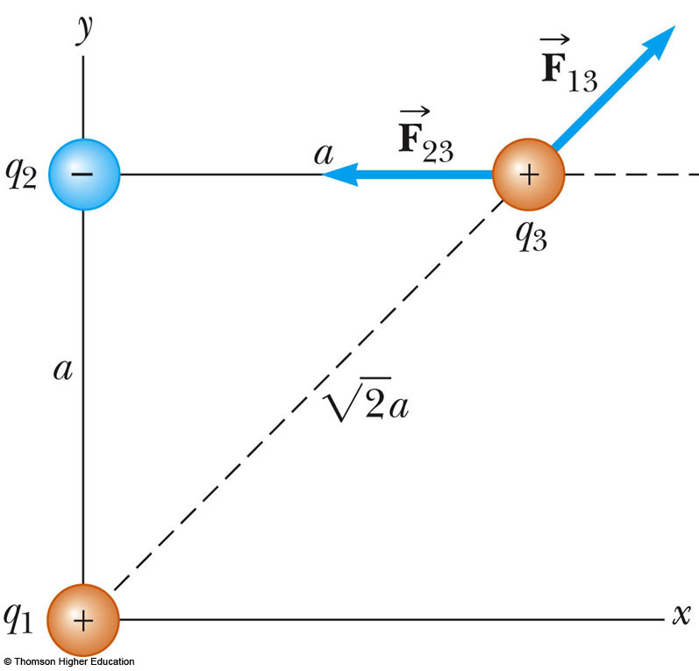


Superposition Principle, Example
The force exerted by q₁ on q₃ is
The force exerted by q₂ on q₃ is
The resultant force exerted on q₃ is the vector sum of and

Slide 43
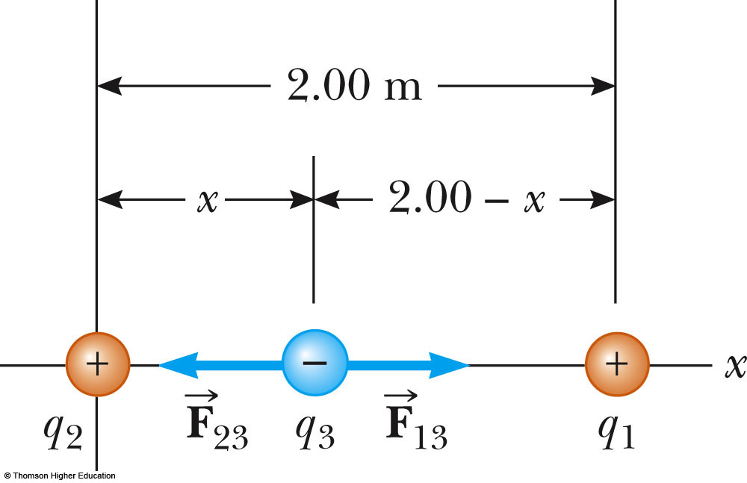
Zero Resultant Force, Example
Where is the resultant force equal to zero?
  The magnitudes of the individual forces will be equal
  Directions will be opposite
Will result in a quadratic
Choose the root that gives the forces in opposite directions

Slide 44
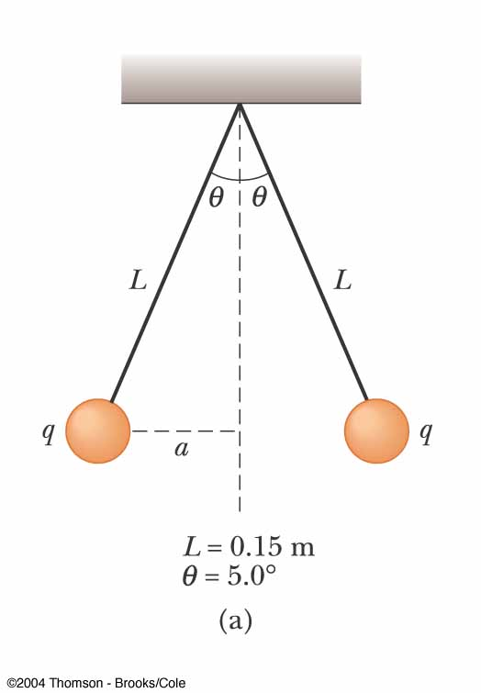
Electrical Force with Other Forces, Example
The spheres are in equilibrium
Since they are separated, they exert a repulsive force on each other
  Charges are like charges
Proceed as usual with equilibrium problems, noting one force is an electrical force

Slide 45
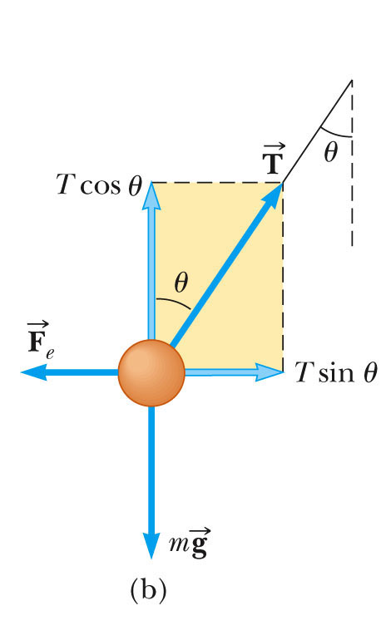
Electrical Force with Other Forces, Example cont.
The free body diagram includes the components of the tension, the electrical force, and the weight
Solve for |q|
You cannot determine the sign of q, only that they both have same sign

