Slide 1
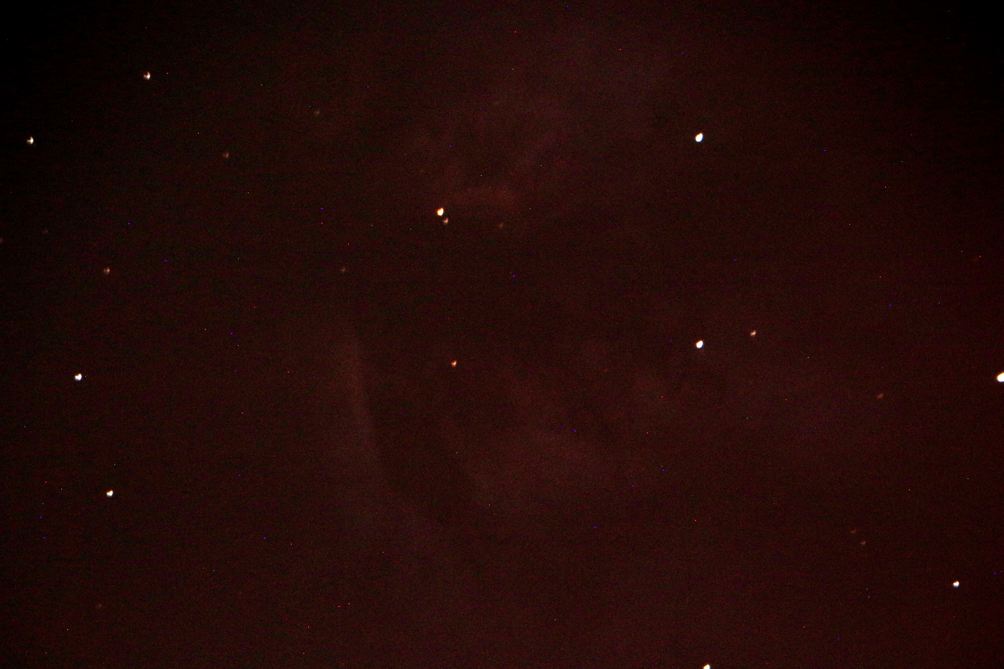
Temp(ºF)______ Cloudcover_______ Wind__________
Seeing(0-5)_____ Transparency(0-5)_____Humid_____%
Name________________
Object: _________________________
Alt./Azim: ________________________
Date/Time: _______________________
Telescope:_______________f/________
CCD: __________________Frame_____
Pix Format:__________ Texp:_______sec
Filter: ____________________________
Remarks: _________________________
_________________________________
_________________________________
_________________________________
_________________________________
_________________________________
Object: _________________________
Alt./Azim: ________________________
Date/Time: _______________________
Telescope:_______________f/________
CCD: __________________Frame_____
Pix Format:__________ Texp:_______sec
Filter: ____________________________
Remarks: _________________________
_________________________________
_________________________________
_________________________________
_________________________________
_________________________________
ONU Observatory Lat=40.76778N Long.=83.839826W

