Slide 1
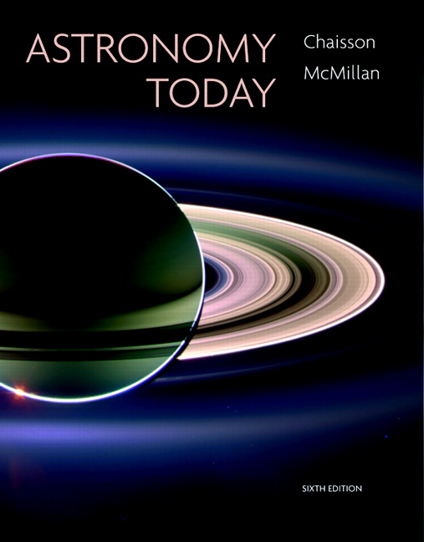
Conceptual Test
Chapter 1
ASTRONOMY TODAY
6th edition
Chaisson
McMillan
© 2008 Pearson Addison-Wesley
This work is protected by United States copyright laws and is provided solely for the use of instructors in teaching their courses and assessing student learning. Dissemination or sale of any part of this work (including on the World Wide Web) will destroy the integrity of the work and is not permitted. The work and materials from it should never be made available to students except by instructors using the accompanying text in their classes. All recipients of this work are expected to abide by these restrictions and to honor the intended pedagogical purposes and the needs of other instructors who rely on these materials.

Slide 2
Question 1
Constellations appear to move across the sky at night because
1) the Earth orbits the Sun.
2) the Moon orbits the Earth.
3) stars are in constant motion.
4) the Sun orbits the Earth.
5) the Earth spins on its axis.

Slide 3
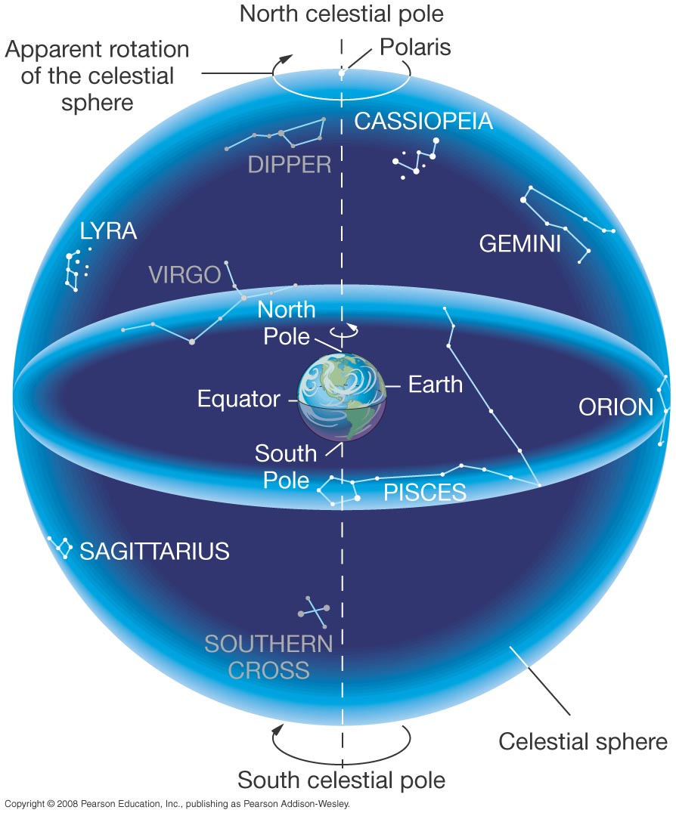
Question 1
Question 1
What motion is responsible for the apparent motion of the constellations (east to west) across the sky?
1) the motion of Earth around the Sun
2) the motion of the Moon around Earth
3) the motion of Mars around the Sun
4) the motion of the constellations around Earth
5) the spinning of Earth on its axis
Constellations appear to move across the sky at night because
1) the Earth orbits the Sun.
2) the Moon orbits the Earth.
3) stars are in constant motion.
4) the Sun orbits the Earth.
5) the Earth spins on its axis.
The Sun, Moon, planets, & stars all rise and set because our planet rotates once each day.

Slide 4
Question 2
What is the path that the Sun, Moon, and planets follow through the constellations?
1) the celestial equator
2) the north celestial pole
3) the Milky Way
4) the zodiac
5) the ecliptic

Slide 5
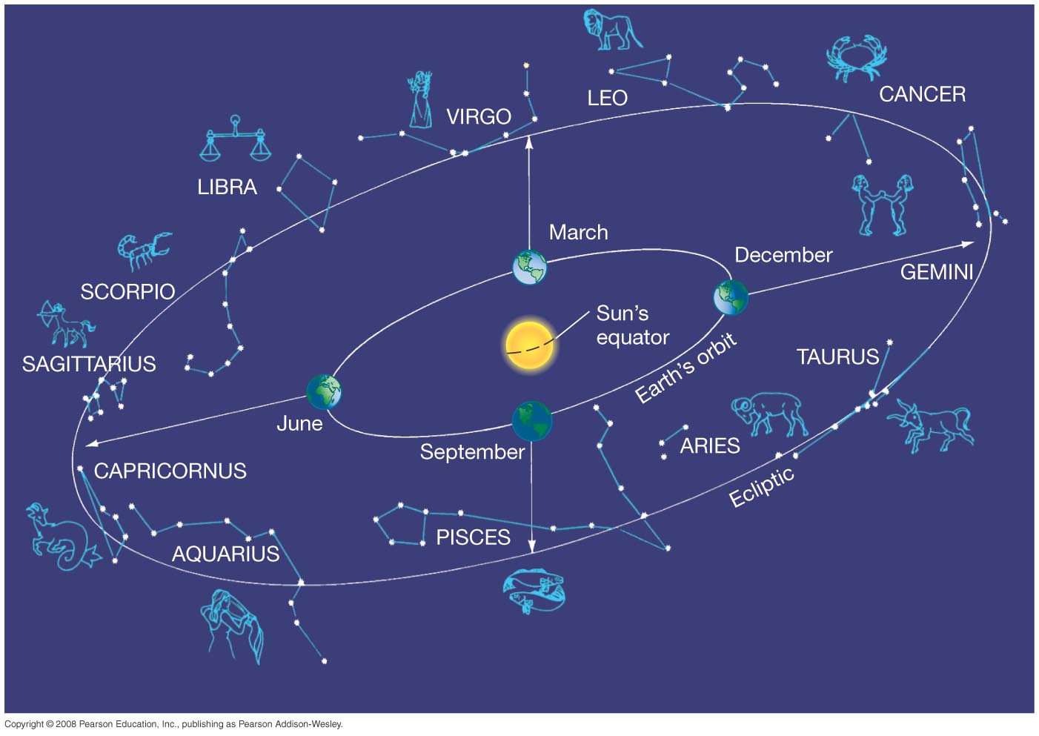
Question 2
What is the path that the Sun, Moon, and planets follow through the constellations?
1) the celestial equator
2) the north celestial pole
3) the Milky Way
4) the zodiac
5) the ecliptic
The ecliptic also marks the plane of Earth’s orbit around the Sun.

Slide 6
Question 3
How long does it take the Sun to complete one circuit of the ecliptic?
1) one hour
2) one day
3) one month
4) one year
5) one decade

Slide 7
Question 3
How long does it take the Sun to complete one circuit of the ecliptic?
1) one hour
2) one day
3) one month
4) one year
5) one decade
The Sun moves around the ecliptic once as the Earth orbits in one year.

Slide 8
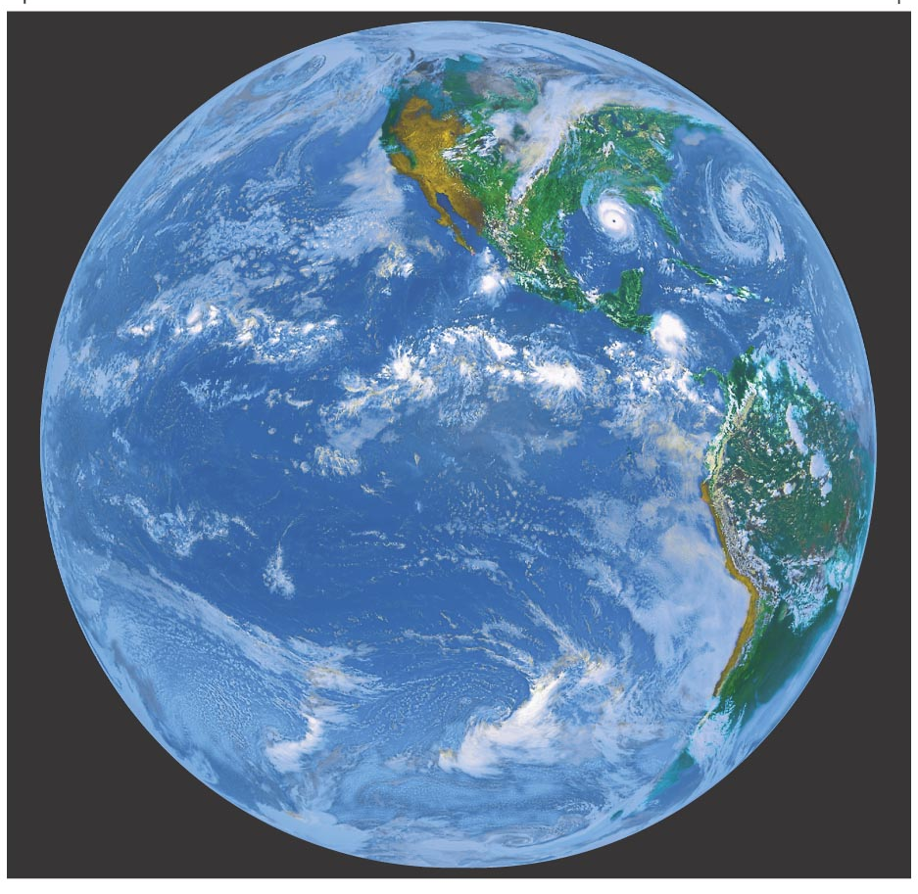
Question 4
1) Earth’s rotation axis wobbles
2) the Greenhouse Effect
3) Earth’s rotational axis is tilted 23.5°
4) Earth moves closer or farther from the Sun
5) global warming and cooling
What causes Earth’s seasons?

Slide 9
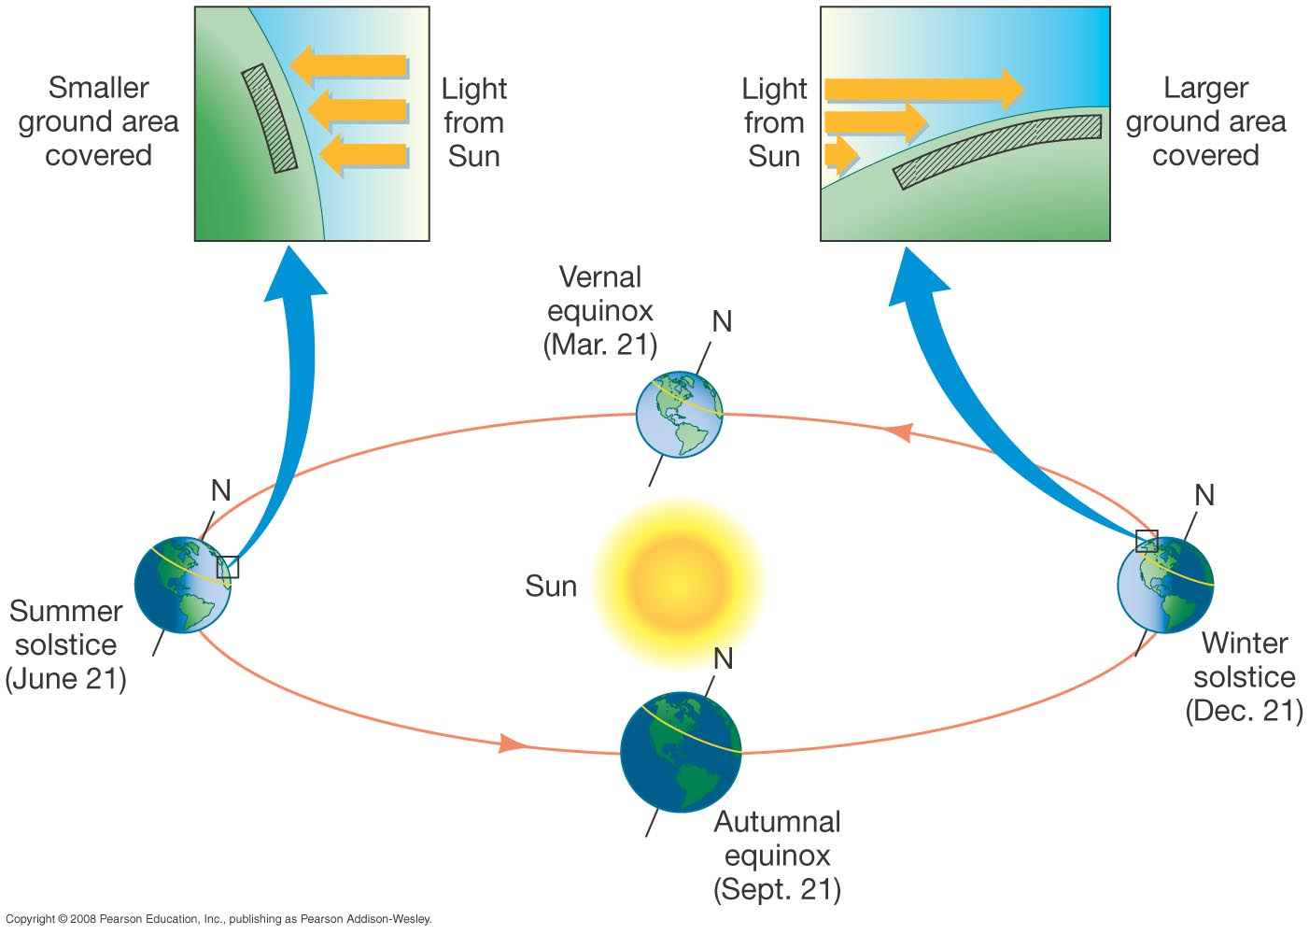
Question 4
1) Earth’s rotation axis wobbles
2) the Greenhouse Effect
3) Earth’s rotational axis is tilted 23.5°
4) Earth moves closer or farther from the Sun
5) global warming and cooling
What causes Earth’s seasons?
Our planet’s tilt, & not its changing distance from the Sun, creates seasons.

Slide 10
Question 5
1) Summer.
2) Fall.
3) Winter.
4) Spring.
The VERNAL EQUINOX marks the beginning of

Slide 11
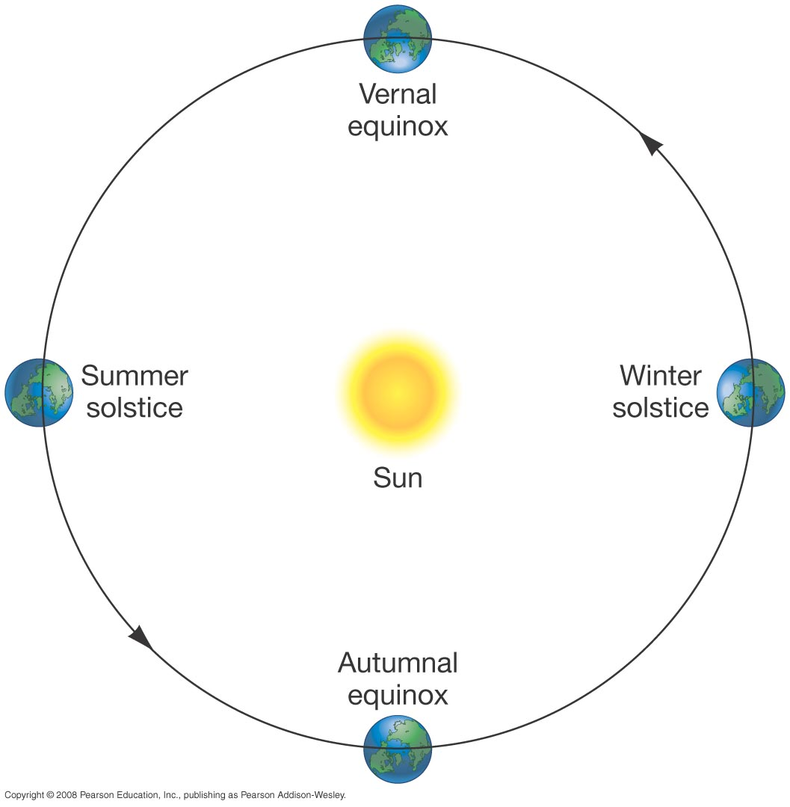
Question 5
1) Summer.
2) Fall.
3) Winter.
4) Spring.
The VERNAL EQUINOX marks the beginning of
The Vernal Equinox occurs around March 21–22.

Slide 12
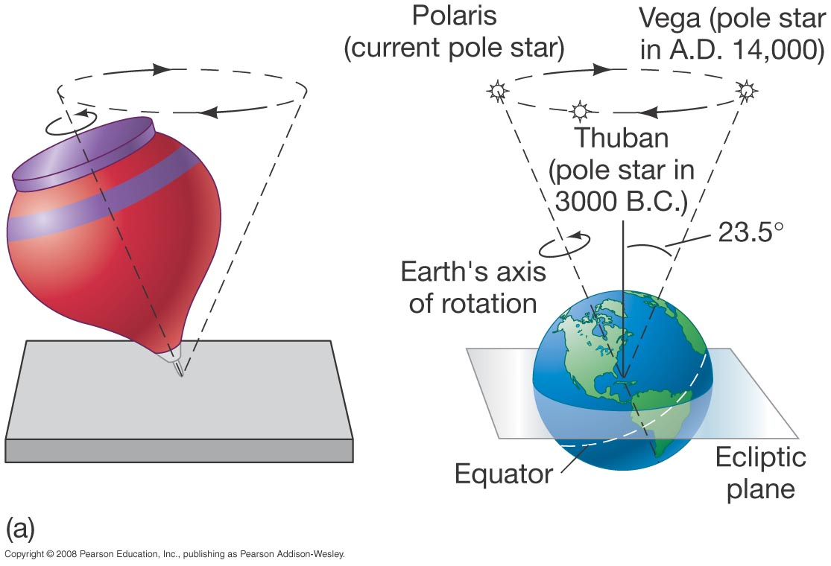
Question 6
1) the rotation of Earth’s molten core.
2) the gravitational pull of the Sun.
3) the gravitational pull of the Moon and Sun.
4) the weight of the ice at the poles.
5) gravitational attractions from comets.
Precession is caused by

Slide 13
Question 6
1) the rotation of Earth’s molten core.
2) the gravitational pull of the Sun.
3) the gravitational pull of the Moon and Sun.
4) the weight of the ice at the poles.
5) gravitational attractions from comets.
Precession is caused by
The Moon’s and Sun’s tug create a slow “wobble” that takes about 26,000 years for one rotation.

Slide 14
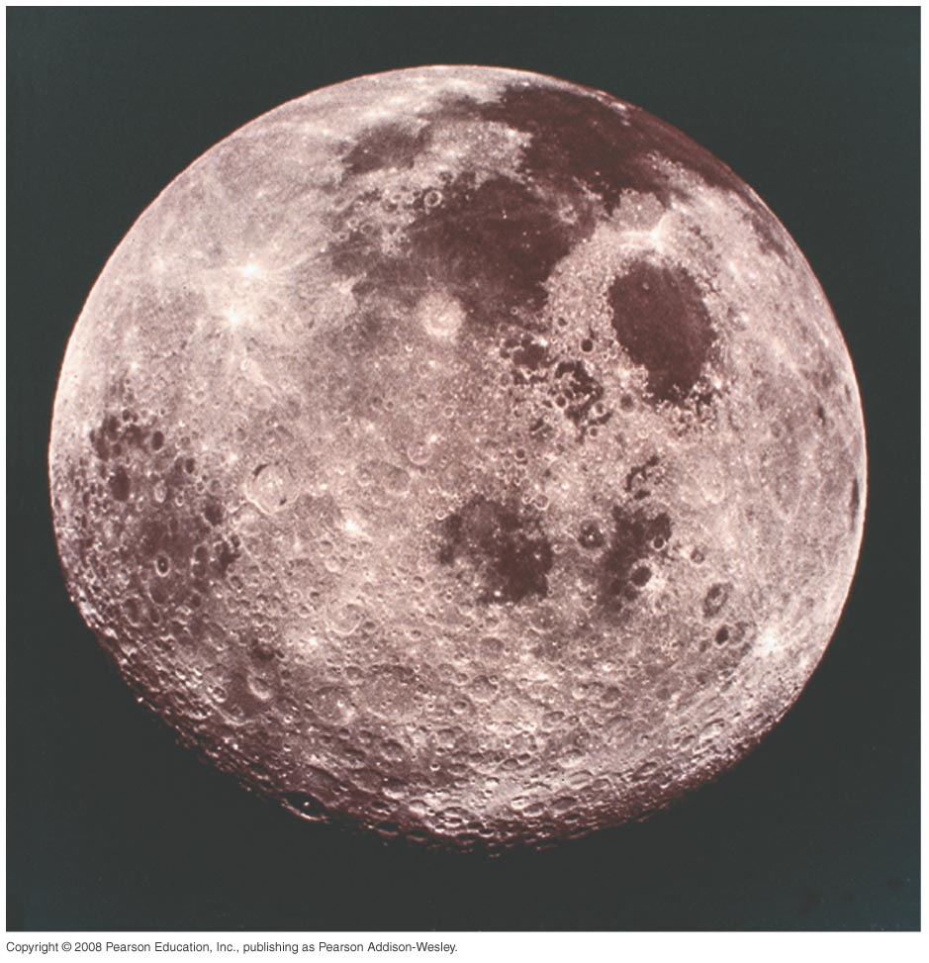
Question 7
1) one day
2) one hour
3) one week
4) one month
5) one year
How long does it take the Moon to go around the ecliptic?

Slide 15
Question 7
1) one day
2) one hour
3) one week
4) one month
5) one year
How long does it take the Moon to go around the ecliptic?
The Moon orbits Earth in a month, and passes in front of the constellations of the zodiac which are arranged around the ecliptic.

Slide 16
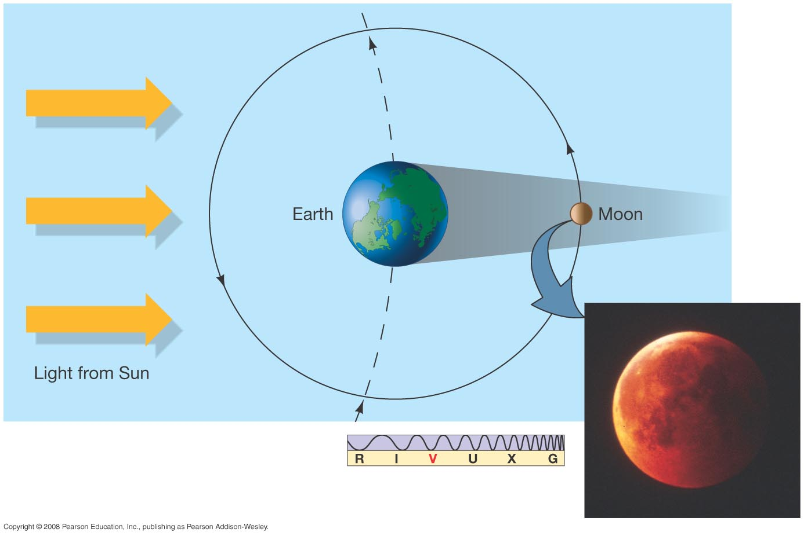
Question 8
1) during the NEW moon phase.
2) when the Sun blocks the Moon.
3) during FULL moon phase.
4) always around the summer solstice.
A total LUNAR eclipse occurs

Slide 17
Question 8
1) during the NEW moon phase.
2) when the Sun blocks the Moon.
3) during FULL moon phase.
4) always around the summer solstice.
A total LUNAR eclipse occurs

Slide 18
Question 9
1) the same phase in 24 hours.
2) different phases in 24 hours.
3) a lunar eclipse once a month.
4) different sides of the Moon.
Considering the Moon’s Phases, everyone on Earth sees

Slide 19
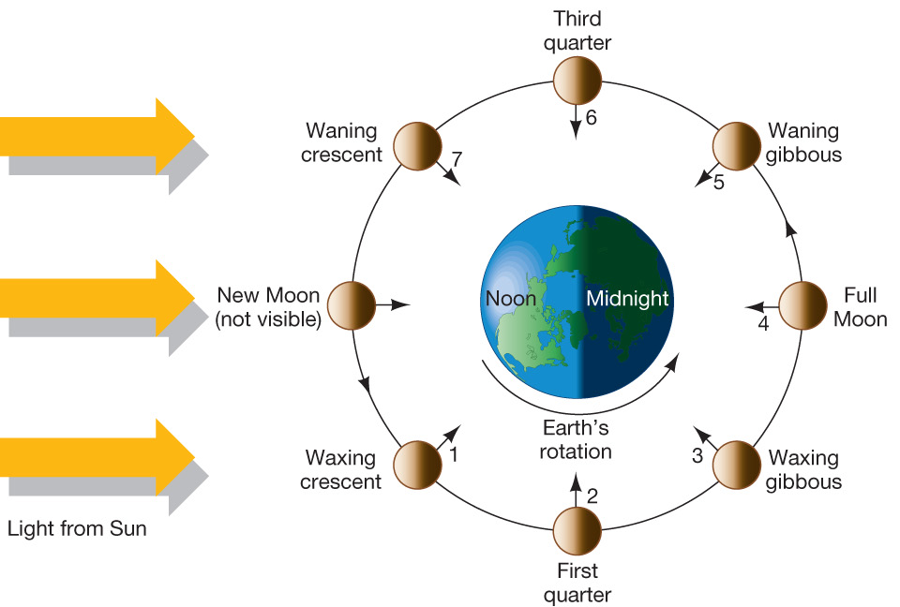
Question 9
1) the same phase in 24 hours.
2) different phases in 24 hours.
3) a lunar eclipse once a month.
4) different sides of the Moon.
Considering the Moon’s Phases, everyone on Earth sees
The Moon goes through its cycle of phases in about 30 days; the Earth rotates once in only 24 hours.
So everyone has a chance to see the same phase!

Slide 20
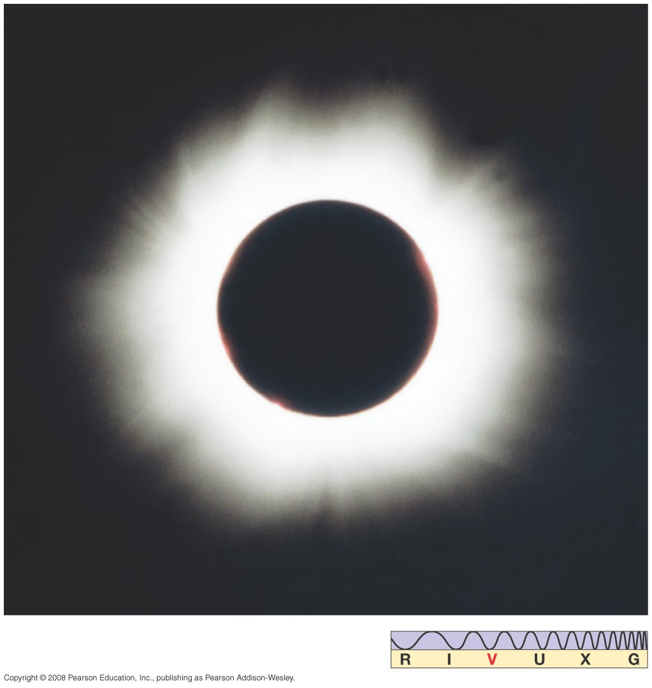
Question 10
1) every month at new moon.
2) every week at the quarter phases.
3) every month at full moon.
4) about every six months at new moon.
5) every year at new moon.
A solar eclipse
happens

Slide 21
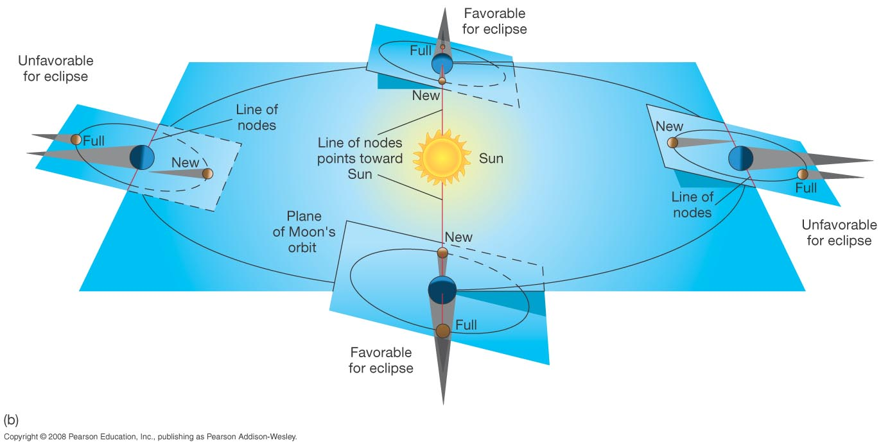
Question 10
1) every month at new moon.
2) every week at the quarter phases.
3) every month at full moon.
4) about every six months at new moon.
5) every year at new moon.
A solar eclipse
happens

Slide 22
Question 11
1) distances to stars increase.
2) the baseline gets larger.
3) the baseline gets smaller.
4) the Earth moves faster in its orbit.
The angle of “Parallax” increases as

Slide 23
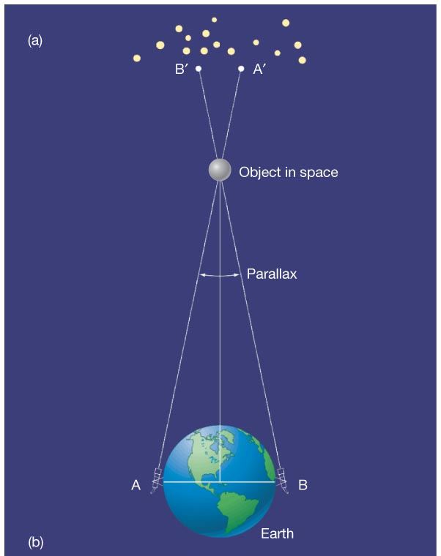
Question 11
1) distances to stars increase.
2) the baseline gets larger.
3) the baseline gets smaller.
4) the Earth moves faster in its orbit.
The angle of “Parallax” increases as
The greater the distance between two observation points (the baseline), the larger the angle of parallax.

Slide 24
Question 12
1) increases if the object is farther away.
2) decreases if the object is farther away.
3) is measured in light years.
4) determines its parallax.
5) depends upon its location in the sky.
The angular diameter of an object

Slide 25
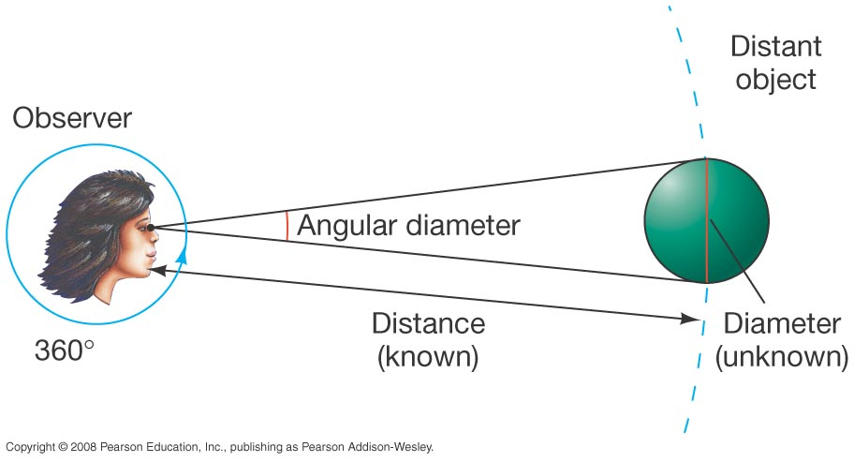
Question 12
1) increases if the object is farther away.
2) decreases if the object is farther away.
3) is measured in light years.
4) determines its parallax.
5) depends upon its location in the sky.
The angular diameter of an object
Angular diameter depends directly on size and inversely on distance.

Slide 26
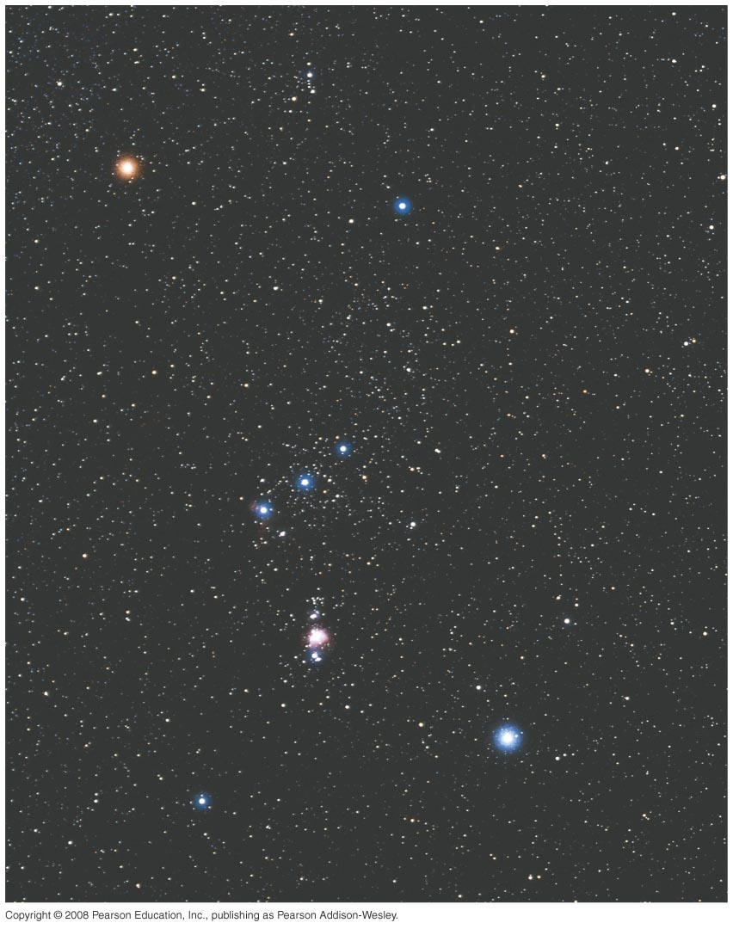
Question 13
Stars in a constellation are
1) physically close to each other.
2) usually equal in brightness.
3) about the same age.
4) about the same distance away.
5) in the same part of the sky.

Slide 27
Question 13
Stars in a constellation are
1) physically close to each other.
2) usually equal in brightness.
3) about the same age.
4) about the same distance away.
5) in the same part of the sky.
Stars within a constellation might be of very different ages, diameters, types, and luminosities.

