Slide 1
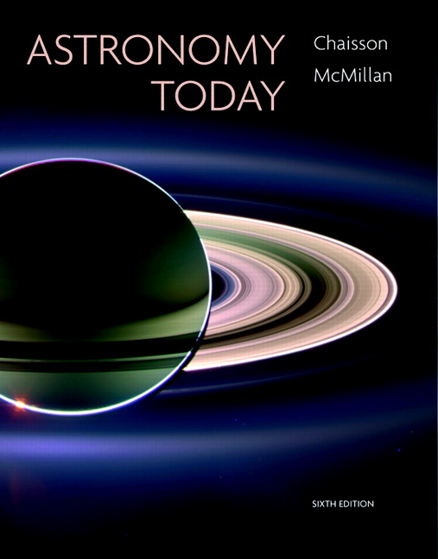
Conceptual Test
Chapter 2
ASTRONOMY TODAY
6th edition
Chaisson
McMillan
© 2008 Pearson Addison-Wesley
This work is protected by United States copyright laws and is provided solely for the use of instructors in teaching their courses and assessing student learning. Dissemination or sale of any part of this work (including on the World Wide Web) will destroy the integrity of the work and is not permitted. The work and materials from it should never be made available to students except by instructors using the accompanying text in their classes. All recipients of this work are expected to abide by these restrictions and to honor the intended pedagogical purposes and the needs of other instructors who rely on these materials.

Slide 2
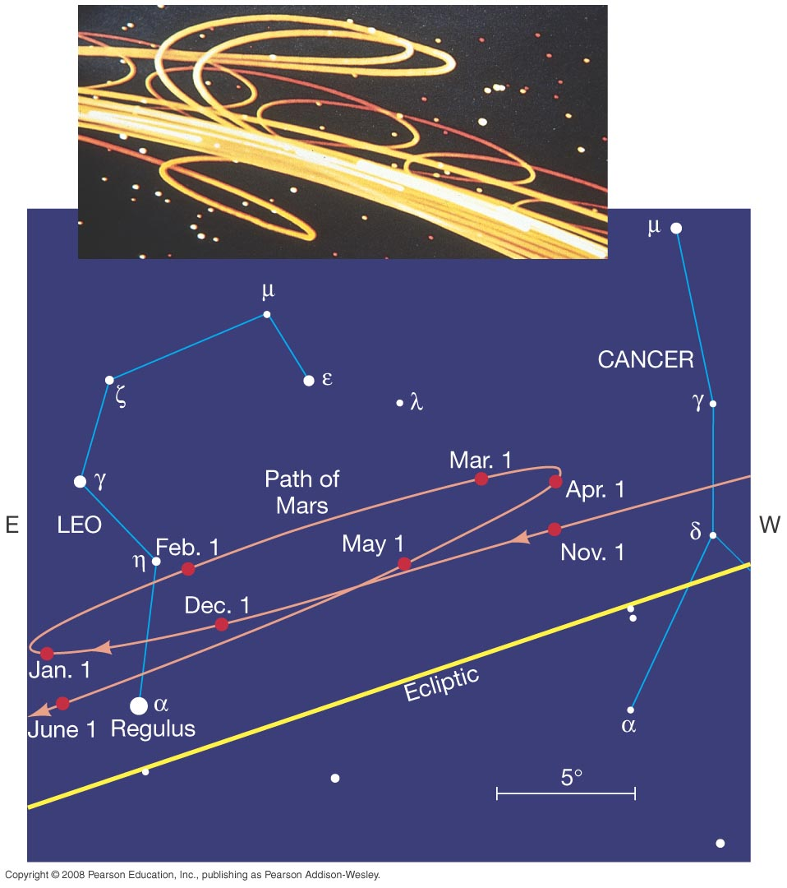
Question 1
1) planets move on epicycles.
2) planets orbit the Sun in the same direction.
3) Earth moves faster in its orbit.
4) they are closer than Uranus.
5) they rotate quickly on their axes.
Mars, Jupiter, & Saturn show Retrograde Motion because

Slide 3
Question 1
1) planets move on epicycles.
2) planets orbit the Sun in the same direction.
3) Earth moves faster in its orbit.
4) they are closer than Uranus.
5) they rotate quickly on their axes.
Mars, Jupiter, & Saturn show Retrograde Motion because
As Earth overtakes and “passes” the outer planets, they seem to slow down & then reverse direction.

Slide 4
Question 2
1) The Earth rotated.
2) The Sun rotated.
3) The geocentric model couldn’t account for day & night.
4) The Earth revolved around the Sun.
5) The Sun orbited Earth.
How did the Geocentric Model account for day & night on Earth?

Slide 5
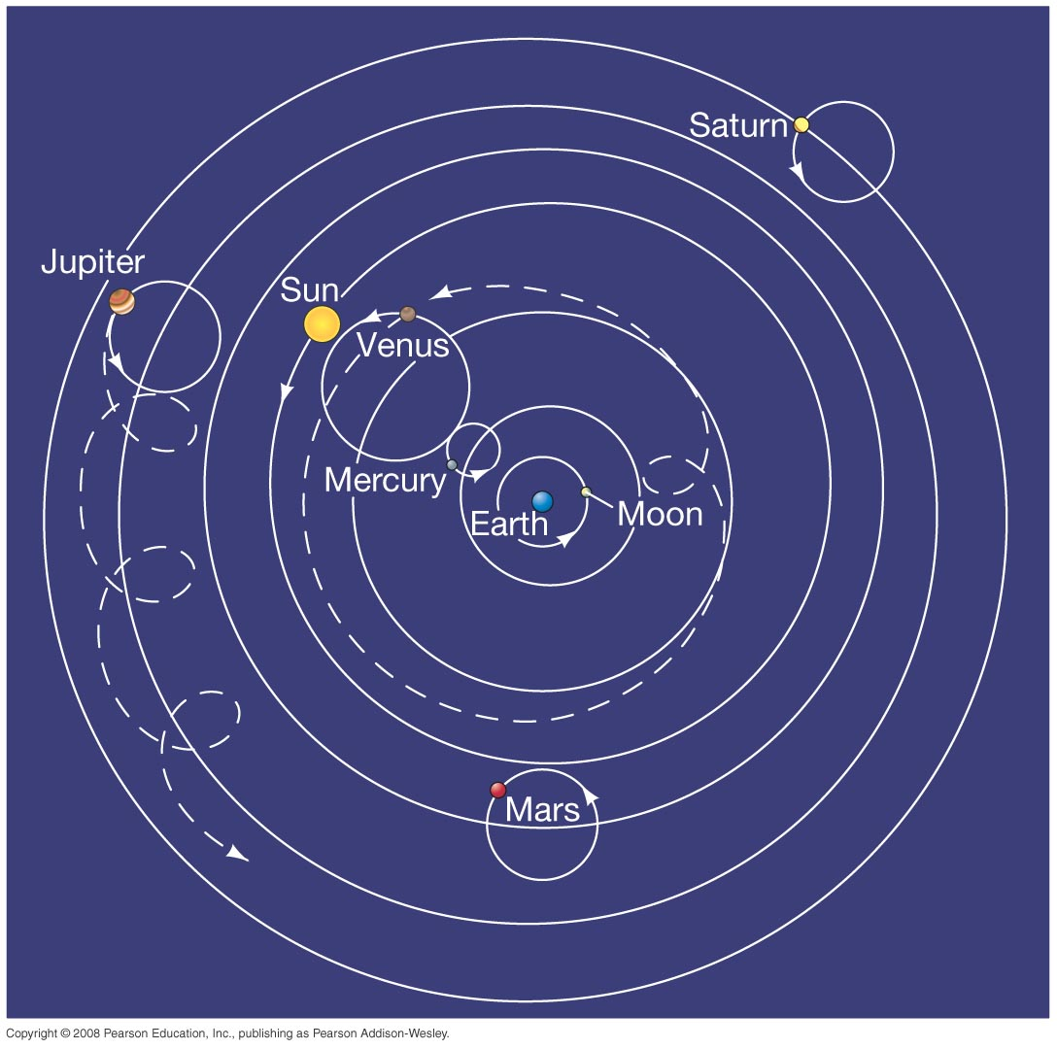
Question 2
1) The Earth rotated.
2) The Sun rotated.
3) The geocentric model couldn’t account for day & night.
4) The Earth revolved around the Sun.
5) The Sun orbited Earth.
How did the Geocentric Model account for day & night on Earth?
The Geocentric Model held that the Earth was motionless in the center of the universe.

Slide 6
Question 2
1) The Earth rotated.
2) The Sun rotated.
3) The geocentric model couldn’t account for day & night.
4) The Earth revolved around the Sun.
5) The Sun orbited Earth.
How did the Geocentric Model account for day & night on Earth?
The Geocentric Model held that the Earth was motionless in the center of the universe.

Slide 7
Question 3
1) why planets moved in the sky.
2) why Earth was at the center.
3) why retrograde motion occurred.
4) why Earth wobbled on its axis.
5) why inner planets were always seen near the Sun.
Epicycles were used in Ptolemy’s model to explain

Slide 8
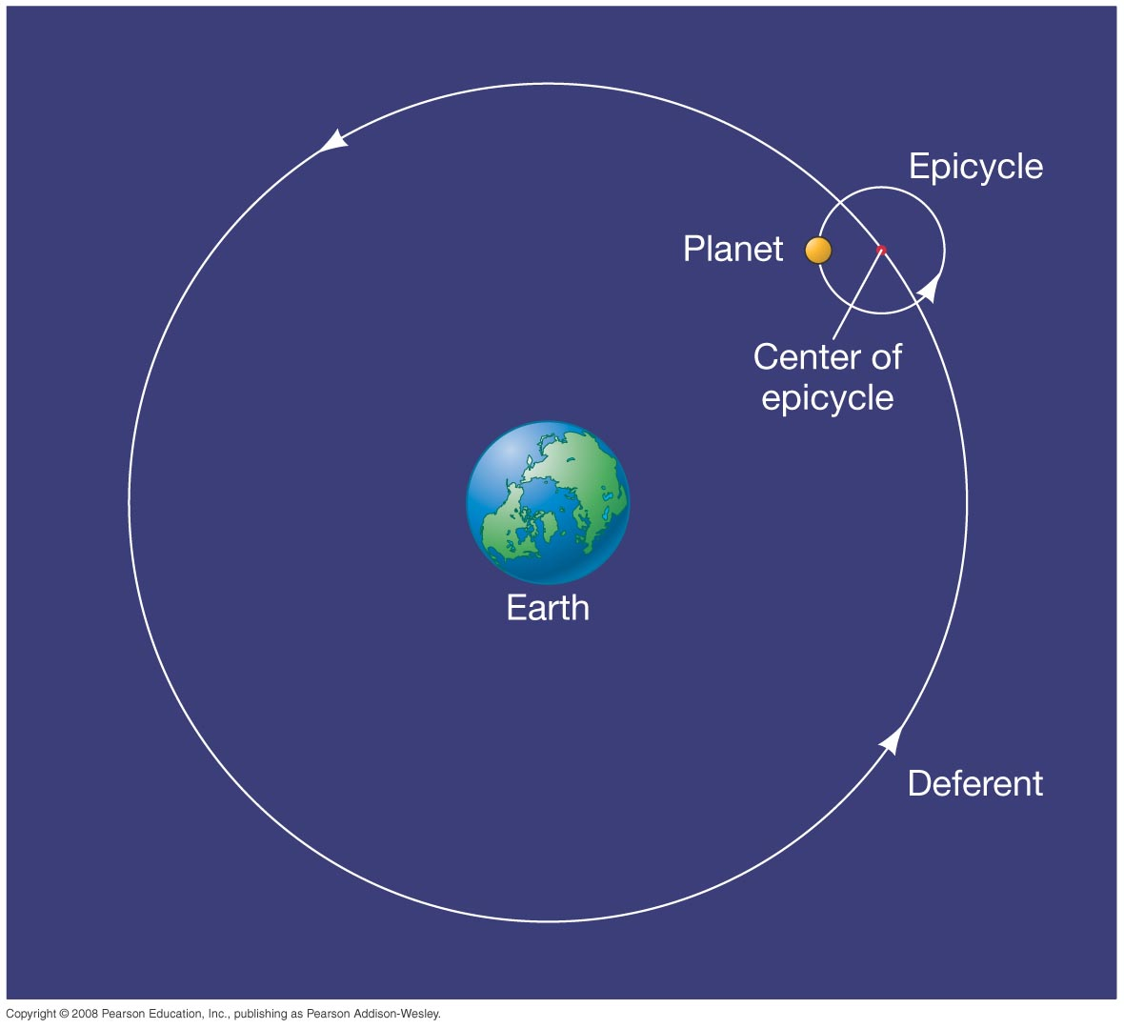
Question 3
1) why planets moved in the sky.
2) why Earth was at the center.
3) why retrograde motion occurred.
4) why Earth wobbled on its axis.
5) why inner planets were always seen near the Sun.
.
Epicycles were used in Ptolemy’s model to explain
Planets were assumed to move uniformly on an epicycle, as it moved uniformly around Earth.

Slide 9
Question 4
1) stars don’t seem to show any parallax.
2) we don’t feel as though Earth moves.
3) objects fall toward Earth, not the Sun.
4) we don’t see an enormous wind.
5) All of the above were valid reasons.
The Geocentric model was supported by Aristotle because

Slide 10
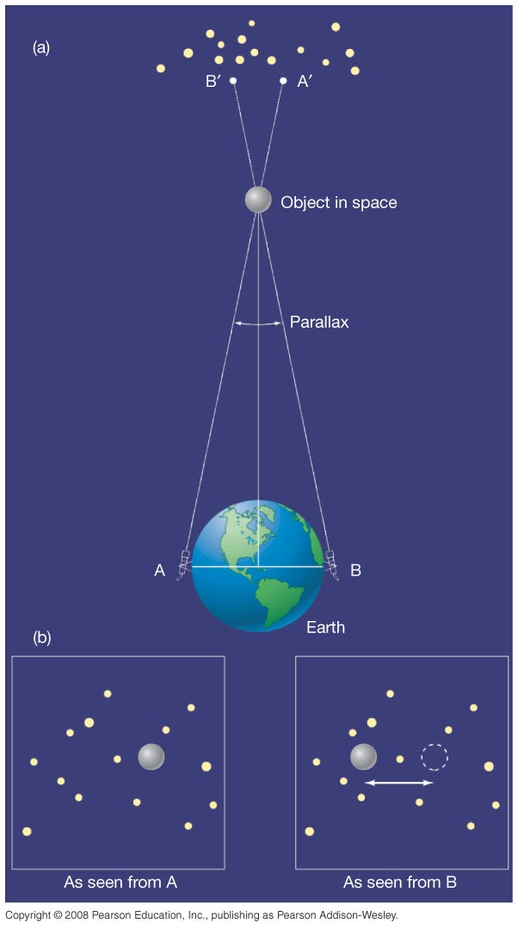
Question 4
1) stars don’t seem to show any parallax.
2) we don’t feel as though Earth moves.
3) objects fall toward Earth, not the Sun.
4) we don’t see an enormous wind.
5) All of the above were valid reasons.
The Geocentric model was supported by Aristotle because
If the Earth rotated and orbited, we would feel its motion.
In Aristotle’s time, the size of the solar system and distances to stars were assumed to be much, much smaller. Parallax was expected to be seen.

Slide 11
Question 5
The Heliocentric model assumes
1) planets move on epicycles.
2) Earth is the center of the solar system.
3) the stars move on the celestial sphere.
4) the Sun is the center of the solar system.
5) Earth’s axis wobbles over 26,000 years.

Slide 12
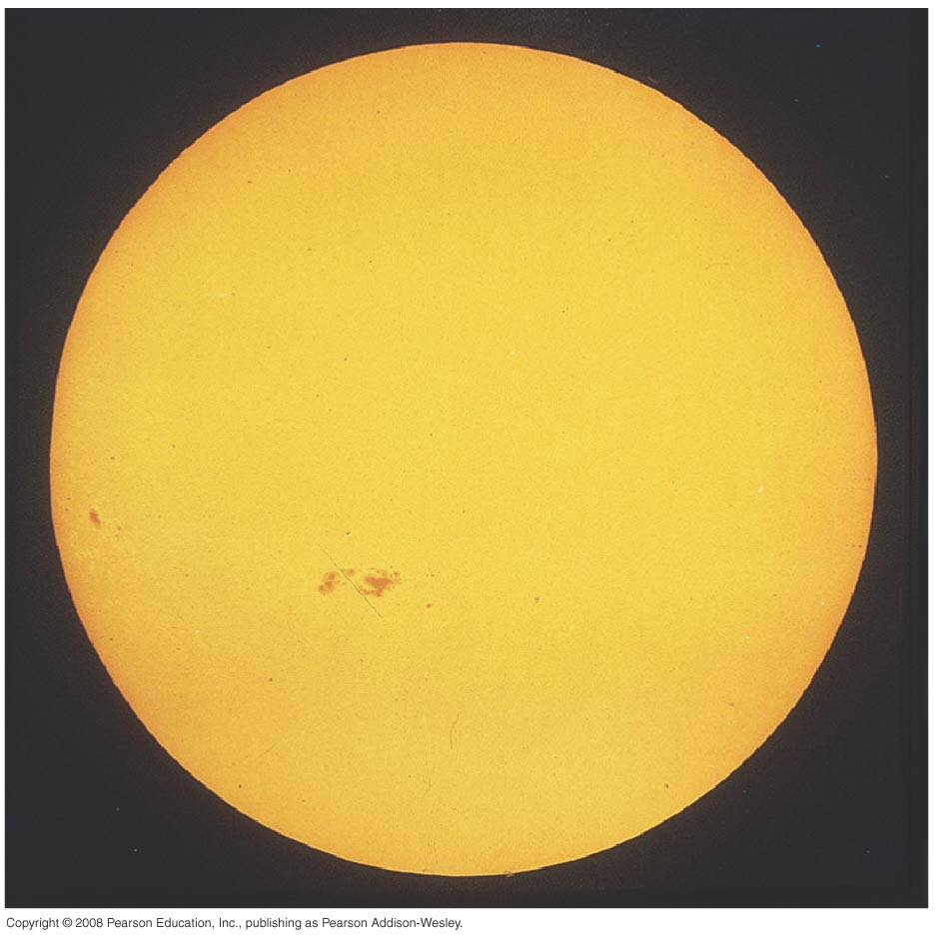
Question 5
The Heliocentric model assumes
1) planets move on epicycles.
2) Earth is the center of the solar system.
3) the stars move on the celestial sphere.
4) the Sun is the center of the solar system.
5) Earth’s axis wobbles over 26,000 years.
Heliocentric models proposed by Aristarchus and others were considered wrong by Aristotle and his followers.

Slide 13
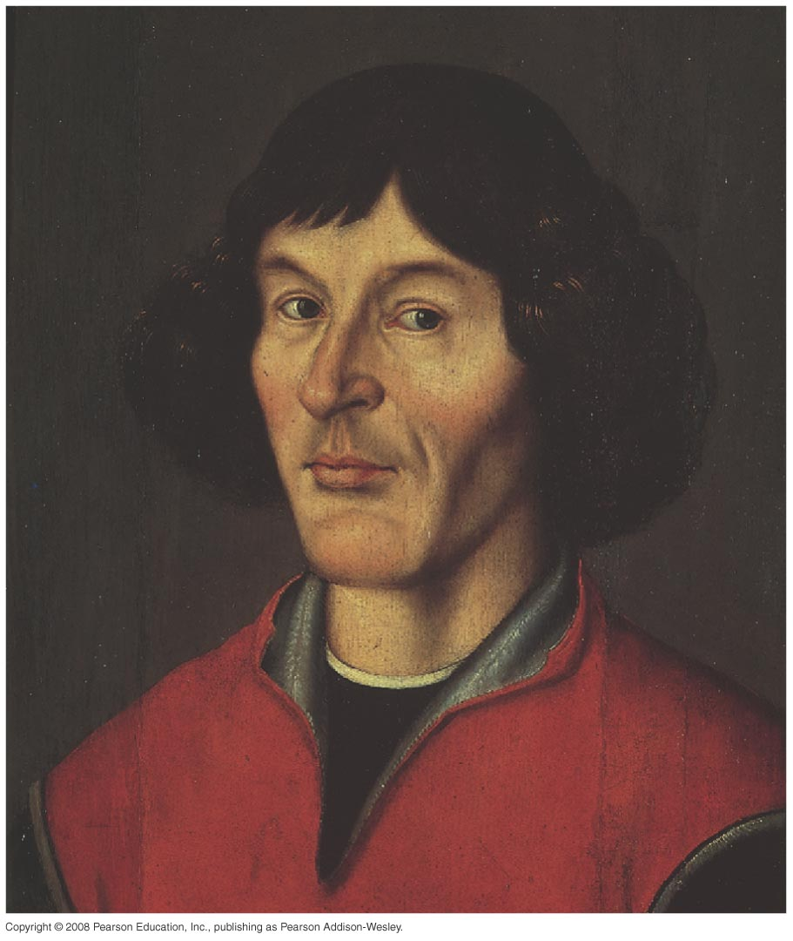
Question 6
1) proving planets move around the Sun in elliptical orbits.
2) the theory of gravity.
3) proposing a simpler model for the motions of planets in the solar system.
4) discovering the Sun was not at the center of the Milky Way.
5) discovering the four moons of Jupiter.
Copernicus’ important contribution to Astronomy was

Slide 14
Question 6
1) proving planets move around the Sun in elliptical orbits.
2) the theory of gravity.
3) proposing a simpler model for the motions of planets in the solar system.
4) discovering the Sun was not at the center of the Milky Way.
5) discovering the four moons of Jupiter.
Copernicus’ important contribution to Astronomy was
His heliocentric model easily explained retrograde motion because planets orbited the Sun at different speeds.

Slide 15
Question 7
Copernicus’ heliocentric model was flawed because
1) he assumed planets moved in ellipses.
2) he didn’t know about Uranus & Neptune.
3) he couldn’t account for gravity.
4) he couldn’t explain retrograde motion.
5) he assumed planets moved in circles.

Slide 16
Question 7
Copernicus’ heliocentric model was flawed because
1) he assumed planets moved in ellipses.
2) he didn’t know about Uranus & Neptune.
3) he couldn’t account for gravity.
4) he couldn’t explain retrograde motion.
5) he assumed planets moved in circles.
Copernicus’ model still needed small epicycles to account for observed changes in planetary speeds.

Slide 17
Question 8
1) Hipparchus
2) Galileo
3) Tycho
4) Copernicus
5) Kepler
Who published the first astronomical observations made with a telescope?

Slide 18
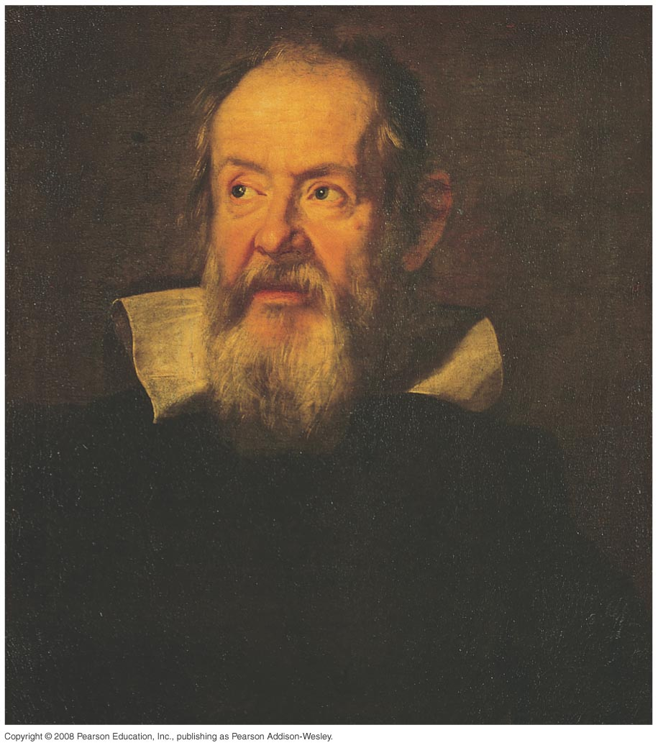
Question 8
1) Hipparchus
2) Galileo
3) Tycho
4) Copernicus
5) Kepler
Who published the first astronomical observations made with a telescope?
Galileo published the “Starry Messenger” in 1610, detailing his observations of the Moon, Jupiter’s moons, stars, and nebulae.

Slide 19
Question 9
Which of Galileo’s initial observations was most challenging to established geocentric beliefs?
1) craters on the Moon
2) sunspots
3) lunar maria
4) satellites of Jupiter
5) stars of the Milky Way

Slide 20
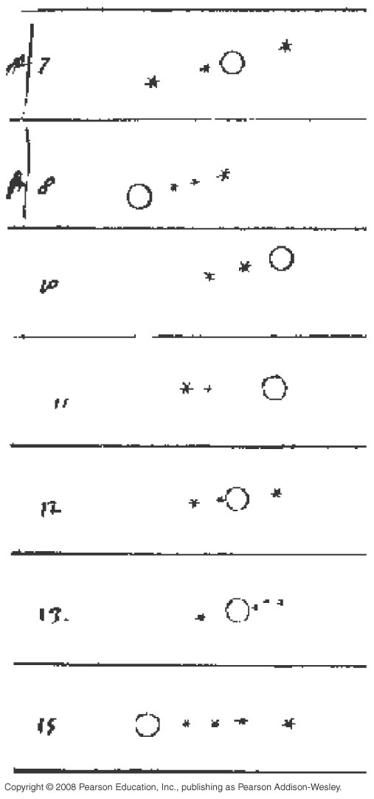
Question 9
Which of Galileo’s initial observations was most challenging to established geocentric beliefs?
1) craters on the Moon
2) sunspots
3) lunar maria
4) satellites of Jupiter
5) stars of the Milky Way
Seeing four moons clearly move around Jupiter disproved that everything orbited Earth
and
showed Earth could orbit the Sun and not lose its moon, too.

Slide 21
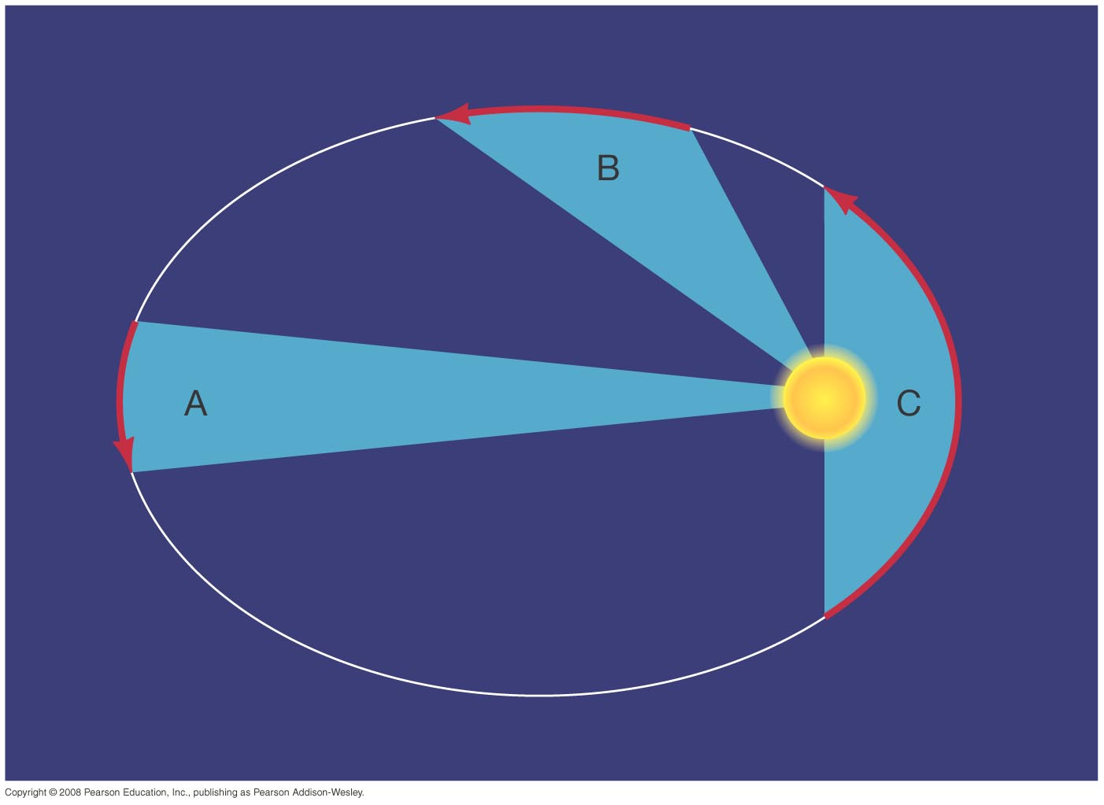
Question 10
1) Kepler
2) Newton
3) Galileo
4) Tycho Brahe
5) Copernicus
Which hero of the Renaissance postulated three “laws” of planetary motion?

Slide 22
Question 10
1) Kepler
2) Newton
3) Galileo
4) Tycho Brahe
5) Copernicus
Which hero of the Renaissance postulated three “laws” of planetary motion?
Note that Isaac Newton is also well known for 3 general laws of motion.
But Kepler’s Laws are about objects in orbits, like planets orbiting a star.

Slide 23
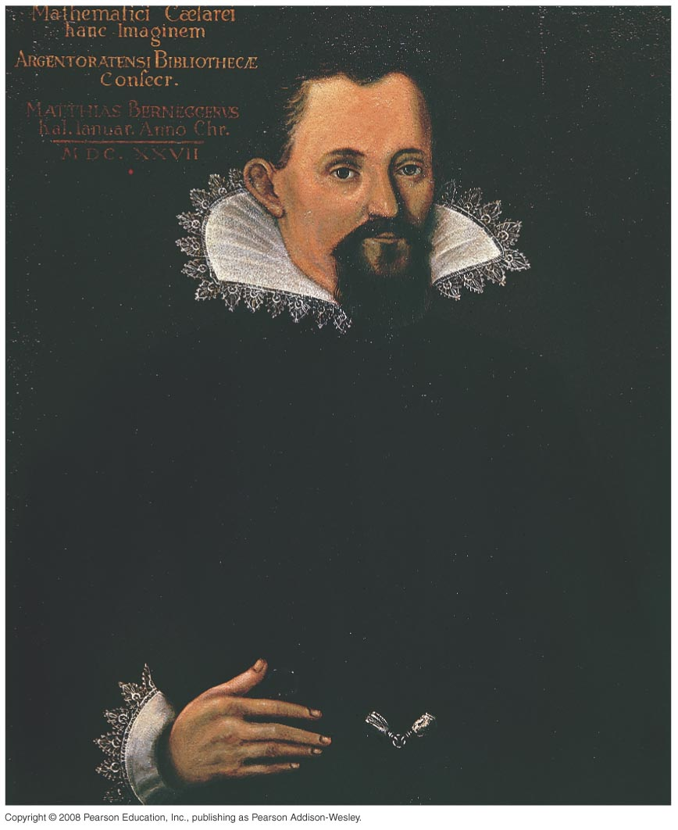
Question 11
1) planets orbit the Sun.
2) orbits are noncircular.
3) orbits are elliptical in shape.
4) all of the above
Kepler’s 1st law of planetary orbits states that

Slide 24
Question 11
1) planets orbit the Sun.
2) orbits are noncircular.
3) orbits are elliptical in shape.
4) all of the above
Kepler’s 1st law of planetary orbits states that
Kepler’s Laws apply to all orbiting objects. The Moon orbits Earth in an ellipse, and the Space Shuttle orbits Earth in an ellipse, too.

Slide 25
Question 12
Earth orbits slower in January.
Earth orbits faster in January.
Earth’s orbital speed doesn’t change.
Earth is closer to the Sun in January. From this fact, Kepler’s 2nd law tells us

Slide 26
Question 12
Earth orbits slower in January.
Earth orbits faster in January.
Earth’s orbital speed doesn’t change.
Earth is closer to the Sun in January. From this fact, Kepler’s 2nd law tells us
Kepler’s 2nd law means that a planet moves faster when closer to the star.
Faster
Slower

Slide 27
Question 13
1) Speed
2) Period
3) Shape
4) Velocity
Kepler’s 3rd law relates a planet’s distance from the Sun and its orbital

Slide 28
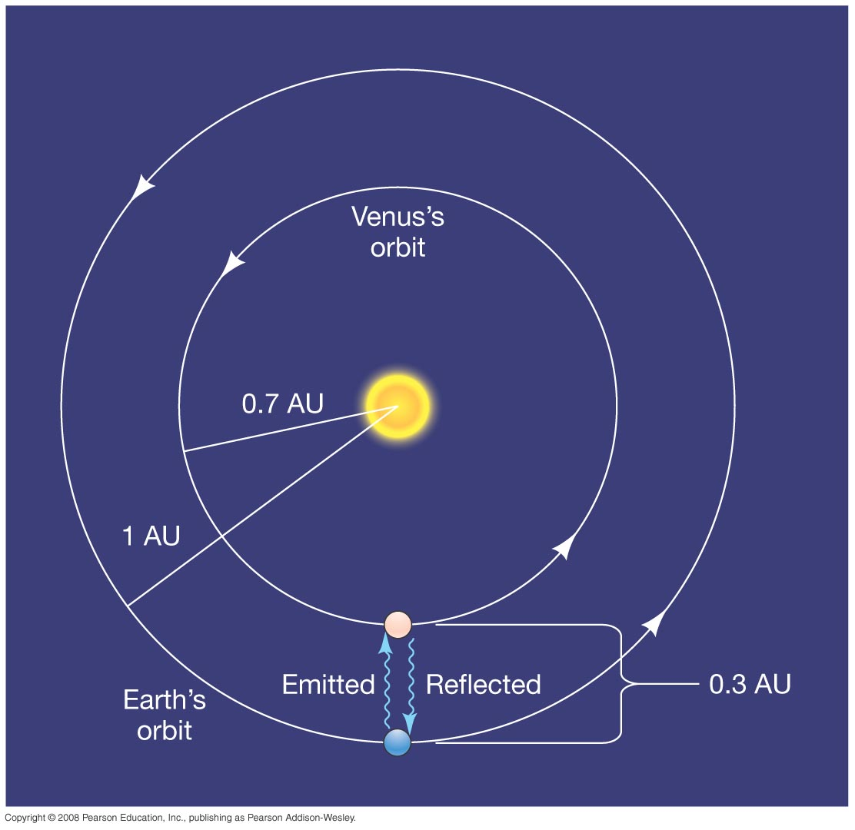
Question 13
speed.
period.
shape.
velocity.
Kepler’s 3rd law relates a planet’s distance from the Sun and its orbital
Venus’ Period = 225 days
Venus’ axis = 0.7 AU
Kepler’s 3rd law P² = a³
means more distant planets orbit more slowly.
Earth’s Period = 365 days
Earth’s axis = 1.0 AU

Slide 29
Question 14
Newton’s Law of Gravity states that the force between two objects
1) increases with distance.
2) depends upon the state of matter (solid, liquid, or gas).
3) can be attractive or repulsive.
4) increases with mass.

Slide 30
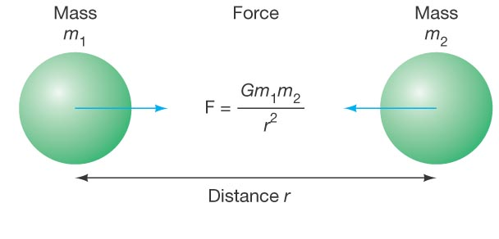
Question 14
Newton’s Law of Gravity states that the force between two objects
1) increases with distance.
2) depends upon the state of matter (solid, liquid, or gas).
3) can be attractive or repulsive.
4) increases with mass.
The attractive force of gravity INCREASES with greater mass, and DECREASES QUICKLY with greater distance.
The force doesn’t depend on the kind of matter.

