Slide 1
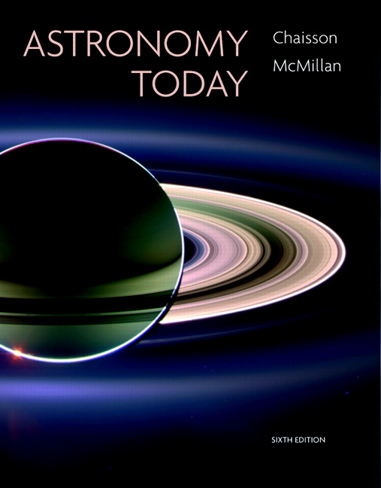
Conceptual Test
Chapter 4
ASTRONOMY TODAY
6th edition
Chaisson
McMillan
© 2008 Pearson Addison-Wesley
This work is protected by United States copyright laws and is provided solely for the use of instructors in teaching their courses and assessing student learning. Dissemination or sale of any part of this work (including on the World Wide Web) will destroy the integrity of the work and is not permitted. The work and materials from it should never be made available to students except by instructors using the accompanying text in their classes. All recipients of this work are expected to abide by these restrictions and to honor the intended pedagogical purposes and the needs of other instructors who rely on these materials.

Slide 2
Question 1
Which of the following has a fundamentally different nature than the other four?
1) proton
2) electron
3) neutron
4) atomic nucleus
5) photon

Slide 3
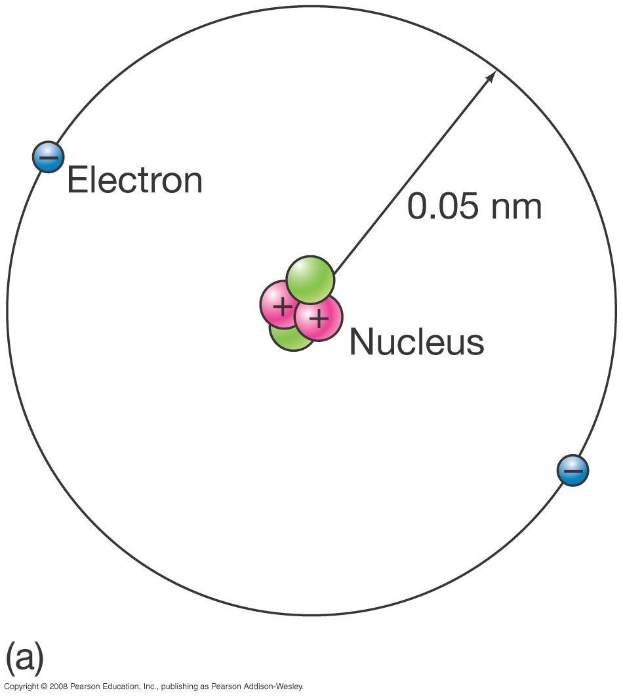
Question 1
Which of the following has a fundamentally different nature than the other four?
1) proton
2) electron
3) neutron
4) atomic nucleus
5) photon
Photons are packages of light energy.
Protons, neutrons, & electrons are particles of matter within an atomic nucleus.

Slide 4
Question 2
1) depend on its temperature.
2) are identical to its absorption lines.
3) depend on its density.
4) are different than its absorption lines.
5) depend on its intensity.
The wavelengths of the emission lines produced by an element

Slide 5
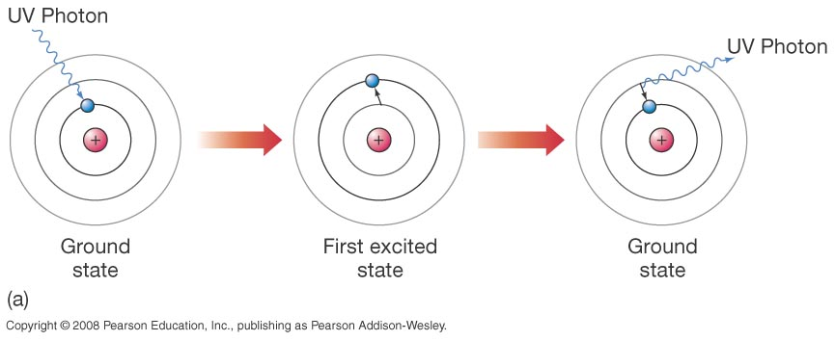
Question 2
1) depend on its temperature.
2) are identical to its absorption lines.
3) depend on its density.
4) are different than its absorption lines.
5) depend on its intensity.
The wavelengths of the emission lines produced by an element
Elements absorb or emit the same wavelengths of light based on their electron energy levels.

Slide 6
Question 3
1) its spectral lines are redshifted.
2) the light is much brighter.
3) its spectral lines are shorter in wavelength.
4) the amplitude of its waves has increased.
5) its photons have increased in speed.
If a light source is approaching you, you will observe

Slide 7
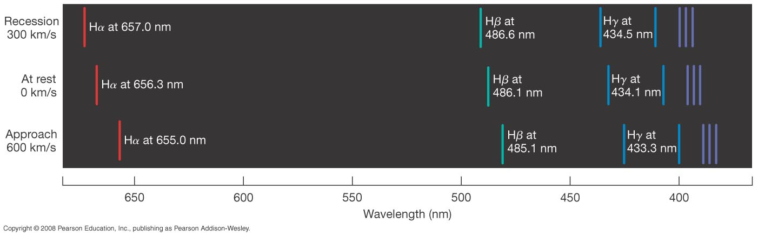
Question 3
1) its spectral lines are redshifted.
2) the light is much brighter.
3) its spectral lines are shorter in wavelength.
4) the amplitude of its waves has increased.
5) its photons have increased in speed.
If a light source is approaching you, you will observe
The Doppler Shift explains that wavelengths from sources approaching us are blue-shifted.

Slide 8
Question 4
Analyzing a star’s spectral lines can tell us about all of these EXCEPT
1) its composition.
2) its surface temperature.
3) its transverse (side-to-side) motion.
4) its rotation.
5) its density.

Slide 9
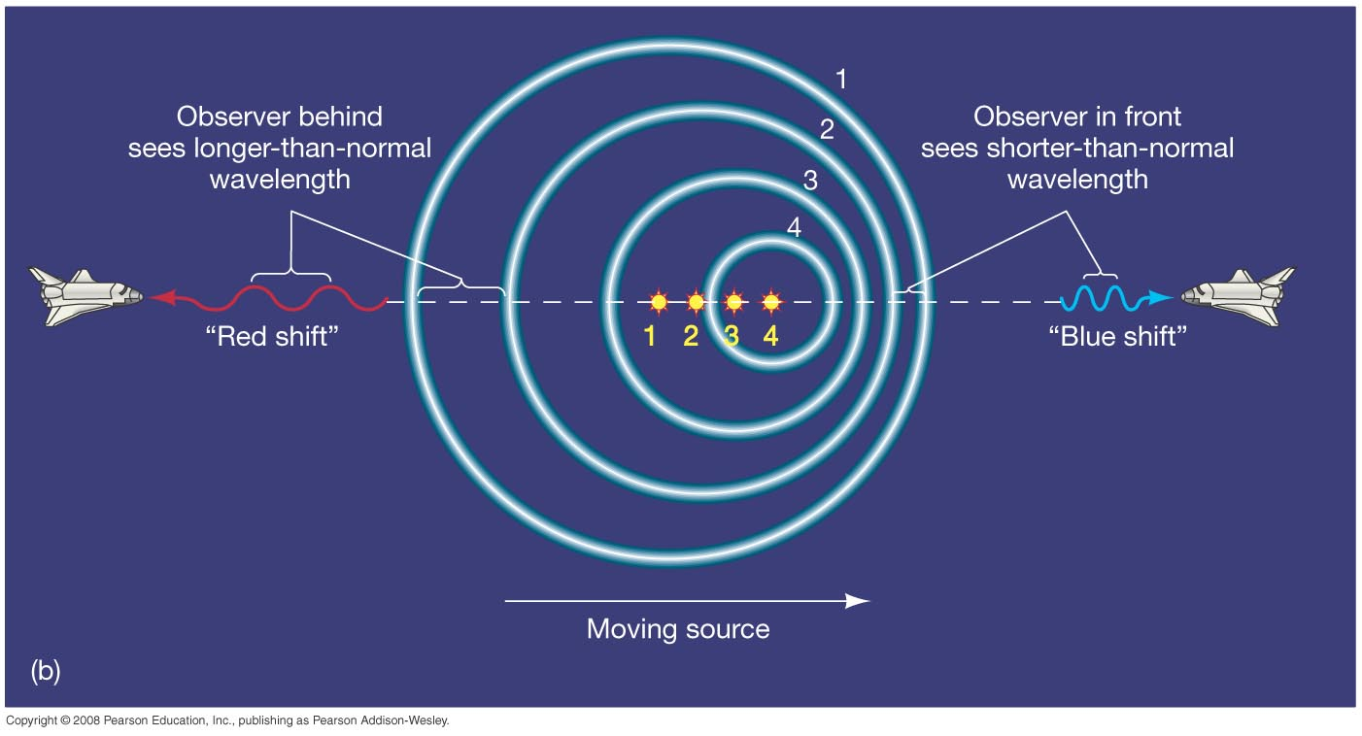
Question 4
Analyzing a star’s spectral lines can tell us about all of these EXCEPT
1) its composition.
2) its surface temperature.
3) its transverse (side-to-side) motion.
4) its rotation.
5) its density.
Only motion towards or away from us influences a star’s spectral lines.
Spectra can also tell us about a star’s magnetic field.

Slide 10
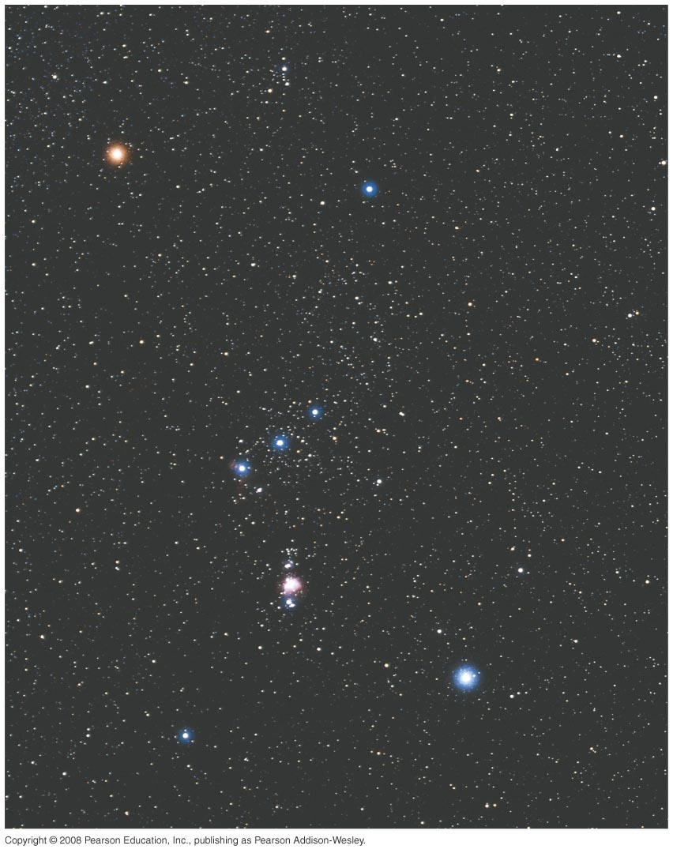
Question 5
Rigel appears as a bright bluish star, while Betelgeuse appears as a bright reddish star.
Rigel is ______ Betelgeuse.
1) cooler than
2) the same temperature as
3) older than
4) hotter than
5) more massive than
Betelgeuse
The constellation ORION
Rigel

Slide 11
Question 5
Rigel appears as a bright bluish star, while Betelgeuse appears as a bright reddish star.
Rigel is ______ Betelgeuse.
1) cooler than
2) the same temperature as
3) older than
4) hotter than
5) more massive than
Betelgeuse
Hotter stars look bluer in color; cooler stars look redder.
The constellation ORION
Rigel

