Slide 1
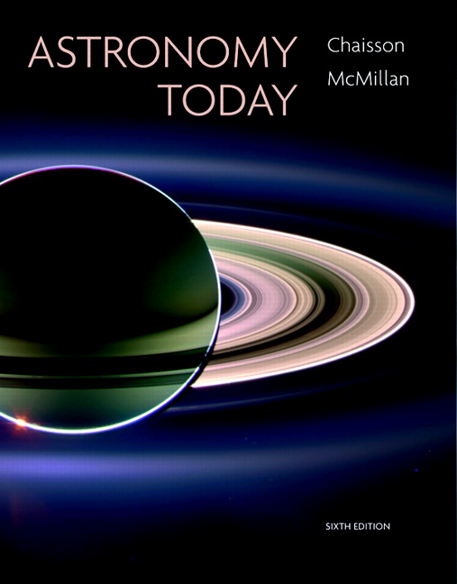
Conceptual Test
Chapter 20
ASTRONOMY TODAY
6th edition
Chaisson
McMillan
© 2008 Pearson Addison-Wesley
This work is protected by United States copyright laws and is provided solely for the use of instructors in teaching their courses and assessing student learning. Dissemination or sale of any part of this work (including on the World Wide Web) will destroy the integrity of the work and is not permitted. The work and materials from it should never be made available to students except by instructors using the accompanying text in their classes. All recipients of this work are expected to abide by these restrictions and to honor the intended pedagogical purposes and the needs of other instructors who rely on these materials.

Slide 2
Question 1
  1) as a protostar.
  2) as a red giant.
  3) as a main-sequence star.
  4) as a white dwarf.
  5) evolving from type O to type M.
A star will spend most of its “shining” lifetime
Notes:
Click to add notes

Slide 3
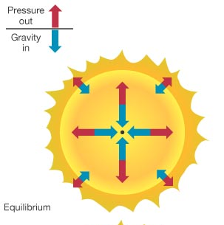
Question 1
  1) as a protostar.
  2) as a red giant.
  3) as a main-sequence star.
  4) as a white dwarf.
  5) evolving from type O to type M.
A star will spend most of its “shining” lifetime
In the main-sequence stage, hydrogen fuses to helium.
Pressure from light and heat pushing out balances gravitational pressure pushing inward.

Slide 4
Question 2
  1) they gradually become cooler and dimmer (spectral type O to type M).
  2) they gradually become hotter and brighter (spectral type M to type O).
  3) they don’t change their spectral type.
As stars evolve during their main-sequence lifetime
Notes:
Click to add notes

Slide 5
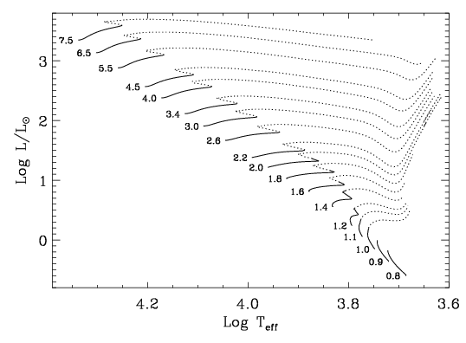
Question 2
  1) they gradually become cooler and dimmer (spectral type O to type M).
  2) they gradually become hotter and brighter (spectral type M to type O).
  3) they don’t change their spectral type.
As stars evolve during their main-sequence lifetime
Stars with M<1.2 Msol do become slightly hotter and brighter while on the main-sequence, but certainly do not change from type M to O. Higher mass stars can cool enough to change their spectral type slightly. So choices 2 and 3 both have problems.

Slide 6
Question 3
What inevitably forces a star like the Sun to evolve away from being a main-sequence star?
1) The core begins fusing iron.
2) The star uses up all of its supply of hydrogen.
3) The carbon detonation explodes it as a type I supernova.
4) Helium builds up in the core, while the hydrogen-burning shell expands.
5) The core loses all of its neutrinos, so all fusion ceases.
Notes:
Click to add notes

Slide 7
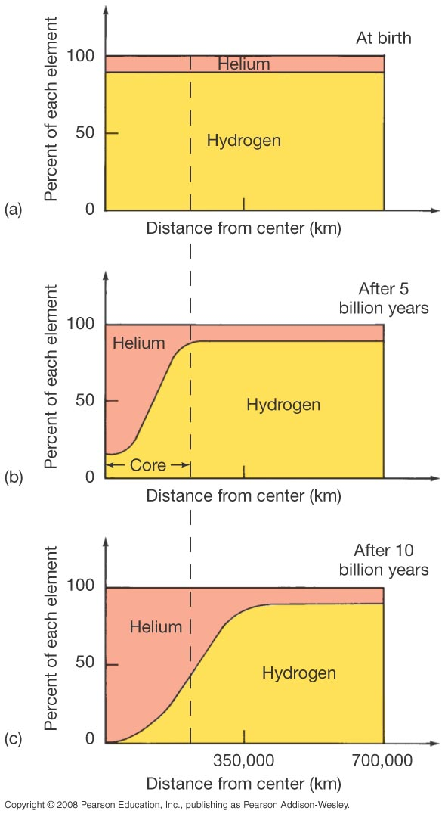
Question 3
What inevitably forces a star like the Sun to evolve away from being a main-sequence star?
1) The core begins fusing iron.
2) The star uses up all of its supply of hydrogen.
3) The carbon detonation explodes it as a type I supernova.
4) Helium builds up in the core, while the hydrogen-burning shell expands.
5) The core loses all of its neutrinos, so all fusion ceases.
When the Sun’s core contracts, it heats, and H shell fusion generates extra heat. The outer star will swell into a red giant.

Slide 8
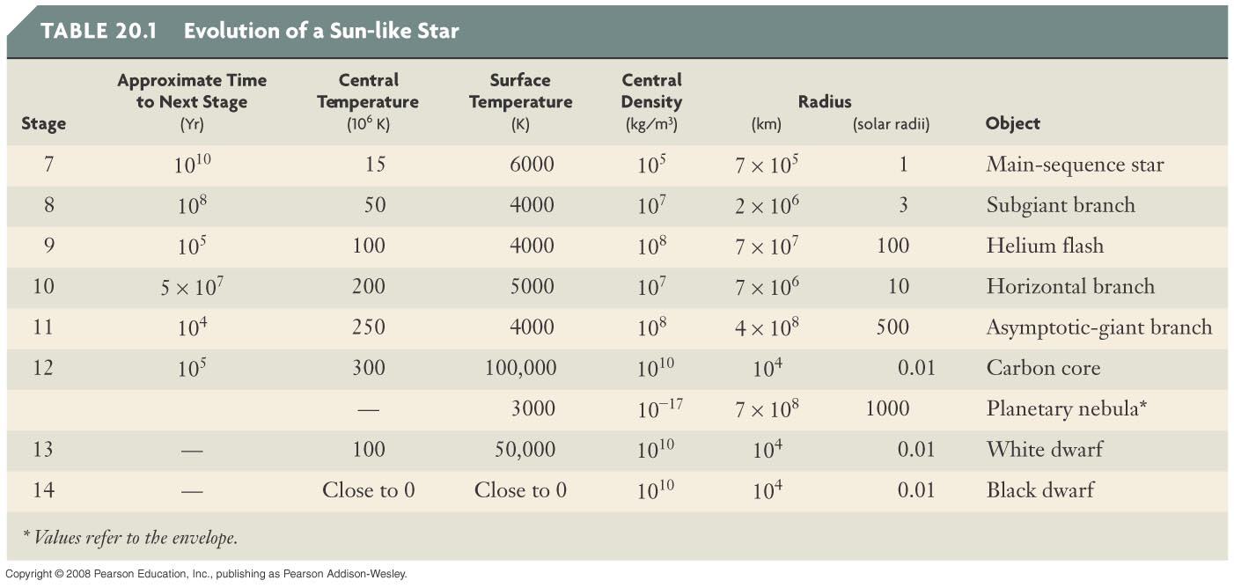
Question 4
1) It is the temperature at which
helium fuses into carbon.
2) It is the temperature needed for carbon to fuse into heavier elements.
3) It is the main-sequence core temperature which makes massive stars so bright.
4) It is the temperature needed for helium to burn into boron.
5) It is the final temperature reached during their evolution.
In the evolution of massive stars, what is the significance of the temperature 600 million K?
Notes:
Click to add notes

Slide 9
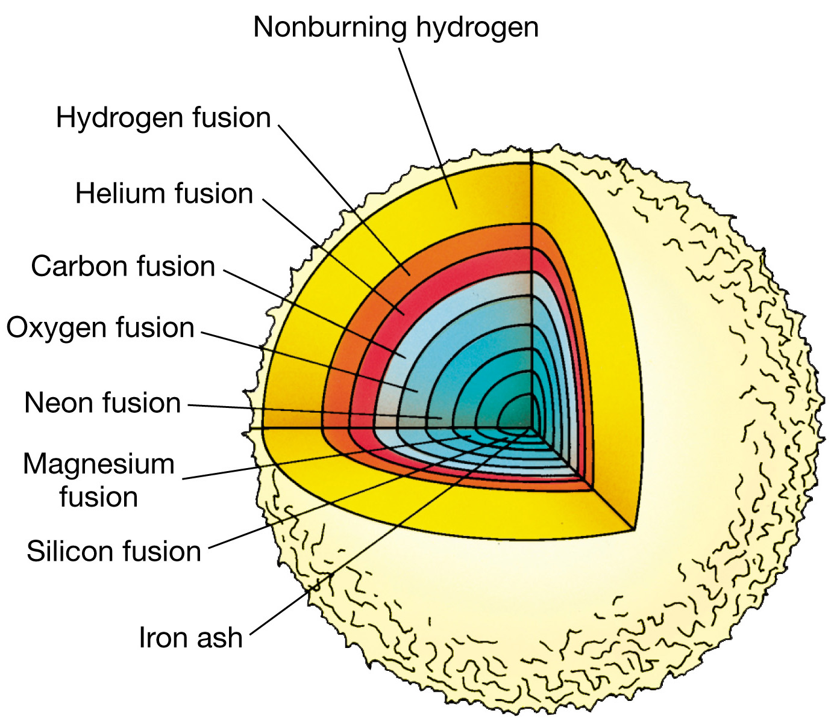
Question 4
1) It is the temperature at which helium fuses into carbon.
2) It is the temperature needed for carbon to fuse into heavier elements.
3) It is the main-sequence core temperature which makes massive stars so bright.
4) It is the temperature needed for helium to burn into boron.
5) It is the final temperature reached during their evolution.
In the evolution of massive stars, what is the significance of the temperature 600 million K?

Slide 10
Question 5
Stars like our Sun will end their lives as
1) red giants.
2) pulsars.
3) black holes.
4) white dwarfs.
5) red dwarfs.
Notes:
Click to add notes

Slide 11
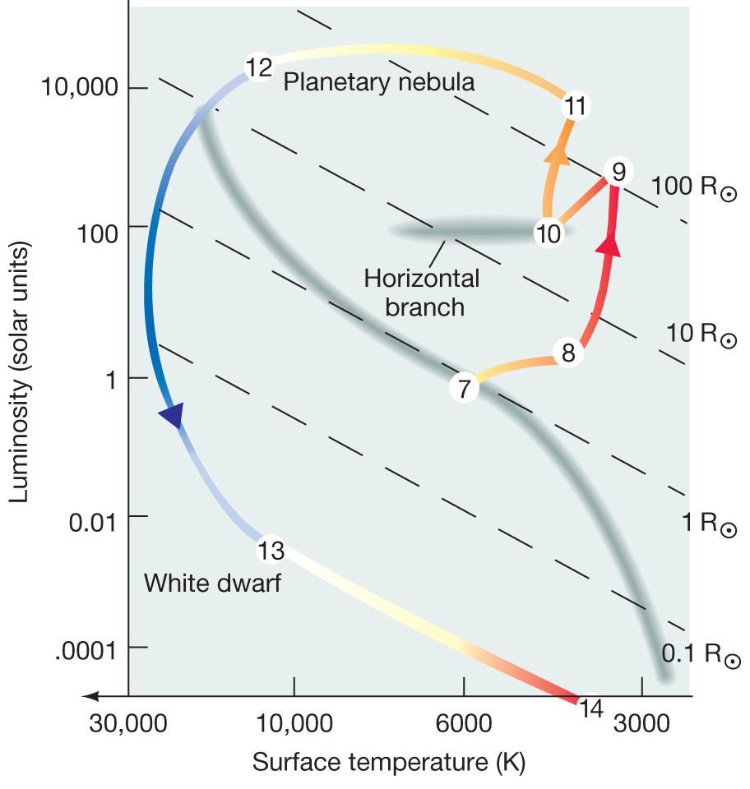
Question 5
Stars like our Sun will end their lives as
1) red giants.
2) pulsars.
3) black holes.
4) white dwarfs.
5) red dwarfs.
Low-mass stars eventually swell into red giants, and their cores later contract into white dwarfs.

Slide 12
Question 6
A ______ is a relatively gentle mass-loss event which allows a star to peacefully readjust its structure into a white dwarf configuration.
1) dark nebula
2) emission nebula
3) planetary nebula
4) nova
5) supernova
Notes:
Click to add notes

Slide 13
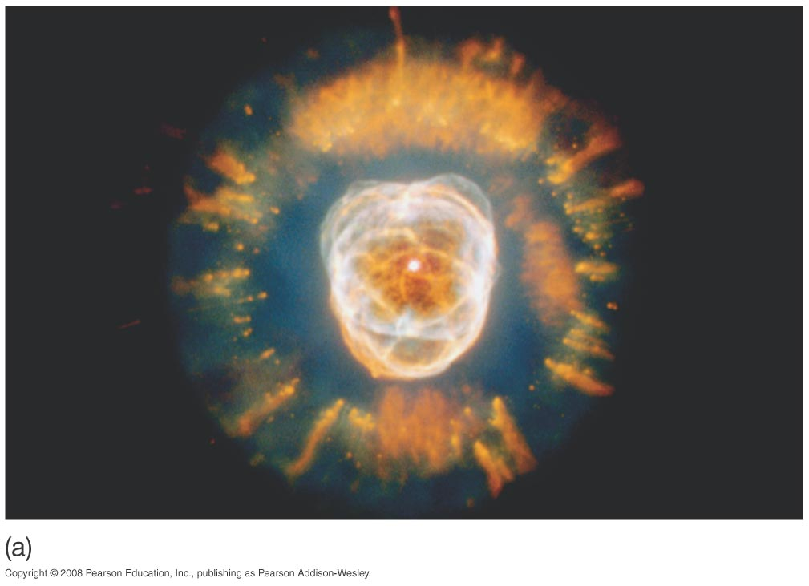
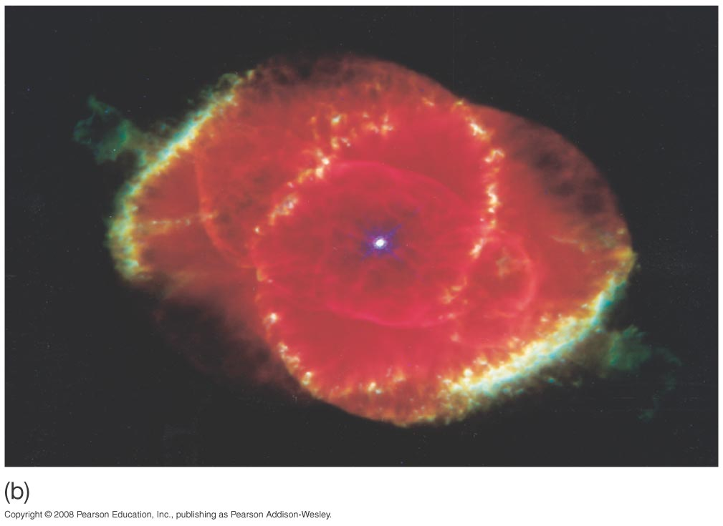
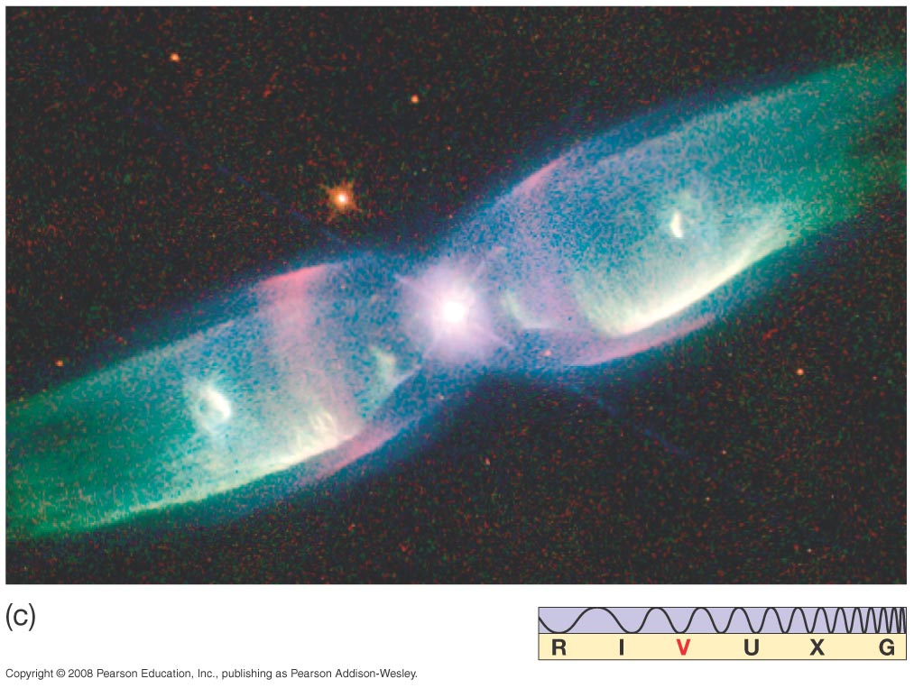
Question 6
A ______ is a relatively gentle mass-loss event which allows a star to peacefully readjust its structure into a white dwarf configuration.
1) dark nebula
2) emission nebula
3) planetary nebula
4) nova
5) supernova

Slide 14
Question 7
1) in the Big Bang.
2) by nucleosynthesis in massive stars.
3) in the cores of stars like the Sun.
4) within planetary nebulae.
5) They have always existed.
The elements heavier than Hydrogen and Helium were created
Notes:
Click to add notes

Slide 15
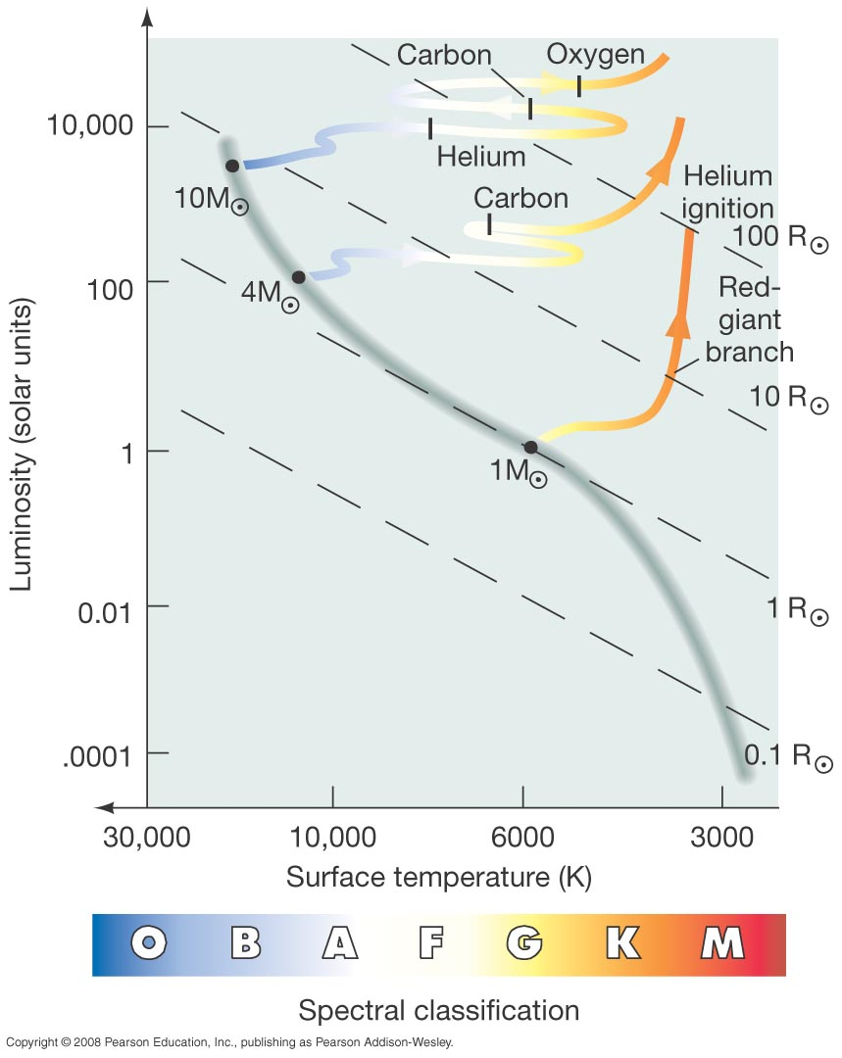
Question 7
1) in the Big Bang.
2) by nucleosynthesis in massive stars.
3) in the cores of stars like the Sun.
4) within planetary nebula
5) They have always existed.
The elements heavier than Hydrogen and Helium were created
Massive stars create enormous core temperatures as red supergiants, fusing Helium into Carbon, Oxygen, and even heavier elements.

Slide 16
Question 8
1) when T-Tauri bipolar jets shoot out.
2) in the middle of the main sequence stage.
3) in the red giant stage.
4) during the formation of a neutron star.
5) in the planetary nebula stage.
The “helium flash” occurs
Notes:
Click to add notes

Slide 17
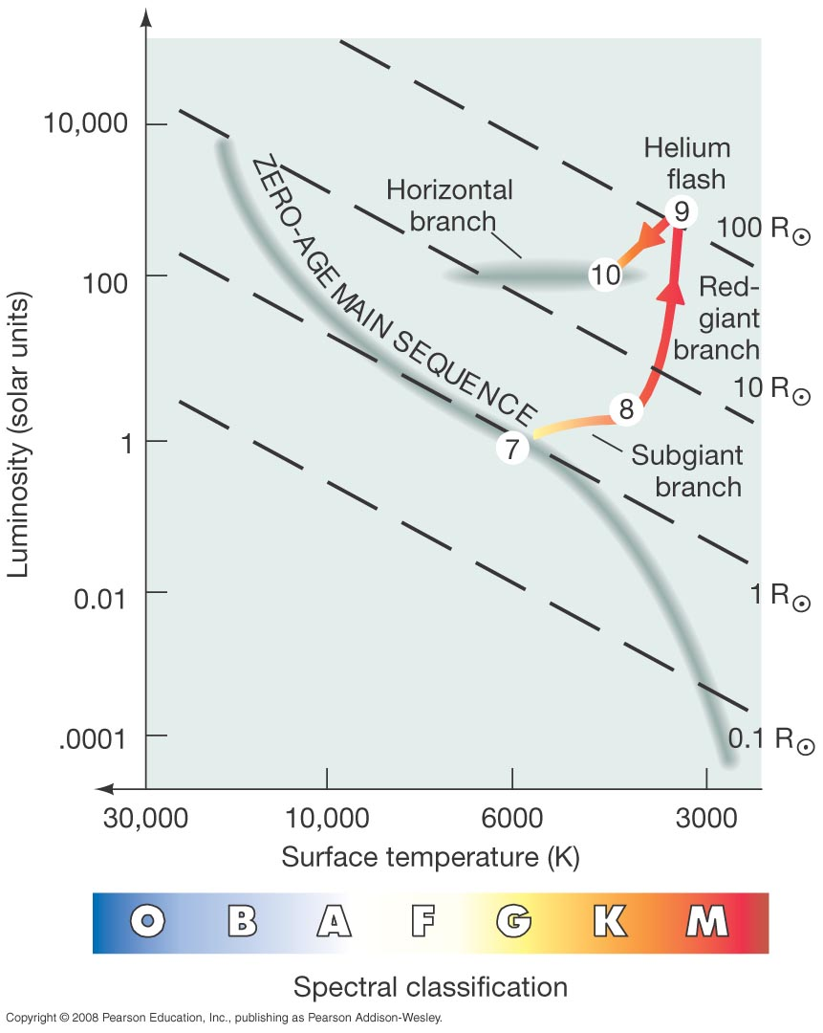
Question 8
1) when T-Tauri bipolar jets shoot out.
2) in the middle of the main sequence stage.
3) in the red giant stage.
4) during the formation of a neutron star.
5) in the planetary nebula stage.
The “helium flash” occurs
When the collapsing core of a red giant reaches high enough temperatures and densities, helium can fuse into carbon quickly – a “helium flash”.

Slide 18
Question 9
Stars gradually lose mass as they become white dwarfs during the
1) T-Tauri stage.
2) emission nebula stage.
3) supernova stage.
4) nova stage.
5) planetary nebula stage.
Notes:
Click to add notes

Slide 19
Question 9
Stars gradually lose mass as they become white dwarfs during the
1) T-Tauri stage.
2) emission nebula stage.
3) supernova stage.
4) nova stage.
5) planetary nebula stage.
Low mass stars forming white dwarfs slowly lose their outer atmospheres, and illuminate these gases for a relatively short time.

Slide 20
Question 10
1) the number of main sequence stars.
2) the ratio of giants to supergiants.
3) the luminosity of stars at the turn-off point.
4) the number of white dwarfs.
5) Supernova explosions.
Astronomers determine the age of star clusters by observing
Notes:
Click to add notes

Slide 21
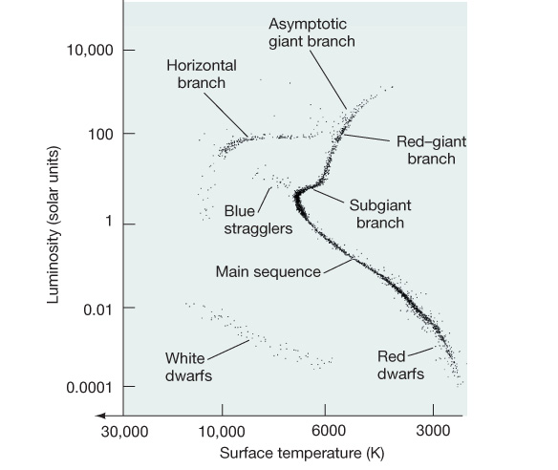
Question 10
1) the number of main sequence stars.
2) the ratio of giants to supergiants.
3) the luminosity of stars at the turn-off point.
4) the number of white dwarfs.
5) Supernova explosions.
Astronomers determine the age of star clusters by observing
The H-R diagram of a cluster can indicate its approximate age.
Turn-off point from the main sequence

Slide 22
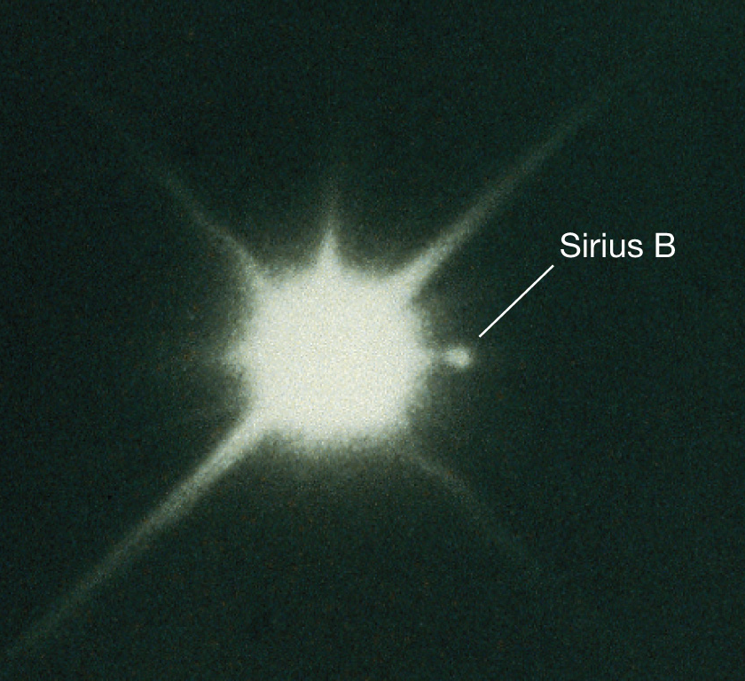
Question 11
1) electron degeneracy.
2) neutron degeneracy.
3) thermal pressure from intense core temperatures.
4) gravitational pressure.
5) helium-carbon fusion.
The source of pressure that makes a white dwarf stable is
Notes:
Click to add notes

Slide 23
Question 11
1) electron degeneracy.
2) neutron degeneracy.
3) thermal pressure from intense core temperatures.
4) gravitational pressure.
5) helium-carbon fusion.
The source of pressure that makes a white dwarf stable is
Electrons in the core cannot be squeezed infinitely close, and prevent a low-mass star from collapsing further.

Slide 24
Question 12
In a white dwarf, the mass of the Sun is packed into the volume of
1) an asteroid.
2) a planet the size of Earth.
3) a planet the size of Jupiter.
4) an object the size of the Moon.
5) an object the size of a sugar cube.
Notes:
Click to add notes

Slide 25
Question 12
In a white dwarf, the mass of the Sun is packed into the volume of
1) an asteroid.
2) a planet the size of Earth.
3) a planet the size of Jupiter.
4) an object the size of the Moon.
5) an object the size of a sugar cube.
The density of a white dwarf is about a million times greater than normal solid matter.

Slide 26
Question 13
In a young star cluster, when more massive stars are evolving into red giants, the least massive stars are
1) ending their main-sequence stage.
2) also evolving into red giants.
3) forming planetary nebulae.
4) barely starting to fuse Hydrogen.
5) starting the Nova stage.
Notes:
Click to add notes

Slide 27
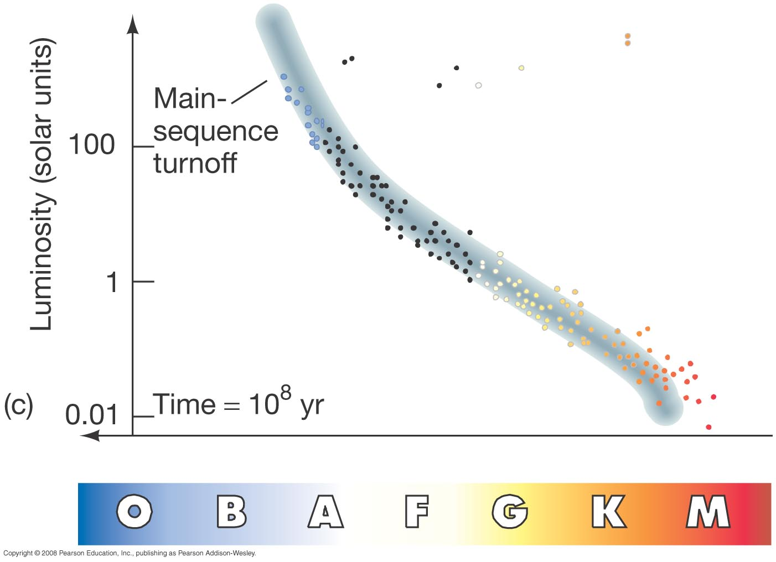
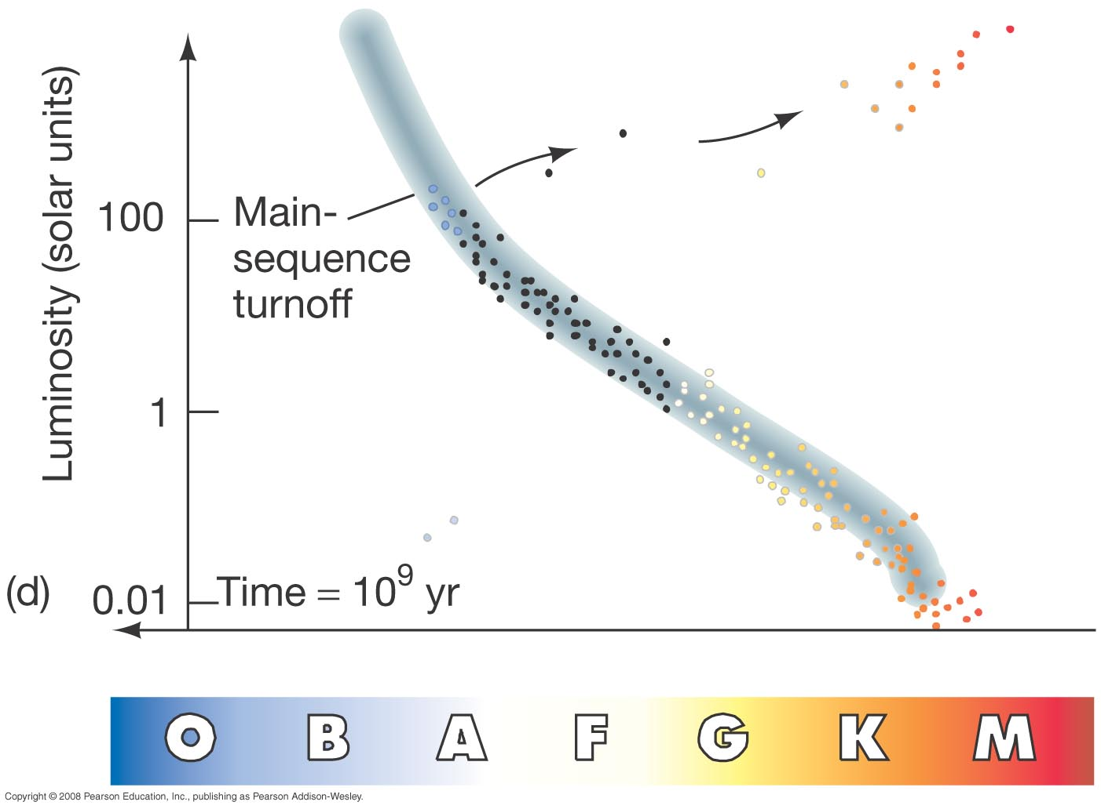
Question 13
In a young star cluster, when more massive stars are evolving into red giants, the least massive stars are
1) ending their main-sequence stage.
2) also evolving into red giants.
3) forming planetary nebulae.
4) barely starting to fuse Hydrogen.
5) starting the Nova stage.
More massive stars form much faster, and have much shorter main-sequence lifetimes.
Low mass stars form more slowly.

Slide 28
Question 14
  1) those heavier than iron, because of supernovae
  2) iron, formed just before massive stars explode
  3) odd-numbered nuclei, built with hydrogen fusion
  4) even-numbered nuclei, built with helium fusion
What type of atomic nuclei heavier than helium are most common, and why?
Notes:
Click to add notes

Slide 29
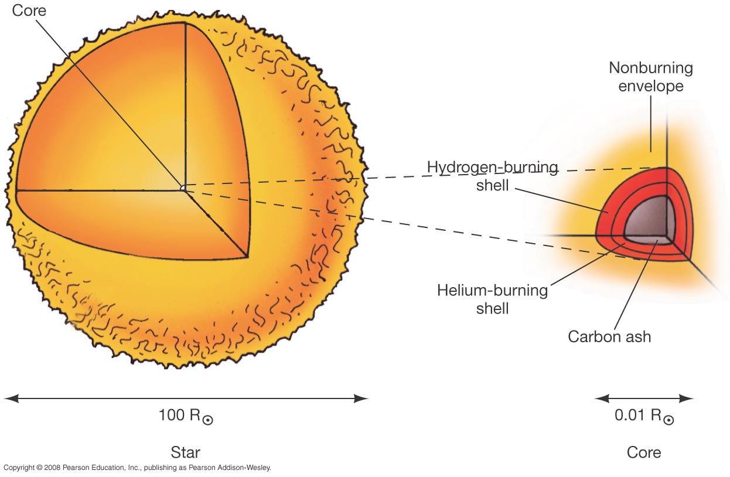
Question 14
  1) those heavier than iron, because of supernovae
  2) iron, formed just before massive stars explode
  3) odd-numbered nuclei, built with hydrogen fusion
  4) even-numbered nuclei, built with helium fusion
What type of atomic nuclei heavier than helium are most common, and why?
Helium nuclei have an atomic mass of 4; they act as building blocks in high-temperature fusion within supergiants.

Slide 30
Question 15
1) hypernova.
2) potential type II supernova.
3) contact binary.
4) spectroscopic binary.
5) mass-transfer binary.
If one star of a binary fills its Roche lobe and is spilling matter onto the other, the system is a
Notes:
Click to add notes

Slide 31
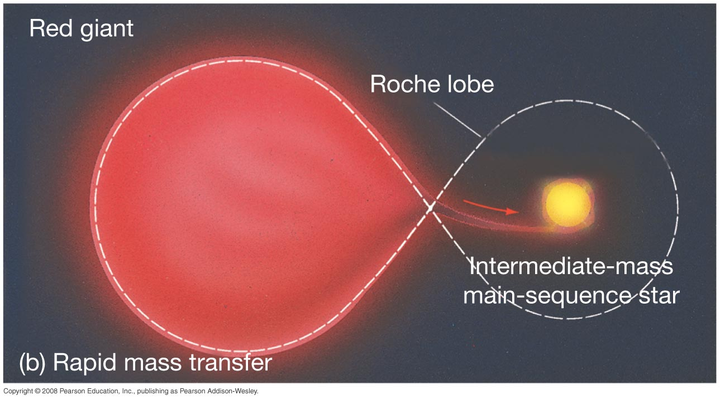
Question 15
1) hypernova.
2) potential type II supernova.
3) contact binary.
4) spectroscopic binary.
5) mass-transfer binary.
If one star of a binary fills its Roche lobe and is spilling matter onto the other, the system is a

