Slide 1
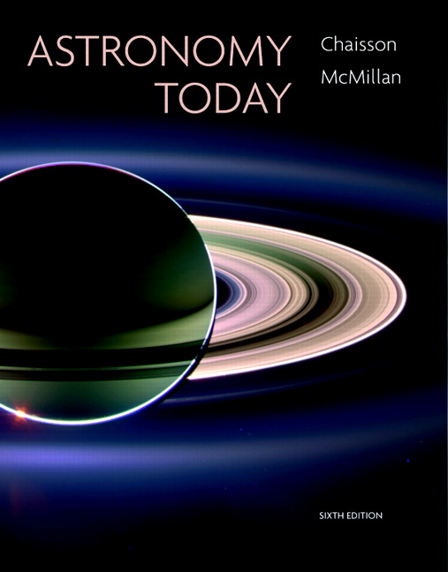
Conceptual Test
Chapter 23
ASTRONOMY TODAY
6th edition
Chaisson
McMillan
© 2008 Pearson Addison-Wesley
This work is protected by United States copyright laws and is provided solely for the use of instructors in teaching their courses and assessing student learning. Dissemination or sale of any part of this work (including on the World Wide Web) will destroy the integrity of the work and is not permitted. The work and materials from it should never be made available to students except by instructors using the accompanying text in their classes. All recipients of this work are expected to abide by these restrictions and to honor the intended pedagogical purposes and the needs of other instructors who rely on these materials.

Slide 2
Question 1
1) about 30 kpc from the center in the halo.
2) 30,000 light years from the center in a globular cluster.
3) at the outer edge of the Galactic disk, in the plane.
4) about half-way from the center, in the spiral arms.
5) in the bulge, near the Orion arm.
Our Sun is located in the Milky Way Galaxy
Notes:
Click to add notes

Slide 3
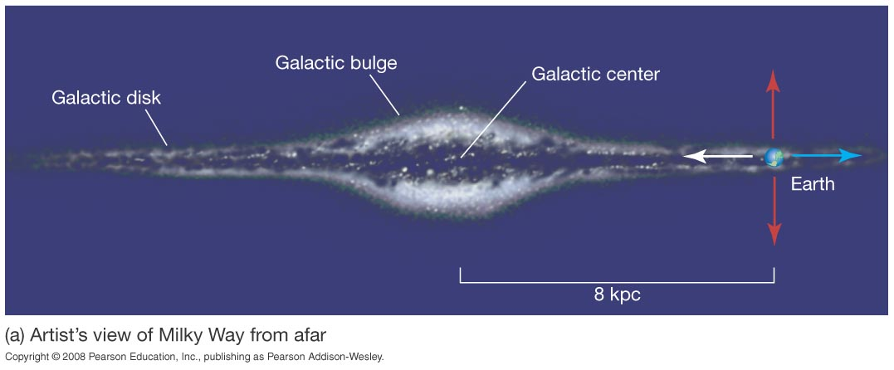
Question 1
1) about 30 kpc from the center in the halo.
2) 30,000 light years from the center in a globular cluster.
3) at the outer edge of the Galactic disk, in the plane.
4) about half-way from the center, in the spiral arms.
5) in the bulge, near the Orion arm.
Our Sun is located in the Milky Way Galaxy
The Sun orbits the center of the Galaxy within the disk, taking about 225 million years to complete one orbit.

Slide 4
Question 2
1) measuring distances with Cepheid variable stars.
2) identifying the mass of the Galaxy’s central black hole.
3) determining the masses of stars in an eclipsing binary system.
4) using spectroscopic parallax to measure distances to stars.
The Period-Luminosity relationship is a crucial component to
Notes:
Click to add notes

Slide 5
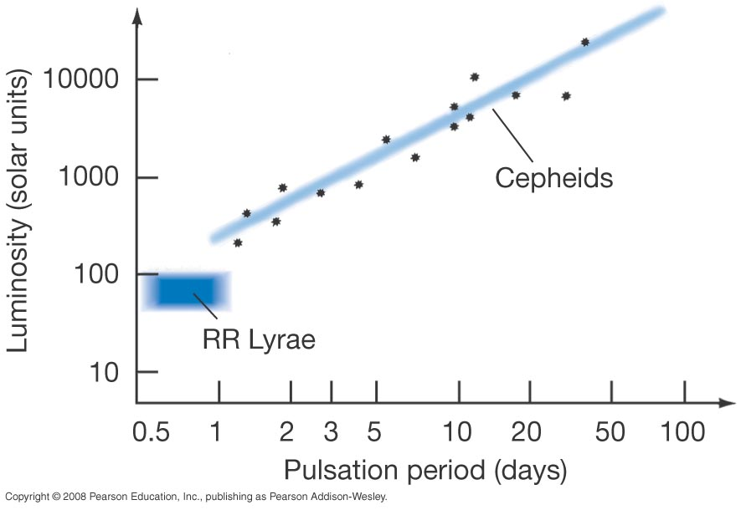
Question 2
1) measuring distances with Cepheid variable stars.
2) identifying the mass of the Galaxy’s central black hole.
3) determining the masses of stars in an eclipsing binary system.
4) using spectroscopic parallax to measure distances to stars.
The Period-Luminosity relationship is a crucial component to
Cepheid variable stars with longer periods have higher actual luminosities; short-period Cepheids are dimmer.

Slide 6
Question 3
1) supernova remnants.
2) white dwarf stars in the spiral arms.
3) red giant variable stars in globular clusters.
4) bright O and B stars in open clusters.
5) X-ray sources.
The location of the Galactic center was identified using
Notes:
Click to add notes

Slide 7
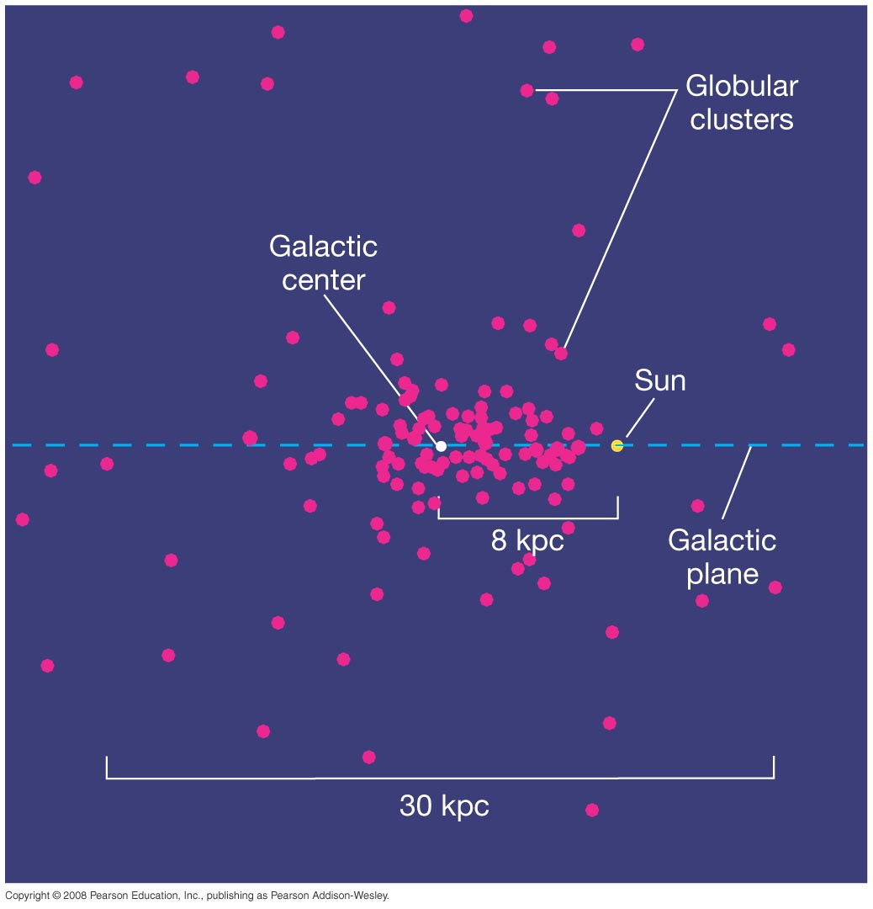
Question 3
1) supernova remnants.
2) white dwarf stars in the spiral arms.
3) red giant variable stars in globular clusters.
4) bright O and B stars in open clusters.
5) X-ray sources.
The location of the Galactic center was identified using
Harlow Shapley used pulsating RR-Lyrae variables as distance indicators to the globular clusters.
He then deduced the distance and direction of the Milky Way’s center.

Slide 8
Question 4
1) the Sun’s mass and velocity in orbit around the Galactic center
2) the rotation of the bulge and disk components
3) the Sun’s age and age of globular cluster stars
4) the motion of spiral arms and the mass of the central black hole
5) the Sun’s orbital period and distance from the center
What two observations allow us to estimate the Galaxy’s mass?
Notes:
Click to add notes

Slide 9
Question 4
1) the Sun’s mass and velocity in orbit around the Galactic center
2) the rotation of the bulge and disk components
3) the Sun’s age and age of the globular cluster stars
4) the motion of spiral arms and mass of the central black hole
5) the Sun’s orbital period and distance from the center
What two observations allow us to estimate the Galaxy’s mass?
Use the modified form of Kepler’s law to find the mass:
Total Mass = (orbital size)³ / (orbital period)²

Slide 10
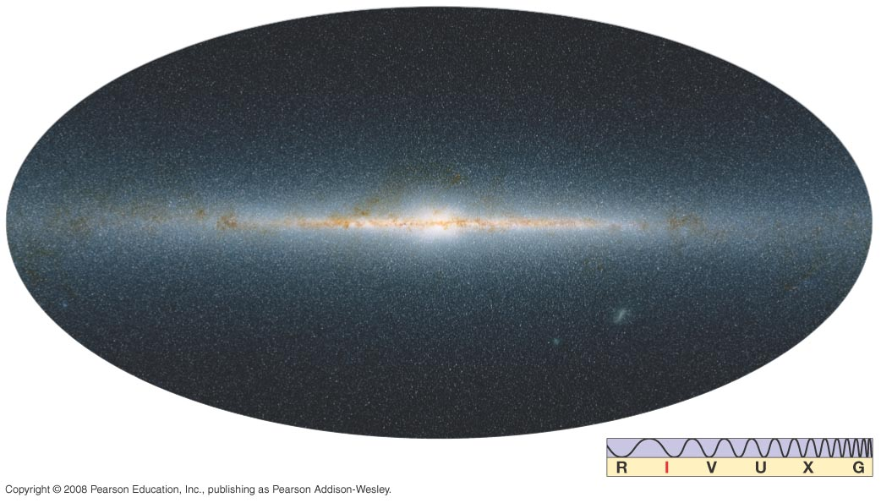
Question 5
1) 10,000 solar masses
2) 10 solar masses
3) 1 million solar masses
4) 200–300 billion solar masses
5) 20 billion solar masses
What is the approximate mass of the Milky Way?
Notes:
Click to add notes

Slide 11
Question 5
1) 10,000 solar masses
2) 10 solar masses
3) 1 million solar masses
4) 200–300 billion solar masses
5) 20 billion solar masses
What is the approximate mass of the Milky Way?

Slide 12
Question 6
1) 21-cm maps of the spiral arms
2) the rotation curve of the outer edges of the Galaxy
3) orbits of open clusters in the disk
4) infrared observations of new star forming regions
5) X-ray images of other galaxies
What suggests that the mass of the Galaxy extends farther than its visible disk?
Notes:
Click to add notes

Slide 13
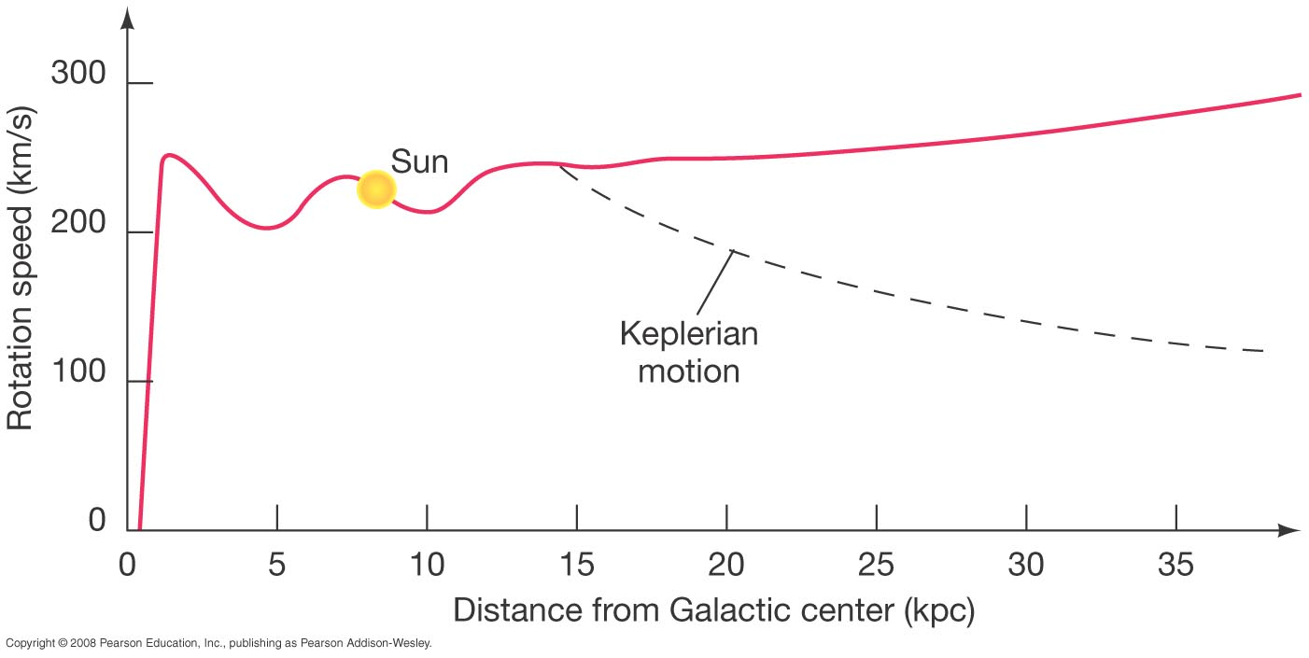
Question 6
1) 21-cm maps of the spiral arms
2) the rotation curve of the outer edges of the Galaxy
3) orbits of open clusters in the disk
4) infrared observations of new star forming regions
5) X-ray images of other galaxies
What suggests that the mass of the Galaxy extends farther than its visible disk?
The outer edges of the Galaxy’s disk rotate much faster than they should.
Most of the mass of the Galaxy must be dark matter.

Slide 14
Question 7
1) the spiral arms formed first.
2) the globular clusters formed first.
3) the disk component started out thin and grew.
4) spiral density waves formed first.
5) the bar in the bulge formed first.
In the formation of our Galaxy
Notes:
Click to add notes

Slide 15
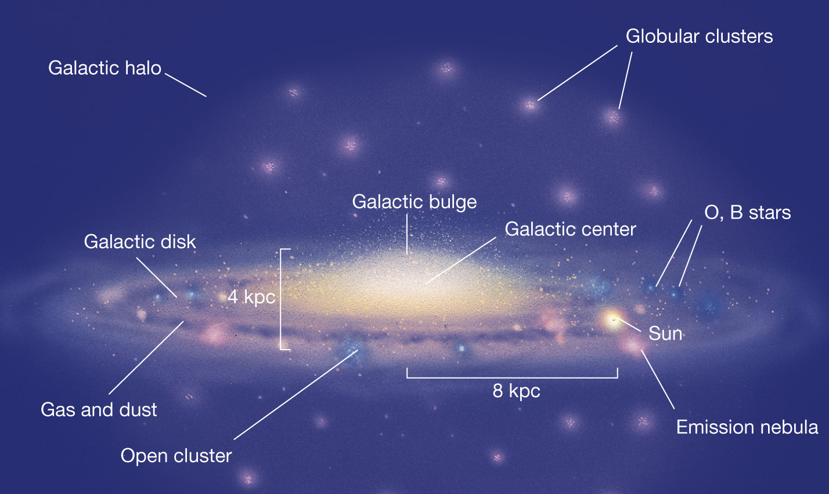
Question 7
1) the spiral arms formed first.
2) the globular clusters formed first.
3) the disk component started out thin and grew.
4) spiral density waves formed first.
5) the bar in the bulge formed first.
In the formation of our Galaxy
Globular clusters contain very old stars, no gas or dust, and orbit around the center randomly.

Slide 16
Question 8
1) nucleus.
2) spiral arms.
3) bulge.
4) halo.
5) Galactic disk.
Star formation ceased first in the
Notes:
Click to add notes

Slide 17
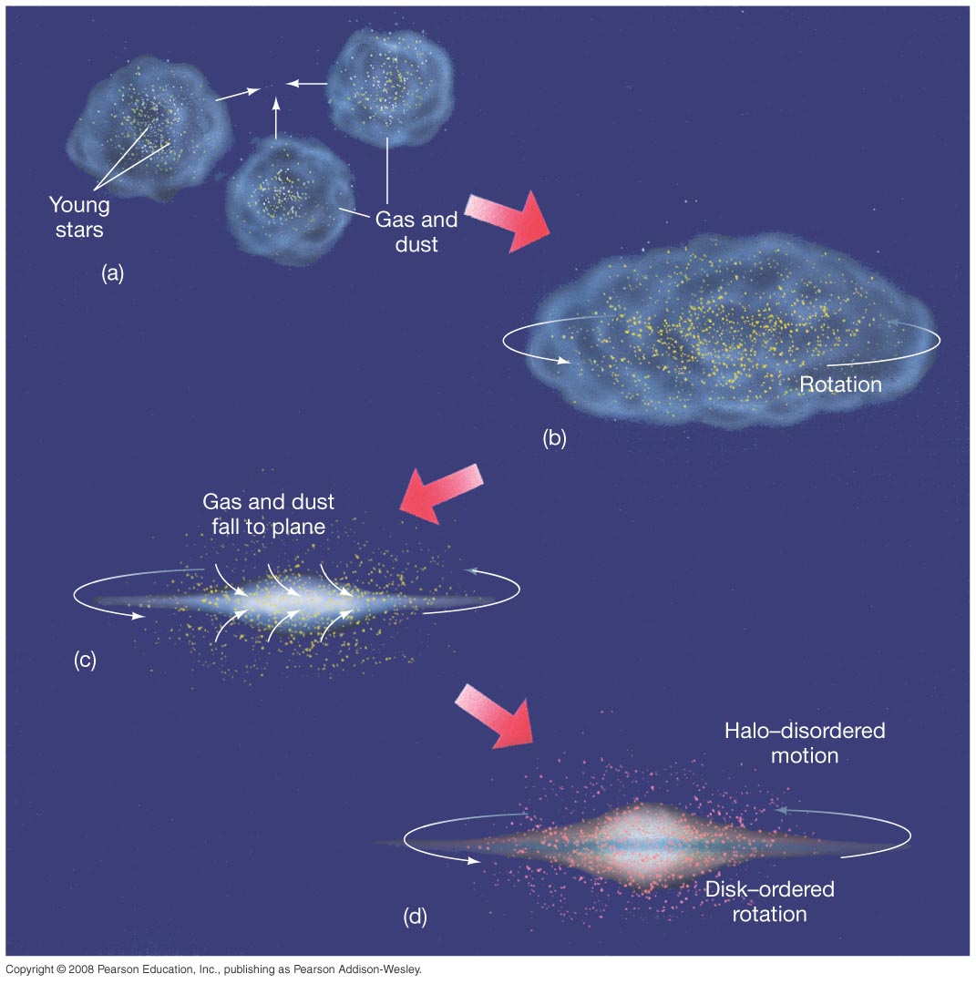
Question 8
1) nucleus.
2) spiral arms.
3) bulge.
4) halo.
5) Galactic disk.
Star formation ceased first in the

Slide 18
Question 9
1) a spiral galaxy.
2) a barred spiral galaxy.
3) an elliptical galaxy.
4) a quasar.
5) an irregular galaxy.
Detailed measurements of the disk suggest that our Milky Way is
Notes:
Click to add notes

Slide 19
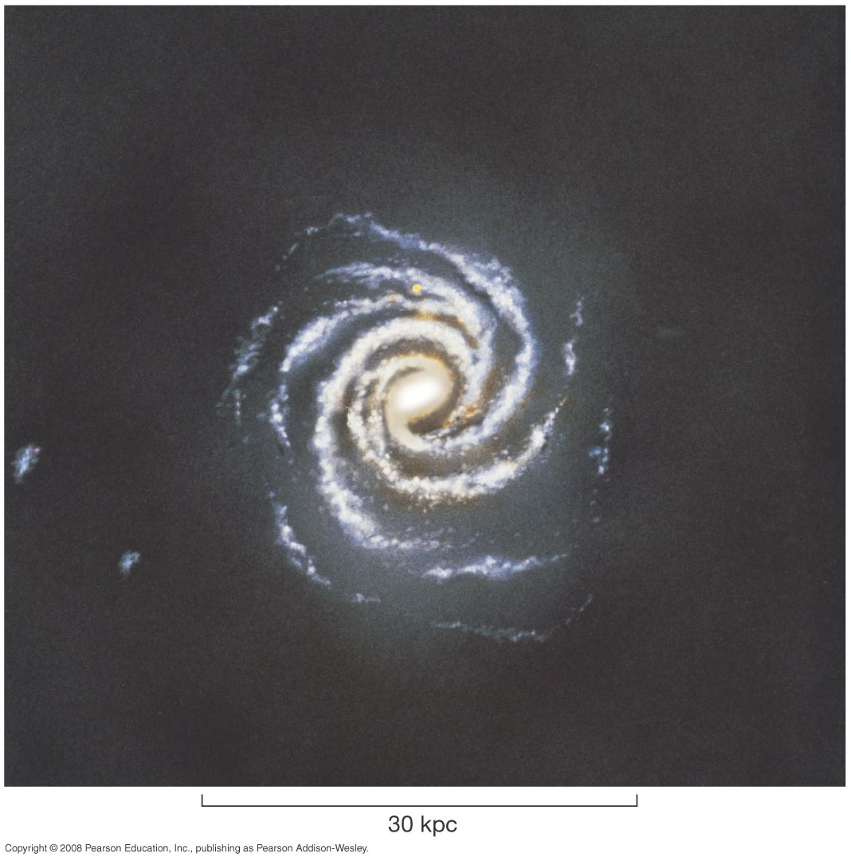
Question 9
1) a spiral galaxy.
2) a barred spiral galaxy.
3) an elliptical galaxy.
4) a quasar.
5) an irregular galaxy.
Detailed measurements of the disk suggest that our Milky Way is
Measurements of stellar motion in and near the bulge imply that it is football shaped, about half as wide as it is long, characteristic of a barred spiral galaxy.

Slide 20
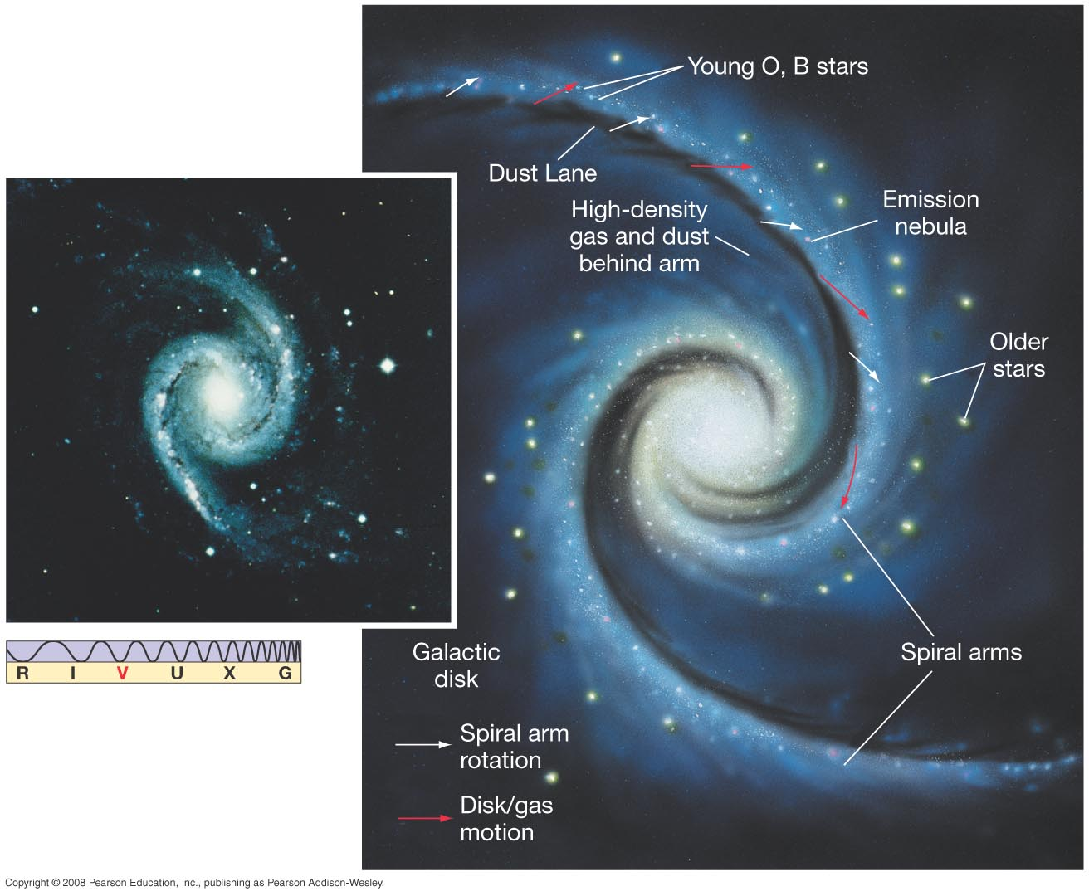
Question 10
1) shock waves from cyclic supernovae explosions.
2) a shock wave from the quasar-like eruption of the Galactic core.
3) passages of spiral density waves through the interstellar medium.
4) passages of massive globular clusters through the Galactic plane.
5) tidal streams of small galaxies being torn up by our monster Galaxy.
The leading explanation for the existence of spiral arms is/are
Notes:
Click to add notes

Slide 21
Question 10
1) shock waves from cyclic supernovae explosions.
2) a shock wave from the quasar-like eruption of the Galactic core.
3) passages of spiral density waves through the interstellar medium.
4) passages of massive globular clusters through the Galactic plane.
5) tidal streams of small galaxies being torn up by our monster Galaxy.
The leading explanation for the existence of spiral arms is/are

Slide 22
Question 11
Which of these is not a typical part of the Galaxy’s spiral arms?
1) OB associations
2) open clusters
3) giant molecular clouds
4) emission nebulae
5) Population II red giant stars
Notes:
Click to add notes

Slide 23
Question 11
Which of these is not a typical part of the Galaxy’s spiral arms?
1) OB associations
2) open clusters
3) giant molecular clouds
4) emission nebulae
5) Population II red giant stars
The spiral arms contain gas, dust, molecular clouds, new clusters, and Population I stars.

Slide 24
Question 12
1) the waves penetrate dusty cocoons to reveal star formation.
2) it reflects from the Galaxy’s core.
3) the waves are not absorbed by Galactic black holes.
4) it can be used to map out the cool hydrogen in spiral arms.
5) radio waves provide a distance measurement like parallax.
21-cm radio radiation is useful in studying the Galaxy because
Notes:
Click to add notes

Slide 25
Question 12
1) the waves penetrate dusty cocoons to reveal star formation.
2) it reflects from the Galaxy’s core.
3) the waves are not absorbed by Galactic black holes.
4) it can be used to map out the cool hydrogen in spiral arms.
5) radio waves provide a distance measurement like parallax.
21-cm radio radiation is useful in studying the Galaxy because
The Doppler shifts of 21-cm radiation from hydrogen in the spiral arms provides astronomers with a tool to map out the Galaxy’s structure.

Slide 26
Question 13
1) Globular Central.
2) Cygnus X-1.
3) Sagittarius A.
4) Centaurus A.
5) SS 443.
As found by radio astronomers, the core of our Galaxy is known as
Notes:
Click to add notes

Slide 27
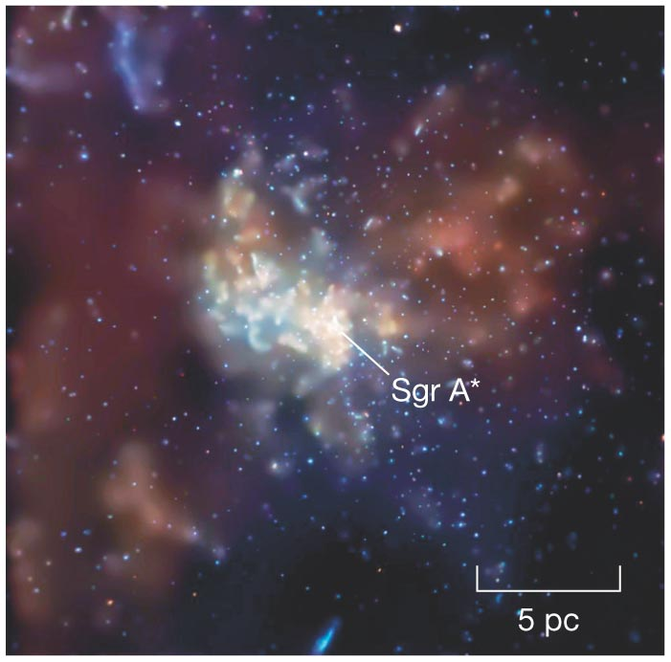
Question 13
1) Globular Central.
2) Cygnus X-1.
3) Sagittarius A.
4) Centaurus A.
5) SS 443.
As found by radio astronomers, the core of our Galaxy is known as

Slide 28
Question 14
High speed motion of gas and stars near the Milky Way Galaxy’s center is explained by
1) tidal forces from the Andromeda Galaxy.
2) accretion disks around neutron stars.
3) gamma-ray bursts.
4) gravitation from globular clusters.
5) a supermassive black hole.
Notes:
Click to add notes

Slide 29
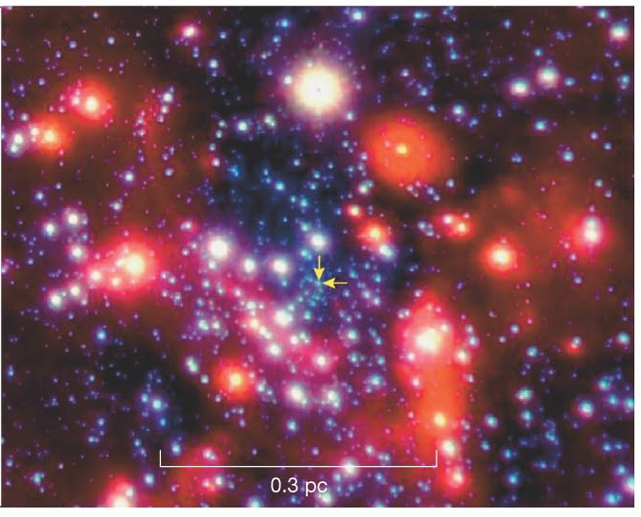
Question 14
High speed motion of gas and stars near the Milky Way Galaxy’s center is explained by
1) tidal forces from the Andromeda Galaxy.
2) accretion disks around neutron stars.
3) gamma-ray bursts.
4) gravitation from globular clusters.
5) a supermassive black hole.
Recent observations estimate the black hole to be 4 million solar masses.

