Slide 1
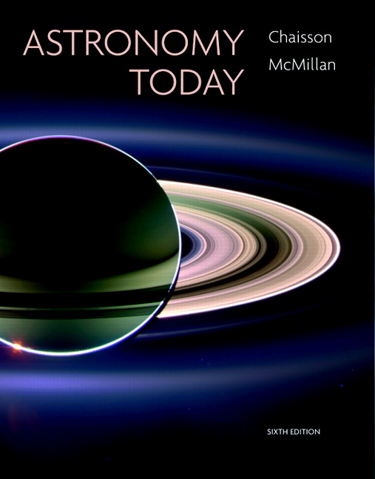
Conceptual Test
Chapter 24
ASTRONOMY TODAY
6th edition
Chaisson
McMillan
© 2008 Pearson Addison-Wesley
This work is protected by United States copyright laws and is provided solely for the use of instructors in teaching their courses and assessing student learning. Dissemination or sale of any part of this work (including on the World Wide Web) will destroy the integrity of the work and is not permitted. The work and materials from it should never be made available to students except by instructors using the accompanying text in their classes. All recipients of this work are expected to abide by these restrictions and to honor the intended pedagogical purposes and the needs of other instructors who rely on these materials.

Slide 2
Question 1
Which of the following is NOT one of the basic types of galaxy?
1) spiral
2) lenticular
3) globular
4) irregular
5) elliptical
Notes:
Click to add notes

Slide 3
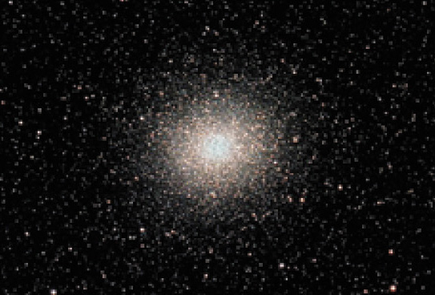
Question 1
Which of the following is NOT one of the basic types of galaxy?
1) spiral
2) lenticular
3) globular
4) irregular
5) elliptical

Slide 4
Question 2
Which type of galaxy contains the most population II stars?
1) spiral
2) globular
3) irregular
4) elliptical
Notes:
Click to add notes

Slide 5
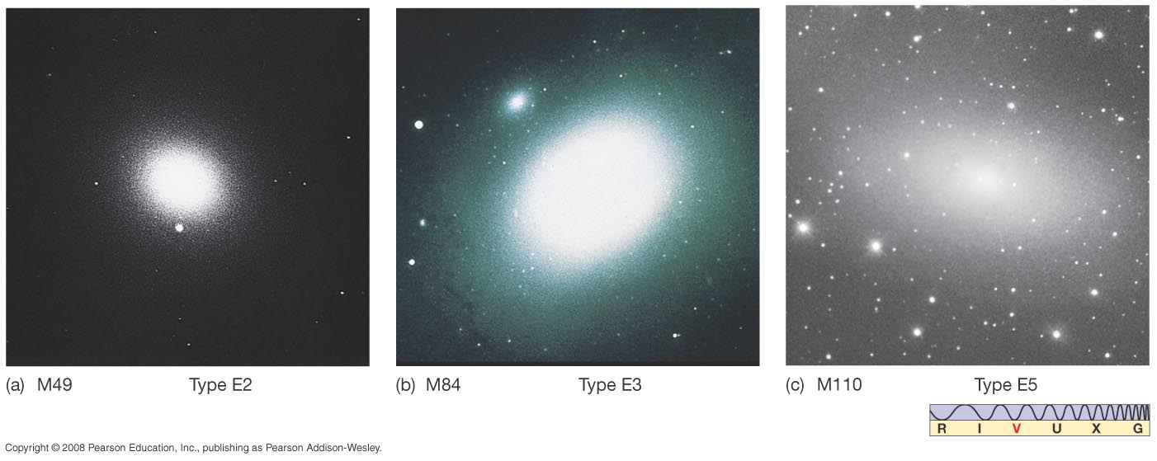
Question 2
Which type of galaxy contains the most population II stars?
1) spiral
2) globular
3) irregular
4) elliptical

Slide 6
Question 3
Which type of galaxy most resembles our Milky Way?
1) spiral
2) globular
3) irregular
4) elliptical
5) lenticular
Notes:
Click to add notes

Slide 7
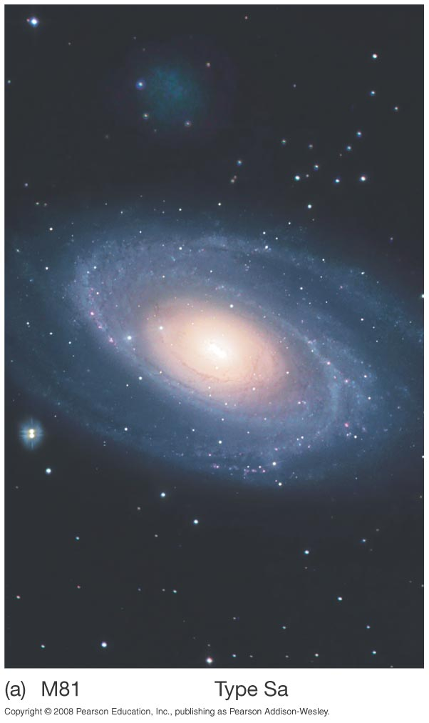
Question 3
Which type of galaxy most resembles our Milky Way?
1) spiral
2) globular
3) irregular
4) elliptical
5) lenticular

Slide 8
Question 4
Which type of galaxy can grow to the greatest mass and possess the largest number of globular clusters?
1) spiral
2) globular
3) irregular
4) elliptical
5) lenticular
Notes:
Click to add notes

Slide 9
Question 4
Which type of galaxy can grow to the greatest mass and possess the largest number of globular clusters?
1) spiral
2) globular
3) irregular
4) elliptical
5) lenticular

Slide 10
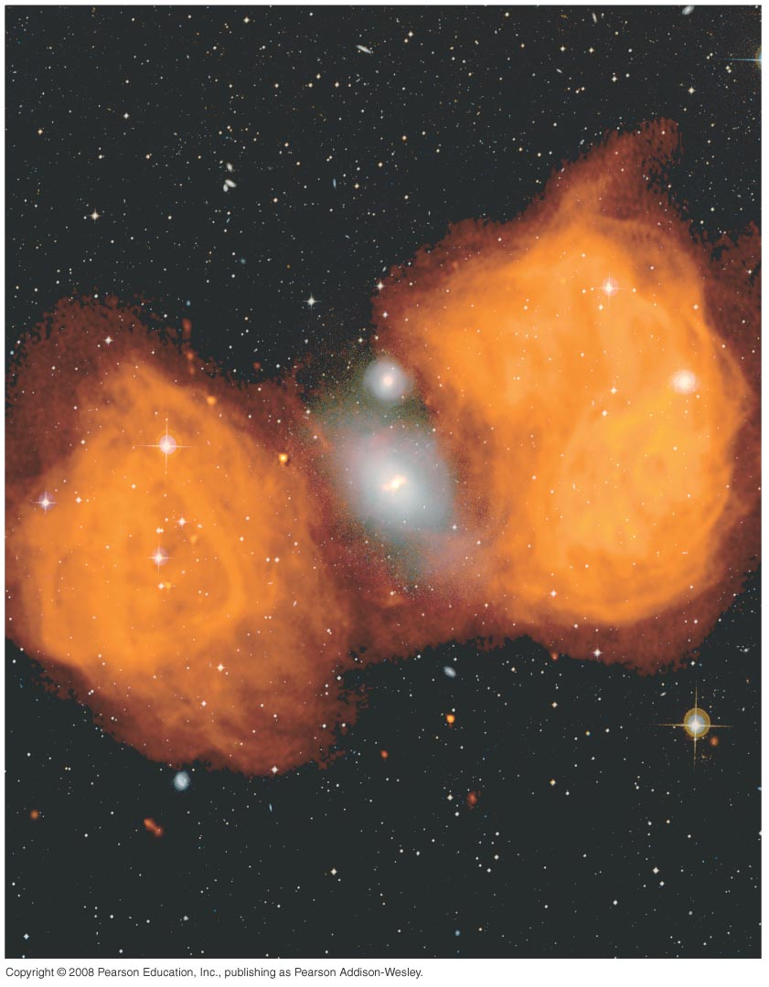
Question 5
Hubble took spectra of galaxies in the 1930s. What did he find?
1) All the galaxies showed blue line shifts.
2) Most galaxies showed redshifts.
3) Galaxies showed about half redshifts and half blueshifts.
4) Galaxies showed no line shifts at all.
5) Some galaxies showed a redshift that changed into a blueshift at other times.
Notes:
Click to add notes

Slide 11
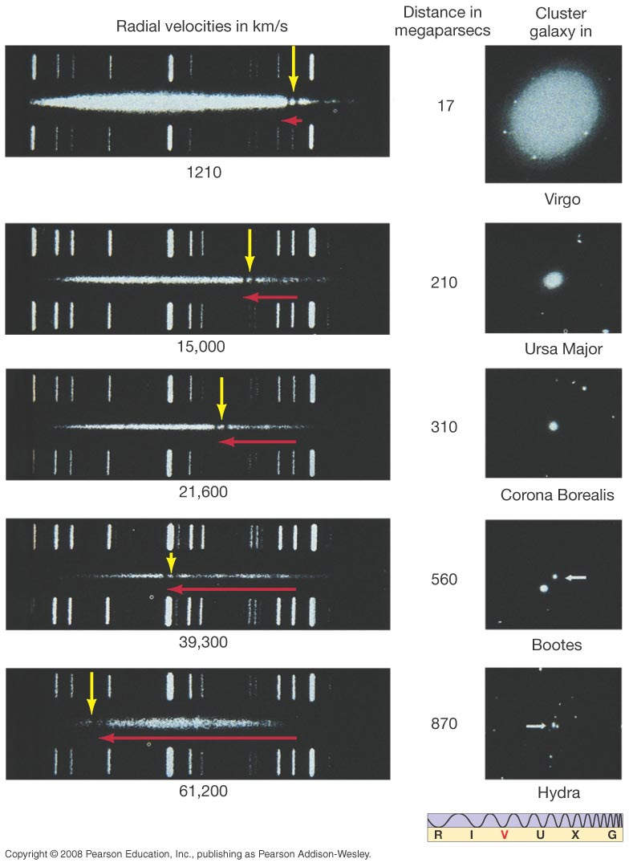
Question 5
Hubble took spectra of galaxies in the 1930s. What did he find?
1) All the galaxies showed blue line shifts.
2) Most galaxies showed redshifts.
3) Galaxies showed about half redshifts and half blueshifts.
4) Galaxies showed no line shifts at all.
5) Some galaxies showed a redshift that changed into a blueshift at other times.

Slide 12
Question 6
What did the discovery suggest to cosmologists?
1) The universe is static.
2) The universe is collapsing.
3) The universe is expanding.
4) The universe is contracting.
5) There is no accepted interpretation.
Notes:
Click to add notes

Slide 13
Question 6
What did the discovery suggest to cosmologists?
1) The universe is static.
2) The universe is collapsing.
3) The universe is expanding.
4) The universe is contracting.
5) There is no accepted interpretation.

Slide 14
Question 7
1) moving around randomly.
2) showing Doppler blueshifts.
3) moving in circles.
4) rushing away from us.
5) approaching us.
Most of the galaxies (99%) are
Notes:
Click to add notes

Slide 15
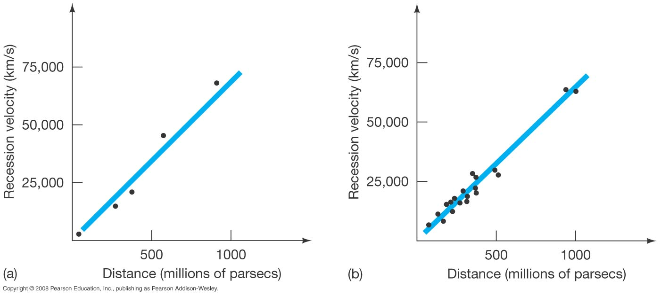
Question 7
1) moving around randomly.
2) showing Doppler blueshifts.
3) moving in circles.
4) rushing away from us.
5) approaching us.
Most of the galaxies (99%) are

Slide 16
Question 8
Galaxy distance and Doppler redshift are correlated for galaxies.
What do we call that correlation?
1) the Hubble “law”
2) Wein’s relation
3) redshift–distance relation
4) period–luminosity relation
5) both 1 and 3
Notes:
Click to add notes

Slide 17
Question 8
Galaxy distance and Doppler redshift are correlated for galaxies.
What do we call that correlation?
1) the Hubble “law”
2) Wein’s relation
3) redshift–distance relation
4) period–luminosity relation
5) both 1 and 3

Slide 18
Question 9
1) Cepheid relation
2) Hubble constant
3) radial velocity
4) distance in megaparsecs
5) Wien’s constant
What is the H in V = Hr?
Notes:
Click to add notes

Slide 19
Question 9
1) Cepheid relation
2) Hubble constant
3) radial velocity
4) distance in megaparsecs
5) Wien’s constant
What is the H in V = Hr?

Slide 20
Question 10
We estimate the value of H by getting what measure for many galaxies at many different (Doppler redshift) recession velocities?
1) temperature
2) luminosity
3) distance
4) color
5) size
Notes:
Click to add notes

Slide 21
Question 10
We estimate the value of H by getting what measure for many galaxies at many different (Doppler redshift) recession velocities?
1) temperature
2) luminosity
3) distance
4) color
5) size

Slide 22
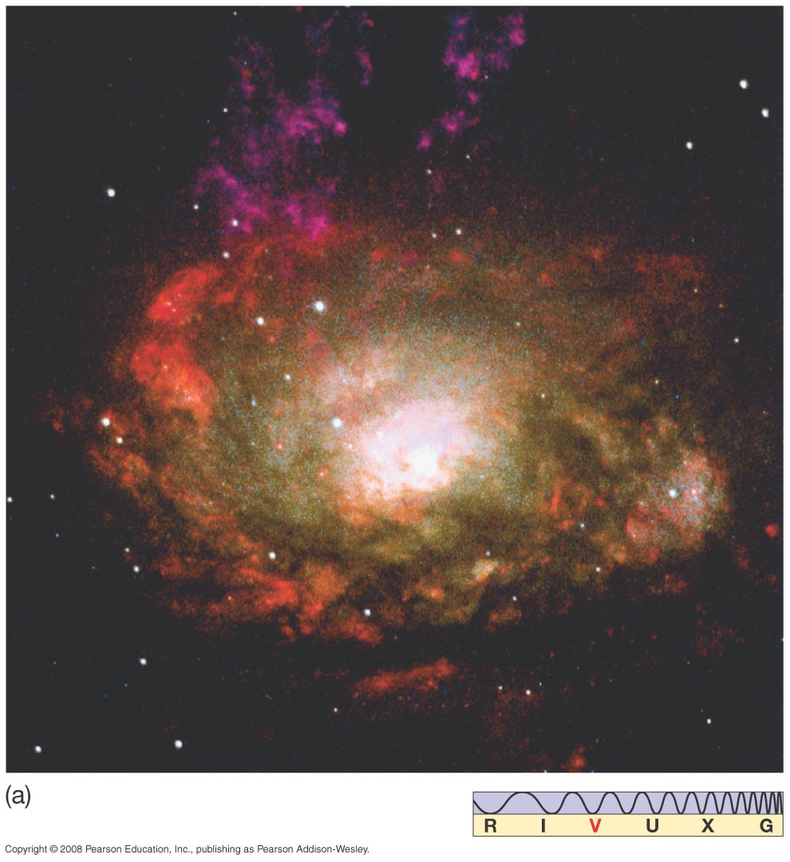
Question 11
1) Hickson
2) Arp
3) Core–halo
4) Seyfert
5) Hubble
_______ galaxies may bridge the gap between spiral galaxies and quasars.
Notes:
Click to add notes

Slide 23
Question 11
1) Hickson
2) Arp
3) Core–halo
4) Seyfert
5) Hubble
_______ galaxies may bridge the gap between spiral galaxies and quasars.

Slide 24
Question 12
Not only does the central engine of active galaxies and quasars require a black hole, but ________ is also needed to provide the energy radiated.
1) a collision with another galaxy
2) an accretion disk of matter
3) a very strong magnetic field
4) a source of very high energy electrons
5) a high rate of rotation of the black hole
Notes:
Click to add notes

Slide 25
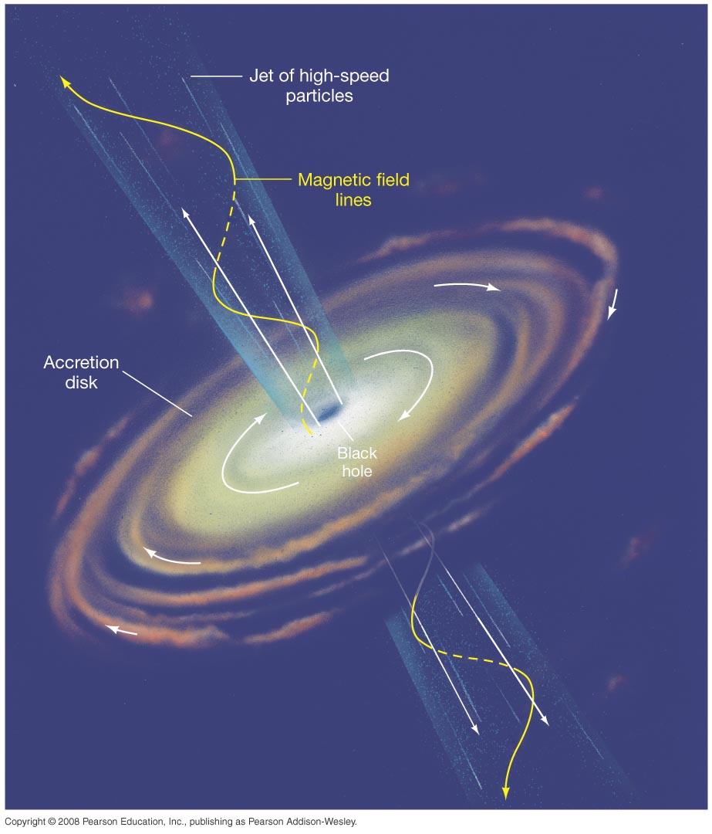
Question 12
Not only does the central engine of active galaxies and quasars require a black hole, but ________ is also needed to provide the energy radiated.
1) a collision with another galaxy
2) an accretion disk of matter
3) a very strong magnetic field
4) a source of very high energy electrons
5) a high rate of rotation of the black hole

Slide 26
Question 13
How would we get Doppler velocity independent distances to the nearest galaxies (a few megaparsecs)?
1) trig parallax
2) period–luminosity relation for Cepheids
3) Hubble’s law (V = Hr)
4) radar reflection
5) main sequence fitting
Notes:
Click to add notes

Slide 27
Question 13
How would we get Doppler velocity independent distances to the nearest galaxies (a few megaparsecs)?
1) trig parallax
2) period–luminosity relation for Cepheids
3) Hubble’s law (V = Hr)
4) radar reflection
5) main sequence fitting

Slide 28
Question 14
How would we get Doppler velocity independent distances to more distant galaxies (tens of megaparsecs) without using the Hubble law?
1) trig parallax
2) period–luminosity relation for Cepheids
3) Comparing brightest stars/clusters/nebulae with similar objects in MW.
4) main sequence fitting
5) impossible to do it
Notes:
Click to add notes

Slide 29
Question 14
How would we get Doppler velocity independent distances to more distant galaxies (tens of megaparsecs) without using the Hubble law?
1) trig parallax
2) period–luminosity relation for Cepheids
3) Comparing brightest stars/clusters/nebulae with similar objects in MW.
4) main sequence fitting
5) impossible to do it

Slide 30
Question 15
1) how fast it is moving towards or away from me (Doppler shift)
2) the apparent brightness (flux) of the distant headlights
3) the intrinsic brightness of the headlights (e.g., 500 or 1000 watts)
4) 1 and 2
5) 2 and 3
You see a distant car in the night. What two things must you know in order to estimate its distance?
Notes:
Click to add notes

Slide 31
Question 15
1) how fast it is moving towards or away from me (Doppler shift)
2) the apparent brightness (flux) of the distant headlights
3) the intrinsic brightness of the headlights (e.g., 500 or 1000 watts)
4) 1 and 2
5) 2 and 3
You see a distant car in the night. What two things must you know in order to estimate its distance?

Slide 32
Question 16
You see a distant (main-sequence!) B-type star like Rigel in a rather distant galaxy. What two things do you need to know in order to estimate its distance?
1) how fast it is moving towards or away from me
2) the apparent brightness (flux or apparent magnitude)
3) the intrinsic brightness of main-sequence B stars like Rigel
4) 1 and 2
5) 2 and 3
Notes:
Click to add notes

Slide 33
Question 16
You see a distant (main-sequence!) B-type star like Rigel in a rather distant galaxy. What two things do you need to know in order to estimate its distance?
1) how fast it is moving towards or away from me
2) the apparent brightness (flux or apparent magnitude)
3) the intrinsic brightness of main-sequence B stars like Rigel
4) 1 and 2
5) 2 and 3

Slide 34
Question 17
What do you need to know in order to estimate the distance of galaxies where we can no longer see individual stars / clusters / nebulae?
1) trig parallax
2) period–luminosity relation for Cepheids
3) main sequence fitting
4) Supernovae give us a reasonable guess.
5) We cannot do it without V = Hr.
Notes:
Click to add notes

Slide 35
Question 17
What do you need to know in order to estimate the distance of galaxies where we can no longer see individual stars / clusters / nebulae?
1) trig parallax
2) period–luminosity relation for Cepheids
3) main sequence fitting
4) Supernovae give us a reasonable guess.
5) We cannot do it without V = Hr.

Slide 36
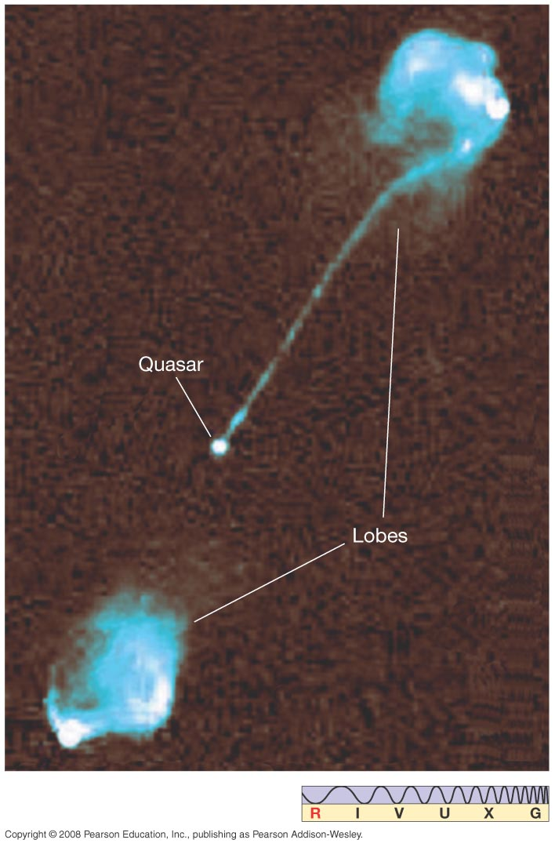
Question 18
1) emission lines with large redshifts.
2) a continuum from the synchrotron radiation.
3) fuzzy absorption lines from the merged light of the billions of stars.
4) too complex for any interpretation.
5) nonexistent, the gas so hot as to be totally ionized, so no lines are seen.
The spectral lines of quasars are
Notes:
Click to add notes

Slide 37
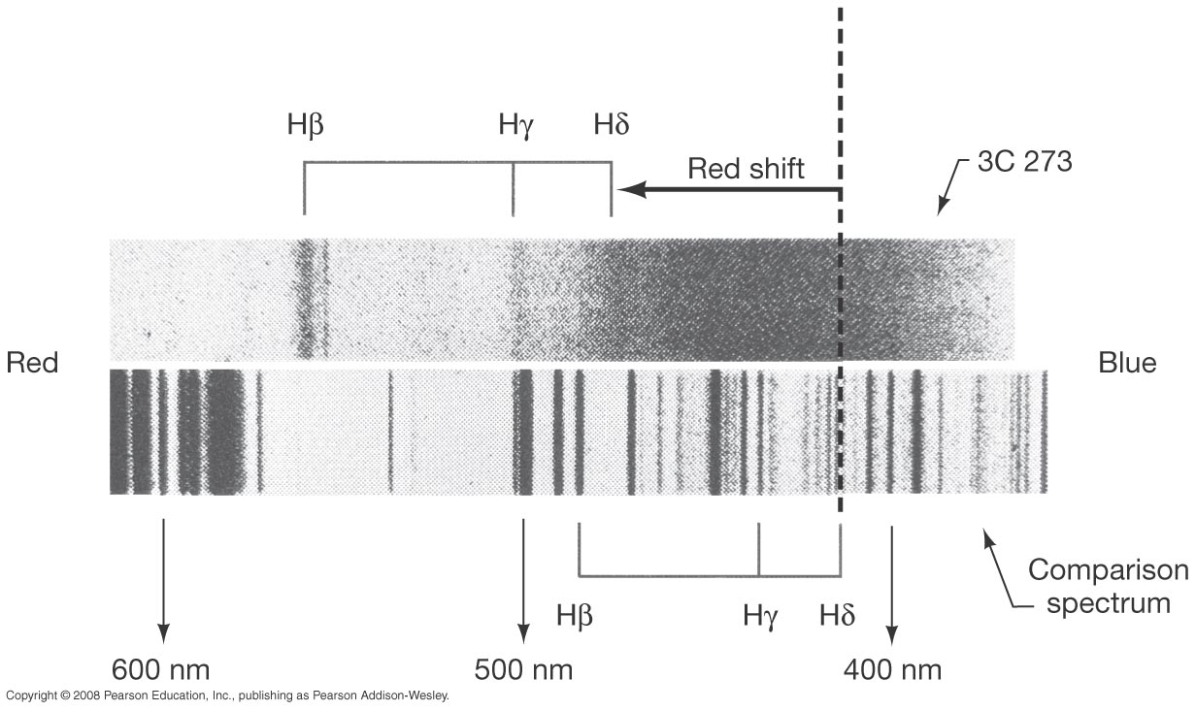
Question 18
1) emission lines with large redshifts.
2) a continuum from the synchrotron radiation.
3) fuzzy absorption lines from the merged light of the billions of stars.
4) too complex for any interpretation.
5) nonexistent, the gas so hot as to be totally ionized, so no lines are seen.
The spectral lines of quasars are

Slide 38
Question 19
What is the most likely source of energy for active galaxies and quasars?
1) collisions of large spiral galaxies
2) large clusters of very massive, luminous stars
3) a single supermassive, superluminous star
4) accretion onto a supermassive black hole
5) numerous supernovae from rapid star formation in young galaxies
Notes:
Click to add notes

Slide 39
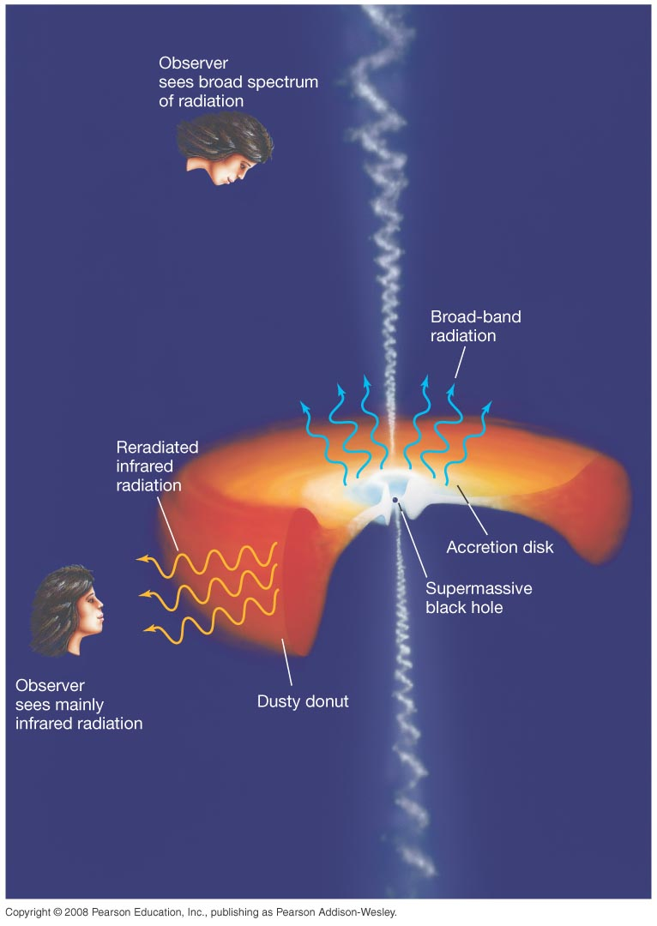
Question 19
What is the most likely source of energy for active galaxies and quasars?
1) collisions of large spiral galaxies
2) large clusters of very massive, luminous stars
3) a single supermassive, superluminous star
4) accretion onto a supermassive black hole
5) numerous supernovae from rapid star formation in young galaxies

