Slide 1
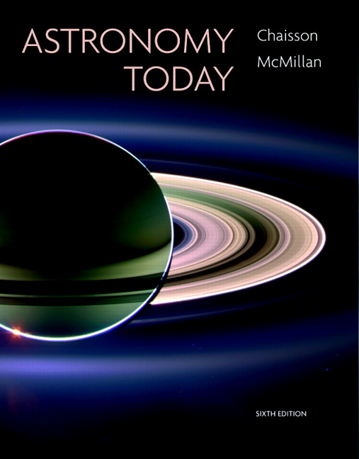
Conceptual Test
Chapter 26
ASTRONOMY TODAY
6th edition
Chaisson
McMillan
© 2008 Pearson Addison-Wesley
This work is protected by United States copyright laws and is provided solely for the use of instructors in teaching their courses and assessing student learning. Dissemination or sale of any part of this work (including on the World Wide Web) will destroy the integrity of the work and is not permitted. The work and materials from it should never be made available to students except by instructors using the accompanying text in their classes. All recipients of this work are expected to abide by these restrictions and to honor the intended pedagogical purposes and the needs of other instructors who rely on these materials.

Slide 2
Question 1
1) the Milky Way must be located at the edge of the universe.
2) the Milky Way is at the center of the universe.
3) the universe is expanding.
4) the sky is dark at night.
5) the universe has not changed significantly.
Because distant galaxies in every direction are moving away from us,
Notes:
Click to add notes

Slide 3
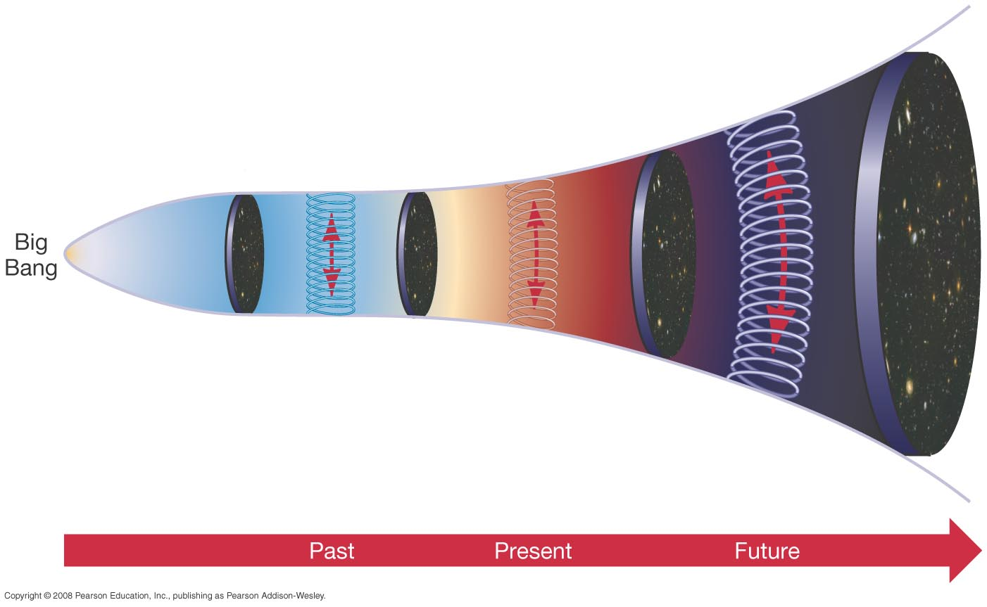
Question 1
1) the Milky Way must be located at the edge of the universe.
2) the Milky Way is at the center of the universe.
3) the universe is expanding.
4) the sky is dark at night.
5) the universe has not changed significantly.
Because distant galaxies in every direction are moving away from us,

Slide 4
Question 2
1) the size of the universe.
2) the age of the universe.
3) the shape of the universe.
4) the temperature of the universe.
5) the distance the universe has expanded.
Hubble’s constant, H_{o}, can be related to
Notes:
Click to add notes

Slide 5
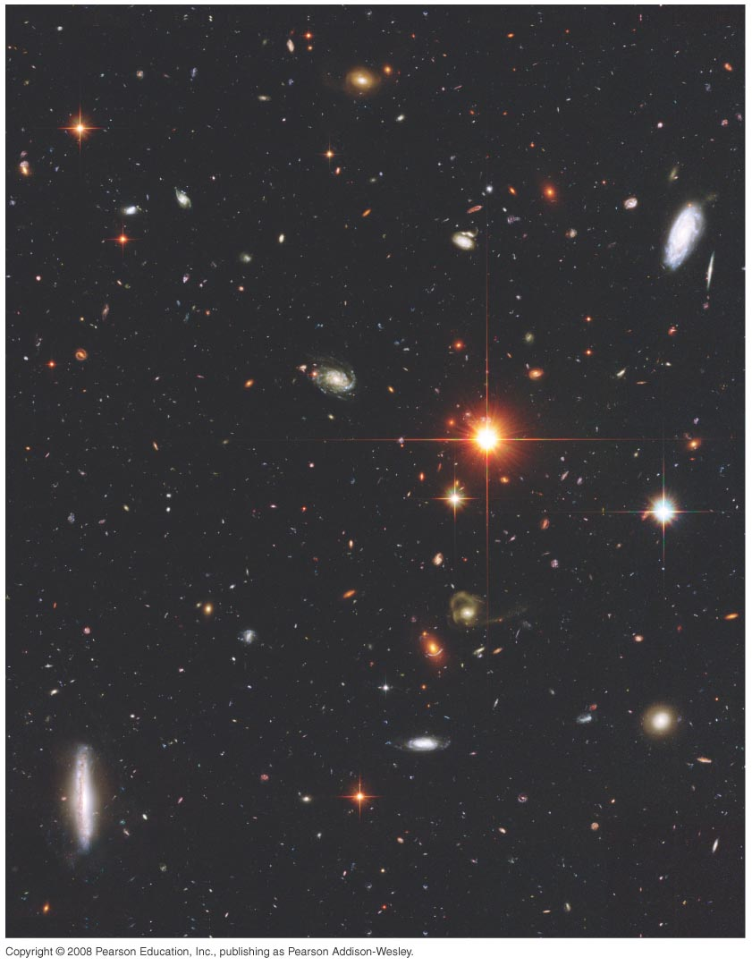
Question 2
1) the size of the universe.
2) the age of the universe.
3) the shape of the universe.
4) the temperature of the universe.
5) the distance the universe has expanded.
Hubble’s constant, H_{o}, can be related to
H_{o} is currently estimated to be about 70 km/sec/Mpc.
This translates to an age for the universe of about 14 billion years.

Slide 6
Question 3
1) is infinitely old and getting larger.
2) began expanding long ago, and has a finite age.
3) will slow down because of dark matter.
4) has repeatedly expanded and contracted.
5) will eventually stop and recollapse.
Hubble’s law implies that the universe
Notes:
Click to add notes

Slide 7
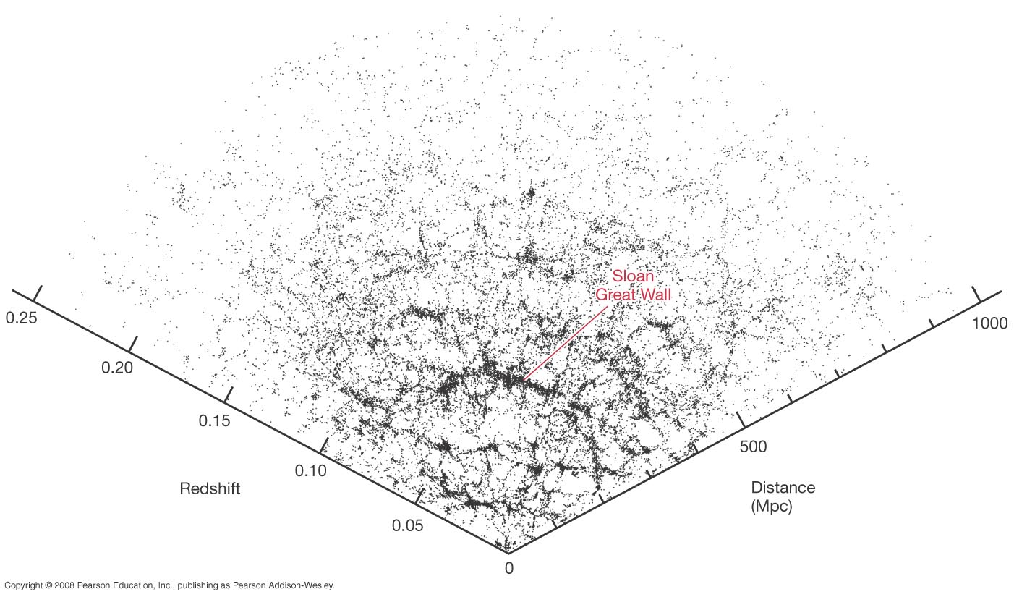
Question 3
1) is infinitely old and getting larger.
2) began expanding long ago, and has a finite age.
3) will slow down because of dark matter.
4) has repeatedly expanded and contracted.
5) will eventually stop and recollapse.
Hubble’s law implies that the universe
Using the Hubble constant H_{o}, astronomers can estimate that the universe was born about 14 billion years ago.

Slide 8
Question 4
1) is explained by General Relativity.
2) results from the presence of dark matter.
3) is a statement of Olbers’ paradox.
4) is the Cosmological Principle.
5) occurs if the universe is static and unchanging.
The darkness of the sky in an infinite universe
Notes:
Click to add notes

Slide 9
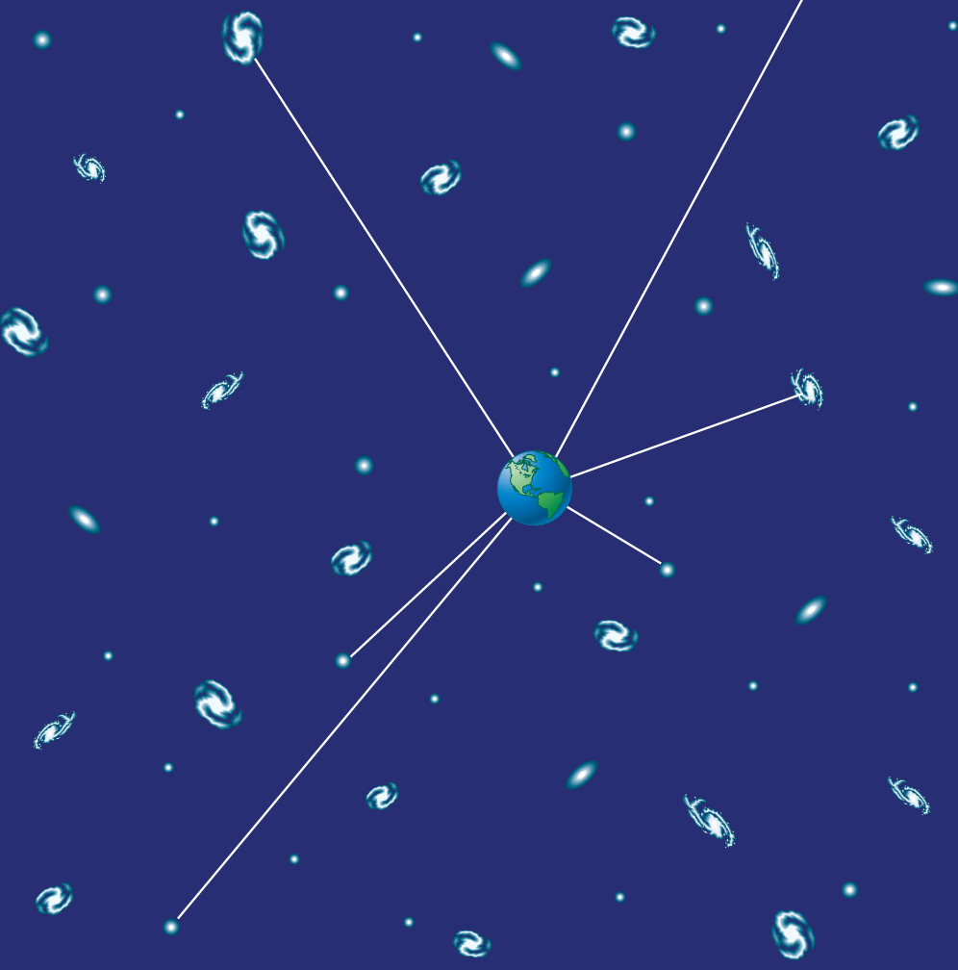
Question 4
1) is explained by General Relativity.
2) results from the presence of dark matter.
3) is a statement of Olbers’ paradox.
4) is the Cosmological Principle.
5) occurs if the universe is static and unchanging.
The darkness of the sky in an infinite universe
If the universe is homogeneous in composition, and appears the same in all directions, then for the sky to be dark, it must be either finite in age, or evolving in time, or both.

Slide 10
Question 5
1) a Doppler shift of the random motions of galaxies.
2) an aging of light as the universe ages.
3) space itself expanding with time, stretching light.
4) the result of the Milky Way’s position at the center.
5) due to the temperature differences in the early and late universe.
The redshift of galaxies is explained best as
Notes:
Click to add notes

Slide 11
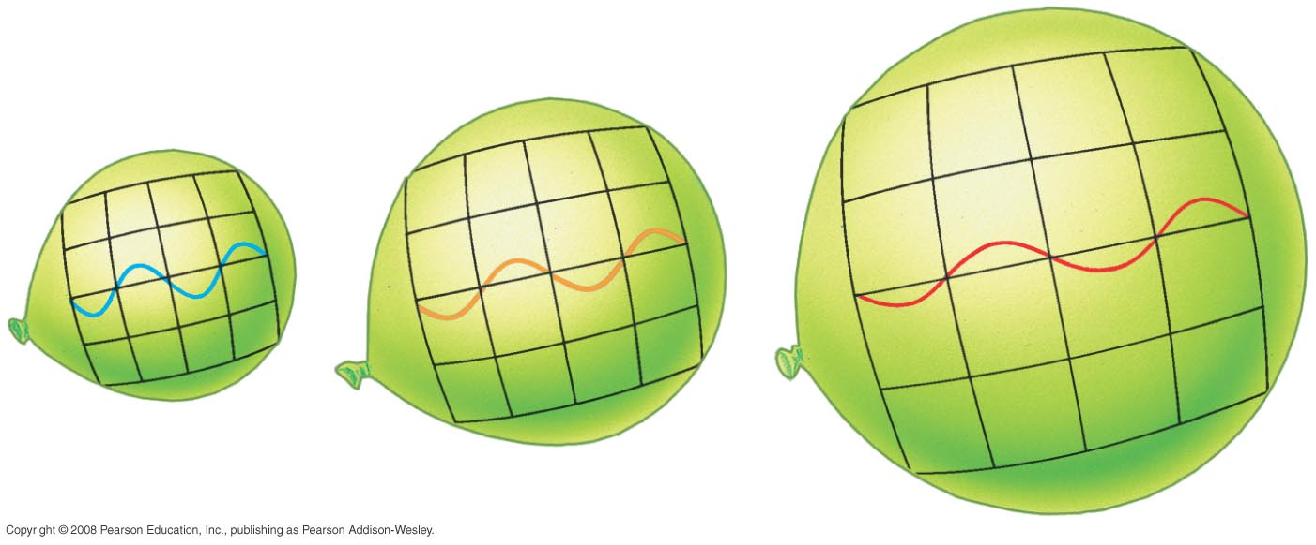
Question 5
1) a Doppler shift of the random motions of galaxies.
2) an aging of light as the universe ages.
3) space itself expanding with time, stretching light.
4) the result of the Milky Way’s position at the center
5) due to the temperature differences in the early and late universe.
The redshift of galaxies is explained best as
As the universe expands, photons of radiation are stretched in wavelength as they move through space.

Slide 12
Question 6
1) the universe will eventually stop expanding and recollapse.
2) dark matter will dominate over dark energy.
3) the universe will stop expanding and remain stationary.
4) dark energy will dominate over dark matter.
5) the universe will not stop expanding.
In a closed universe
Notes:
Click to add notes

Slide 13
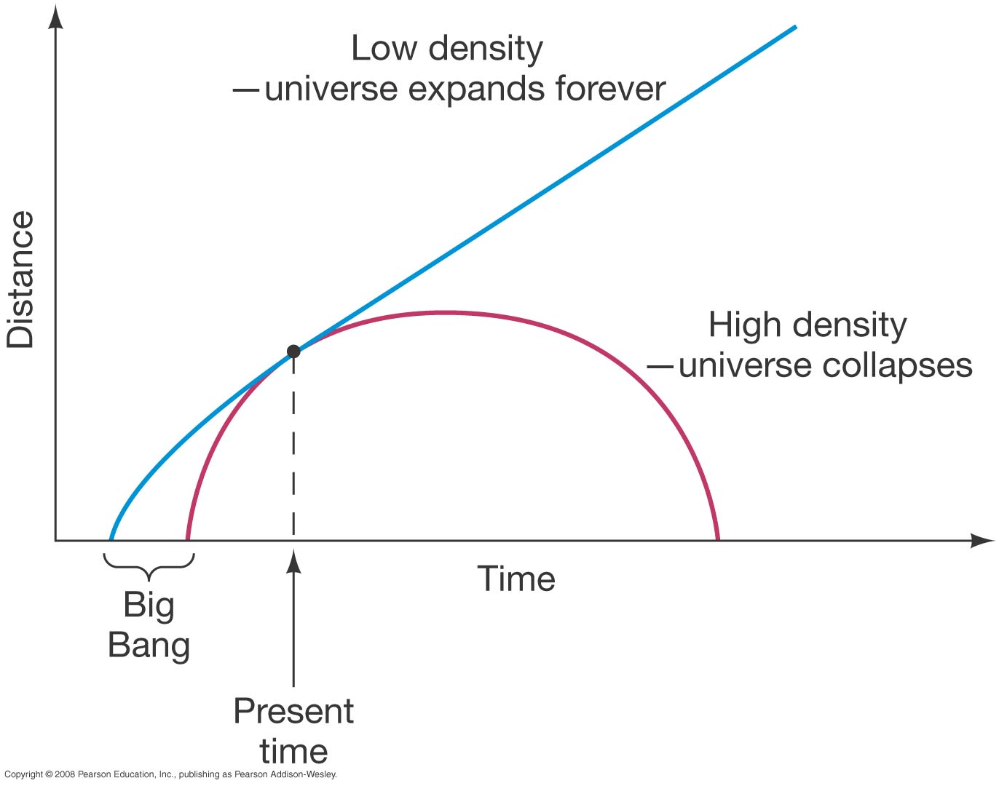
Question 6
1) the universe will eventually stop expanding and recollapse.
2) dark matter will dominate over dark energy.
3) the universe will stop expanding and remain stationary.
4) dark energy will dominate over dark matter.
5) the universe will not stop expanding.
In a closed universe
Greater density means more matter in a smaller volume, and gravity will be strong enough to stop the expansion and cause a “Big Crunch.”

Slide 14
Question 7
The geometry of a closed universe, in two dimensions, resembles which one of the following?
1) a space–time pyramid
2) a flat piece of paper
3) the surface of a saddle
4) the surface of a cylinder
5) the surface of a sphere
Notes:
Click to add notes

Slide 15
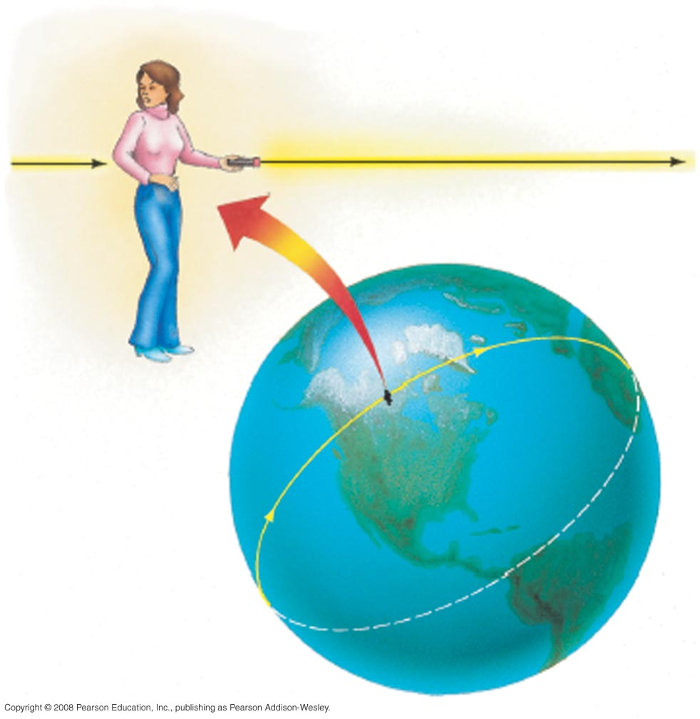
Question 7
The geometry of a closed universe, in two dimensions, resembles which one of the following?
1) a space–time pyramid
2) a flat piece of paper
3) the surface of a saddle
4) the surface of a cylinder
5) the surface of a sphere

Slide 16
Question 8
1) there is more matter than energy.
2) the universe is closed, and will recollapse.
3) the universe is open, and will keep expanding.
4) dark matter will dominate, and galaxies will stop expanding.
5) there was more helium than hydrogen created in the Big Bang.
If the density of the universe is greater than “critical”
Notes:
Click to add notes

Slide 17
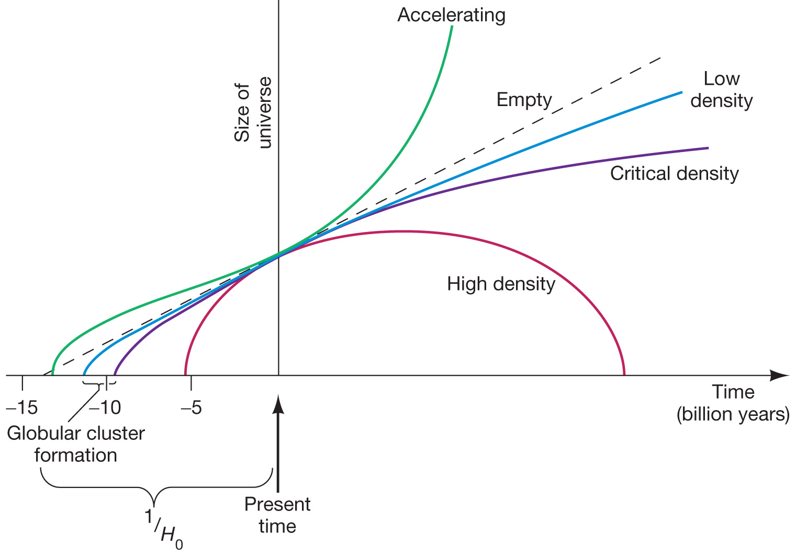
Question 8
1) there is more matter than energy.
2) the universe is closed, and will recollapse.
3) the universe is open, and will keep expanding.
4) dark matter will dominate, and galaxies will stop expanding.
5) there was more helium than hydrogen created in the Big Bang.
If the density of the universe is greater than “critical”

Slide 18
Question 9
1) hypernovae.
2) gamma-ray bursts.
3) type I supernovae.
4) type II supernovae.
5) ages of globular clusters.
The critical evidence for cosmic acceleration came in 1998 from two teams of astronomers, both observing
Notes:
Click to add notes

Slide 19
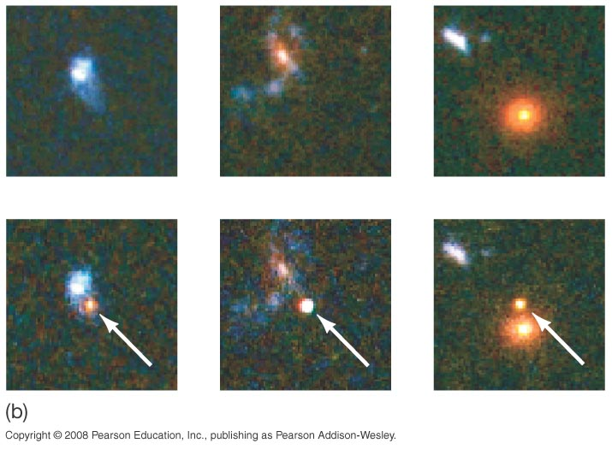
Question 9
1) hypernovae.
2) gamma-ray bursts.
3) type I supernovae.
4) type II supernovae.
5) ages of globular clusters.
The critical evidence for cosmic acceleration came in 1998 from two teams of astronomers, both observing

Slide 20
Question 10
The assumption of an accelerating, expanding universe lowers the Hubble Time to
1) 12.3 billion years.
2) 13.7 billion years.
3) 14.3 billion years.
4) 15.7 billion years.
5) 18 billion years.
Notes:
Click to add notes

Slide 21
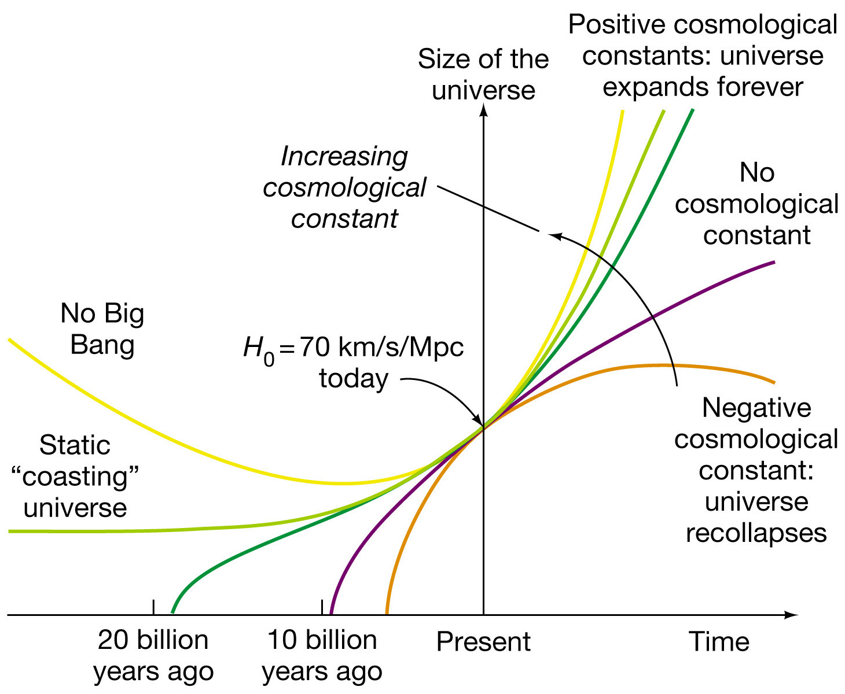
Question 10
The assumption of an accelerating, expanding universe lowers the Hubble Time to
1) 12.3 billion years.
2) 13.7 billion years.
3) 14.3 billion years.
4) 15.7 billion years.
5) 18 billion years.

Slide 22
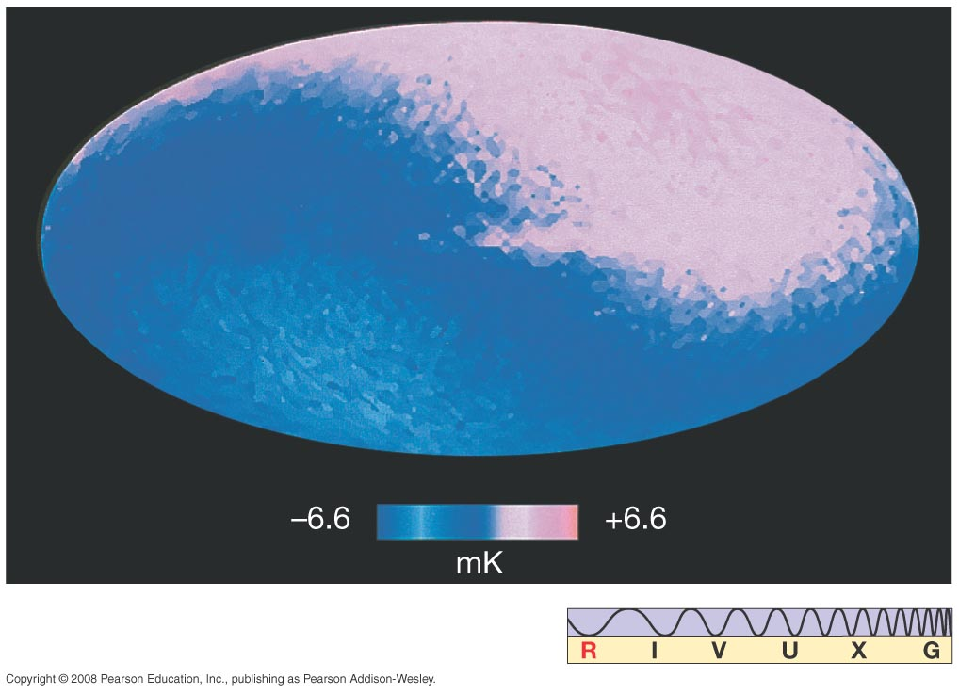
Question 11
1) evidence supporting the Big Bang.
2) proof that the universe is getting warmer.
3) a result of the hot intergalactic gas between clusters.
4) the observable form of dark energy.
5) released from the first generation of stars in the universe.
The cosmic microwave background radiation is
Notes:
Click to add notes

Slide 23
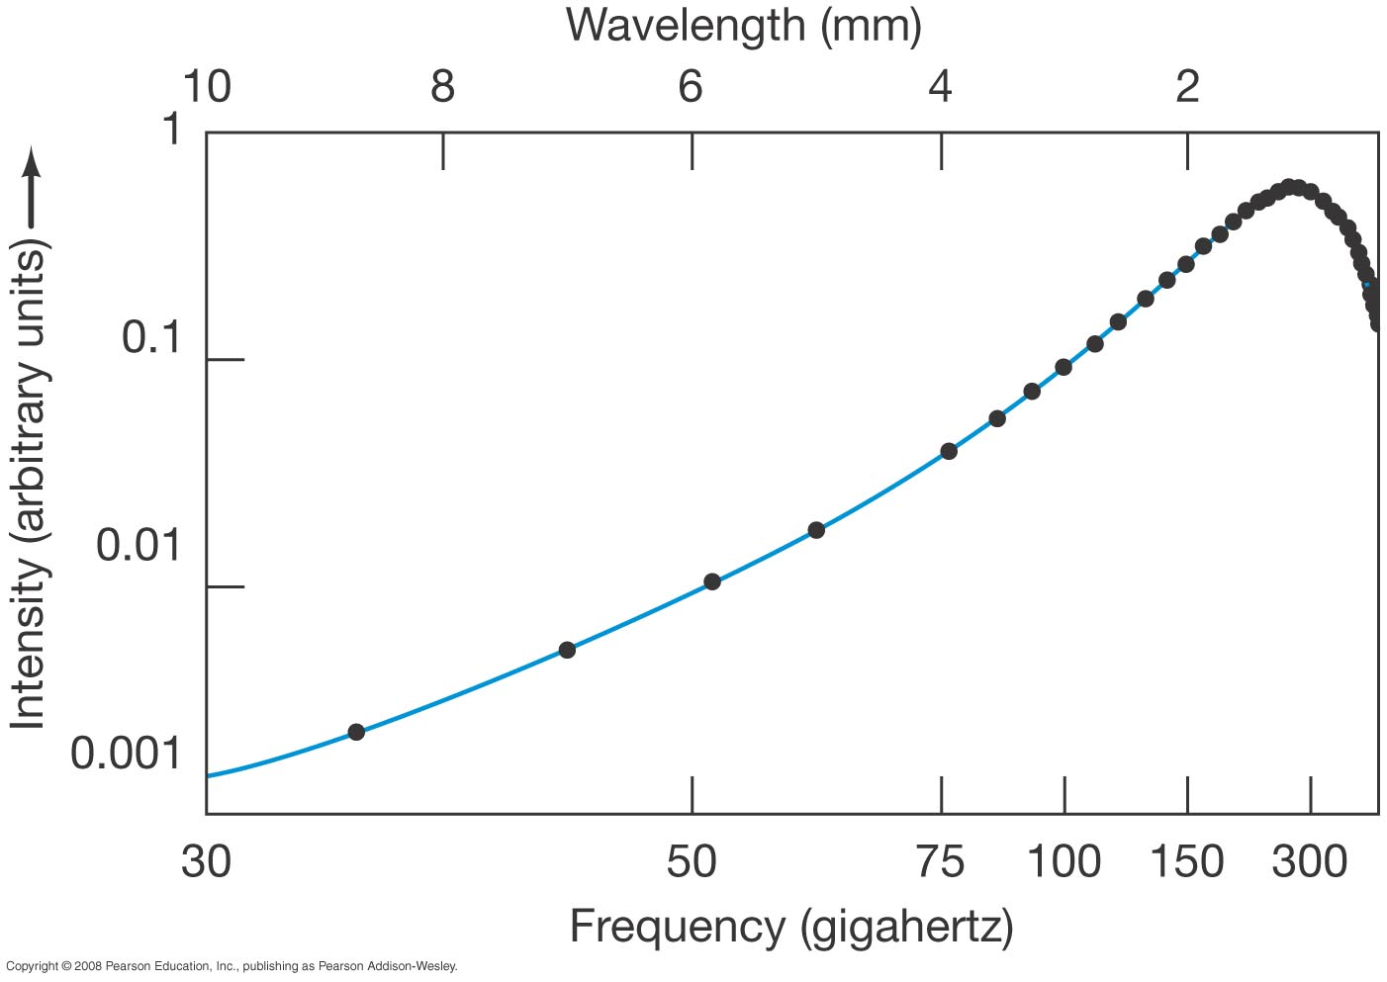
Question 11
1) evidence supporting the Big Bang.
2) proof that the universe is getting warmer.
3) a result of the hot intergalactic gas between clusters.
4) the observable form of dark energy.
5) released from the first generation of stars in the universe.
The cosmic microwave background radiation is
The radiation observed is the “fossil remnant” of the primeval fireball that existed at the very beginning of the universe.

Slide 24
Question 12
1) 37.8 K.
2) 4.8 K.
3) 2.7 K.
4) 1.4 K.
5) 0.23 K.
The COBE data showed that, with very minor variations, the temperature of the background radiation is exactly
Notes:
Click to add notes

Slide 25
Question 12
1) 37.8 K.
2) 4.8 K.
3) 2.7 K.
4) 1.4 K.
5) 0.23 K.
The COBE data showed that, with very minor variations, the temperature of the background radiation is exactly

