Slide 1
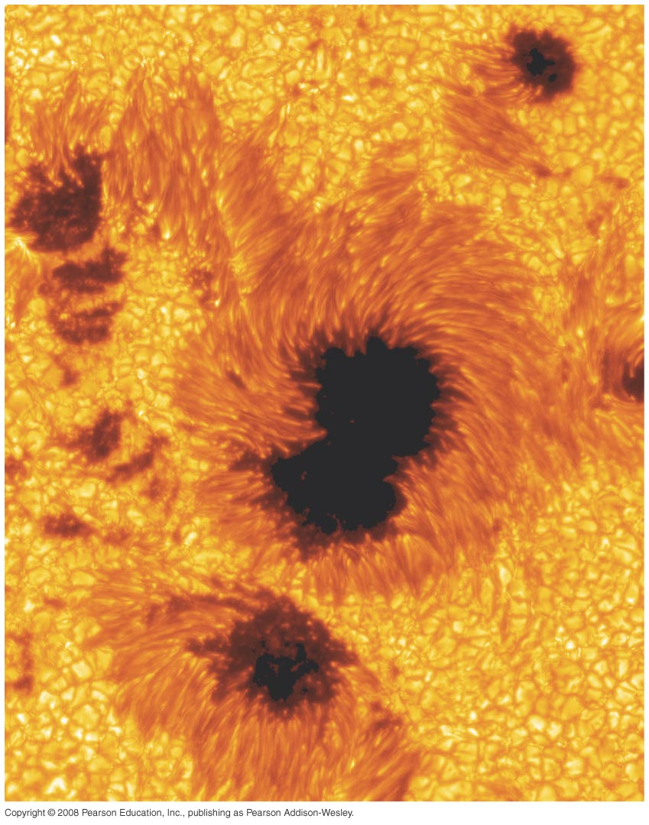
Chapter 16
The Sun
Notes:
Chapter 16 opener. The Sun is our star—the main source of energy that powers weather, climate, and life on Earth. Humans simply would not exist without the Sun. Although we take it for granted each and every day, the Sun is of great importance to us in the cosmic scheme of things. This spectacular image shows a small piece of the Sun “up close”—a high resolution photograph taken from Earth, revealing its granulated surface and dark spots, all of which are gas. The region shown is 50,000 kilometers on a side, equal to about four times the size of Earth, but only a few percent of the Sun’s complete surface. (ROYAL SWEDISH ACADEMY OF SCIENCES)‏

Slide 2
Units of Chapter 16
16.1 Physical Properties of the Sun
16.2 The Solar Interior
SOHO: Eavesdropping on the Sun
16.3 The Sun’s Atmosphere
16.4 Solar Magnetism
16.5 The Active Sun
Solar–Terrestrial Relations

Slide 3
Units of Chapter 16 (cont.)‏
16.6 The Heart of the Sun
Fundamental Forces
Energy Generation in the Proton–Proton Chain
16.7 Observations of Solar Neutrinos

Slide 4
16.1 Physical Properties of the Sun
Radius: 700,000 km
Mass: 2.0 × 10³⁰ kg
Density: 1400 kg/m³
Rotation: Differential; period about a month
Surface temperature: 5800 K
Apparent surface of Sun is photosphere

Slide 5
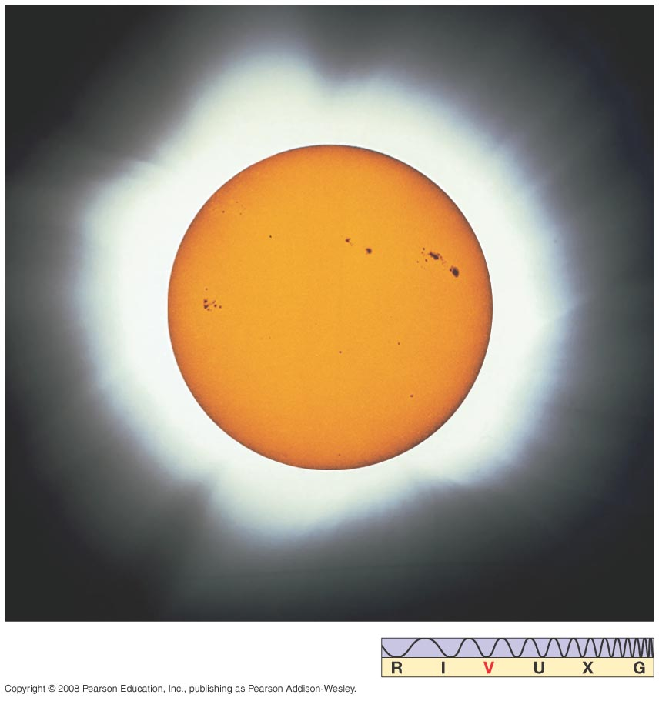
16.1 Physical Properties of the Sun
This is a filtered image of the Sun showing sunspots, the sharp edge of the Sun due to the thin photosphere, and the corona:
Notes:
Figure 16-1. The Sun The inner part of this composite, filtered image of the Sun shows a sharp solar edge, although our star, like all stars, is made of a gradually thinning gas. The edge appears sharp because the solar photosphere is so thin. The outer portion of the image is the solar corona, normally too faint to be seen, but visible during an eclipse, when the light from the solar disk is blotted out. Note the blemishes; they are sunspots.

Slide 6
16.1 Physical Properties of the Sun
Luminosity—total energy radiated by the Sun— can be calculated from the fraction of that energy that reaches Earth.
Solar constant—amount of Sun's energy reaching Earth—is 1400 W/m².
Total luminosity is about 4 × 10²⁶ W—the equivalent of 10 billion 1-megaton nuclear bombs per second.

Slide 7
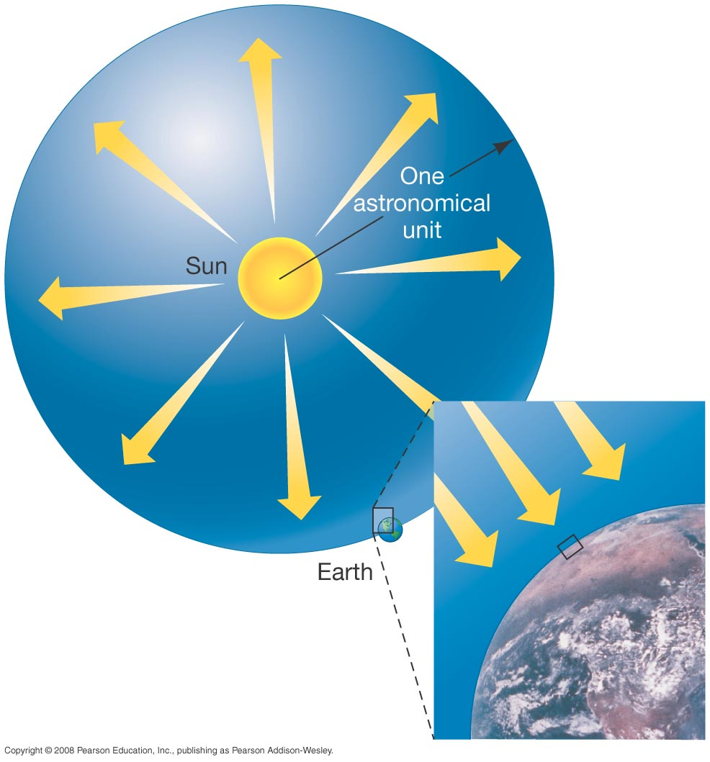
16.1 Physical Properties of the Sun
This diagram illustrates how one can extrapolate from the radiation hitting Earth to the entire output of the Sun:
Notes:
Figure 16-3. Solar Luminosity We can draw an imaginary sphere around the Sun so that the sphere’s surface passes through Earth’s center. The radius of this imaginary sphere equals 1 AU. The “solar constant” is the amount of power striking a 1-m² detector at Earth’s distance, as suggested by the inset. By multiplying the sphere’s surface area by the solar constant, we can measure the Sun’s luminosity—the amount of energy it emits each second.

Slide 8
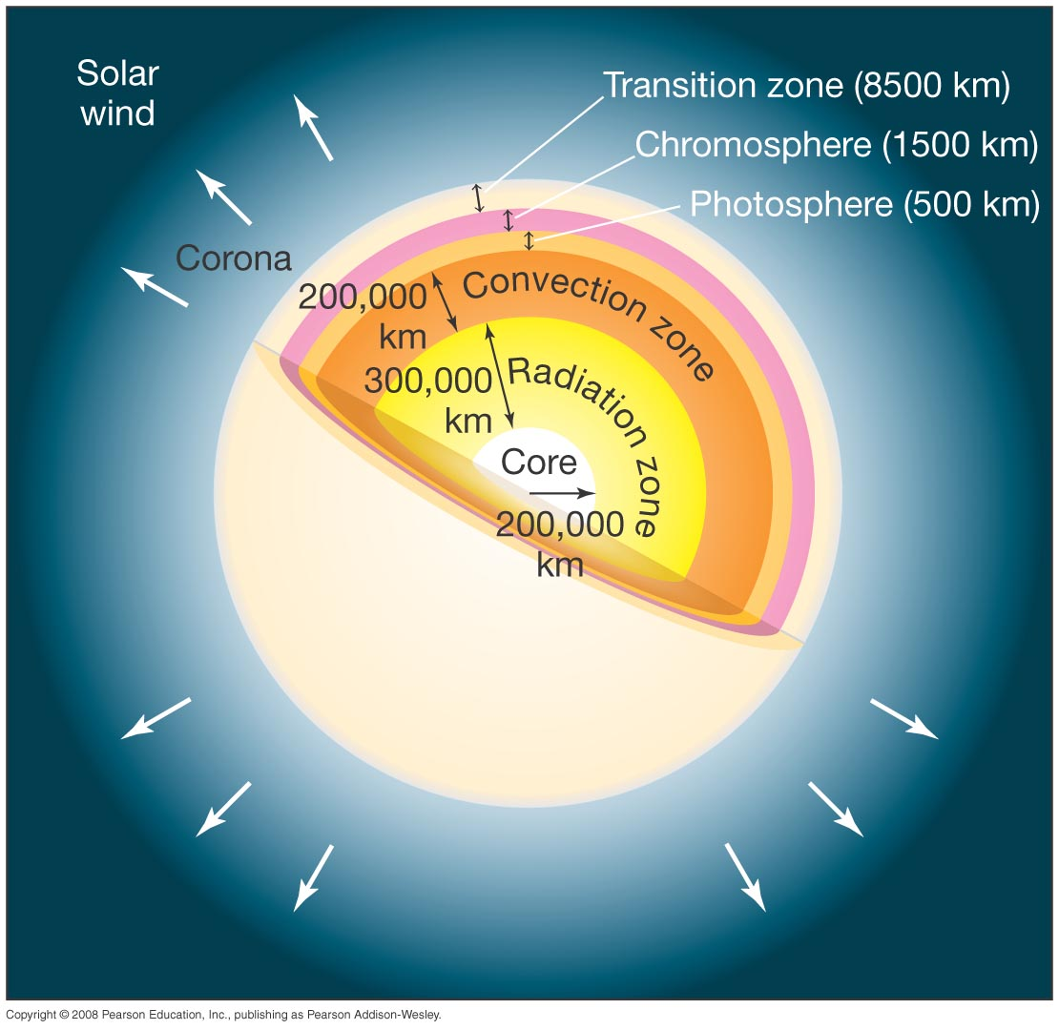
16.2 The Solar Interior
Interior structure of the Sun:
Outer layers are not to scale
The core is where nuclear fusion takes place
Notes:
Figure 16-2. Solar Structure The main regions of the Sun, not drawn to scale, with some physical dimensions labeled. The photosphere is the visible “surface” of the Sun. Below it lie the convection zone, the radiation zone, and the core. Above the photosphere, the solar atmosphere consists of the chromosphere, the transition zone, and the corona.

Slide 9
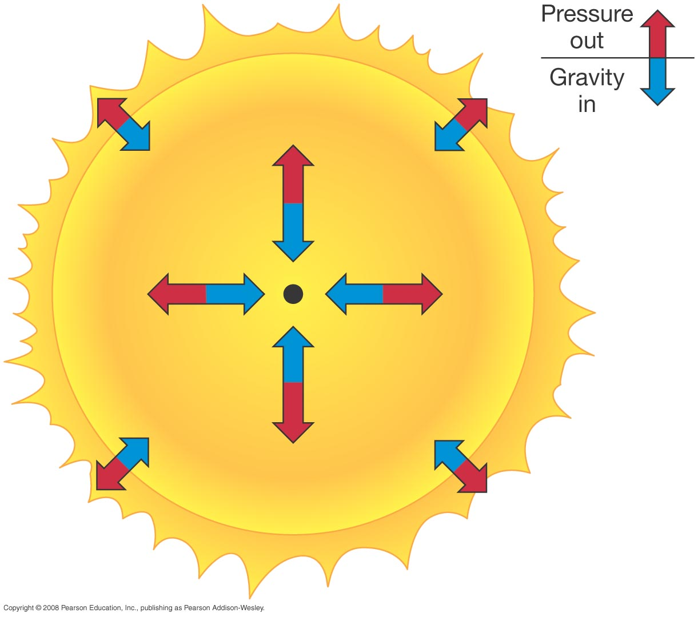
16.2 The Solar Interior
Mathematical models, consistent with observation and physical principles, provide information about the Sun’s interior.
In equilibrium, inward gravitational force must be balanced by outward pressure:
Notes:
Figure 16-4. Hydrostatic Equilibrium In the interior of a star such as the Sun, the outward pressure of hot gas exactly balances the inward pull of gravity. This is true at every point within the star, guaranteeing its stability.

Slide 10
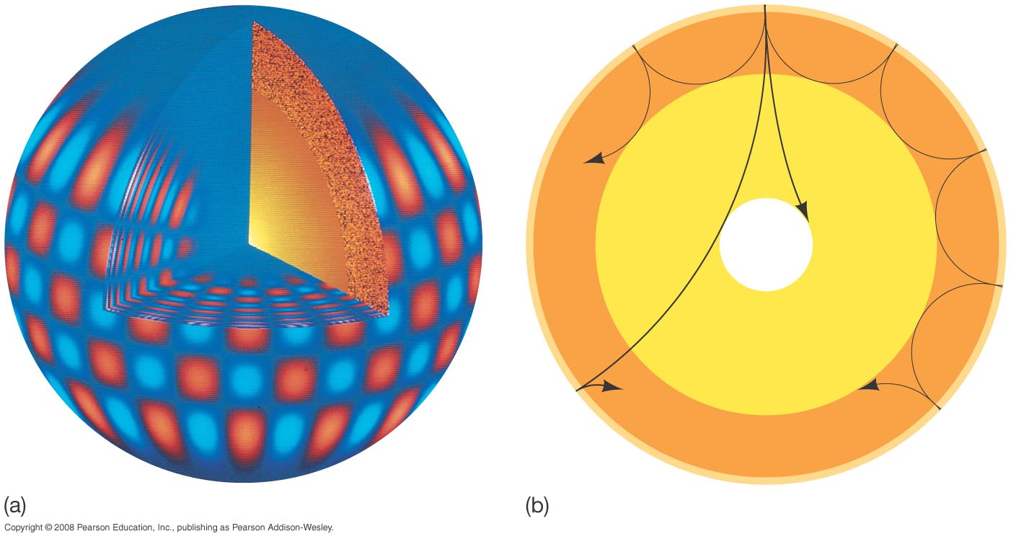
16.2 The Solar Interior
Doppler shifts of solar spectral lines indicate a complex pattern of vibrations.
Notes:
Figure 16-5. Solar Oscillations (a) The Sun has been found to vibrate in a very complex way. By observing the motion of the solar surface, scientists can determine the wavelengths and the frequencies of the individual waves and deduce information about the Sun not obtainable by other means. The alternating patches represent gas moving down (red) and up (blue). (See also Discovery 16-1.) (b) Depending on their initial directions, the waves contributing to the observed oscillations may travel deep inside the Sun, providing vital information about the solar interior. The wave shown closest to the surface here corresponds approximately to the vibration pattern depicted in part (a). (National Solar Observatory)‏

Slide 11
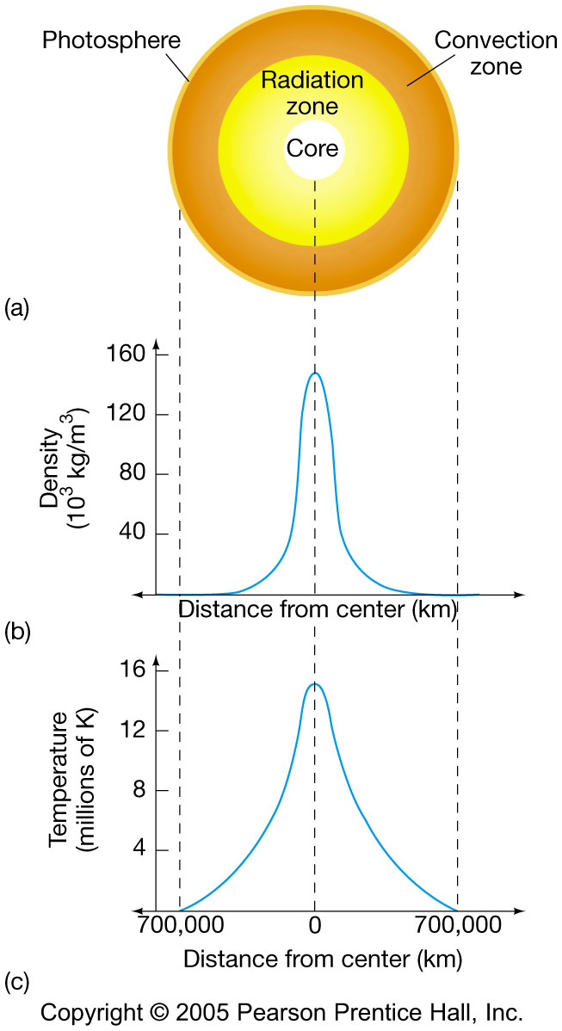
16.2 The Solar Interior
Solar density and temperature, according to the standard solar model:
Notes:
Figure 16-6. Solar Interior (a) A cross-sectional cut through the middle of the Sun, with corresponding graphs of (b) density and (c) temperature across the cut, according to the standard solar theoretical model.

Slide 12
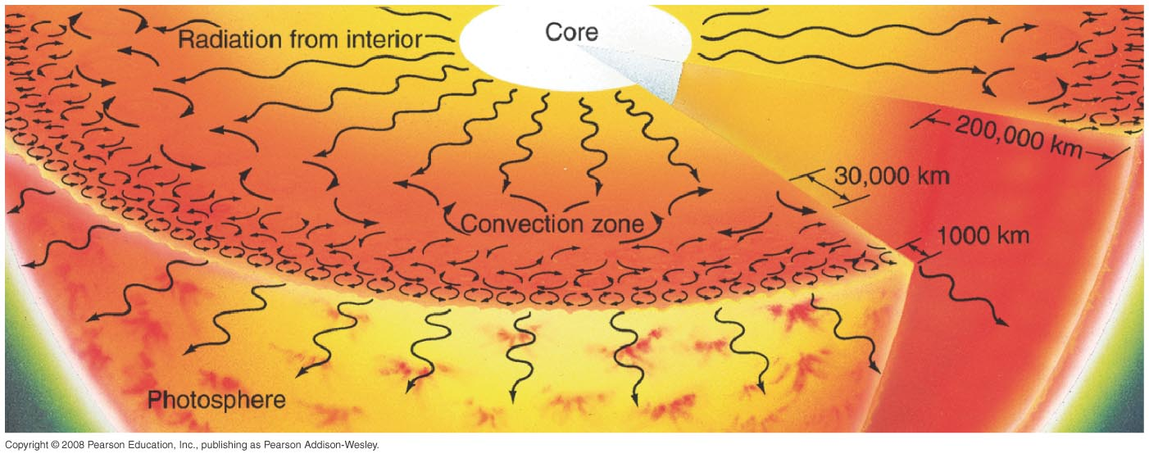
16.2 The Solar Interior
Energy transport:
The radiation zone is relatively transparent; the cooler convection zone is opaque
Notes:
Figure 16-7. Solar Convection Physical transport of energy in the Sun’s convection zone. The upper interior region is visualized as a boiling, seething sea of gas. Near the surface, each convective cell is about 1000 km across. The sizes of the convective cells become progressively larger at greater depths, reaching some 30,000 km in diameter at the base of the convection zone, 200,000 km below the photosphere. (This is a highly simplified diagram; there are many different cell sizes, and they are not so neatly arranged.)‏

Slide 13
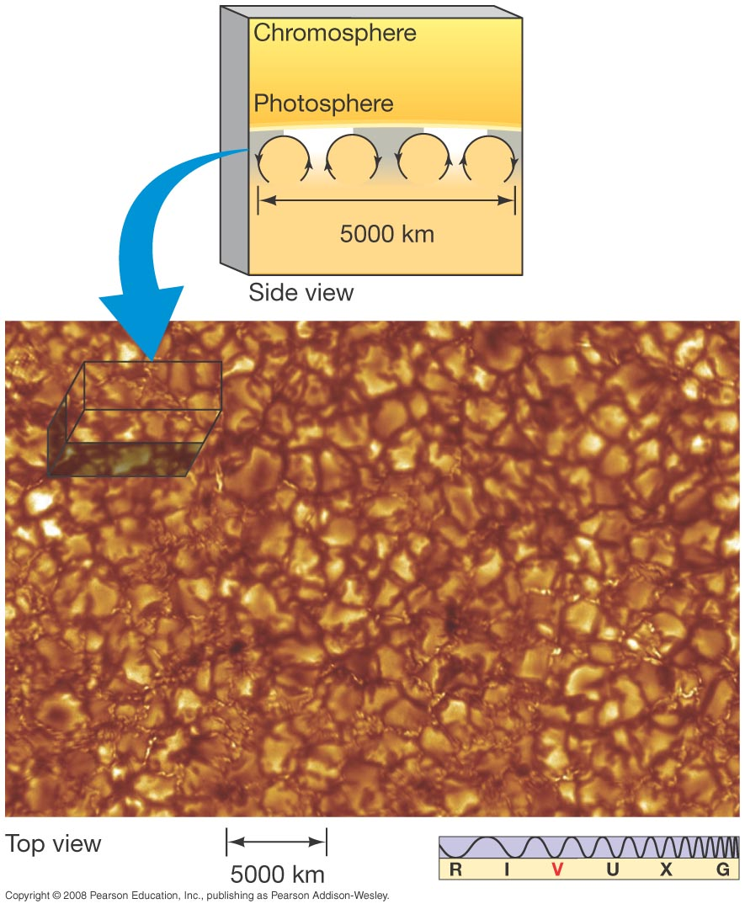
16.2 The Solar Interior
The photosphere appears granulated, because of convection below.
Upwelling gas - hot sinking gas - cool
Notes:
Figure 16-8. Solar Granulation A photograph of the granulated solar photosphere, taken with the 1-m Swedish Solar Telescope looking directly down on the Sun’s surface. Typical solar granules are comparable in size to Earth’s continents. The bright portions of the image are regions where hot material is upwelling from below, as illustrated in Figure 16.7. The darker (redder) regions correspond to cooler gas that is sinking back down into the interior. The inset drawing shows a perpendicular cut through the solar surface. (SST)‏

Slide 14
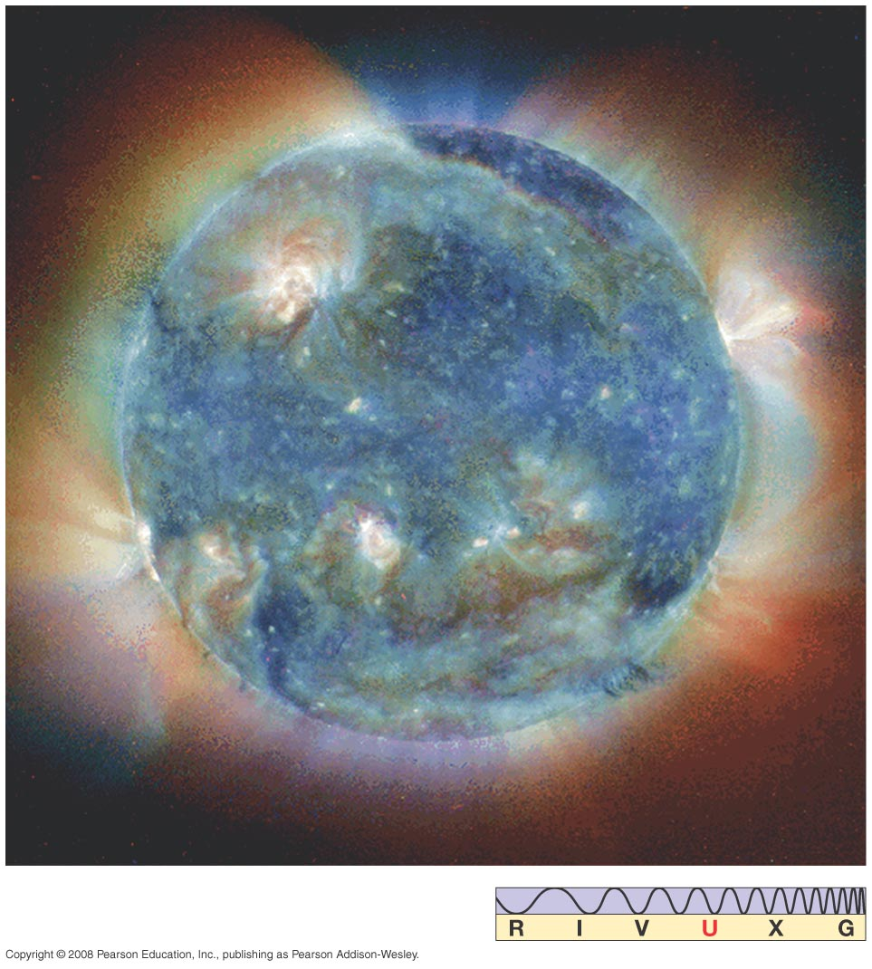
SOHO: Eavesdropping on the Sun
SOHO: Solar and Heliospheric Observatory
Measures magnetic field, corona, vibrations, and UV emissions
Finds comets!

Slide 15
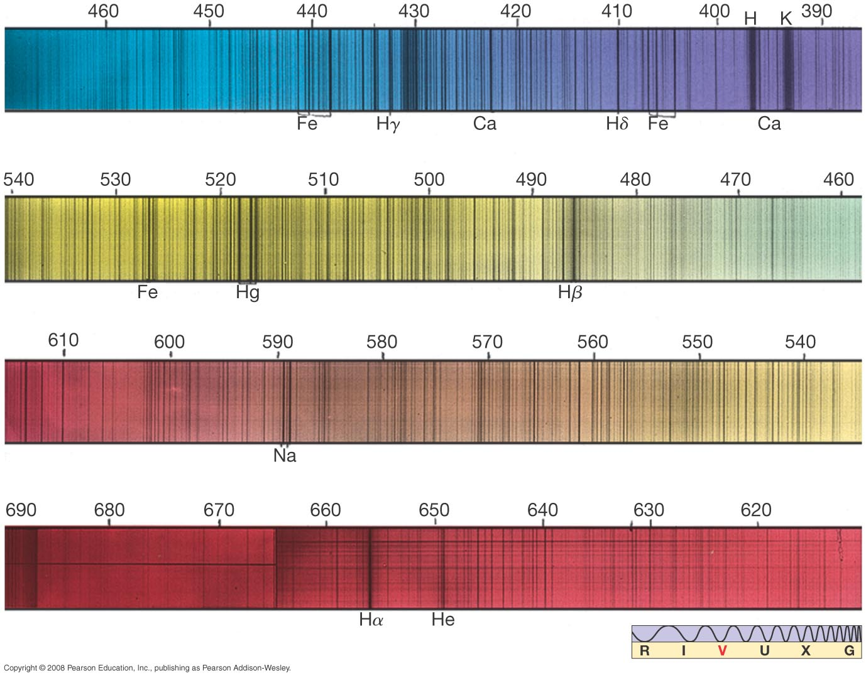
16.3 The Sun’s Atmosphere
Spectral analysis can tell us what elements are present in the chromosphere and photosphere of the Sun. This spectrum has lines from 67 different elements:
Notes:
Figure 16-9. Solar Spectrum A detailed visible spectrum of our Sun shows thousands of dark Fraunhofer (absorption) spectral lines indicating the presence of 67 different elements in various stages of excitation and ionization in the lower solar atmosphere. The numbers give wavelengths, in nanometers. (Palomar Observatory/Caltech)‏

Slide 16
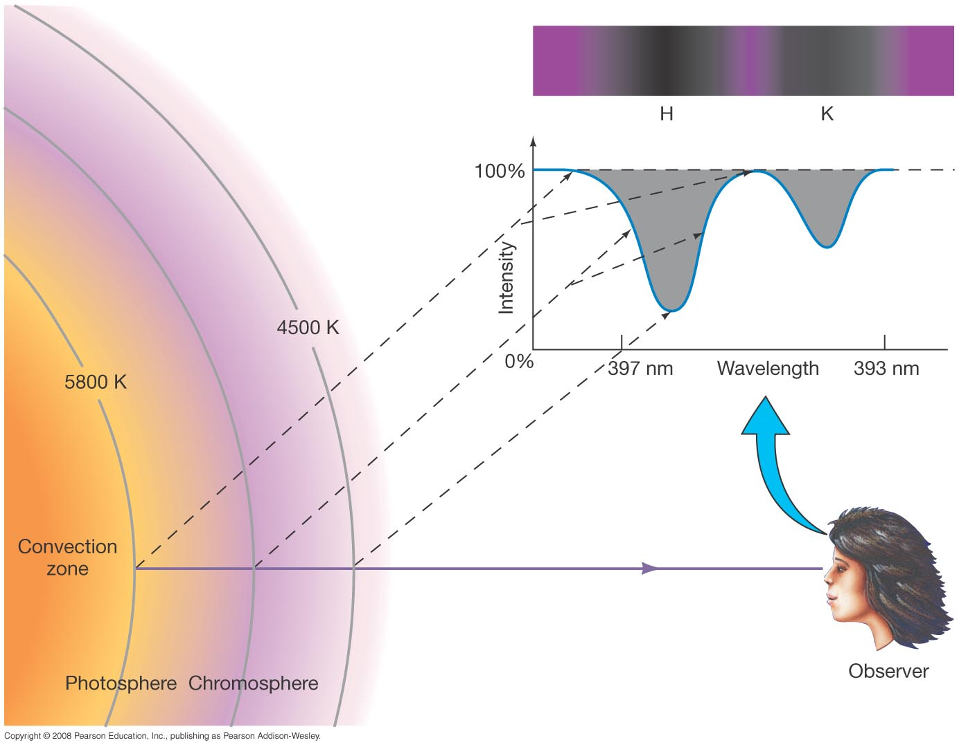
16.3 The Sun’s Atmosphere
Spectral absorption lines. We can't see as deep into the Sun at the wavelengths being absorbed.
Notes:
Figure 16-10. Spectral Line Formation Photons with energies well away from any atomic transition can escape from relatively deep in the photosphere, but those with energies close to a transition are more likely to be reabsorbed before escaping, so those we see on Earth tend to come from higher, cooler levels in the solar atmosphere. The dashed lines indicate schematically the levels in the atmosphere where photons corresponding to different parts of the absorption line originate. The inset shows a close-up tracing of two of the thousands of solar absorption lines: the “H” and “K” lines of calcium at about 395 nm.

Slide 17
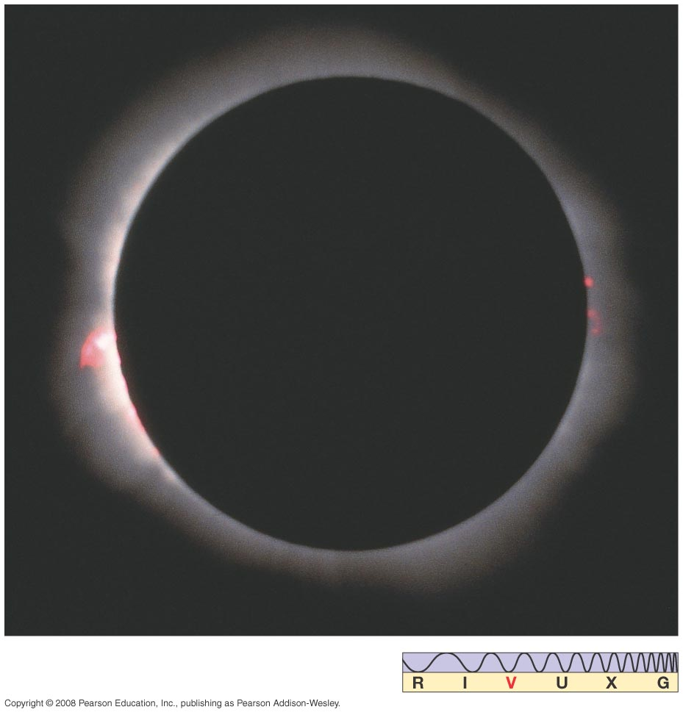
16.3 The Sun’s Atmosphere
The cooler chromosphere is above the photosphere.
The chromosphere is reddish-pink.
Notes:
Figure 16-11. Solar Chromosphere This photograph of a total solar eclipse shows the solar chromosphere a few thousand kilometers above the Sun’s surface. (G. Schneider)‏

Slide 18
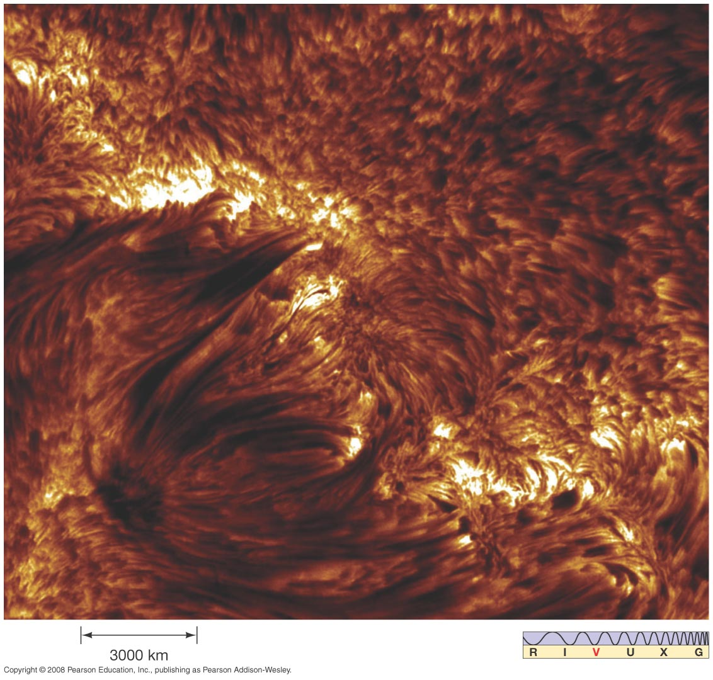
16.3 The Sun’s Atmosphere
Small solar storms in chromosphere emit spicules: tubes of magnetically channeled hot gas
Notes:
Figure 16-12. Solar Spicules Short-lived, narrow jets of gas that typically last mere minutes can be seen sprouting up from the solar chromosphere in this Hα image of the Sun. These so-called spicules are the thin, dark, spikelike regions. They appear dark against the face of the Sun because they are cooler than the underlying photosphere. (SST)‏

Slide 19
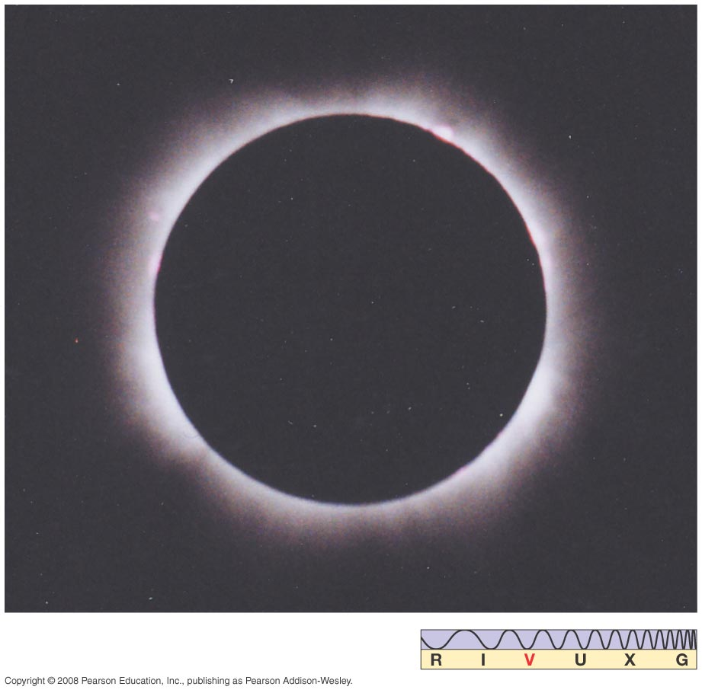
16.3 The Sun’s Atmosphere
Solar corona can be seen during eclipse if both photosphere and chromosphere are blocked:
Notes:
Figure 16-13. Solar Corona When both the photosphere and the chromosphere are obscured by the Moon during a solar eclipse, the faint corona becomes visible. This photograph clearly shows the emission of radiation from a relatively inactive solar corona. (Bencho Angelov)‏

Slide 20
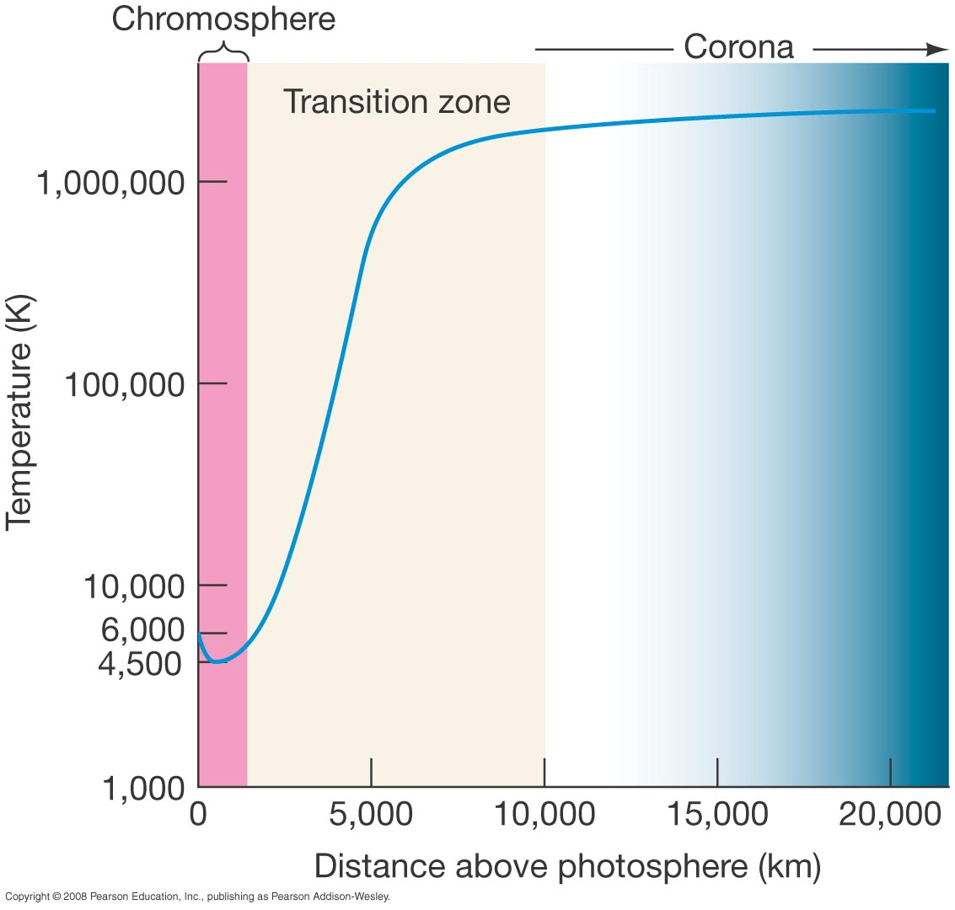
16.3 The Sun’s Atmosphere
Corona is much hotter than layers below it— must have a heat source ...
Notes:
Figure 16-14. Solar Atmospheric Temperature The change of gas temperature in the lower solar atmosphere is dramatic. The temperature, indicated by the blue line, reaches a minimum of 4500 K in the chromosphere and then rises sharply in the transition zone, finally leveling off at around 3 million K in the corona.

Slide 21
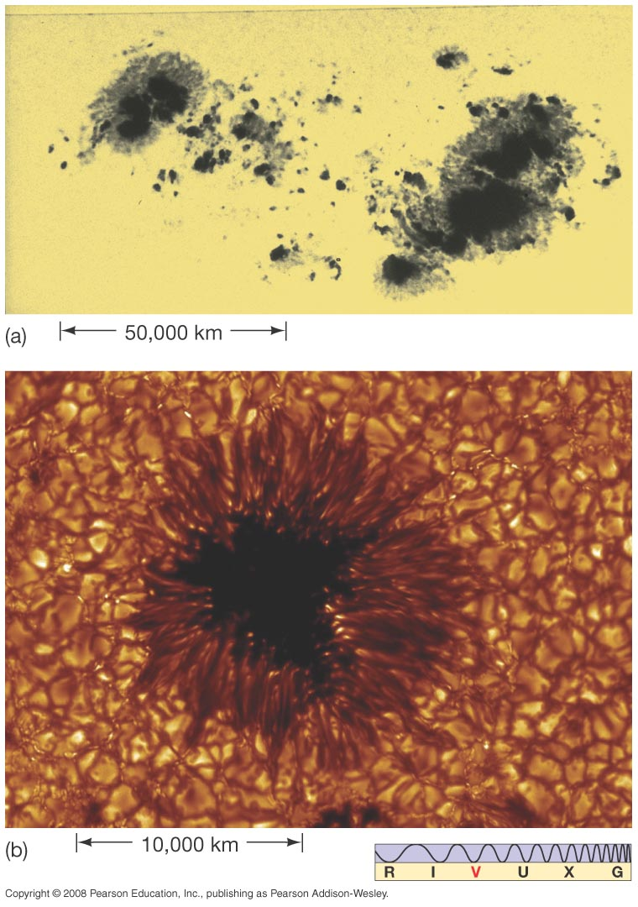
16.4 Solar Magnetism
Sunspots: Appear dark because slightly cooler than surroundings
Notes:
Figure 16-16. Sunspots, Up Close (a) An enlarged photograph of the largest pair of sunspots in Figure 16.15 shows how each spot consists of a cool, dark inner region called the umbra surrounded by a warmer, brighter region called the penumbra. The spots appear dark because they are slightly cooler than the surrounding photosphere. (b) A high-resolution image of a single typical sunspot—about the size of Earth—shows details of its structure as well as the surface granules surrounding it. See also the full-page opening photo at the start of this chapter. (Palomar Observatory/Caltech; SST/Royal Swedish Academy of Science)‏

Slide 22
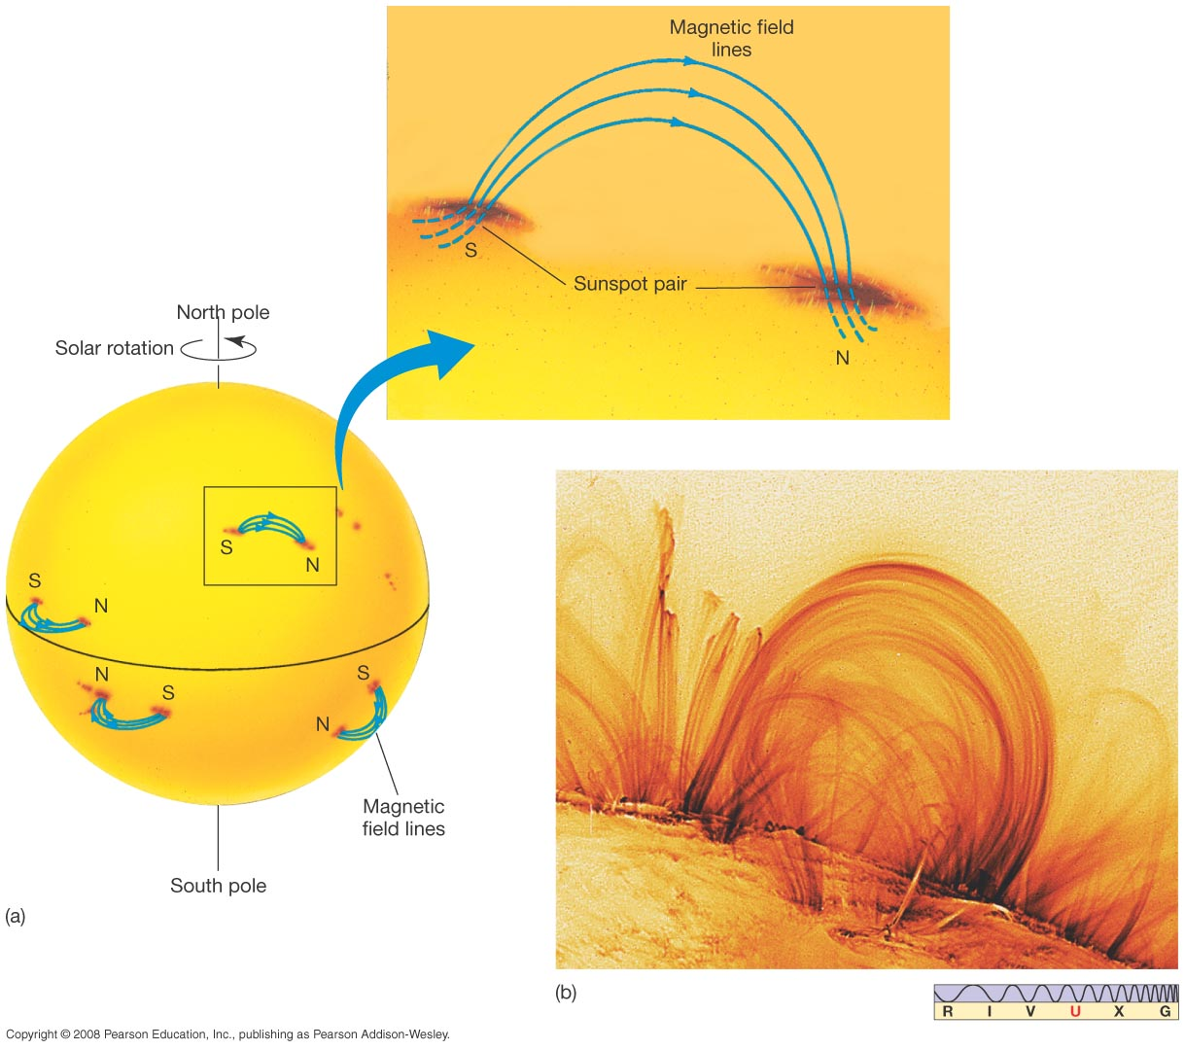
16.4 Solar Magnetism
Sunspots come and go, typically in a few days.
Pairs of sunspots are linked by magnetic field lines:
Notes:
Figure 16-17. Solar Magnetism (a) Sunspot pairs are linked by magnetic field lines. The Sun’s magnetic field lines emerge from the surface through one member of a pair and reenter the Sun through the other member. The leading members of all sunspot pairs in the solar northern hemisphere have the same polarity (labeled N or S, as described in the text). If the magnetic field lines are directed into the Sun in one leading spot, they are inwardly directed in all other leading spots in that hemisphere. The same is true in the southern hemisphere, except that the polarities are always opposite those in the north. The entire magnetic field pattern reverses itself roughly every 11 years. (b) A far-ultraviolet image taken by the Transition Region and Coronal Explorer (TRACE) satellite in 1999, showing magnetic field lines arching between two sunspot groups. Note the complex structure of the field lines, which are seen here via the radiation emitted by superheated gas flowing along them. Resolution here is about 700 km. In this negative image (which shows the lines more clearly), the darkest regions have temperatures of about 2 million K. (NASA)‏

Slide 23
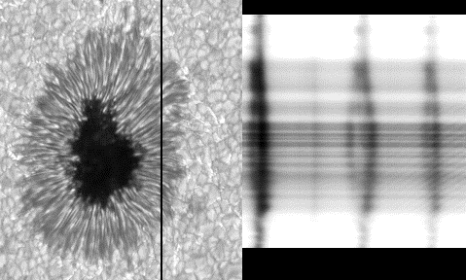
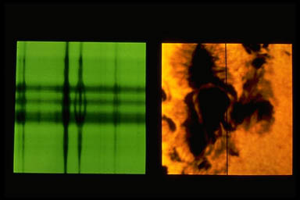
16.4 Solar Magnetism
Confirmation of strong magnetic fields in sunspots ...
the Zeeman Effect!
Notes:
Figure 16-17. Solar Magnetism (a) Sunspot pairs are linked by magnetic field lines. The Sun’s magnetic field lines emerge from the surface through one member of a pair and reenter the Sun through the other member. The leading members of all sunspot pairs in the solar northern hemisphere have the same polarity (labeled N or S, as described in the text). If the magnetic field lines are directed into the Sun in one leading spot, they are inwardly directed in all other leading spots in that hemisphere. The same is true in the southern hemisphere, except that the polarities are always opposite those in the north. The entire magnetic field pattern reverses itself roughly every 11 years. (b) A far-ultraviolet image taken by the Transition Region and Coronal Explorer (TRACE) satellite in 1999, showing magnetic field lines arching between two sunspot groups. Note the complex structure of the field lines, which are seen here via the radiation emitted by superheated gas flowing along them. Resolution here is about 700 km. In this negative image (which shows the lines more clearly), the darkest regions have temperatures of about 2 million K. (NASA)‏

Slide 24
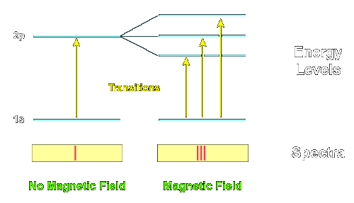
16.4 Solar Magnetism
The Zeeman Effect Is explained in terms of splitting
energy levels in atoms.
Notes:
Figure 16-17. Solar Magnetism (a) Sunspot pairs are linked by magnetic field lines. The Sun’s magnetic field lines emerge from the surface through one member of a pair and reenter the Sun through the other member. The leading members of all sunspot pairs in the solar northern hemisphere have the same polarity (labeled N or S, as described in the text). If the magnetic field lines are directed into the Sun in one leading spot, they are inwardly directed in all other leading spots in that hemisphere. The same is true in the southern hemisphere, except that the polarities are always opposite those in the north. The entire magnetic field pattern reverses itself roughly every 11 years. (b) A far-ultraviolet image taken by the Transition Region and Coronal Explorer (TRACE) satellite in 1999, showing magnetic field lines arching between two sunspot groups. Note the complex structure of the field lines, which are seen here via the radiation emitted by superheated gas flowing along them. Resolution here is about 700 km. In this negative image (which shows the lines more clearly), the darkest regions have temperatures of about 2 million K. (NASA)‏

Slide 25
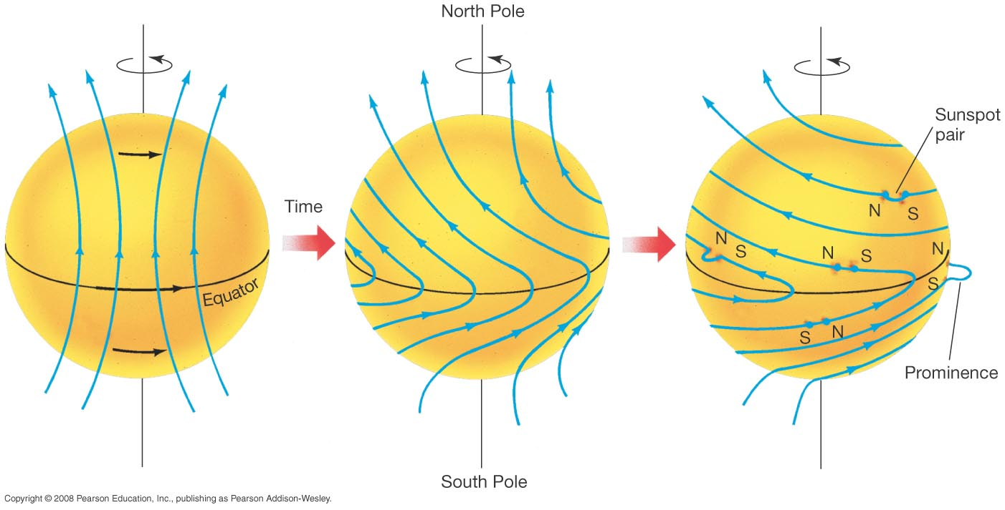
16.4 Solar Magnetism
Sunspots originate when magnetic field lines are distorted by Sun’s differential rotation.
Notes:
Figure 16-18. Solar Rotation (a, b) The Sun’s differential rotation wraps and distorts the solar magnetic field. (c) Occasionally, the field lines burst out of the surface and loop through the lower atmosphere, thereby creating a sunspot pair. The underlying pattern of the solar field lines explains the observed pattern of sunspot polarities. If the loop happens to occur on the edge of the Sun and is seen against the blackness of space, we see a phenomenon called a prominence, described in Section 16.5. (See Figure 16.22.)‏

Slide 26
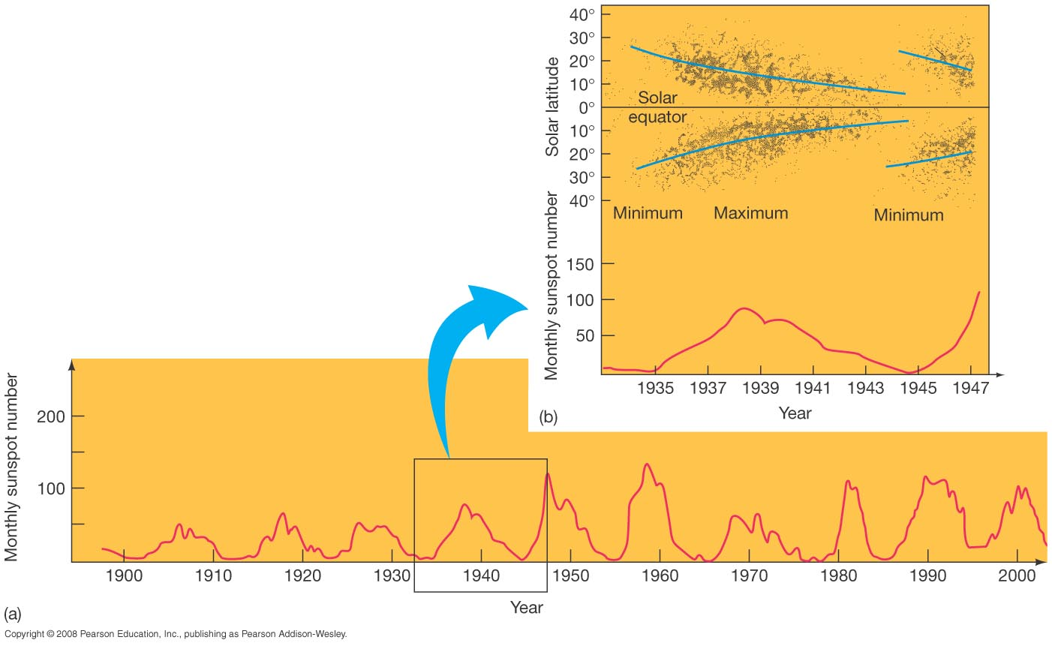
16.4 Solar Magnetism
The Sun has an 11-year sunspot cycle.
Notes:
Figure 16-20. Sunspot Cycle (a) Annual number of sunspots throughout the 20th century, showing 5-year averages of annual data to make long-term trends more evident. The (roughly) 11-year solar cycle is clearly visible. At the time of minimum solar activity, hardly any sunspots are seen. About 4 years later, at maximum solar activity, about 100 to 200 spots are observed per year. The most recent solar maximum occurred in 2001. (b) Sunspots cluster at high latitudes when solar activity is at a minimum. They appear at lower and lower latitudes as the number of sunspots peaks. They are again prominent near the Sun’s equator as solar minimum is approached once more. The blue lines in the upper plot indicate how the “average” sunspot latitude varies over the course of the cycle.

Slide 27
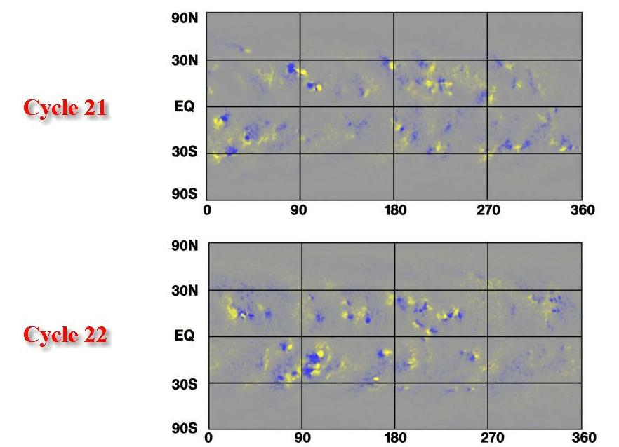
16.4 Solar Magnetism
This is really a 22-year cycle, because the spots switch polarities every 11 years.
Notes:
Figure 16-21. Maunder Minimum Number of sunspots occurring each year over the past four centuries. Note the absence of spots during the late 17th century.

Slide 28
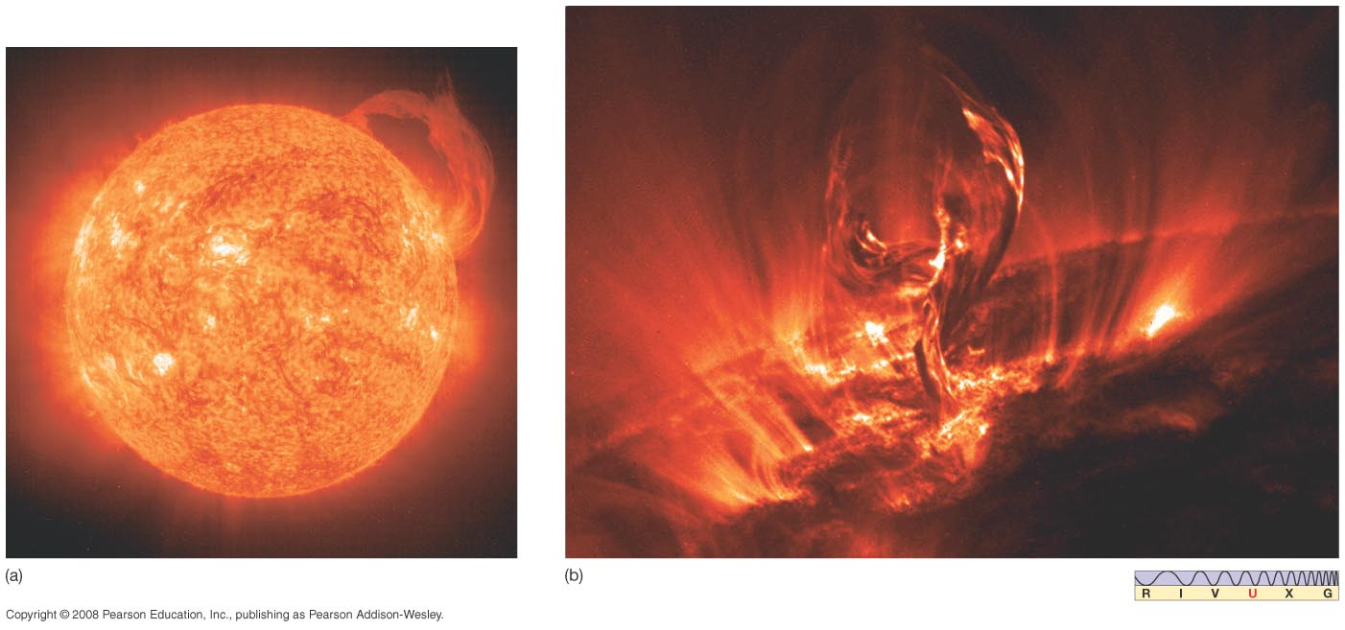
16.5 The Active Sun
Areas around sunspots are active.
Solar prominence : gas loop on limb
Solar Filament: gas loop viewed “head on”
Coronal mass ejection: loop breaks
Solar Flare:
Notes:
Figure 16-22. Solar Prominences (a) This particularly large solar prominence was observed by ultraviolet detectors aboard the SOHO spacecraft in June 2002. (b) Like a phoenix rising from the solar surface, this filament of hot gas measures more than 100,000 km in length. Earth could easily fit between its outstretched “arms.” Dark regions in this TRACE image have temperatures less than 20,000 K; the brightest regions are about 1 million K. The ionized gas follows the solar magnetic field lines away from the Sun. Most of the gas will subsequently cool and fall back into the photosphere. (NASA)‏

Slide 29
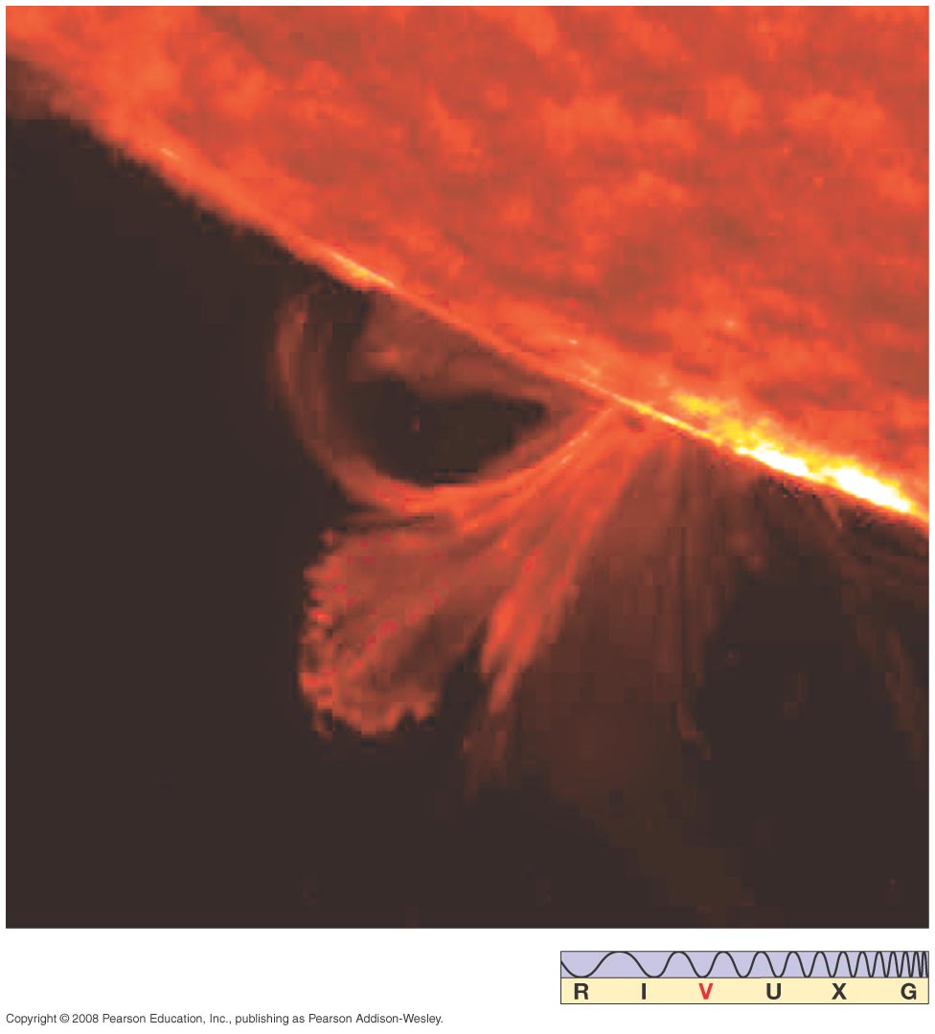
16.5 The Active Sun
Solar flare is a large explosion on Sun’s surface, emitting a similar amount of energy to a prominence, but in seconds or minutes rather than days or weeks:
Notes:
Figure 16-23. Solar Flare Much more violent than a prominence, a solar flare is an explosion on the Sun’s surface that sweeps across an active region in a matter of minutes, accelerating solar material to high speeds and blasting it into space. (USAF)‏

Slide 30
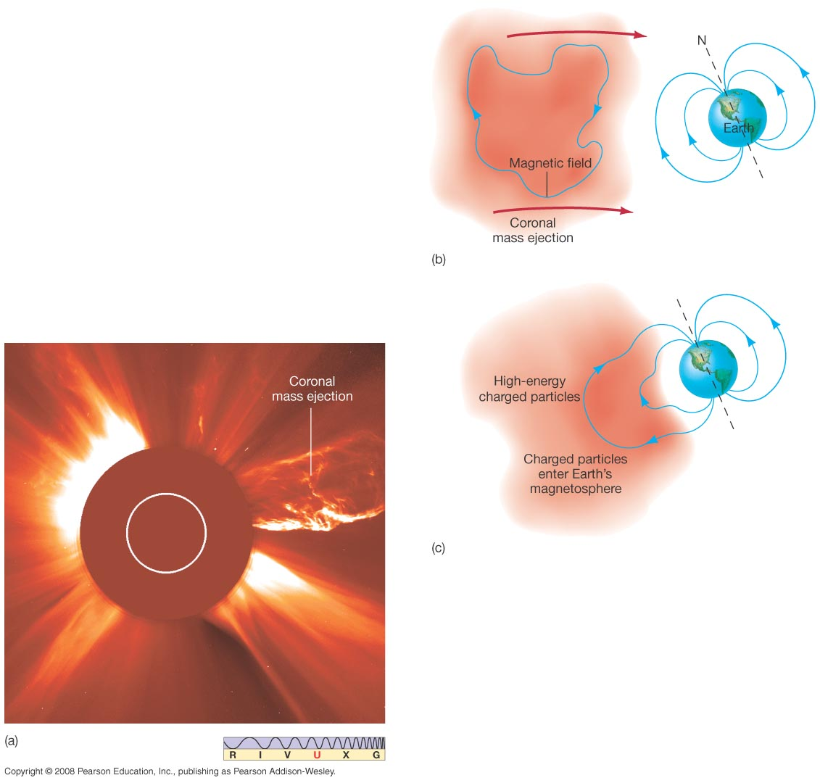
16.5 The Active Sun
Coronal mass ejection occurs when a large “bubble” detaches from the Sun and escapes into space.
Notes:
Figure 16-24. Coronal Mass Ejection (a) A few times per week, on average, a giant magnetized “bubble” of solar material detaches itself from the Sun and rapidly escapes into space, as shown in this SOHO image taken in 2002. The circles are artifacts of an imaging system designed to block out the light from the Sun itself and exaggerate faint features at larger radii. (b) Should a coronal mass ejection encounter Earth with its magnetic field oriented opposite to our own, as illustrated, the field lines can join together, allowing high-energy particles to enter and possibly severely disrupt our planet’s magnetosphere. By contrast, if the fields are oriented differently, the coronal mass ejection can slide by Earth with little effect. (NASA/ESA)‏

Slide 31
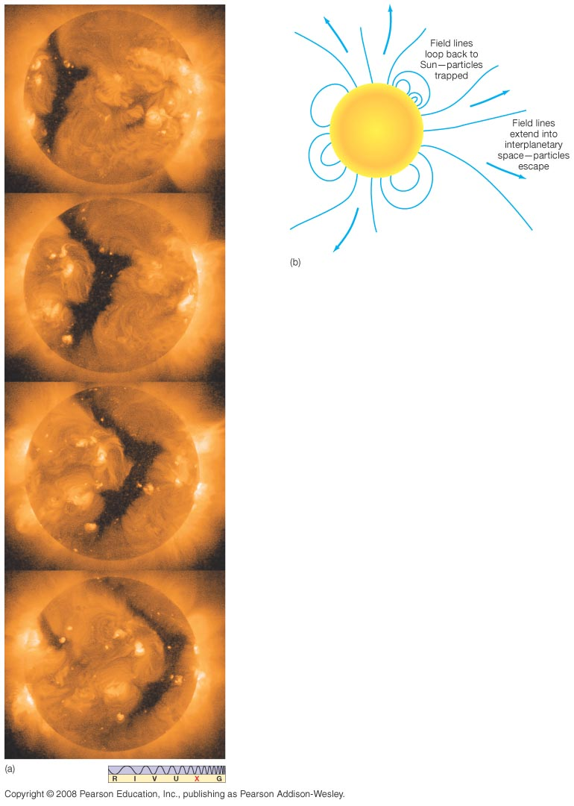
16.5 The Active Sun
Solar wind escapes Sun mostly through coronal holes, which can be seen in X-ray images as dark regions.
Notes:
Figure 16-25. Coronal Hole (a) Images of X-ray emission from the Sun observed by the Yohkoh satellite. These frames were taken at roughly 2-day intervals, starting at the top. Note the dark, V-shaped coronal hole traveling from left to right, where the X-ray observations outline in dramatic detail the abnormally thin regions through which the high-speed solar wind streams forth. (b) Charged particles follow magnetic field lines that compete with gravity. When the field is trapped and loops back toward the photosphere, the particles are also trapped; otherwise, they can escape as part of the solar wind. (ISAS/Lockheed Martin)‏

Slide 32
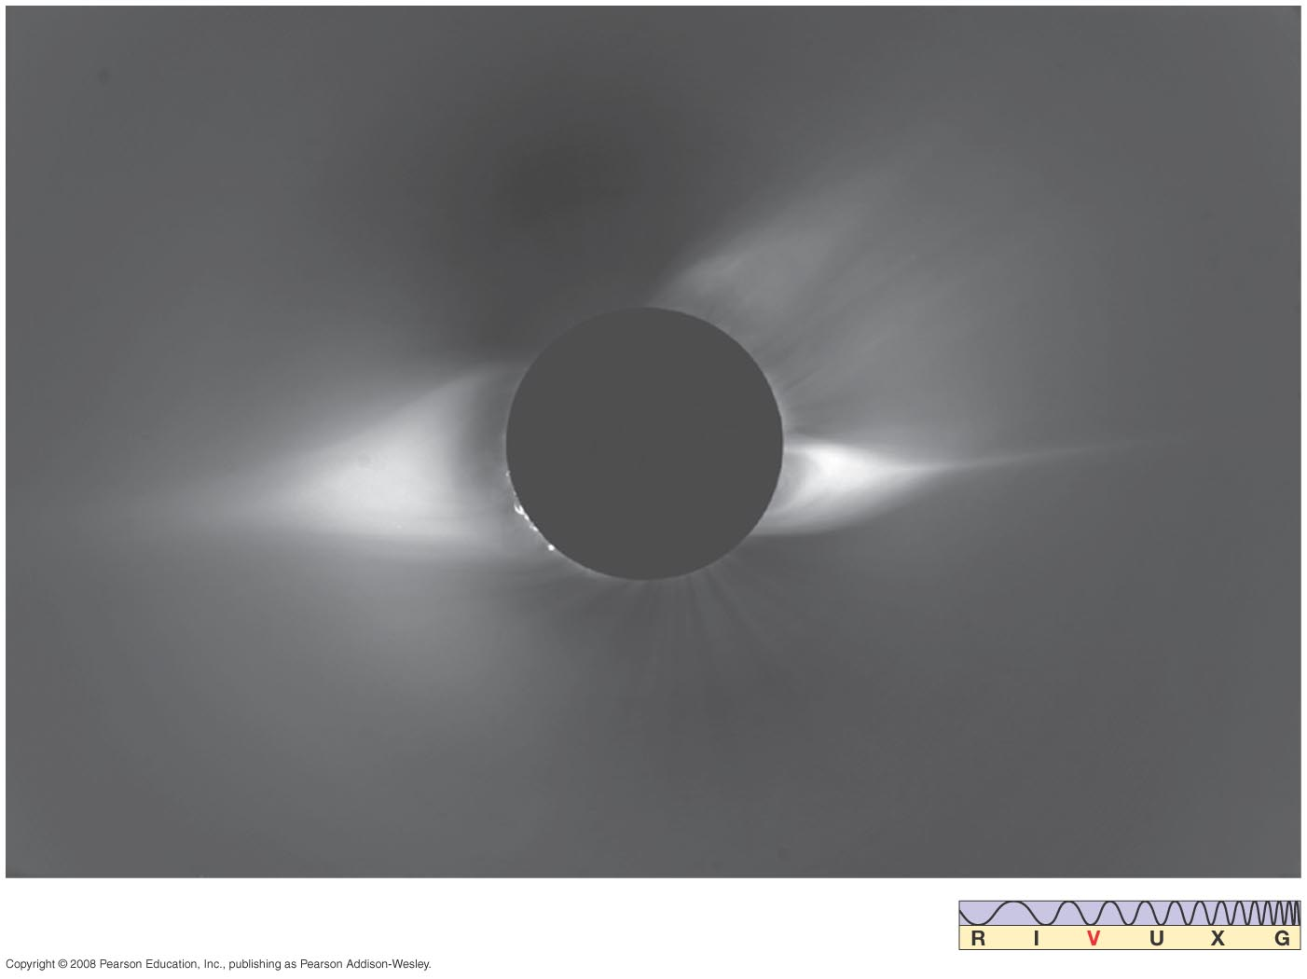
16.5 The Active Sun
Solar corona changes along with sunspot cycle; it is much larger and more irregular at sunspot peak.
Notes:
Figure 16-26. Active Corona Photograph of the solar corona during the July 1994 eclipse, near the peak of the sunspot cycle. At these times, the corona is much less regular and much more extended than at sunspot minimum (compare to Figure 16.13.) Astronomers think that coronal heating is caused by surface activity on the Sun. The changing shape and size of the corona is the direct result of variations in prominence and flare activity over the course of the solar cycle. (NCAR High Altitude Observatory)‏

Slide 33
16.5 The Active Sun
See YouTube video “Sun Montage – SOHO” for video of all of the preceding phenomena.
Notes:
Figure 16-26. Active Corona Photograph of the solar corona during the July 1994 eclipse, near the peak of the sunspot cycle. At these times, the corona is much less regular and much more extended than at sunspot minimum (compare to Figure 16.13.) Astronomers think that coronal heating is caused by surface activity on the Sun. The changing shape and size of the corona is the direct result of variations in prominence and flare activity over the course of the solar cycle. (NCAR High Altitude Observatory)‏

Slide 34
Discovery 16-2:
Solar–Terrestrial Relations
Does Earth feel effects of 22-year solar cycle directly?
Possible correlations seen; cause not understood, as energy output doesn’t vary much
Solar flares and coronal mass ejections ionize atmosphere, disrupting electronics and endangering astronauts

Slide 35
16.6 The Heart of the Sun
What powers the Sun??
It emits energy at the rate of 4X10²⁶ W.
It continues emitting for 10 billion years.
We find that the total lifetime energy output is about 3 × 10¹³ J/kg
This is a lot, and it is produced steadily, not explosively. How?

Slide 36
16.6 The Heart of the Sun
Gravitational contraction? no
Combustion? no
Nuclear fusion yes!
In general, nuclear fusion works like this:
nucleus 1 + nucleus 2 → nucleus 3 + energy
But where does the energy come from?
It comes from the mass:
The initial mass is greater than the final mass.

Slide 37
16.6 The Heart of the Sun
The relationship between mass and energy comes from Einstein’s famous equation:
E = mc²
E = energy
c is the speed of light
m=difference between final and initial mass
→ a small amount of mass becomes a large amount of energy

Slide 38
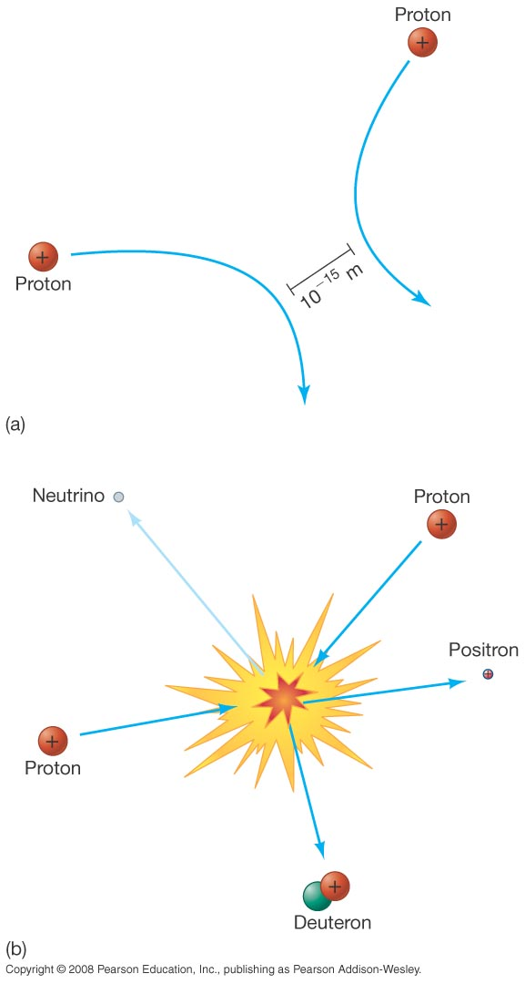
16.6 The Heart of the Sun
Nuclear fusion requires that like-charged nuclei get close enough to each other to fuse.
This can happen only if the temperature is extremely high—over 10 million K.
¹H + ¹H → ²H + positron +
neutrino
Notes:
Figure 16-27. Proton Interactions (a) Since like charges repel, two low-speed protons veer away from one another, never coming close enough for fusion to occur. (b) Sufficiently high-speed protons may succeed in overcoming their mutual repulsion, approaching close enough for the strong force to bind them together—in which case they collide violently, triggering nuclear fusion that ultimately powers the Sun.

Slide 39
16.6 The Heart of the Sun
The previous image depicts proton–proton fusion. In this reaction:
proton + proton → deuteron + positron + neutrino
The positron is just like the electron except positively charged; the neutrino is also related to the electron but has no charge and very little, if any, mass.
In more conventional notation:
¹H + ¹H → ²H + positron + neutrino

Slide 40
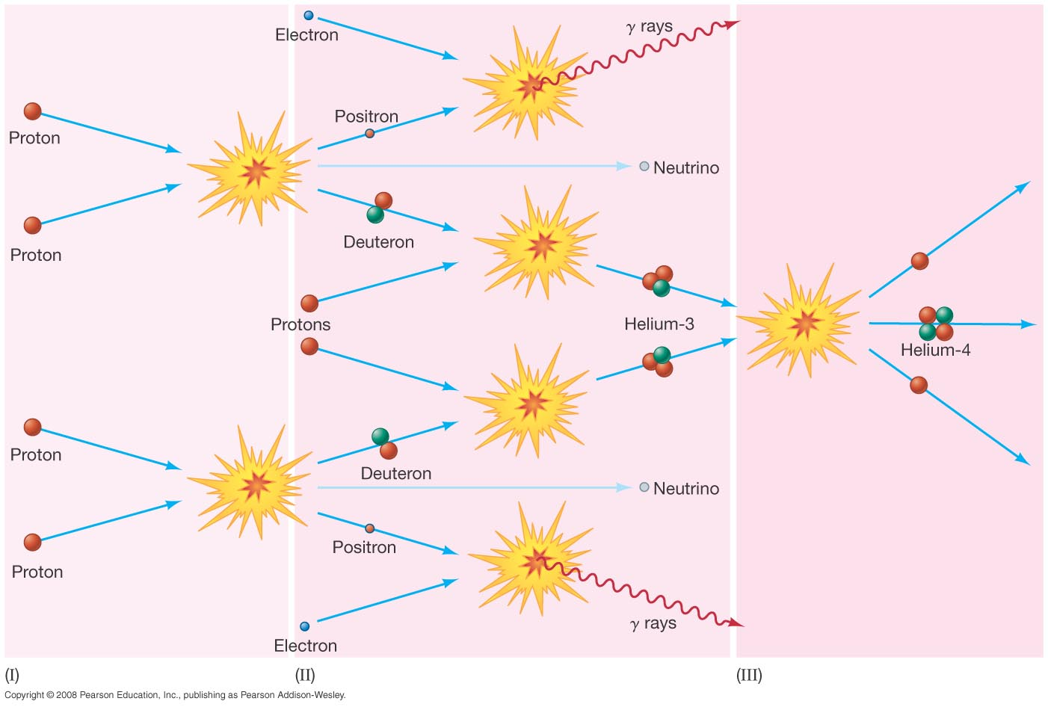
16.6 The Heart of the Sun
This is the first step in a three-step fusion process that powers most stars:
Notes:
Figure 16-28. Solar Fusion In the proton–proton chain, a total of six protons (and two electrons) are converted into two protons, one helium-4 nucleus, and two neutrinos. The two leftover protons are available as fuel for new proton–proton reactions, so the net effect is that four protons are fused to form one helium-4 nucleus. Energy, in the form of gamma rays, is produced at each stage. (Most of the photons are omitted for clarity.) The three stages indicated correspond to reactions (I), (II), and (III) described in the text.

Slide 41
16.6 The Heart of the Sun
The second step is the formation of an isotope of helium:
²H + ¹H → ³He + energy
The final step takes two of the helium-3 isotopes and forms helium-4 plus two protons:
³He + ³He → ⁴He + ¹H + ¹H + energy

Slide 42
16.6 The Heart of the Sun
The ultimate result of the process:
4(¹H) → ⁴He + energy + 2 neutrinos
The helium stays in the core.
The energy is in the form of gamma rays, which gradually lose their energy as they travel out from the core, emerging as visible light.
The neutrinos escape without interacting.

Slide 43
16.6 The Heart of the Sun
Sun must convert 4.3 million tons of matter into energy every second.
The Sun has enough hydrogen left to continue fusion for about another 5 billion years.

Slide 44
More Precisely 16-1:
Fundamental Forces
Physicists recognize four fundamental forces in nature:
Gravity: Very weak, but always attractive and infinite in range
Electromagnetic: Much stronger, but either attractive or repulsive; infinite in range
Weak nuclear force: Responsible for beta decay; short range (1-2 proton diameters); weak
Strong nuclear force: Keeps nucleus together; short range; very strong

Slide 45
More Precisely 16-2:
Energy Generation in the Proton–Proton Chain
Mass of four protons: 6.6943 x 10⁻²⁷ kg
Mass of helium nucleus: 6.6466 x 10⁻²⁷ kg
Mass transformed to energy: 0.0477 x 10⁻²⁷ kg (about 0.71%)‏
Energy equivalent of that mass: 4.28 x 10⁻¹² J
Energy produced by fusion of one kilogram of hydrogen into helium: 6.40 x 10¹⁴ J

Slide 46
16.7 Observations of Solar Neutrinos
Neutrinos are emitted directly from the core of the Sun and escape, interacting with virtually nothing. Being able to observe these neutrinos would give us a direct picture of what is happening in the core.
Unfortunately, they are no more likely to interact with Earth-based detectors than they are with the Sun; the only way to spot them is to have a huge detector volume and to be able to observe single interaction events.

Slide 47
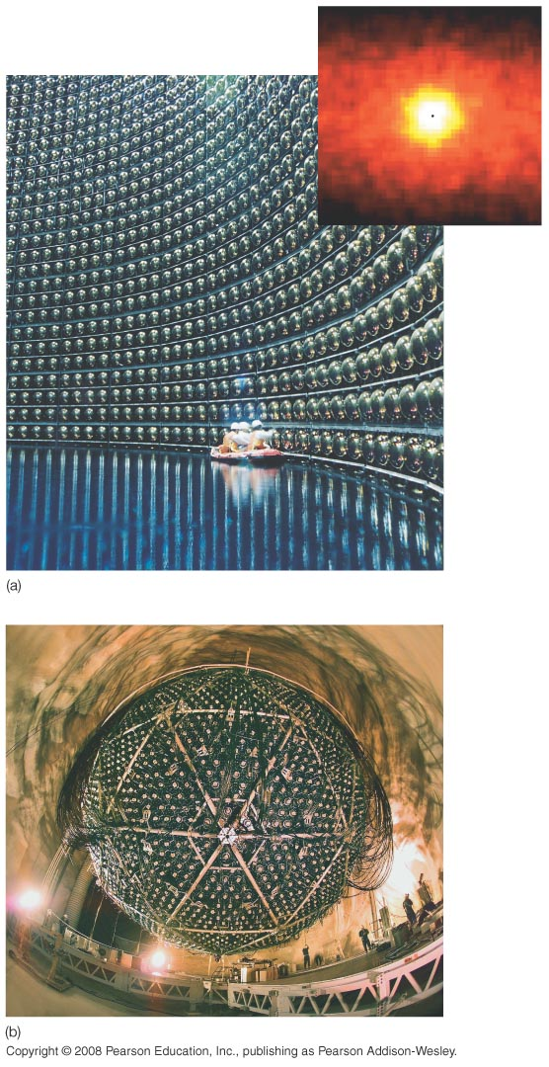
16.7 Observations of Solar Neutrinos
Typical solar neutrino detectors; resolution is very poor
Notes:
Figure 16-29. Neutrino Telescopes (a) This swimming pool-sized “neutrino telescope” is buried beneath a mountain near Tokyo, Japan. Called Super Kamiokande, it is filled (in operation) with 50,000 tons of purified water, and contains 13,000 individual light detectors (some shown here being inspected by technicians) to sense the telltale signature—a brief burst of light—of a neutrino passing through the apparatus. The inset shows an “image” of the Sun made by the Kamiokande instrument. Current neutrino detectors have very low resolution, and the field of view here is about 90° across. The small black dot indicates the actual size of the Sun. (b) The Sudbury Neutrino Observatory (SNO), situated 2 km underground in Ontario, Canada. The SNO detector is similar in design to the Kamiokande device, but by using “heavy” water (with hydrogen replaced by deuterium) instead of ordinary water, and adding two tons of salt, it also becomes sensitive to other neutrino types. The device contains 10,000 light-sensitive detectors arranged on the inside of the large sphere shown here. (ICRR, SNO)‏

Slide 48
16.7 Observations of Solar Neutrinos
Detection of solar neutrinos has been going on for more than 30 years now; there has always been a deficit in the type of neutrinos expected to be emitted by the Sun.
Recent research proves that the Sun is emitting about as many neutrinos as the standard solar model predicts, but the neutrinos change into other types of neutrinos between the Sun and the Earth, causing the apparent deficit.

Slide 49
Summary of Chapter 16
Main interior regions of Sun: core, radiation zone, convection zone, photosphere, chromosphere, transition region, corona, solar wind
Energy comes from nuclear fusion; produces neutrinos along with energy
Standard solar model is based on hydrostatic equilibrium of Sun
Study of solar oscillations leads to information about interior

Slide 50
Summary of Chapter 16 (cont.)‏
Absorption lines in spectrum tell composition and temperature
Sunspots associated with intense magnetism
Number of sunspots varies in an 11-year cycle
Large solar ejection events: prominences, flares, and coronal ejections
Observations of solar neutrinos show deficit, due to peculiar neutrino behavior

