Slide 1
Chapter 23
The Milky Way Galaxy

Slide 2
Units of Chapter 23
Our Parent Galaxy
Measuring the Milky Way
Early Computers
Galactic Structure
The Formation of the Milky Way
Galactic Spiral Arms
Density Waves

Slide 3
Units of Chapter 23
The Mass of the Milky Way Galaxy
The Galactic Center
Cosmic Rays

Slide 4
23.1 Our Parent Galaxy
From Earth, see few stars when looking out of galaxy (red arrows), many when looking in (blue arrows). Milky Way is how our Galaxy appears in the night sky (b).

Slide 5
23.1 Our Parent Galaxy
Our Galaxy is a spiral galaxy. Here are two other spiral galaxies, one viewed from the side and the other from the top, which are thought to resemble the Milky Way:

Slide 6
23.2 Measuring the Milky Way
One of the first attempts to measure the Milky Way was done by Herschel using visible stars.
Unfortunately, he was not aware that most of the Galaxy, particularly the center, is blocked from view by vast clouds of gas and dust.

Slide 7
23.2 Measuring the Milky Way
We have already encountered variable stars –novae, supernovae, and related phenomena – these are called cataclysmic variables.
There are other stars whose luminosity varies in a regular way, but much more subtly. These are called intrinsic variables.
Two types of intrinsic variables have been found: RR Lyrae stars, and Cepheids.

Slide 8
23.2 Measuring the Milky Way
The upper plot is an RR Lyrae star. All such stars have essentially the same luminosity curve, with periods from 0.5 to 1 day.
The lower plot is a Cepheid variable; Cepheid periods range from about 1 to 100 days.

Slide 9
23.2 Measuring the Milky Way
The variability of these stars comes from a dynamic balance between gravity and pressure – they have large oscillations around stability.

Slide 10
23.2 Measuring the Milky Way
The usefulness of these stars comes from their period–luminosity relation:

Slide 11
23.2 Measuring the Milky Way
This allows us to measure the distances to these stars.
RR Lyrae stars all have about the same luminosity; knowing their apparent magnitude allows us to calculate the distance.
Cepheids have a luminosity that is strongly correlated with the period of their oscillations; once the period is measured, the luminosity is known and we can proceed as above.

Slide 12
23.2 Measuring the Milky Way
Many RR Lyrae stars are found in globular clusters. These clusters are not all in the plane of the Galaxy, so they are not obscured by dust and can be measured.
This yields a much more accurate picture of the extent of our Galaxy and our place within it.

Slide 13
23.2 Measuring the Milky Way
We have now expanded our cosmic distance ladder one more step:

Slide 14
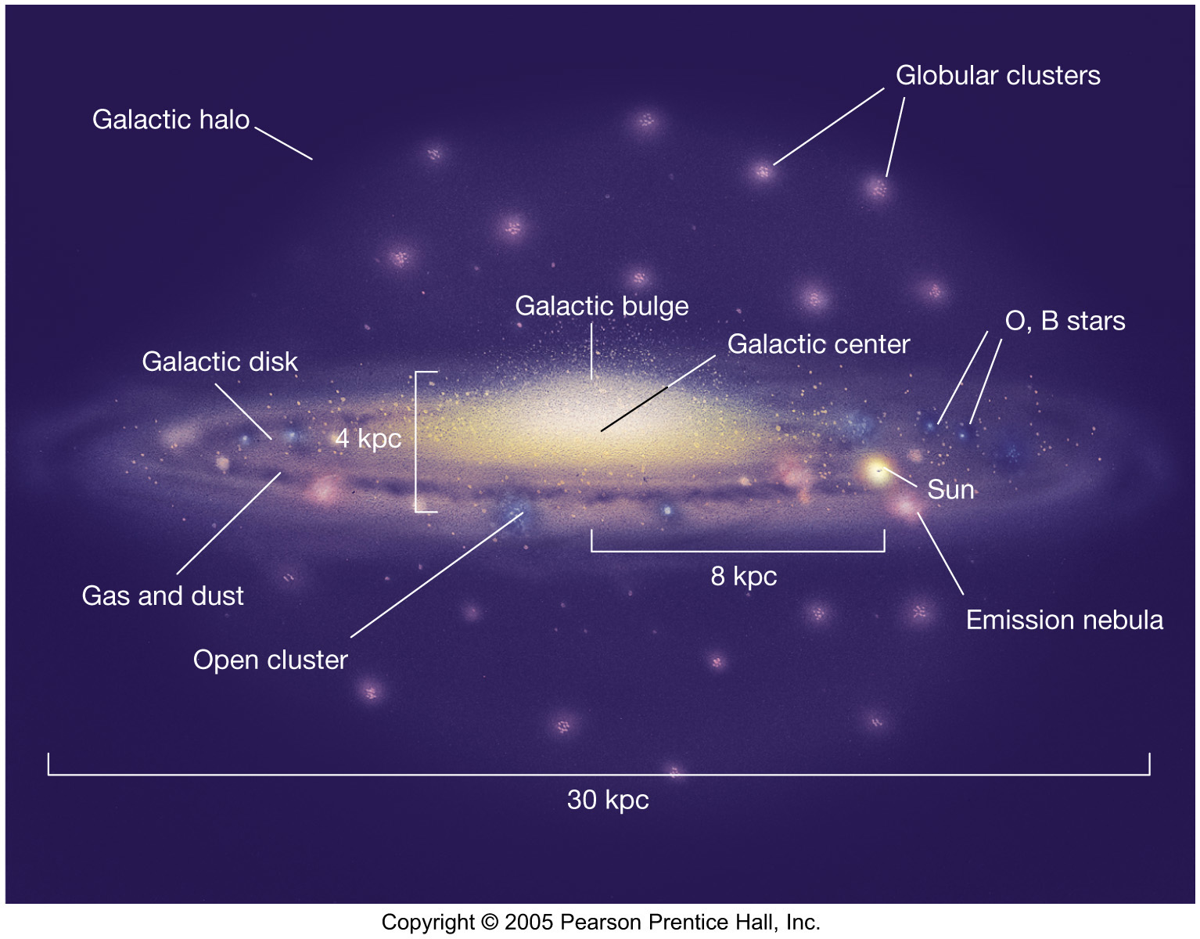
23.3 Galactic Structure
This artist’s conception shows the various parts of our Galaxy, and the position of our Sun:

Slide 15
23.3 Galactic Structure
The Galactic halo and globular clusters formed very early; the halo is essentially spherical. All the stars in the halo are very old, and there is no gas and dust.
The Galactic disk is where the youngest stars are, as well as star formation regions – emission nebulae, large clouds of gas and dust.
Surrounding the Galactic center is the Galactic bulge, which contains a mix of older and younger stars.

Slide 16
23.3 Galactic Structure
This infrared view of our Galaxy shows much more detail of the Galactic center than the visible-light view does, as infrared is not as much absorbed by gas and dust.

Slide 17
23.3 Galactic Structure
Stellar orbits in the disk are in a plane and in the same direction; orbits in the halo and bulge are much more random.

Slide 18
23.4 The Formation of the Milky Way
Any theory of galaxy formation should be able to account for all the properties below:

Slide 19
23.4 The Formation of the Milky Way
The formation of the Galaxy is believed to be similar to the formation of the solar system, but on a much larger scale:

Slide 20
23.5 Galactic Spiral Arms
Measurement of the position and motion of gas clouds shows that the Milky Way has a spiral form:

Slide 21
23.5 Galactic Spiral Arms
The spiral arms cannot rotate along with the Galaxy; they would “curl up”:
The “winding problem”.

Slide 22
23.5 Galactic Spiral Arms
Rather, they appear to be density waves, with
stars moving in and out of them much as cars move in and out of a traffic jam:

Slide 23
23.5 Galactic Spiral Arms
As clouds of gas and dust move through the spiral arms, the increased density triggers star formation. This may contribute to propagation of the arms. The origin of the spiral density waves is not yet under- stood.

Slide 24
23.6 The Mass of the Milky Way Galaxy
The orbital speed of an object depends only on the amount of mass between it and the Galactic center:

Slide 25
23.6 The Mass of the Milky Way Galaxy
Once all the Galaxy is within an orbit, the velocity should diminish with distance, as the dashed curve shows.
It doesn’t; more than twice the mass of the Galaxy would have to be outside the visible part to reproduce the observed curve.

Slide 26
23.6 The Mass of the Milky Way Galaxy
What could this “dark matter” be? It is dark at all wavelengths, not just the visible.
Stellar-mass black holes?
Probably no way enough could have been created
Brown dwarfs, faint white dwarfs, and red dwarfs?
Currently the best star-like option
Weird subatomic particles?
Could be, although no evidence so far

Slide 27
23.6 The Mass of the Milky Way Galaxy
A Hubble search for red dwarfs turned up very few; any that existed should have been detected:

Slide 28
23.6 The Mass of the Milky Way Galaxy
The bending of spacetime can allow a large mass to act as a gravitational lens:
Observation of such events suggests that low-mass white dwarfs could only account for about half of the mass needed.
See animation.

Slide 29
23.6 The Mass of the Milky Way Galaxy
Summary
Rotation curve gives total mass 2x10¹¹ M_sun.
Rotation curve predicts dark matter.
Candidates: MACHO's, mini BH, brown dwarfs, Jupiters, fundamental particles (e.g., neutrinos).
Searches have not solved the mystery of the composition of dark matter.

Slide 30
23.7 The Galactic Center
This is a view towards the Galactic center, in visible light. The two arrows in the inset indicate the location of the center; it is entirely obscured by dust.

Slide 31
23.7 The Galactic Center
These images, in infrared, radio, and X-ray, offer a different view of the Galactic center.

Slide 32
23.7 The Galactic Center
The Galactic center appears to have a stellar density a million times higher than near Earth;
a ring of molecular gas 400 pc across;
strong magnetic fields;
a rotating ring or disk of matter a few parsecs across; and
a strong X-ray source at the center

Slide 33
23.7 The Galactic Center
Apparently, there is an enormous black hole at the center of the Galaxy, which is the source of these phenomena.
An accretion disk surrounding the black hole emits enormous amounts of radiation.

Slide 34
23.7 The Galactic Center
Stars from IR imaging with adaptive optics. The orbit on the right is the best fit; it assumes a central black hole of 3.7 million solar masses.

Slide 35
Summary of Chapter 23
Galaxy is stellar and interstellar matter bound by its own gravity
Our Galaxy is spiral
Variable stars can be used for distance measurement, through period–luminosity relationship
True extent of our Galaxy can be mapped out using globular clusters
Star formation occurs in disk, but not in halo or bulge

Slide 36
Summary of Chapter 23, cont.
Spiral arms may be density waves
Galactic rotation curve shows large amounts of undetectable mass at large radii; called dark matter
Activity near Galactic center suggests presence of a 2–3 million solar-mass black hole

