Slide 1
Physics 231
Outline for Day 1
Attendance and a list of units
Discuss syllabus
Units & Measurements

Slide 2

P231 Week 1: measurements
Goals of Week 1:
Learn about base and derived units
Learn dimensions and dimensional analysis
Understand measurements and their errors
Learn how to propagate errors
Understand how μ, σ, and σ_{μ} are related to measurements and errors

Slide 3
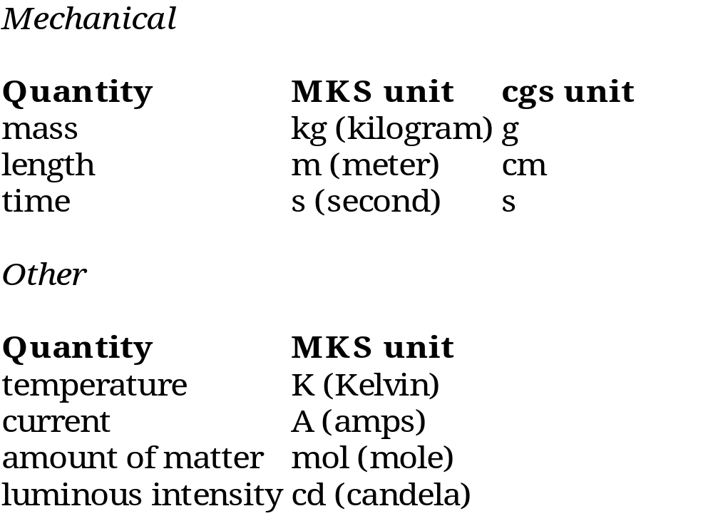
P231 Week 1: measurements
Units
Base Units
Derived Units
miles/hour
km/s
mol/liter
kg m/s²
etc.
etc.
etc.

Slide 4

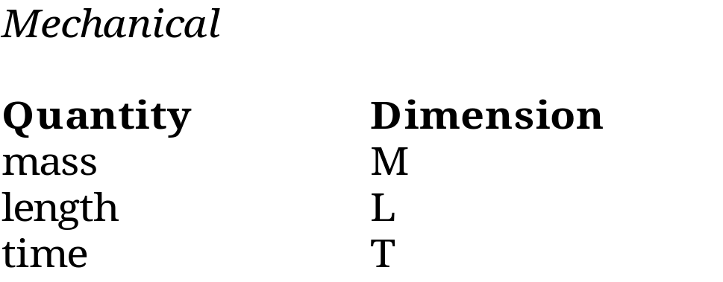
P231 Week 1: measurements
Dimensions
dimension: “the manifoldness with which the fundamental units of time, length, and mass are involved in determining the units of other physical quantities.”
dimension: a measureable quantity
For mechanical base units ...
For some derived units ...
[miles/hours] =
[km/s] =
[knot] =
[L (liter)] =
[kg m/s²] =
L/T
L/T
L/T
L³
ML/T²

Slide 5
P231 Week 1: measurements
Dimensional Analysis
a way to figure out if an equation is correct
allows you to decide which equation to use.
Ex. 1) Is this equation dimensionally correct?
ma = ½†mv²
where m=mass, v=speed, a=acceleration=L/T²
Soln: [ma]=ML/T² and [½ mv²]=ML²/T²
since ML/T² ≠ ML²/T² the equation cannot be correct.
Ex. 2) Is this equation dimensionally correct?
y = at²
where y=position (L), t=time, a=acceleration=L/T²
Soln: [y]=L, [at²]=L/T² * T²=L.
since L = L, the equation is dimensionally correct.
However, the equation is still wrong! How?
†1/2 is a dimension less constant

Slide 6
P231 Week 1: measurements
Dimensional Analysis (cont)‏
Ex. 3) How long does it take to drive 20 miles (to Lima) at a constant 60 mph?
Soln: Let v=speed (L/T), d=distance (L) and t=time (T).
Possible (linear) equations: t=v*d, t=v/d, t=d/v
check dimensions: L²/T 1/T T
so: t=d/v = 20/60 = 1/3 hr or 20 minutes.

Slide 7
P231 Week 1: measurements
Measurements
measurement: the act or result of measuring
Example: use a plastic ruler to measure a shoe's length
to be L=12.0±0.1 inches.
Example: use a Vernier caliper to measure the same shoe length
to be L=12.13±0.04 inches.
Notice:
A measurement consists of a number, an error (or uncertainty,
or tolerance), and a unit. 3 things!
The number of significant digits shown is related to the error.
The caliper is more precise than the ruler.
It is uncertain which measurement device is more accurate.

Slide 8
P231 Week 1: measurements
Measurements
Accuracy and precision
i. accuracy: how close the a measurement is to some accepted “true” value
ii. precision: how repeatable the measurement is with a given
instrument and technique

Slide 9
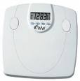
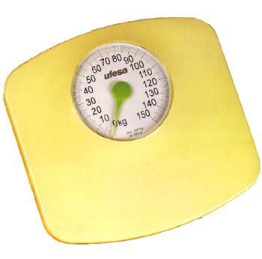
P231 Week 1: measurements
Measurements -accuracy and precision
Example: two bathroom scales.
Step on and off them repeatedly in a consistent way.
digital scale analog (yellow) scale
155.1 lbs 150. lbs
155.0 148
155.1 149
155.2 149
155.3 151
Q: Which scale is more precise?
Q: Which scale has the greater “spread” in values?
Q: Which scale is most accurate?
You go to the doctors office and they tell you 157.2 lbs.
Q: Which scale is most accurate?
Q: Which scale is more precise?

Slide 10
P231 Week 1: measurements
Measurements
Significant figures or (significant digits)‏
-- a way of suggesting precision.
significant figure: any digit of a number that is known with certainty;
any digit of a number beginning with the leftmost non-zero digit and
ending with the rightmost non-zero digit (or a zero considered to be
the exact value.
Notes:
1. The number left of a decimal point is sig-
nificant.
2. errors should have 1 significant figure.
3. For homework after week 1, give answers
to 3 or 4 significant digits.
4. The least significant digit (LSD) is the right-
most significant digit.
5. the weights from the yellow scale should not
be quoted to more than the 1's place.
Examples:
1) 4,567,000 4
2) 4.567 0 5
3) 4,567,000 6
4) 4,567,000. 7
5) 0.03450 4
6) 30.003 5

