Slide 1
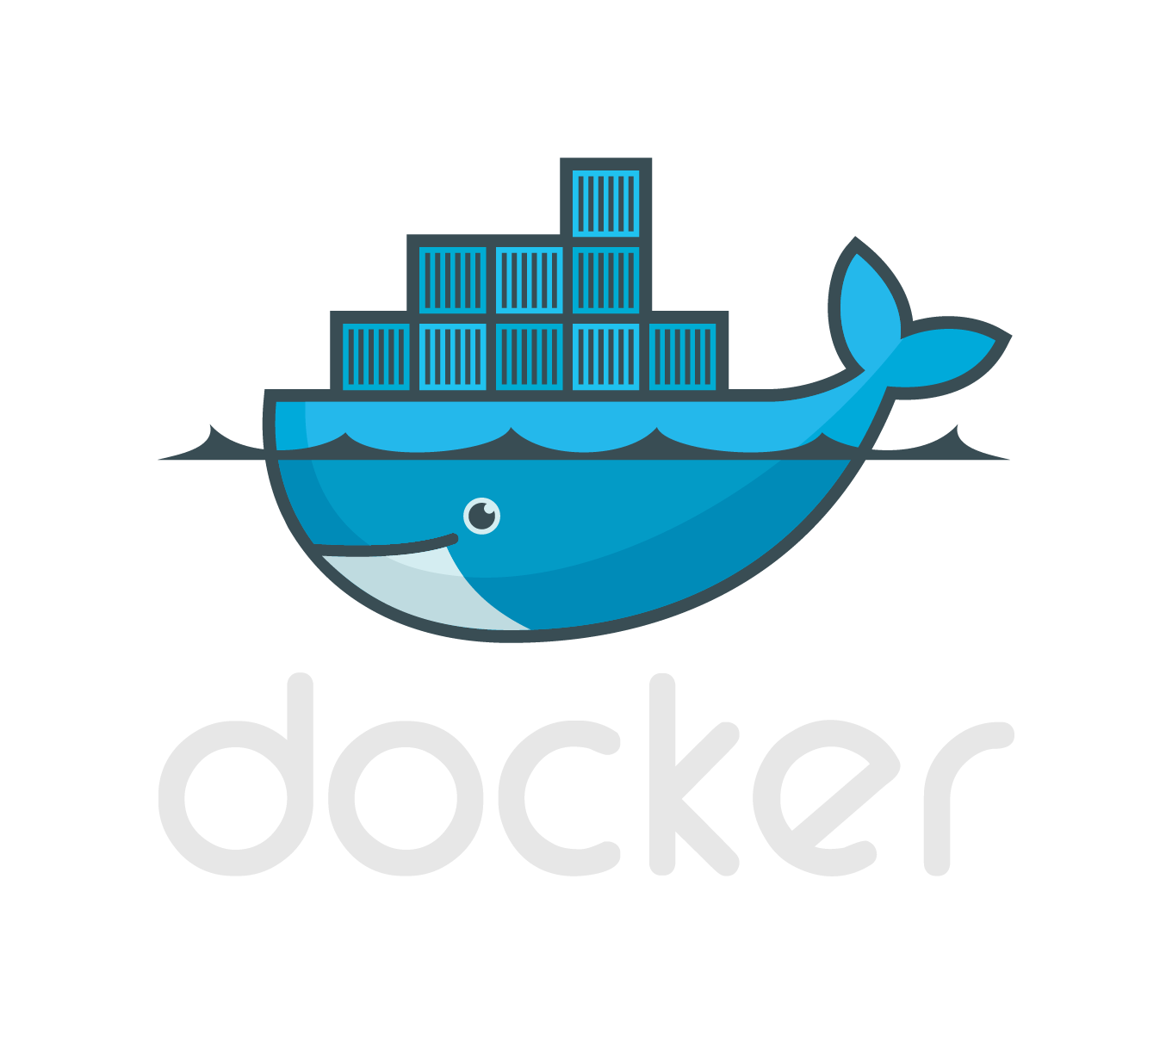
Project
So far…

Slide 2
Modules
Jenkins
Jira
Nexus
Postfix
Tomcat
Urbancode Deploy
Zabbix

Slide 3
Dependencies
 | Java (Latest) | Java 7 | Maven | MySQL | Apache | PHP | CentOS | PostFix
Jenkins |  | X | X |  |  |  |  | O
Jira | X |  |  | X |  |  |  | O
Nexus | X |  |  |  |  |  |  | O
Postfix |  |  |  | O |  |  |  | -
Tomcat | X |  |  |  |  |  |  | O
Urbancode Deploy |  |  |  |  |  |  | X | O
Zabbix |  |  |  | X | X | X |  | O
Puppet Enterprise |  |  |  |  |  |  | X | O
Key: X = Mandatory O = Optional - = Not Applicable N.B. Everything else will be running Ubuntu Server 16.04 LTS.

Slide 4
Base Images
Ubuntu 16:04 LTS
Java base
MySQL base
CENTOS 7
Images contain only what they need in order for the application or service to run
E.g. no Java on containers that do not need it.

Slide 5
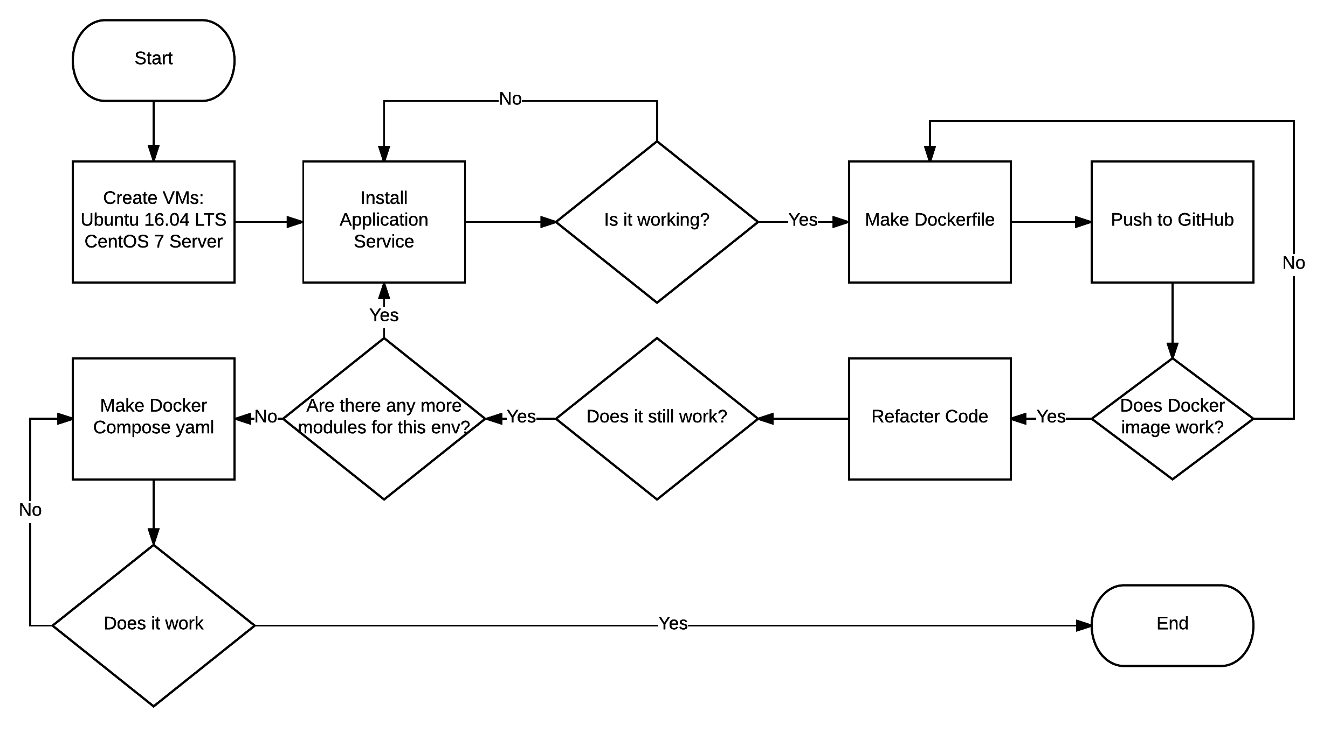
Process of making modules

Slide 6
Redundancies
The use of Volumes – can be backed up elsewhere – NAS, Offsite, etc.
Downside – potentially huge entrypoint.sh
The use of storage containers (No longer recommended)
No data is theoretically lost should a container go down.

Slide 7



Problems
Urbancode Deploy – Silent installer doesn’t work
This is specific to version 6.2.2 (Latest)
IBM’s workaround does not work in Docker
IBM do not provide older versions
Tomcat – Does not run properly as non-root
Tried chown –R tomcat:tomcat chmod a+x and chmod 777
MySQL Data Volumes – reinitialization issues
Seems reset to default, root no longer has a password, database inaccessible despite having correct accounts.
Postfix – Since I don’t know
Unable to test this
Seems to involve a lot of configuration and managing certificates.
(╯ರ ~ ರ）╯︵ ┻━┻

Slide 8
To-do
More research into how to use Volumes properly, especially with MySQL
Making other applications and services utilise Volumes
Urbancode (If there is a IBM update) deploy with the use of MySQL
Puppet Enterprise
The dreaded Postfix of doom – Properly

