Slide 1

Project
So far…

Slide 2
Modules
Jenkins
Jira
Nexus
Postfix
Tomcat
Urbancode Deploy
Zabbix

Slide 3
Dependencies
 | Java (Latest) | Java 7 | Maven | MySQL | Apache | PHP | CentOS | PostFix
Jenkins |  | X | X |  |  |  |  | O
Jira | X |  |  | X |  |  |  | O
Nexus | X |  |  |  |  |  |  | O
Postfix |  |  |  | O |  |  |  | -
Tomcat | X |  |  |  |  |  |  | O
Urbancode Deploy |  |  |  |  |  |  | X | O
Zabbix |  |  |  | X | X | X |  | O
Puppet Enterprise |  |  |  |  |  |  | X | O
Key: X = Mandatory O = Optional - = Not Applicable N.B. Everything else will be running Ubuntu Server 16.04 LTS.

Slide 4
Base Images
Ubuntu 16:04 LTS
Java base
MySQL base
CENTOS 7
Images contain only what they need in order for the application or service to run
E.g. no Java on containers that do not need it.

Slide 5
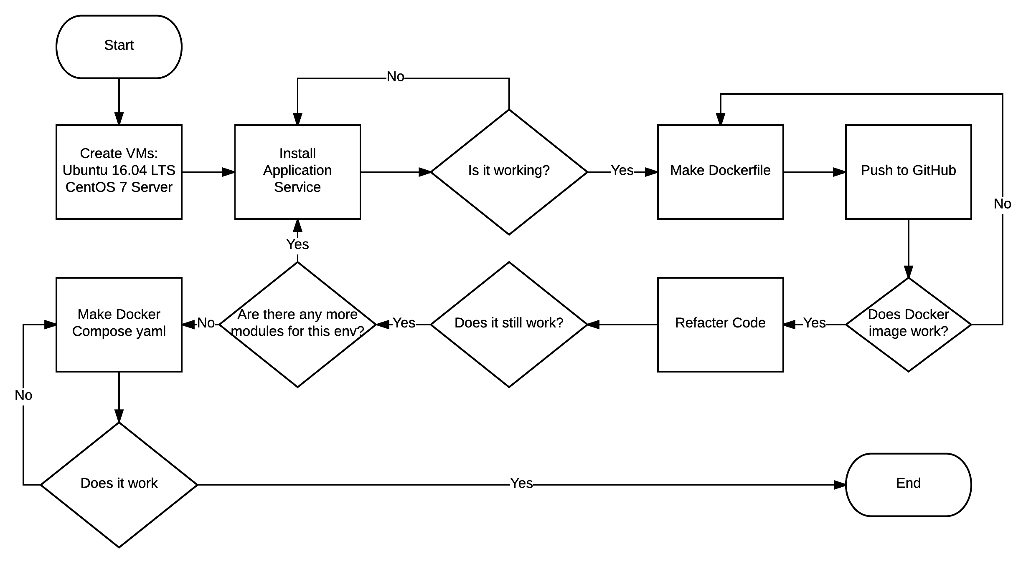
Process of making modules

Slide 6
Redundancies
The use of Volumes – can be backed up elsewhere – NAS, Offsite, etc.
Downside – potentially huge entrypoint.sh
The use of storage containers (No longer recommended)
No data is theoretically lost should a container go down.

Slide 7



Problems
Urbancode Deploy – Silent installer doesn’t work
This is specific to version 6.2.2 (Latest)
IBM’s workaround does not work in Docker
IBM do not provide older versions
Tomcat – Does not run properly as non-root
Tried chown –R tomcat:tomcat chmod a+x and chmod 777
MySQL Data Volumes – reinitialization issues
Seems reset to default, root no longer has a password, database inaccessible despite having correct accounts.
Postfix – Since I don’t know
Unable to test this
Seems to involve a lot of configuration and managing certificates.
(╯ರ ~ ರ）╯︵ ┻━┻

Slide 8
To-do
More research into how to use Volumes properly, especially with MySQL
Making other applications and services utilise Volumes
Urbancode (If there is a IBM update) deploy with the use of MySQL
Puppet Enterprise
The dreaded Postfix of doom – Properly

Slide 9
Summary
Listed modules to install
Listed dependencies of modules
Flow diagram of making modules
The potential use of volumes
The problems with some of the modules
Things still to do
This slide

