Slide 1
G2P: Genotype to Phenotype

Slide 2
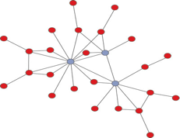
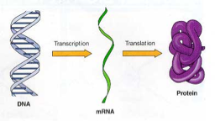
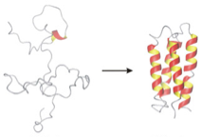
G2P: Connecting the Genotype to Phenotype
Genotype
Phenotype
Image: Jesse Poland

Slide 3
Genomic Selection
Predict phenotype value
No knowledge of the genes or even the chromosomal position.

Slide 4
Design of
Experiment
Imputation
Phenotypic Value
Marker Discovery
Data
Filtering
Marker
Filtering
Bio
informatics
Phenotype
High throughput phenotyping
Alignment
Genomic Selection
Reference
Genome
GWAS
Associated Analysis
Genotype
Genetic
Map
Population
Structure
QTL Mapping
Markers

Slide 5
Design of
Experiment
Imputation
Phenotypic Value
Marker Discovery
Data
Filtering
Marker
Filtering
Bio
informatics
Phenotype
High throughput phenotyping
Alignment
Genome Wide Association Studies
Reference
Genome
GS
Associated Analysis
Genotype
Genetic
Map
Population
Structure
QTL Mapping
Markers

Slide 6
Design of
Experiment
Imputation
Phenotypic Value
Marker Discovery
Data
Filtering
Marker
Filtering
Bio
informatics
Phenotype
High throughput phenotyping
Alignment
Genome Wide Association Studies
Jared says this is sad.
Reference
Genome
GS
Associated Analysis
Genotype
Genetic
Map
Population
Structure
QTL Mapping
Markers

Slide 7
Genome Wide Association Studies
Associate markers to phenotype

Slide 8
Genome Wide Association Studies
Associate markers to phenotype
Identify the location
in the genome

Slide 9
Genome Wide Association Studies
Associate markers to phenotype
Identify the location
in the genome
SNP effect

Slide 10
Why perform a GWAS?
Identify chromosomal locations controlling trait of interest.
Identify candidate genes for fine mapping and cloning.
Estimate allele (SNP) effects

Slide 11
Information Needed to Perform GWAS
Phenotype
Model
Genotype

Slide 12
Phenotype
Phenotype of interest
Accurate phenotypic measurements
Increase accuracy through replication
Precision of measurements
✭ Population for GWAS

Slide 13
Genotype
Molecular markers scored on phenotyped individuals.
Reference genome
High marker density
Linkage between markers and phenotyped trait

Slide 14
GWAS Model
Mixed model
Y = X𝜷 + Zu + ε (Mixed model from GS)

Slide 15
GWAS Model
Mixed model
Y = X𝜷 + Zu + ε (Mixed model from GS)
﻿Y = X𝜷 + Sα + Q𝝊 + Zu + ε (Expanded mixed model)

Slide 16
GWAS Mixed Model
﻿Y = X𝜷 + Sα + Q𝝊 + Zu + ε
Vector of phenotypes (n x 1)

Slide 17
GWAS Mixed Model
﻿Y = X𝜷 + Sα + Q𝝊 + Zu + ε
Vector of phenotypes (n x 1)
Design matrix of fixed effects (n x p)
Vector of fixed effects (p x 1)
Covariates (age at maturity, etc)

Slide 18
GWAS Mixed Model
﻿Y = X𝜷 + Sα + Q𝝊 + Zu + ε
Vector of phenotypes (n x 1)
Marker matrix
Design matrix of fixed effects (n x p)
Vector of fixed effects (p x 1)
Design matrix of fixed effects for markers (n x markers)
Vector of fixed effects for markers (markers x 1)

Slide 19
GWAS Mixed Model
﻿Y = X𝜷 + Sα + Q𝝊 + Zu + ε
Population structure to control for false positives. NEW!!
Vector of phenotypes (n x 1)
Design matrix of fixed effects (n x p)
Vector of fixed effects (p x 1)
Design matrix of population strucutre for markers (n x structure)
Vector of fixed effects for structure (structure x 1)
Design matrix of fixed effects for markers (n x markers)
Vector of fixed effects for markers (markers x 1)

Slide 20
GWAS Mixed Model
Genomic realized relationship matrix. Control for unequal relatedness.
﻿Y = X𝜷 + Sα + Q𝝊 + Zu + ε
Vector of phenotypes (n x 1)
Design matrix of relatedness (n x n)
Vector of random effect (n x 1)
Design matrix of fixed effects (n x p)
Vector of fixed effects (p x 1)
Design matrix of population strucutre for markers (n x structure)
Vector of fixed effects for structure (structure x 1)
Design matrix of fixed effects for markers (n x markers)
Vector of fixed effects for markers (markers x 1)

Slide 21
GWAS Mixed Model
﻿Y = X𝜷 + Sα + Q𝝊 + Zu + ε
Random error term (n x 1)
Vector of phenotypes (n x 1)
Design matrix of relatedness (n x n)
Vector of random effect (n x 1)
Design matrix of fixed effects (n x p)
Vector of fixed effects (p x 1)
Design matrix of population strucutre for markers (n x structure)
Vector of fixed effects for structure (structure x 1)
Design matrix of fixed effects for markers (n x markers)
Vector of fixed effects for markers (markers x 1)

Slide 22
Elements for the GWAS Model
Phenotype ✓
Genotype (markers) ✓
Realized relationship matrix ✓
Experimental Covariates ✓
Population structure NEW

Slide 23
✭ Population Structure
Broadly: departure from Hardy Weinberg equilibrium
Different subpopulations can have different allele frequencies
Not accounting for population structure leads to inflated GWAS results

Slide 24
GWAS Output
Manhattan plot
Significance values of markers
QQ plots
Allele effects (some software programs)

Slide 25

Manhattan plots
https://skylinecruises.com/a-guide-to-the-manhattan-skyline/

Slide 26
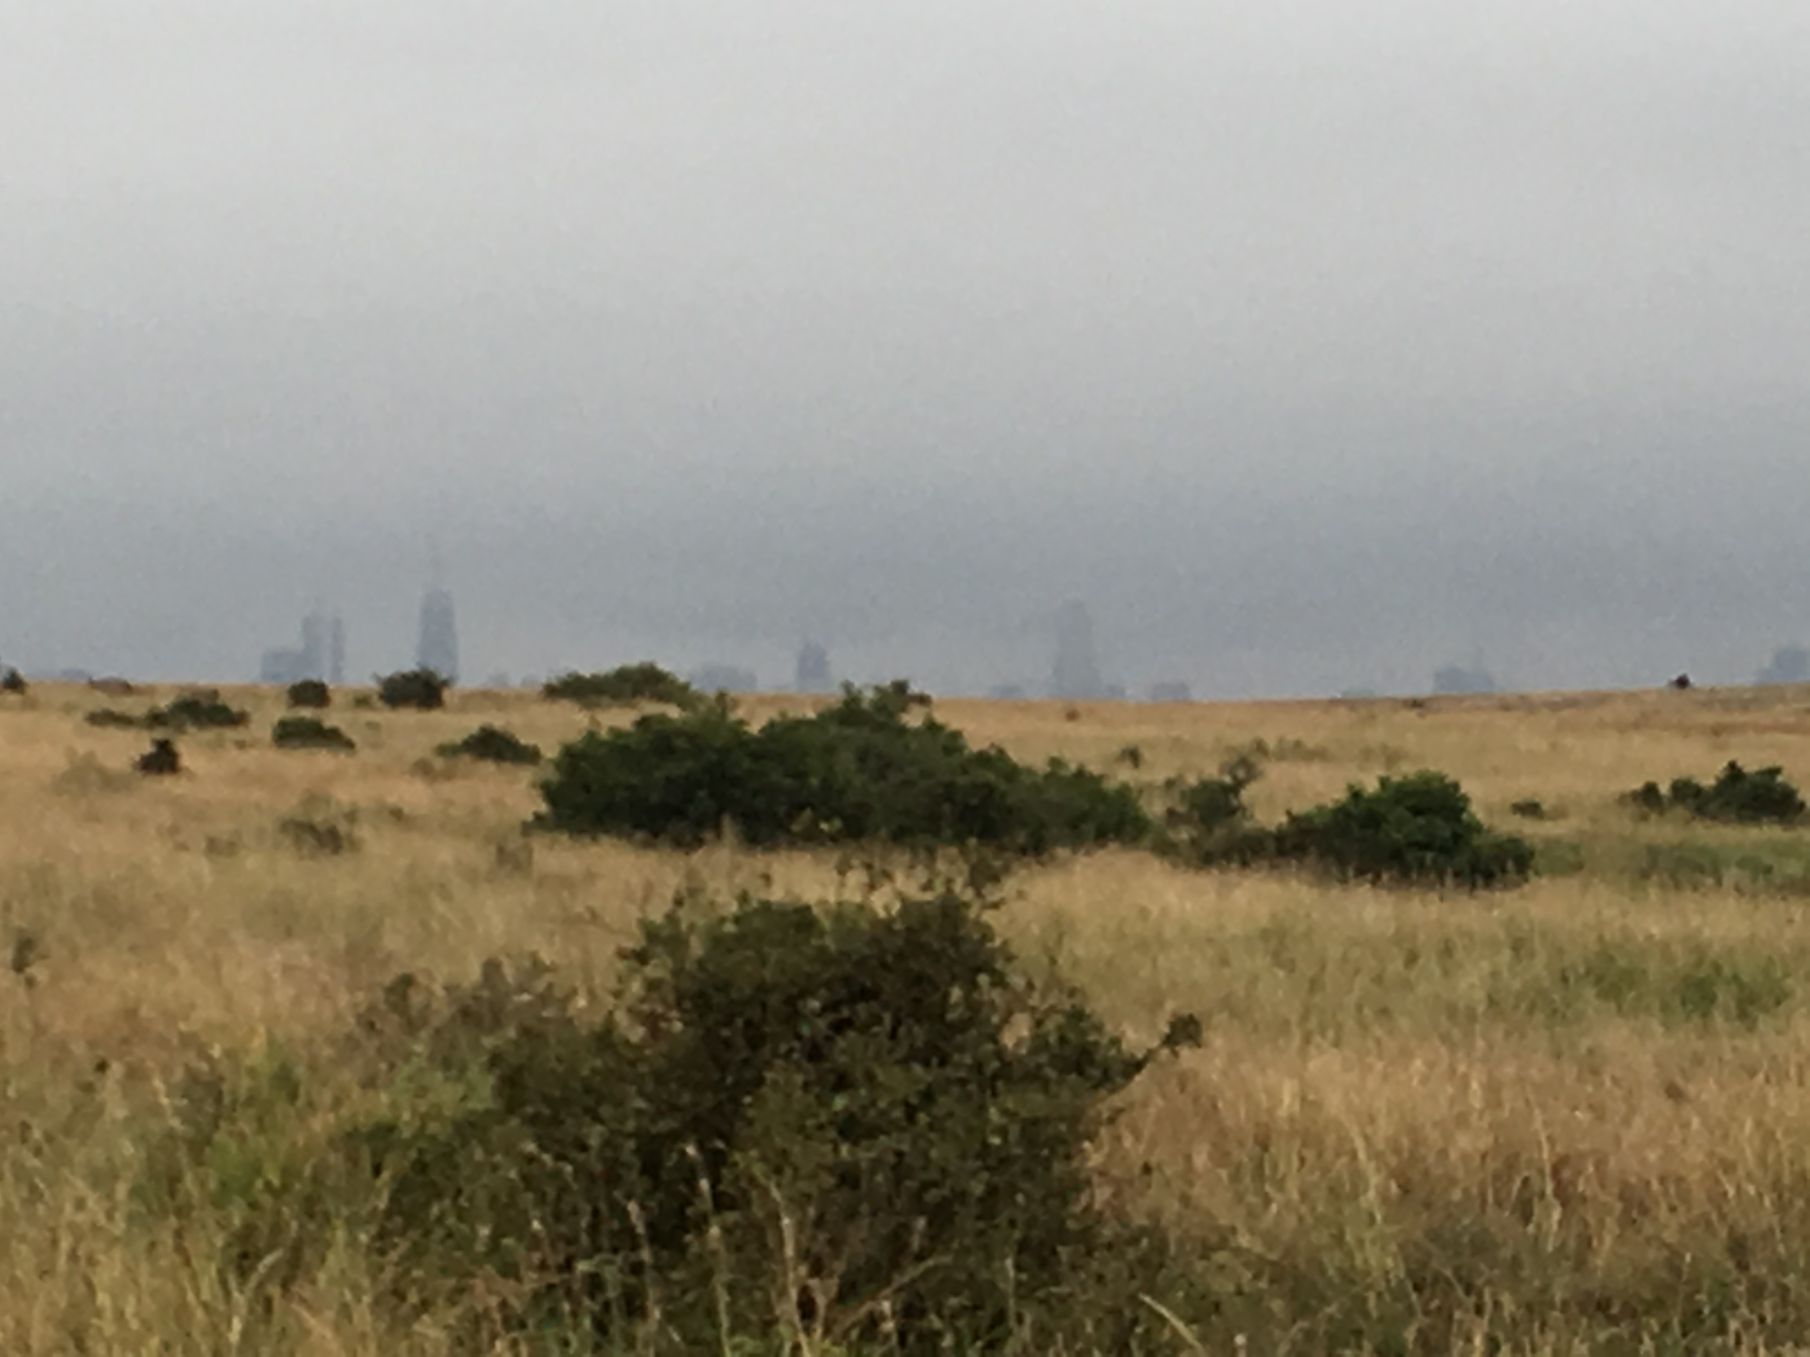
Nairobi Plots?

Slide 27
Manhattan Plot

Slide 28
Marker Significance
rrBLUP used False Discovery Rate (FDR) multiple testing correction
Bonferroni
Significance listed as –log(p-value)
p-value = 10^(-listed value)

Slide 29
QQ Plots

Slide 30
Results

Slide 32
IWG Progeny Observed

Slide 33
IWG Progeny Observed

