Slide 1
Year Round Schooling in the US

Slide 2

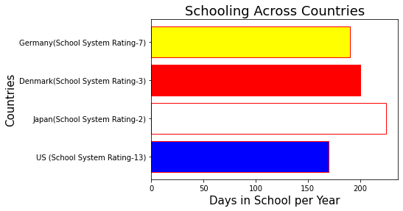
School is in Session!
A brief history of school year length in the US
How US schools compare
Notes:
Initially it was highly regional.
Rural areas where children were expected to help with farming had long breaks during the summer
Kids in the city on there other hand may spend as much as 260 days a year in school
That’s a lot more days than the current national average of around 170

Slide 3
School is in Session!
A brief history of school year length in the US
How US schools compare
Notes:
According to worldtop.org (international project aimed to serve and protect children around the world by ensuring they have access to quality education) and Research done by the Pew Research center the most recent the PISA (an international test given every 3 years which measures reading ability, math and science literacy and other key skills among 15-year-olds in dozens of developed and developing countries) results, from 2015, placed the U.S. an 38th out of 71 countries in math and 24th in science and reading
In 2021 the US ranked 13th in overall school system, all top 5 schools had short summer vacations and breaks spaced throughout the year
US avg is 170 compared to 225 in Japan or 200 in Denmark and 190 in Germany
In short schools with better education outcomes in k-12 tend to have more days in schools and shorter summer breaks

Slide 4

Getting Schooled
Defining the term:
Year round
Single track vs. multitrack
What problems are schools often trying to address?
-Overcrowding
Achievement gap
Notes:
The classification for a school to be year round varies from one state to another
Florida defines year-round schools as at least 180 days of instruction versus 8 or 9 consecutive months attendance.
Oklahoma defines year-round schools as at least 10 months of 4 weeks during which the school will be in session and instruction offered not less than 180 days.
Tennessee defines year-round schools as operating on a 200-day calendar.
Texas operate during the greater part of 10 months and up to 12 calendar months of the year.

Slide 5


Getting Schooled
Defining the term:
Year round
Single track vs. multitrack
What problems are schools often trying to address?
Overcrowding
Achievement gap
vs.
Notes:
In addition, the schools can also be broken up into single track and multi track
Single track is simple, all kids go to school at the same time
Multi track breaks kids up into to groups (often 4) and has 3 of the 4 groups in school at any given time

Slide 6
Getting Schooled
Defining the term:
Year round
Single track vs. multitrack
What problems are schools often trying to address?
Overcrowding
Achievement gap
Notes:
One reason some districts in the US have switched to year round schooling is to deal with overcrowding, using the multi-track approach allows you educate 100% of the students while decreasing class sizes by 25%

Slide 7
Getting Schooled
Defining the term:
Year round
Single track vs. multitrack
What problems are schools often trying to address?
Overcrowding
Achievement gap
Notes:
Part of the rationale for year round schools other than the obvious more time in school is obviously equivalent to more learn assumption (not always the case) is that shorter breaks decrease the amount of knowledge lost during those breaks. Summer reading list and packets of homework do not do enough to keep student’s skills sharp. Also, for those students who fall behind, having a short break earlier allows for remedial work to begin earlier instead of waiting for an entire school year to pass and then taking the class again in summer school, being held back a year, or worse, doing neither and simply starting the next school year at a deficit.

Slide 8
The Question
In the US how do year round schools compare to those that are not?
Dropout rate
Cost per student
Graduation rate
Notes:
How do districts that have year round school compare to the districts in their region in regard to the very basic metrics of dropout rate and graduation rate as well as cost per student. There are so many other metrics that could be taken into consideration such as grades on standardized test, rate of applying to college, rate of college acceptance, attendance, amount of disciplinary actions required per student, teacher pay compared to national avg. And many of them are valuable, and some of them have data just waiting to analyzed, but for the purposes of this case study, I kept the focus narrow.

Slide 9
The Question
In the US how do year round schools compare to those that are not?
Dropout rate
Cost per student
Graduation rate
Notes:
The count of grade dropouts divided by the enrollment base for all 4 years
#A dropout is a student who was enrolled at some time during the school year, was not enrolled at the beginning of the following year and who was not completed school, transferred or died.

Slide 10
The Question
In the US how do year round schools compare to those that are not?
Dropout rate
Cost per student
Graduation rate
Notes:
The number of diplomas given divided by the number of students in 12th grade that year (if not all seniors graduate, the number is below 1 and if a few juniors graduate early, it’s above 1

Slide 11
The Question
In the US how do year round schools compare to those that are not?
Dropout rate
Cost per student
Graduation rate (Diplomas given/ Senior class size)
Notes:
Determined by the total expenditures per student in a given district factoring in the cost for instruction, the building and other cost associated with keeping a child in school

Slide 12
Methodology
Pick 3 school districts from the 17 available: Socorro ISD, Murrieta Valley Unified, and Bardstown Independent
Used district map to locate adjacent districts for comparison
Looked at the dropout rate, and cost per student in all districts across several school years
Compared the years just before transition into year round schedule to those after when possible
Notes:
I chose 3 districts of the roughly 17 in the country that are year round and crunched the numbers over a number of years.
Finding these schools was easier said than done because despite claiming to be year some districts are only year round for elementary also, finding districts surrounding the one of interest was not easily automated so I had to do it individually.

Slide 13
Methodology
Pick 3 school districts from the 17 available: Socorro ISD, Murrieta Valley Unified, and Bardstown Independent
Used district map to locate adjacent districts for comparison
Looked at the dropout rate, and cost per student in all districts across several school years
Compared the years just before transition into year round schedule to those just after
Notes:
I chose 3 districts of the roughly 17 in the country that are year round and crunched the numbers over a number of years.
Finding these schools was easier said than done because despite claiming to be year some districts are only year round for elementary also, finding districts surrounding the one of interest was not easily automated so I had to do it individually.

Slide 14
Methodology
Pick 3 school districts from the 17 available: Socorro ISD, Murrieta Valley Unified, and Bardstown Independent
Used district map to locate adjacent districts for comparison
Looked at the dropout rate, and cost per student in all districts across several school years
Compared the years just before transition into year round schedule to those just after
Notes:
I chose 3 districts of the roughly 17 in the country that are year round and crunched the numbers over a number of years.
Finding these schools was easier said than done because despite claiming to be year some districts are only year round for elementary also, finding districts surrounding the one of interest was not easily automated so I had to do it individually.

Slide 15
Methodology
Pick 3 school districts from the 17 available: Socorro ISD, Murrieta Valley Unified, and Bardstown Independent
Used district map to locate adjacent districts for comparison
Looked at the dropout rate, and cost per student in all districts across several school years
Compared the years just before transition into year round schedule to those just after
Notes:
I chose 3 districts of the roughly 17 in the country that are year round and crunched the numbers over a number of years.
Finding these schools was easier said than done because despite claiming to be year some districts are only year round for elementary also, finding districts surrounding the one of interest was not easily automated so I had to do it individually.

Slide 16
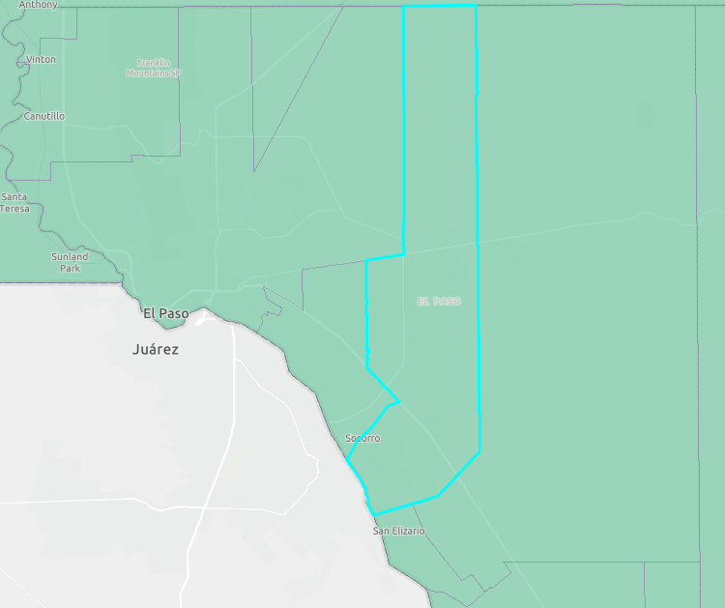

Methodology
X
Socorro ISD
El Paso, Texas

Slide 17
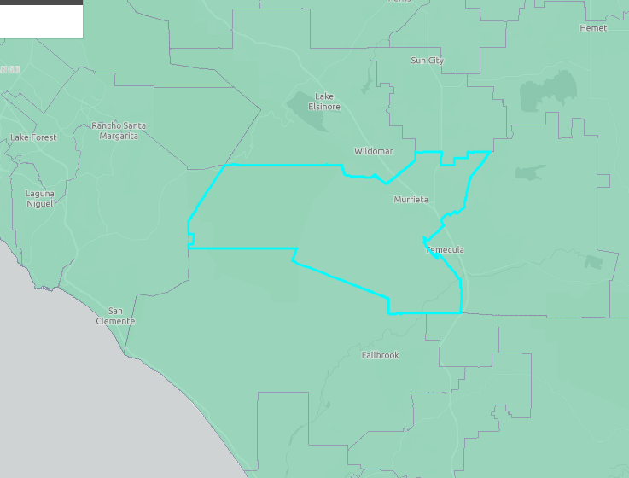
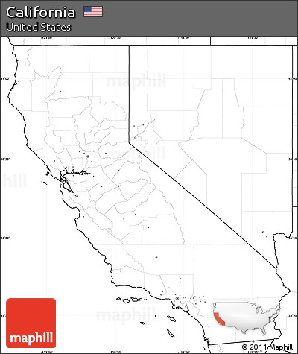
Methodology
Murrieta Valley Unified
Murrieta, California
X

Slide 18
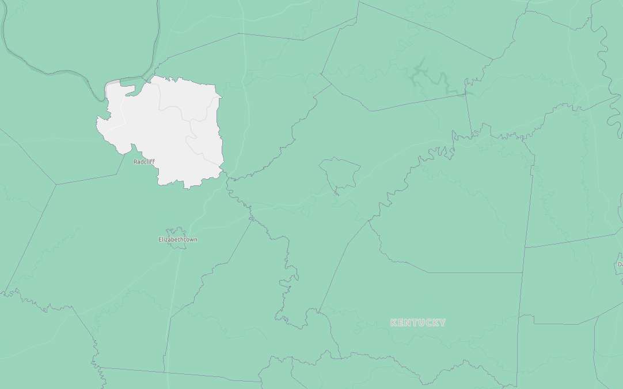
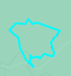
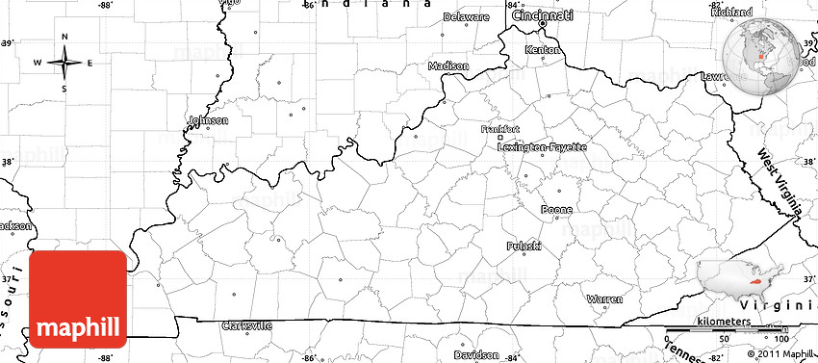
Methodology
Bardstown Independent
Bardstown, Kentucky
X

Slide 19
Summary
The next slides will

Slide 20
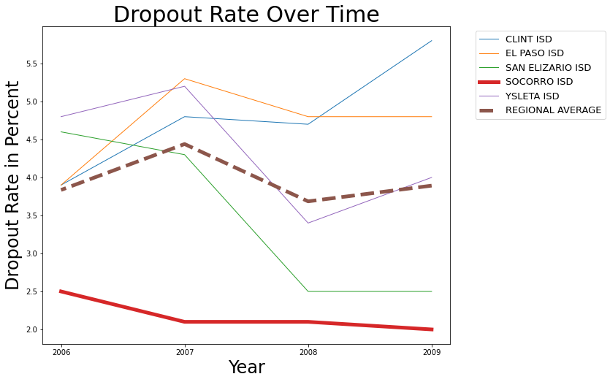
Summary of Dropouts by Percent
Notes:
The Soccorro district in Texas did well having a low dropout rate compared to the schools around it

Slide 21
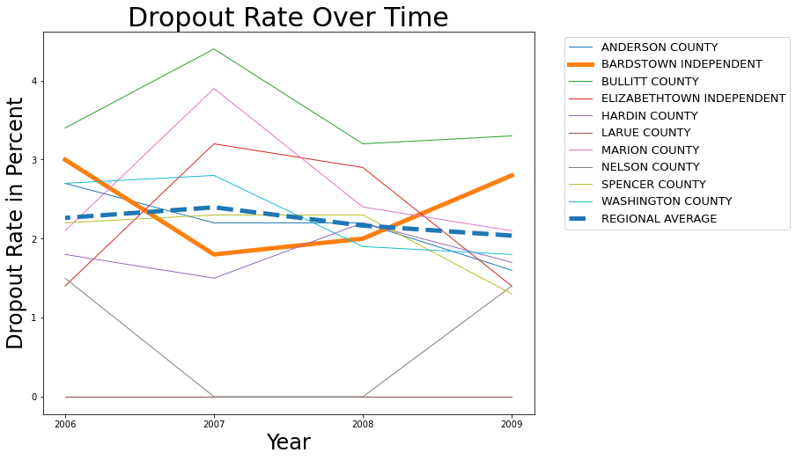
Summary of Dropouts by Percent
Notes:
For the Bardstown district in Kentucky the dropout rate moves in the opposite direction of the weighted average, going down when everyone else and is going up and vice versa, although ultimately never being far off in either direction

Slide 22
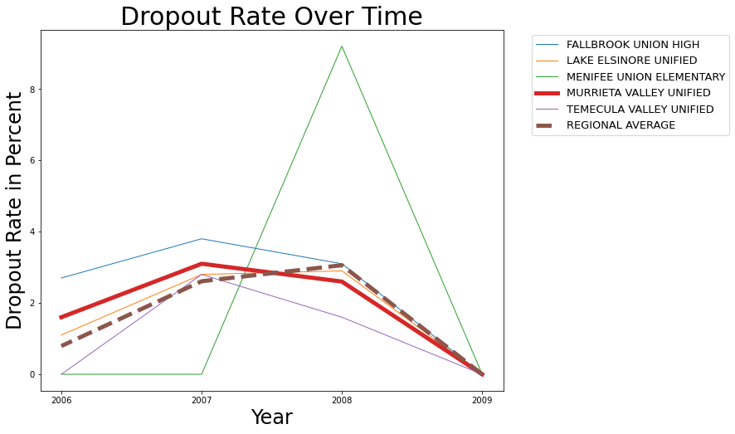
Summary of Dropouts by Percent
Notes:
The Murrieta District in California dropout rate closely follows the weighted avg and has a net drop between 2006 and 2009. So for all three schools, the dropout rate is rarely much different than the weighted avg of their region but when it has been, it’s been much better.

Slide 23
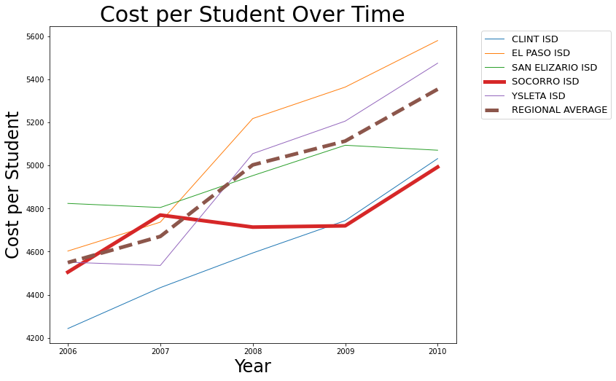
Summary of Cost
Notes:
As you can see Soccorro is competitive in cost per per student with those districts around it

Slide 24
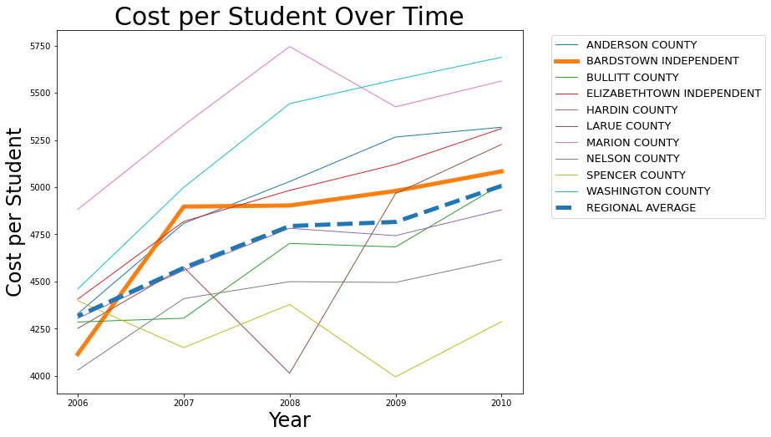
Summary of Cost
Notes:
For Barstown, it stays in the middle of the pack compared to districts in its region

Slide 25
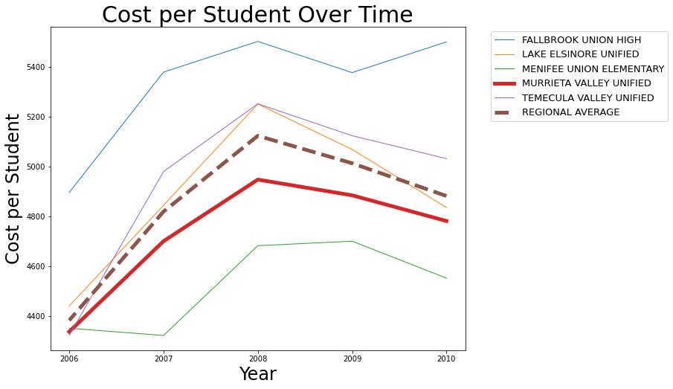
Summary of Cost
Notes:
Murrietta is fairly comparable with those schools in it’s region, with lower cost most years than most other school districts
For Cost per student all 3 districts of interest are competitive with those in their region

Slide 26
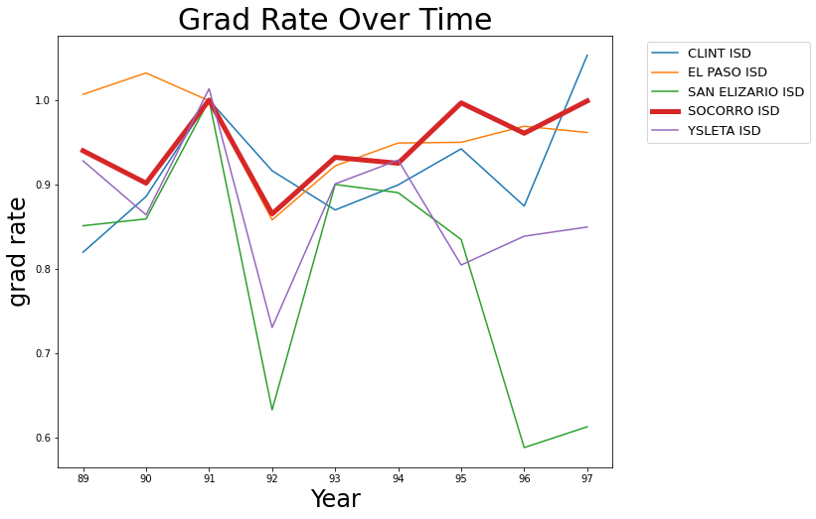
Summary Graduation Rate
Transition Year
Notes:
For graduation rate over time, I looked to see if it changed noticeably in the time before and after the school went to a year round schedule. For Soccorro, there was only information available for the 2 years before school switched in the 1990-91 school year, so I looked at the two years before and after.

Slide 27
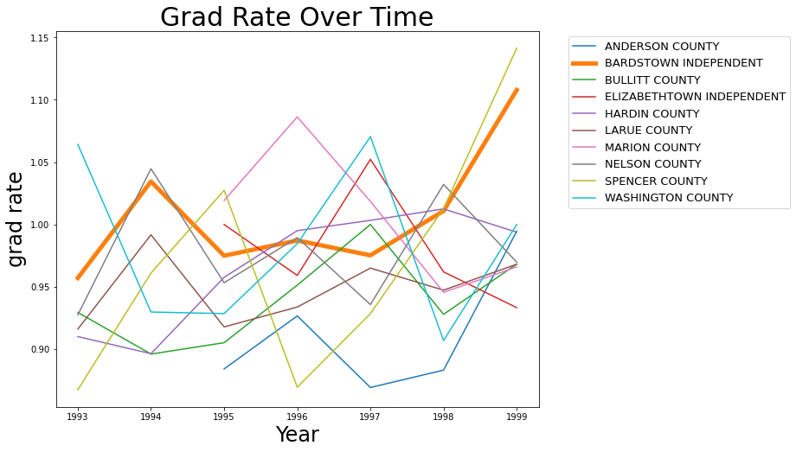
Summary Graduation Rate
Transition Year
Notes:
For Bardstown, they switched inthe 95-96 school year, and I took a few years before and after. There was not a substantial change in the first two years, although there was noticeable improvement in the years to follow, even as the national average dropped. Unfortunately Murrieta did not have data available for this time frame.

Slide 28
Conclusion
Can year round schools be done in the US?
Should it be done?
Notes:
Moving forward, I would like to use the demographic data available to see different groups benefit more or less from year round school
I would also like to look at the rest of the districts that switched to year round schools in the US as well those that switch from year round school to see if there are any interesting findings.
Finally I think it would be interesting to compare these US districts with other countries with year round schooling, especially in terms of cost per student

Slide 29
Conclusion
Can year round schools be done in the US?
Should it be done?
Notes:
Moving forward, I would like to use the demographic data available to see different groups benefit more or less from year round school
I would also like to look at the rest of the districts that switched to year round schools in the US as well those that switch from year round school to see if there are any interesting findings.
Finally I think it would be interesting to compare these US districts with other countries with year round schooling, especially in terms of cost per student

Slide 30
Graduation Plans
Extra credit
US tour
Study abroad
Extra credit
-US tour
- Study abroad
Notes:
Moving forward, I would like to use the demographic data available to see different groups benefit more or less from year round school
I would also like to look at the rest of the districts that switched to year round schools in the US as well those that switch from year round school to see if there are any interesting findings.
Finally I think it would be interesting to compare these US districts with other countries with year round schooling, especially in terms of cost per student

Slide 31
Graduation Plans
Extra credit
US tour
Study abroad
Extra credit
-US tour
- Study abroad
Notes:
Moving forward, I would like to use the demographic data available to see different groups benefit more or less from year round school
I would also like to look at the rest of the districts that switched to year round schools in the US as well those that switch from year round school to see if there are any interesting findings.
Finally I think it would be interesting to compare these US districts with other countries with year round schooling, especially in terms of cost per student

Slide 32
Graduation Plans
Extra credit
US tour
Study abroad
Notes:
Moving forward, I would like to use the demographic data available to see different groups benefit more or less from year round school
I would also like to look at the rest of the districts that switched to year round schools in the US as well those that switch from year round school to see if there are any interesting findings.
Finally I think it would be interesting to compare these US districts with other countries with year round schooling, especially in terms of cost per student

Slide 33

Questions?
Notes:
Moving forward, I would like to use the demographic data available to see different groups benefit more or less from year round school
I would also like to look at the rest of the districts that switched to year round schools in the US as well those that switch from year round school to see if there are any interesting findings.
Finally I think it would be interesting to compare these US districts with other countries with year round schooling, especially in terms of cost per student

