Slide 1

Predicting Strokes
Prediction and Data Analysis
Jacob Crawford
Jaimi Patel
Seif Abuhashish

Slide 2
Preventing Stroke
Strokes are the second leading cause of death and the third leading cause of disability in the world.
According to The World Stroke Organization (WSO), about 14 million people a year suffer from stroke and about 5.5 million die. (“What We Do | World Stroke Organization”)
As scary as this seems, there is hope according to the CDC (Centers for Disease Control) because a stroke can sometimes be dependent on avoidable risk factors. These risk factors can be prevented and minimized with proper health/nutritional education, healthcare monitoring, regular physician follow ups, and awareness of the risk factors. (George et al.)
George, Mary G., et al. “CDC Grand Rounds: Public Health Strategies to Prevent and Treat Strokes.” MMWR. Morbidity and Mortality Weekly Report, no. 18, Centers for Disease Control MMWR Office, May 2017, pp. 479–81. Crossref, doi:10.15585/mmwr.mm6618a5.
“What We Do | World Stroke Organization.” World Stroke Organization, WSO, https://www.world-stroke.org/what-we-do. Accessed 18 Mar. 2022.

Slide 3
Predicting Stroke as Preventive Medicine
In this study, we utilize a healthcare dataset that describes each data point as an individual person characterized by 11 independent variables to predict whether they are at risk for stroke or not.
These variables include information such as gender, age, pre-existing conditions, smoking status, job type and relationship status.
By predicting stroke incidence based on a set of variables, we can understand the influence of these variables on stroke. We can then reverse engineer our findings to understand how these individual variables affect the likelihood of stroke. We identify the variables with the highest risk factors to avoid and minimize their impact to increase stroke risk.
Through a prediction stroke model, we discover from the influencing variables, better and more actionable steps to lower the risk of stroke which is our study goal.

Slide 4
Stroke Dataset
The Stroke dataset has 12 attributes and 5110 observations.
‘Stroke’ is the dependent variable we are attempting to predict.
The other 11 independent variables are:
7 Categorical variables = (gender, ever_married, work_type, Residence_type, smoking_status, hypertension, heart_disease)
3 Numeric continuous variables = (age, BMI, avg_glucose_level)
Dataset Link:https://www.kaggle.com/fedesoriano/stroke-prediction-dataset

Slide 5
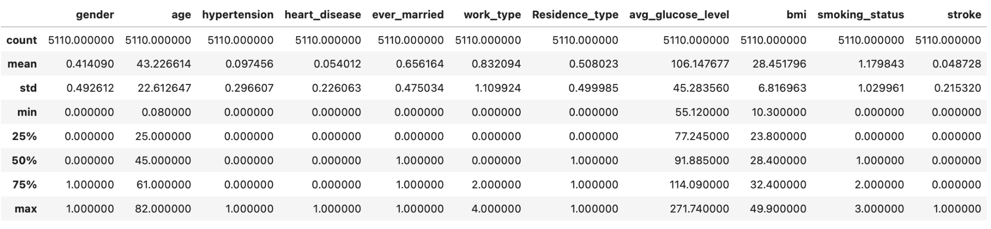
Exploratory Data Analysis
After loading and preprocessing our data set, we investigate the independent variables for insightful patterns, unique distributions, and anomalies. With the help of statistical descriptives and graphs we can test theories and hypotheses we think may be true.
Below we have displayed a summary of our data set statistics after converting all variables to numeric values.

Slide 6
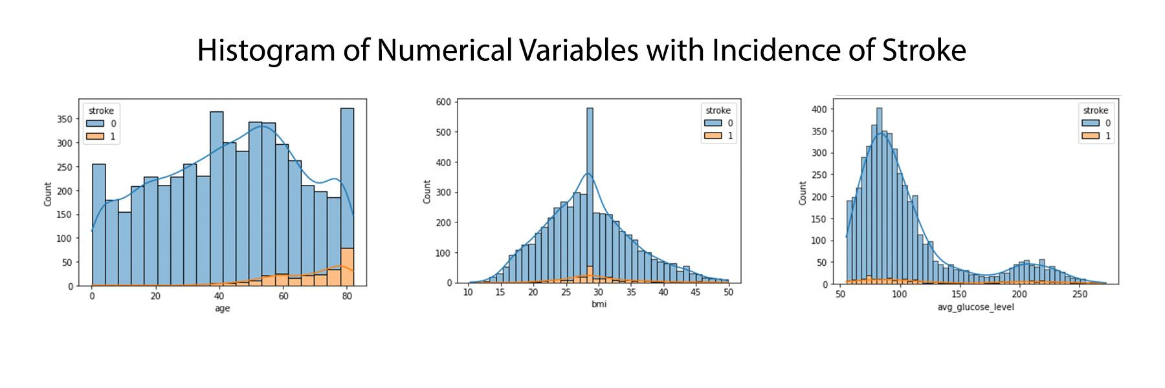
Exploring Continuous Numeric Variables
“Age” is normally distributed but has a much higher incidence of stroke as age increases. Ages below 40 had very few stroke incidences while ages above 60 seemed to increase in stroke. Graphical plots like histograms tell us a story about our dataset that helps us easily draw simple conclusions. As we would expect, older people may suffer from a decline in health as they get older which would leave them more vulnerable to stroke vs a younger healthier person.
Stroke incidences increase as “bmi” increased but eventually tapers down after bmi=40. Stroke increasing with higher bmi values make logical sense because BMI is an indication of a person’s physical health, and poor health will lead to greater stroke risk.
“Avg_glucose_level” had two areas with increased stroke incidences. The first is within a normal glucose level (for people that suffer a stroke with no relation to glucose levels) and then interestingly when glucose levels are above 160 (which may indicate that high blood sugar, increase the risk of stroke as poor glucose control leads to diabetes and a list of other health complications).

Slide 7
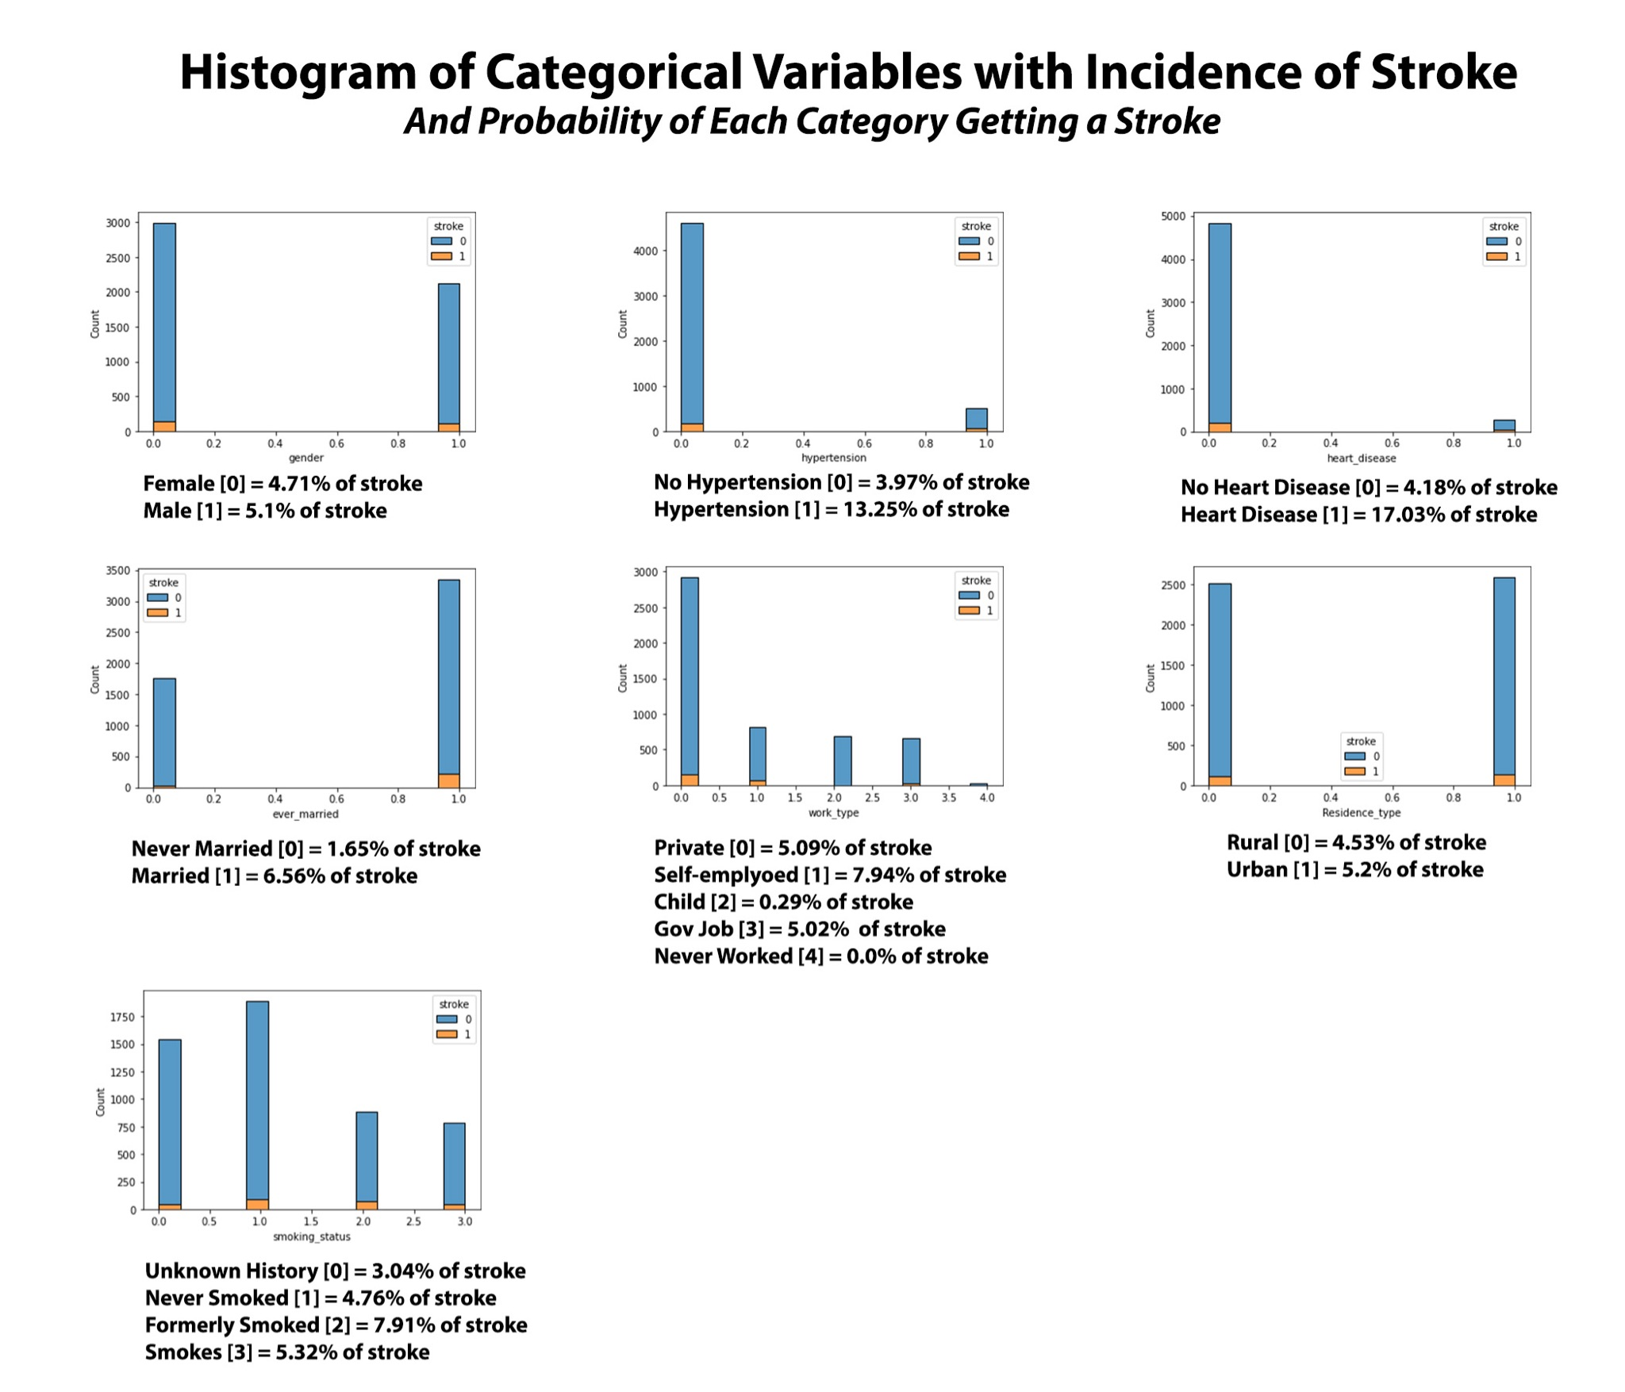
Exploring Categorical Variables
Interesting observations from exploring the categorical variables is the factors related to health (heart disease and hypertension) always increased the risk of stroke. The presence of heart disease increases risk by 4 times and hypertension increases risk by 3 times. This makes logical and medical sense because all three conditions have similar mechanisms of pathophysiology (caused by blockage in the arteries that can lead to cutting off blood supply to a major organ like the brain or heart). This information is very helpful because it can help in preventing a major health related issues. Early medical intervention and medical knowledge can help as preventive medicine.

Slide 8
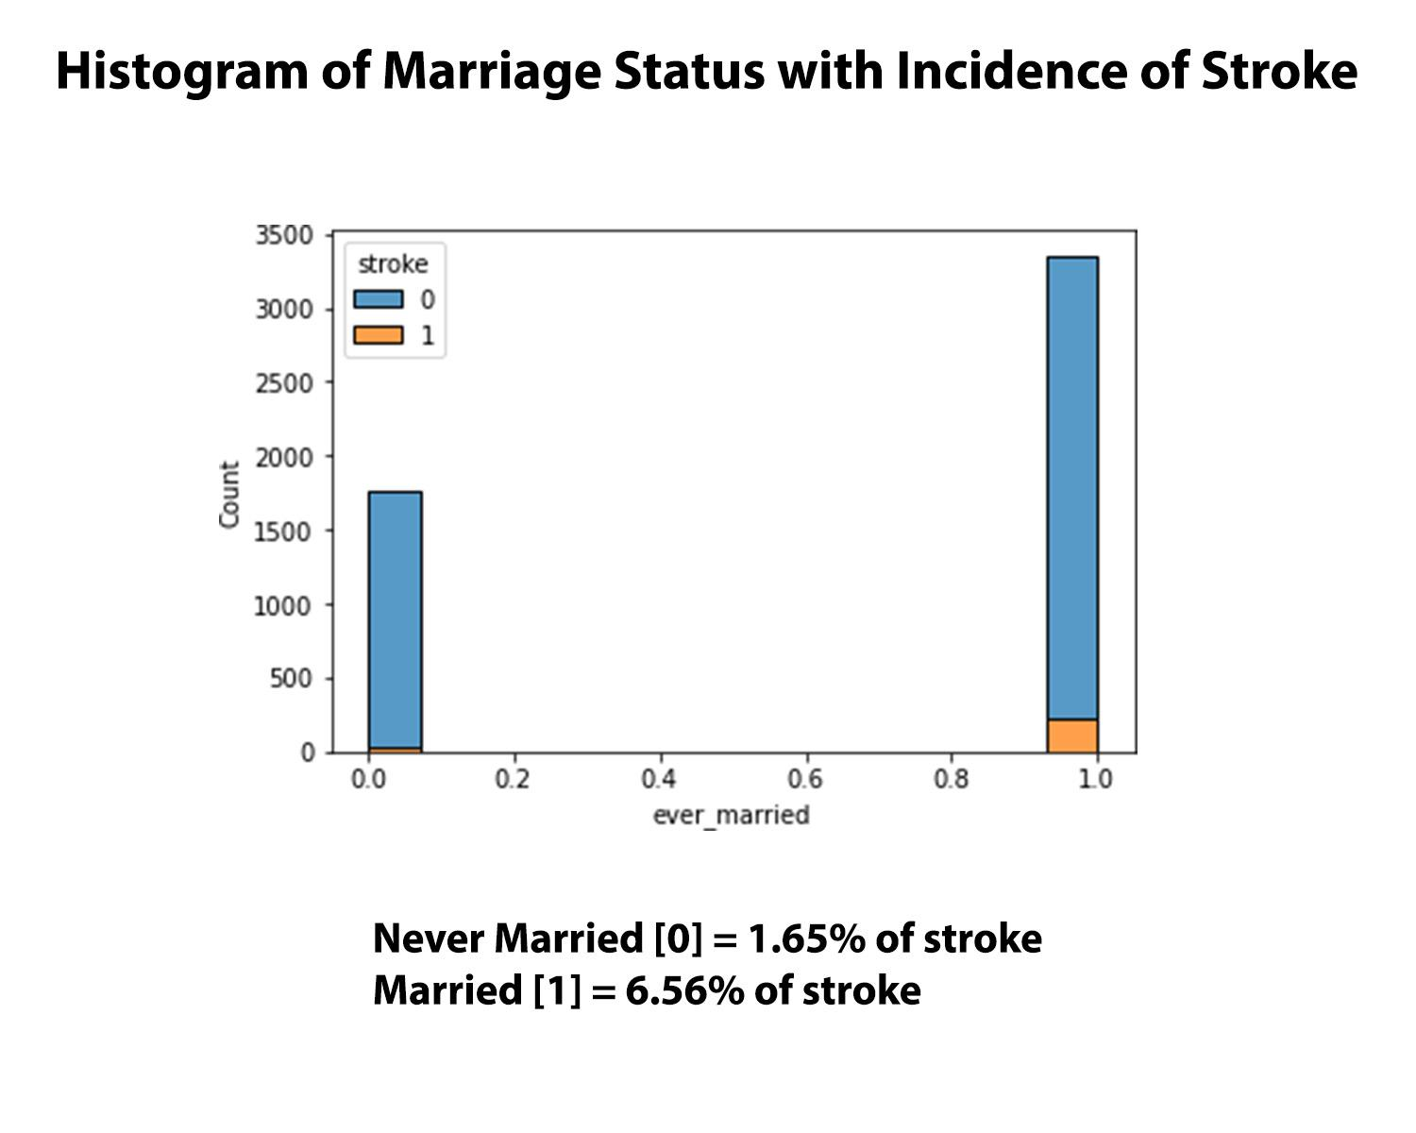
Exploring Categorical Variables
Individuals who are married or were married have a stroke probability of 6.56% vs. People who have never been married have a 1.65% stroke probability. This means that individuals who have been in a relationship increase their risk of stroke by about 4 times. This makes partial sense because I can agree that relationships may be stressful at times and that pressure can potentially cause an increase in health risks but the probability of increasing one's risk by 4 times like heart disease seems to be inaccurate. Further investigation of this variable is needed.

Slide 9
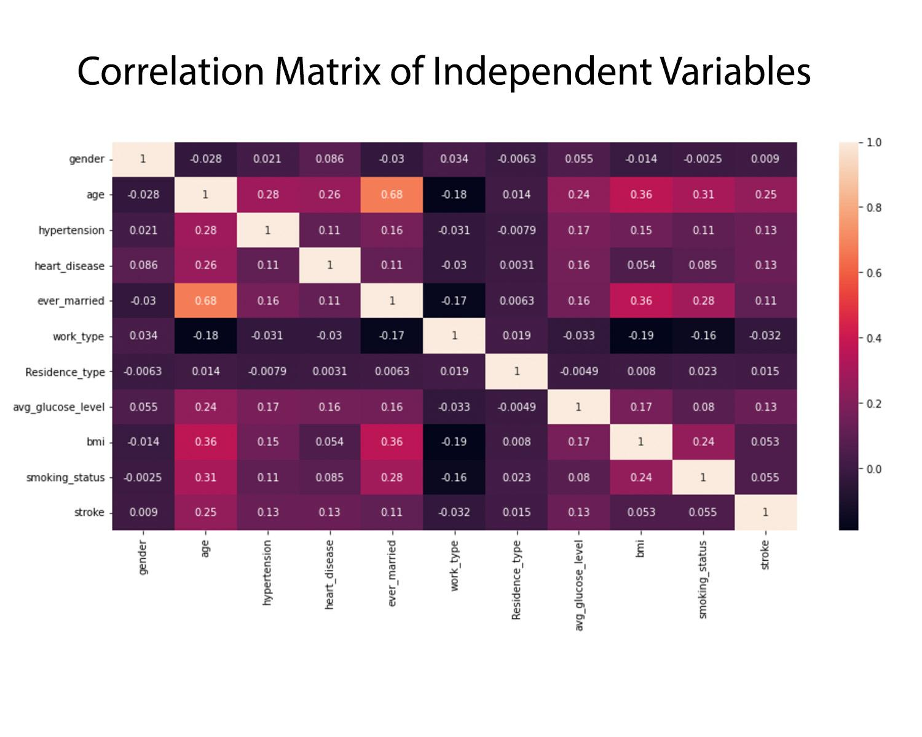
The strongest correlation was 0.68 which is for variables ‘age’ and ‘ever_married’. Correlation coefficient of 0.68 would indicate a strong positive correlation, but this needs to be further investigated because it may be inaccurate due to the disproportional density of the marriage categories.
The second strongest correlation was 0.36 which is a fairly weak positive correlation between ‘age’ and ‘bmi’.
A weak negative correlation is observed for ‘work_type’ and ‘smoking_status’ = -0.16, ‘bmi’= -0.19, ‘ever_married’= -0.17, ‘age’ = -0.18. This would mean that, as long as work type was ‘never worked’, ‘child’ or ‘government job’ the negatively correlated factors would decrease a little bit. We can see lower bmi, lower smoking status (no smoking or unknown), unmarried, and younger aged individuals.

Slide 10
Unsupervised Learning
Using KMeans Clustering to explore the data
Created a KMeans clustering model with 2 clusters fit to the training set
Do the clusters show some way of predicting stroke ?
No
Very low completeness score
Very low homogeneity score
KMeans had a low accuracy compared to the supervised learning algorithm models

Slide 11
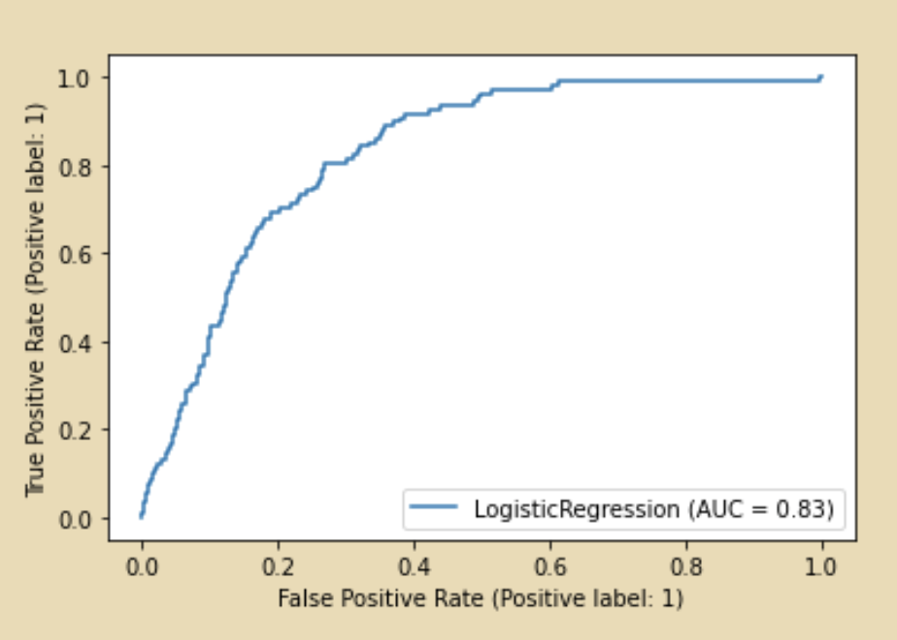
Using Logistic Regression
Logistic regression models the probability of some event occurring as a linear function of a set of predictor variables. In our study we wanted to predict whether or not someone would have a stroke given their attributes.
Accuracy rating: .95
AUC = 0.83

Slide 12
Decision Tree Model Benefits
easier to interpret the model,
Can handle numerical and categorical features
No need for pre-processing like scaling
Our Decision Tree model:
Worst performing classifier model
.53 ROC area-under-the–curve score
Relative to the other models had lower accuracy

Slide 13
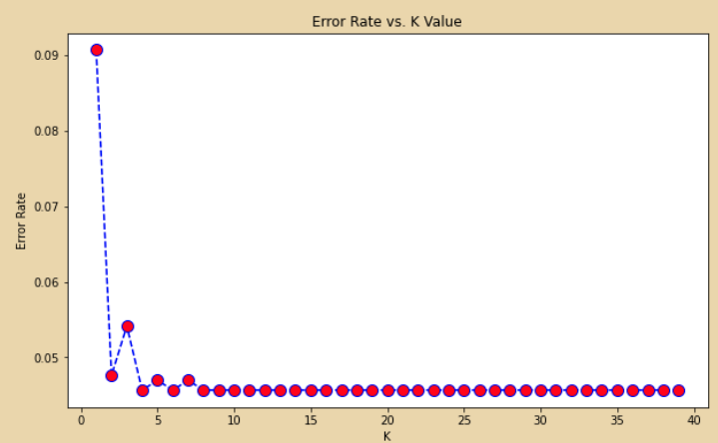
K Nearest Neighbor Model
Made several KNN models with different values of K (1-40) and evaluated each of their error rate

Slide 14
KNN: tuning the model
By looking at the error rate vs the value of K we can see that after about 6 the Error rate does not get any lower
We can retry building and evaluating the model with K=6 to see if accuracy and the ROC and area under the curve improve
The model’s accuracy and ROC auc improved
Changing K changes the outcome

Slide 15
The best model
Logistic Regression was the best model for classifying strokes
Best accuracy : 0.95
Best F1-score: 0.97
Best ROC area-under-the-curve: 0.83
Value in simplicity

Slide 16
Relevant Findings and Conclusion About the Data
A female has a probability of 4.71 % to get a stroke whereas male has 5.1 %.
A person with hypertension has a probability of 13.25 % get a stroke, whereas without hypertension has 3.97%.
A person with heart disease has a probability of 17.03 % get a stroke, whereas without heart disease has 4.18%.
A person married (or married before) has a probability of 6.56 % get a stroke, whereas never married has 1.65%.
A person with private work type has a probability of 5.09 % to get a stroke, Self-employed has 7.94%, government job has 5.02%, having a Child has 0.29%.
A person, who lives in urban area, has a probability of 5.2 % get a stroke, lives in rural area has 4.53%.
A formerly smoking person has a probability of 7.91 % get a stroke, never smoked has 4.76%,smokes has 5.32%, whom smoking history is not known has 3.04%.
In conclusion, This project is built using Kmeans Clustering, Decision Tree, Logistical Regression model and KNN. These algorithms compare various attributes to predict stroke. By comparing the classification reports and confusion matrices of these algorithms, the Logistic Regression model gives the best accuracy to predict stroke.

