Slide 1
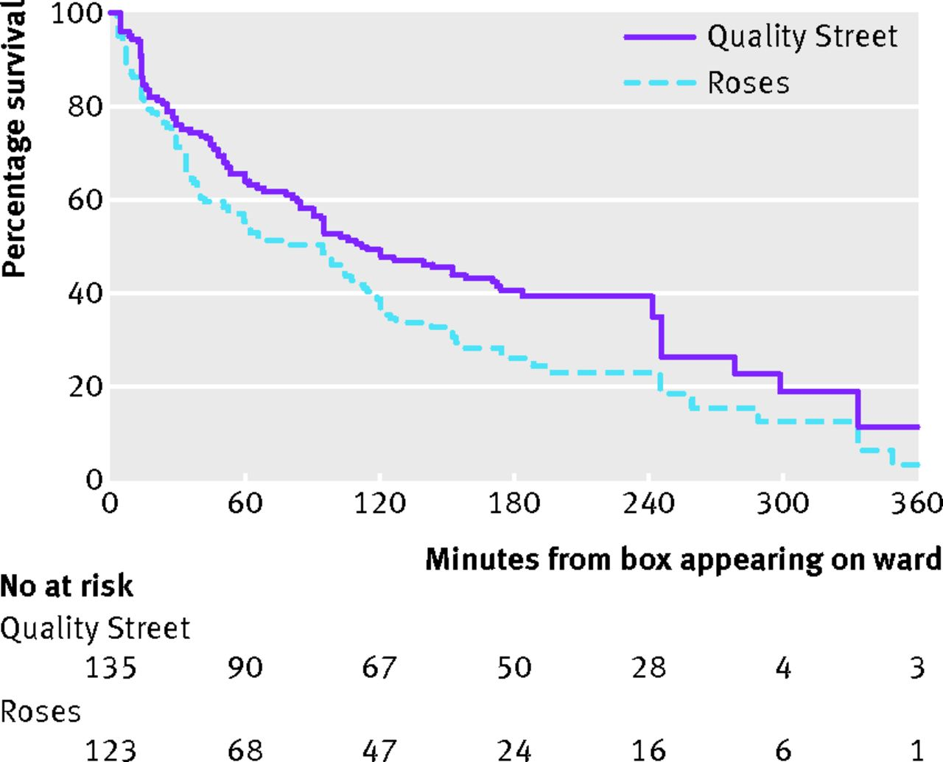

Fig 1 Kaplan-Meier survival curves for Quality Street and Roses chocolates across all wards.
Gajendragadkar P R et al. BMJ 2013;347:bmj.f7198
©2013 by British Medical Journal Publishing Group
Notes:
Fig 1 Kaplan-Meier survival curves for Quality Street and Roses chocolates across all wards

Slide 2
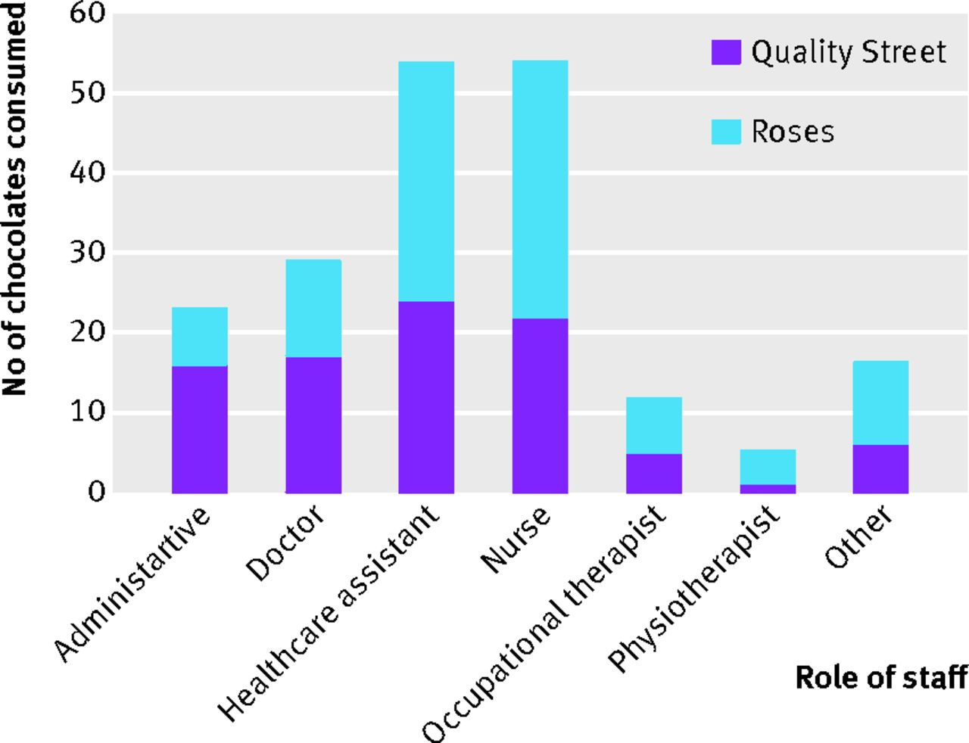
Fig 2 Bar chart showing number and type of chocolate consumed by role of staff.
Gajendragadkar P R et al. BMJ 2013;347:bmj.f7198
©2013 by British Medical Journal Publishing Group
Notes:
Fig 2 Bar chart showing number and type of chocolate consumed by role of staff

