Slide 1
Implementing Dictionary Learning in Apache Flink
or: How I Learned to Relax and Love Iterations
Geoffrey Mon, Milad Makkie, Xiang Li, Tianming Liu, and Shannon Quinn

Slide 2
Outline
Technical background
Spark vs. Flink
Objectives
Experiences and lessons learned
Results
Conclusion
Notes:
Go over a brief outline of the information covered in the presentation

Slide 3
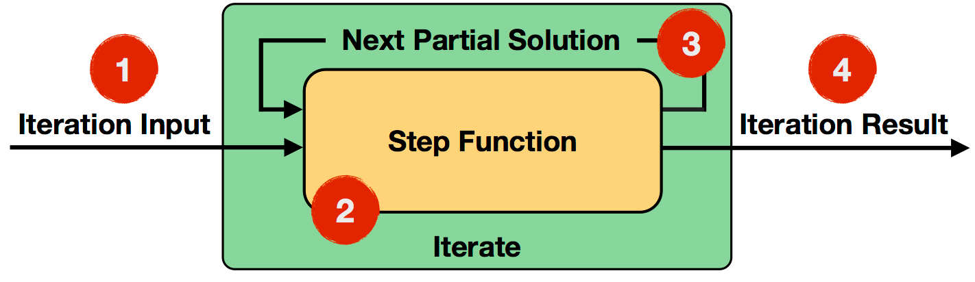
Iterative Algorithms
Repeatedly apply a step function until a termination criterion is reached
More and more prevalent, but difficult to scale
Used for tasks such as graph analytics, gradient learning, dimensionality reduction, and more
Notes:
Brief description of what iterative algorithms are and important characteristics

Slide 4
Rank-1 Dictionary Learning
Dictionary learning: sparse representation of a data set
Good for image analysis
Distributed rank-1 dictionary learning (r1DL)
Our dictionary learning algorithm that decomposes matrix S by iteratively estimating multiple rank-1 basis vectors and their loading coefficient vectors
Distributed over a cluster to handle huge data sets
Iterative algorithm
We apply r1DL on huge fMRI data sets (images!) to derive functional networks
Notes:
Describe what dictionary learning and what rank-1 dictionary learning is and how it’s applied to fMRI
Dictionary learning is good for images and fMRI data is images!
r1DL is distributed, which means we need a cluster to handle the large data sets we are using
Mention what functional networks are briefly?

Slide 5
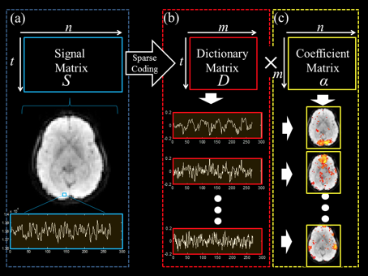
Notes:
The methods aim to identify the functional networks signals as well as the loading matrix based on the sparsity in the loading coefficients
The spatial and temporal pattern of a sample network decomposed result is shown here.

Slide 6
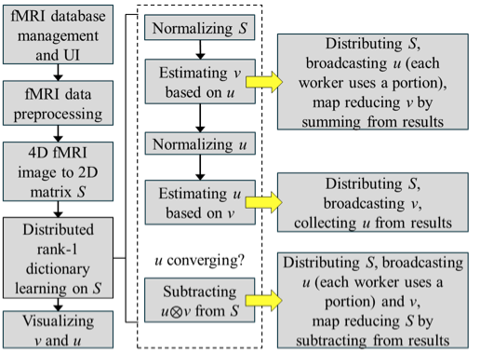
Notes:
Compared to the gradient-based dictionary learning algorithms rank-1 dictionary learning algorithm has a few critical advantages:
1) The learning process is a fix-point algorithm by alternating least squares updates, thus avoiding the tuning of the learning rate/step size while also avoiding the slow convergence near the solution;
2) The memory cost of the proposed algorithm is very low because it needs not to maintain the potentially large gradient matrix in the memory. The intermediate results will be discarded after each rank-1 basis is learned and stored, which further reduce the memory cost.

Slide 7
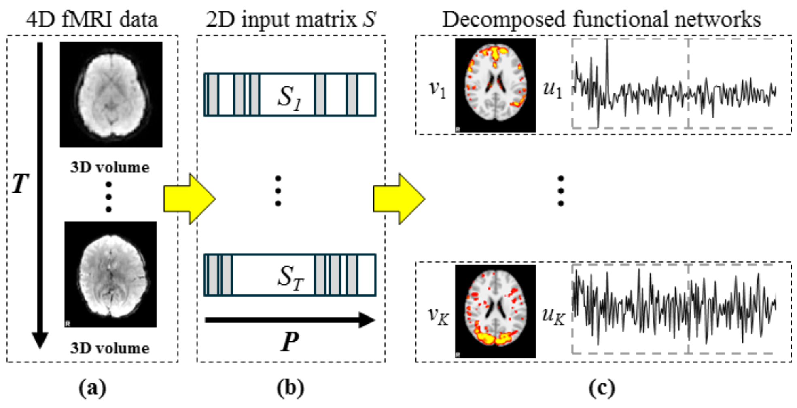
fMRI
Notes:
r1DL diagram
4D fMRI data
2D S matrix from 4D data
Spatial (v) and temporal (u) patterns of decomposed functional networks from S using r1DL

Slide 8

Apache Spark
r1DL implemented and works with Python API of Apache Spark
What is Spark?
Open source data analysis framework
Based around “resilient distributed datasets” (RDDs)
Very popular and versatile, extended for graph processing, machine learning, streaming data, etc.
But not perfect for iterative algorithms
Non-native iteration support
Notes:
Spark is a high performance distributed compute engine for large-scale data processing. It is similar to MapReduce, but has several distinct advantages that make it ideal for the deployment of large-scale analytics frameworks. First, its basic abstraction for distributed data, the resilient distributed dataset (RDD) [27], combines robust fault-tolerance with highly efficient data layout strategies. RDDs track their computation lineage as a directed acyclic graph; therefore, if a segment is lost, it can be easily recomputed from the lineage. These lineages can be optimized on-the-fly to minimize the overhead of the prescribed computations. Second, all operations in Spark are performed in-memory, thus significantly improving throughput of data pipelines. This is a departure from Hadoop MapReduce, in which data are serialized to disk in between map and reduce steps. Third, the Spark compute engine is much more generalizable than MapReduce, and can efficiently support highly diverse workloads. While Spark supports the map and reduce primitives from Hadoop MapReduce, it also supports graph processing [10] and streaming [28] APIs on the same compute engine, in addition to numerous functional primitives beyond map and reduce. This structural flexibility is crucial to the efficient implementation of a wide variety of distributed algorithms. Spark isn’t good for iterations because it does not support them natively
You have to repeatedly schedule the step function and check in your own code for the termination criterion.
More overhead = bad

Slide 9

Apache Flink
We previously used Spark, but now we use Flink
What is Flink and why use it over Spark?
Novel data analysis framework
Notable features:
Streaming first: everything is a stream
Optimizing engine
Native iterations
We repeatedly tell Spark to perform a step function (non-native)
We tell Flink to repeatedly perform a step function (native)
The difference? Less overhead!
Notes:
Flink is good for iterations because it supports them natively
You tell Flink these are the transformations to repeatedly apply and this is how to check the termination criterion, and it handles it for you. Less overhead and better performance, at least in theory

Slide 10

Flink vs. Spark Overview
Flink
Everything is a streaming job
Optimizes transformations
Lazy execution for all primitives
Native iteration support
Spark
Everything is a batch job
Doesn’t optimize
Some high-level eager executed primitives
Non-native iterations
Notes:
“In summary…”
A summary of the main differences between Flink and Spark that are relevant to us
Streaming is Flink’s identifying feature
Flink optimizes transformations such as join transformations by determining the best execution strategy from the input data
Flink lazily executes all primitive operations, but Spark doesn’t. This means Flink has more opportunity to optimize and boost performance prior to actual execution
Flink supports native iterations, which as described previously have less overhead than non-native iterations

Slide 11



Python API
r1DL used the Spark Python API
What about the Flink Python API?
Young (~21-month old feature)
Python bindings implemented separately from JVM-based Flink core
Uses serial data channels to communicate data and transformations between Python API and JVM core
Lacks features we need because of age and design
...especially access to native iterations!
But not a problem, because...
Notes:
We will need to port r1DL to use the Flink Python API
The Flink Python API is a very young feature, less than two years old at this point in time
It’s separate from Flink core, and is made up of bindings that access their JVM-based equivalent operations
It does this by serializing and deserializing data and operations since text is something both Java and Python can read and code/decode
Because Flink Python API is young and separate from Flink core, some features are not implemented, especially iterations
This is OK, because we can address this. We can address the problems with Flink because...

Slide 12

Flink is Open Source!
We can adapt and modify it while supporting open/free software!
Open Science!
Notes:
Richard Stallman ...because Flink is free software! Workshop is named: __Open Science__ in Big Data, after all! All hail RMS
Image source:
https://upload.wikimedia.org/wikipedia/commons/6/69/Richard_Stallman_by_Anders_Brenna_03.jpg

Slide 13
Open Science
Benefits of open science:
Freely available software
Modifiable and transparent
Reproducible results
Portable scripts for testing different frameworks
Neurobiology is built on open source tools like Spark and Flink.
Notes:
Open source software is freely available, modifiable, and transparent
Anyone can download the code for their own reproduction, or to modify for their own improvements on the experiment
In our case, our scripts can be ported to a new platform (Spark to Flink)
We are in the field of neurobiology which is already based on open source tools

Slide 14
Objectives
Implement Python bindings for Flink features
Aggregations
zip_with_index
Iterations
Port Spark r1DL to Flink
Measure performance data
Compare Spark and Flink
Notes:
This is what we wish to do:
Features to implement
Port the script
Run the script
Get comparison

Slide 15
Python API: Aggregations
Predefined easily-used group reduce functions applied to tuple-based data sets
Example:
[(0, 1), (0, 2), (1, 3), (2, 4)] is grouped (color-coded here) by first field of tuples = [(0, 1), (0, 2), (1, 3), (2, 4)]
Notes:
Aggregation functions are essentially predefined group reduce functions for tuple-based data sets.
You can add up all of the numbers in one field of each tuple in each group, or find the minimum, or the maximum, etc.
First, you group by one field so that all tuples with the same value in that field are in the same group
Then, you apply the aggregation to another field so that all values in that field of the tuples in each group are subjected to the aggregation function
Example, here we have a data set of tuples
We group by the first field of the tuples

Slide 16
Python API: Aggregations
[(0, 1), (0, 2), (1, 3), (2, 4)]
Using the sum aggregation on the second field adds up the second field of each group of tuples
[(0, 1 + 2), (1, 3), (2, 4)] = [(0, 3), (1, 3), (2, 4)]
Notes:
The sum aggregation adds up all of the values in the second field of each tuple for each group

Slide 17
Python API: Aggregations
First feature, seems simple enough…
We don’t necessarily need it for our project, but it’s a simple task to get to grips with Flink and its Python API
Also, get involved in the Flink community
Notes:
This task was actually first encountered when we were testing Flink examples and noticed that while the Java version of the classic word count program used an aggregation, the Python version used a group reduce function that performed an equivalent role.
We thought it would be a relatively simple way to get acquainted with Flink and the Python API, and to get involved in the community

Slide 18
Python API: Aggregations
Simple? Wrong
Python is dynamically typed, but Java is statically typed
Python API converts all data into a generic type (byte arrays) before they are sent to Java
We tried to implement aggregation accessors that made use of existing Java aggregations, but Java aggregations are type-specific
Java aggregations don’t accept generic type (byte array) data
Notes:
Turns out aggregations were not as simple as we had hoped.
We at first wanted to simply write bindings that deferred to existing Java aggregations.
But Java aggregations are type-specific. For example, there was a Sum aggregation for integers, for doubles, etc.
The Python API needs to deal with the fact that Python is dynamic type and Java is static type. So the API converts data into a generic data type: byte arrays
Java aggregations don’t accept byte arrays.

Slide 19
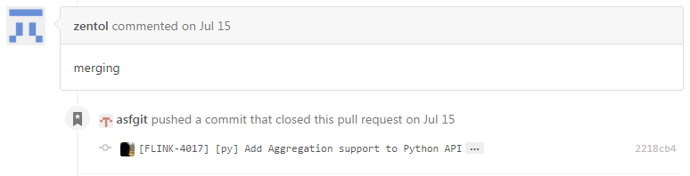
Python API: Aggregations
Python API aggregations successfully implemented entirely Python-side
Aggregations are predefined useful group reduce functions for tuples
Group reduce function bindings were already present in the Python API
So we made aggregations as internally defined group reduce functions
Merged!
Notes:
We implemented Python API aggregations on the Python side, making use of the existing Python API group reduce function bindings

Slide 20
Python API: zip_with_index
zip_with_index is a utility method that adds an index to each element of a data set, forming tuples
zip_with_index([1, 9, 8, 4]) = [(0, 1), (1, 9), (2, 8), (3, 4)]
We need this to preserve order and perform order-sensitive matrix and vector transformations
Notes:
Zip_with_index adds an index to each item of a data set. It can be used to record and preserve the order of a data set, so we will need it to do our matrix and vector transformations

Slide 21
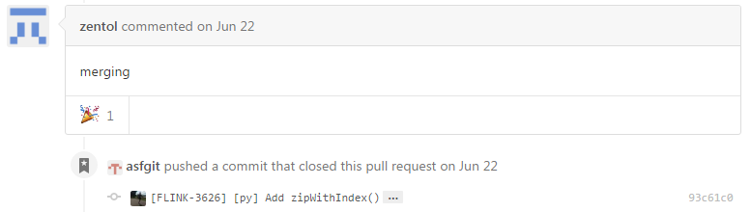
Python API: zip_with_index
Remember Python data turns into generic byte array-type data?
We can’t modify Python tuple data sets in Java, so we implement this on the Python side as well
The Python code for zip_with_index greatly resembles the Java code for its equivalent
Merged!
Notes:
We can’t edit tuples of Python data sent to Java because its in byte array form.
We implement this Python-side just like the aggregations.

Slide 22
Python API: Iterations
Most important feature, selling point of Flink for us
Allows user to define transformations to be a step function that will be repeatedly applied until a termination criterion is satisfied
Faster than Spark non-native iterations
Notes:
Iterations were most important for us.
r1DL is iterative, and native iteration support was the Flink feature we thought would be most significant for our task.
It promised significant gain over Spark

Slide 23
Python API: Iterations
Native iterations are a part of the Flink engine
This can’t be a Python-side implementation
We implement an accessor that works with Java aggregations and...the program hangs
Chesnay Schepler, Flink committer, Python API author and guru, discovers that an internal iterator function hangs if evaluated after returning false
Normally, this function isn’t evaluated after returning false, but the Python API does strange things
Notes:
Iterations need to use the Flink engine and can’t be Python-side making use of existing API features like how we implemented aggregations or zip_with_index
We implement bindings that make use of Flink Java iterations, and the program hangs
Thanks to Schepler (to audience: remember this name, it becomes important throughout!), we find out there is an internal iterator function that, if it is evaluated after returning false, will hang. This doesn’t occur in normal usage because this function isn’t called after returning false, but the Python API is different from the conventional Java API.
This wrapped function will prevent the hanging problem from reoccurring with Python or JVM-based APIs.

Slide 24
Python API: Iterations
Solution: wrap the function so that if it returns false, remember it
We don’t have to evaluate it anymore and we can just return false
Now does it work? Yes, for basic iteration-using test programs
But when we run our ported script (which we’ll describe later) we get a ClassCastException from a deserializer function handling Python-Java communication
Notes:
We solved this issue by wrapping the function to remember if it has returned false to avoid needing to evaluate it again. It seems to work fine now, but appearances are deceiving

Slide 25
Python API: Iterations
We send what we think is a simple Flink script that will reproduce the error, but the mailing list is unable to do so
Turns out, the ClassCastException persists in the communication channels and a restart of Flink is required to clear out any “ghosting” of the issue
Once again, Schepler saves the day
Flink chains transformations to increase efficiency
Chaining = combining sequential transformations into one transformation
Flink doesn’t understand chaining isn’t supposed to be applied to iterations
Chaining selectively disabled for iterations gets rid of the problem
Notes:
We send the mailing list a simple script we thought would reproduce the error, but they can’t reproduce the error.
This script turns out does not cause the error. The error we got from it was a “ghost” of the actual error, left residually in the communication channels of the Python API.
Restarting Flink clears any ghosting.
Schepler discovers that Flink’s chaining is causing the problem.
Chaining is when consecutive transformations are merged to be more efficient.
The Python API was trying to chain iterations which aren’t meant to be chained, so chaining was selectively disabled for iterations

Slide 26
Python API: Iterations
Now does it work? Almost.
When reusing a data set calculated from iterations, a race condition occurs
We ask the Flink mailing list; Schepler discovers that the data channels were colliding from data set reuse
Adding a random integer to the end of each data channel name prevents this from happening and resolves the issue
Iterations work!
Notes:
Finally, iterations didn’t work when the data set made from iterations was reused.
The data channels were conflicting from data set reuse, so we added a random integer to the end of each channel name to prevent collision
Iterations now work!

Slide 27
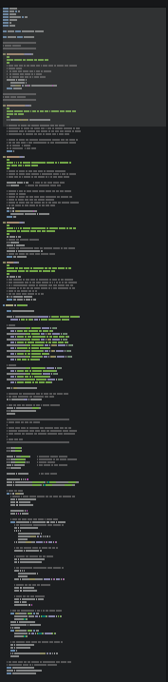
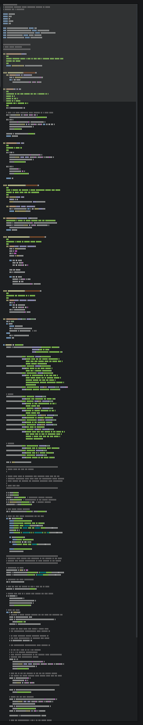
Porting r1DL to Flink
Now we port r1DL to use Flink and the Python features we implemented
With Spark, data sets could be directly accessed from the Python API
Numpy could operate directly on data sets as if they were matrices or vectors
Flink doesn’t allow direct access from Python; functionality must be re-implemented without the libraries
Significant logic changes
Even more off screen ↓
Notes:
With Spark Python API, we could directly access data sets that have been collected. We can treat it as a matrix or vector and use numpy methods directly on it.
With Flink, we can’t do that. So we have to reimplement the functionality in transformations.
Note that the Flink script on the right is much larger than the Spark script.

Slide 28
Porting r1DL to Flink
One interesting issue we ran into that demonstrated how the Python API works:
Flink r1DL runs, but the output v vector is full of integers, not doubles
v is finalized by filling in unused vector components with zeroes (0)
We used an integer zero (0) instead of an explicitly floating point zero (0.0)
The Flink Python API inferred from the integer zero that the entire tuple field would be integers, causing the number to be deserialized as an integer
Baffling problem caused by a lack of two characters
Notes:
One of our problems porting r1DL to Flink that proved most interesting and illuminating about the Python API was when our answers were all huge long integers rather than the floating points numbers we had put into it.
We were baffled by where this problem was coming from, but we noticed that the long integers were huge and were made up of the same amount of bytes as doubles
So packing the integers into byte form and re-interpreting the bytes as floating point numbers gave us the same results as Spark r1DL
Turns out:
vector v is finalized by filling in empty components with zero values.
We used an integer zero in the source code. Python doesn’t really care about type (dynamic type). However, Java is statically typed.
When the vector with the integer zeroes and some floating point values had to be moved between Python and Java, the API saw the integer zero and thought that the entire value field of the data set was made up of integers.
As a result, when the data was deserialized, it was deserialized as a long integer, which worked because long and double have the same amount of bytes.
We fixed this by using a floating point zero literal (0.0). So it was two characters that caused a whole lot of confusion

Slide 29
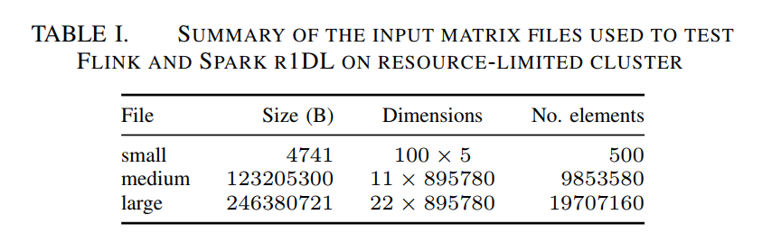
Results
Using a locally-hosted virtual cluster of three nodes, each with four virtual CPUs, 8192 MB RAM, and 30 GB disk storage
Not a lot of resources
Three different sized input files, using Spark and Flink

Slide 30
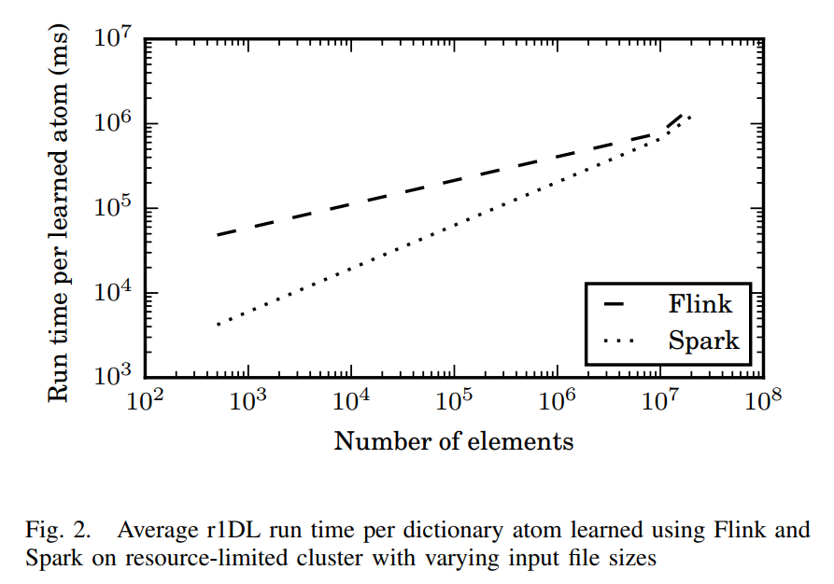
Notes:
Flink starts out slower, but the two converge as number of elements increases

Slide 31
Results
Flink starts out slower than Spark for a very small file, but the two converge as the input data set becomes larger and larger
Um...Flink is slower than Spark?
Our cluster was very limited in computing resources, preventing both data frameworks from reaching their full potential
We couldn’t even handle large (~ 1+ GB) data sets
If Flink is close to Spark in low-resource situations, it should be faster than Spark with more resources
Promising!
Notes:
Flink starts out slower, does that mean its slower?
No, our cluster was overloaded because it didn’t have a lot of resources, so both frameworks were limited
If we give it more resources we think it will work much better! Flink is converging on Spark for larger data sets

Slide 32
Conclusion
We got features implemented in the Flink Python API for all to use, improving humanity as a whole
Flink is promising compared to Spark for iterative algorithms
We need to get it working on more powerful clusters (Amazon EMR anyone?) and get some better data
Open source communities are priceless
Notes:
Conclusion: We Implemented features, showed Flink is promising, need to use better clusters, <3 open source communities

Slide 33
Acknowledgements
Thanks to the Flink community for helping out and putting up with our questions.
Huge thanks to Chesnay Schepler (zentol) for his invaluable assistance in solving our many problems and for his code reviews of our merged features.

