Slide 1
MassMutual DSDP 2019: Crash Course in ggplot2
June 24, 2019
R. Jordan Crouser
Assistant Professor of Computer Science
Smith College

Slide 2
Outline
Introductions
Visualization overview
Flashback to early experiences in data wrangling
Visualization (def.)
Data (def.)
Graphical primitives
Visual dimensions
Pre-lunch activity: mapping visual to data dimensions
After lunch: ggplot2 crash course

Slide 3
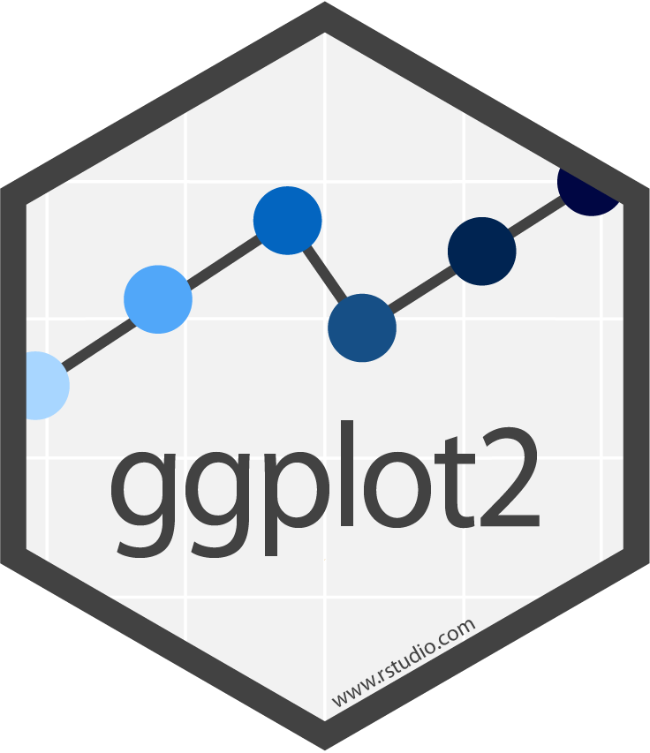
10-minute crash course
“(g)rammar
of (g)raphics”

Slide 4
What is the “Grammar of Graphics”?
Big idea: independently specify plot building blocks and combine them to create graphical displays
Building blocks include:
data (obvi.)
geometric objects (the literal stuff we draw)
aesthetic mappings (how we draw that stuff)
statistical transformations (underlying model)
scales (range of values, colors, etc.)
faceting (small multiples)

Slide 5
Geometric objects (geom)
In ggplot2, the actual marks we put on a plot are called geometric objects or geoms
Examples:
points (geom_point, for scatter plots, dot plots, etc.)
lines (geom_line, for time series, trend lines, etc.)
boxplot (geom_boxplot, for, well, boxplots!)
… and many more!

Slide 6
Aesthetic mapping (aes)
In ggplot2, an aesthetic means “something you can see”
Aesthetic mappings are set with the aes() function
Each type of geom accepts only a subset of all aesthetics.
Examples include:
position (i.e., on the x and y axes)
color (“outside” color)
fill (“inside” color)
shape (of points)
line type
size
… and many more!

Slide 7
All you really need to know…
geoms + aes()

Slide 8
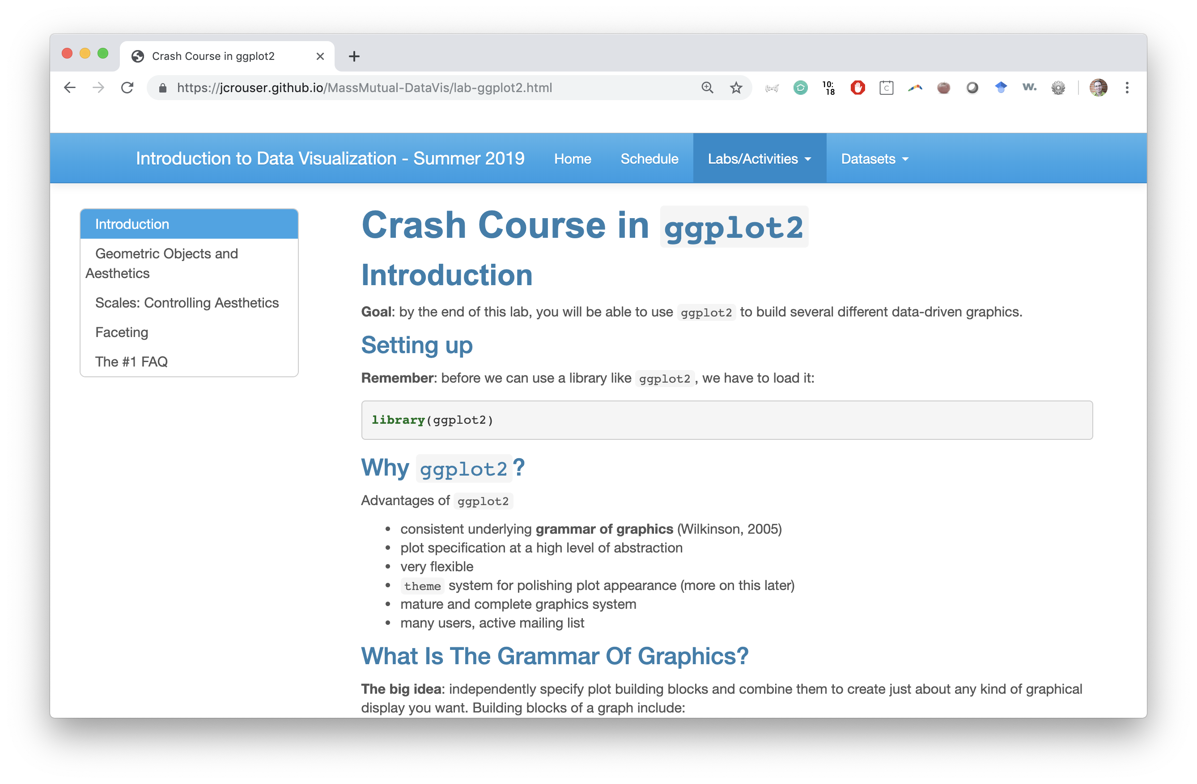
Lab: ggplot2 crash course

