Slide 1
Promoting Air Travel Safety
Joelle Rudolph
DSC-640: Data Presentation and Visualization
30 June, 2024

Slide 2
The Problem
Issue
Our Goal
Solution
Media and news outlets have been promoting statistics that say air is no longer as safe of a way to travel anymore.
Combat negative publicity while remaining truthful and transparent.
Encourage enthusiasm and peace of mind for customers who may otherwise choose alternative travel methods.
Present the facts - compare air travel to automobile travel and examine the number of incidents with each method.

Slide 3
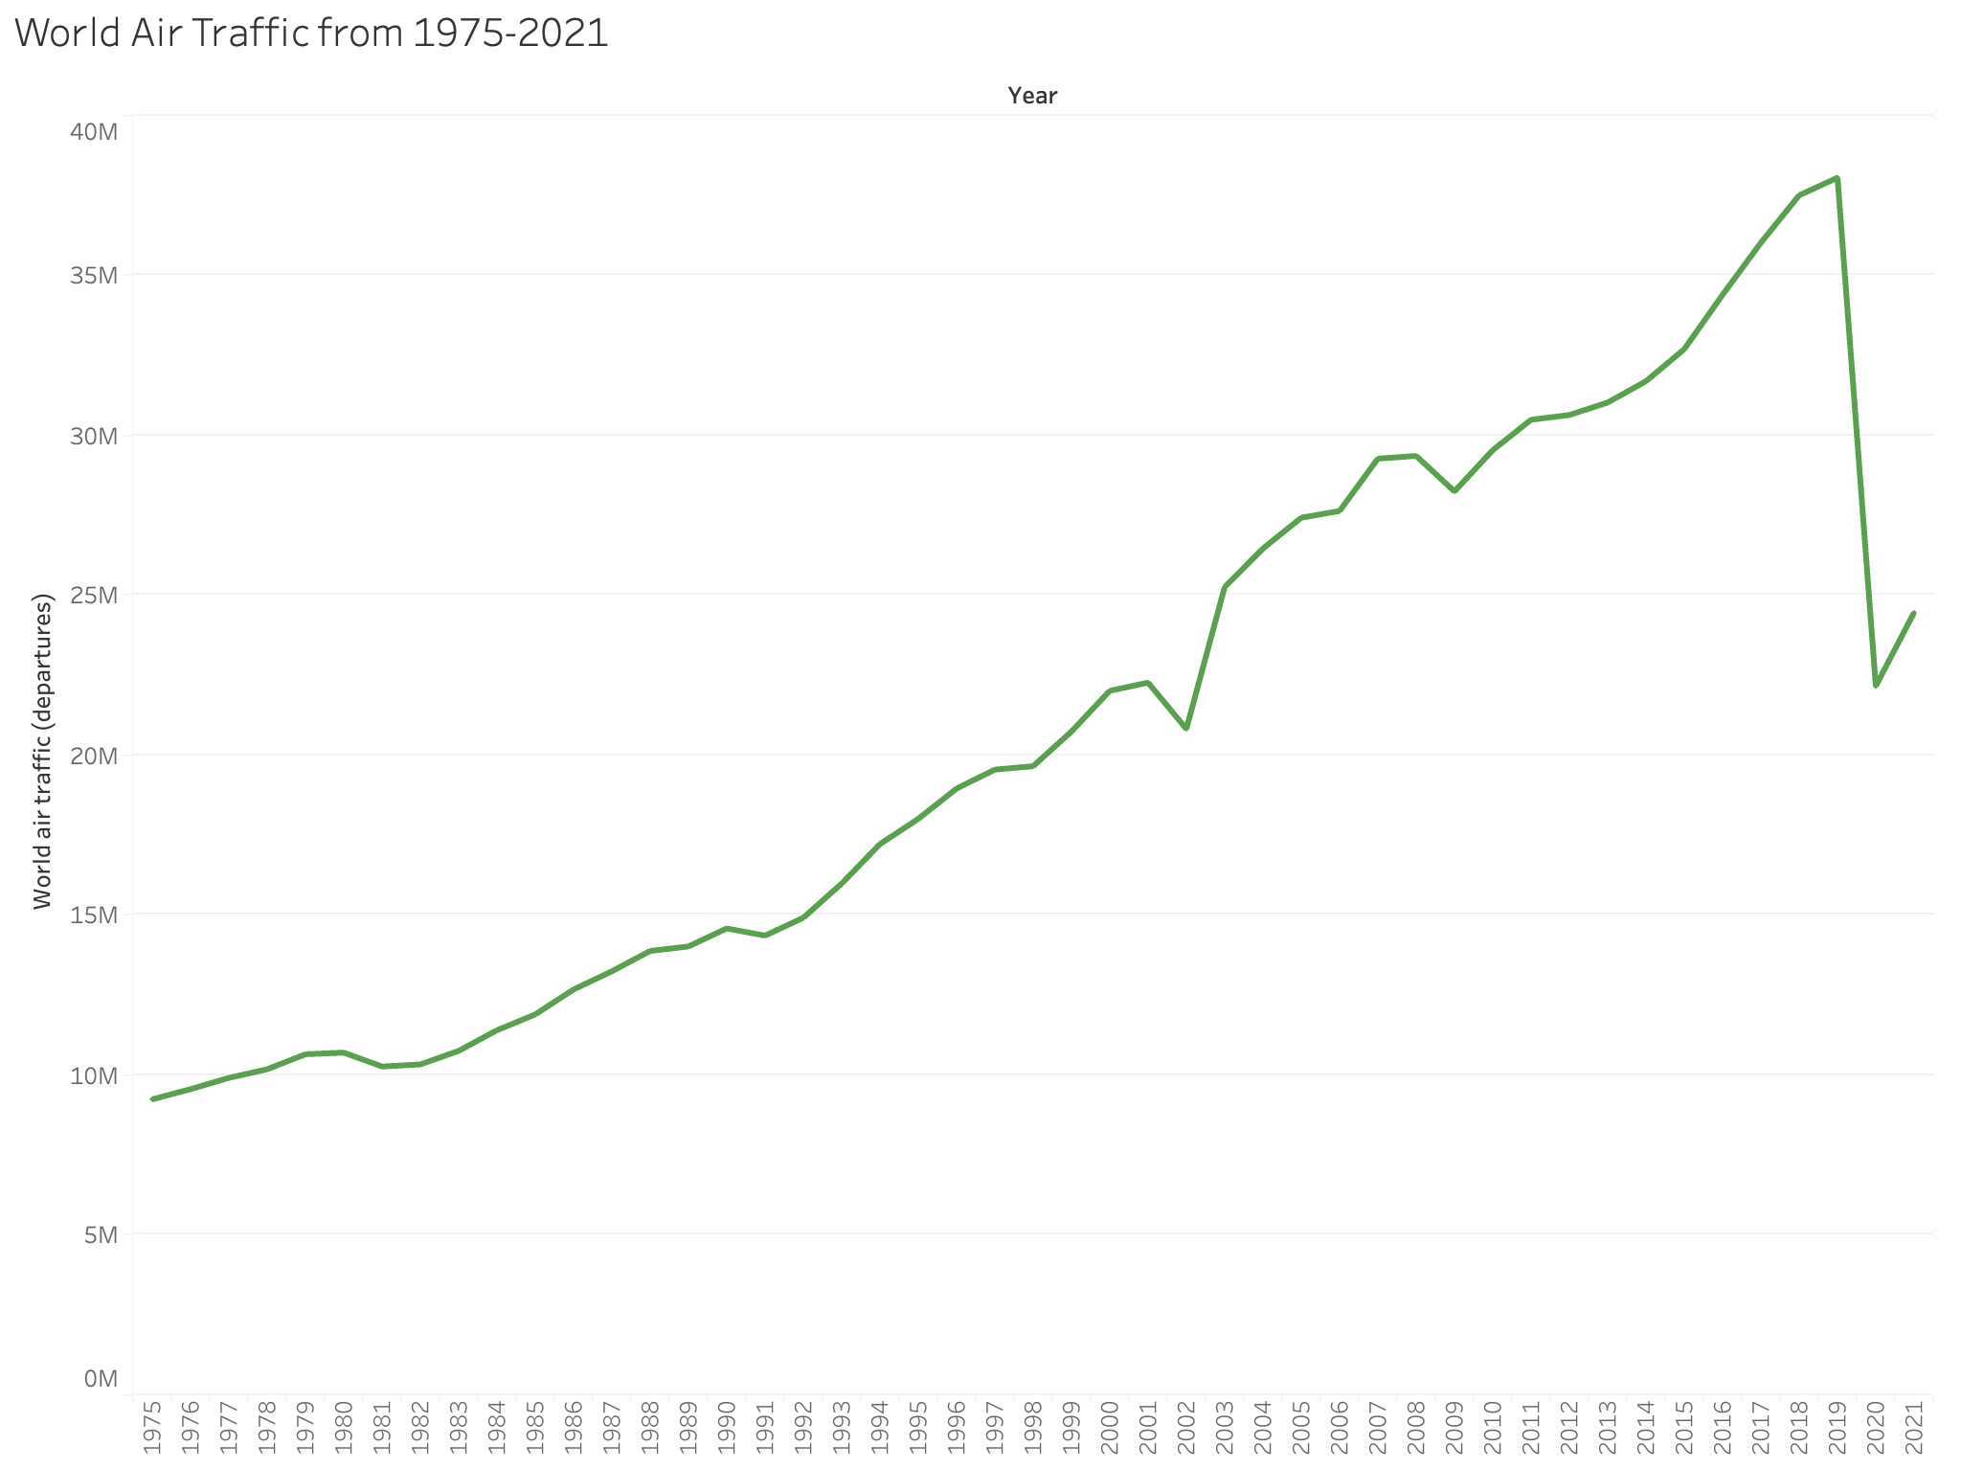
The world had been travelling more than ever pre-COVID-19 pandemic.
We need to increase these numbers back to what they were pre-pandemic, but the recent news coverage will not be conducive to this.

Slide 4
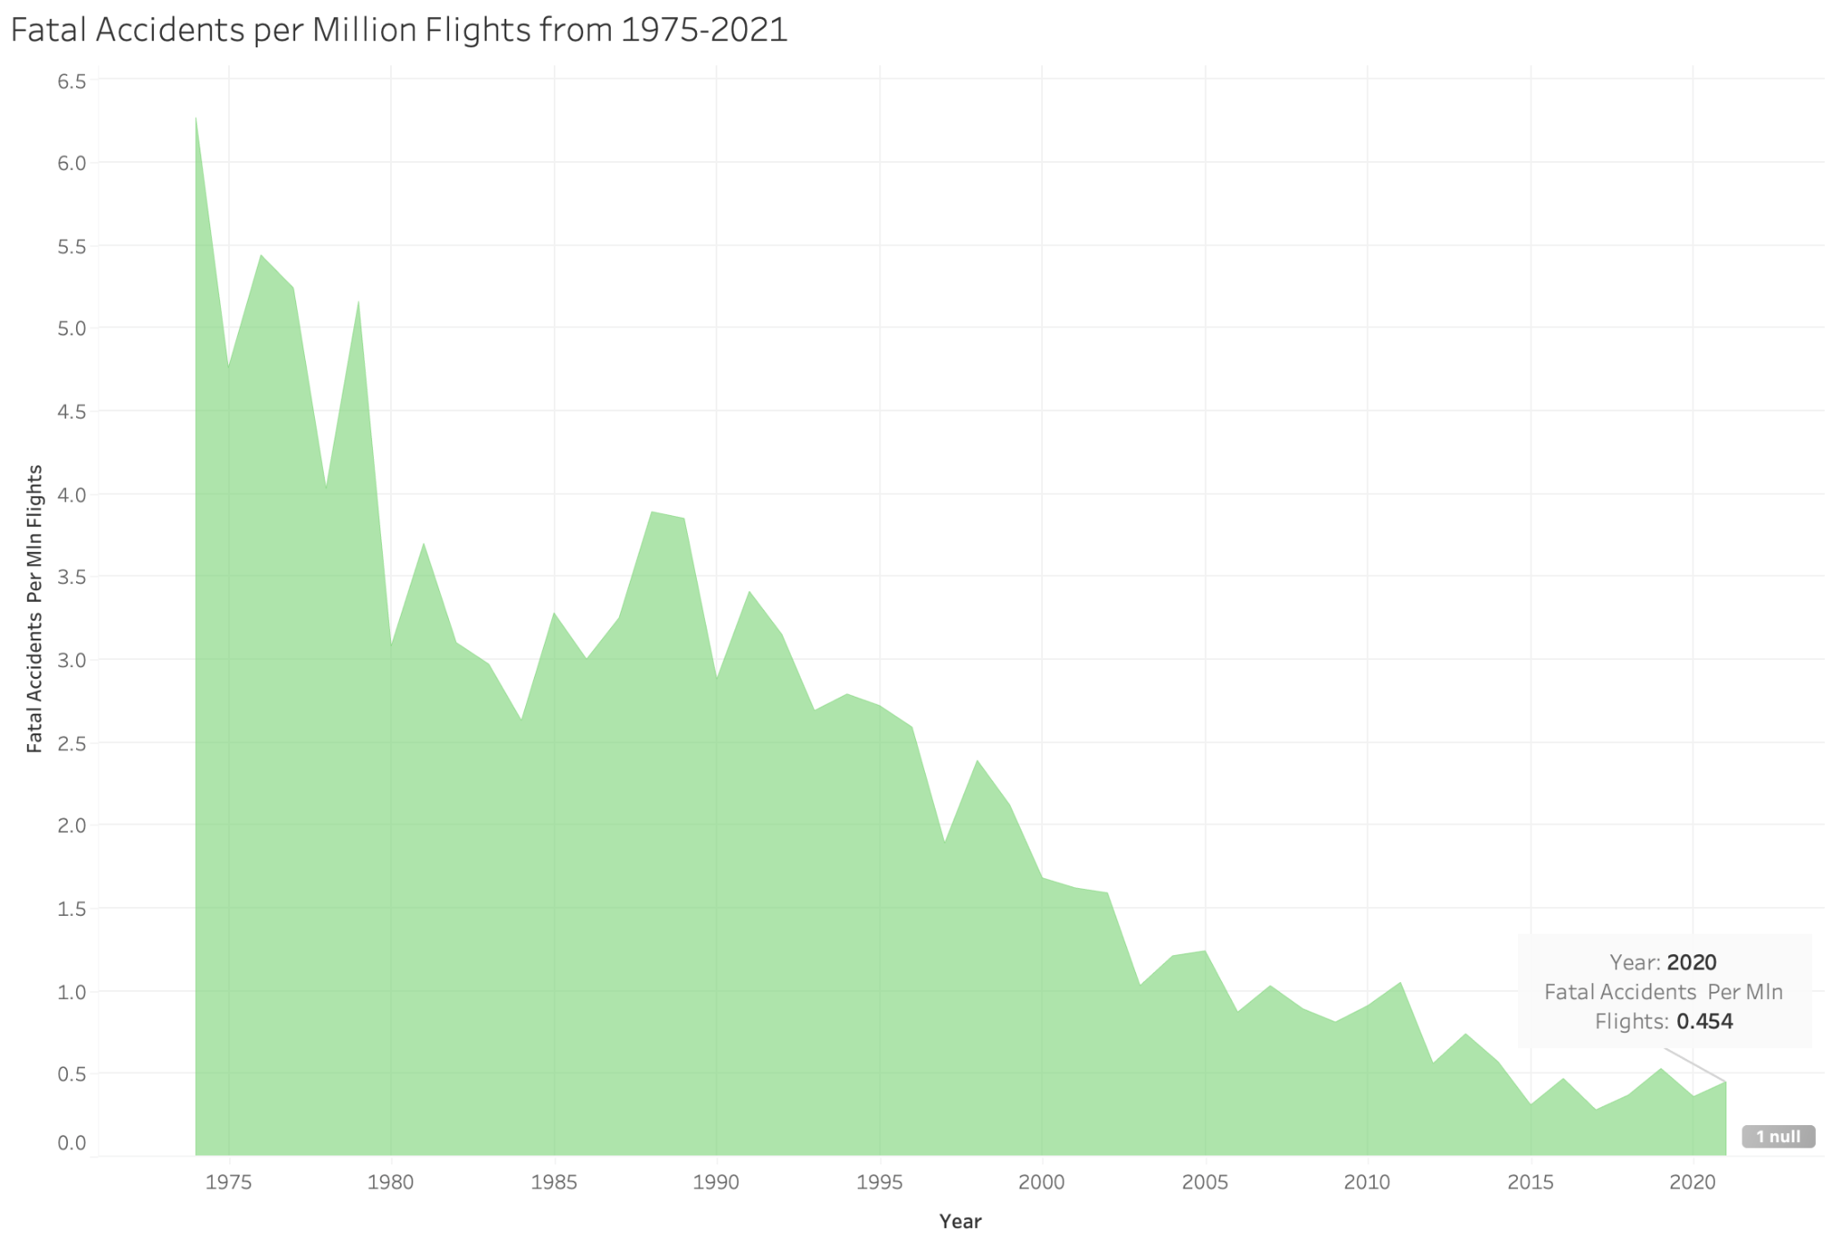
The proportion of fatal accidents involving air travel have steadily decreased over the past 50 years, with the most recent number being only 0.454 fatal accidents per every million flights in 2020.

Slide 5
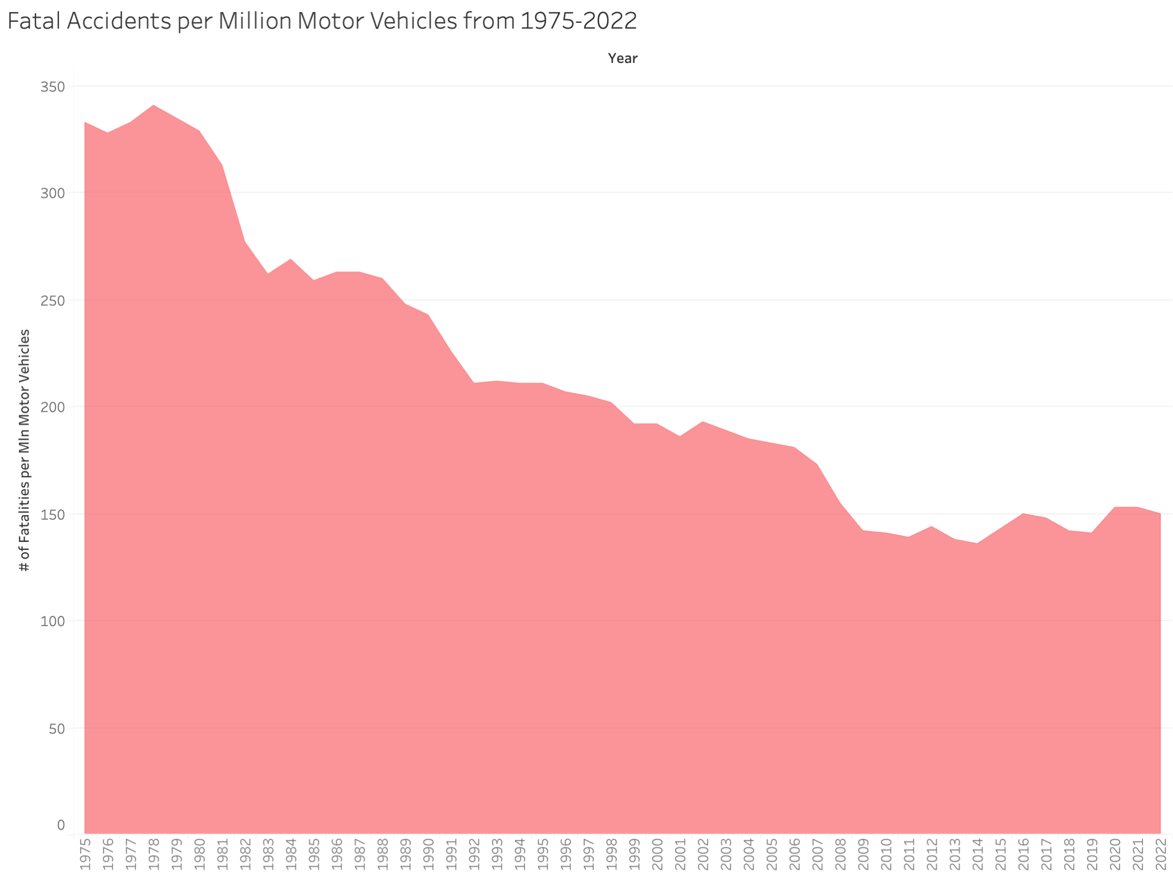
Fatal accidents involving a motor vehicle show a vaguely similar pattern, but have a much higher number of fatalities (150 fatalities for every million cars in 2022).

Slide 6
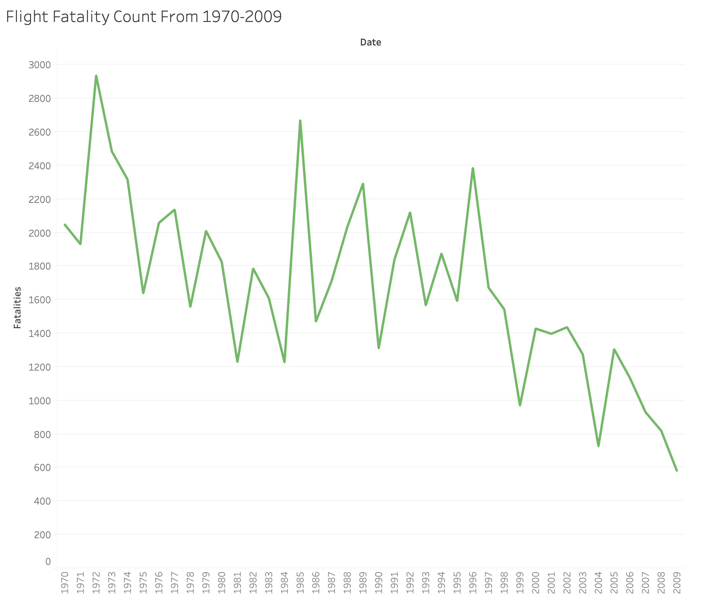
Flight fatality counts have had a relatively strong downward trend over the last 50 years - airline travel has never been safer.

Slide 7
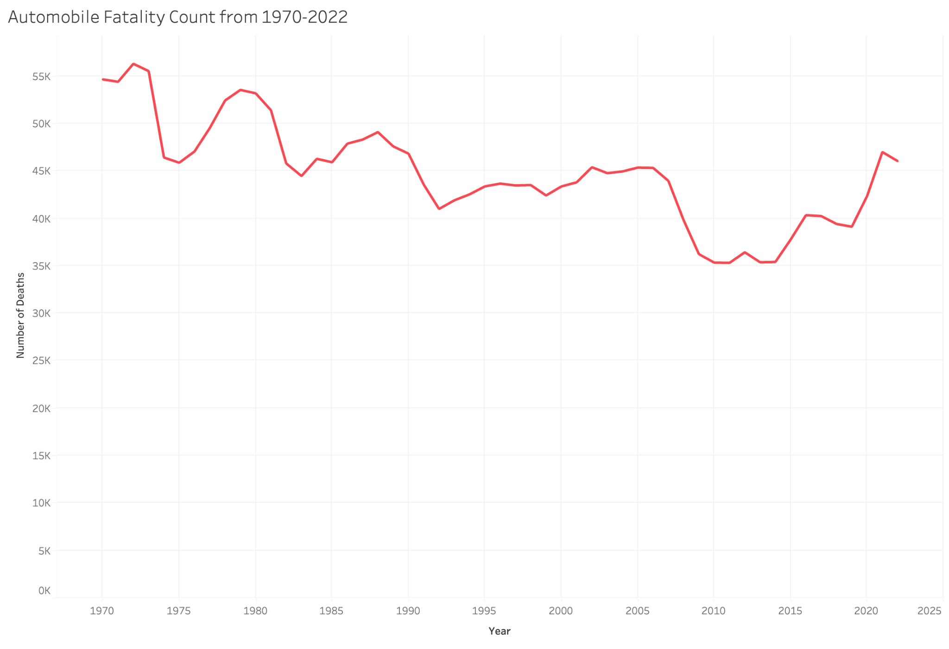
On the other hand, automobile fatality counts have remained at relatively the same numbers in the same timeframe.

Slide 8
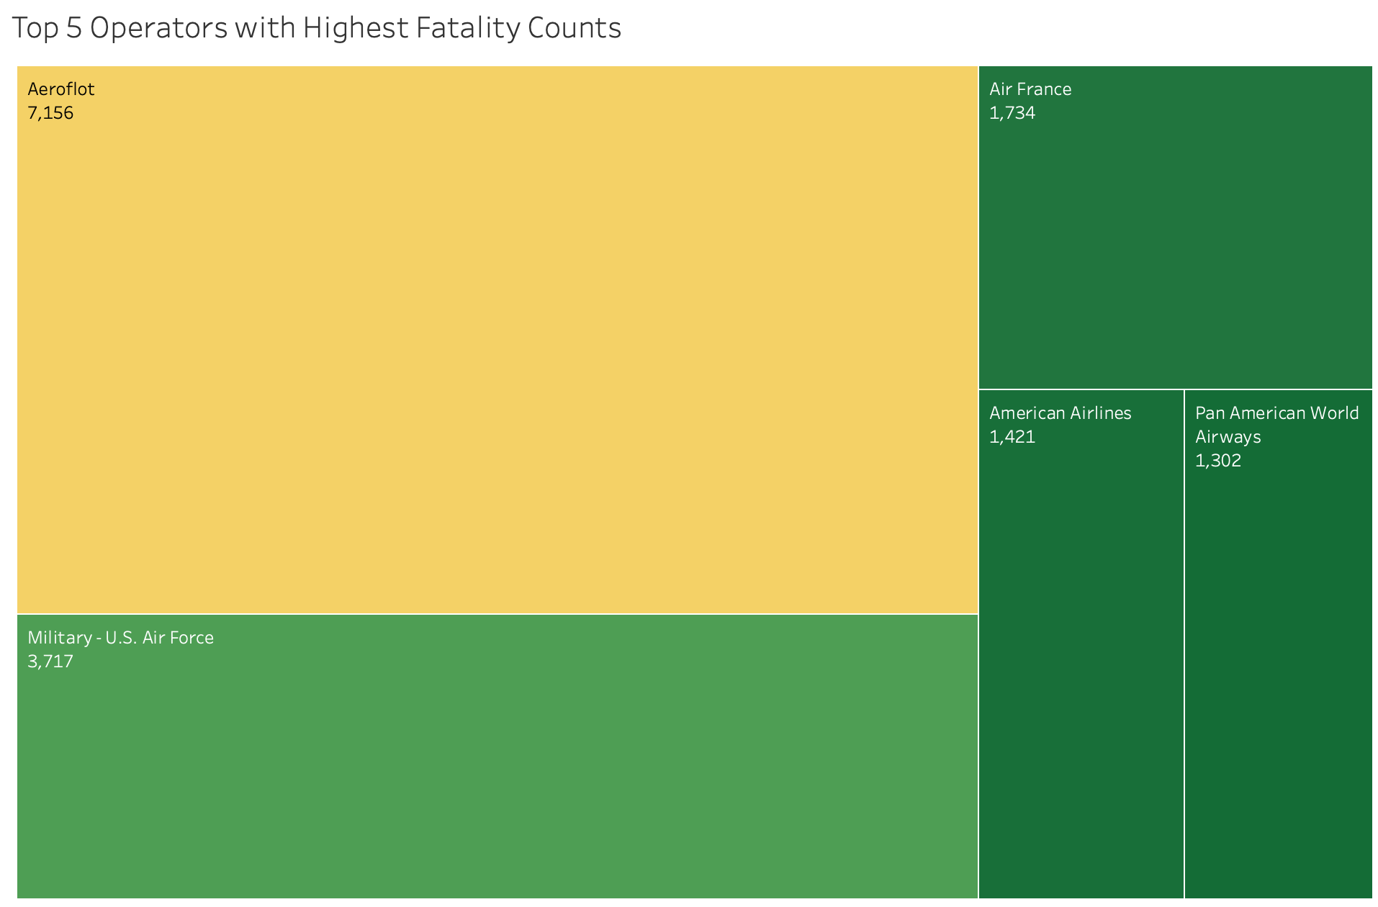
We don’t see American-based passenger airlines within the top 3 operators with the highest fatality counts.
Aeroflot (Russian Airline)
U.S. Air Force (Military)
Air France (French Airline)
This should help provide some peace of mind to travelers choosing our domestic U.S. flights.

Slide 9

What to focus on for customers?
There are far less fatal accidents involving air travel, especially for passenger flights
Planes are at the safest they have ever been
There is a much higher proportion of fatal accidents involving cars than planes

Slide 10
Sources
The three datasets that I used were:
Accidents and Fatalities Per Year (Blackboard, initial)
https://docs.google.com/spreadsheets/d/1SDp7p1y6m7N5xD5_fpOkYOrJvd68V7iy6etXy2cetb8/edit?gid=1448957446#gid=1448957446
Airplane Crashes Since 1908 (Kaggle, supplemental)
https://www.kaggle.com/datasets/saurograndi/airplane-crashes-since-1908
Car Crash Deaths and Rates (National Safety Council, supplemental)
https://injuryfacts.nsc.org/motor-vehicle/historical-fatality-trends/deaths-and-rates/

