Slide 1

Team 2 Members:
Capstone Steps:
Review Current State Architecture
Review shared Team 2 ADO project
Kickstart a Packer change in ADO Pipeline
Deploy Frontend Application to GCE
Deploy Orders and Products Containers to GKE
Show Finished Application in Browser
Review Future State and Q&A

Slide 2
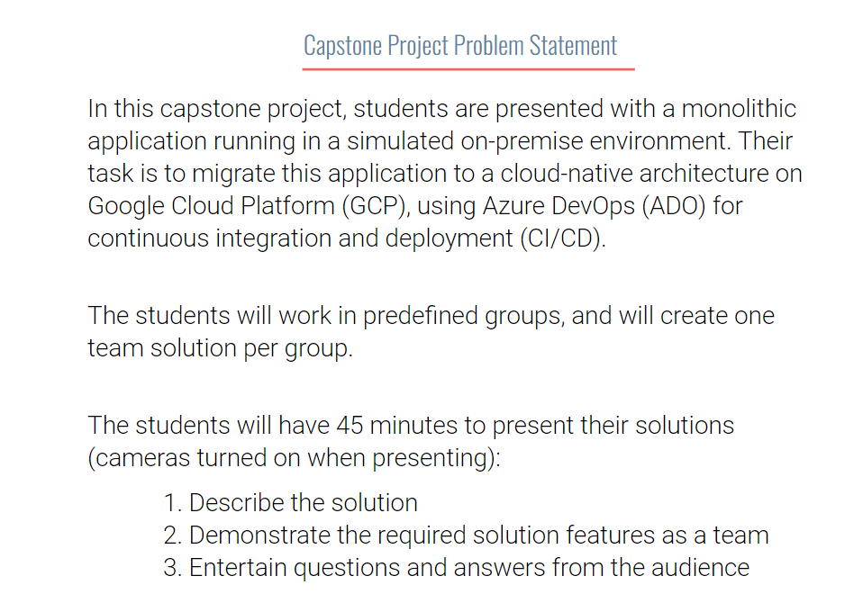

Slide 3
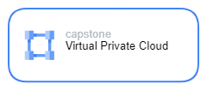
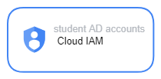





Current State
GCP Shared Services
Region: us-central1
Orders
Pipelines
Frontend
Products
Zones: us-central1-a, us-central1-b

Slide 5
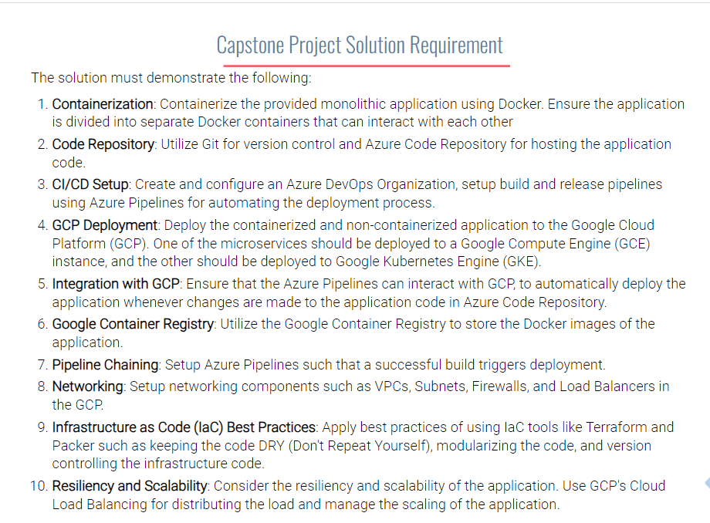


Slide 6

Future State
GCP Shared Services
Region: us-central1
Frontend
Pipelines
Orders
Products
Zones: us-central1-a, us-central1-b

Slide 7

Thank You!
Q & A

