Slide 1
Rain water Harvesting

Slide 2
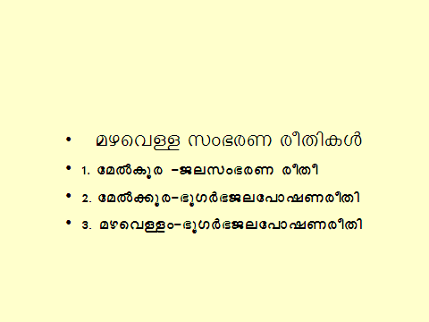

Slide 3
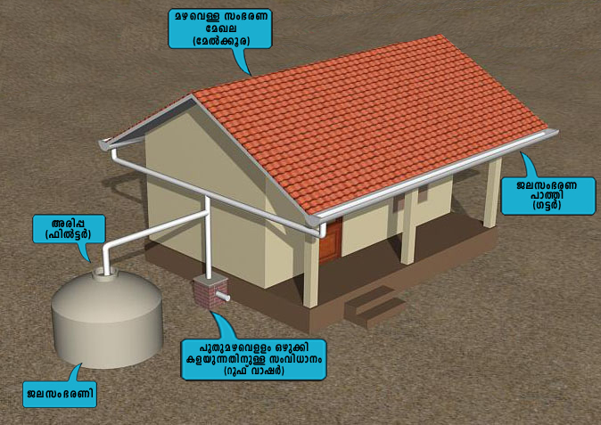

Slide 4
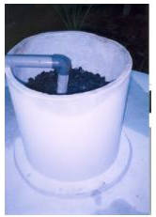
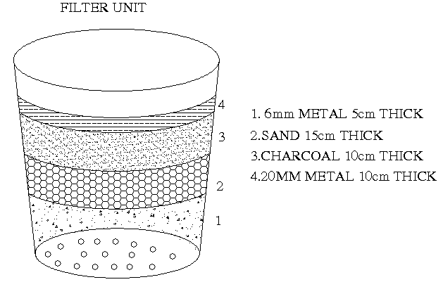
Filter

Slide 5
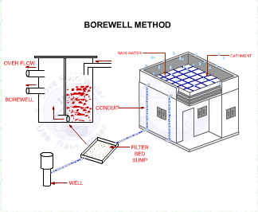

Slide 6
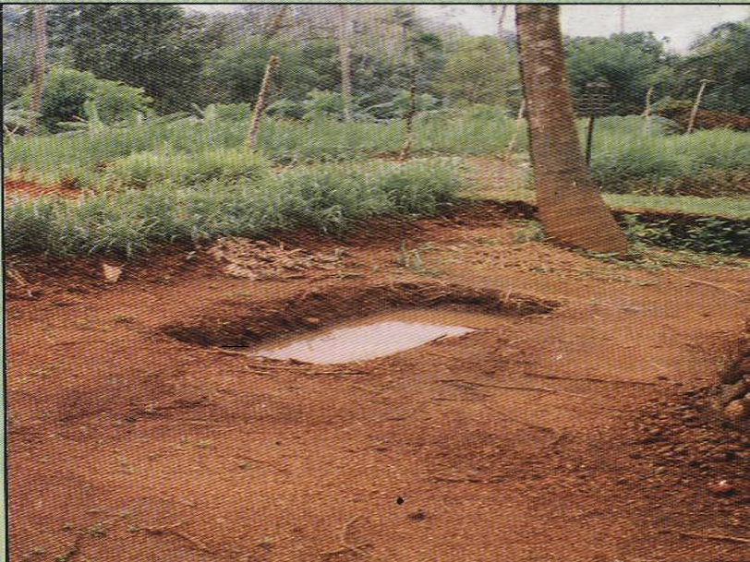
ag-¡pgn

Slide 7
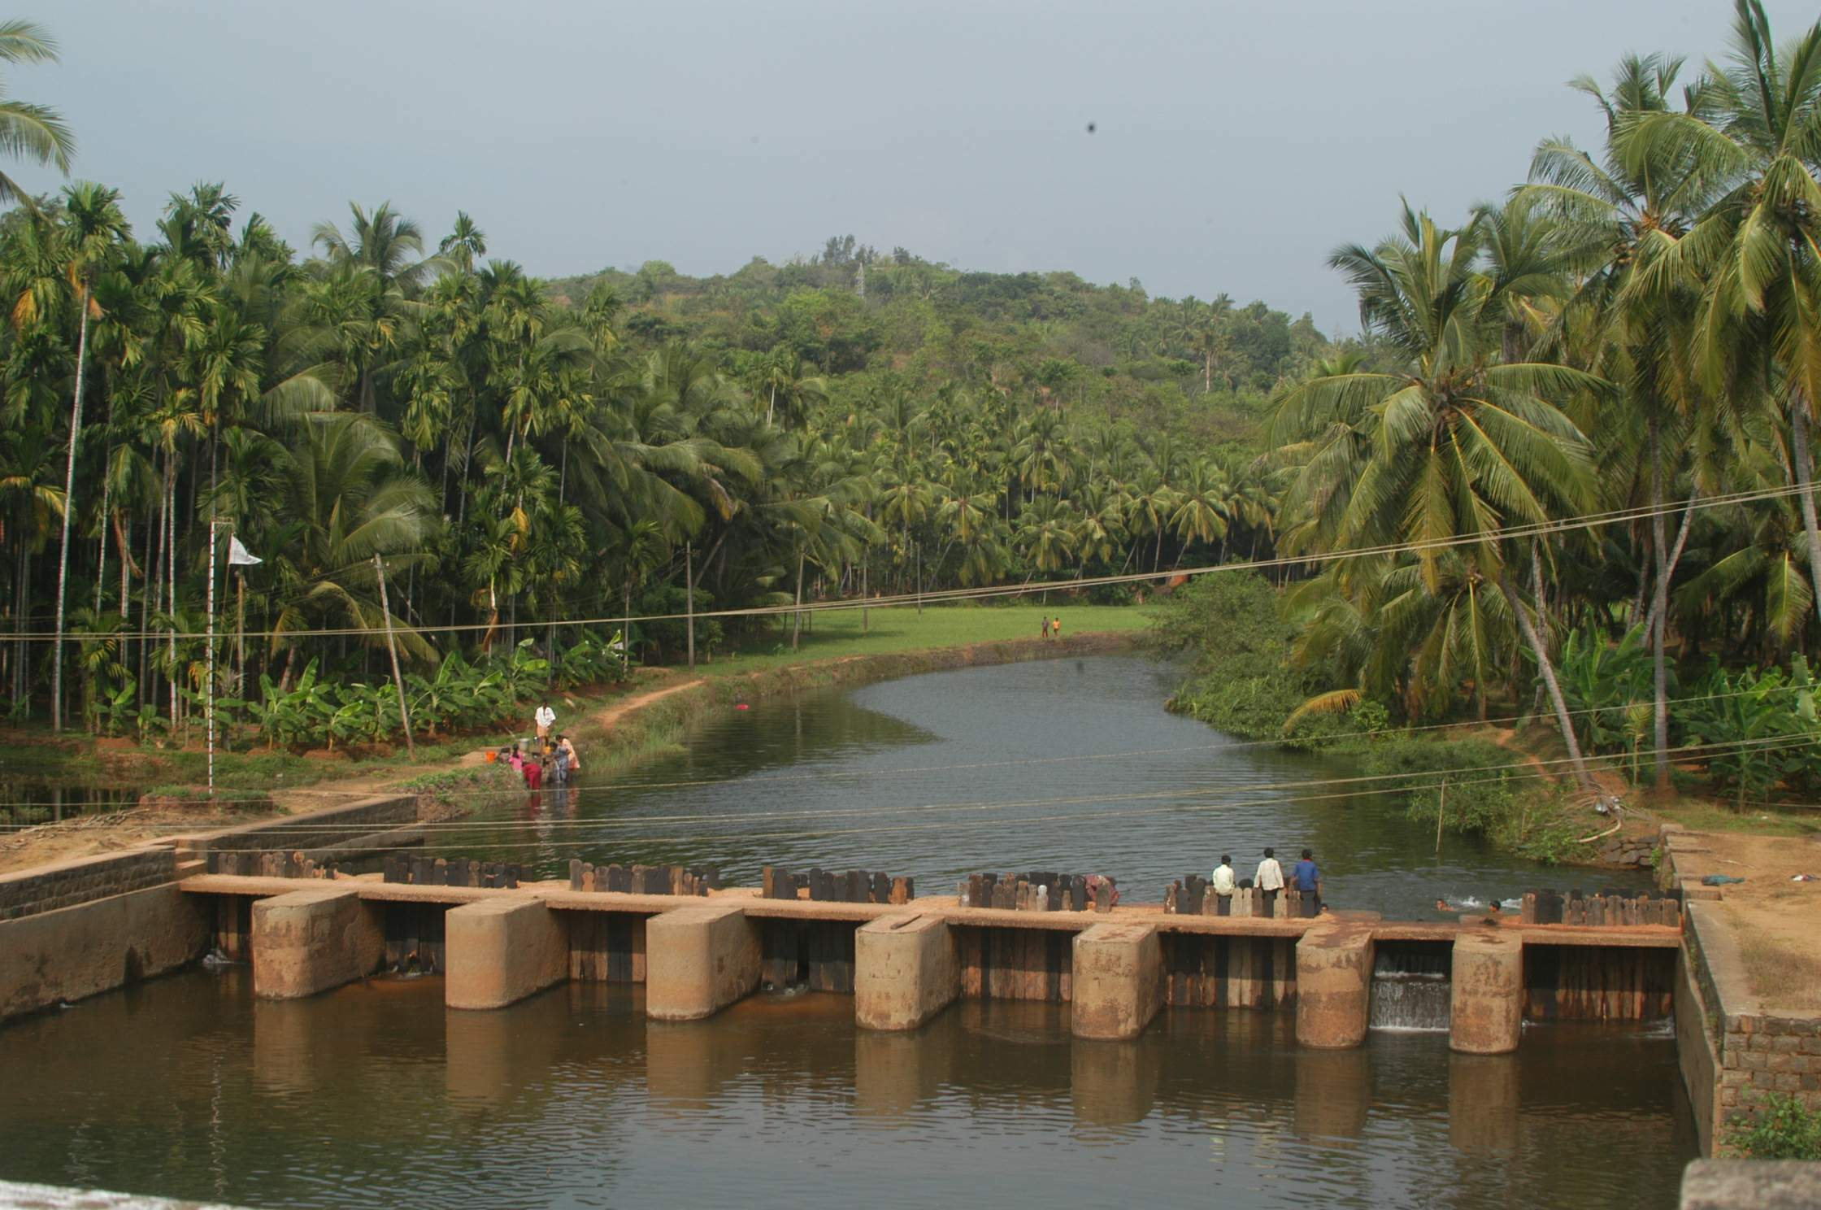
Cross bar

Slide 8
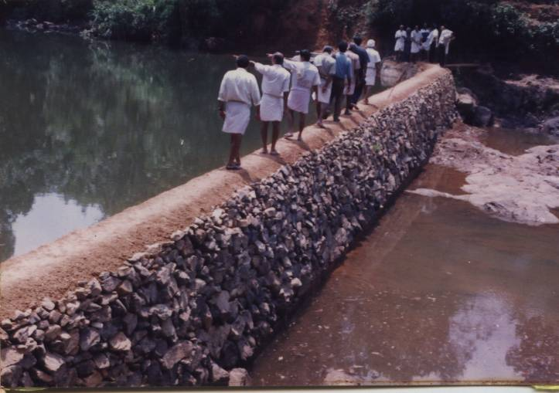
XS-bW

Slide 9
Direct Harvesting of Rain Water through roof top
1. ROOF CATCHMENT AREA
2. ROOF GUTTERS
3. DOWN PIPE AND FIRST FLUSH ARRANGEMENT
4. FILTER UNIT
5. STORAGE TANK WITH PROVISION FOR DRAWING WATER AND SPILL OVER.

