Slide 1
Sanitary Survey and Identification of Well Pollution and Analysis of Water Quality Using Kits
Prof M.G.Cyriac

Slide 2
Format for sanitary survey
Type of facility open well or borewell etc
1. General information about the location
Village ...............................................................................
2. Address ................................................................................................
3. Date of visit ......................................
5.sample identification mark
6 Specific diagnostic information for assessment Risk

Slide 3
Sl No | Specification | Yes / No | Remarks
1 | Is there a latrine within 7.5 m of the well?
2 | Is the nearest latrine on higher ground than the well?
3 | Is there any other source of pollution (e.g. animal excreta, rubbish) within 10m of the well?
4 | Is the drainage poor, causing stagnant water within 2m of the well
5 | Is the wall (parapet) around the well inadequate, allowing surface water to enter the well

Slide 4
6 | Whether the wall of the well inadequately sealed at any point for 3m below ground?
7 | Whether rope and bucket system is used
8 | Any attached bathrooms to the well
9 | Whether the well is not covered
10 | Whether the foot valve is fixed to the bottom of the well
11 | Whether sufficient platform of 1 m width is not provided

Slide 5
Total score of risks ..................... /11
Contamination risk score: 9–11 =very high; 6–8 =high; 3–5 intermediate; 0–2 low
The following important points of risk were noted: ................................. (list nos 1–11)
and the authority advised on remedial action.
Signature of the Sanitarian

Slide 6
Attachment to sanitary survey
Sl no | Problem | Reason | Remarks
1 | Turbid | Improper maintenance of well or geogenic problems or other problems
2 | Smell | Do
3 | Black colour | presence of organic matter or other problems | Identify the pollution source and remove
4 | Sour taste | Low pH | Site specific conditions
5 | Alkaline taste | High pH | Depending on type of source –borewells

Slide 7
6 | 1)Change in colour when exposed to atmosphere 2)Excess requirement of milk to prepare tea of required flavor 3)Staining in vessels and cloths and bathroom floor 4)Deposition of mud after the water is boiled | Presence of iron | Site specific conditions – more in bore wells

Slide 8
7 | 1) White deposit on boiling 2) More consumption of Soap | Hardness
8 | Salty taste | Chloride presence | Sea water intrusion or geogenic reasons

Slide 9
Analysis using water analysis kits
1) pH value
2)Iron
3)Fluoride
4)Chloride
5)Nitrate
6)Coliform

Slide 10
Prominent water quality problems in Kerala
Excess Bacterial presence | Excess conductivity/TDS
Excess iron | Organic pollution measured as BOD/COD
Deviation pH | Excess hardness
Excess turbidity | Excess Nitrate
Excess fluoride | Growth of Algae
Excess Chloride | Carbonate deposition
Presence of Pesticides

Slide 11
1)PRESENCE OF COLIFORM BACTERIA
Coliform is a group of bacteria present in human excreta
It comprises of 10 % of all the bacteria in human excreta
In water analysis it is used as an indicator of presence of human excreta in water supply
Coliform is present in more than 80 % of our water sources

Slide 12
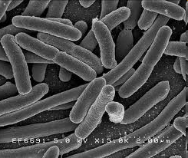
COLIFORMS

Slide 13
REASON FOR SELECTING COLIFORM AS AN INDICATOR
Its presence in human excreta is significant
Out of all the bacteria in human excreta it is the long lived
Its analysis is simple

Slide 14
LIMITATION OF COLIFORM AS AN INDICATOR
In addition to human being it is present in the excreta of all the hot blooded animals
A strict indicator should not reproduce after discharging in to the surface of earth but in favorable conditions coliform reproduces
Treatmentfor coliform is effective disinfection

Slide 15
DEVIATION IN PHVALUE
About 60 % of well water samples are having low pH
High pH occurs in limited places
Low pH imparts sour taste and corrosive
nature
Carbon dioxide dissolution from the surface of the earth and subsequent chemical reaction
is the cause for variation in pH value

Slide 16
CHEMICAL CHANGE WHILE WATER IS PERCOLATED THROUGH THE EARTH

Slide 17
WATER QUALITY VARIATION WHEN WATER IS PERCOLATED THROUGH THE EARTH
In a shallow well pH will be less but in a deep well or borewell pH will be high
In a deep well hardness, calcium, magnesium ,alkalinity will be more compare to shallow well
Dissolved minerals will also be more in deep water sources

Slide 18
TREATMENT FOR PH VARIATION
Low pHcan be increased by adding any suitable alkaline substances
Commonly used are lime , soda ash etc
High pHcan be reduced by adding acidic substances

Slide 19
PRESENCE OF EXCESS IRON
Iron constitutes 6% of the earth crust
3% in soluble Fe2+ form and 3% in insoluble Fe 3+ form
While rain water is percolated through the earth Fe2+ dissolves in the water

Slide 20
BAD EFFECTS OF IRON
Change in colour when exposed to atmosphere ( oxidation of ferrous Iron to ferric Iron)-
Fe ²⁺ +O₂+H₂O Fe(OH)₃+H⁺
Excess requirement of milk to prepare tea of required flavor(Iron +Tanin = black colour)
Staining in vessels
Deposition of mud after the water is boiled
(More oxidation on heating)
Oily appearance on the surface of water

Slide 21
TREATMENT FOR REMOVAL OF IRON FROM DRINKING WATER
Increase the pH of water by adding suitable alkaline materials ( lime , Soda ash, bleaching powder )
Aerate the water for oxidation to take place
Allow for settling and thereafter for filtering
Disinfect to make it potable

Slide 22
REMOVAL OF IRON IN OPEN WELLS

Slide 23
Excess Turbidity

Slide 24
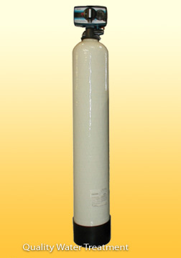
IRON REMOVAL USING GREEN SAND,IRON SPECIFIC RESIN,BIRM MEDIA

Slide 25
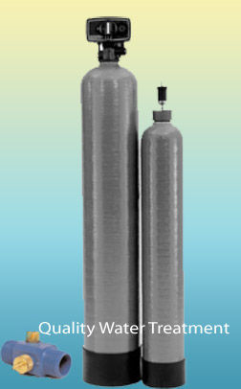

Slide 26
EXCESS TURBIDITY
It occurs in certain well and in certain water sources
Treatment is plain sedimentation /coagulationsedimentation/ Filtration

Slide 27
EXCESS FLOURIDE
Flouride dissolves from the crust of the earth
Flouride presence will be more in water sample with less calcium
Ca +F CaF₂
In kerala Alappuzha and Palakkad is mainly affected
Domestic kit using activated Alumina is suitale for removal of Flouride

Slide 28
HEALTH EFFECTS OF FLOURIDE
Excess consumption of flouride results in to Flourosis
Flourosis are three types
Dental Flourosis
Skeletal Flourosis
Non Skeletal Flourosis

Slide 29
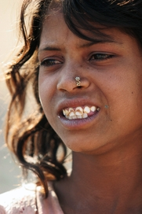
MOTTLING

Slide 30
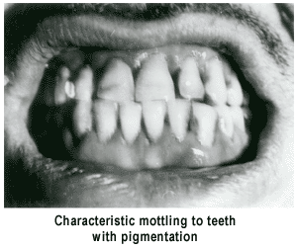
CHARACTERISTIC MOTTLING TO TEETH WITH PIGMENTATION

Slide 31
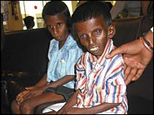
“Ramaswamy” is the symbol of our dreadful fate, our horrendous sufferings.

Slide 32
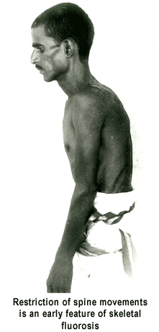
RESTRICTION OF SPINE MOVEMENTS IS AN EARLY FEATURE OF SKELETAL FLUOROSIS

Slide 34
PRESENCE OF CHLORIDE IN DRINKING WATER
Sea water intrusion in coastal area
In certain open wells in Palakkad district
Ghyben – Hertzberg equation for intrusion of sea water
Commonly used method for treatment for removal of Chloride is Reverse osmosis (RO)
Some (RO) units are being used in coastal area of Kerala

Slide 35
PRINCIPLE OF REVERSE OSMOSIS

Slide 37
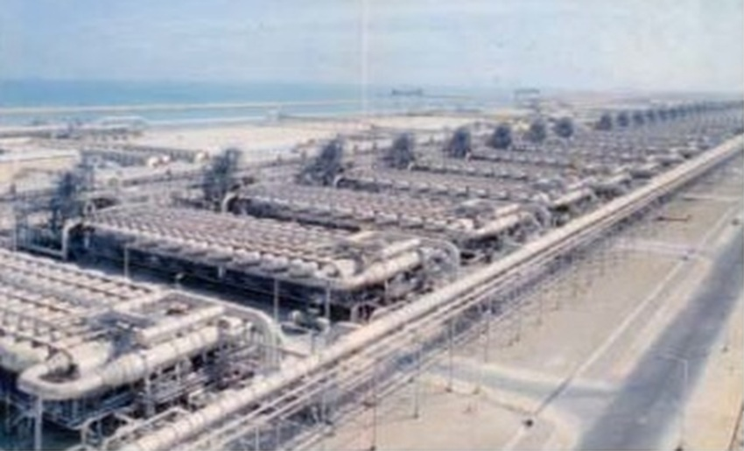
2500M3/HOUR UNIT IN JUBAIL , SAUDI ARABIA

Slide 38
POLLUTION OF WATER SOURCES DUE TO ORGANIC MATTER
Intrusion of waste in to water sources causes pollution
Black colour and death of fish / uneasiness for the fish is manifested
Always remove such waste sources from near the water sources

Slide 39
HARDNESS
Hardness is caused by multivalent metallic cations
Deep water sources are generally hard
Calcium and Magnesium are generally causes hardness
If topsoil is Thick hardness will be more
Softeners are which remove calcium and magnesium are commonly used for its removal

Slide 40
CHEMICAL CHANGE WHILE WATER IS PERCOLATED THROUGH THE EARTH

Slide 41
GROWTH OF ALGAE
In wells water is good in the morning but as sunlight falls color change occurs
Water sources gets polluted
Algae is water plant which requires sunlight for its growth
Treatment for algae growth is prevention of sunlight, chlorine or copper sulphate

Slide 42
CARBONATE DEPOSITION
As water percolates through the earth CaCo3 dissolves in water Ca(HCO3)2
H2O+CO2 H2CO3
CaCO3+H2CO3 Ca(HC03)2
In deep water sources Ca(HC03)2 will be more and as it is pumped to open areaCO2 starts escaping and CaCO3 starts depositing. Predominant in borewell water

Slide 43
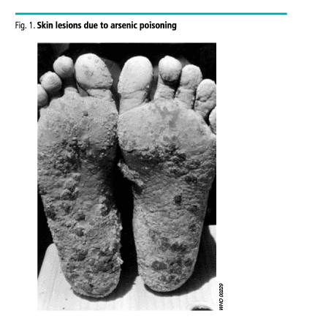

Slide 44
WATER QUALITY BIS STANDARDS
SLNO | CHARACTERISTICS | UNIT | ACCEPTABLE | CAUSE FOR REJECTION | ACTUAL CONTENTS
1 | Turbidity | NTU | 5 | 10
2 | PH |  | 6.5 to 8.5 | <6.5 & > 8.5
3 | Electrical Conductivity | Micro mhos/cm
4 | Temperature (0C) | mg/litre
5 | Acidity | mg/litre
6 | Alkalinity (Total) | mg/litre | 200 | 600
7 | Total hardness (as Ca CO3) | mg/litre | 300 | 600
8 | Calcium(as Ca) | mg/litre | 75 | 200

Slide 45
9 | Magnesium (as Mg) | mg/litre | 30 | 150
10 | Chloride (as Cl) | mg/litre | 250 | 1000
11 | Fluoride (as F) | mg/litre | 1.0 | 1.5
12 | Iron(as Fe) | mg/litre | 0.3 | 1.0
13 | Nitrate (as NO3) | mg/litre | 45 | 100
14 | Bacteriological Analysis | No. of Coliforms/ 100 ml
15 | Chemical Oxygen Demand (COD) | mg/litre

Slide 46
BACTERIOLOGICAL QUALITY (BIS STANDARDS)
Water in distribution system
a. Throughout any year 95% of samples should not contain any coli form organism in 100 ml.
b. No sample should contain E.Coli in 100 ml.
c. No sample should contain more than 10 coliform organisms per 100 ml.
d. Coliform organisms should not be detectable in 100 ml of any two consecutive samples.

