Slide 1
Terrafil Technology
Prof S.Rathish

Slide 2
Terrafil technology for Iron removal
New method developed by IMMT Bhuvaneswar
Sand,clay and saw dust is mixed in a definite proportion
Thereafter it is moulded in the form of a circular disk
The disk is heated and the saw dust burns away and pores are formed
An iron removal system is arranged in such a way that
Iron containing water is filtered through the disk and the water gets treated

Slide 3
Terafil technology for water treatment prepare a filtering disk with the following proportion
Sl no | Materials | Percentage
1 | Pottery clay | 58
2 | Wood saw dust | 21
3 | River sand | 21

Slide 4
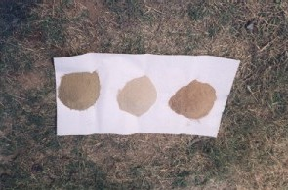
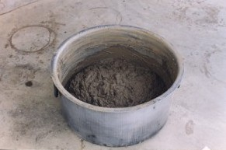
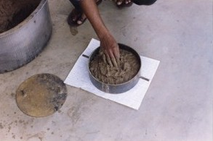
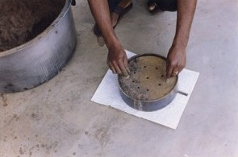
Production of TERAIL Media (Disc)
Sand, Saw dust & Clay
Mixed with water
Molding of Green Terafil

Slide 5
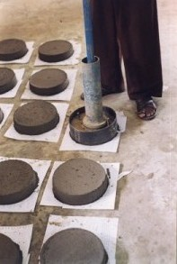
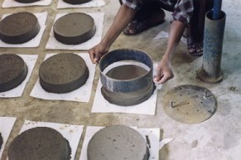
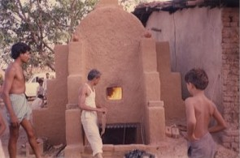
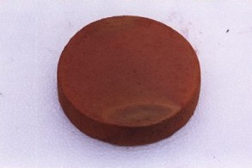
Green Terafil
Sintering of Terafil
Sintered Terafil
Construction of Terafil

Slide 6
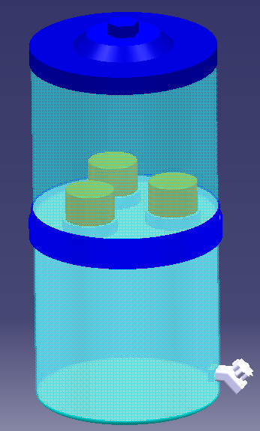
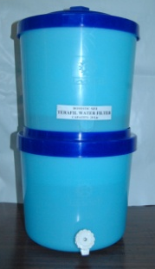
LID
TOP CONTAINER
TERAFIL
SUPPORT RING
BOTTOM
CONTAINER
TAP
TERAFIL WATER FILTER

Slide 7
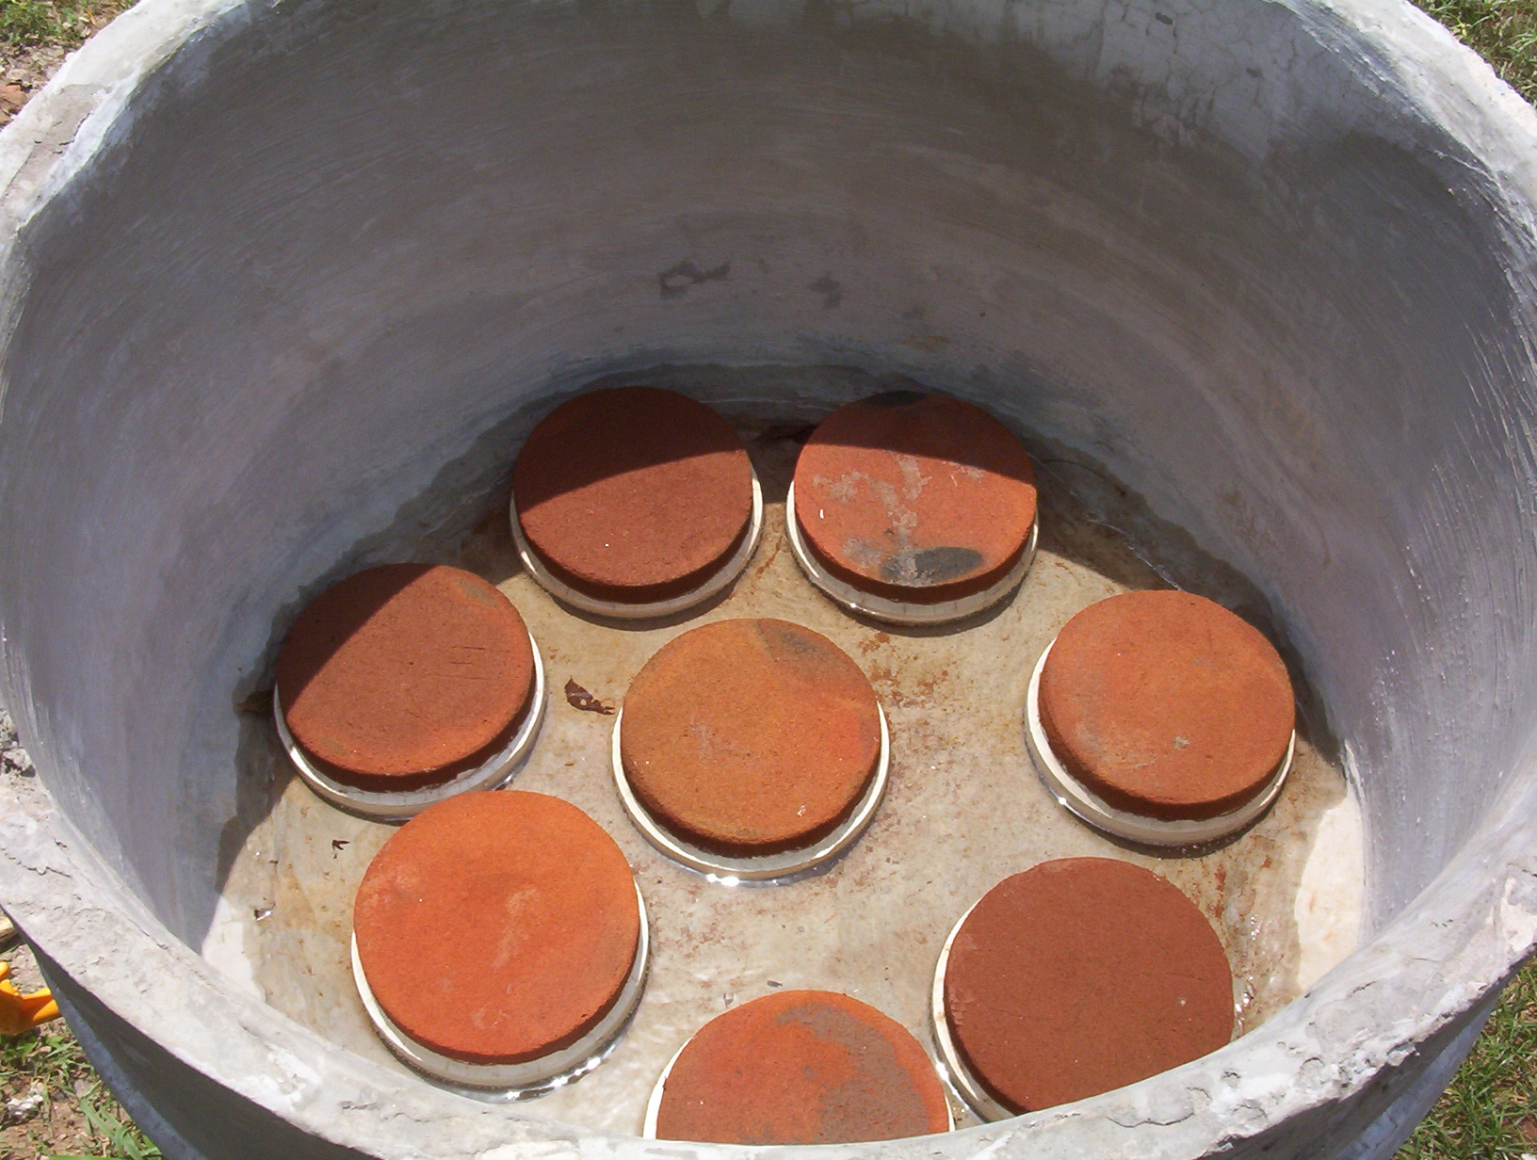
A model RCC Chamber for Terafil water filter
Notes:
7

Slide 8
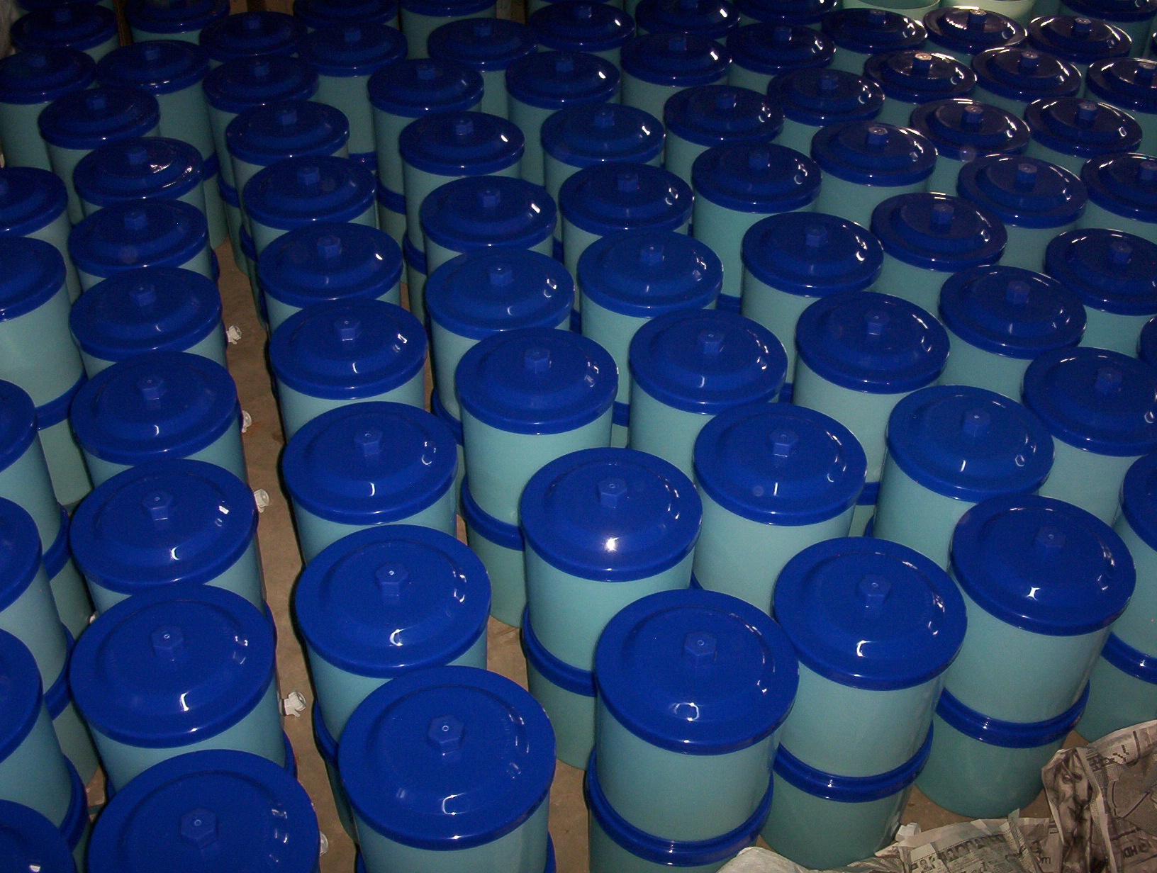
Assembled of Terafil water filter at IMMT, Bhubaneswar

Slide 10
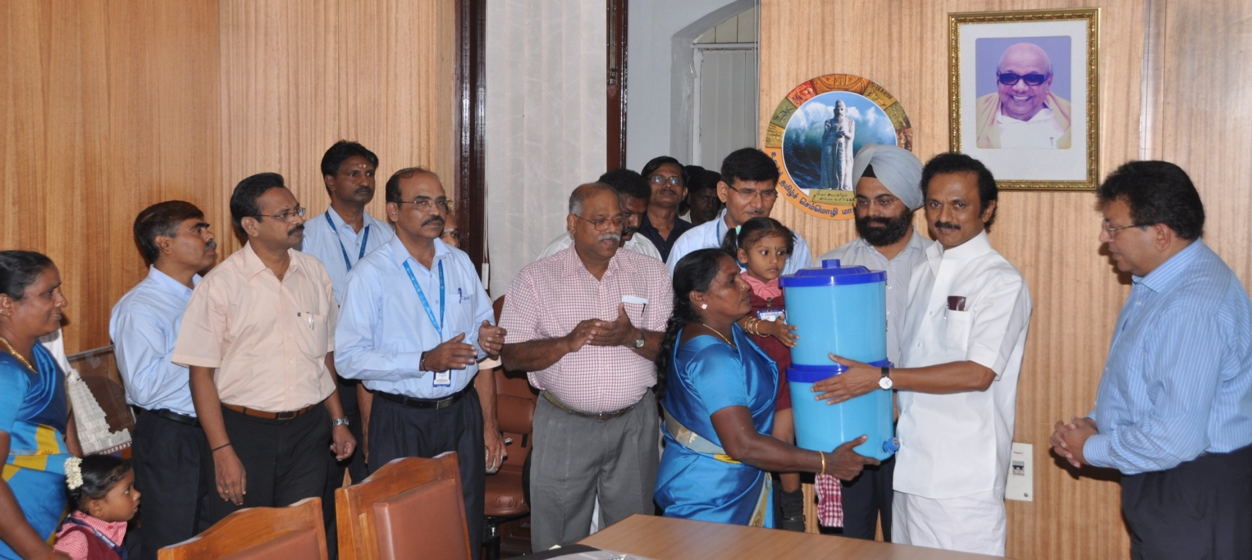
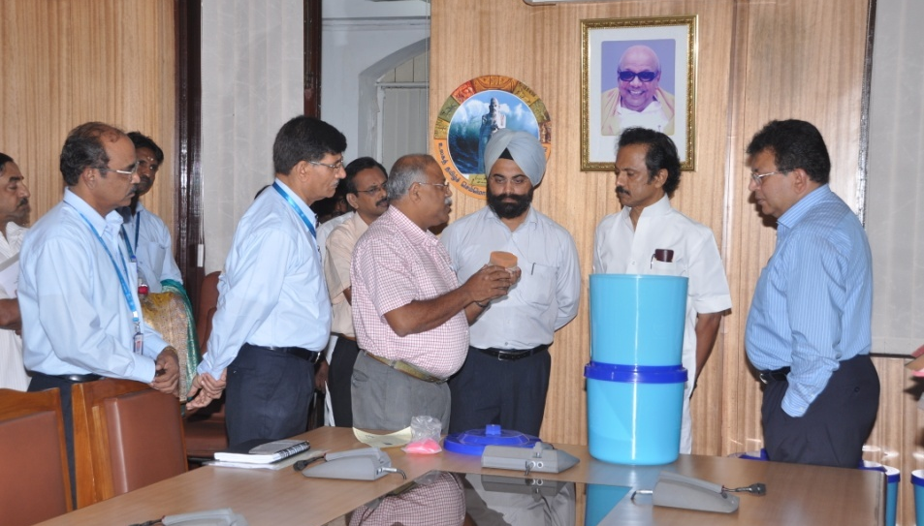

TERAFIL WATER FILTER launched by Hon’ble Dy. Chief Minister of Tamilnadu on 25th August 2010 at Chennai

Slide 11
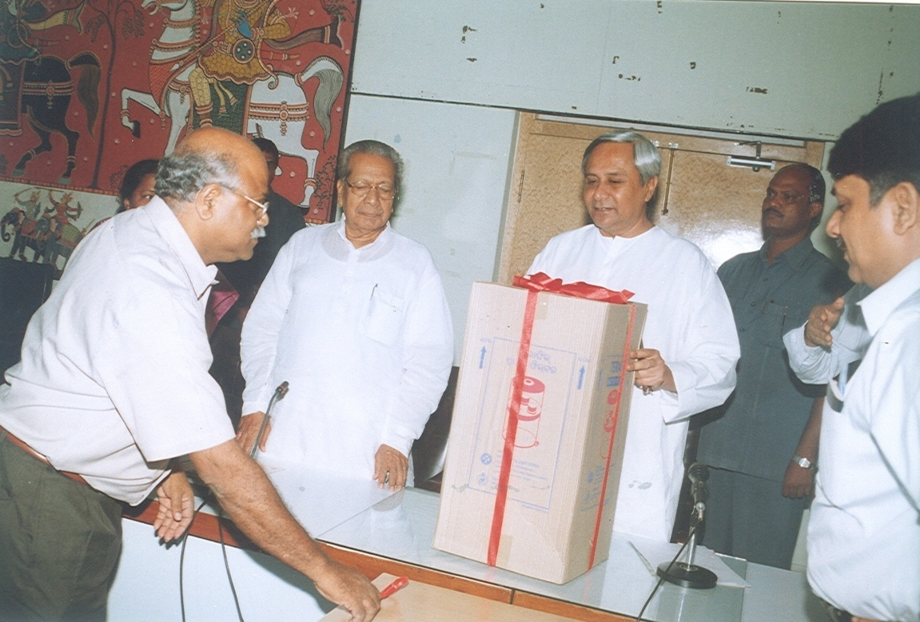
TERAFIL WATER FILTER launched by Hon’ble Chief Minister of Orissa on 10th August 2007

Slide 12
Terrafil technology for Iron removal
New method developed by IMMT Bhuvaneswar
Sand,clay and saw dust is mixed in a definite proportion
Thereafter it is moulded in the form of a circular disk
The disk is heated and the saw dust burns away and pores are formed
An iron removal system is arranged in such a way that
Iron containing water is filtered through the disk and the water gets treated

Slide 13
Production of TERAIL Media (Disc)
Sand, Saw dust & Clay
Mixed with water
Molding of Green Terafil

Slide 14
Green Terafil
Sintering of Terafil
Sintered Terafil
Construction of Terafil

Slide 15
LID
TOP CONTAINER
TERAFIL
SUPPORT RING
BOTTOM
CONTAINER
TAP
TERAFIL WATER FILTER

Slide 16
A model RCC Chamber for Terafil water filter
Notes:
16

Slide 17
Assembled of Terafil water filter at IMMT, Bhubaneswar

Slide 19
TERAFIL WATER FILTER launched by Hon’ble Dy. Chief Minister of Tamilnadu on 25th August 2010 at Chennai

Slide 20
TERAFIL WATER FILTER launched by Hon’ble Chief Minister of Orissa on 10th August 2007

Slide 21
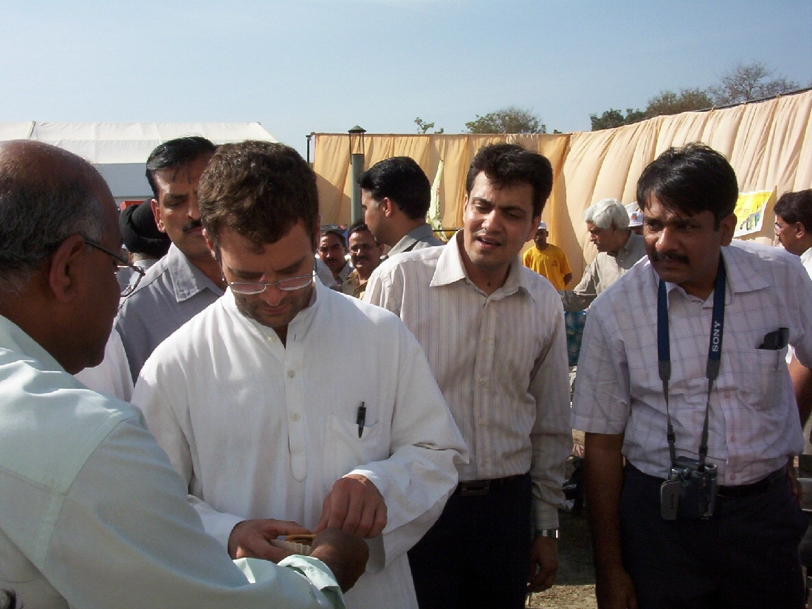
Inspection of IMMT technology by Hon’ble MP Sri Rahul Gandhi & Minister S&T, GOI Sri Kapil Sibal at Amethi, UP

Slide 22

Thank you
Save drinking water

