Slide 1
Bacteriological Analysis of Water
M.G.Cyriac

Slide 2
Microorganisms
Bacteria
Virus
Fungi
Algae
Protozoa

Slide 3
MICRO ORGANISMS
Bacteria-Unicellular-Prepare food by themselves
Virus-obligate parasite and do not have ability to synthesize new products
Algae-water plants –Grow in water in the presence of sunlight- imparts taste and order affecting water quality

Slide 4
Protozoa-Single celled
microorganism without cellwall
Example;Giardia and Cryptospridium-
resistant to chlorination
Fungi-obtain their food from dead organic matter-Responsible for the decomposition
of carbon in the biosphere. They grow in low moisture areas and grow in low pH environment

Slide 5
History of water borne diseases
14th Century - Black Death in Europe-
Killed 14% people of Europe
1769 -Repeated the same problem
and killed 25% of the people of Europe
1854 -Spread of Asiatic Cholera in London town- Found out the root cause of the problem-John snow &John York

Slide 6
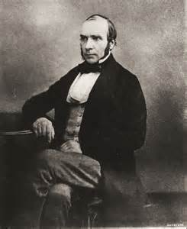
John snow
He is considered one of the fathers of modern epidemiology, in part because of his work in tracing the source of a cholera outbreak in Soho, London, in 1854. His findings inspired fundamental changes in the water and waste systems of London, and subsequently in other areas

Slide 7
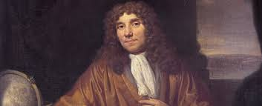
Antony Van leuvenholk
October 24, 1632 – August 26, 1723) was a Dutch tradesman and scientist. He is considered to be the first microbiologist. He is best known for his work on the improvement of the microscope and for his contributions towards the establishment of microbiology.

Slide 8
Pathogenic Organisms
From the excreta of human beings
1)Cholera
2)Typhoid
3)Dysentry
4)Diarrhoea
Direct analysis of the above diseases is difficult and risky

Slide 10
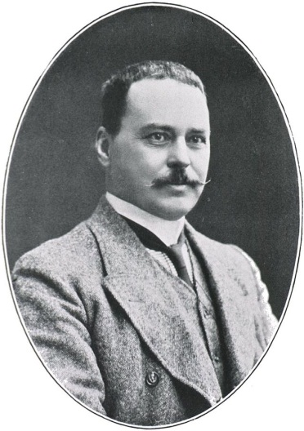
Sir Ronald Ross, (1857 – 1932), Indian-born British medical doctor who discovered that malaria is transmitted by mosquitoes, and laid the foundation for combating the disease. Won noble prize in 1902

Slide 11
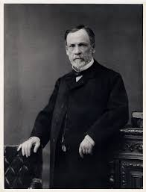
Luois Paster
Louis Pasteur (1822 – 1895) was a French chemist and microbiologist renowned for his discoveries of the principles of vaccination, microbial fermentation and pasteurizationHe is remembered for his remarkable, and his discoveries have saved countless lives ever since

Slide 12
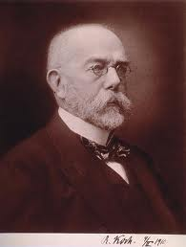
Robert Koch ; ( 1843 – 1910)
German physician and microbiologist. The founder of modern bacteriology, He is known for his role in identifying the specific causative agents of tuberculosis, cholera, and anthrax and for giving experimental support for the concept of infectious disease

Slide 13
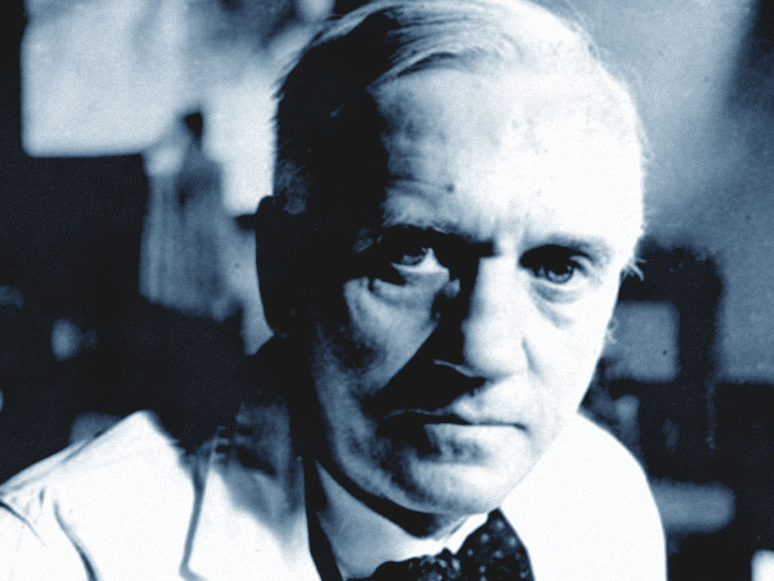
Alexander Fleming
Alexander Fleming ( 1881— 1955) Scottish bacteriologist well known for his discovery of penicillin in 1928 ,which started the use of antibiotics for treatment . He won noble prize in 1945

Slide 14
Commonly Used Indicator Organisms a)Coliform bacteria b)Faecal Coliforms c)Escherichia Coli

Slide 15
Coliforms-Advantages
10% of the bacteria in the human excreta consists of coliforms
On an average a human being discharges 100 to 400billion coliforms per day
Compared to other bacteria in the human excreta life period of coliform is maximum after coming out of the intestine
Analysis of coliform is simple

Slide 16
Limitations
a) In addition to the excreta of human beings it is present in the excreta all cold blooded animals
b) In certain favourable conditions it multiplies even outside the stomach

Slide 17
Methodology for analysis
Growing the bacteria in a favourable condition by providing food and other environment and counting its growth by a suitable method
Commonly used methods are
a) Standard plate count method
b) Membrane filtration technique
Multiple tube method
Presumptive and confirmed test

Slide 18
Test for Coliforms
Water Samples
↓
Macconkey broth
↓
Incubate 24hours at 37⁰C
No gas
Negative for coliforms
Gas

Slide 19
Gas
BGLB
48hrs at 37⁰C
BGLB
24hrs at 44.5⁰C
No Gas
Negative coliform
Gas Positive Confirmed coliform test
Gas
Positive for Faecal Coliforms
No gas
Negative for faecal coliforms

Slide 20
Gas
Positive for faecal coliforms
Peptone
24hrs at 44.5⁰C
Water
Indole Negative
E.Coli Absent
Indole Positive
E.Coli present

Slide 21
Standard plate count
Incubate the water directly in a petridish with the specified ingredients at a specified temperature

Slide 22
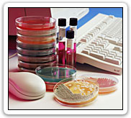

Slide 23
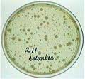

Slide 24
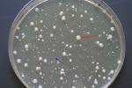

Slide 25
Membrane filter technique

Slide 26


Slide 27
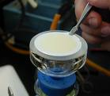

Slide 28
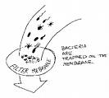

Slide 29
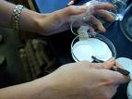

Slide 31
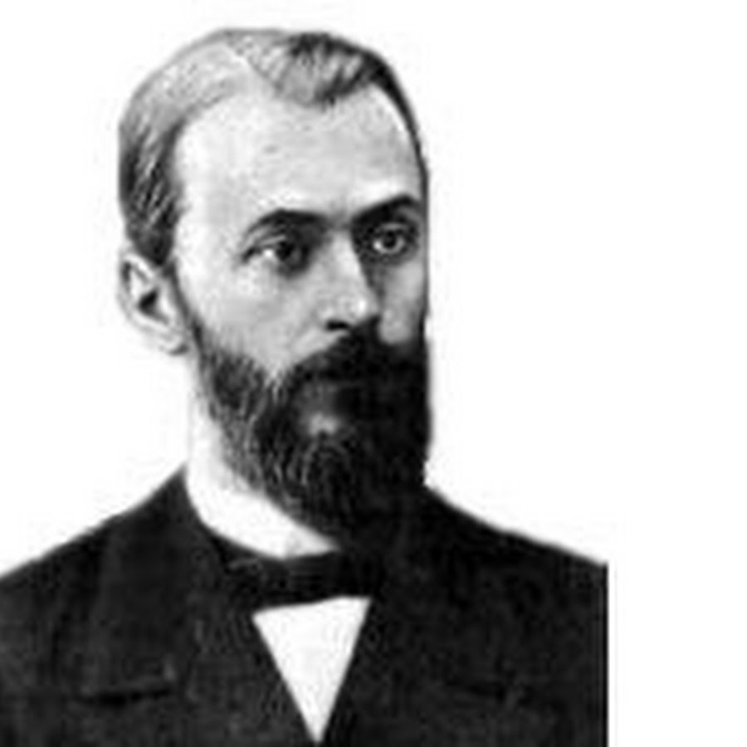
Dimitri IVanosky
Dimitri Ivanosky (1824-1920) Russian botanist, who discovered virus and considered as the founder of virology

Slide 32
Multiple tube method

Slide 33
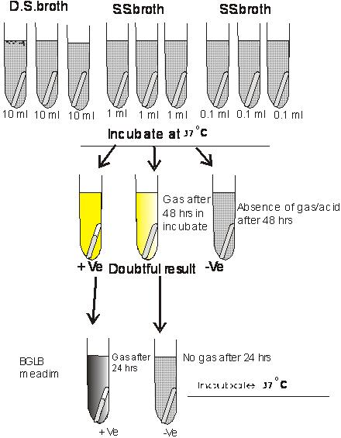
BGLB
medium
Incubate at
37⁰c

Slide 34
Thomas equation for estimation of MPN
MPN = No; of positive tubes *100
Ml in negative tubes * ML in all tubes

Slide 35
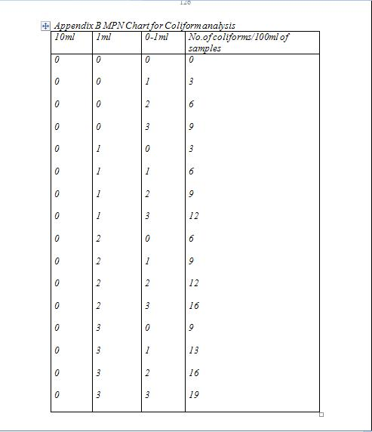

Slide 36
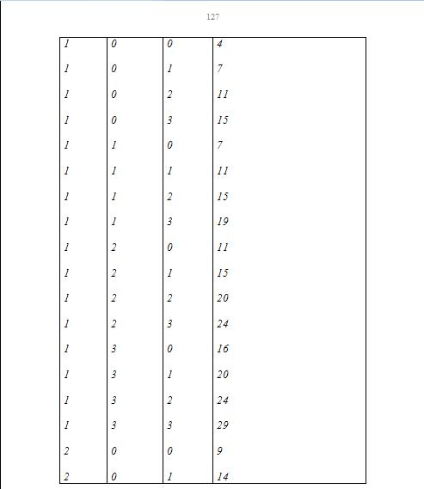

Slide 37
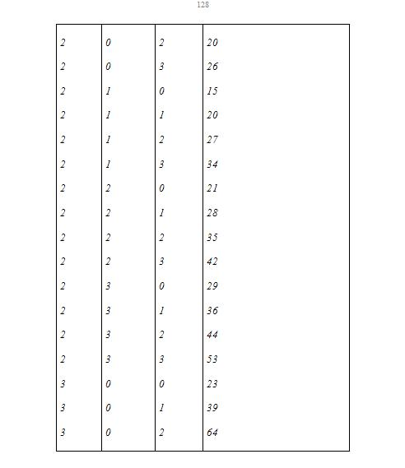

Slide 38
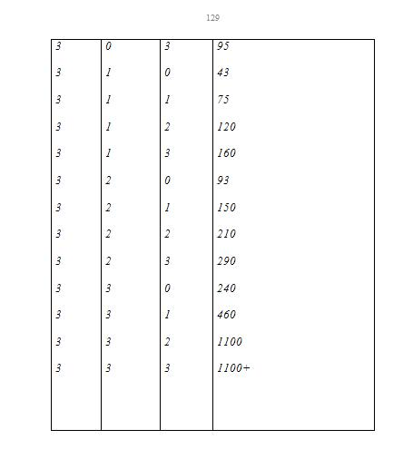

Slide 39
WHY DISINFECTION ?
To Remove
Harmful Pathogenic Bacteria
    Viruses
    Amoebic cysts
To Avoid
Transmission of water born diseases
To Prevent
Contamination of water in the distribution network

Slide 40
METHODS OF DISINFECTION
1. Physical.
2. Chemical.
3. By Radiation.
1. BY PHYSICAL MEANS
    Thermal treatment
    Ultrasonic waves
    Cont…

Slide 41
2. USING CHEMICALS
    Oxidising Chemicals
    Chlorine, Chloramine, Chlorine
    Dioxide, Bromine, Iodine, Potassium
    Permanganate, Ozone
    Metal ions
    Alkalies and Acids
    Cont…

Slide 42
3.BY RADIATION
    Ultra Violet radiation
    Gamma Rays
    X Rays
    Micro Waves

Slide 43
PHYSICAL METHOD
THERMAL TREATMENT
Most effective method for epidemic control
  But ,
        Not Economical
        Taste difference
        Impractical on large scale
    Advisable at consumer side

Slide 44
CHEMICAL METHOD
POINTS OF DISCUSSION
Criteria for a good Chemical disinfectant
Mechanism of disinfection
Factors affecting efficiency of disinfection
Different methods

Slide 45
CHEMICAL METHOD
CRITERIA FOR A GOOD DISINFECTANT
  Capable of destroying / inactivating / removing pathogenic organism within the contact time
  Should not unduly influence physical &chemical properties of water
  Should not leave toxic or impart colour

Slide 46
CHEMICAL METHOD
CRITERIA FOR A GOOD DISINFECTANT (Cont)
  Should possess the property of leaving residual concentration to deal possible contamination
  Detection possible by simple , rapid, analytical techniques
  Readily available
  Economical
  Safe and Easy for handling

Slide 47
No chemicals available meeting all these requirements

Slide 48
But ,
Chlorine, Chloramine, Chlorine Dioxide
Bromine, Iodine,
Pottasium Permanganate
Ozone
Several Metal ions
Selected Acids and Bases
Meet these requirements to varying levels
& Selection is based on other considerations that is availability ,cost, stability etc

Slide 49
CHEMICAL METHOD
EFFICIENCY FACTORS OF DISINFECTION (Cont)
Chemical and physical properties of water
Contact time
Temperature of water
pH of water

Slide 50
METHODS OF CHEMICAL DISINFECTION USING
CHLORINE,CHLORAMINE, CHLORINE DI-OXIDE
BROMINE & IODINE
OZONE
POTTASSIUM PERMANGANATE
METAL IONS
ACIDS AND BASES

Slide 51
CHEMICAL METHOD - CHLORINATION
PROPERTIES OF CHLORINE
Symbol- Cl
Atomic weight- 35.453
Melting point- -101⁰ c
Boiling point -34⁰ c
Colour-Pale greenish yellow
Odour-Pungent

Slide 52
PROPERTIES OF CHLORINE (Cont)
Chemical activity-displaces Br and I
Bleaching action readily bleaches vegitable colouring matters
Corosivity - extremely corrosive in solution Not so corrosive when dry conditions
Materials for handling
  copper, Iron, Steel for gas
  Glass, Hard Rubber,Lead , Silver for Solutions

Slide 53
REACTIONS OF CHLORINE (Cont)
Cl₂+H₂O HCl+HOCl
HOCl H⁺ + OCl

Slide 54
EFFICIENCY FACTORS
Nature ,concentration,distribution and condition of organisms
Nature and concentration of chlorine
Nature of water,pH
Temperature

Slide 55
EFFICIENCY FACTORS (Cont)
Contact time
Side reactions
Pre treatment
Ferrous and manganese ions
Hydrogen sulphide
Sulphite

Slide 56
EFFICIENCY FACTORS (Cont)
Nitrite
Suspended matter (sedimentation,Filtration)
Distance from point of addition to consumer

Slide 57
FORMS OF CHLORINE (Cont)
Bleaching Powder (CaO.2CaOCl₂.3H₂O)
  49% (theoretical) < 37% (usually 25% to
  30%) or less
Gas chlorine -liquid-solid

Slide 58
DOSE OF CHLORINE
Chlorine demand=amount of chlorine added-amount of chlorine remaining at the end of the test
Dose=chlorine demand+residual chlorine required

Slide 59
POINTS OF CHLORINATION
  At source
  At one or more points in the treatment plant
  At one or more points in the distribution system (more effective)

Slide 60
FORMS OF CHLORINATION
  Simple Chlorination
  Pre chlorination (before filtration)
  Post chlorination(after chlorination)
  Rechlorination (boosting)
  Cont..

Slide 61
CHLORINE RESIDUALS
If no Residual Chlorine
  Treatment inadequate
  Dose insufficient
  Large contamination of treated water
Method of Test
  Orthotolidine test

Slide 62
RESIDUAL CHLORINE IS MEASURED IN THREE CRITICAL POINTS (Cont)
- Before the first customer to ensure potability
- At the chlorinator to ensure the equipment is functioning
- At the end of the distribution system to ensure water is treated.

Slide 63
ADVANTAGES OF CHLORINE
Ease of application
Ease of measurement
Ease of control
Reasonable persistence in treated water - to prevent the regrowth of micro organisms
Low cost
200 years experience with chlorine
Cont..

Slide 64
ADVANTAGES OF CHLORINE (Cont)
Reduces Taste and Odour by oxidising foul smelling algae secretions and odour from decaying vegetation
Controls nuisance organisms which can grow in reservoirs, walls of transmission mains etc
Destroys Hydrogen sulphide and removes Ammonia and other nitrogenous compounds that have unpleasant taste and hinders disinfection.

Slide 65
DISADVANTAGES OF CHLORINE
Production of odours and harmful compounds
Risk factor-high
Tri halo methane not greater than 30 micrograms / litre

Slide 66
DISADVANTAGES OF CHLORINE (Cont)
By product - Trihalomethane Carcinogen - includes Chloroform.
Chlorine reacts with organic matter present in water
- Temperature
- pH
- quantity of organic matter
Risk of death due to pathogen in 100 to 1000 times then the risk of Cancer due to by product.
So remedy
Enhance the coagulation and reduce organic matter

