Slide 1
Artificial Intelligence and its Use in the Clinic
An analysis of adherence to best practices by AI models in the last 10 years
John Snell

Slide 2


Slide 3

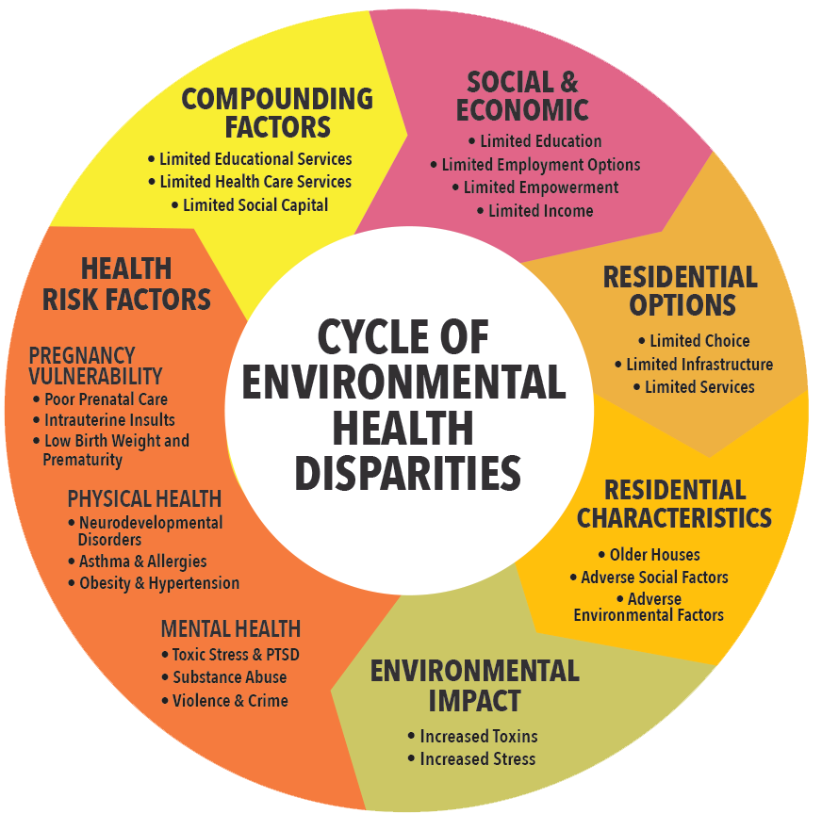



Improved Outcomes
Health Disparities
Improved Value
ARTIFICIAL INTELLIGENCE
Broad Utility
Improved Transparency

Slide 4
But…
Is this true?

Slide 5
Core Principles
AI tools should aim to alleviate existing health disparities
Outcomes of AI tools should be clinically meaningful
AI tools should aim to reduce overdiagnosis and overtreatment
AI tools should aspire to have high healthcare value and avoid diverting resources from higher priority areas
AI tools should consider the biographical drivers of health
AI tools should be designed to be easily tailored to the local population
AI tools should promote a learning healthcare system
AI tools should facilitate shared decision-making
Badal, K. et al. (2023) Guiding principles for the responsible development of artificial intelligence tools for healthcare.

Slide 6
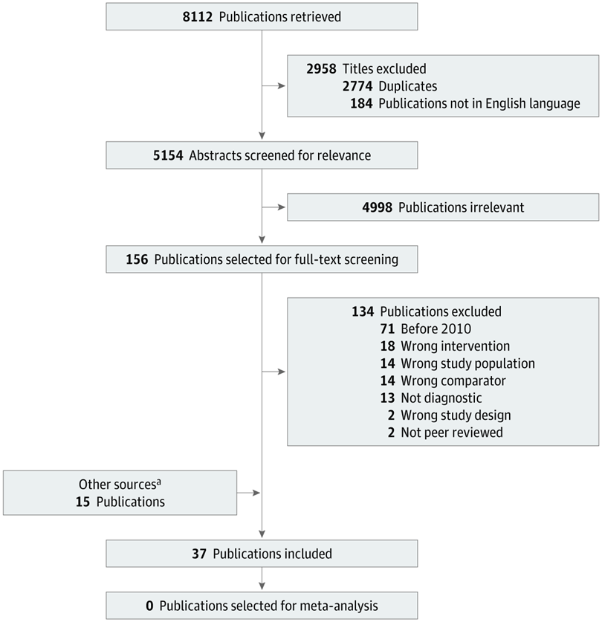
Data Collection
42 Papers were analyzed from the years 2010 through 2022
Initial data collection based on Vasey et al. 2021 (37 papers)
Their metric of interest was association between clinician diagnostic performance and use of machine-learning based clinical diagnostic systems
They found no robust evidence of using algorithms to support rather than replace clinicians
5 additional papers of interest were added to diversify results
Vasey et al. 2021 Figure 1
Vasey, B. et al. (2021). Association of Clinician Diagnostic Performance With Machine Learning-Based Decision Support Systems: A Systematic Review.

Slide 7
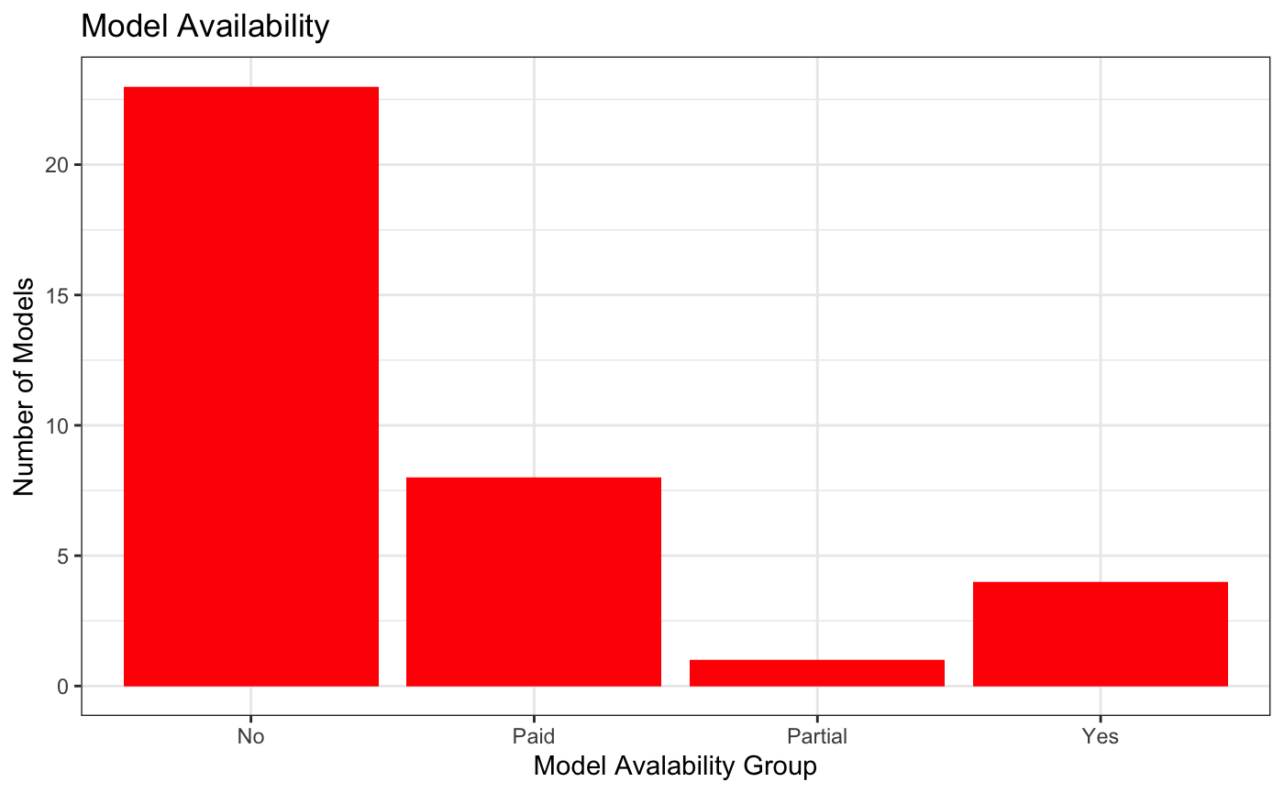
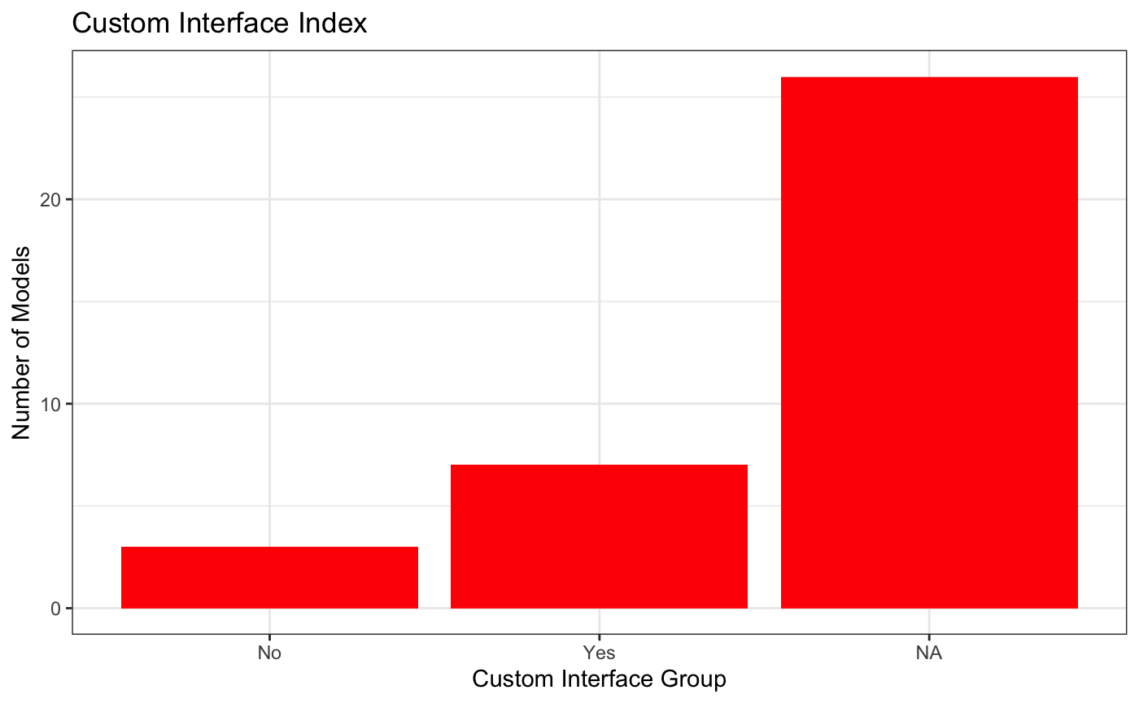
Principle 1: AI tools should aim to alleviate existing health disparities
Can disadvantaged groups equally access and benefit from the AI model?
Can less specialized physicians use the model in smaller settings?

Slide 8
Principle 1: AI tools should aim to alleviate existing health disparities
Custom Interface
 | No | Yes | NA
No | 0 | 3 | 20
Paid | 0 | 3 | 5
Partial | 0 | 0 | 1
Yes | 3 | 1 | 0
Public Availability
Notes:
19.4% of models were yellow or green

Slide 9
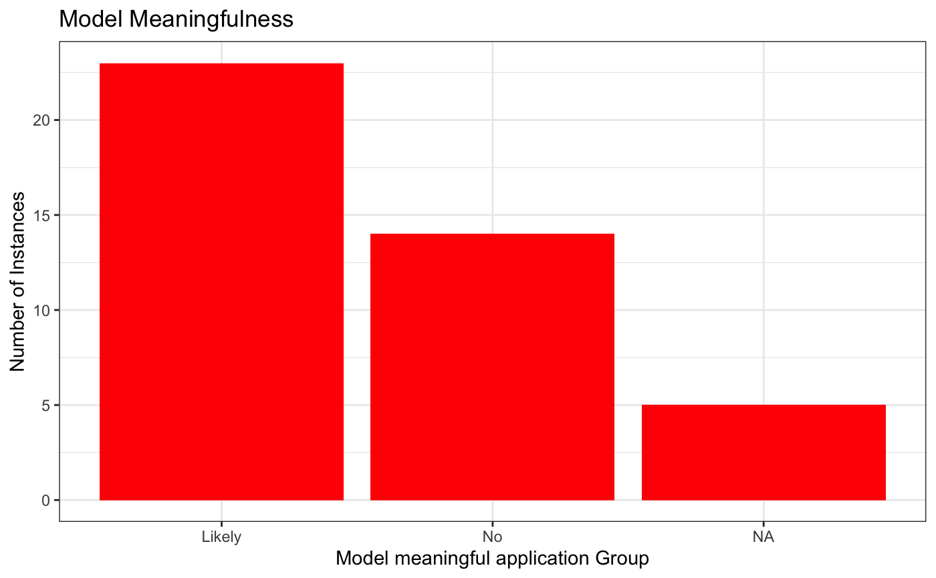
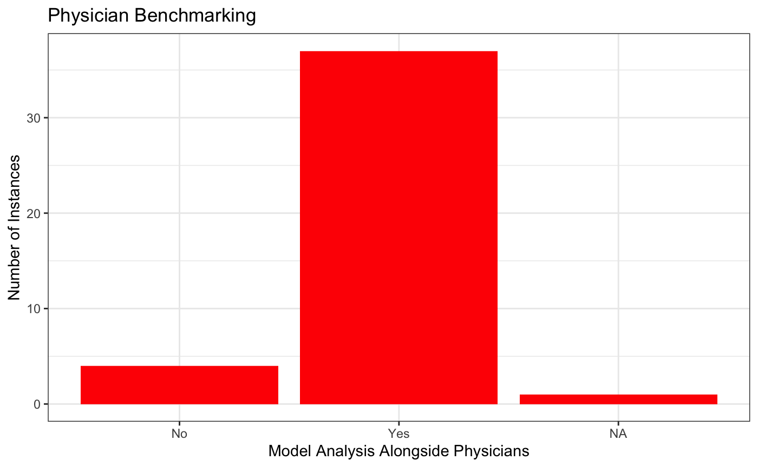
Principle 2: Outcomes of AI tools should be clinically meaningful
Does model perform in a meaningful manner in any capacity clinically? Has it been tested against clinicians?

Slide 10
Principle 2: Outcomes of AI tools should be clinically meaningful
Benchmarked Against Physicians
 | No | Yes | NA
Likely | 1 | 22 | 0
No | 0 | 14 | 0
NA | 3 | 1 | 1
Model Is Likely to be Meaningful
Notes:
Data includes alternate utilizations of models. 42.9% of instances are in green

Slide 11
Principle 3: AI tools should aim to reduce overdiagnosis and overtreatment
Does the model limit incorrect diagnoses in patients, limiting improper treatment?
This metric is adjacent to this goal. Tested models were measured for efficacy, not generally clinically applied.
Notes:
0% of models shown to reduce overdiagnosis, 54.8% of instances show potential to improve overdiagnosis

Slide 12
Principle 4: AI tools should aspire to have high healthcare value and avoid diverting resources from higher priority areas
Does the model have a high value per dollar ratio?
This metric is not able to well characterized through the method of analysis performed here.
Notes:
Currently 0% of models are shown to have high healthcare value

Slide 13
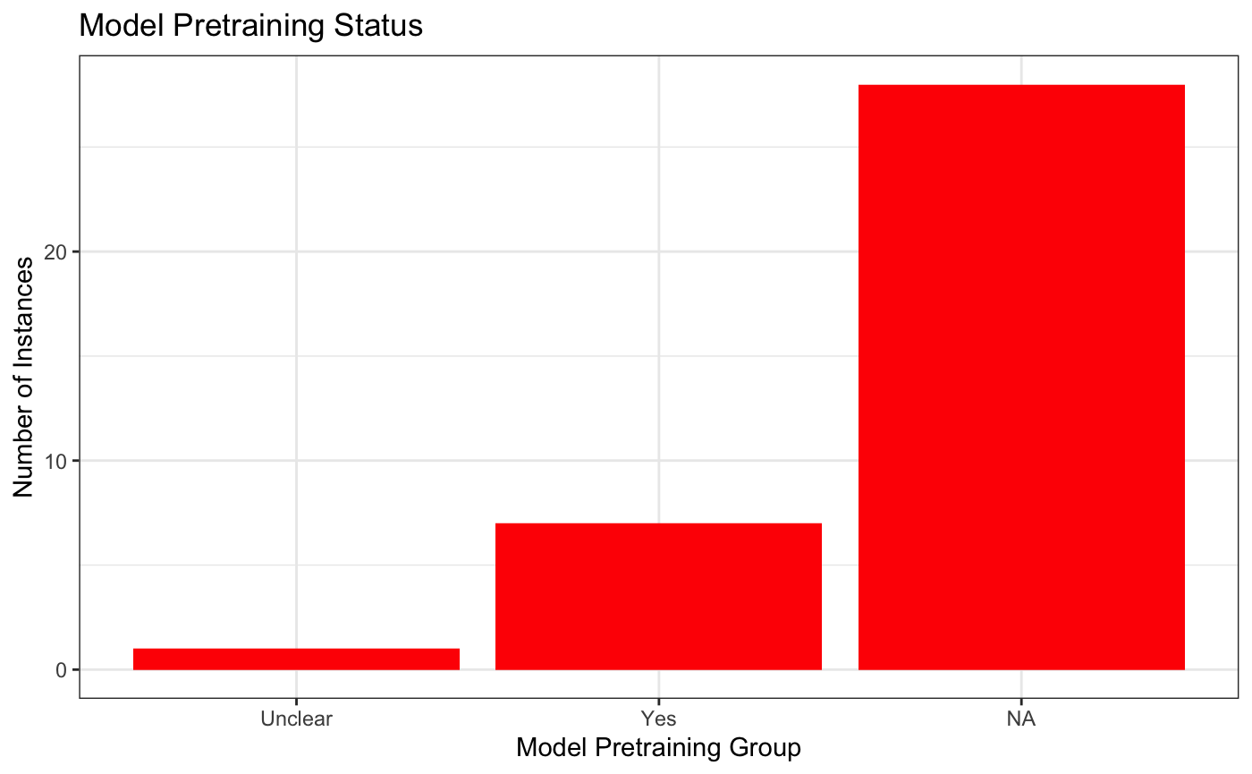
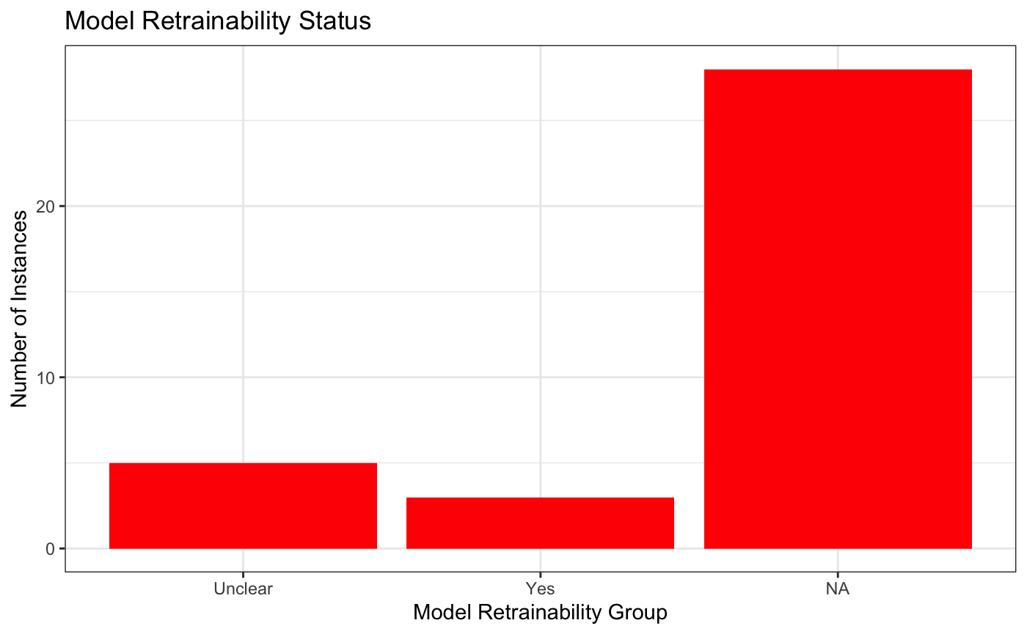
Principle 5: AI tools should consider the biographical drivers of health
Are models either pretrained or retrainable to include social/genetic determinants of health?

Slide 14
Principle 5: AI tools should consider the biographical drivers of health
Are models either pretrained or retrainable to include social/genetic determinants of health?
Model Retrainability
 | Unclear | Yes | NA
Unclear | 1 | 0 | 0
Yes | 4 | 3 | 0
NA | 0 | 0 | 28
Model Pretraining Status
Notes:
8.3% of models in green area

Slide 15
Principle 5: AI tools should consider the biographical drivers of health
Are models either pretrained or retrainable to include social/genetic determinants of health?
Model Retrainability
 | Unclear | Yes | NA
No | 0 | 0 | 23
Paid | 4 | 0 | 4
Partial | 0 | 0 | 1
Yes | 1 | 3 | 0
Model Availability
Notes:
21.9% of models in green and yellow area

Slide 16
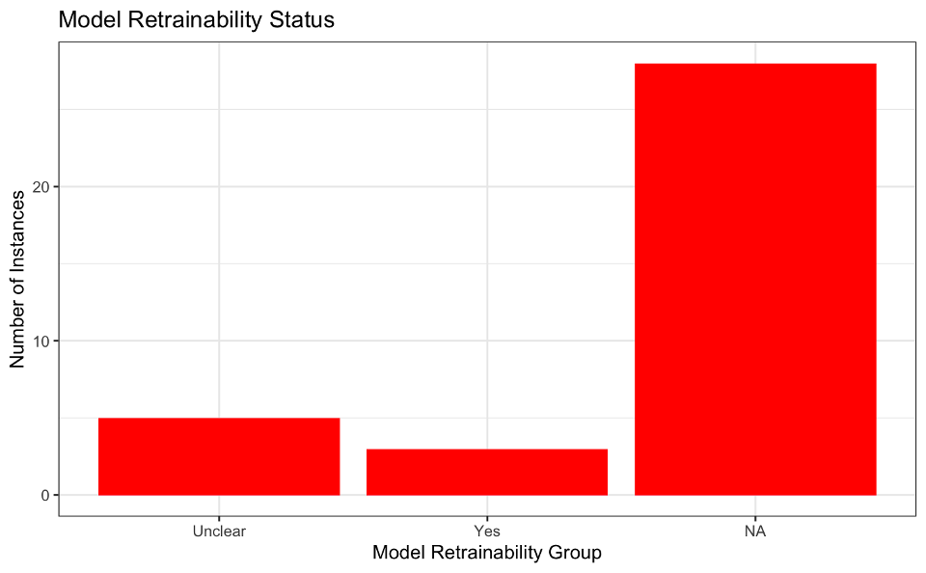
Principle 6: AI tools should be designed to be easily tailored to the local population
Can the model be tailored to a physician’s local populations?
Notes:
8.3% of models were retrainable
13.9% of models were unclear on retrainability

Slide 17
Principle 7: AI tools should promote a learning healthcare system
Is the model set up in such a way that it can be regularly updated as new data comes in so as to improve learning by both the model and physicians?
This metric is not able to well characterized through the method of analysis performed here.
Notes:
No good metrics were measured to observe this outcome, but 8.3% of models can be openly retrained as needed, and are plainly capable of this.

Slide 18
Principle 8: AI tools should facilitate shared decision-making
Is the model set up in such a way that it facilitates shared decision making between physicians and patients?
This metric is not able to well characterized through the method of analysis performed here.

Slide 19
Overall Adherence to Best Practices
Principle | Adherence
Principle 1 | 19.4%
Principle 2 | 42.9%
Principle 3 | Up to 54.8%
Principle 4 | Not Characterized
Principle 5 | 8.3%
Principle 6 | Up to 22.2%
Principle 7 | Not Characterized *** (Up to 8.3%)
Principle 8 | Not Characterized

Slide 20
Overall Adherence to Best Practices
Principle | Adherence
Principle 1 | 19.4%
Principle 2 | 42.9%
Principle 3 | Up to 54.8%
Principle 4 | Not Characterized
Principle 5 | 8.3%
Principle 6 | Up to 22.2%
Principle 7 | Not Characterized *** (Up to 8.3%)
Principle 8 | Not Characterized

Slide 21
Steps For Improvement
Focus on How to Alleviate Health Disparities
Be presented alongside proposed value
Reduce ‘Black Box’ nature of current models
Improve ability to retrain/augment existing models
Make non-paid models from research publicly available!!!

Slide 22
Conclusions

Slide 23
Questions?

