Slide 1
GI Stromal Tumors of the Stomach

Slide 2
GI Stromal Tumors
Arise from the wall of the stomach
Grow slowly over time
Lymph nodes rarely involved
Not conventional stomach cancer

Slide 3
GIST vs Adenocarcinoma
GIST
Starts from wall of stomach
Slow growing
Rarely spreads to lymph nodes
Adenocarcinoma
Conventional “stomach cancer”
Starts from lining of stomach
Can spread to lymph nodes
More aggressive

Slide 4
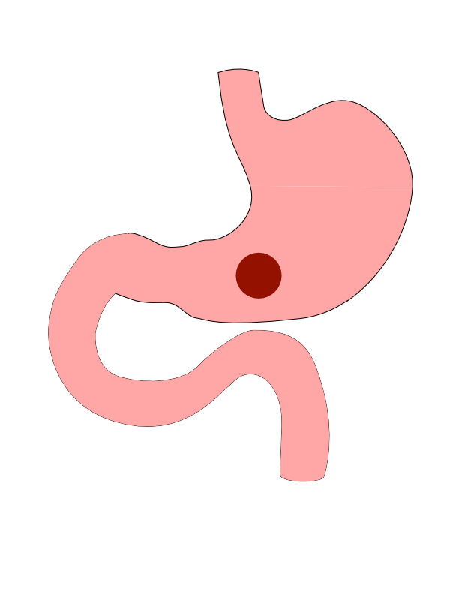
Patial Gastrectomy
GI Stromal Tumor can come in a variety of sizes

Slide 5
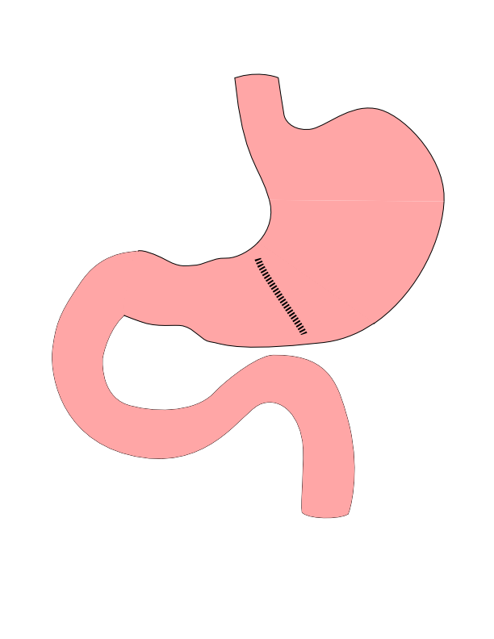
Partial Gastrectomy
- Tumor removed from wall - Stomach wall closed - Lymph nodes not removed

Slide 6
Partial Gastrectomy

Slide 7
Risks of Partial Gastrectomy
- Leakage from closure of wall - Bleeding requiring return to surgery - Delayed stomach emptying

Slide 8
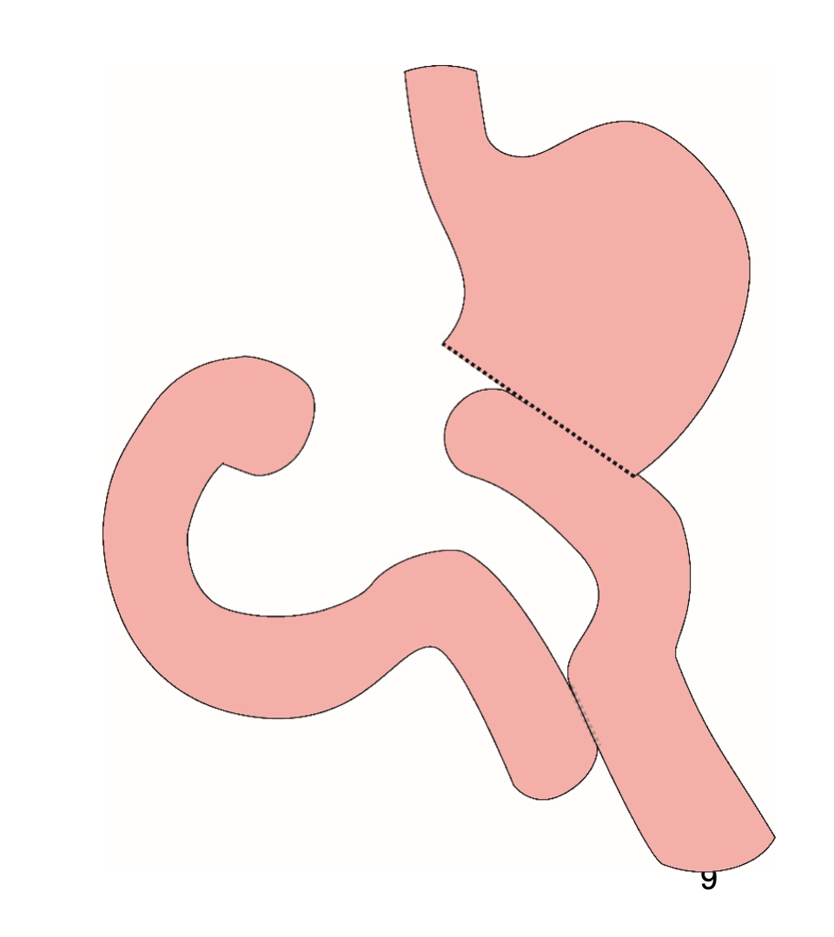
Distal Gastrectomy
Removes bottom half of the stomach
Rarely required for GI Stromal Tumors

Slide 9
Distal Gastrectomy

Slide 10
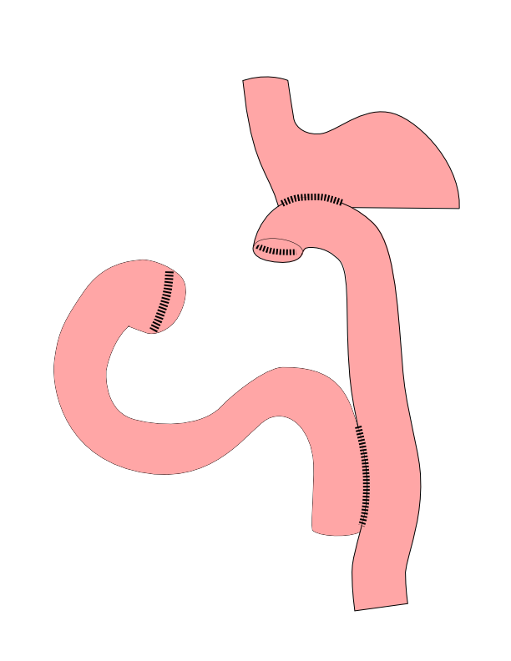
Subtotal Gastrectomy
- Removes bottom 2/3 of stomach - Rarely required for GI Stromal Tumors

Slide 11
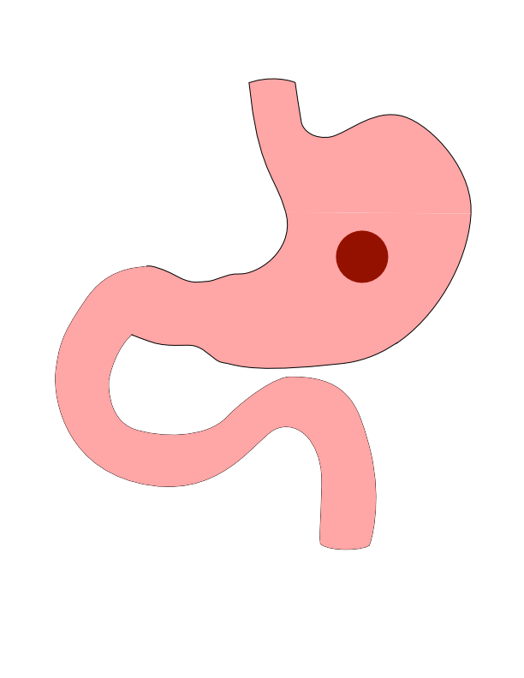
Subtotal Gastrectomy

Slide 12
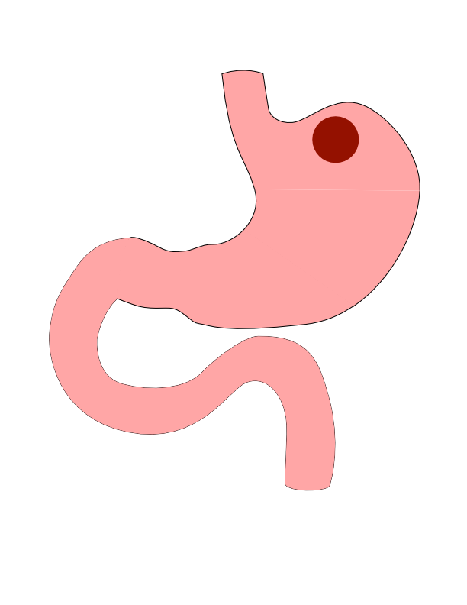
Proximal Tumors
- Located near the top of the stomach - Challenging area for surgery

Slide 13
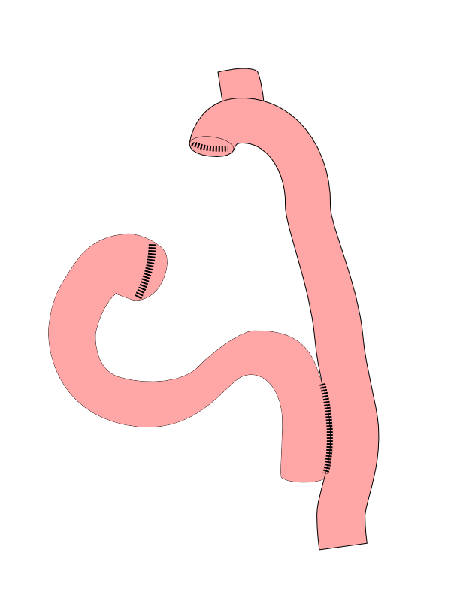
Total Gastrectomy
- Removes all of the stomach - Very rarely required for GI Stromal Tumors

Slide 14
Total Gastrectomy

Slide 15
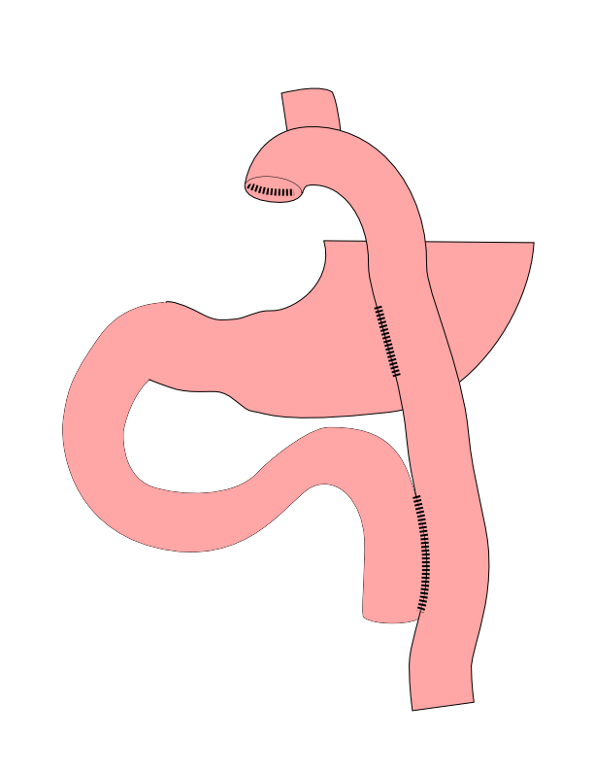
Dual Tract Gastrectomy
Alternative surgical approach for small tumors near the top of the stomach
Preserves the bottom of the stomach as a reservoir

Slide 16
Dual Tract Gastrectomy

Slide 17
Risks of Surgery
Leak where bowel is joined together (anastomosis)
Bleeding requiring reoperation
Delayed stomach function
Infection in the abdomen

Slide 18
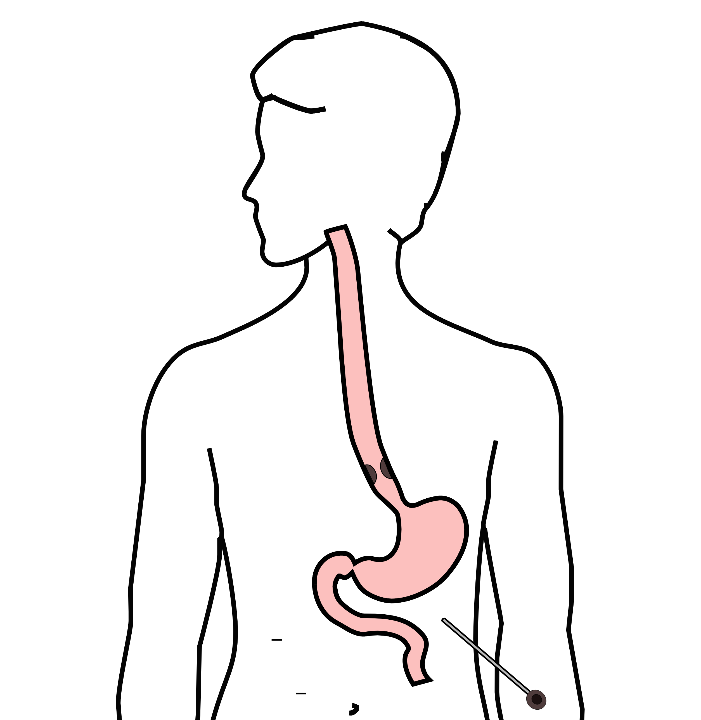
Laparoscopy
Some stomach cancers can spread inside the abdomen
Areas of spread can be very small (grain of rice)
Laparoscopy can detect spread inside the abdomen

Slide 19
Laparoscopy
A laparoscopy is performed under a general anesthetic.
Several incisions 1/4” long
A telescope is inserted to look inside the abdominal cavity.
Biopsies can be performed.

Slide 20
Other Presentations
Nutrition Slideshow
Gastrectomy Slideshow

