Slide 1
Central Venous Port

Slide 2
Chemotherapy Administration
Most chemotherapy for esophageal cancer is administered into a vein.
Several options exist to administer chemotherapy through veins:
Intravenous catheter in peripheral veins
Peripheral Intravenous Central Catheter (PICC)
Central Venous port

Slide 3
Peripheral IV catheter
A peripheral IV catheter involves placing a small tube into the veins, which is then used to give fluids or chemotherapy
A new catheter is placed for each dose of chemotherapy

Slide 4
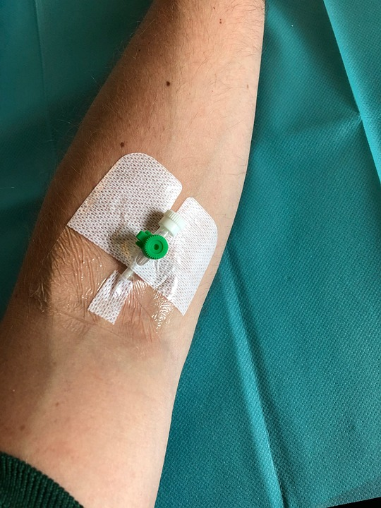
Intravenous Catheter in Peripheral Vein (“IV”)
IV catheter placed into a vein in the hand or arm
Allows administration of chemotherapy and fluids
Placed at the beginning of each dose
Removed that day at the end of treatment
Some chemotherapy (such as FLOT) can’t be given through peripheral IV

Slide 5
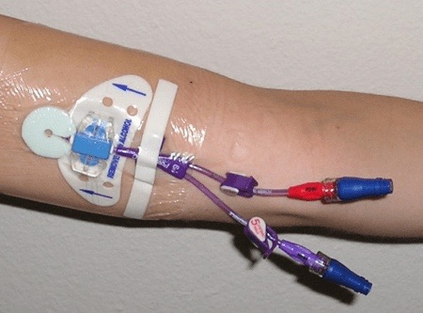
PICC Lines
Placed in Radiology
Stay in place during all of treatment
Can stay in place for weeks
Special care is needed at home to keep it clean and dry
Suitable for FLOT chemotherapy
Special care is needed at home to keep the catheter and it’s dressing clean and dry

Slide 6
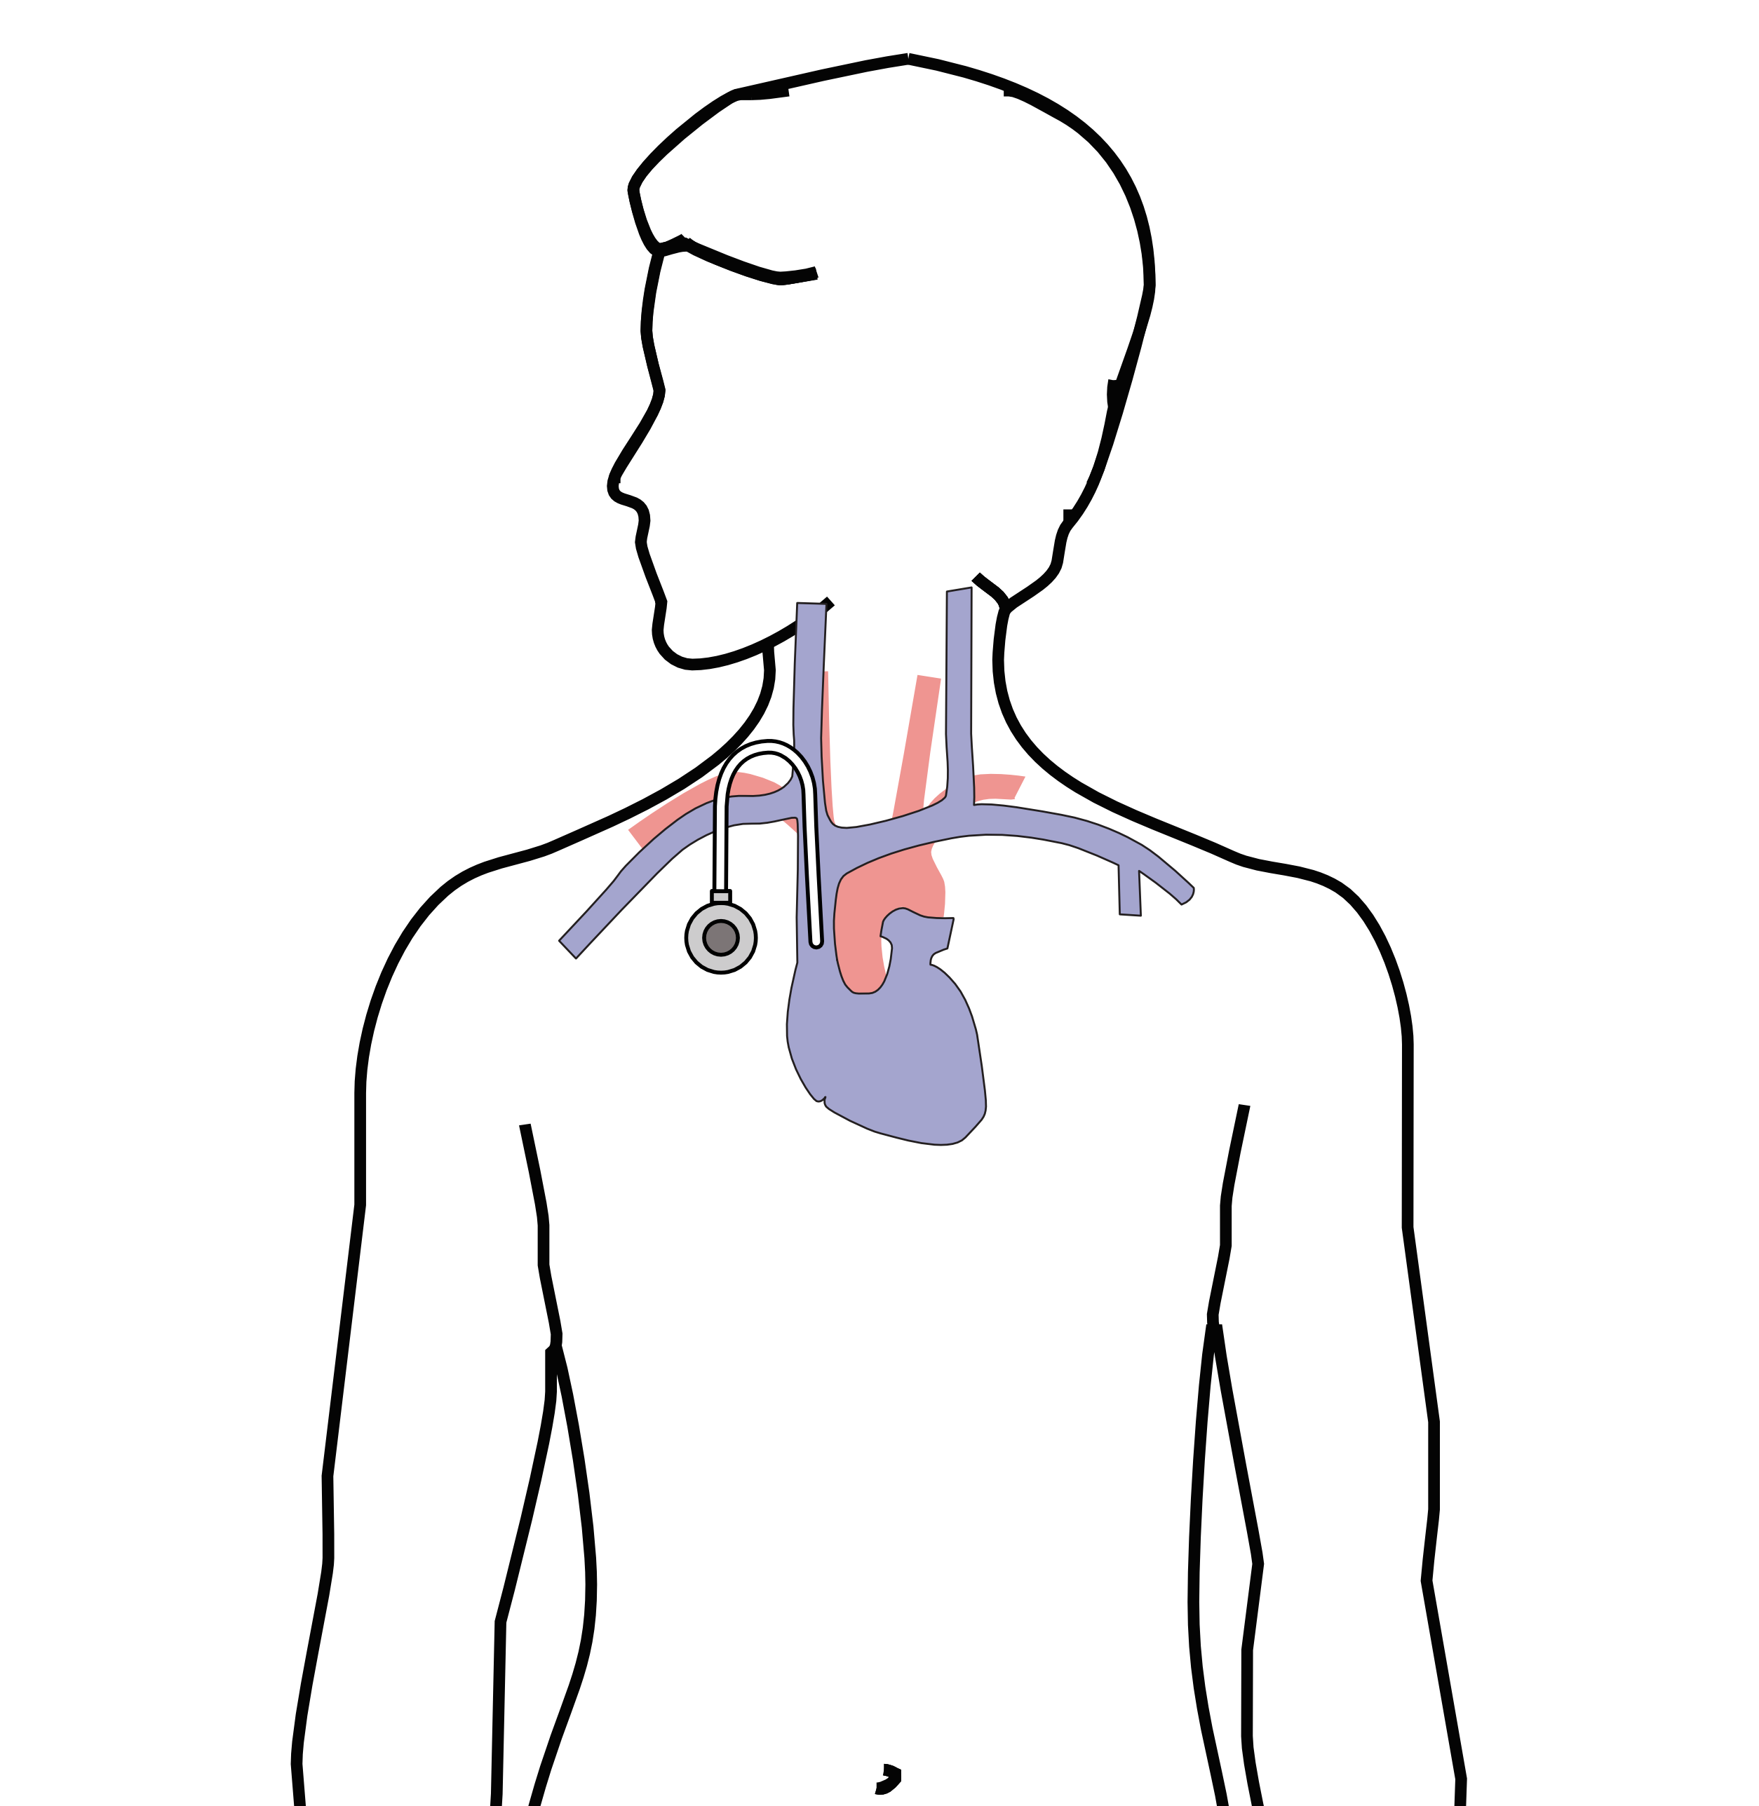
Central Venous Port
Implantable device that makes the administration of chemotherapy easier
No special care at home
Allows showering, bathing, swimming
Suitable for FLOT chemotherapy
Allows for blood draws

Slide 7
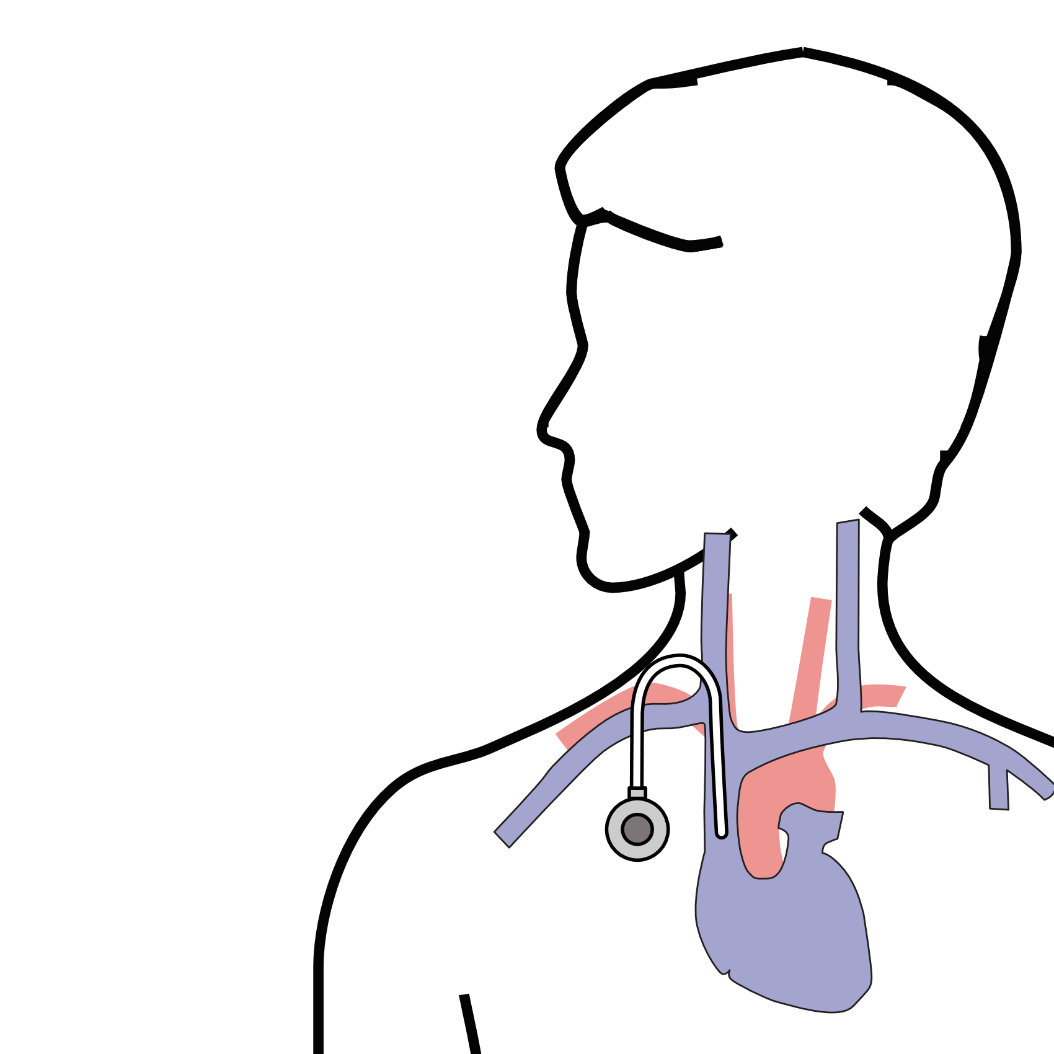
Central Venous Port
Placed underneath the skin below the right collarbone
Incision in the neck (1/4”)
Incision below the collarbone
Sutures dissolve on their own
“Superglue” on incisions

Slide 8
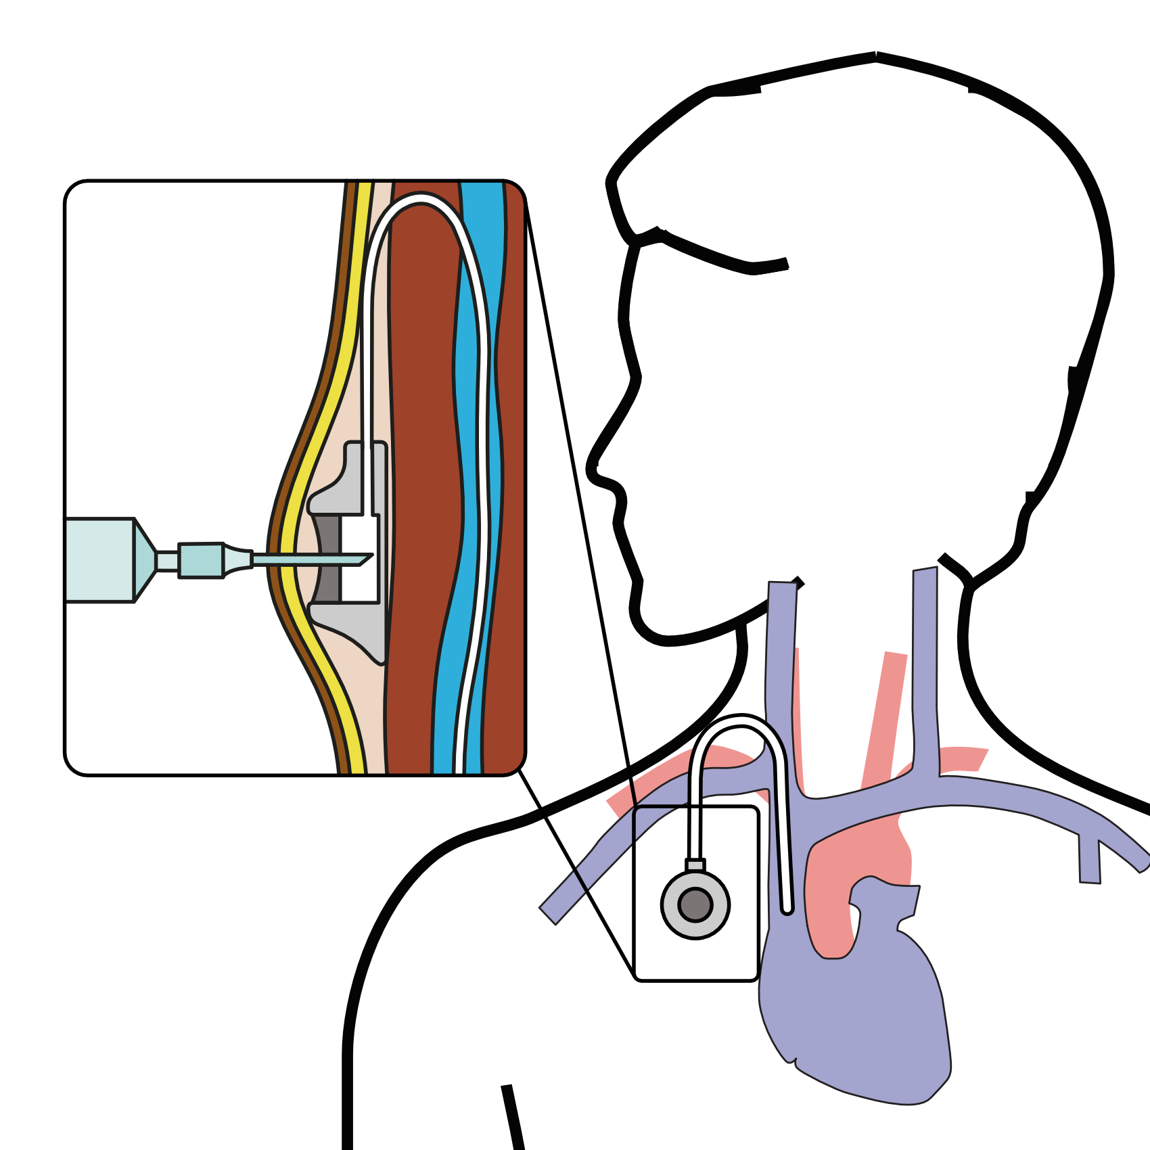
Central Venous Port
When it is time for chemotherapy, a needle is inserted through the skin into the port

