Slide 1
Stage IV Cancer of the Esophagus and GE Junction

Slide 2
Anatomy

Slide 3
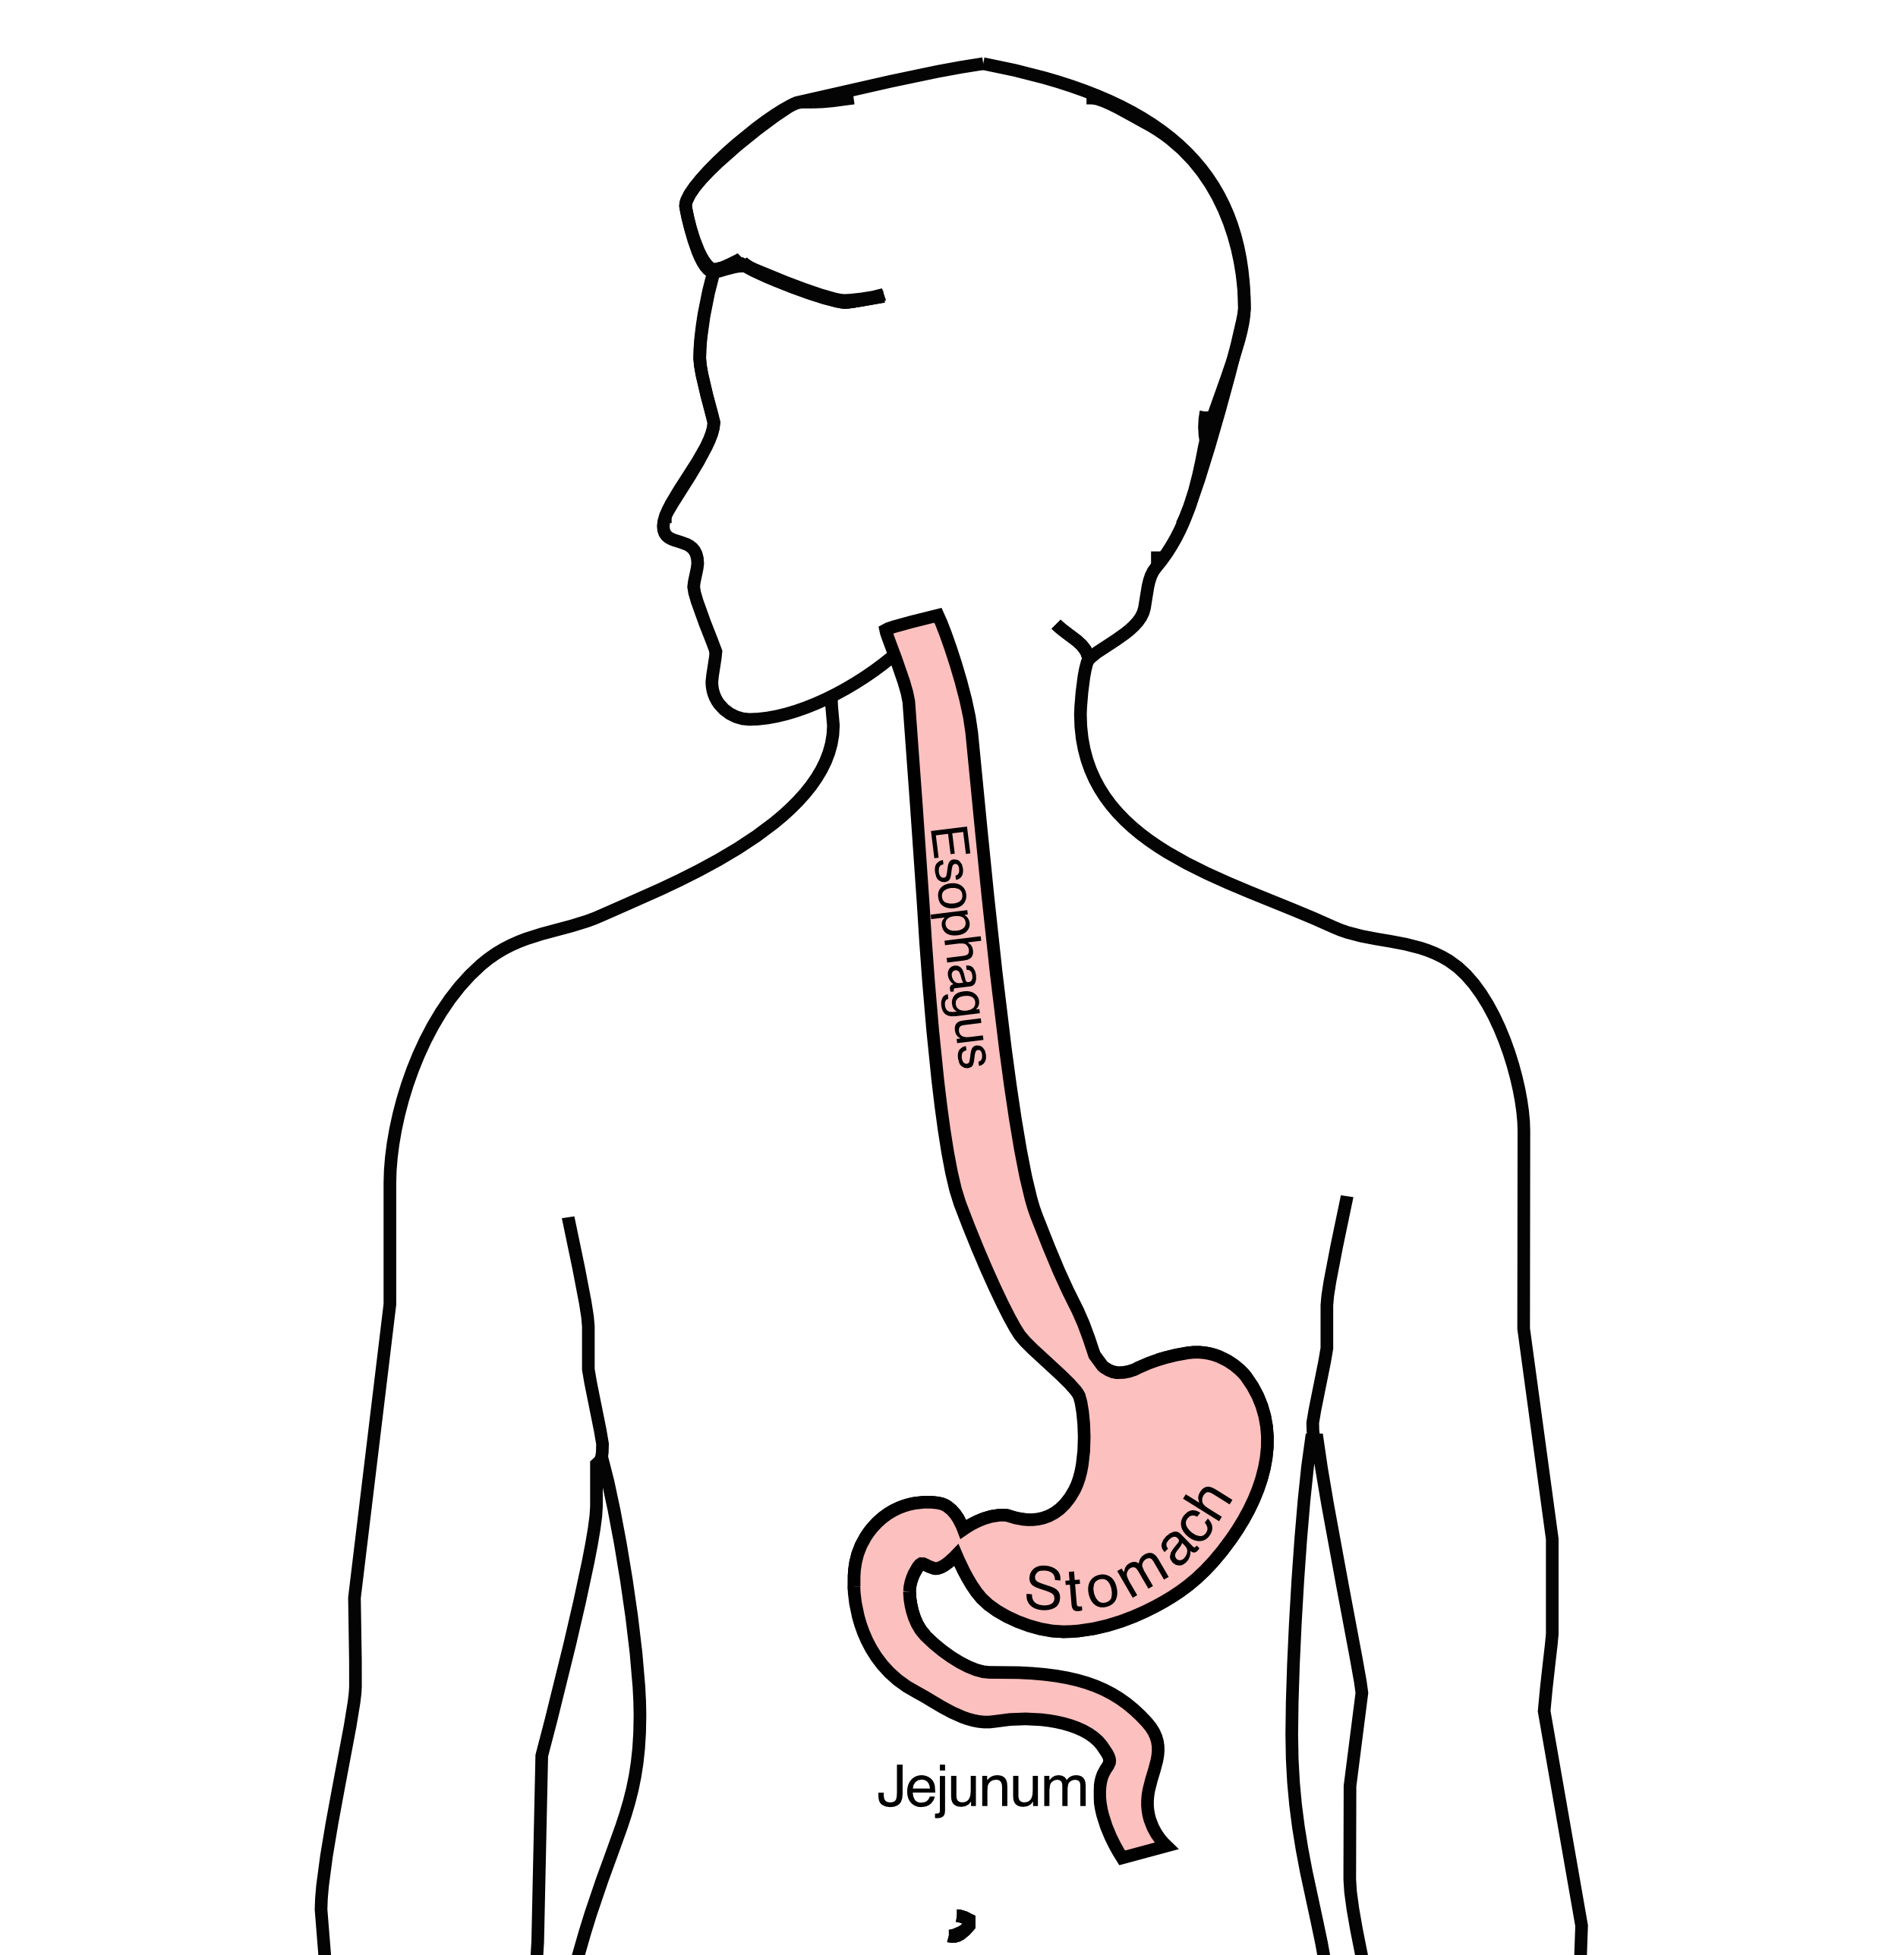
Food moves from the throat
$→$ esophagus
$→$ stomach
$→$ small bowel (jejunum)

Slide 4
Esophageal Cancer Staging
T = Tumor - Depth of growth into the wall of the esophagus
N = Nodes - Spread to the lymph nodes
M = Metastasis - Spread to liver, lungs, or bone
Metastatic Cancers

Slide 5
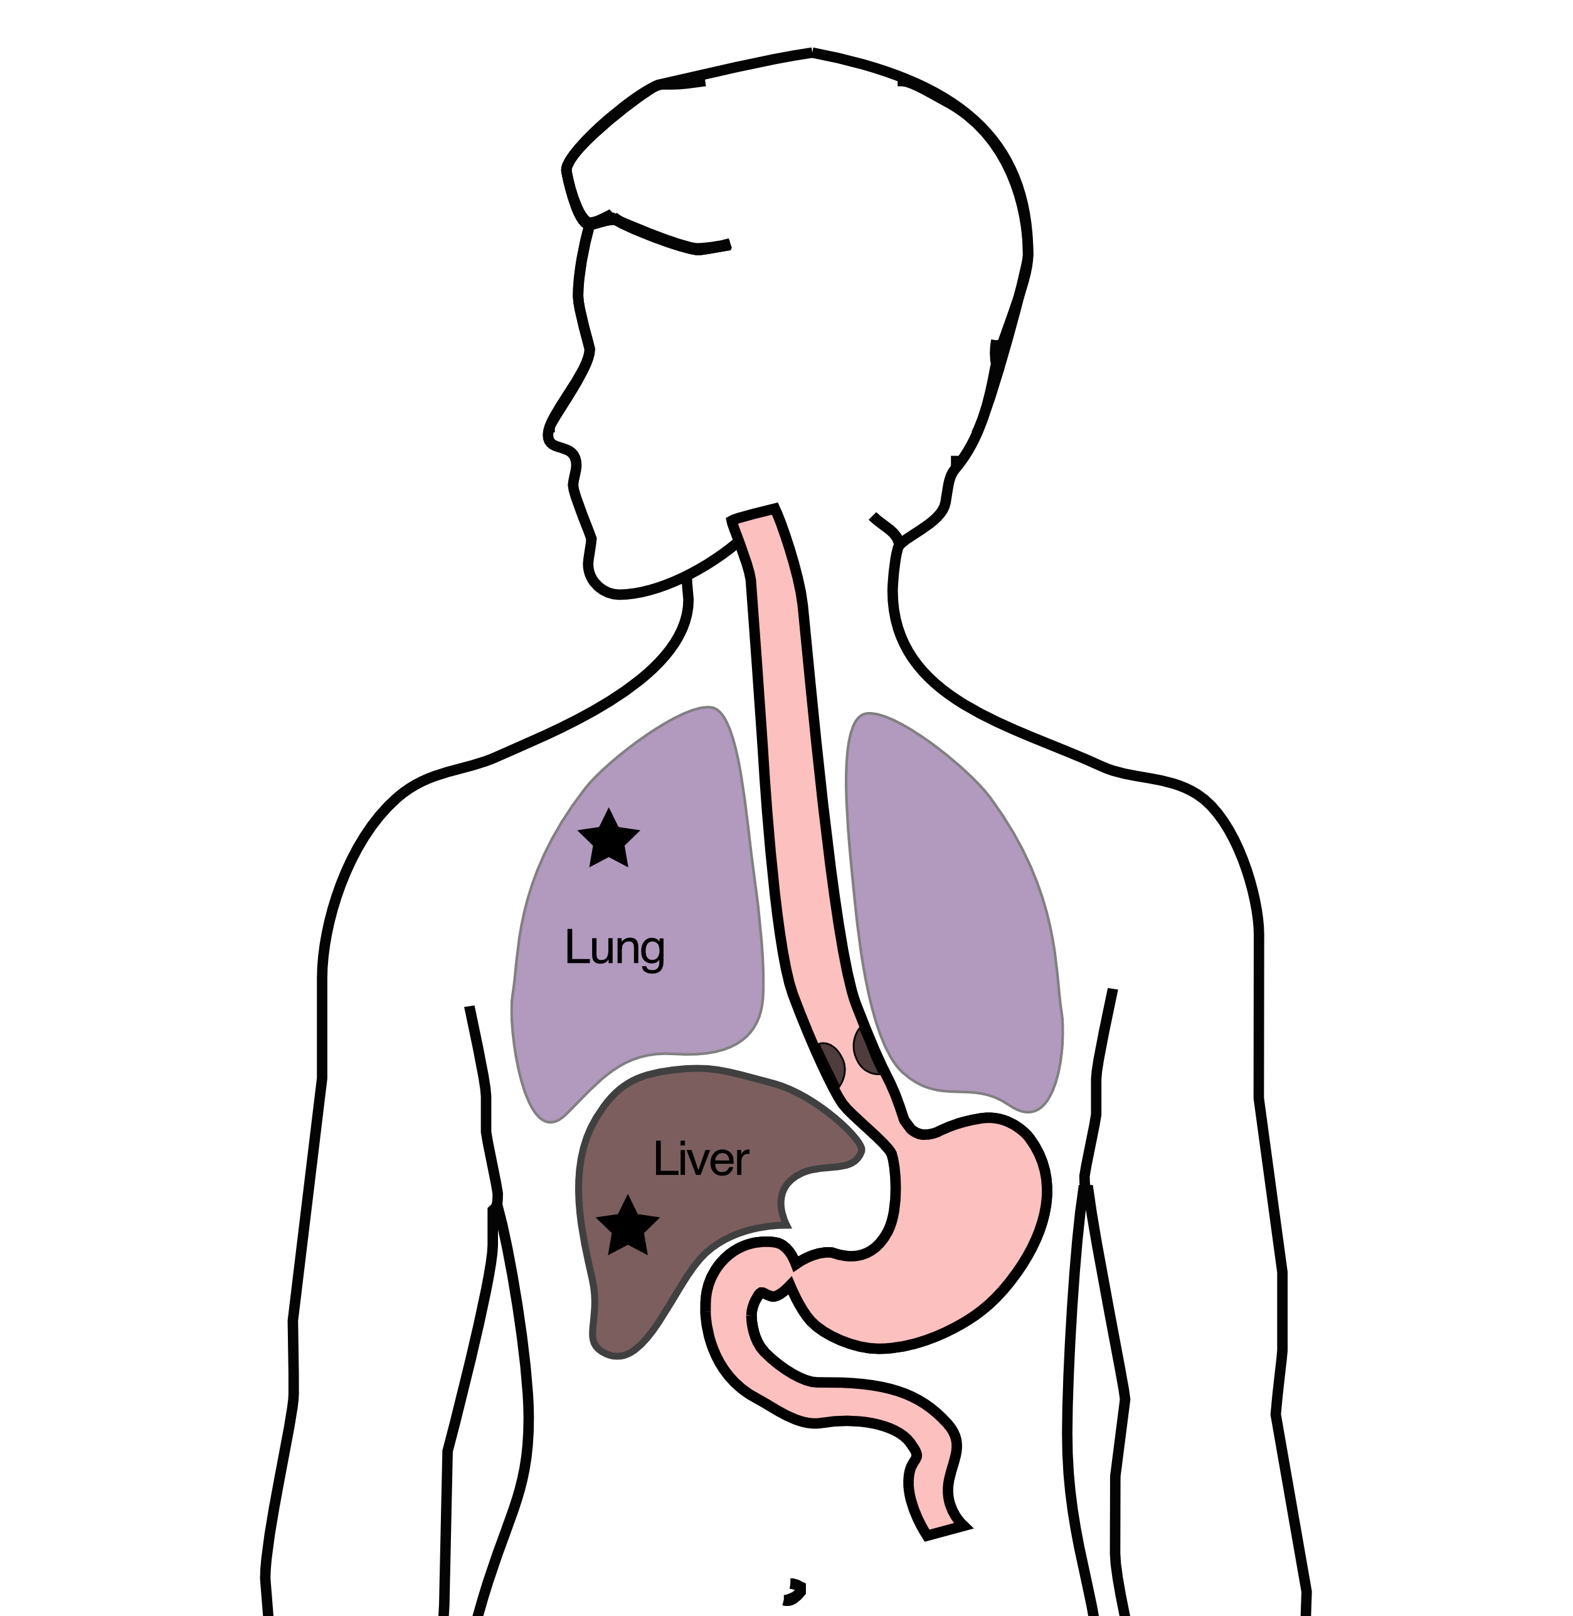
Metastatic cancers spread from the esophagus to other parts of the body
M0 cancers have not spread to other parts of the body
M1 cancers have spread lungs, liver, or bone
M1 cancers is also known as Stage 4

Slide 6
Treatment Plan
Superficial (T1) $Rightarrow$ Endoscopic Therapy
Localized (T1b/T2) $Rightarrow$ Surgery
Locally-advanced (T3/N1) $⇒$ Chemo $±$ Radiation $→$Surgery
Metastatic (M1) $⇒$ Systemic Therapy $±$ Radiation
Systemic Therapy
Systemic therapy is administered intravenously (or by mouth) and circulates to kill cancer cells anywhere in the body.
Chemotherapy (FOLFOX)
Immunotherapy (nivolumab, pembrolizumab)
Hormone therapy (herceptin)
Goals of Therapy
Symptom control
Prolong life
Minimize symptoms due to treatment
Systemic Therapy
By shrinking tumor and decreasing cancer burden
Can improve symptoms
Can prolong life
Goals:
Maximize cancer shrinkage
Minimize side-effects due to therapy
Radiation Therapy
Radiation uses high-energy x-rays to kill cancer cells
Bone metastasis: Can relieve pain
Esophagus: Can shrink tumor and improve eating

Slide 7
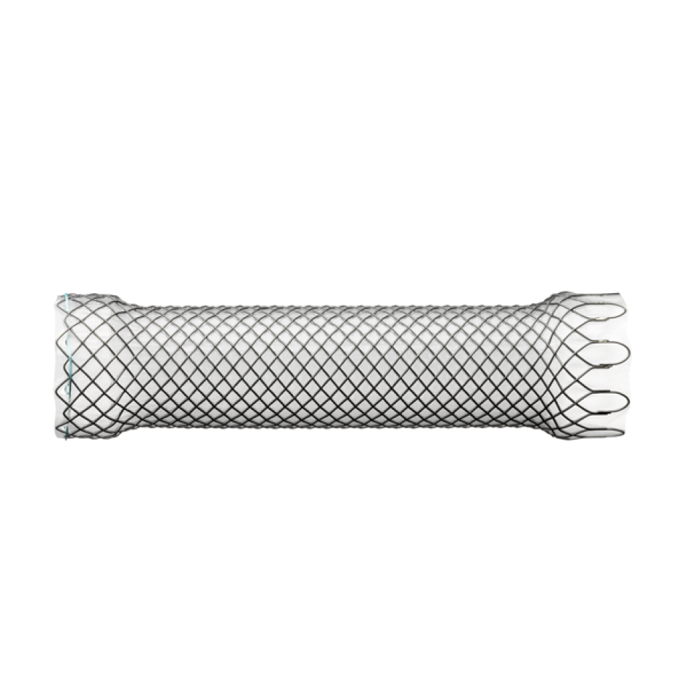
Endoluminal Stent
An endoluminal stent can be placed inside an esophageal cancer to improve eating

Slide 8
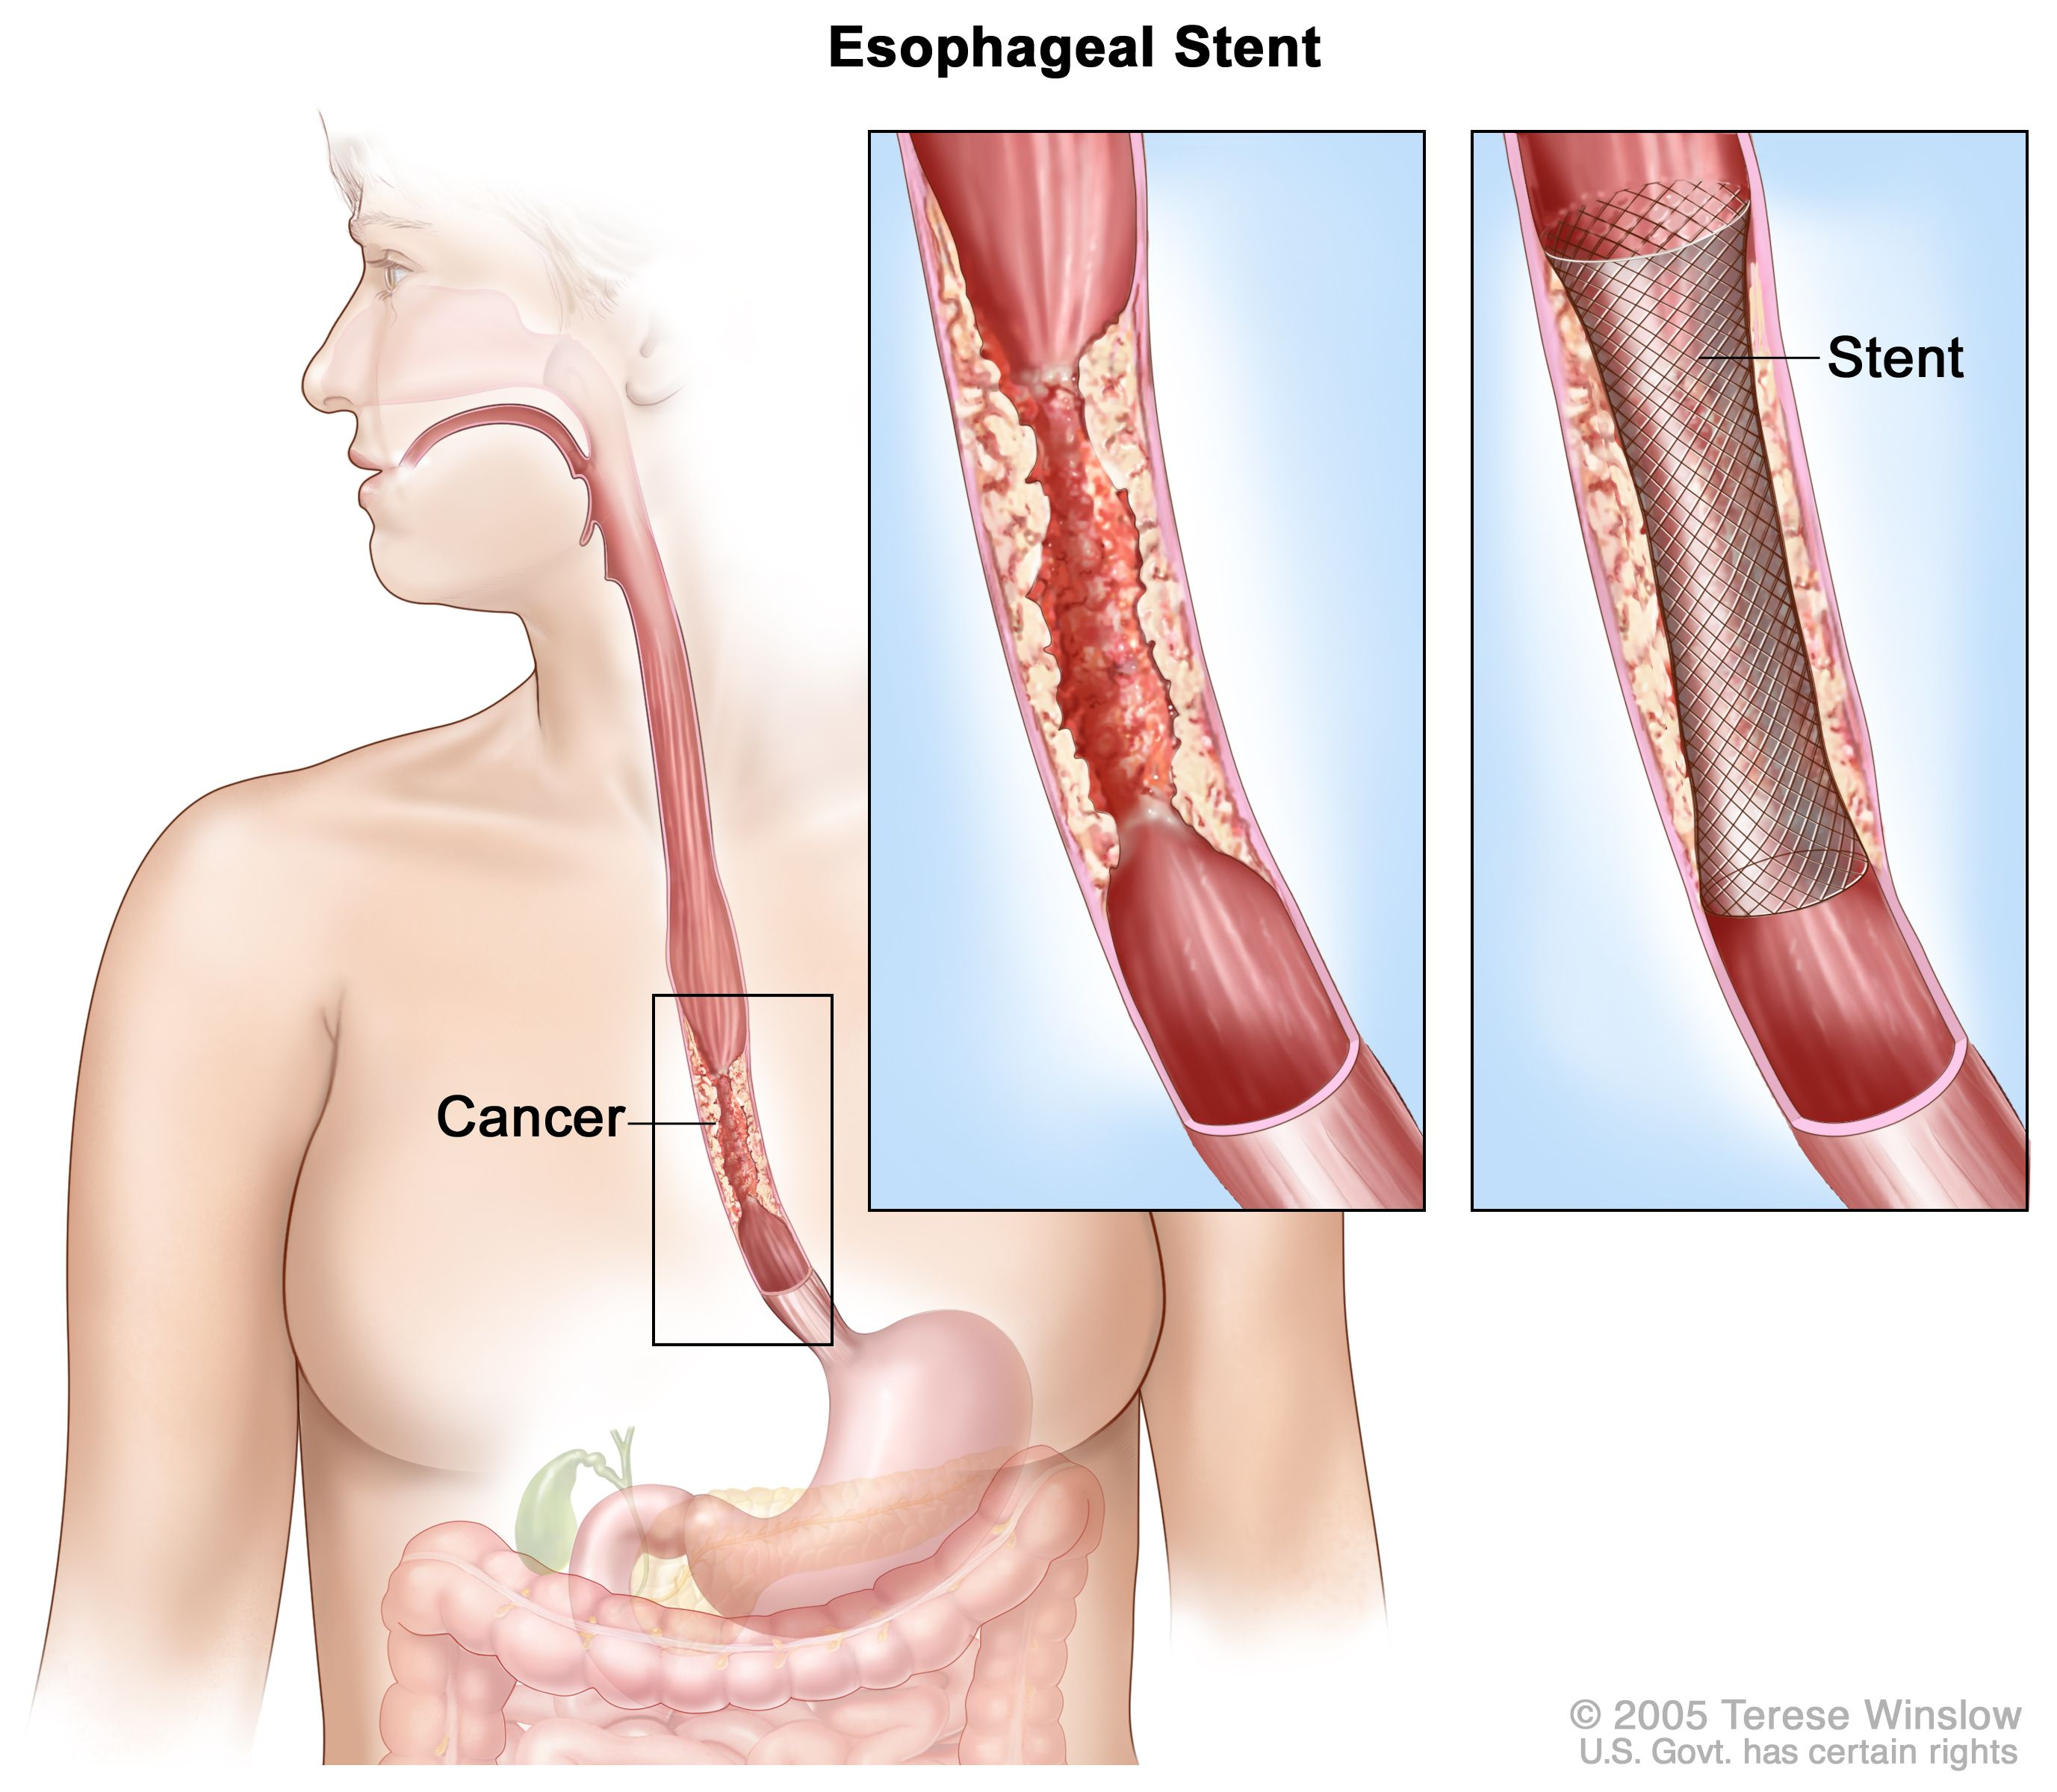
Endoluminal Stent
An endoluminal stent can be placed inside an esophageal cancer to improve eating

Slide 9
Endoluminal Stents
Advantages:
Outpatient procedure
Does not require surgery
Can improve swallowing
Disadvantages:
Discomfort
Reflux
Can make surgery to remove esophagus more complicated
Radiation Therapy - Esophagus
Radiation therapy to the esophagus can improve swallowing. There are two approaches:
Short Course - 10 treatments over 2 weeks
Conventional Dosing - 25-30 treatment over 5-6 weeks
Radiation Therapy - Bone
For patients with metastasis to bone causing pain, radiation can provide pain relief wiht a relatively short (two week) treatment course
Intravenous Drug Administration
Systemic Therapy drugs are administered intravenously.
There are several options for intravenous access:
Peripheral IVs in the hand
PICC line (Peripheral Inserted Central Catheter)
Central Venous Port
Central Venous Port
Hospice
Hospice provides end-of-life care for patients whose priority is treatment of symptoms rather than systemic therapy of the cancer.
Usually provided in the home
Residential hospice is available as an alternative
Hospice team manages symptoms including pain managemnt
Nutrition
Nutrition Slideshow

