Slide 1
GI Stromal Tumors of the Stomach

Slide 2
GI Stromal Tumors
Arise from the wall of the stomach
Grow slowly over time
Lymph nodes rarely involved
Not conventional stomach cancer

Slide 3
GIST vs Adenocarcinoma
GIST
Starts from wall of stomach
Slow growing
Rarely spreads to lymph nodes
Adenocarcinoma
Conventional “stomach cancer”
Starts from lining of stomach
Can spread to lymph nodes
More aggressive

Slide 4
Benign or Malignant?
GIST tumors have a range of behavior:
Small tumors tend to behave in a benign manner but can grow over time
Larger tumors tend to behave in a malignant (cancerous) manner

Slide 5
GIST Treatment
Initial treatment usually surgery
Risk of recurrence determined by pathology
Size of tumor
Mitotic rate = how rapidly tumor is dividing

Slide 6
Imatinib = Gleevec
Oral drug shrinks GIST tumors
Well tolerated
Given after surgery for high-risk tumors
1 or 3 years depending upon risk
Given before surgery for large tumors

Slide 7
Stomach Cancer Surgery Goals
Staging refers to the tests to determine
Remove the tumor
Remove lymph nodes (depends upon tumor type)
Preserve stomach function
Reconstruct GI tract
Treatment options depend upon the cancer stage

Slide 8
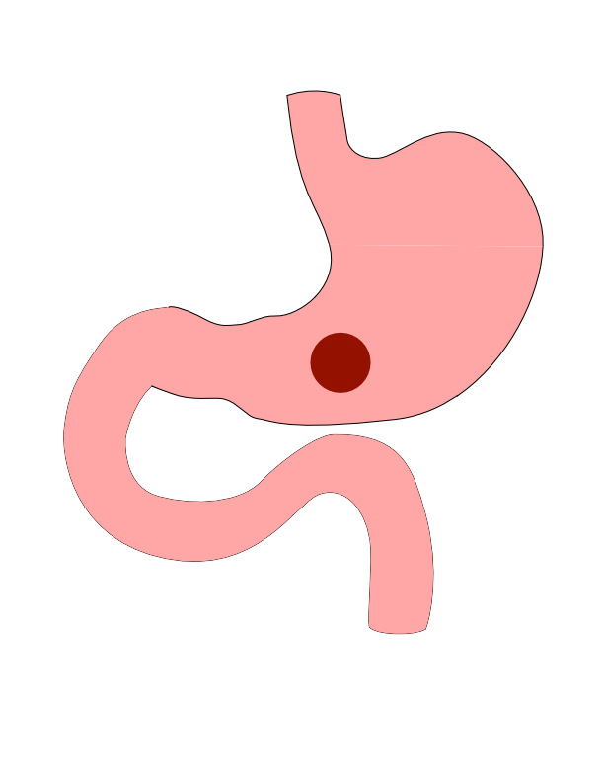
Distal Cancers
Distal cancers are those in the lower part of the stomach

Slide 9
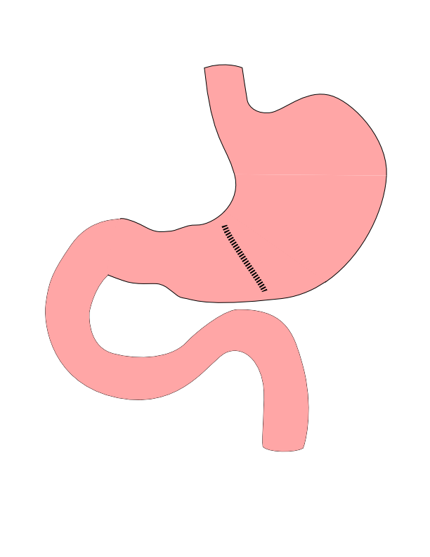
Partial Gastrectomy
Removes the tumor
Lymph nodes not removed
Best suited for:
Small adenocarcinoma
GI Stromal Tumors

Slide 10
Partial Gastrectomy

Slide 11
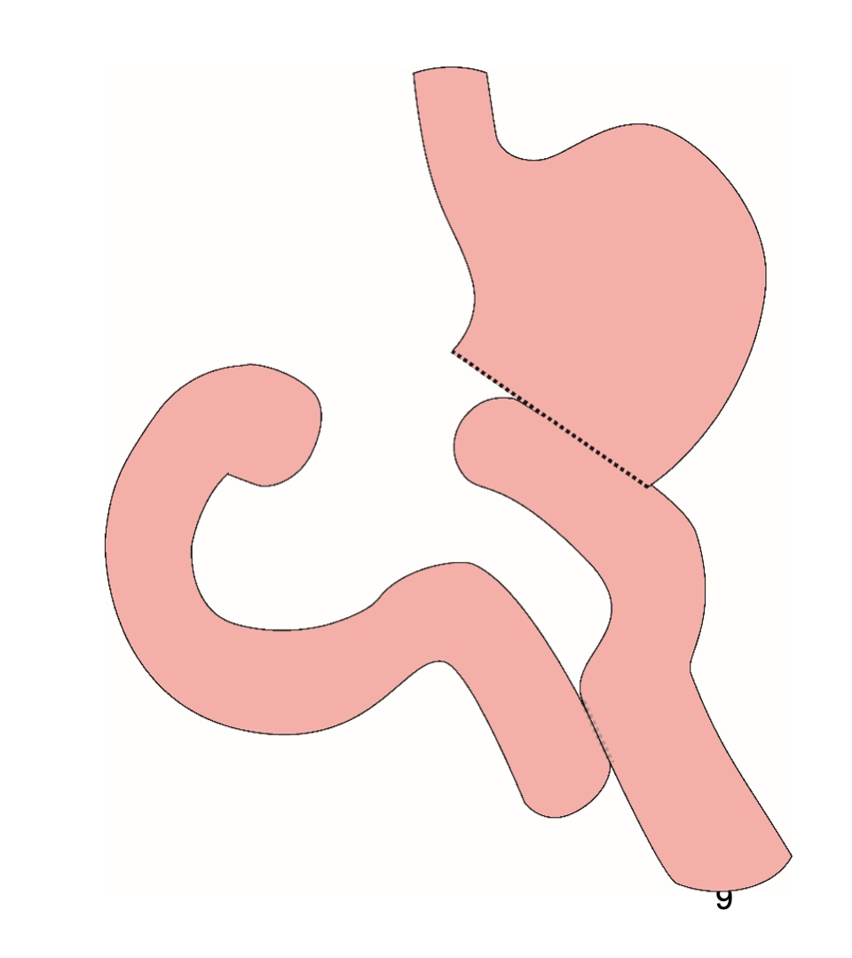
Distal Gastrectomy
Removes bottom half of the stomach
Does lower lymph nodes

Slide 12
Distal Gastrectomy

Slide 13
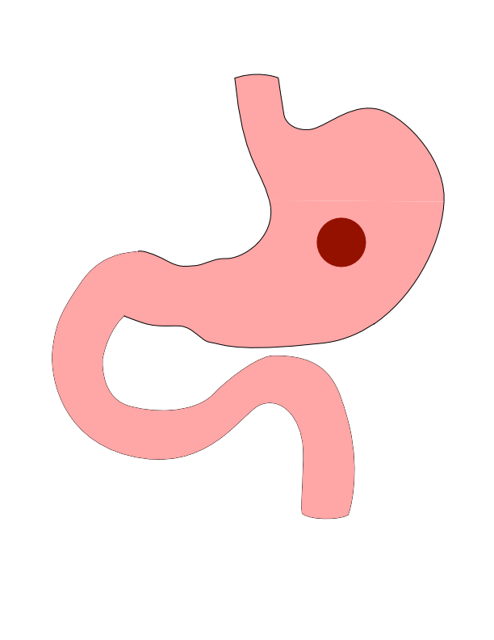
Body Cancers
Body is the mid-portion of the stomach

Slide 14
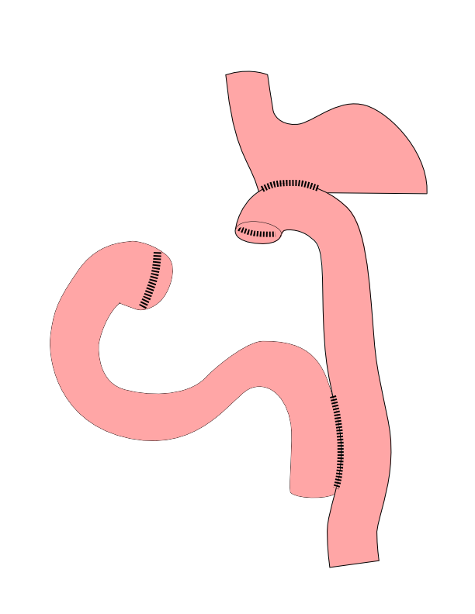
Subtotal Gastrectomy
Removes bottom 2/3 of stomach
Removes lymph nodes
Reconstruction with small intestine

Slide 15
Subtotal Gastrectomy

Slide 16
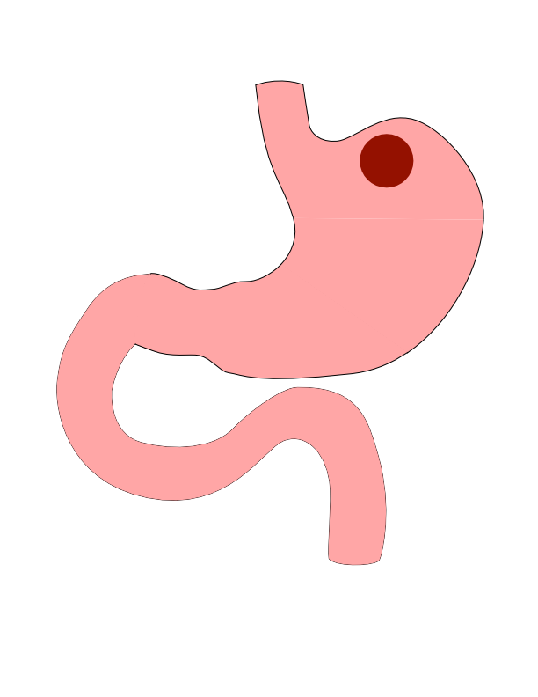
Proximal Tumors
Located near the top of the stomach
Challenging area for surgery

Slide 17
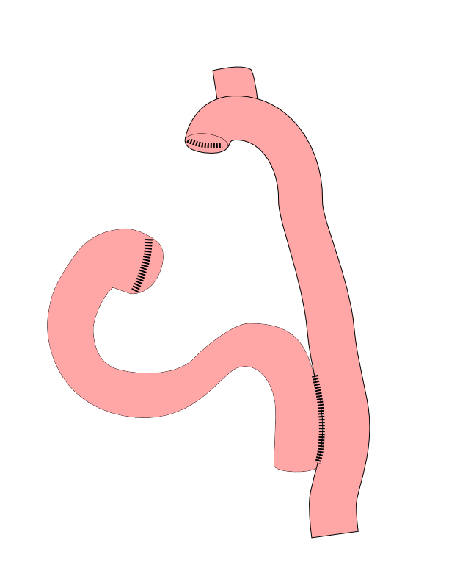
Total Gastrectomy
Removes all of the stomach
Reconstruction with small intestine
Needed for those with CDH1 mutations

Slide 18
Total Gastrectomy

Slide 19

Esophagogastrectomy
Removes top part of stomach
Remove bottom half of esophagus
Surgery in both abdomen and chest

Slide 20

Esophagogastrectomy
Removes top part of stomach
Remove bottom half of esophagus
Surgery in both abdomen and chest

Slide 21
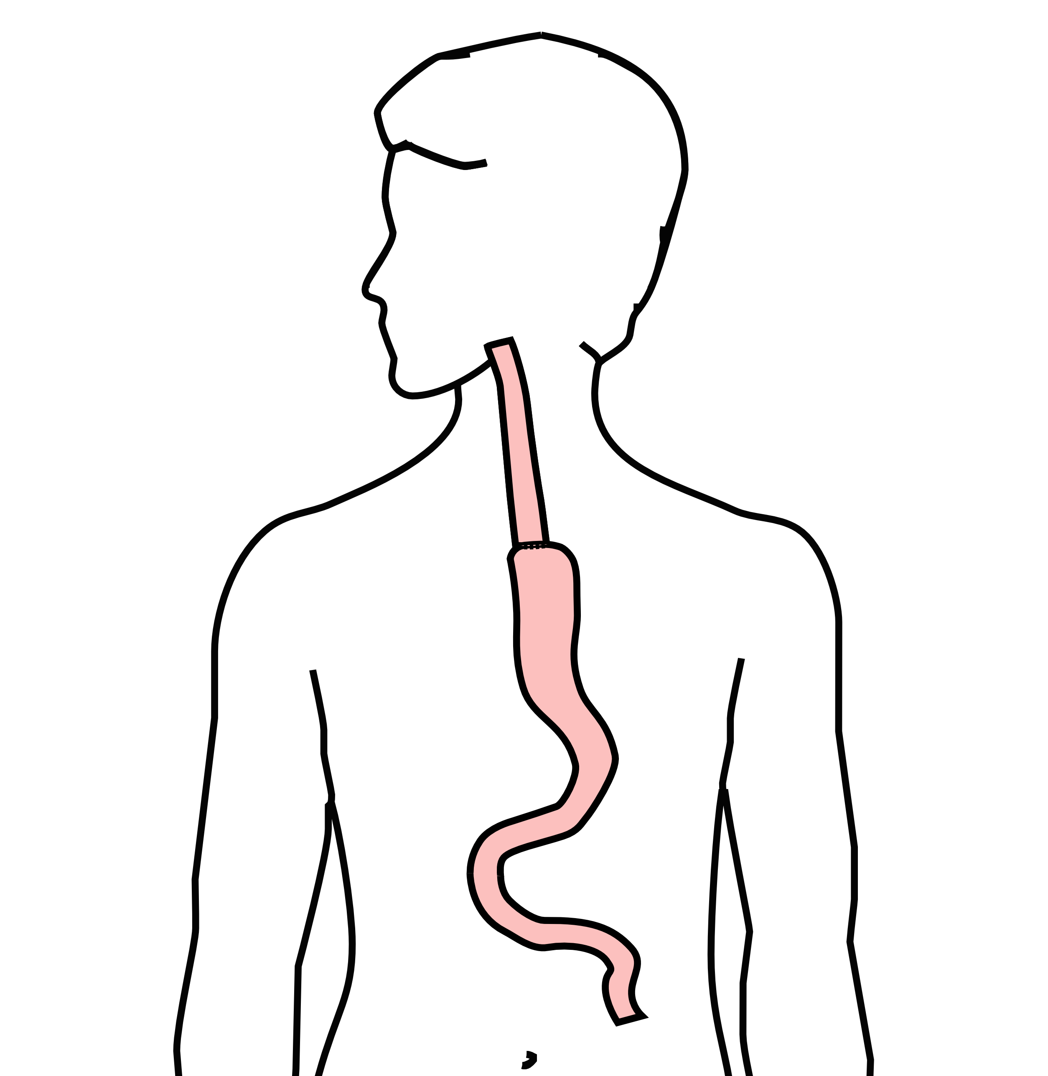
Esophagogastrectomy
Removes top part of stomach
Remove bottom half of esophagus
Surgery in both abdomen and chest

Slide 22
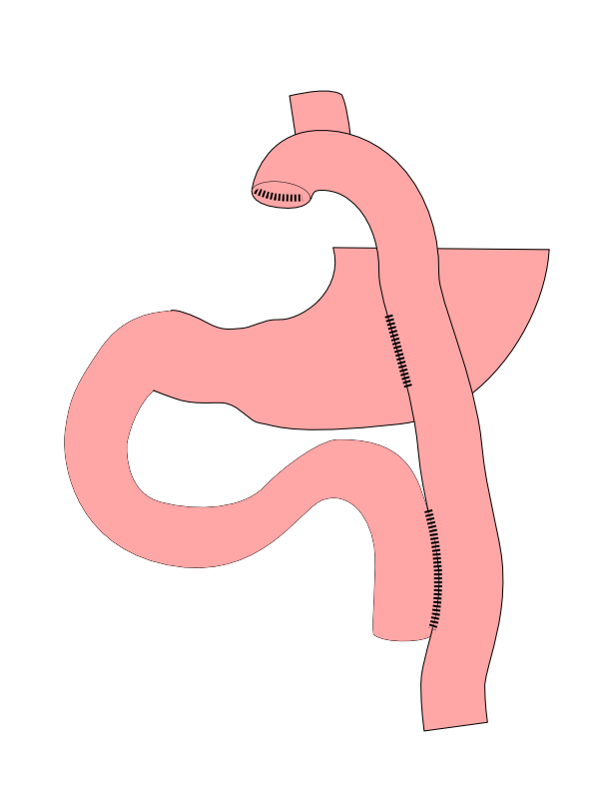
Dual Tract Gastrectomy
Alternative surgical approach for small tumors near the top of the stomach
Preserves the bottom of the stomach as a reservoir

Slide 23
Dual Tract Gastrectomy

Slide 24
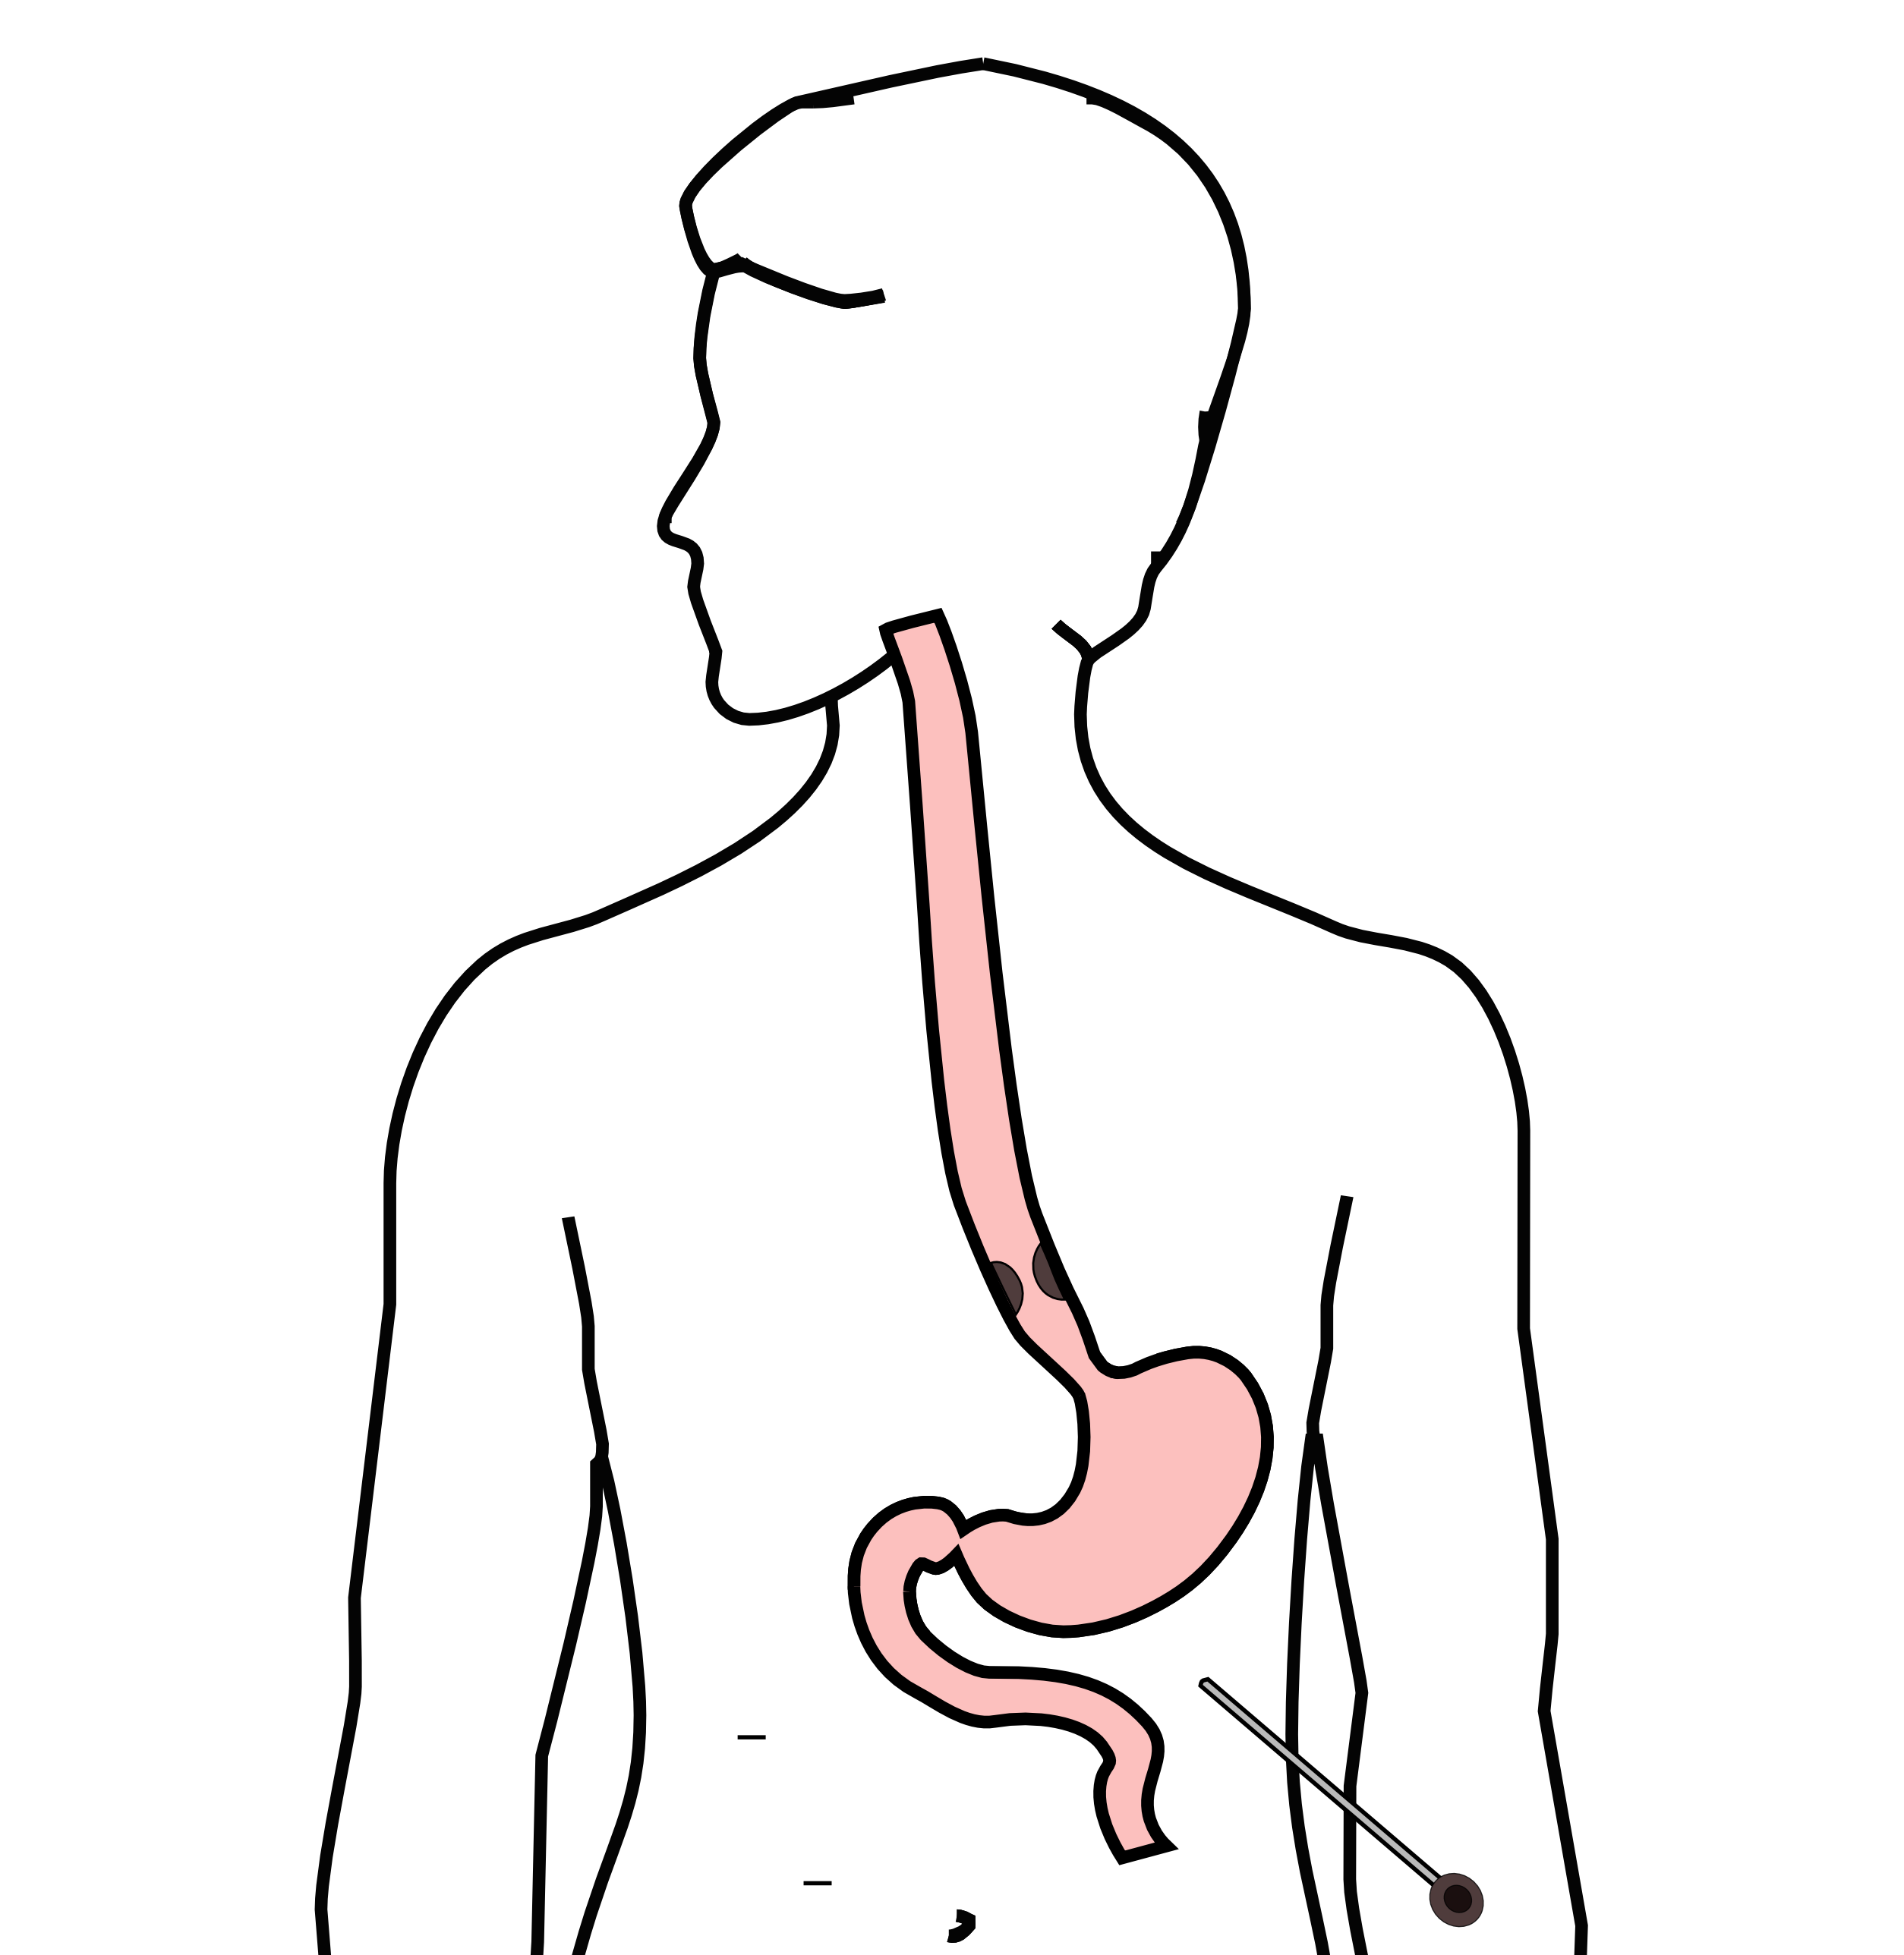
Laparoscopy
Some stomach cancers can spread inside the abdomen
Areas of spread can be very small (grain of rice)
Laparoscopy can detect spread inside the abdomen

Slide 25
Laparoscopy
General anesthetic
Several 1/4” incisions
Telescope examines the abdomen
Biopsies can be performed.

Slide 26
Risks of Surgery
Leak where bowel is joined together (anastomosis)
Bleeding requiring reoperation
Delayed stomach function
Infection in the abdomen

Slide 27
Primary Care Practitioner (PCP)
Critical to coordinate care between specialists.
We will update your PCP after each visit
PCP Referral Line (844) 235-6998

Slide 28
My Atrium Patient Portal
Critical to good communication with your care team
Available for desktop or laptop or phone
Sign up at my.atriumhealth.org

Slide 29
Exercise
Reduces risk of complications from treatment
Goal is 30min/day of vigorous exercise 6 days/wk
Working hard enough that you can’t converse
Start slowly and build up
Every day counts! (Aim for daily activity)

Slide 30
Smoking Cessation
Smoking makes cancer treatment more difficult
Increases risk of complications after surgery
Options for help with smoking cessation:
NC Quit Line 1-800-QUIT-NOW (1-800-784-8669)
American Lung Assn www.freedomfromsmoking.org
Smoking Cessation Counseling (Metro Charlotte)

