Slide 1
Stage IV Cancer of the Esophagus and GE Junction

Slide 2
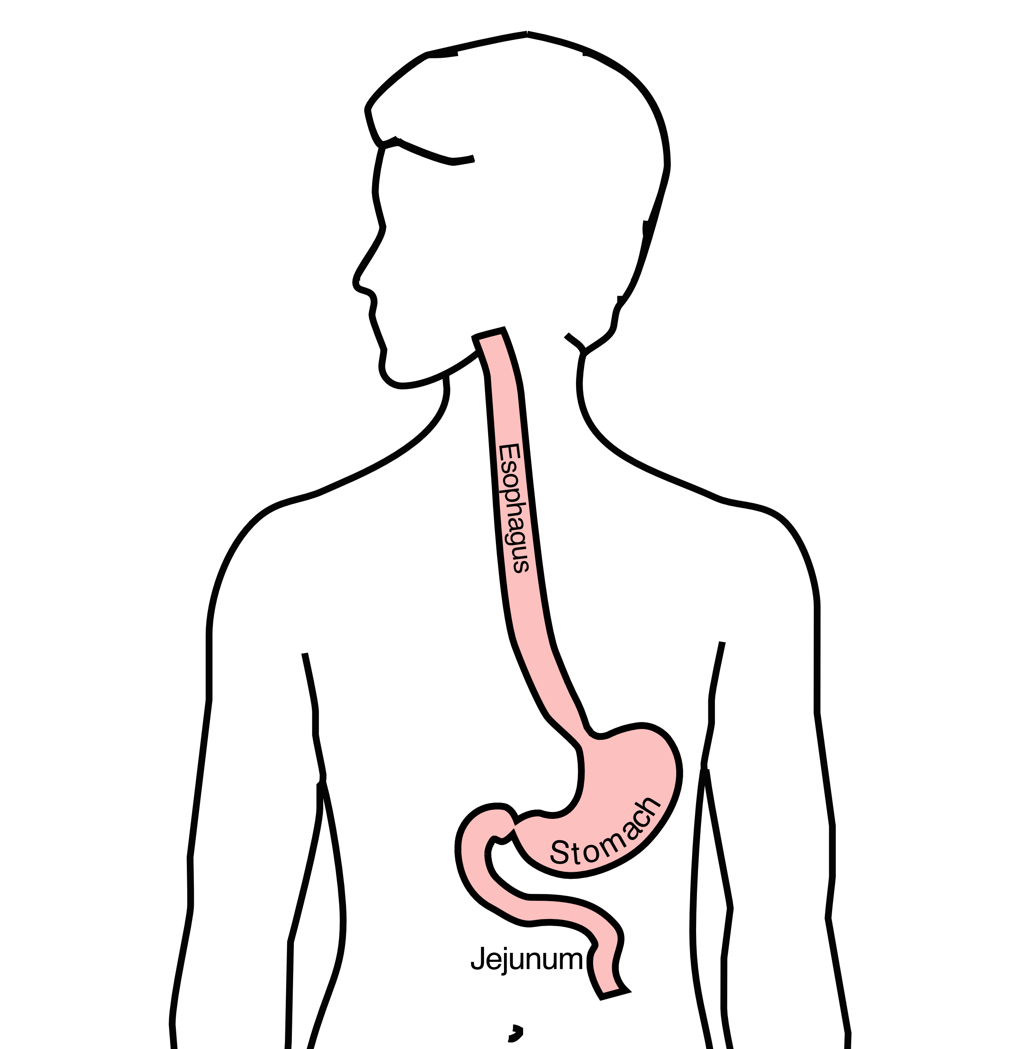
Anatomy
Food moves from the throat
$→$ esophagus
$→$ stomach
$→$ small bowel (jejunum)

Slide 3
Esophageal Cancer Staging
T = Tumor - Depth of growth into the wall of the esophagus
N = Nodes - Spread to the lymph nodes
M = Metastasis - Spread to liver, lungs, or bone

Slide 4
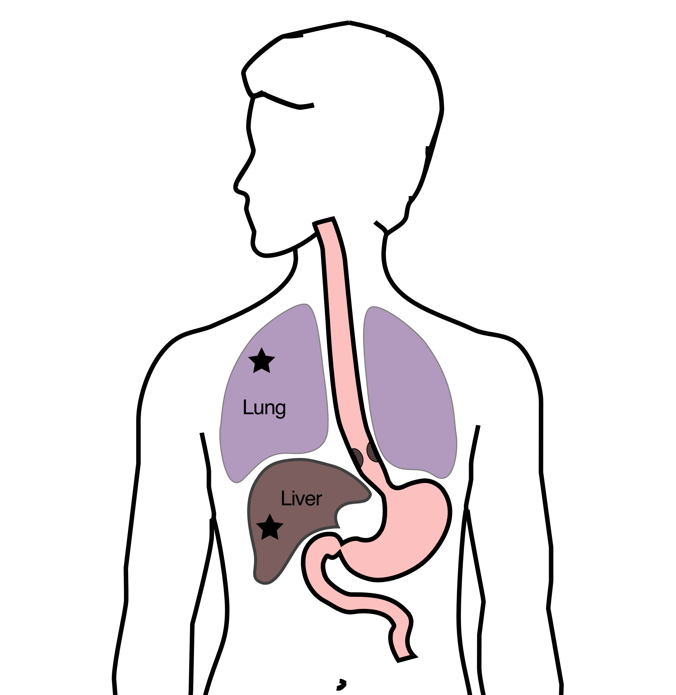
Metastatic Cancers
Metastatic cancers spread from the esophagus to other parts of the body
M0 cancers have not spread to other parts of the body
M1 cancers have spread lungs, liver, or bone
M1 cancers is also known as Stage 4

Slide 5
Treatment Plan
Superficial (T1) $Rightarrow$ Endoscopic Therapy
Localized (T1b/T2) $Rightarrow$ Surgery
Locally-advanced (T3/N1) $⇒$ Chemo $±$ Radiation $→$Surgery
Metastatic (M1) $⇒$ Systemic Therapy $±$ Radiation

Slide 6
Systemic Therapy
Systemic therapy is administered intravenously (or by mouth) and circulates to kill cancer cells anywhere in the body.
Chemotherapy (FOLFOX)
Immunotherapy (nivolumab, pembrolizumab)
Hormone therapy (herceptin)

Slide 7
Goals of Therapy
Symptom control
Prolong life
Minimize symptoms due to treatment

Slide 8
Systemic Therapy
By shrinking tumor and decreasing cancer burden
Can improve symptoms
Can prolong life
Goals:
Maximize cancer shrinkage
Minimize side-effects due to therapy

Slide 9
Radiation Therapy
Radiation uses high-energy x-rays to kill cancer cells
Bone metastasis: Can relieve pain
Esophagus: Can shrink tumor and improve eating

Slide 10
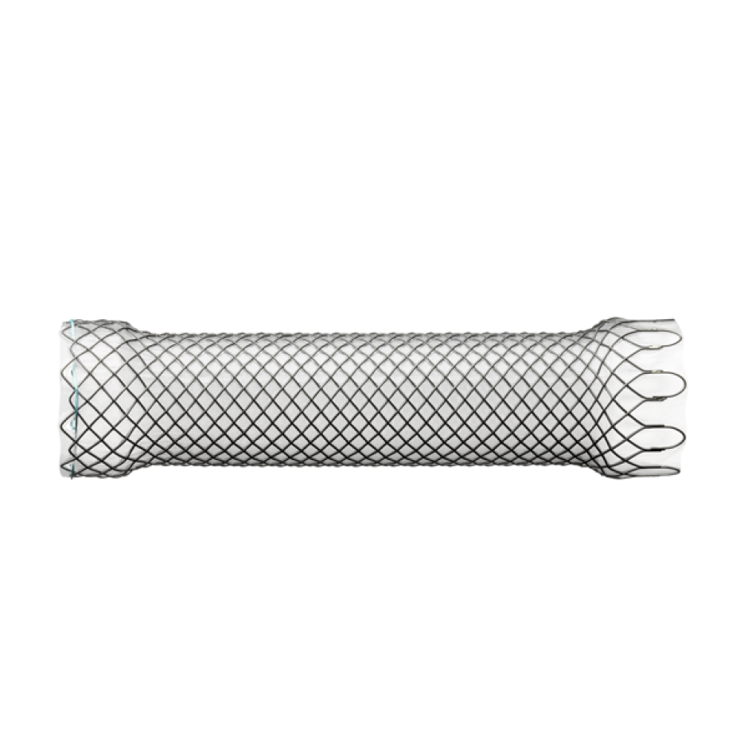
Endoluminal Stent
An endoluminal stent can be placed inside an esophageal cancer to improve eating

Slide 11
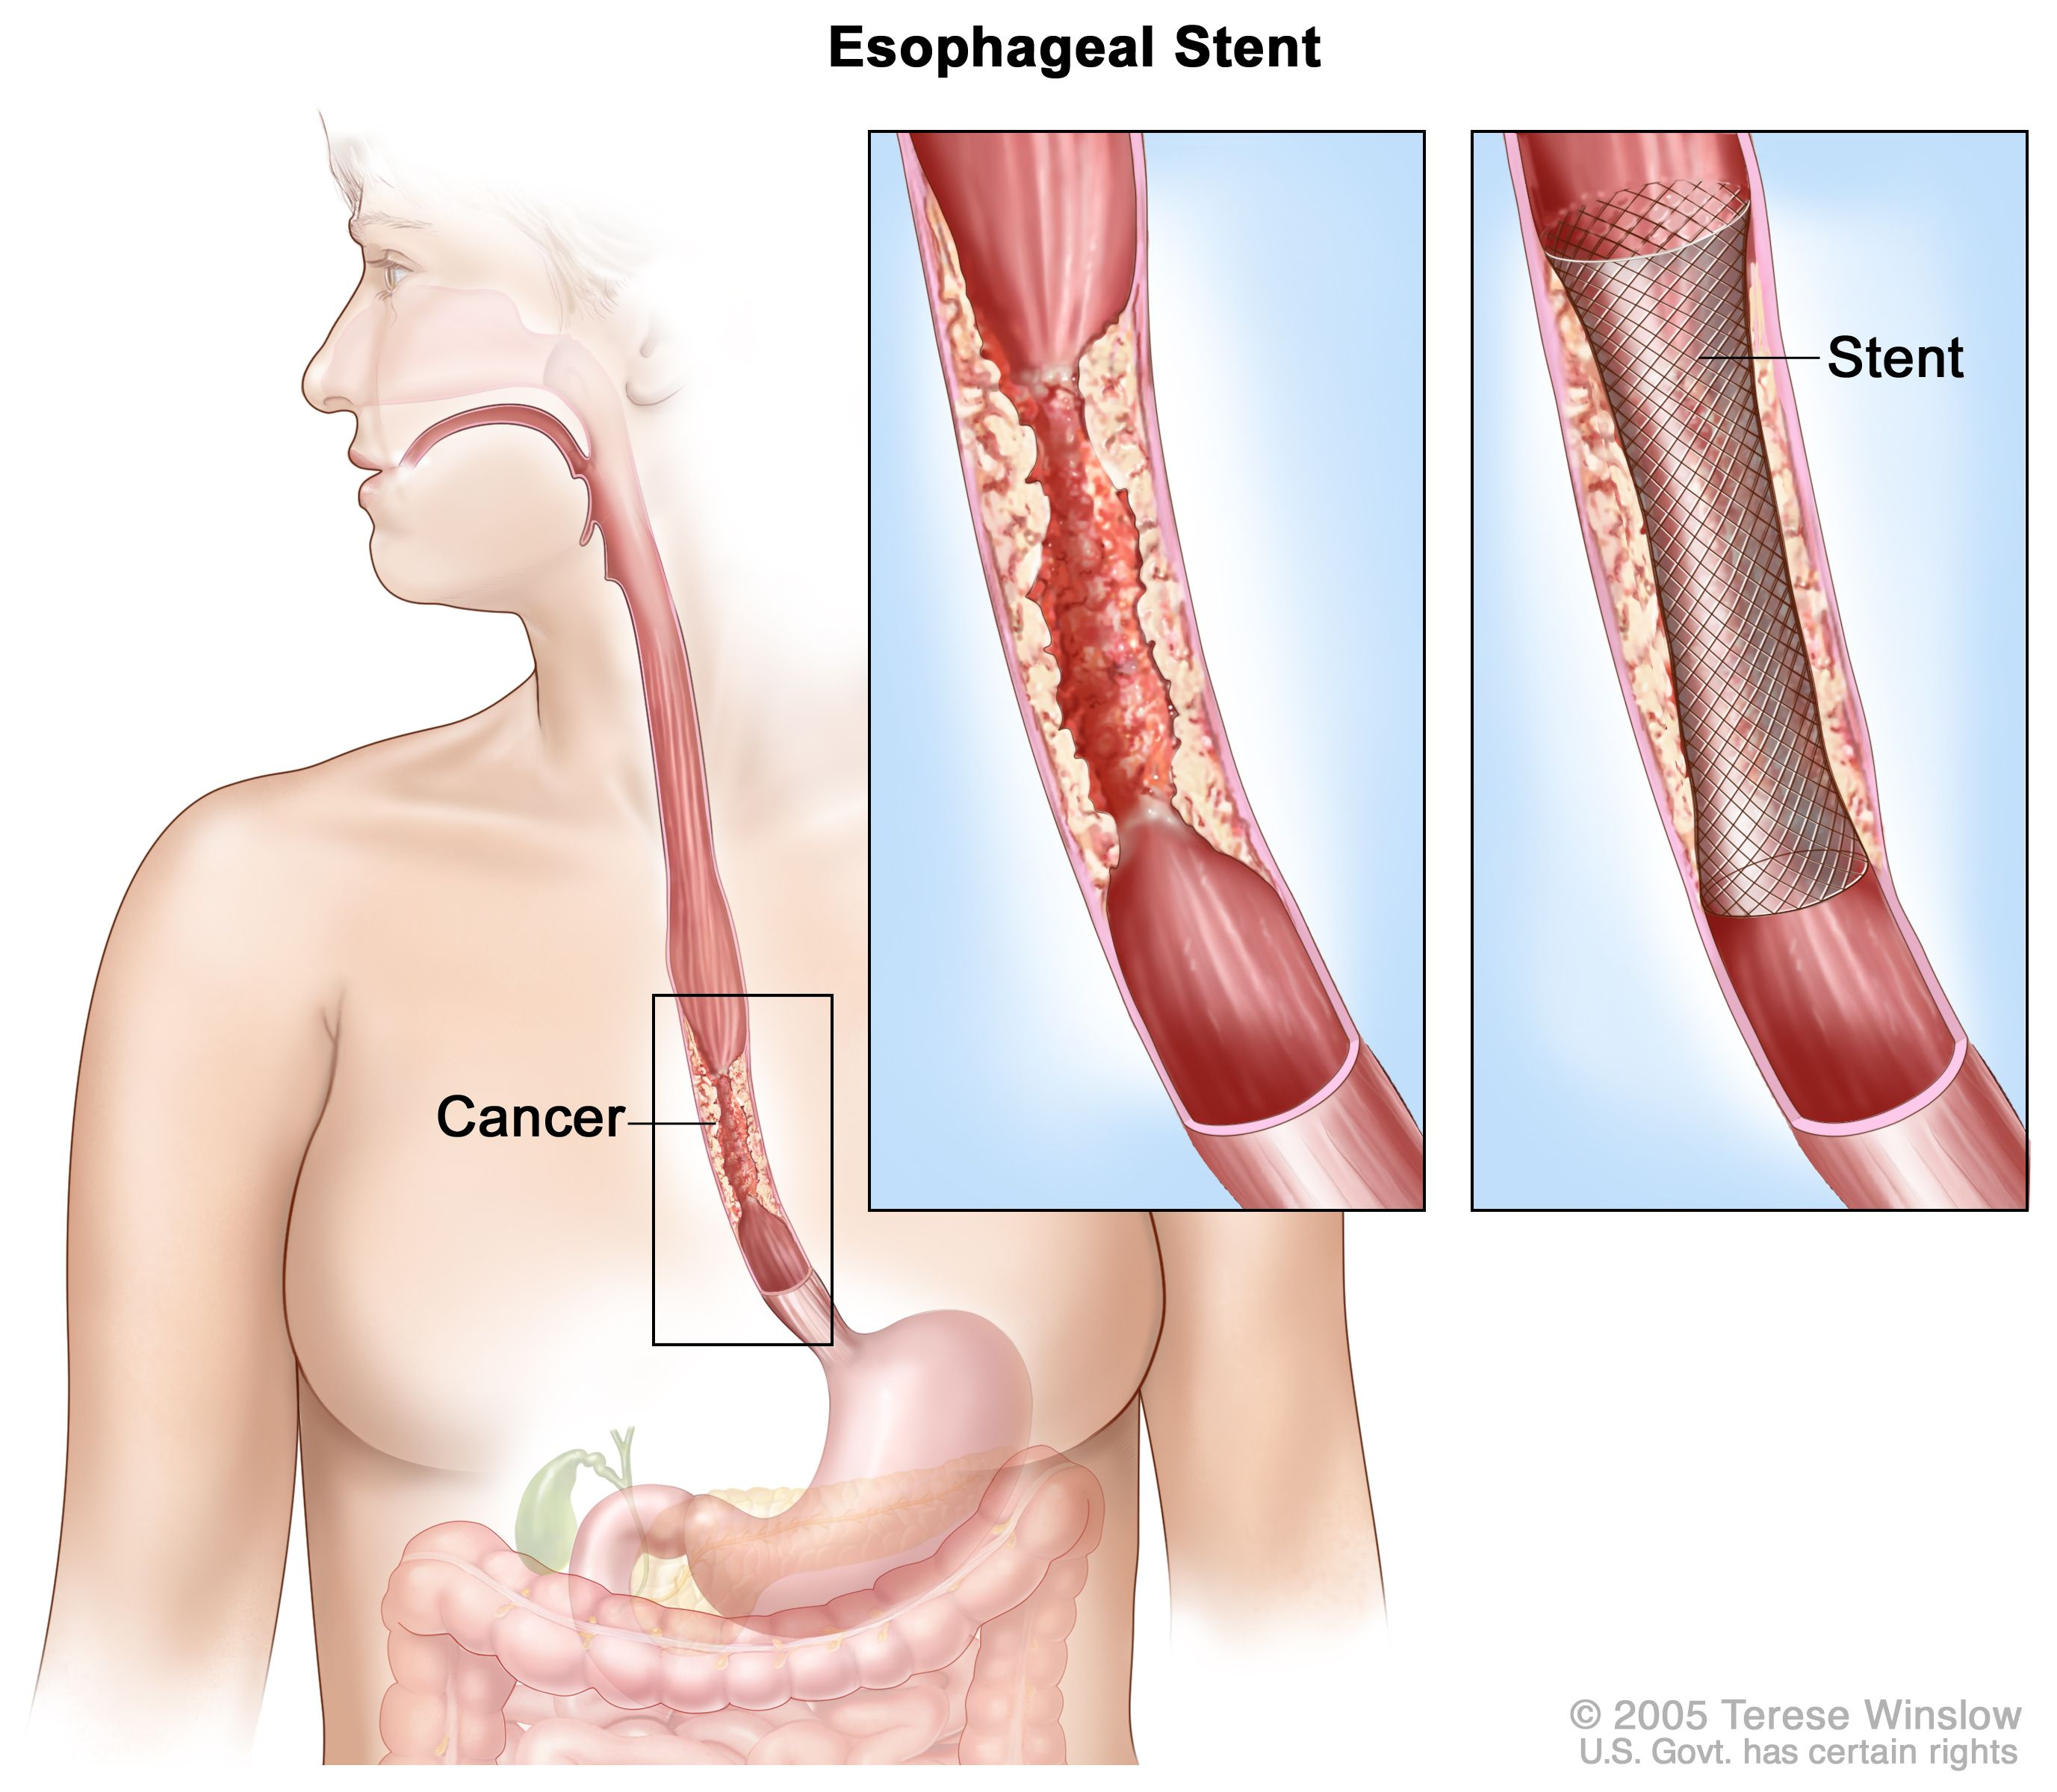
Endoluminal Stent
An endoluminal stent can be placed inside an esophageal cancer to improve eating

Slide 12
Endoluminal Stents
Advantages:
Outpatient endoscopic procedure (no surgery)
Can improve swallowing
Disadvantages:
Discomfort and reflux
Can make surgery to remove esophagus more complicated

Slide 13
Radiation Therapy - Esophagus
Radiation therapy to the esophagus can improve swallowing. There are two approaches:
Short Course
10 treatments over 2 weeks
Conventional Dosing
25-30 treatment over 5-6 weeks
Usually combined with low-dose chemo

Slide 14
Radiation Therapy - Bone
For patients with metastasis to bone causing pain
Radiation can provide pain relief
Typically 10 daily treatments over two weeks

Slide 15
Intravenous Drug Administration
Systemic Therapy drugs are administered intravenously.
There are several options for intravenous access:
Peripheral IVs in the hand
PICC line (Peripheral Inserted Central Catheter)
Central Venous Port
Central Venous Port

Slide 16
Hospice
Hospice provides end-of-life care for patients whose priority is treatment of symptoms rather than systemic therapy of the cancer.
Usually provided in the home
Residential hospice is available as an alternative
Hospice team manages symptoms including pain managemnt

Slide 17
Nutrition
Nutrition Slideshow

